Slide 1

AZ-900 Microsoft Azure Fundamentals
Section 2
Benefits of Cloud Computing

Slide 2
AZ-900 Microsoft Azure Fundamentals
Benefits of Cloud Computing
Section: 2.5, 2.6, 2.7
Date: 24/02/22
Describe Cloud Concepts (20-25%)
Benefits of Cloud Computing
Cost Saving
Generally cloud companies can manage a server much cheaper than you can. More efficient air-conditioning, bulk buying hardware (economies of scale)
Don’t have to overprovision resources like you do in your own environment. This is auto scaled, you pay for what you use.
CapEx (capital expenditure) is money invested in assets like computers that return investment over time. OpEx (operational expenditure) is money spent on day to day operating expenditure. All of a sudden instead of having to invest loads of money in hardware in one go, we now don’t need any CapEx on servers, paying for the cloud is entirely OpEx and this is better for tax purposes, to have only a steady amount of money going out.
Agility (respond to marketplace, to demand etc.)
Agility is the ability to change rapidly based on changes to the market or environment (say you have a critical period of the day, for an hour then you can add more servers.)
Elasticity is the ability of a system to automatically grow and shrink based on application demand.
Availability (often have duplicate data on the cloud so if a storm hits one centre, the application can still function as normal)
Generally achievable to get four nines availability (99.99%). That equates to around 4 minutes a month of downtime. Importance of this depends on the use case of the application. Maybe its internal and only being used 9-5, that will have lower importance that say Facebook.
Disaster recover is the ability of a system to recover from failure within a period of time and how much data is lost. Can be done easily and automatically in the cloud.

Slide 3
AZ-900 Microsoft Azure Fundamentals
Benefits of Cloud Computing
Section: 2.5, 2.6, 2.7
Date: 24/02/22
Security
Global reach
It’s often not possible to setup datacentres in multiple countries (end users will gain the speed improvements from cloud datacentres positioned correctly for who is using them.)
Ready to go on-demand services
Such as pre-trained AI models, dashboards, analytics tools etc.
Range of tools
Many tools designed to help you manage the server are already built.

Slide 4
AZ-900 Microsoft Azure Fundamentals
Section 3
Cloud Models and Cloud Types

Slide 5
AZ-900 Microsoft Azure Fundamentals
Cloud Models and Cloud Types
Section: 3.8, 3.9
Date: 24/02/22
Cloud Models
All of these are ‘as a service’. The reason for this is that we don’t own the thing, we rent it and therefore it is a service. In IaaS we don’t own the virtual machine we provision we rent them. A great anaology is cooking at home versus going to a restaurant. Going to a restaurant could be described as CaaS (cooking as a service). We don’t have any CapEx (we don’t pay for the oven, the pots the pans etc.) we just pay the OpEx. We also have no control over the maintenance of the hardware (oven)
Infrastructure-as-a-Service (IaaS)
Most basic foundational type of cloud model.
This is where you’re receiving virtual machine. You basically take what you’re doing on your local machine and transfer that to the cloud.
We need to configure IaaS, we need to select the CPU’s, RAM etc. Examples include VMs, Azure Storage, Load Balancer etc.
Platform-as-a-Service (PaaS)
Next level of abstraction. Here you take you code, place it in a zip file, upload and the cloud will run it for you.
You may need to select a tier, but you don’t have to manage the CPU’s the RAM etc. like you do when running a IaaS.
An example is ‘App Services’, ‘Azure SQL Database’ or ‘Azure ML Studio’. Key here is that you need to build upon this platform with code for it to be useful.
Software-as-a-Service (SaaS)
This is the next level of abstraction. An example of this is dropbox, google drive, Microsoft docs etc. Here we’re accessing a piece of ready made software on the cloud.
Anything where you use a web browser to access a service is typically a SaaS service.
It should be useful as a standalone product.

Slide 6
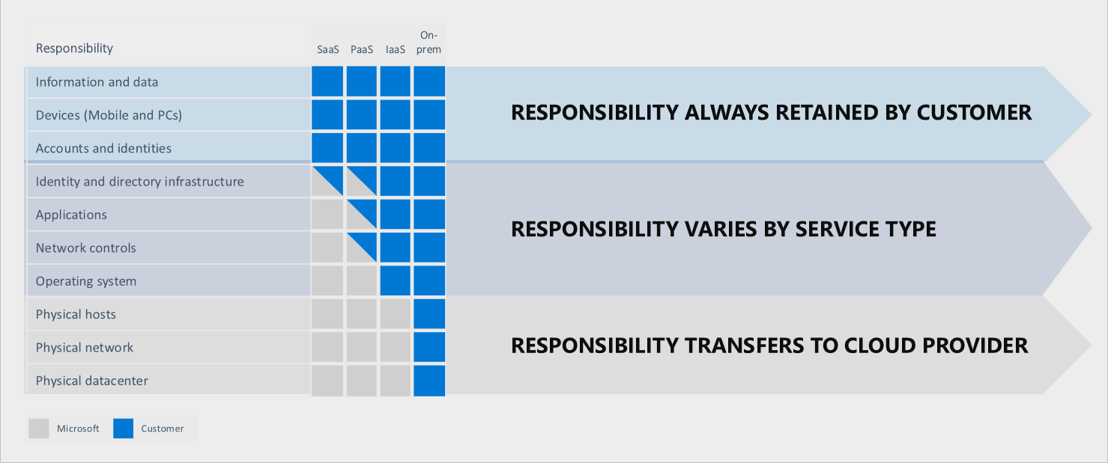
AZ-900 Microsoft Azure Fundamentals
Cloud Models and Cloud Types
Section: 3.8, 3.9
Date: 24/02/22
IaaS, PaaS and SaaS Shared Responsibility Model.

Slide 7
AZ-900 Microsoft Azure Fundamentals
Cloud Models and Cloud Types
Section: 3.10
Date: 24/02/22
Cloud Models
Serverless Model
The most prominent other cloud model available out there is called the serverless model. It’s a little confusing, there are still servers, its just the user will never have to deal with them.
Here we have even less control that PaaS. In PaaS we can at least select a performance tier and pay more for more or less. In serverless we do not even have access to this.
In a serverless model, you give them the code and they will take responsibility for scaling. If traffic increases, they will handle adding more CPU. In PaaS we have control over this scaling, we may need to up the tier to pay for more performance.
So with serverless we don’t even need to worry about choosing the right plan or tier.
Serverless also means you might actually pay nothing. If you host a website and no one visits, then you wont pay anything. In PaaS you will be.

Slide 8
AZ-900 Microsoft Azure Fundamentals
Cloud Models and Cloud Types
Section: 3.11
Date: 24/02/22
Cloud Types
Public Cloud
Basically if you have a credit card you can sign up for it.
AWS, Azure, Google Cloud are all examples of public cloud providers.
Private Cloud
Can setup a cloud environment with your own hardware. A large enterprise with their own data centre may want to do this. They may be running many applications all with varying demand from different parts of the business and a private cloud can offer much of the same benefits around scalability and elasticity that a public cloud offers.
Often have to work with a company like IBM to help set this up.
Hybrid
Microsoft is bigger on this than Google or Amazon.
It’s a combination of public and private clouds. You could have agents installed on a local machine that allows you to connect to the public cloud. If I understand correctly you don’t even need a full private cloud, the private part can simply be your own manchine.

Slide 9
AZ-900 Microsoft Azure Fundamentals
Section 4
Core Azure Architectural Components

Slide 10
AZ-900 Microsoft Azure Fundamentals
Core Azure Architectural Components
Section: 4.12
Date: 24/02/22
Describe Core Azure Services (15-20%)

Slide 11
AZ-900 Microsoft Azure Fundamentals
Section 5
Core Resources Available in Azure

Slide 12
AZ-900 Microsoft Azure Fundamentals
Section 6
Azure Core Solutions

Slide 13
AZ-900 Microsoft Azure Fundamentals
Section 7
Azure Management Tools

Slide 14
AZ-900 Microsoft Azure Fundamentals
Section 8
Azure Security Features

Slide 15
AZ-900 Microsoft Azure Fundamentals
Section 9
Azure Network Security

Slide 16
AZ-900 Microsoft Azure Fundamentals
Section 10
Azure Identity Services

Slide 17
AZ-900 Microsoft Azure Fundamentals
Section 11
Azure Governance Features

Slide 18
AZ-900 Microsoft Azure Fundamentals
Section 12
Azure Policy and Compliance Features

Slide 19
AZ-900 Microsoft Azure Fundamentals
Section 13
Managing Azure Costs

Slide 20
AZ-900 Microsoft Azure Fundamentals
Section 14
Azure Service Level Agreement

