Slide 1
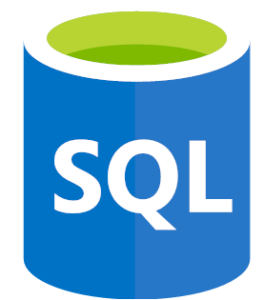
Complete SQL and Database Bootcamp: Zero to Mastery
Section 2
History and Story of Data

Slide 2
Complete SQL and Database Bootcamp: Zero to Mastery
History & Story of Data
Section: 2.6, 2.7, 2.8
Date: 11/01/22
A database is a logically modeled cluster of information [data] that is typically stored on a computer or other type of hardware that is easily accessible in various ways.
A database management system is a computer program or other piece of software that allows one to access, interact with, and manipulate a database.
Terms
DBMS: database management system – it’s a computer program or piece of software used to manage a database, it receives instruction from a user and performs an action on a database.
RDBMS: relational database management system – it’s a DBMS but on a relational database, which is the most common and popular type of database. RDBMS's include the Amazon RDS, Oracle, and MySQL, PostgreSQL which all utilize Structured Query Language (SQL) to manipulate the different databases they interact with.
SQL: structured query language, it’s a way for us to interact with a database management system. The beauty is it works and can interact with a lot of databases.
https://www.exactdata.net/data-blog/databases-vs-database-management-systems

Slide 3
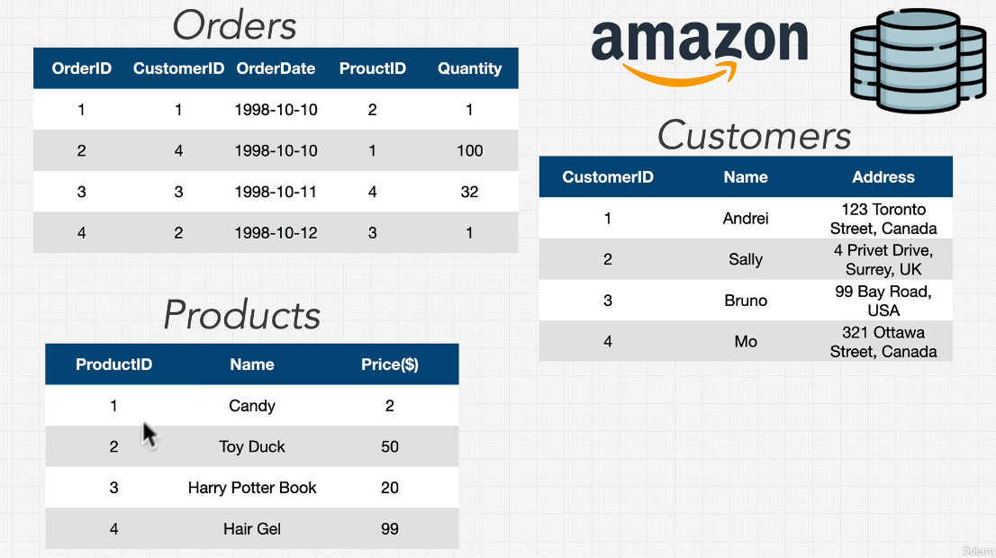
Complete SQL and Database Bootcamp: Zero to Mastery
History & Story of Data
Section: 2.9, 2.10
Date: 11/01/22
Relational Database Example
An example of a relational database is shown in the figure below. Here on our ‘Orders’ table we have columns which refer to information in other tables. Customer ID in the orders table is useless without the Customers table which provides information on the name, address etc of each ID.

Slide 4
Complete SQL and Database Bootcamp: Zero to Mastery
History & Story of Data
Section: 2.11
Date: 11/01/22
Types of Databases
Relational (e.g. mySQL) we’ve just seen an example of this, they support something called asset transactions. Often used with customers or users.
Document (e.g. mongoDB) instead of lots of tables, rows and columns, instead data is stored more in a document format with each document holding lots of data inside. Highly scalable.
Key Value (e.g. dynamoDB, redis) simplest form of database where you provide a key and a value is returned, functions like a python dictionary
Graph (e.g. AWS Neptune) much rarer, more complex and very specific. Useful for highly relational data.
Wide Columnar (e.g. Apache Cassandra) fairly new, pioneered by google.

Slide 5
Complete SQL and Database Bootcamp: Zero to Mastery
Section 3
Databases and SQL Fundamentals

Slide 6
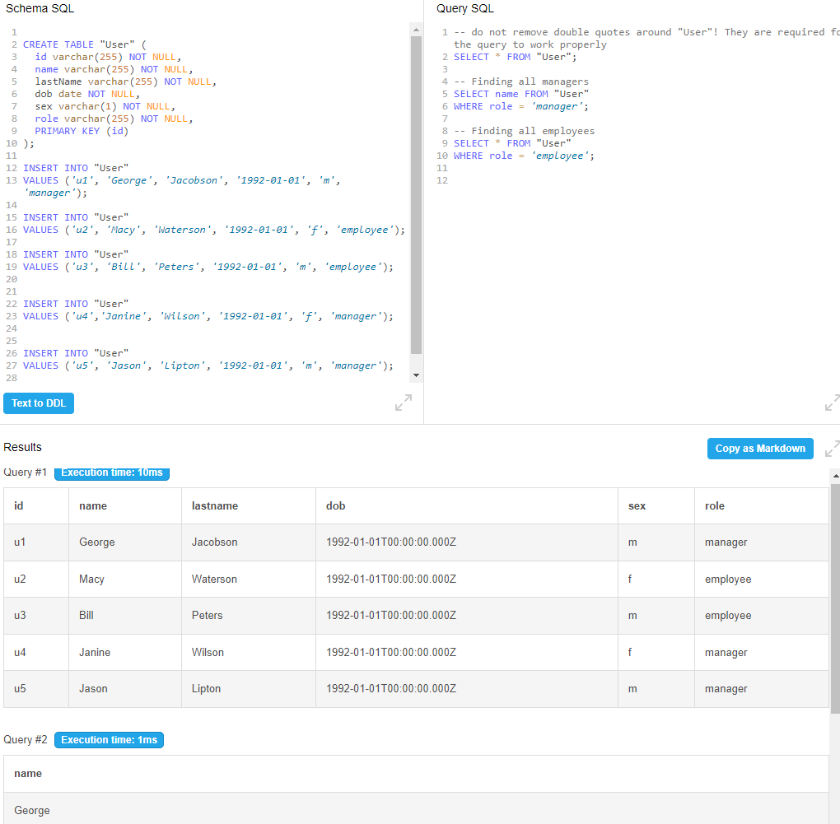
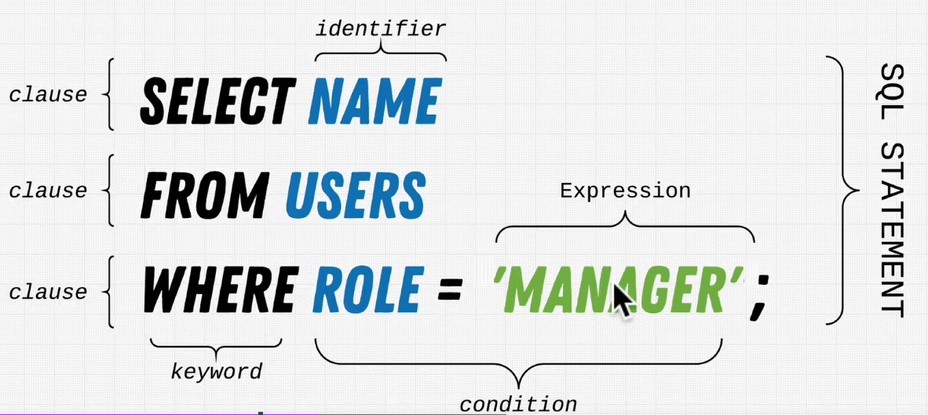
Complete SQL and Database Bootcamp: Zero to Mastery
History & Story of Data
Section: 2.16, 2.17
Date: 11/01/22
Example to the right shows the formation of a database with a table called ‘User’, along with a few basic SQL queries that return all the data as well as some more reduced queries just looking for specific data dependant on role (employee vs manager).
Note that often all keywords are placed in capitals in SQL.
https://www.db-fiddle.com/f/ogAiTgZPjwvDxwVHiVK3Ek/530
https://stackoverflow.com/questions/292026/is-there-a-good-reason-to-use-upper-case-for-sql-keywords

Slide 7
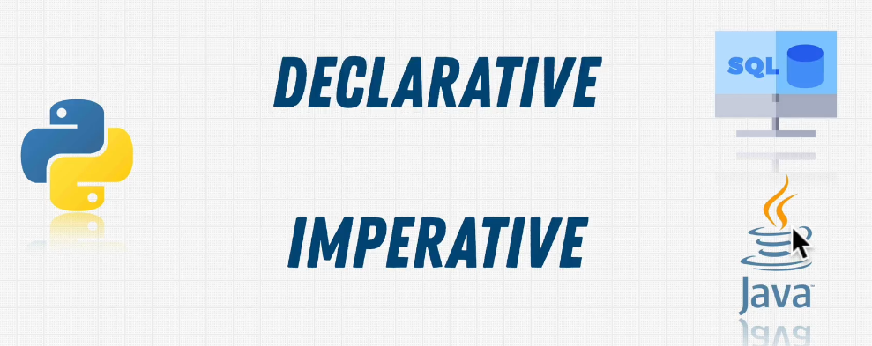
Complete SQL and Database Bootcamp: Zero to Mastery
History & Story of Data
Section: 2.18
Date: 11/01/22
Declarative vs Imperative Programming
In declarative we say what will happen, but do not define how to achieve this. This is SQL, we say we want all the data on managers in a ‘User’ table using SELECT * FROM ‘User’ WHERE role = ‘manager’. We do not specify to SQL how to perform this task we simply state what we would like.
In imperative programming (e.g. Java), we must state how to achieve something. Therefore we might need to tell the program where to read from a hard drive. In python we can do both declarative and imperative.
Declarative is powerful because of its simplicity. Imperative on the other hand is far more flexible.

Slide 8
Complete SQL and Database Bootcamp: Zero to Mastery
History & Story of Data
Section: 2.19
Date: 11/01/22
History of SQL
SQL or Sequel? Originally it was called Sequel and stood for structured English query language, but had to change its name due to copywrite conflict. So now its simply structured query language.
Originally developed by IBM in the 1980s.

Slide 9
Complete SQL and Database Bootcamp: Zero to Mastery
Section 4
Environment Setup

Slide 10
Complete SQL and Database Bootcamp: Zero to Mastery
Section 5
SQL Deep Dive

Slide 11
Complete SQL and Database Bootcamp: Zero to Mastery
Section 6
Advanced SQL

Slide 12
Complete SQL and Database Bootcamp: Zero to Mastery
Section 7
Database Management

Slide 13
Complete SQL and Database Bootcamp: Zero to Mastery
Section 8
Solving the Mystery

Slide 14
Complete SQL and Database Bootcamp: Zero to Mastery
Section 9
Database Design

Slide 15
Complete SQL and Database Bootcamp: Zero to Mastery
Section 10
Database Landscape, Performance and Security

