Slide 1
Itemtracker:
x-as-a-Service
SC4052 Cloud Computing
M Hisham B Khairul A (U2121992E)
github.com/mhbka/itemtracker

Slide 2
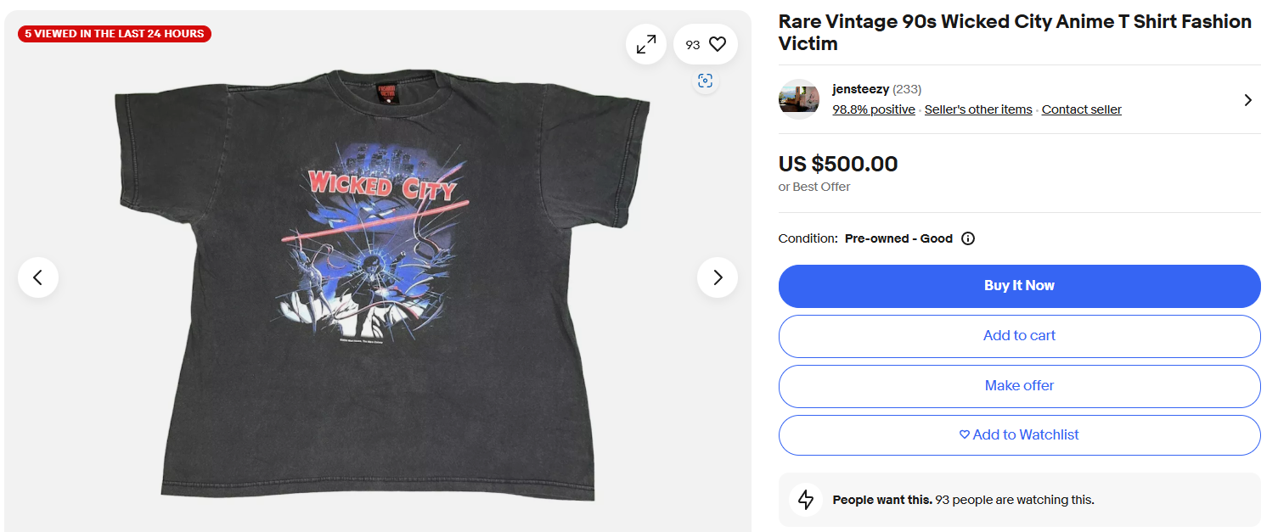
Problem
I like rare shirts
Sometimes they’re impossible to find (<5 on the internet ever)
Sometimes they’re just too expensive (hundreds - thousands!), so I need a bargain!
Hunting them takes a lot of time and sometimes I miss out
Can this be automated?

Slide 3
Yes it can!

Slide 4

Solution: itemtracker!
A SaaS that:
Scrapes marketplaces as often as you want
Lets you ask an AI questions about each item
Filters out what you don’t want
Gathers everything in a nice place

Slide 5
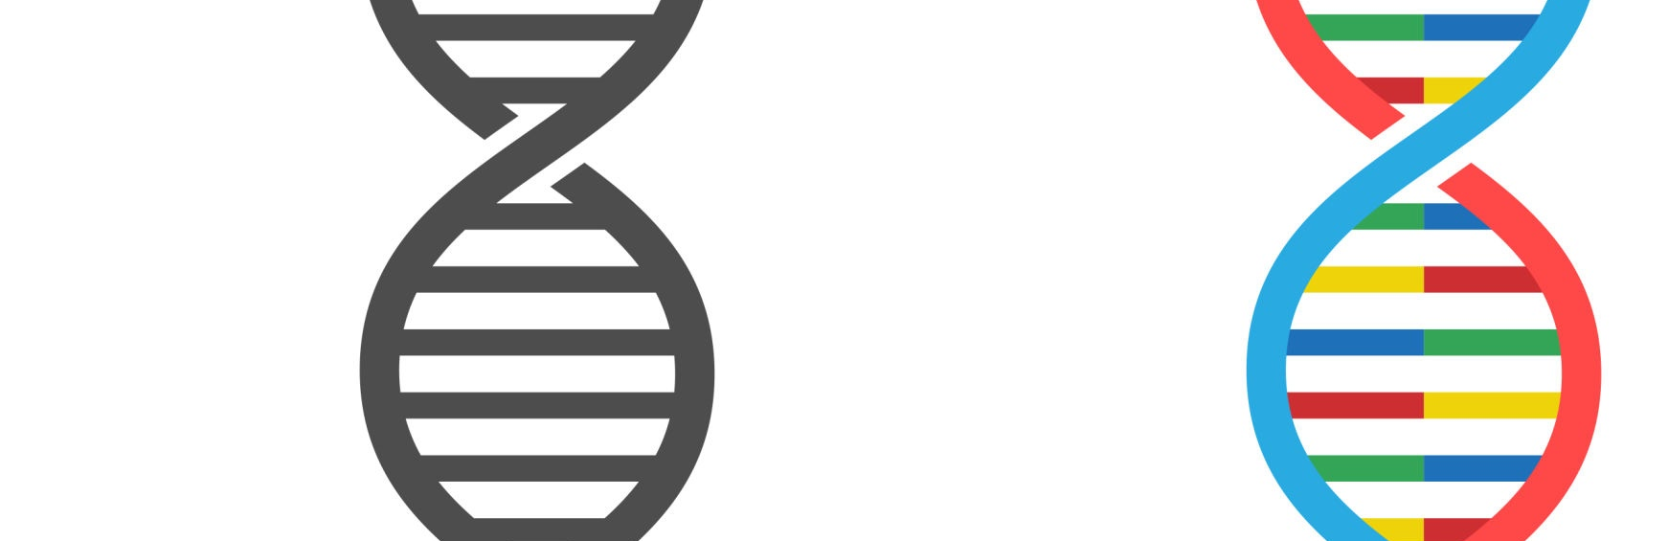
How does it work?
Search criteria
Set the search criteria that you’re looking for (keywords, price etc)

Slide 6
How does it work?
Periodicity
Set how often you want to scrape (remember though, more often = more cost!)

Slide 7
How does it work?
Evaluation criteria
Set what you want to ask the LLM for each item! You can set some mandatory “hard” criteria; if the item fails, its filtered out, letting you cut down your curation.

Slide 8

Then, just run it!
The “gallery” will keep running and curating items for you, keeping you up-to-date on item listings!

Slide 9
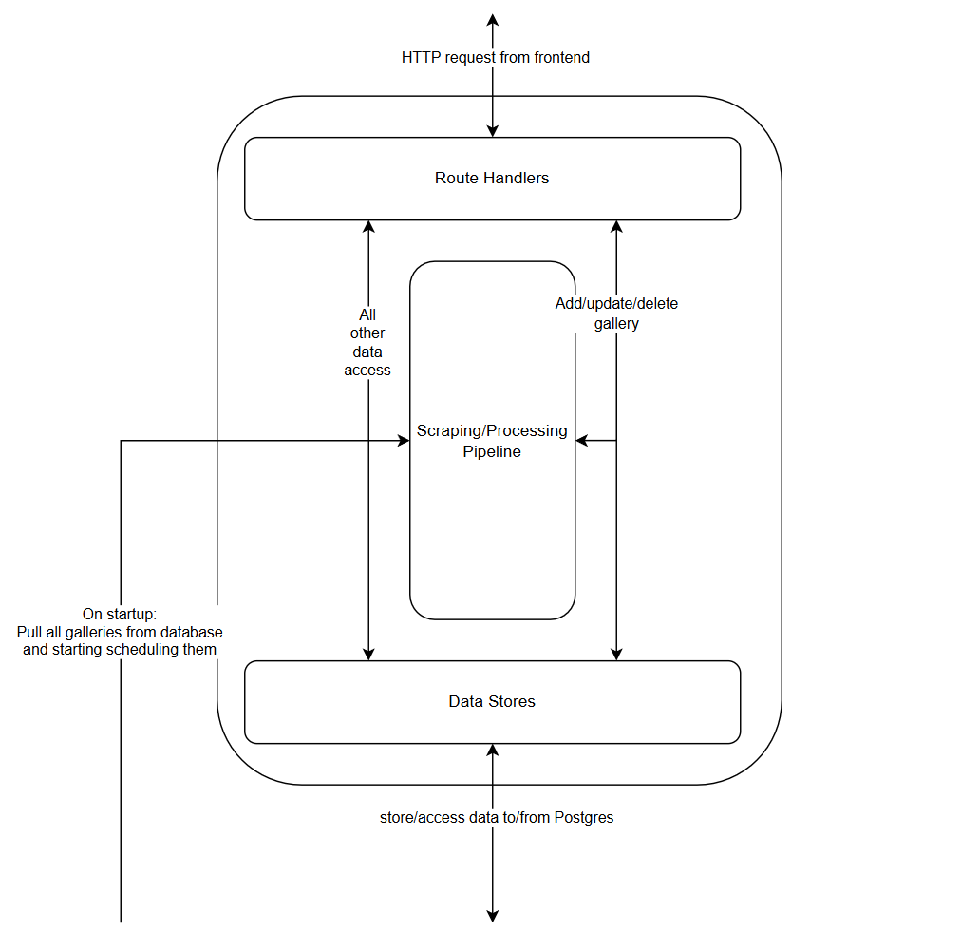
Under the hood: Backend
Using Supabase’s auth + Postgres database
Written in Rust
Database migrations/queries with Diesel ORM
Axum framework handling the web stuff
Perpetually running pipeline getting the goods

Slide 10
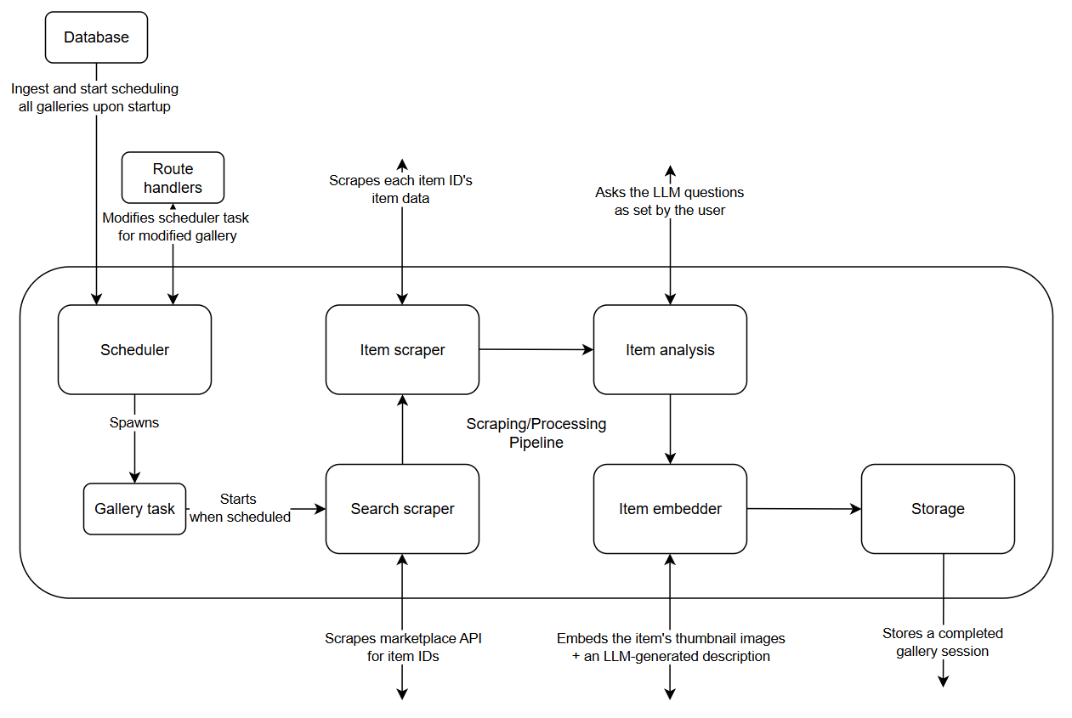
Pipeline
Scheduler runs pipelines based on each gallery’s periodicity
Search scraper gets new item IDs, while item scraper gets the actual data
Item analysis hits up the LLM for analyzing each item
Embedder embeds item thumbnail + description (not in use for now)
Storage… stores it, so you can see it!

Slide 11
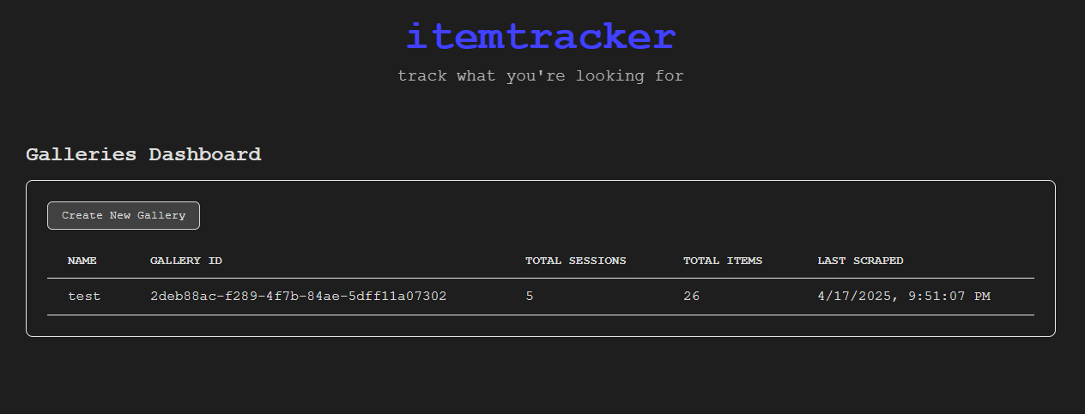
Frontend: Main dashboard
Check out your galleries here…

Slide 12
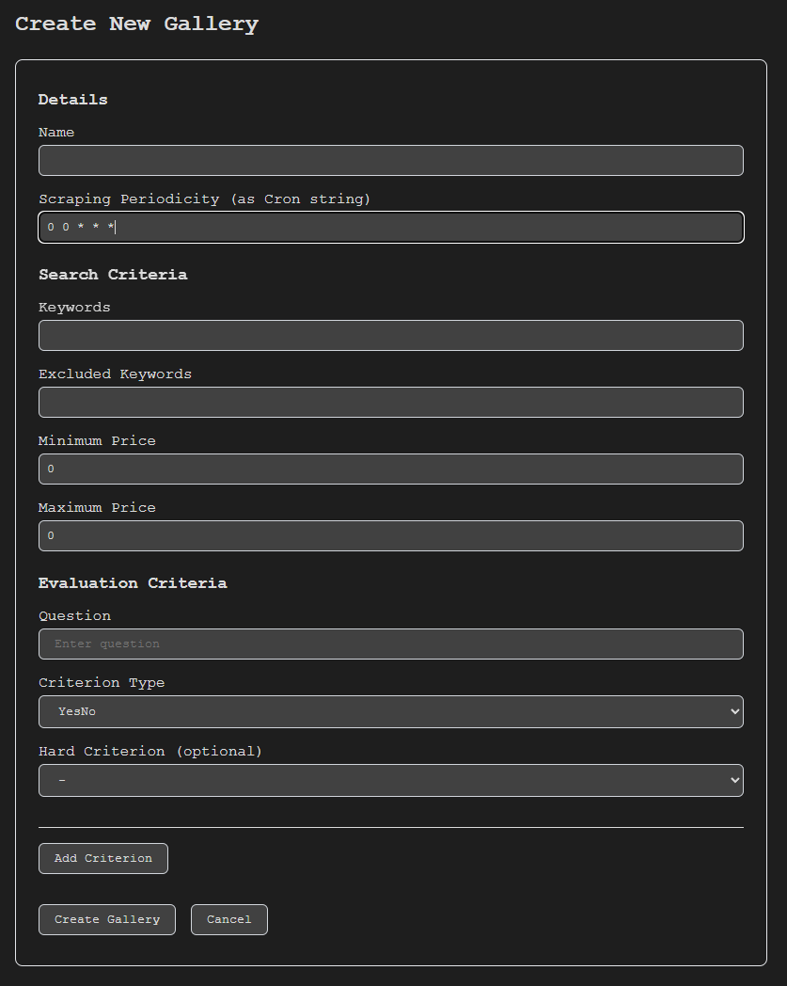
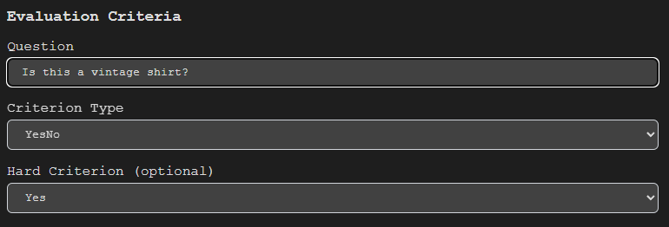
Gallery registration
Nice, formatted inputs for your evaluation criteria!

Slide 13
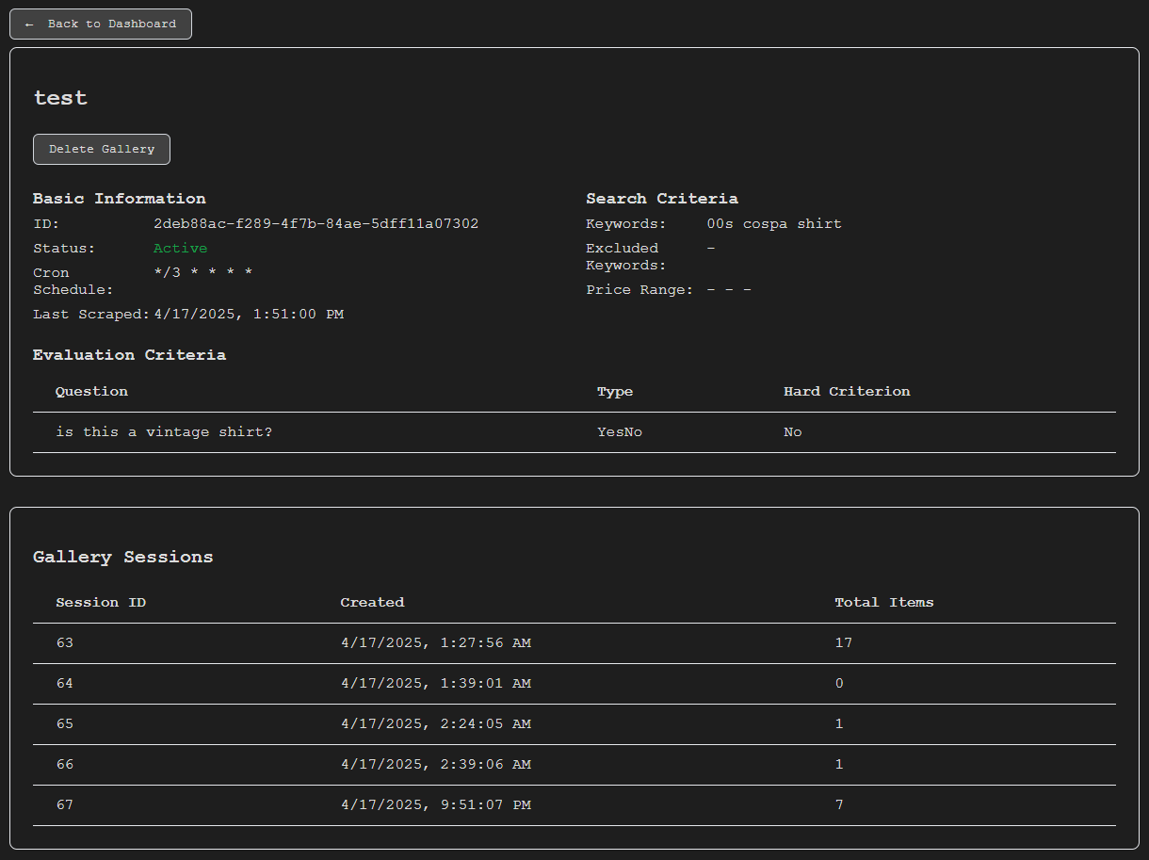
Gallery dashboard
Check out every scraping session under your gallery here, as well as some information about the gallery itself!
<- click on one of these…

Slide 14
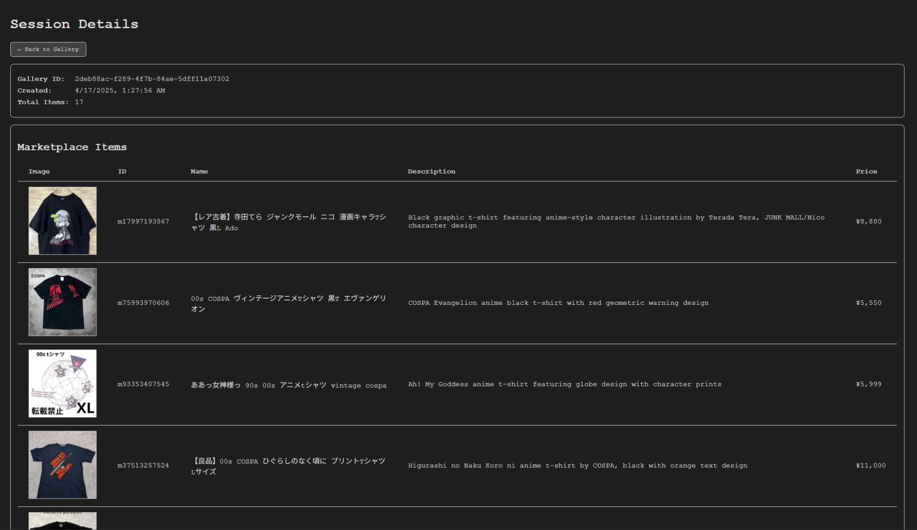
Gallery session items
… and get your fresh baked items!

Slide 15
Future roadmap
Item classification
Use the previous embeddings to group together same items in galleries, letting the user see price/availability trends over time
Irrelevant item storage
Some items that get filtered out, you might actually want; store these in gallery sessions too
Deployment
Currently a local-only proof-of-concept; now preparing CI/CD build + docker pipeline

Slide 16
Thank you!

