Slide 1
Testing at Fid Core NY
Coverage Driven Development
Strategy
Arbitrary code coverage numbers leave your code vulnerable.
Theory: If you just agree on some arbitrary coverage factor, say 50%, then it is impossible to know when some new important feature has not been tested.
Instead, require 100% coverage.
If something is to be purposely ignored, then annotate it as ignored.
After tests are generated, execute and measure coverage. Anything not covered must be assessed:
Either mark it as ignored
Or write a test
Either way, get to 100% coverage!

Slide 2
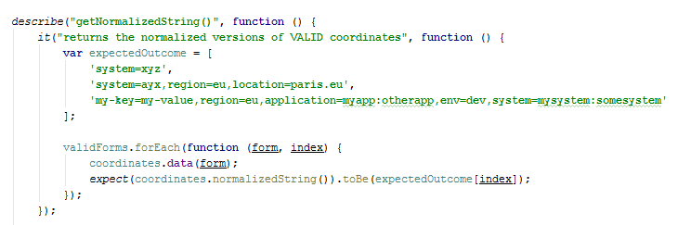
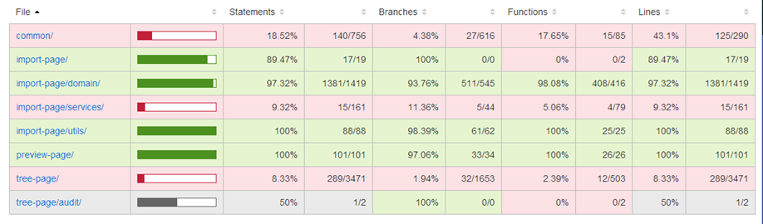
Testing at Fid Core NY
JavaScript Coverage Driven Development
Jasmine/Karma – Allow us to create BDD style tests that can be executed from IntelliJ IDEA and from Bamboo

Slide 3
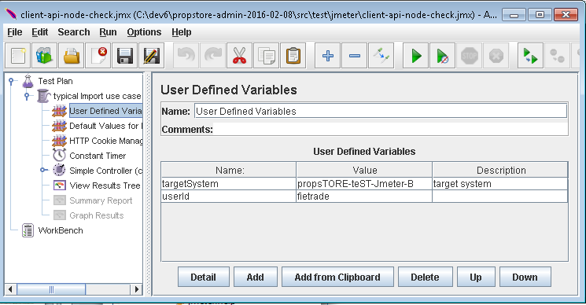
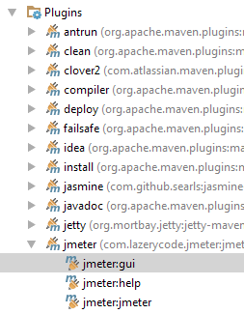
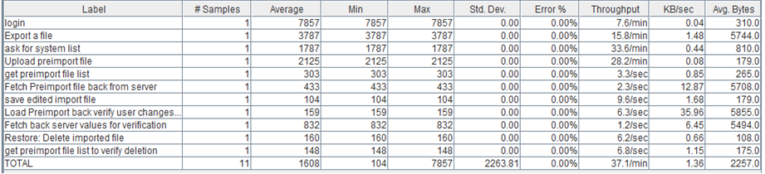
Testing at Fid Core NY
JMeter Tests – One stop testing for hard to test code
1. Launch from Maven:
3. Generate automated results from Bamboo:
2. Define Jmeter Tests from the GUI:

Slide 4
Testing at Fid Core NY
Writing Testable Code
Extract functionality into testable units (For example excluding I/O calls and set up)
If unit is reusable, make it public (and if possible static) and move it to a Util class
If not, keep it private and local
Use PowerMock or Java reflection for testing it.

