Slide 1
Up and Running with Jenkins

Slide 2
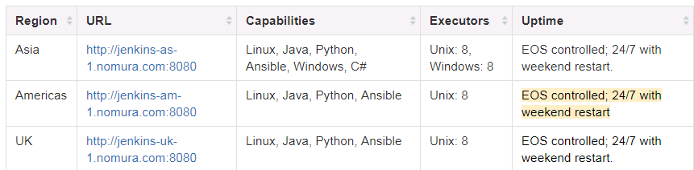
Nomura Enterprise USA installation: http://jenkins-am-1.nomura.com:8080/
Or download from jenkins.io (choose generic war. Requires Java 7 or greater)
java –jar jenkins.war
Find the initial password in: %USERPROFILE%\.jenkins\secrets\initialAdminPassword

Slide 3
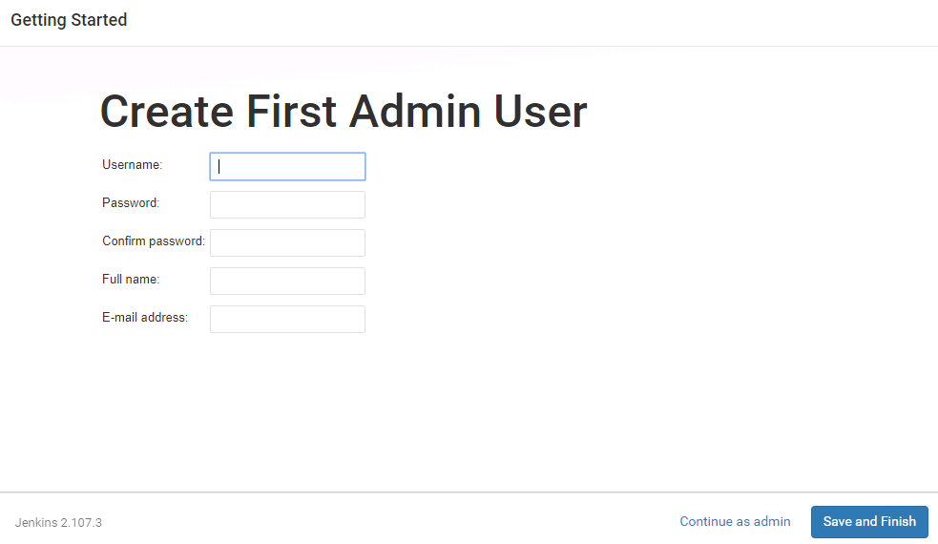

Slide 4
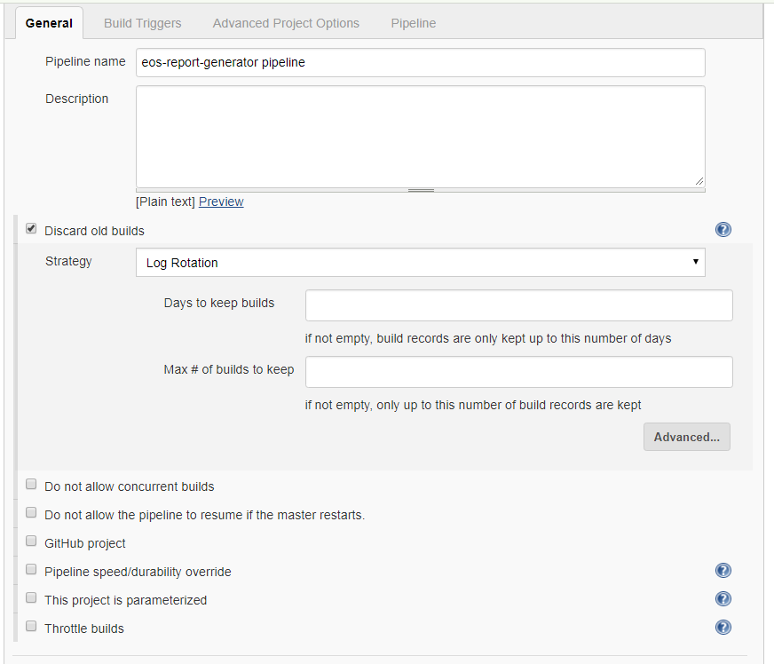
Configure a pipeline

Slide 5
Configure a pipeline
Nodes
Allow you to specify a particular set of slaves to execute on
Stages
Segregate your build into separate reporting sections

Slide 6
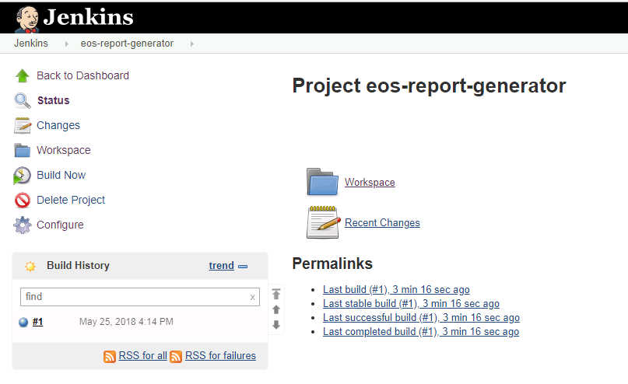

Slide 7
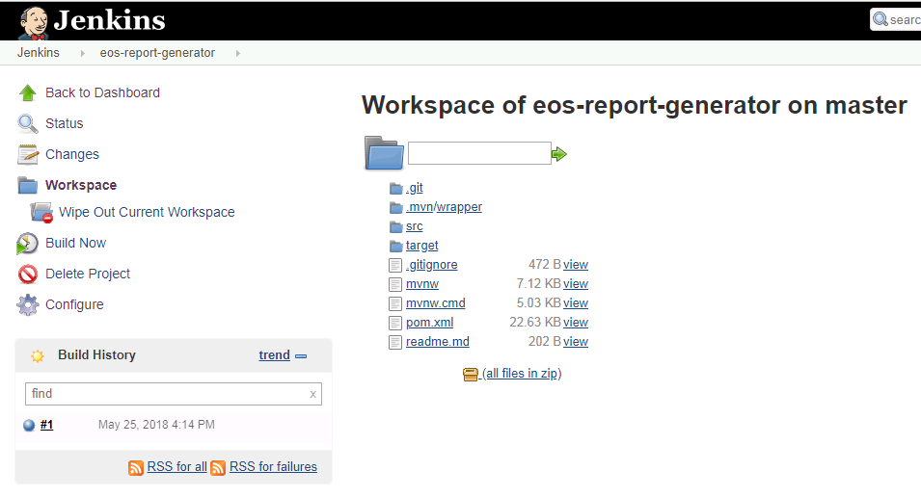

Slide 8
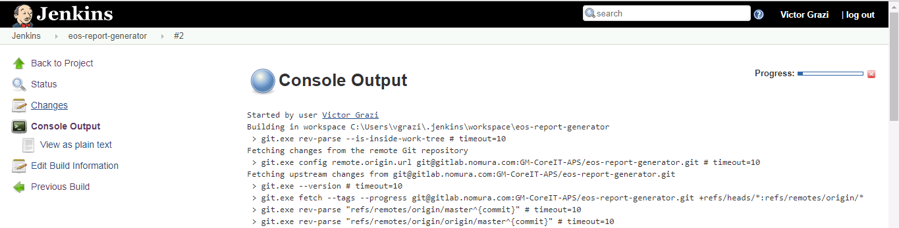

Slide 9
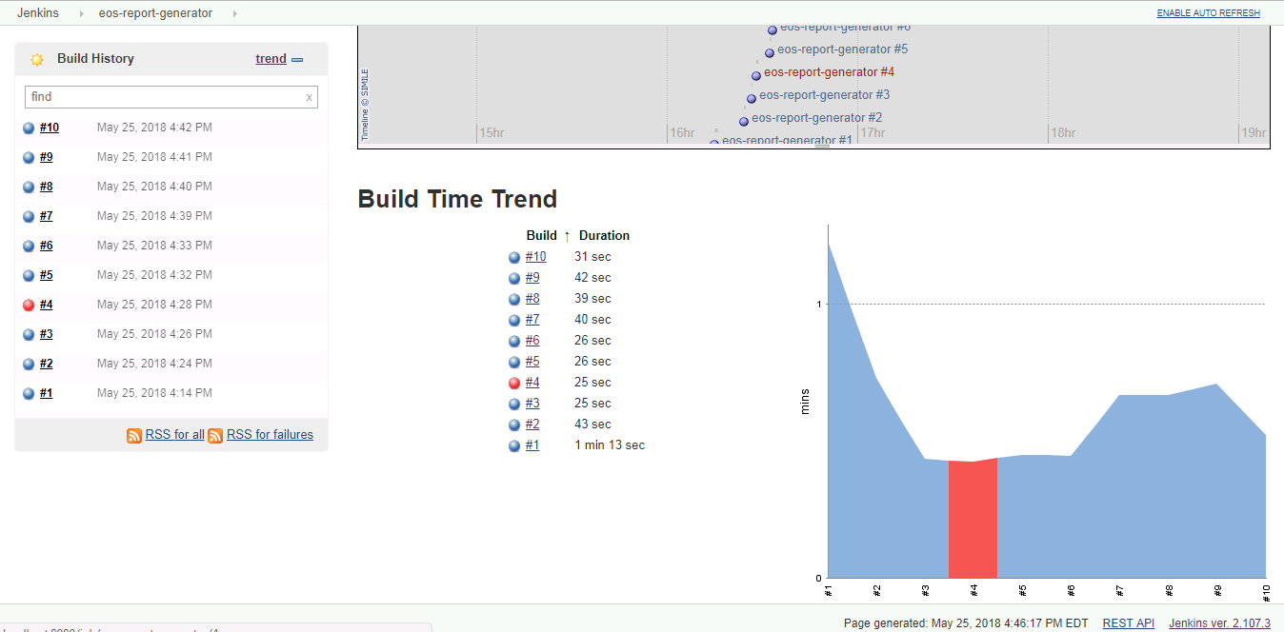

Slide 10
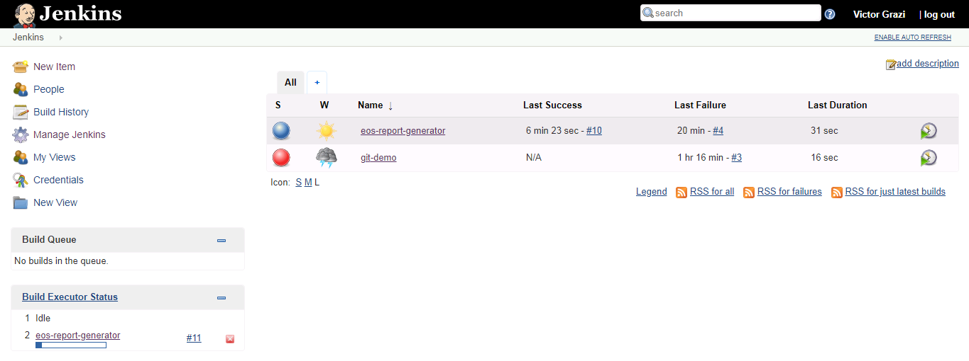

Slide 11
Creating a new Jenkins folder
http://jenkins-as-1.nomura.com:8080/view/Jenkins/job/JENKINS/job/Jenkins_folder/
Email DecOps-Core-ProdServices
devops-core-prodservices-fidl@nomura.com

Slide 12
Pipeline
node {
env.JAVA_HOME="${tool 'JDK 1.8'}“ // essential for our environment
def mvnHome
stage('Preparation') { // for display purposes
// Get the Maven tool.
// ** NOTE: This 'M3' Maven tool must be configured
// ** in the global configuration.
mvnHome = tool 'Maven‘// essential for our environment
}
stage('Checkout') {
// Get some code from a GitHub repository
// git credentialsId: 'e7baa8c2-060a-4ebb-b386-9bf2d9d98c23', url: 'https://gitlab.nomura.com/GM-CoreIT-APS/eos-report-generator.git‘
checkout scm // use “scm” when running as a Jenkinsfile, to indicate the current repo
}
stage('Build') {
// Run the maven build
if (isUnix()) {
sh "'${mvnHome}/bin/mvn' -Dmaven.test.failure.ignore clean package"
} else {
bat(/"${mvnHome}\bin\mvn" -Dmaven.test.failure.ignore clean package/)
}
}
stage('Results') {
junit '**/target/surefire-reports/TEST-*.xml'
archive 'target/*.jar'
}
}

Slide 13
Archiving of feature branch builds:
Since each build archives its binaries, you can configure your build to use Ansible to deploy features to a particular UAT server, based on the branch name.

Slide 14
For more info:
http://gm-dev-tools.nomura.com/ETCB/confluence/display/DEVOPS/Supported+Products+-+Jenkins
Tactical playbook:
http://gm-dev-tools.nomura.com/ETCB/confluence/display/DEVOPS/Playbook+-+Jenkins
Pipeline syntax:
https://jenkins.io/pipeline/getting-started-pipelines/
FAQ:
http://gm-dev-tools.nomura.com/ETCB/confluence/display/DEVOPS/Jenkins+FAQ

