Slide 1
Liquibase
Database Refactoring and Version Control
Victor Grazi
Aruneesh Salhotra
June 14th

Slide 2
PROBLEM STATEMENT
Why use DB deployment orchestration tools
How do we do it today without tooling?
Why do we need to change that?
DevOps automation
Rollback
Database vendor independent
Testing

Slide 3
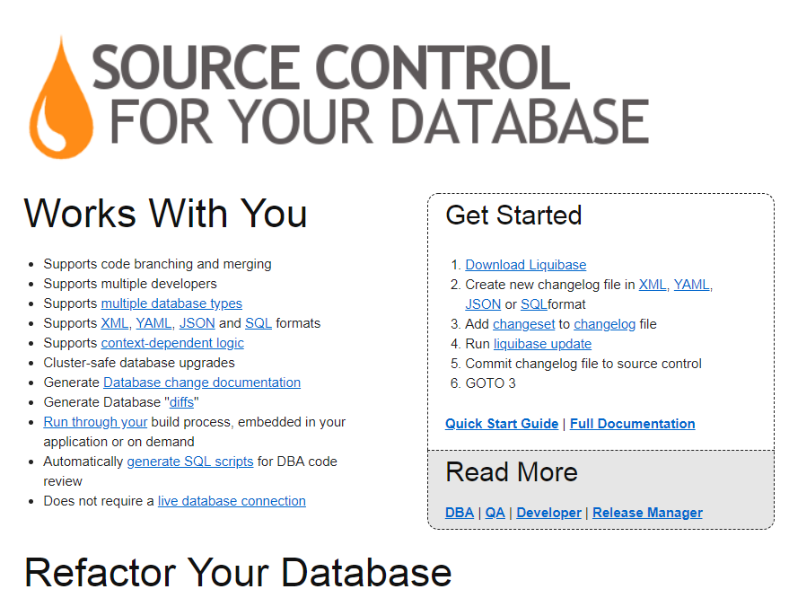
What is Liquibase
http://www.liquibase.org/

Slide 4
Change Sets
A change set is the basic unit for a database
It includes metadata for the change and the change itself
Instructions contain one or more atomic changes
For example
add table
alter column
add constraint
Change set is uniquely identified by ID, Author, Filename

Slide 5
Change Log and Change Sets
Change set: describes a set of changes that Liquibase executes in a single transaction.
Change sets use the Liquibase specific commands to produce database independent commands
To facilitate rollback, a change set should consist of a single logical change
Each change set is performed in an atomic transaction, and is recorded in an audit table within the database
Change log: Contains many change sets.
One change log per file

Slide 6
Change Log and Change Sets
Create a new change log for each release
In the master change log, insert an include for each change log file
eg <include file=“changelog-0.0.1.xml”/>
Best practice – Make a change log for each release
Formats:
XML
JSON
YAML
SQL

Slide 7
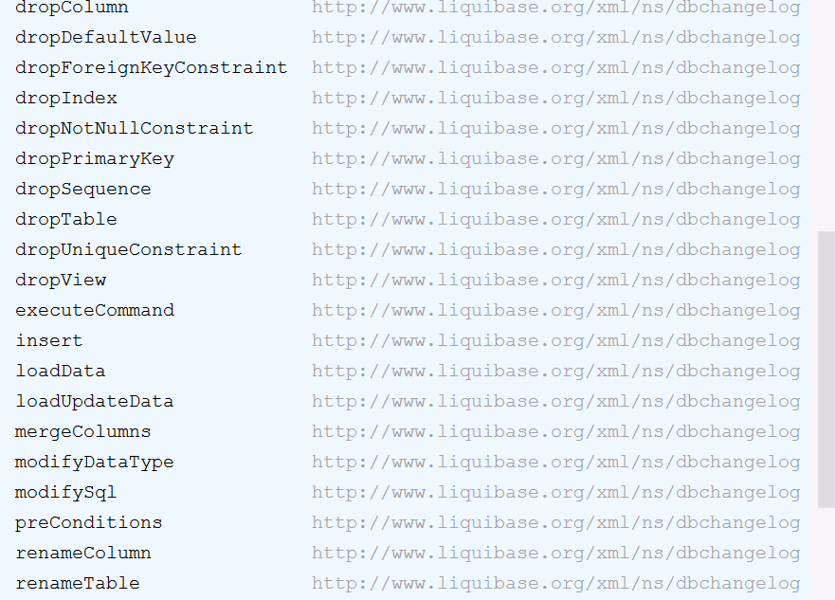
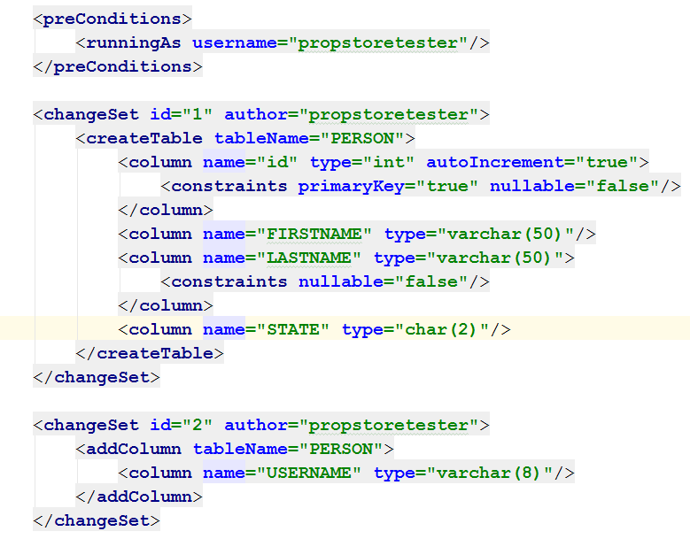
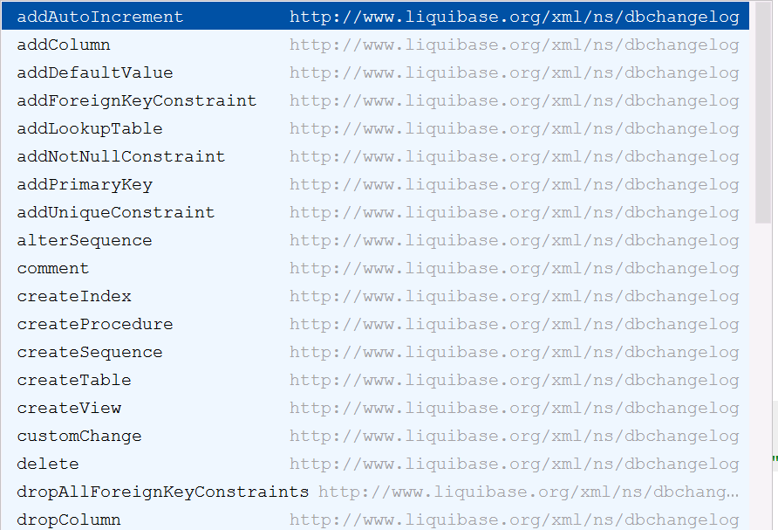
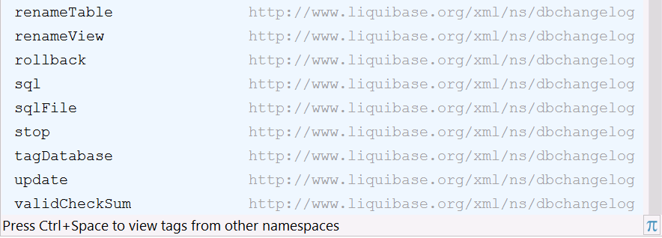
Defining a Changeset
Constraints
primaryKey
nullable
foreignKeyName
. . .

Slide 8
Getting started with existing DB
Two major approaches for migrating to Liquibase:
Make it look like you’ve always been using Liquibase:
Generate a change log file of current state of database
Usually the best long term, but requires more work up front.
Just start using Liquibase
Good for maintaining incremental versions
BUT: cannot bootstrap an empty database with Liquibase alone

Slide 9
How Change Log File is applied “internally” [FYI]
A change log file is passed to a change log parser (based on the file extension)
Parser converts the original text into Change objects.
Change objects are executed and generate SqlStatement objects. (Describe required statement types. )
For each Statement object, an appropriate SqlGenerator is manufactured
Creates one or more Sql objects for the statement
Invoked to produce the changes
Change Log File
Change Log Parser
Fed To
Creates
Sql Statement Object
Change Objects
Change Objects
Change Objects
Returns
Sent to
Sql Generator
Factory
Sql
Generator
Selects Correct
Generates
Database
Change Objects
Invokes Sql
Change Objects
Sql
Objects

Slide 10
Overriding/Extensions [FYI]
Each stage can be modified to support new functionality or to modify existing logic.
Any default implementation step can be overridden with a custom subclass.
At each step, Liquibase searches classes in known packages (liquibase core jar and all liquibase.ext.* package structures) for classes that implement the correct interfaces.
If more than one match for an interface, uses getPriority() method defined for each class to select the highest priority 1 and 5

Slide 11
SpringBoot
Properties:
liquibase.enabled=true
liquibase.change-log=classpath:/db/changelog/db.changelog-master.xml (default)
Actuator endpoint for liquibase
todo: How to add to standard Spring and non-spring applications???

Slide 12
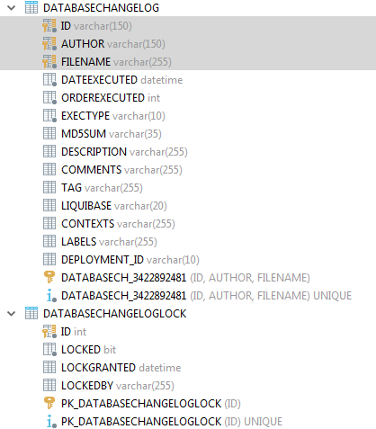
Two audit tables created:
DATABASECHANGELOG – Audit log of all changes
Identified by ID and Author name
Liquibase scans this table to determine which change sets need to be applied
DATABASECHANGELOCK – Ensures that multiple instances only execute the DB changes once, and prevent concurrent modification.

Slide 13
Can dump a full DB to get started
Command????

Slide 14
Can also add direct SQL using the<sql> element
This is useful for inserting data

Slide 15
Command Line
Maven
Grails
Spring
Servlet listener so it automatically runs when web site is first deployed
IDE
Ant
Can also add custom logic by creating custom classes

Slide 16
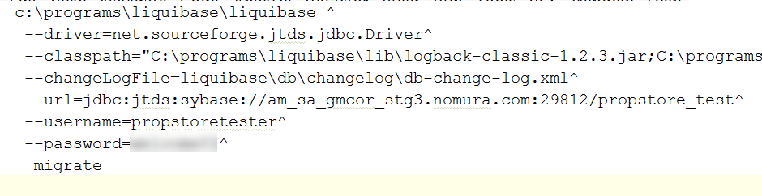

Slide 17
Liquibase Commands
Commands:
migrate
rollbackCount=2
generateChangeLog
Aruneesh – Supply specific use cases

Slide 18
How does this fit into the CI/CD workflow?
Aruneesh will fill in

Slide 19
http://www.liquibase.org
http://www.liquibase.org/blog/
http://www.liquibase.org/bestpractices.html
Liquibase Commercial version: Datical
Competitive/Industry tools: Flyway

