Slide 1
Building with Maven and Nexus
Reduce your build size and your build time

Slide 2
Are there library binaries in your build?
WRONG
WAY
GO BACK

Slide 3
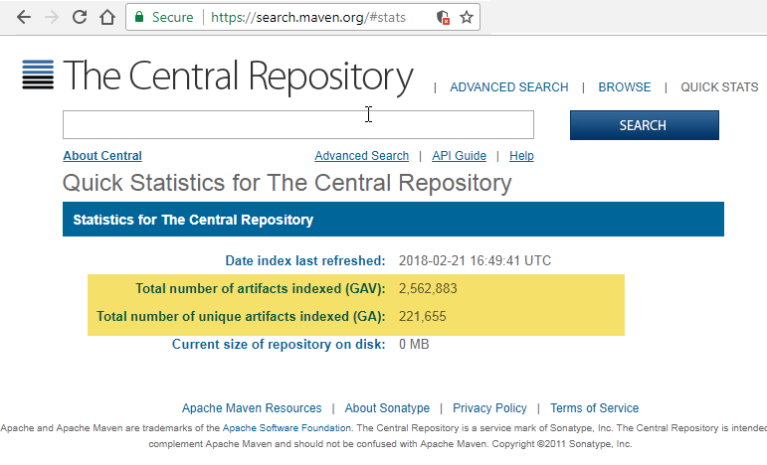
Maven Central – Home to Hundreds of Thousands of Libraries!
https://search.maven.org/#stats

Slide 4
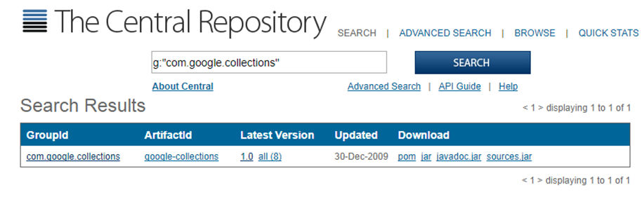
https://search.maven.org/#search%7Cga%7C1%7Cg%3A%22com.google.collections%22
Notes:
Sorry, PowerPoint has a “feature” that replaces # signs in hyperlinks with %20-%20. So I could not make these links

Slide 5
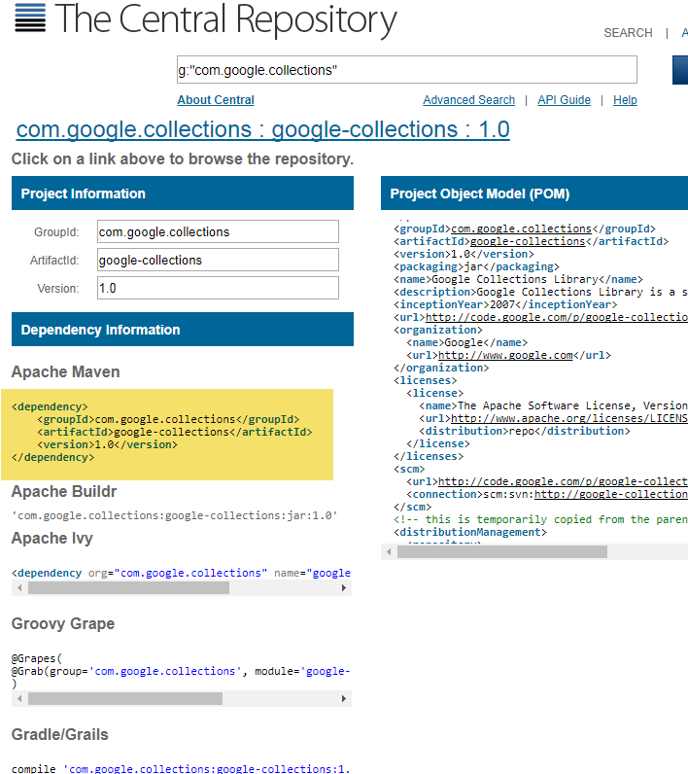

https://search.maven.org/#artifactdetails%7Ccom.google.collections%7Cgoogle-collections%7C1.0%7Cjar

Slide 6
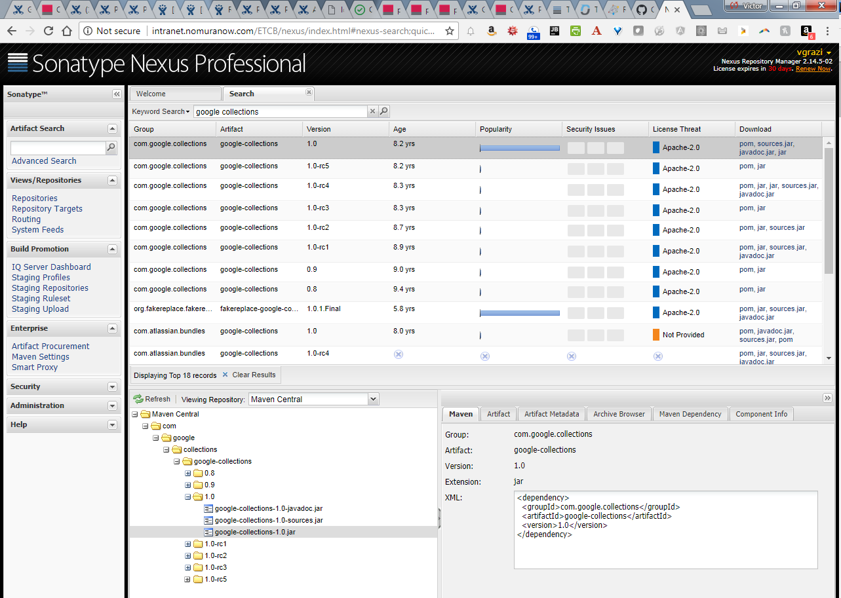
Internal Nexus: http://intranet.nomuranow.com/ETCB/nexus/

Slide 7
Libraries are specified by a “GAV” coordinate
GAV:
Group ID: e.g. com.google.collections (think of it like a package)
Artifact ID:google-collections (basically, the name of this module)
Version: 1.0 (the version of the package)
Use Semantic Versioning (contains three integer sections)
eg <version>4.2.1</version>
4 - MAJOR version when you make incompatible API changes,
2 - MINOR version when you add functionality in a backwards-compatible manner, and
1 - PATCH version when you make backwards-compatible bug fixes.
Snapshot versions end in –SNAPSHOT. New builds replace the previous snapshot version
Release versions do not end in –SNAPSHOT. New builds must increment the version number

Slide 8
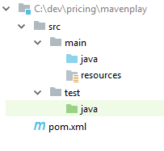
Maven – Convention over configuration –
best if you use the proposed structure:

Slide 9
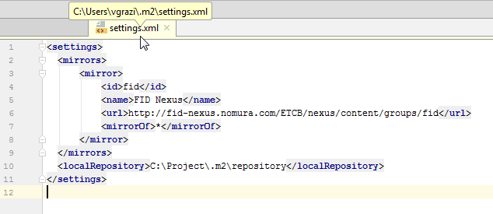
%userprofile/.m2/settings.xml contains basic Maven configuration. It is used across all of your projects.
It points to the Nexus proxy to use for downloads
and to your local repository location. (Your local repository can get very large. We recommend moving it out of your roaming profile.)

Slide 10
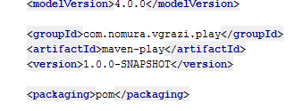
Your pom.xml file completely defines your build configuration.
Convention over configuration
Must declare the GAV coordinates

Slide 11
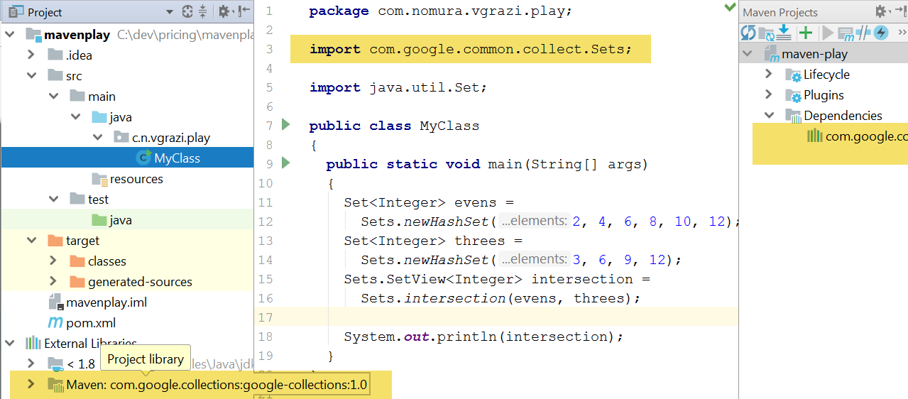
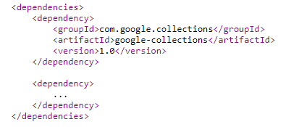
Once you add your maven dependencies, you can refer to those libraries in your projects

Slide 12
To view transitive dependencies, use the dependency plugin
mvn dependency:tree
C:\dev\pricing\mavenplay>mvn dependency:tree
[INFO] Building maven-play 1.0.0-SNAPSHOT
[INFO] +- com.google.collections:google-collections:jar:1.0:compile
[INFO] +- org.slf4j:slf4j-log4j12:jar:1.7.5:compile
[INFO] | +- org.slf4j:slf4j-api:jar:1.7.5:compile
[INFO] | \- log4j:log4j:jar:1.2.17:compile
[INFO] +- org.mockito:mockito-core:jar:1.10.19:test
[INFO] | +- org.hamcrest:hamcrest-core:jar:1.1:test
[INFO] | \- org.objenesis:objenesis:jar:2.1:test
[INFO] +- org.powermock:powermock-module-junit4:jar:1.6.5:test
[INFO] | +- junit:junit:jar:4.12:test
[INFO] | \- org.powermock:powermock-module-junit4-common:jar:1.6.5:test
[INFO] | +- org.powermock:powermock-core:jar:1.6.5:test
[INFO] | | \- org.javassist:javassist:jar:3.20.0-GA:test
[INFO] | \- org.powermock:powermock-reflect:jar:1.6.5:test
[INFO] \- org.powermock:powermock-api-mockito:jar:1.6.5:test
[INFO] \- org.powermock:powermock-api-mockito-common:jar:1.6.5:test
[INFO] \- org.powermock:powermock-api-support:jar:1.6.5:test
[INFO] ------------------------------------------------------------------------
[INFO] --- maven-dependency-plugin:2.8:tree (default-cli) @ my-sub ---
[INFO] com.nomura.vgrazi.play:my-sub:jar:1.0.0-SNAPSHOT
[INFO] \- com.google.collections:google-collections:jar:1.0:compile
[INFO] ------------------------------------------------------------------------

Slide 13
Filter to a specific library using the –Dincludes switch
C:\dev\pricing\mavenplay>mvn dependency:tree -Dincludes=org.javassist
C:\dev\pricing\mavenplay>mvn dependency:tree -Dincludes=org.javassist
[INFO] Scanning for projects...
[INFO] ------------------------------------------------------------------------
[INFO] Building maven-play 1.0.0-SNAPSHOT
[INFO] ------------------------------------------------------------------------
[INFO]
[INFO] --- maven-dependency-plugin:2.8:tree (default-cli) @ maven-play ---
[INFO] com.nomura.vgrazi.play:maven-play:pom:1.0.0-SNAPSHOT
[INFO] \- org.powermock:powermock-module-junit4:jar:1.6.5:test
[INFO] \- org.powermock:powermock-module-junit4-common:jar:1.6.5:test
[INFO] \- org.powermock:powermock-core:jar:1.6.5:test
[INFO] \- org.javassist:javassist:jar:3.20.0-GA:test
[INFO]

Slide 14
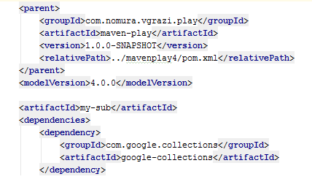
You can also create child projects that inherit from the parent

Slide 15
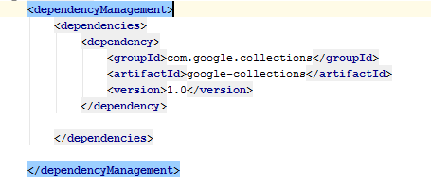
Put a <dependencyManagement> section in your parent pom, then all child modules can omit versions in those dependencies, to refer to the same versions

Slide 16
You can see the effective pom (including all implied dependencies and versions)
mvn help:effective-pom
mvn help:effective-pom
Effective POMs, after inheritance, interpolation, and profiles are applied:
<?xml version="1.0" encoding="UTF-8"?>
<!-- ====================================================================== -->
<!-- Generated by Maven Help Plugin on 2018-02-28T03:10:01 -->
<!-- See: http://maven.apache.org/plugins/maven-help-plugin/ -->
<!-- ====================================================================== -->
<projects>
<!-- Effective POM for project -->
<!-- 'com.nomura.vgrazi.play:maven-play:pom:1.0.0-SNAPSHOT' -->
<project xmlns="http://maven.apache.org/POM/4.0.0" xmlns:xsi="http://www.w3.org/2001/XMLSchema-instance" xsi:schemaLocation="http://maven.apache.org/POM/4.0.0 http://ma
ven.apache.org/xsd/maven-4.0.0.xsd">
<modelVersion>4.0.0</modelVersion>
<groupId>com.nomura.vgrazi.play</groupId>
<artifactId>maven-play</artifactId>
. . . . . . . . .

Slide 17
Maven lifecycle
mvn clean – clear your target (output area)
mvn test – run all tests
mvn package – run your tests and if passed, build your jars
mvn install – package and install to your local repository
mvn deploy – package and deploy to Nexus (specified in your settings.xml ). This should only be done on a build server
mvn exec:java –DmainClass=“my.package.MyClass” runs your program, automatically assembles the required libraries into the classpath.

Slide 18
Nexus architecture
http://intranet.nomuranow.com/ETCB/confluence/display/CORE/Sonatype+Nexus+-+Maven+Repository#SonatypeNexus-MavenRepository-NexusInfrastructure

