Slide 1
Enterprise Java Debugging Advanced techniques for gaining insight into your code at run time
Victor Grazi – GM Core IT

Slide 2
Agenda
JStack: Preemptive Java thread dumps
Btrace: Invoke Java diagnostics against a running JVM
Bytecode reweaving: Bytecode Explorer/ASM
Java agents: Bespoke instrumentation of your code

Slide 3
JStack
Displays detailed stack trace of the supplied pid.
Similar to kill -3 on unix, but platform independent.
Unlike kill -3, can be invoked remotely.
Can be invoked by an executing program on itself, to preemptively generate log data when thresholds have been breached.
Suggestion – Thread names are not final, reassign them according to their function.

Slide 4
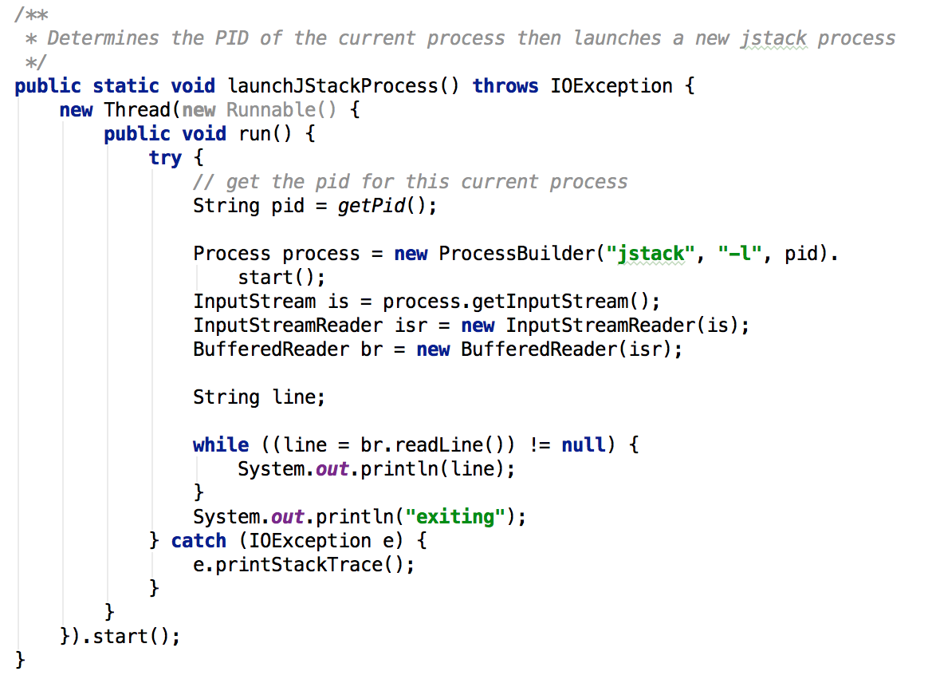
Notes:
Using JMX we can determine the pid of the current process, then test for threshold conditions and preemptively invoke our launchJstackProcess() method as needed.

Slide 5
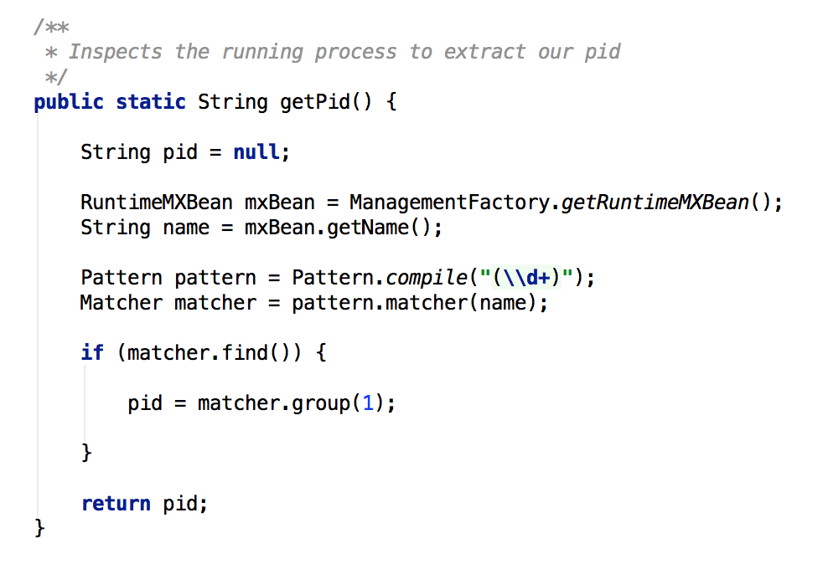
Notes:
Using JMX we can determine the pid of the current process, then test for threshold conditions and preemptively invoke our launchJstackProcess() method as needed.

Slide 6
Demo

Slide 7
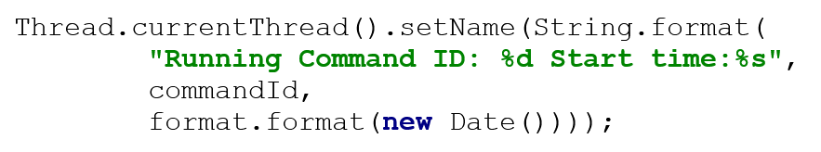
Thread names are not final! Setting a descriptive thread name adds clarity in tools and stack traces:

Slide 8
Before:
"Thread-18" #30 prio=5 os_prio=0 tid=0x0000000017c8b800 nid=0x46878 in Object.wait() [0x000000001b65e000]
java.lang.Thread.State: TIMED_WAITING (on object monitor)
at java.lang.Object.wait(Native Method)
After
"Running Command ID: 19 Start time:15-09-09 10:39:50" #30 prio=5 os_prio=0 tid=0x0000000017ea7800 nid=0x47a68 in Object.wait() [0x000000001b12e000]
java.lang.Thread.State: TIMED_WAITING (on object monitor)
at java.lang.Object.wait(Native Method)

Slide 9
Btrace
A read-only microscope into your running code. (No JVM restart required).
Traces a running Java program – similar to DTrace for OpenSolaris applications.
Dynamically instruments classes of the target application to inject tracing code.

Slide 10
BTrace
Scripts are similar to Aspect Oriented. Consist of:
Probes – Like pointcuts, define when the instrumentation should be executed.
Actions – advices, define the instrumentation.
Probe can consist of:
Method/Constructor entry/exit
Line number
Field updated/accessed
Specific method call/return
Before Exception thrown
Synchronization entry/exit

Slide 11
Using BTrace
1. Download latest BTrace from Github: https://github.com/jbachorik/btrace/releases/
2. Unzip and set BTRACE_HOME env variable, point PATH to BTRACE_HOME/bin.
3. Detailed User Guide at: https://kenai.com/projects/btrace/pages/UserGuide
4. Identify Java process PIDs (jps utility.)
5. btrace <pid> <btrace-script.java> (Note btrace-script is Java source, omit package.)

Slide 12
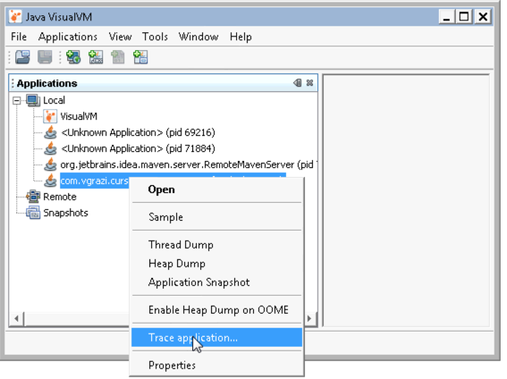
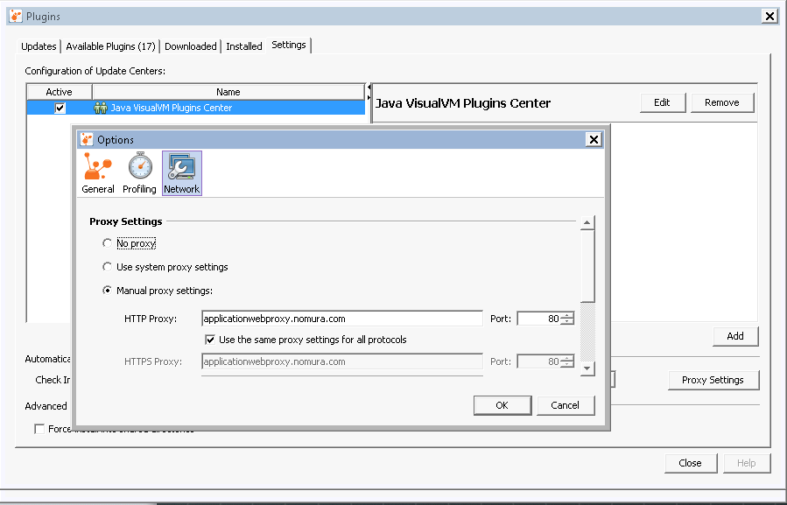
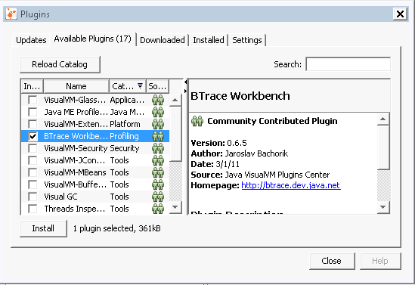
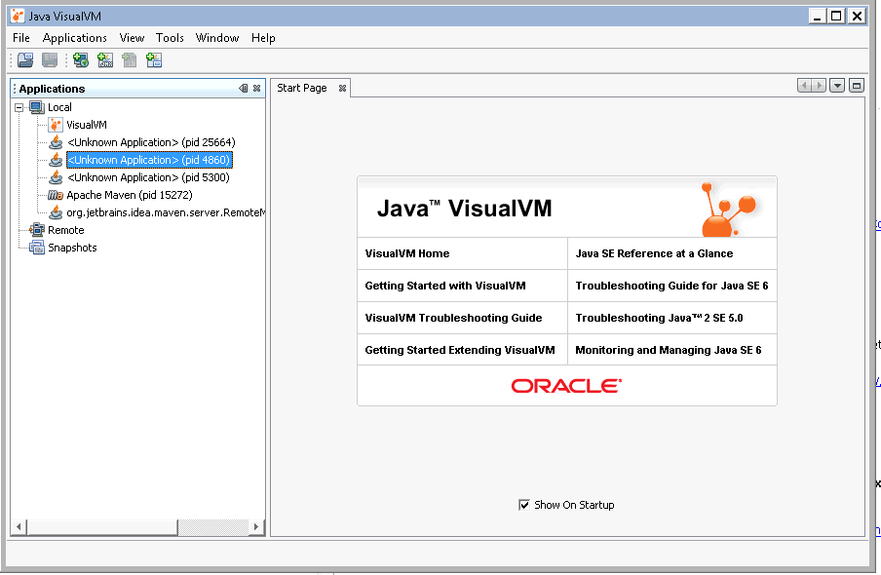
Installing Optional Visual VM Btrace Plugin
Start Java Visual VM by typing jvisualvm at a command prompt
Make sure your proxy is set to applicationwebproxy.nomura.com:80
On the plugins tab, reload the catalog and select Btrace plugin.
Restart Visual VM.
Right click on a PID and select “Trace”.

Slide 13
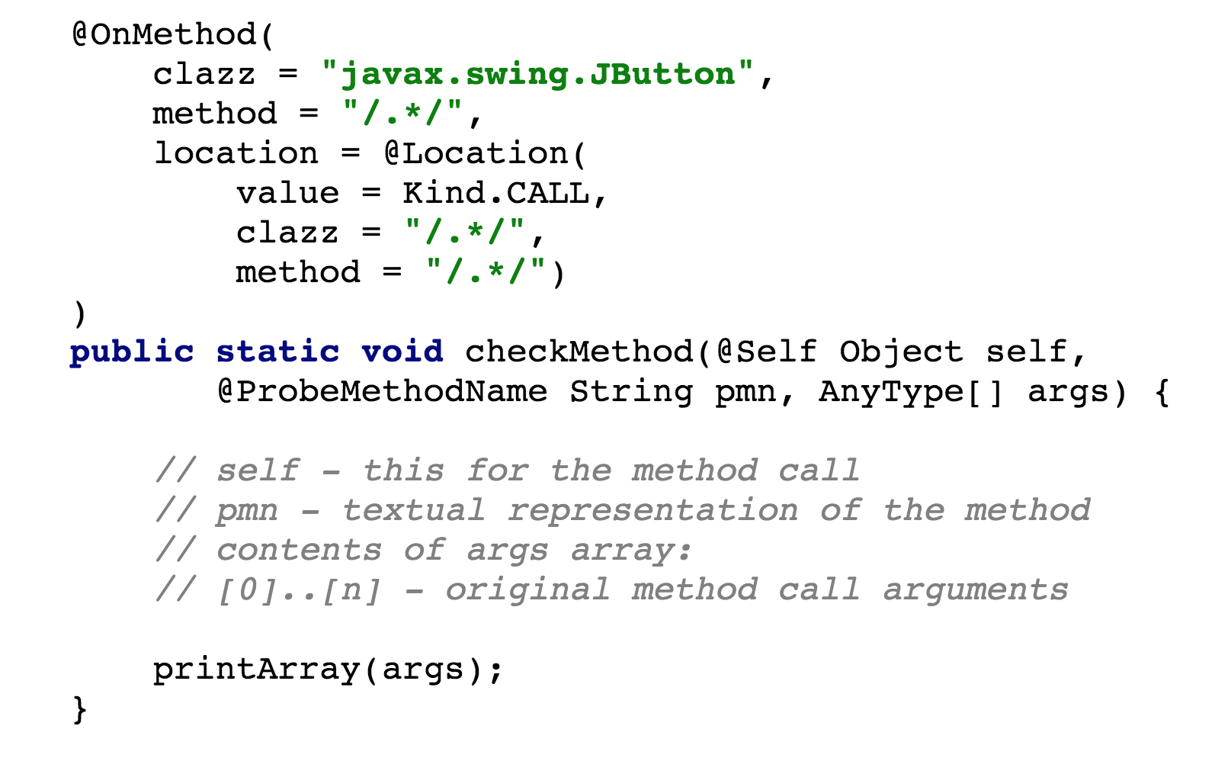
Btrace Samples
https://github.com/jbachorik/btrace/ tree/master/samples
Calling member
Called member

Slide 14
Btrace Samples
Can capture
Calling class
Calling method
On entry or return
Or on access to a specific method
Or at a specific line
Or synchronized entry/exit
Can schedule repeated execution via Timer

Slide 15
Demo

Slide 16
JVM Instruction Set
load | load a variable onto the stack
dup | duplication the top stack entry
swap | swap the top two stack entries
return | return, leaving result on the caller stack
const | place a constant on the stack
add | Replace top two stack entries with sum
mul | Replace top two stack entries with product
div | Replace top two stack entries with quotient
sub | Replace top two stack entries with diff

Slide 17
store | store top stack entry into a var
if_cmpeq | if eq, branch
if_cmpgt | if > branch
invoke_virtual | standard method invocation
invoke_special | special (final and super) method invocation
invoke_interface | invoke an interface method
invoke_static | invoke a static method
invoke_dynamic | invokes a dynamic method, to support “duck” typed languages
monitor_enter | grab a lock if available or block
monitor_exit | release an owned lock
new | create a new instance

Slide 18
Bytecode Explorer
Upload .class files to display bytecode structure.
Hover over constant pool to display translation of each constant.
Hover over any method to display disassembled method instructions.
Open source AngularJS application. Download from https://github.com/vgrazi/BytecodeExplorer
Contributors welcome!

Slide 19
Demo

Slide 20
Java Agents Static, launch with Java application
Implement premain… public static void premain(String args, Instrumentation inst)
Launch command: java –javaagent:target/lib/ my-agent.jar=<agent-args> my.JavaMainClass <java-args>

Slide 21
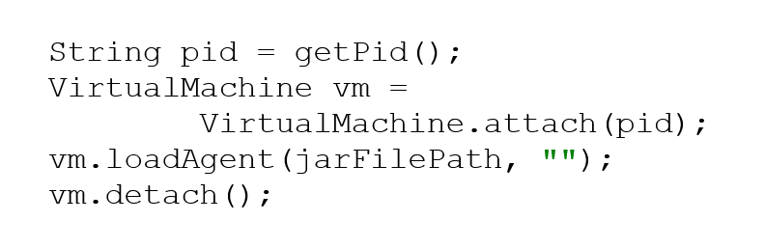
Java Agents Dynamically attach to running application
Load the agent at startup. Implement public static void agentmain(String args, Instrumentation inst)

Slide 22
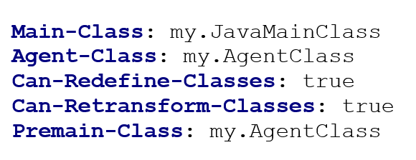
Agent manifest
Add agent to the jar manifest:

Slide 23
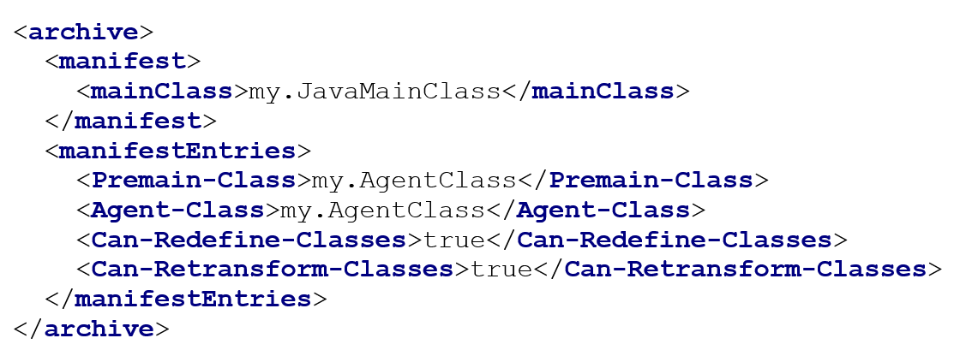
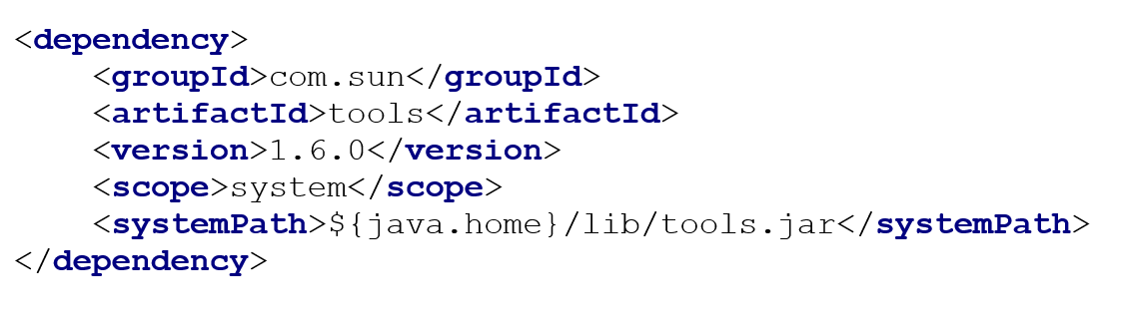
Maven definition
Manifest
Generation
Dynamic Agent
Generation

Slide 24
Additional References
http://www.infoq.com/presentations/java8-debugging
https://docs.oracle.com/javase/specs/jvms/se7/html/jvms-4.html
https://en.wikipedia.org/wiki/Java_bytecode_instruction_listings
http://www.h-schmidt.net/FloatConverter/IEEE754.html

