Slide 1
Java Swing JFrame with FlowLayout
The FlowLayout class provides a very simple layout manager that is used, by default, by the JPanel objects. The FlowLayout class puts components in a row, sized at their preferred size. If the horizontal space in the container is too small to put all the components in one row, the FlowLayout class uses multiple rows. If the container is wider than necessary for a row of components, the row is, by default, centered horizontally within the container.

Slide 2
Java Swing JFrame
JFrame works like the main window where components like labels, buttons, textfields are added to create a GUI.

Slide 3
Constructors:
JFrame frame = new JFrame();
JFrame frame = new JFrame (String title);
JFrame frame = new JFrame(GraphicsConfiguration gs);
JFrame frame = new JFrame(String title,
GraphicsConfiguration gs);

Slide 4
Methods
import java.awt.GraphicsConfiguration;
import javax.swing.JFrame;
/**
*
* @author mhcrnl
*/
public class Main {
/**
* @param args the command line arguments
*/
static GraphicsConfiguration gc;
public static void main(String[] args) {
// TODO code application logic here
JFrame frame = new JFrame(gc);
frame.setVisible(true);
}
}

Slide 5
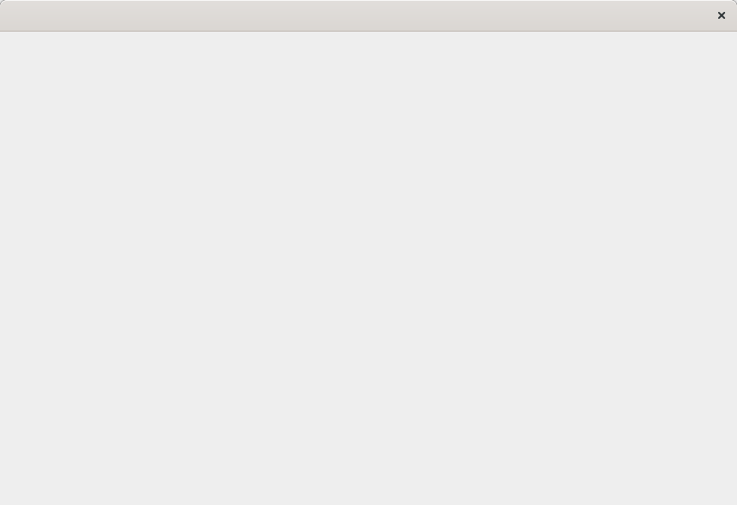
Photo:

Slide 6
Set title of JFrame:
import java.awt.GraphicsConfiguration;
import javax.swing.JFrame;
public class Main {
/**
* @param args the command line arguments
*/
static GraphicsConfiguration gc;
public static void main(String[] args) {
// TODO code application logic here
JFrame frame = new JFrame(gc);
frame.setTitle("JFrame tutorial");
frame.setVisible(true);
}
}

Slide 7
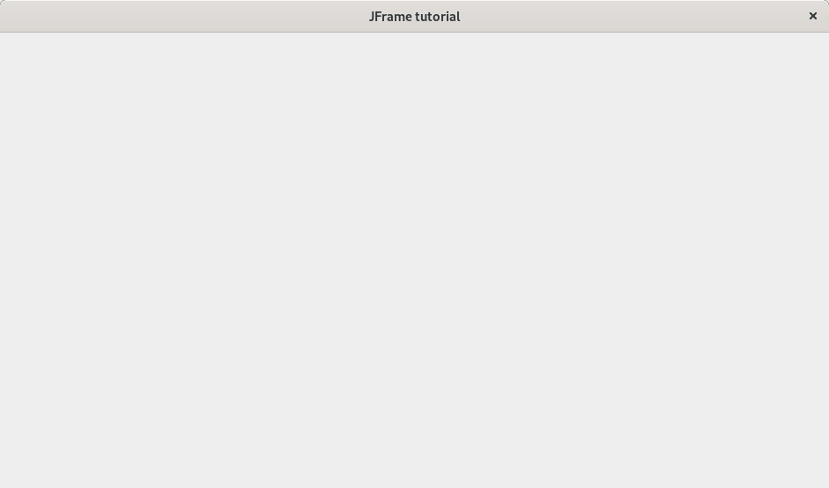
Set title of JFrame:

Slide 8
Change window size of a frame
import java.awt.GraphicsConfiguration;
import javax.swing.JFrame;
public class Main {
static GraphicsConfiguration gc;
public static void main(String[] args) {
// TODO code application logic here
JFrame frame = new JFrame(gc);
frame.setTitle("JFrame tutorial");
frame.setSize(600, 400);
frame.setVisible(true);
}
}

Slide 9
Closing a frame:
import java.awt.GraphicsConfiguration;
import javax.swing.JFrame;
public class Main {
static GraphicsConfiguration gc;
public static void main(String[] args) {
// TODO code application logic here
JFrame frame = new JFrame(gc);
frame.setTitle("JFrame tutorial");
frame.setSize(600, 400);
frame.setLocation(200, 200);
frame.setVisible(true);
frame.setDefaultCloseOperation(JFrame.EXIT_ON_CLOSE);
frame.setResizable(true);
}
}

Slide 10
Java Swing JPanel
JPanel, a part of Java Swing package, is a container that can store a group of components. The main task of JPanel is to organize components, various layouts can be set in JPanel which provide better organisation of components, however it does not have a title bar.

Slide 11
Constructor of JPanel are :
JPanel() : creates a new panel with flow layout
JPanel(LayoutManager l) : creates a new JPanel with specified layoutManager
JPanel(boolean isDoubleBuffered) : creates a new JPanel with a specified buffering strategy
JPanel(LayoutManager l, boolean isDoubleBuffered) : creates a new JPanel with specified layoutManager and a specified buffering strategy

Slide 12
Commonly used functions :
add(Component c) : adds component to a specified container
setLayout(LayoutManager l) : sets the layout of the container to specified layout manager
updateUI() : resets the UI property with a value from the current look and feel.
setUI(PanelUI ui) : sets the look and feel object that renders this component.
getUI() : returns the look and feel object that renders this component.
paramString() : returns a string representation of this JPanel.
getUIClassID() : returns the name of the Look and feel class that renders this component.
getAccessibleContext() : gets the AccessibleContext associated with this JPanel.

Slide 13
Code:
import javafx.scene.paint.Color;
import javax.swing.JButton;
import javax.swing.JFrame;
import javax.swing.JLabel;
import javax.swing.JPanel;
public class Main {
static JFrame fr;
static JButton bt, bt1, bt2;
static JLabel lb;
public static void main(String[] args) {
// TODO code application logic here
fr = new JFrame("Frame with panel");
bt = new JButton ("Button1");
bt1 = new JButton ("Button2");
bt2 = new JButton ("Button3");
lb = new JLabel("label in panel");
JPanel panel = new JPanel();
panel.add(lb);
panel.add(bt);
panel.add(bt1);
panel.add(bt2);
//panel.setBackground(Color.BISQUE);
fr.add(panel);
fr.setSize(300, 300);
fr.setVisible(true);
}
}

Slide 14
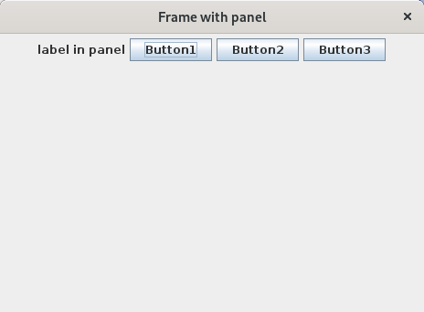
Photo

Slide 15
Java panel layouts:
BorderLayout
BoxLayout
CardLayout
FlowLayout
GridBagLayout
GridLayout
GroupLayout
SpringLayout

Slide 16
Java Swing FlowLayout
Flow layout is the common used layout. It is default layout used by JPanel. It is used to arrange components in a line or a row for example from left to right or from right to left. It arranges components in a line, if no space left remaining components goes to next line. Align property determines alignment of the components as left, right, center etc.

Slide 17
FlowLayout
import java.awt.FlowLayout;
import javafx.scene.paint.Color;
import javax.swing.JButton;
import javax.swing.JFrame;
import javax.swing.JLabel;
import javax.swing.JPanel;
public class Main {
static JFrame fr;
static JButton bt, bt1, bt2;
static JLabel lb;
public static void main(String[] args) {
// TODO code application logic here
fr = new JFrame("Frame with panel and Flowlayout");
bt = new JButton ("Button1");
bt1 = new JButton ("Button2");
bt2 = new JButton ("Button3");
lb = new JLabel("label in panel");
JPanel panel = new JPanel();
panel.add(lb);
panel.add(bt);
panel.add(bt1);
panel.add(bt2);
panel.setLayout(new FlowLayout());
//panel.setBackground(Color.BISQUE);
fr.add(panel);
fr.setSize(300, 300);
fr.setVisible(true);
}
}

Slide 18
Photo

Slide 19
BorderLayout
Every content pane is initialized to use a BorderLayout. (As Using Top-Level Containers explains, the content pane is the main container in all frames, applets, and dialogs.) A BorderLayout places components in up to five areas: top, bottom, left, right, and center. All extra space is placed in the center area. Tool bars that are created using JToolBar must be created within a BorderLayout container, if you want to be able to drag and drop the bars away from their starting positions.

Slide 20
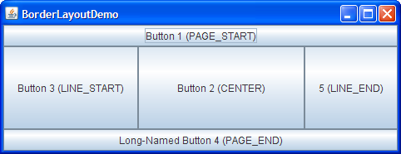
BorderLayout

Slide 21
BorderLayout constructors:
BorderLayout(): It will construct a new borderlayout with no gaps between the components.
BorderLayout(int, int): It will constructs a border layout with the specified gaps between the components.

Slide 22
BorderLayout methods:
toString(): Returns a string which is representation of the state of border layout.
getLayoutAlignmentX(Container parent): Returns the layout alignment along the X-axis.
getLayoutAlignmentY(Container parent): It will returns the layout alignment along the Y-axis.
removeLayoutComponent(Component comp): This method is used to remove the specified component from the borderlayout.
getVgap(): Return the vertical gap between the components.
getHgap(): Returns the Horizontal gap between the components.
setHgap(int hgap): It is used to set the horizontal gap between the components.
setVgap(int vgap): It is used to set the vertical gap between the components.

Slide 23
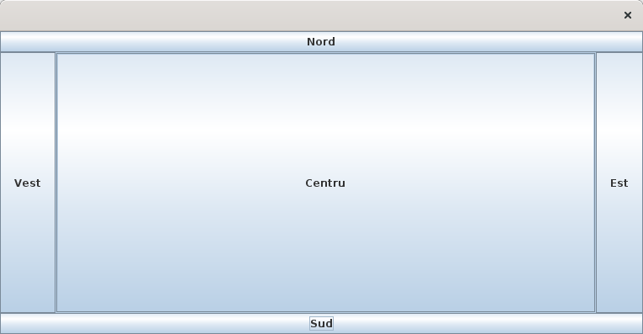
BorderLayout photo:

Slide 24

Java CardLayout

Slide 25
Java CardLayout constructors:
CardLayout(): It is used to create a new card layout with gaps of size is zero.
CardLayout(int horizontalgap, int verticalgap): It is used to create a new CardLayout class with the specified horizontal and vertical gaps.

Slide 26
Java CardLayout methods:
getLayoutAlignmentX(Container parent): Returns the alignment along the x axis.
getLayoutAlignmentY(Container parent): Returns the alignment along the y axis.
getVgap(): Used to get the vertical gap between components.
addLayoutComponent(Component cm, Object cn): Used to add the specified component to this card layout’s internal table of names.
getHgap(): Used to get the horizontal gap between components.
toString(): Returns a string representation of the state of this card layout.
removeLayoutComponent(Component cm): Used to remove the specified component from the layout.

Slide 27
Java CardLayout code:
import java.awt.CardLayout;
import java.awt.Container;
import java.awt.event.ActionEvent;
import java.awt.event.ActionListener;
import javax.swing.JButton;
import javax.swing.JFrame;
/**
*
* @author mhcrnl
*/
public class Cardlayout extends JFrame implements ActionListener{
/**
* @param args the command line arguments
*/
CardLayout card;
JButton b1, b2, b3;
Container c;
Cardlayout(){
c = getContentPane();
card = new CardLayout(40, 30);
c.setLayout(card);
b1 = new JButton("Button_1");
b2 = new JButton("Button_2");
b3 = new JButton("Button_3");
b1.addActionListener(this);
b2.addActionListener(this);
b3.addActionListener(this);
c.add("a", b1);
c.add("b", b2);
c.add("c", b3);
}
public static void main(String[] args) {
// TODO code application logic here
Cardlayout cl = new Cardlayout();
cl.setTitle("CardLayout Example!");
cl.setSize(400, 400);
cl.setVisible(true);
cl.setDefaultCloseOperation(EXIT_ON_CLOSE);
}
@Override
public void actionPerformed(ActionEvent e) {
card.next(c);
}
}

Slide 28
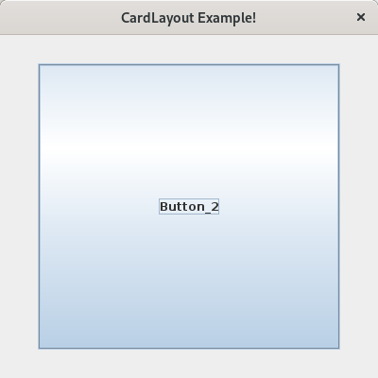
Java CardLayout photo:

Slide 29
End
Youtube:
https://www.youtube.com/watch?v=TFLCTfMMa_k
https://www.youtube.com/watch?v=434Cj27IPp8

