Slide 1
PERL SDL TUTORIAL
'Simple DirectMedia Layer is a cross-platform multimedia library designed to provide low level access to audio, keyboard, mouse, joystick, 3D hardware via OpenGL, and 2D video framebuffer. It is used by MPEG playback software, emulators, and many popular games, including the award winning Linux port of "Civilization: Call To Power."' --www.libsdl.org

Slide 2
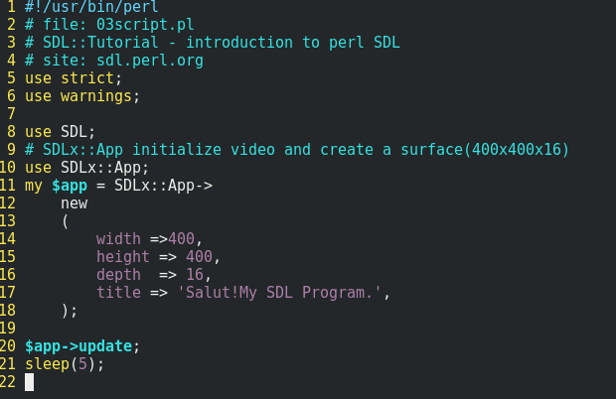
Template

Slide 3
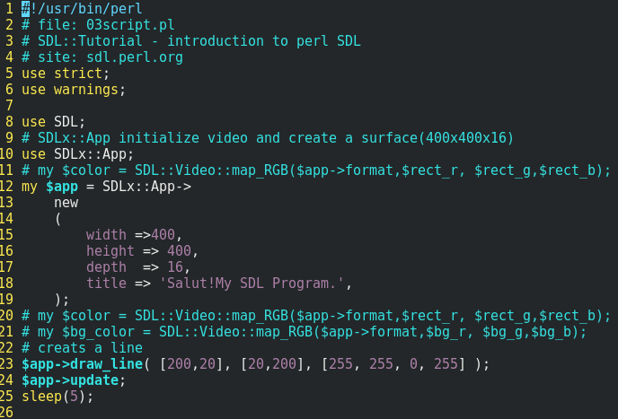
Create a line

Slide 4
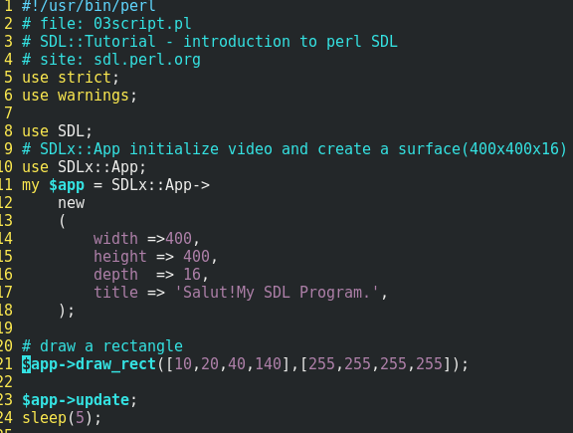
Draw a rectangle

Slide 5
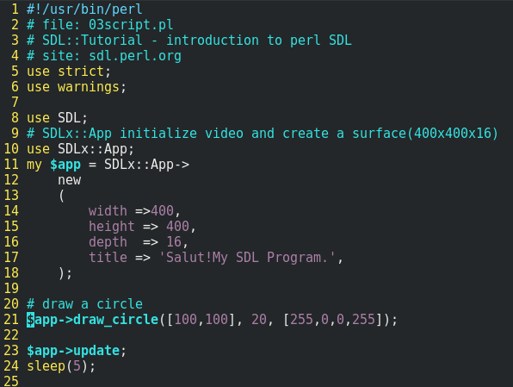
Draw a circle

Slide 6
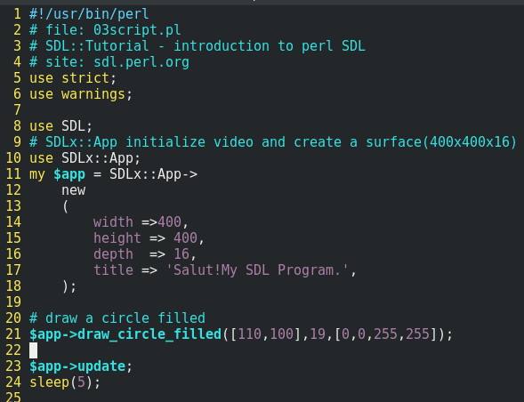
Draw a filled circle

