Slide 1
Beyond the Headline
Calibrated news article classifier: 13 topics, read from the whole article, and quiet when it is not sure
Mohamed Riaz · PES1PGE25DS037
Supervised Machine Learning — Classification · Mini Project · Department of DS & Ai, PES University

Slide 2
PROBLEM
The same story, filed five different ways
One PTI story on the repo rate. The Hindu files it under Business. Indian Express files it under India. Deccan Herald puts it in Top Stories.
Every paper has its own section names. There is no common list, because sections are a newsroom habit, not a fact about the article.
My job: give every article one topic from a fixed list of 13, no matter who published it.
Rule I set for myself: only the classical ML from this course. No ChatGPT, no LLM anywhere. If the model says sport, I must be able to point at the words that made it say sport.
The 13 topics: politics · business · crime and justice · technology · sport · entertainment · health · education · science and space · environment · disaster · conflict · society and lifestyle

Slide 3
HYPOTHESIS
My question
An RSS feed gives me the headline and a one-line summary. About 33 words. Most news classifiers stop there.
My collector opens the link and pulls the full article. About 650 words, roughly 100 times more text.
Is the extra text actually useful? Not obvious. Full articles also carry ads, author bios and “Story continues below this ad”. The model can easily learn those instead of the topic.
Does the full article beat the headline? I wanted to measure it, not assume it.

Slide 4
SYSTEM
What was built
Collector
Go service, 97 RSS/Atom feeds → MongoDB, deduplicated
Preparation
clean · admit · group near-duplicate stories
Snapshot
frozen corpus, so every number can be re-run
Model
word counts → linear SVM → an honest probability
Demo UI
Streamlit: classify, explain, abstain, validate
Nothing is deployed. This is a proof of concept. Build it, measure it properly, then decide if it is worth putting anywhere near production.

Slide 5
DATASET
The data
 | Value
Articles collected | 14,189 from 40 publishers
Articles I labelled by hand | 8,001
Articles where the full body was available | 94.3%
Biggest class vs smallest class | 6.7 : 1
Train / validation / test | 5,487 / 1,120 / 1,159
Thrown out as not-an-article | 4.1% (582)
Random sampling was not an option. War and conflict stories are about 1.7% of Indian news, so getting 150 of them by random draw means reading about 9,000 articles. I wrote a sampler that goes looking for the rare topics instead, and ran three rounds of labelling.

Slide 6
METHOD
Cleaning the data is where the accuracy came from
Every paper repeats the same lines. “Story continues below this ad” shows up in 75% of one publisher's articles. I found 355 such lines across 47 sources and removed them.
Author bios are the dangerous ones. A cricket reporter's bio sitting at the bottom of a business story pulls the whole article towards sport.
9 rules to throw out things that are not really articles: photo galleries, weather bulletins, “Today's headlines for school assembly”. That removed 4.1%.
The same PTI copy runs in five papers. I group those together, so a copy of a training article can never appear in the test set.
If I skip this, the model sees the answer during training and my score looks better than it really is. Grouping on full bodies catches 41% more copies than grouping on headlines.

Slide 7
CHAPTER 07 §1
Why I do not report accuracy
Accuracy = (TP + TN) / (TP + TN + FP + FN)
macro-F1 = (F1 of topic 1 + F1 of topic 2 + ... + F1 of topic 13) / 13
On the 1,120 validation articles | accuracy | macro-F1
one line of code: always answer “politics” | 19.0% | 0.025
my model | 79.5% | 0.769
Politics is the biggest topic. A model that always answers politics scores 19% and finds nothing in the other 12 topics. Same trick as the guard who waves everybody through.
Accuracy here is exactly micro-F1, so it just repeats the confusion matrix.
macro-F1 gives all 13 topics an equal vote. Society and lifestyle with 66 articles counts as much as politics with 213. That is why I use it.

Slide 8
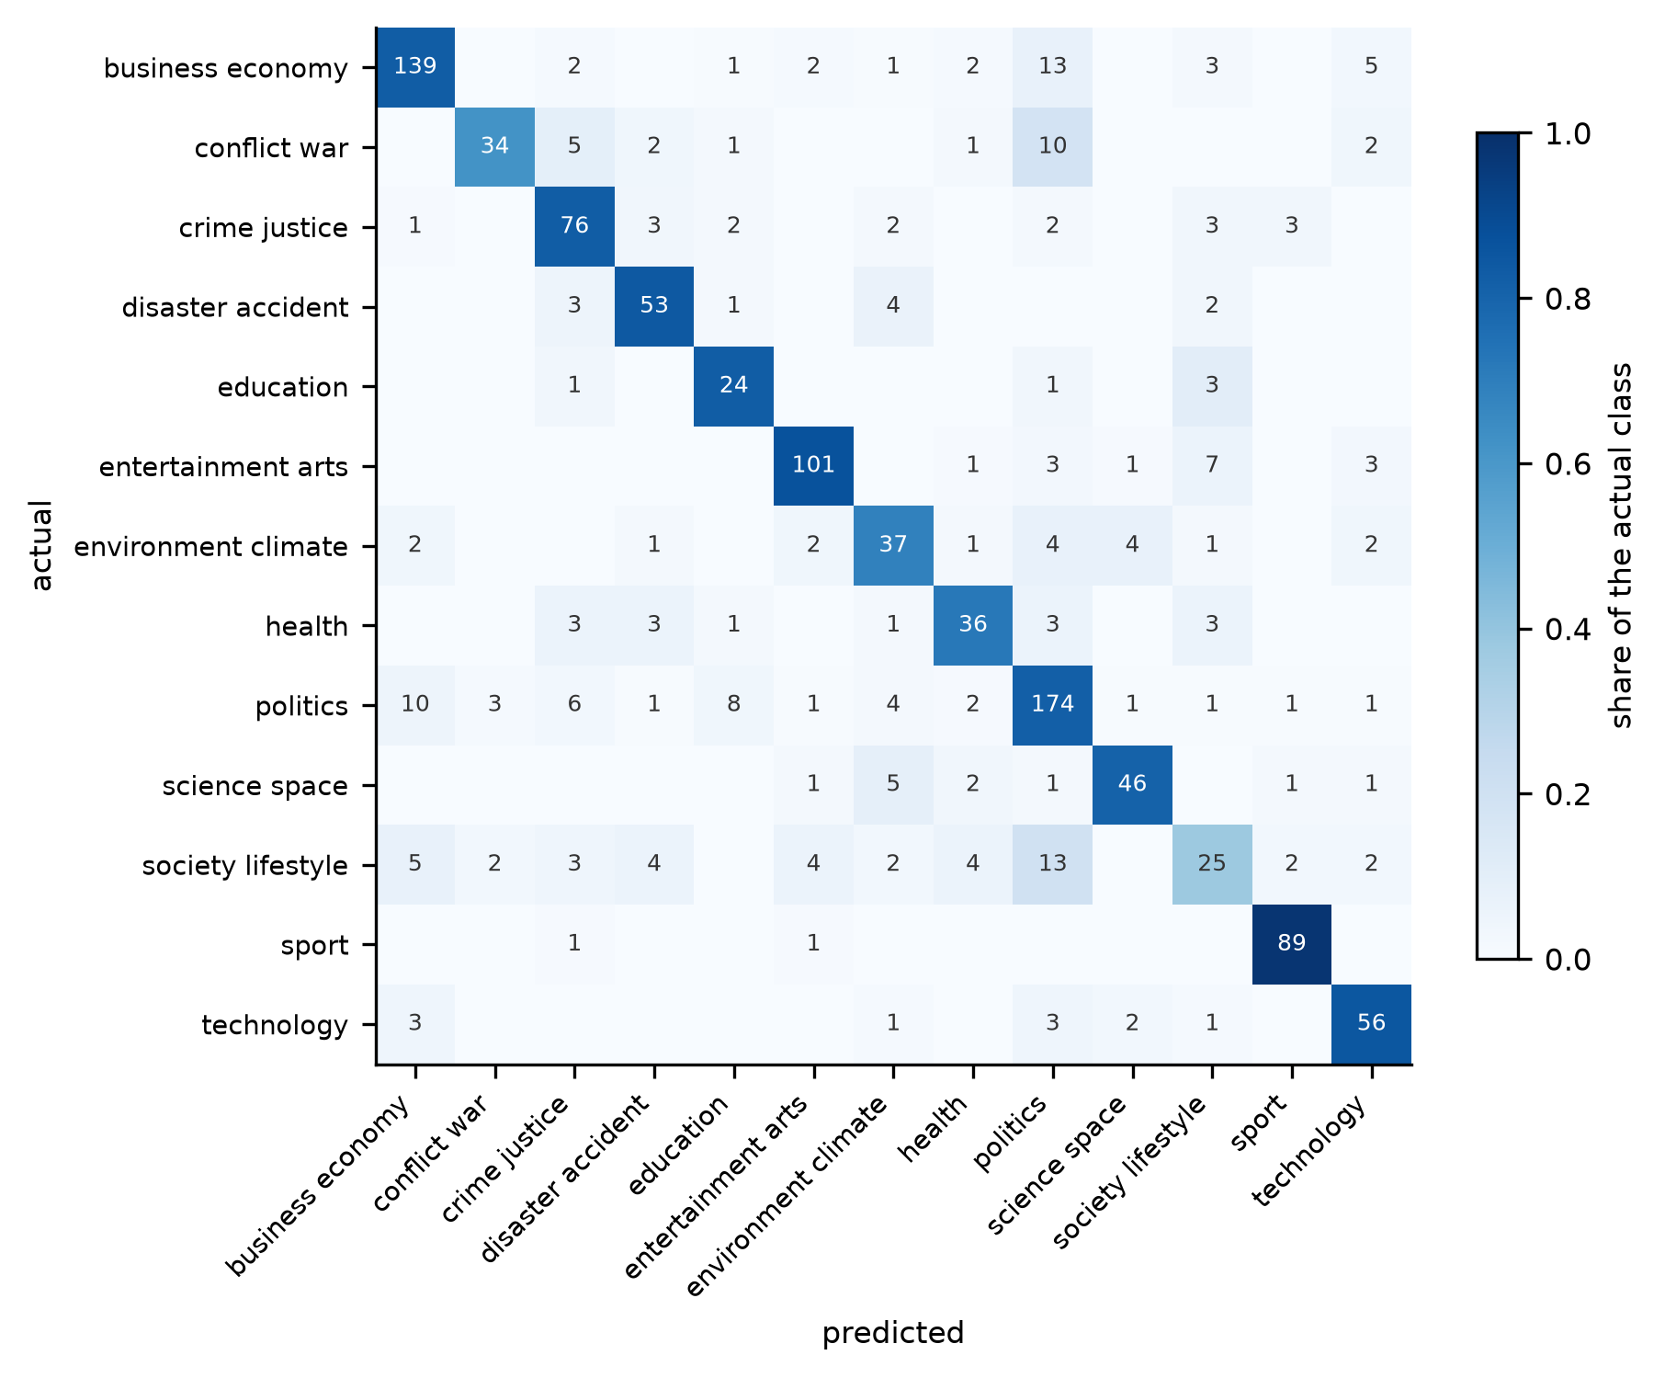
CHAPTER 07 §2
The confusion matrix, all 13 topics
Rows are the true topic. Columns are what my model said. The diagonal is what it got right.
Politics is the dustbin. It wrongly takes 13 business stories, 13 society stories and 10 conflict stories.
Fair enough, honestly. A story about the budget IS both business and politics. My labellers argued about the same pairs.
Society and lifestyle is the weak row. Only 25 of its 66 articles land on the diagonal. The rest scatter everywhere.
Sport is the clean row: 89 out of 91. Cricket and football vocabulary does not look like anything else.

Slide 9
CHAPTER 07 §3
Taking one topic out of that matrix
conflict / war = the positive class | model said conflict | model said something else
really conflict | TP = 34 | FN = 21
really something else | FP = 5 | TN = 1,060
Precision = TP/(TP+FP) = 34/39 = 0.87 Recall = TP/(TP+FN) = 34/55 = 0.62
F1 = 2PR/(P+R) = 0.72
So when it says conflict, it is right 87% of the time. But it only finds 62% of the conflict stories. Too shy.
Education is the opposite: precision 0.63, recall 0.83. Too eager. It shouts education at any story that mentions a school.
Both land at F1 near 0.72. One number, two completely different problems.

Slide 10
VALIDATION
How I stopped myself from cheating
Train, validation and test are split by time. Every test article was collected after every training article, like a real deployment.
No story group is split across two sets, so the same PTI copy cannot be in both training and test.
Error bars come from bootstrap resampling. Same bootstrap as Chapter 06 §3.1, just used for confidence intervals instead of for bagging.
I never compare two models by subtracting their scores. On 1,120 articles a gap of 0.02 can easily be luck, so I use a paired test on the articles where the two models actually disagree.
Two publishers held out on every run: The Hindu and The Guardian, each time refitting the model without that publisher.
The test set was opened once, at the very end, after the model was frozen.

Slide 11
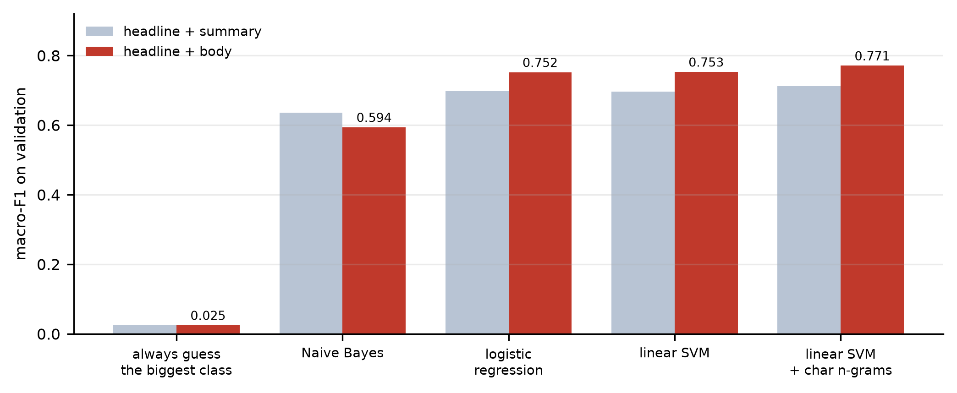
RESULTS
I started with the models we studied
Logistic regression first, because that is the classifier Chapter 03 builds. It reached 0.752.
Then the tree side of the course: random forest, XGBoost, and a majority vote of ten models. Every one of them came in lower.
So I was stuck around 0.75 with nothing left on the syllabus to try.
That is when I went and read about the support vector machine.
Naive Bayes is the odd one. It gets WORSE with the full article, 0.635 down to 0.594. More text is not automatically better.
Every bar is validation macro-F1 on the same 1,120 articles, same split, same cleaning. Only the model changes.

Slide 12
METHOD
Why I ended up using an SVM
logistic regression: p = 1 / (1 + e^-(w·x + b))
linear SVM: answer yes if w·x + b > 0
Both are the same shape. Multiply every word count by a weight, add them up, look at the sign. Only the fitting rule is different.
Logistic regression picks weights that maximise likelihood. The SVM picks weights that push the boundary as far as it can from both classes. That gap is the margin.
Chapter 06b mentions the SVM once, as the expensive strong learner that ensembles try to replace. It never builds one, so I read about it on my own.
Honest result: on its own the SVM ties logistic regression, 0.753 against 0.752. What actually helped was adding character n-grams, which took it to 0.771.
It also stays linear, so I can still print the exact words behind any prediction. A tree ensemble cannot.
One problem it brought with it: no sigmoid, so the output is a distance and not a probability. That is fixed two slides from now.

Slide 13
THE MAIN RESULT
The full article wins
Same model, same split, same cleaning. The only change is the text I feed it: headline and summary gives 0.712, headline and full body gives 0.771.
The two confidence intervals do not overlap. The paired test on the articles where the two versions disagree gives p = 0.0000075, so this is not luck.
Why it works: a headline says “RBI holds rates”. The body says repo rate, inflation, monetary policy committee, bond yields. Four more chances to get it right instead of one.
+0.059 macro-F1 just from reading the article instead of the headline

Slide 14
RESULTS
Things I tried that did not work
What I tried | From | What happened | Kept?
Random forest / extra trees | Ch 06 §4 | 0.04 to 0.09 worse | no
XGBoost on compressed features | Ch 06 §5.3 | 0.036 worse, 5× slower | no
Majority vote of 10 models | Ch 06 §2 | +0.001, p = 1.00 | no
KNN | Ch 04 | ruled out on paper, not run | no
Removing names and places | my idea | no version helped | no
Giving the headline extra weight | my idea | steadily worse | no
Tuning the SVM over a 6× range | my idea | changes score by 0.002 | no
Sentence embeddings (MiniLM) | researched | 0.061 worse | no
KNN is the one I ruled out by reasoning instead of by running it. It is a lazy learner: it keeps all 5,487 training articles and measures distance to each one at predict time. My feature space has about 30,000 dimensions, which is exactly the curse of dimensionality Chapter 04 warns about.

Slide 15
FINDING
Why my ensemble failed, and Chapter 06 told me so
Chapter 06 §2 gives two conditions for a vote to beat its members. Each model must be better than random, and their mistakes must be roughly independent. Mine failed the second one.
The models do disagree, a lot. If I could magically pick the right model for every article I would score 0.900 instead of 0.771. So the disagreement is real and it is big.
But it is lopsided. The embedding model fixes 70 of the SVM's mistakes and breaks 148 of its correct answers. A vote has no way to tell those apart.
Four different combinations of models, four identical scores, p = 1.0000.
So I dropped the stacked ensemble I had planned and wrote down why. If a chooser would help but an average does not, then what I need is abstention, which is the next slide.

Slide 16
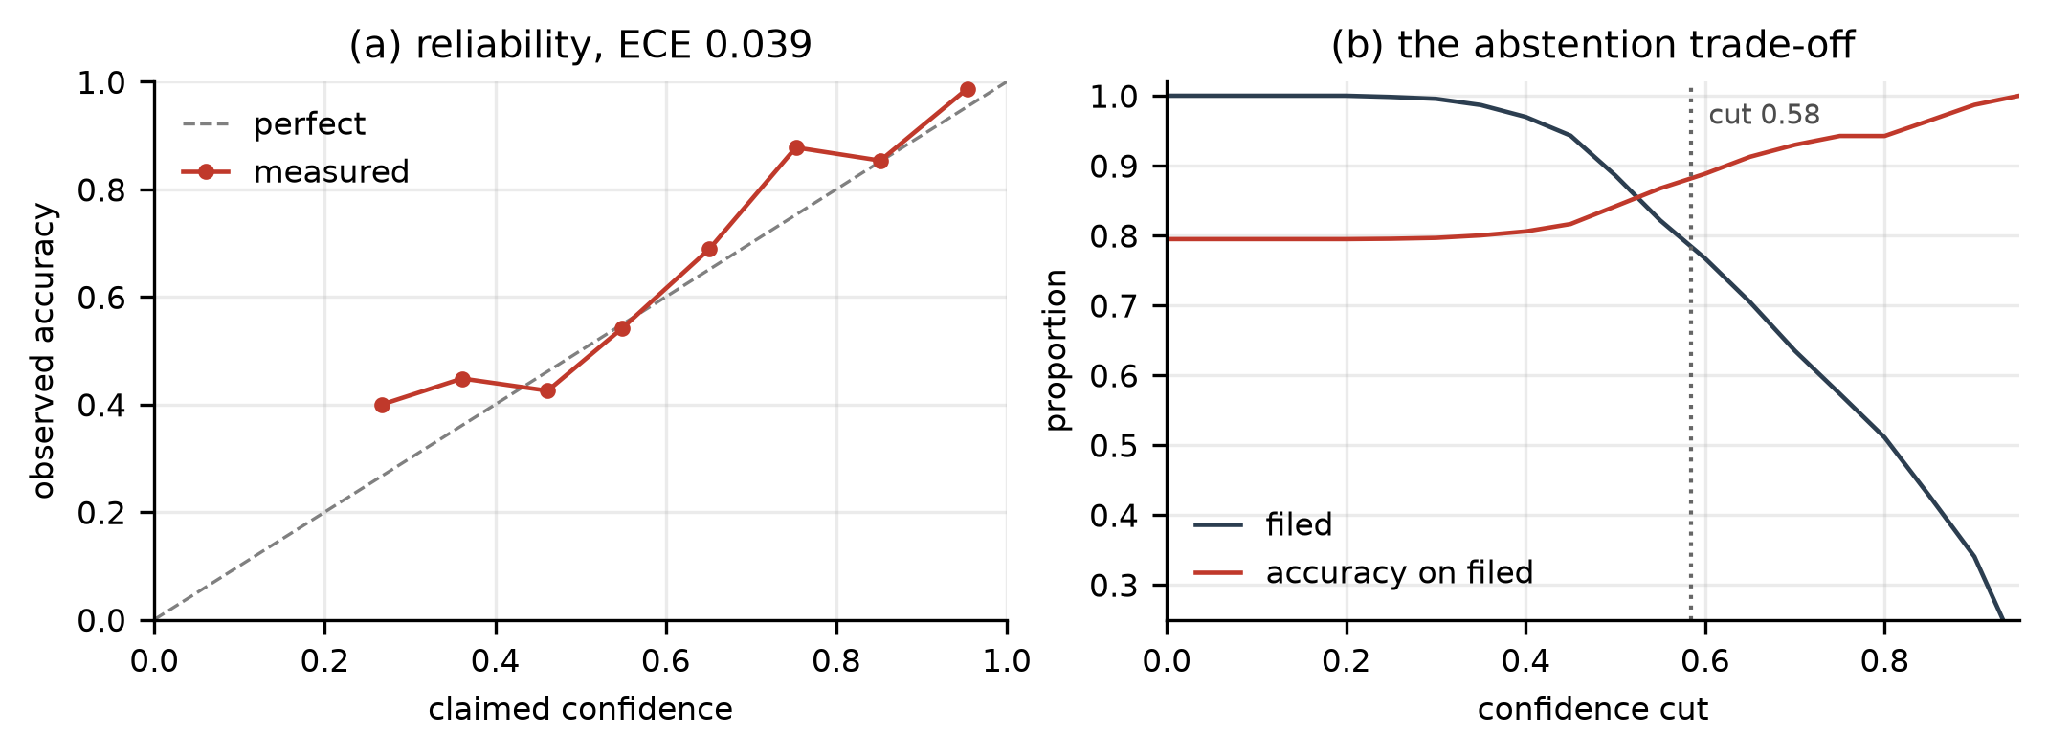
INNOVATION
Novelty 1: making the confidence number mean something
The SVM gives me w·x + b, a distance from the boundary. A score of 2.4 does not mean 90% sure, it does not mean anything on its own. So I take the training data, check how often a score of that size is actually correct, and use that fraction as the confidence. Left chart: the dots should sit on the dotted line, and they nearly do. When it claims 0.9 it is right about 9 times in 10. Average gap is 0.021 on test. Chapter 07 §7 warns that AUC cannot see this at all.

Slide 17
CHAPTER 07 §4
Novelty 2: letting it say “I am not sure”
Coverage = articles it answered / all articles
On the held-out test set | coverage | accuracy on what it filed
forced to answer everything | 100% | 77.7%
stays quiet below 0.584 | 80.7% | 83.4%
Chapter 07 §4 moves the threshold to trade precision against recall. I move the same threshold, but instead of flipping the answer I hold the article back and send it to a person.
The cut-off is chosen on training data only, at the point where precision hits 90%. It never looks at validation or test.
One cut-off for all 13 topics. Separate cut-offs per topic gained nothing, because calibration had already put every topic on the same scale.
It doubts the right things. On 63 articles that my labellers could not classify either, the median confidence is 0.70 against 0.81 on the rest.

Slide 18
RESULTS
Opening the test set, once
 | validation | test
articles | 1,120 | 1,159
macro-F1 | 0.769 [0.738, 0.794] | 0.751 [0.719, 0.780]
accuracy | 0.795 | 0.778
gap between claimed and real confidence | 0.039 | 0.021
how much it answered | 76.1% | 80.7%
accuracy on what it answered | 0.879 | 0.834
Test is -0.018 below validation. I had written down beforehand that anything inside 0.05 was fine, so I changed nothing after seeing it.

Slide 19
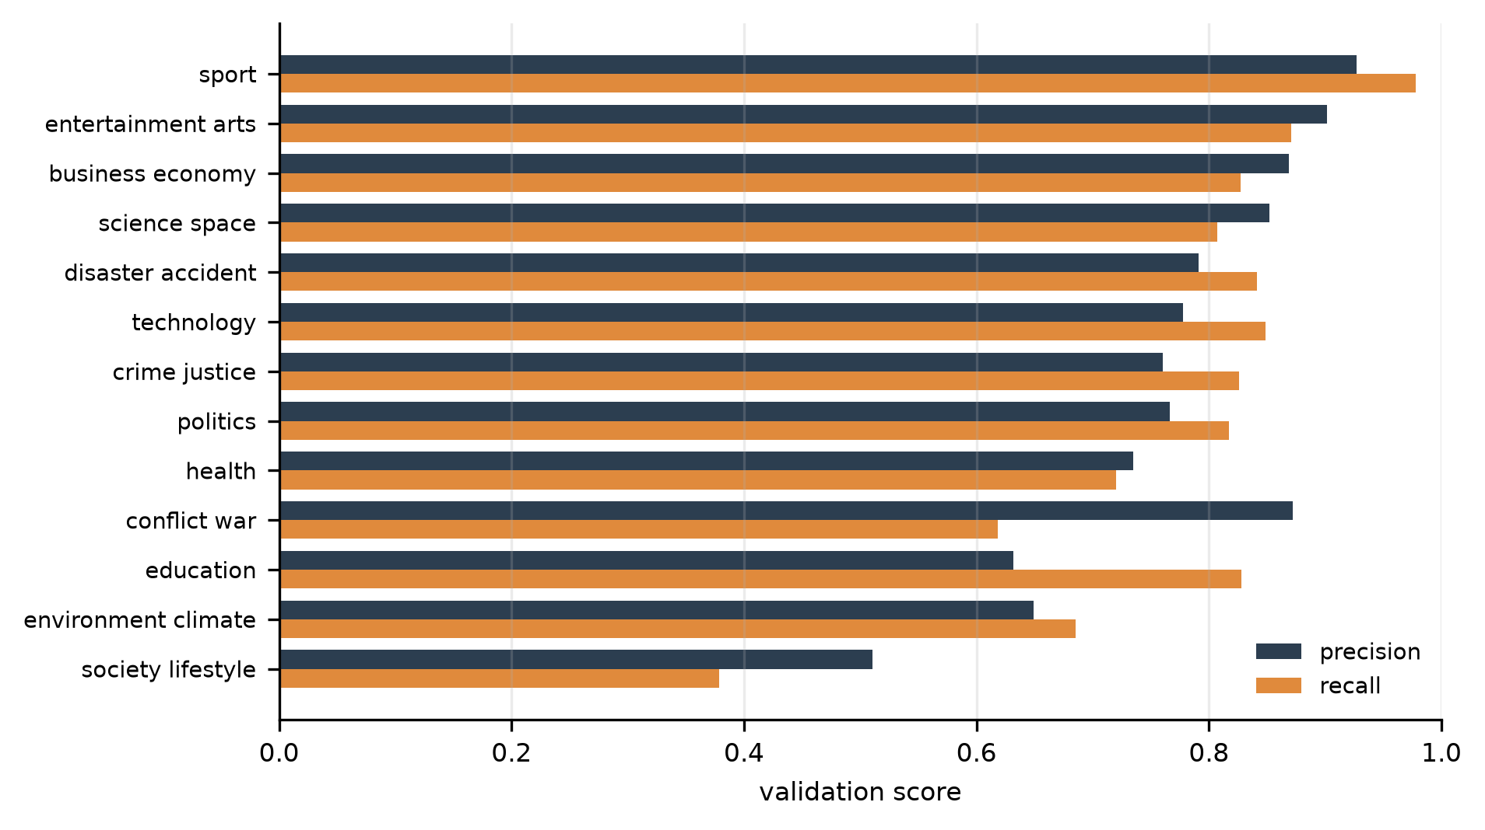
RESULTS
Precision and recall, topic by topic
Sport is the best: precision 0.93, recall 0.98.
Conflict and education both have F1 near 0.72, but look at the bars. Conflict is high precision and low recall. Education is the reverse. Two different problems hiding behind one number.
Education only has 29 validation articles, so its bars move a lot. I treat that as noise, not as a result.
Society and lifestyle is the genuine failure. Recall 0.38, so it misses 41 of its 66 articles. It is three ideas stuck together: community, jobs, lifestyle.
About 19% of all mistakes are on topic pairs where my own labellers disagreed with each other. So there is a ceiling here well below a perfect score.

Slide 20
HONESTY
Four things I had to learn outside class
The SVM itself. Chapter 06b names it in one line as the strong learner that ensembles try to replace, and never builds one.
Calibration. Chapter 07 §7 says AUC cannot see it, but nothing in the course fixes it. I learn a curve from raw score to how often that score is right.
Turning text into numbers. Every chapter starts from a table with columns. News has no columns, so I count words, and also 3 to 5 letter chunks, which is what catches Rs. against Rs and different word endings.
A paired test, so a 0.02 gap on 1,120 articles does not get reported as a real improvement when it is luck.
And one thing I thought was new and was not. The bootstrap behind my error bars is Chapter 06 §3.1's bootstrap sample, doing a different job.

Slide 21
LIVE
The demo
Paste any news article. It gives a topic, a confidence, and either files it or holds it back for a human.
It shows its working. The model is a weighted sum of word counts, so the words with the biggest weights are literally the reason. That is the actual sum, not an explanation invented afterwards.
The threshold is a live slider. Move it and watch coverage and accuracy trade against each other, which is the Chapter 07 §4 curve running in front of you.
A Validation tab with the real per-class bars, the reliability chart and the confusion matrix, so you can check the claims instead of believing them.
A batch tab that runs it over real collected articles that nobody labelled.
uv run streamlit run app/streamlit_app.py

Slide 22
LIMITATIONS
What I am not claiming
I collected over four days. So I cannot say anything about how news topics change over months. The two publisher holdouts are the only evidence I have that it generalises.
English only, and mostly Indian papers, plus The Guardian, BBC and France 24. I would not trust it on Hindi or Tamil news without retraining.
Conflict and war has only 120 training articles and dropped 0.14 on the test set. A thin class behaving like a thin class. I flagged that before opening the test set, not after.
Most of the labelling was done by one person, me. So I cannot measure how noisy the labels are by comparing two labellers.
I do not report ROC or AUC. Chapter 07 §7 says AUC only scores ranking and ignores whether the probabilities are honest, and honest probabilities are the whole basis of my abstention. So I measured that instead.
Obvious next step is a modern language model. I deliberately left it until after this comparison, so any gain belongs to one change and not two.

Slide 23
CONCLUSION
What I found
Reading the full article beats reading the headline, by 0.059 macro-F1 with p = 7.5e-06. My hypothesis held.
Trees, forests, boosting and voting, the entire ensemble half of the course, all scored below one plain linear model. The classifier was never my problem. Cleaning the data was.
Adding an honest confidence and the right to stay quiet turned a 77.7% accurate model into one that answers 80.7% of new articles and gets 83.4% of those right.
Final score on the test set: macro-F1 0.751, opened once, never reopened.
The most useful part of this project is the list of things that did not work, with a number attached to each one.

