Slide 1
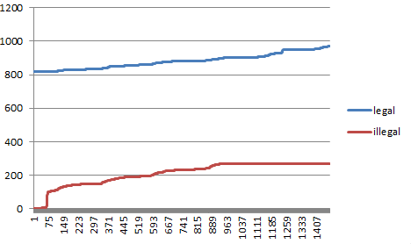
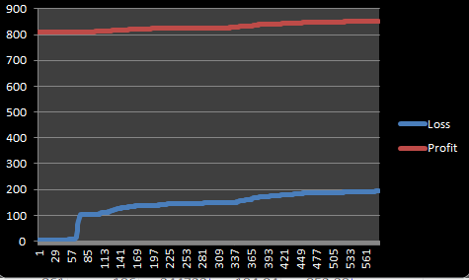
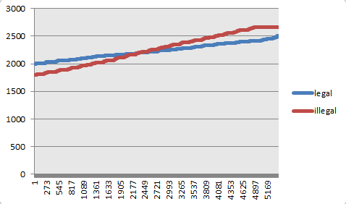
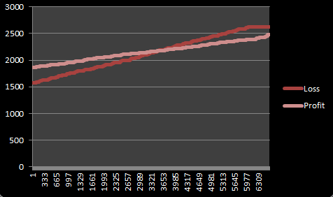




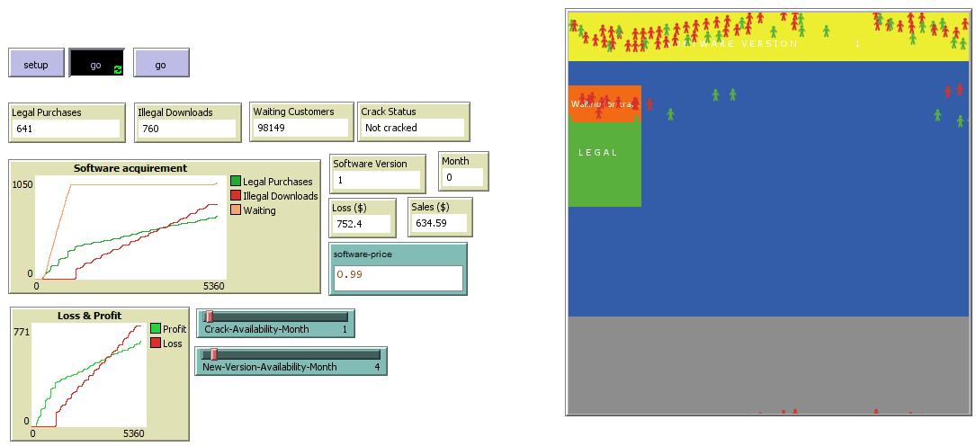
Netlogo - Software Piracy Model
M. Mahad Aamir (FA15-BCS-010) and Ahmad Yar Rashid (FA15-BCS-001)
OVERVIEW
morality values. Morality values are randomly assigned to each user. We have set the assignment code in such a way that the probability of
assigning a high morality value to any user is 1/3 whereas the assignment of low morality is 2/3. This is done in order to correctly simulate a real world scenario. The number of people with a high morality is much lower than those with a low morality. In the initial stage of the model, the crack for the software is not released so the users with the low morality value decide to wait for the crack, whereas the users with the high morality value obtain the software through the legal patch. As the model progresses and the software crack is released then the users with a low morality value will obtain the software illegally through the illegal patch. As a new version comes out, the process of obtaining the software will be reset, i.e. users with low morality value will wait for the next version of the crack.
The plots will reflect the changes at every step. Initially in the plot the number of illegal purchases remains zero until the crack for the software is released. As the crack is released there will be a sharp rise in the number of illegal attainments. The loss and profit plot will also initially only consist of the company’s revenue made through legal sales but after the release of crack, there will be sharp increase in the loss suffered through the illegal attainments.
Observations:
The decision making of the users completely depends on the randomly assigned morality values although the total number of legal/illegal attainments can be varied by changing the state variables through the sliders, i.e. by increasing/decreasing the number of months between updates/crack’s release.
Implementation:
Our Model is based heavily on the concept of morality. The main problem discussed in the model the inverse proportionality between morality and piracy. The model correctly simulates this problem and produces helpful insights. The problems discussed in the model include:
If there are no updates to the software and a crack is released then the number of illegal attainments will greatly surpass the number of legal attainments over time.
If cracks are released faster than updates even then the loss over time will be greater than the profit.
A low morality society is more likely to obtain the software illegally rather than legally.
Initialization:
At initial stage the users with high morality values move towards the legal patches and obtain the software legally whereas the users with low morality values move towards the waiting patch where they wait for the crack to be released. The version and illegal patches are not present in this stage.
Sliders:
Number of months after which crack is released
Number of months after which a new version is released.
METHODS
RESULTS
Purpose:
The model would help us in understanding the workings of software piracy by simulating its propagation behavior.
The model simulates the behavior of people who are willing to obtain some arbitrary software by assigning each customer a random morality value.
The model will help us predict the trends of revenue gained through sales/lost through piracy over a period of time.
We can also observe valuable trends obtained by varying the number of months after which a software is updated or by changing the number of months between each crack’s release.
Mainly the model is used to study the relation between the morality and the way a software is obtained.
Entities, state variables and scales:
Our model consists of turtles of breed customers which represent the users who want to attain the software. Customers are divided into two categories based on their morality values. Those with a high morality value are represented by green and those with a low morality value are represented by red. Patches are there to represent the methods through which a software is obtained. Red patches represent an illegal way to download the software while green patches represent the legal way. Orange patches house those users with a low morality value which are waiting for a crack of the software to be released. Every thousand ticks account to a month in the model time frame. There are two state variables which can be varied through sliders, i.e. one that controls the number of months between each update and one that controls the number of months between crack’s release..
Initially the model consists of waiting and legal patches along with the customer turtles. But as the model runs and reaches a predefined month (set through slider), the crack of the software is released, hence the red patches appear, at the same time the orange patches are removed because all the customers waiting for the crack now move towards the illegal patch. Same is the case when a new version is released. As soon as the month for the next update is reached, a set of new yellow colored patches which show the new version appear. At this stage, the illegal patches are removed and the waiting patch is again reinstated.
Process overview and scheduling:
Our model represents the life span of an arbitrary software. So our first entity is “legal users” who obtain the software legally. The second entity is “illegal users” who obtain the software through illegal means. Then the third entity is “legal obtain method” which is used by the users with high morality value to purchase the software. Then the fourth one is “illegal obtain method” which is used by users with low morality to obtain the software illegally. The last entity is “software version” which is updated by the creators to combat piracy. These entities work in the same order in which they are explained.
The agents used in the model consist of turtles (breed customers) and patches.
Green turtles represent those customers with a high morality value. They will legally obtain the software.
Red turtles represent those customers with a low morality value. They will illegally obtain the software.
Patches with green color represent the way to legally obtain the software. Initially, such patches will represent the sole method to obtain the software.
Patches with red color will represent two things. First and foremost an illegal way to obtain the software, secondly they will inform that the crack for the software is available.
Orange colored patches will house those customers with a low morality value who are waiting for the crack of the software to be released.
There is a single input box which can be used set the price of the software. This will be used in calculating revenue from sales and loss from illegal downloads.
There are two sliders which are used to set the number of months after which the crack will be released. There is another slider to set the number of months it will take for a new version of software to come out.
There are two plots. The first one plots the number of legal purchases, illegal downloads and the number of people waiting for the crack of software to come out. The second plot shows the revenue from sales and the loss by the illegal downloads.
There are multiple monitors which show data in numerical form. These include the number of legal purchases, illegal downloads, the number of waiting customers, sales, loss, the current month and the software version.
The methods consist of:
Setup/remove legal, illegal, version and waiting patches (total 6).
Obtain-software
Move
Set-customers
High morality customers
Low morality customers
Illegal patch Waiting patch
Legal patch Software version patch
When the number of months between updates is greater than the number of months between crack’s release (updates being released faster):
When the number of months between updates is less than the number of months between crack’s release (cracks being released faster):
DETAILS
CONCLUSIONS
DESIGN
Morality is largest deciding factor when it comes to software piracy.
The loss by software piracy can be greatly reduced by pushing out faster updates.
Awareness about software piracy can increase the morality which in turn will lead to decrease in the amount of software piracy.
Theoretical and Empirical Background:
The number of legal and illegal attainments at any given time are shown by a plot. The results of these plots can be varied by changing the state variables through the sliders. If there are greater number of months between each crack release than the number of months between each update than the number of legal purchases will be much higher. When the update of the software is released, the user cannot obtain the software illegally unless a new crack is released, i.e. such users are contained within the waiting patch.
The users make their attainment decisions on the basis of assigned

