Slide 1
NETLOGO – SOFTWARE PIRACY MODEL
BY:
M. Mahad Aamir
Ahmad Yar Rashid

Slide 2
Working
Each user is assigned a random morality value.
High morality move towards legal patches.
Low morality wait if crack is not released. When crack is released then they move towards illegal patches.

Slide 3
Green patches are used to record legal purchases.
Red patches record illegal attainments.
Orange patches house the users waiting for crack.
Yellow patches represent the version.

Slide 4
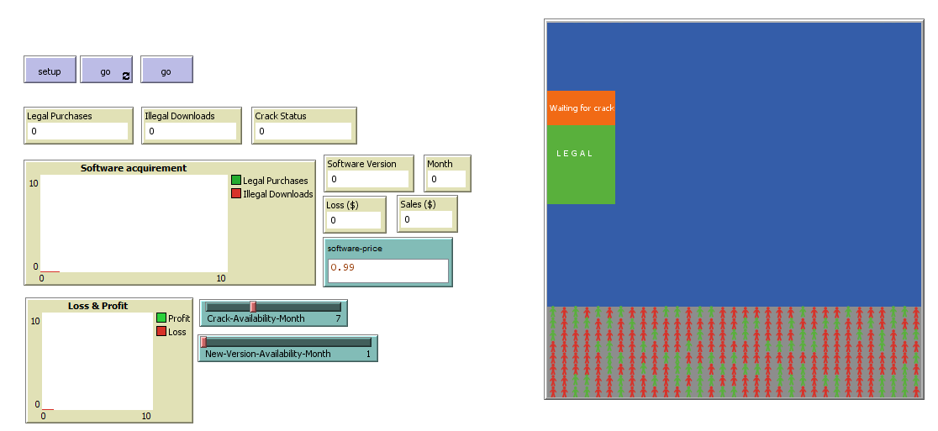
Model LAYOUT

Slide 5
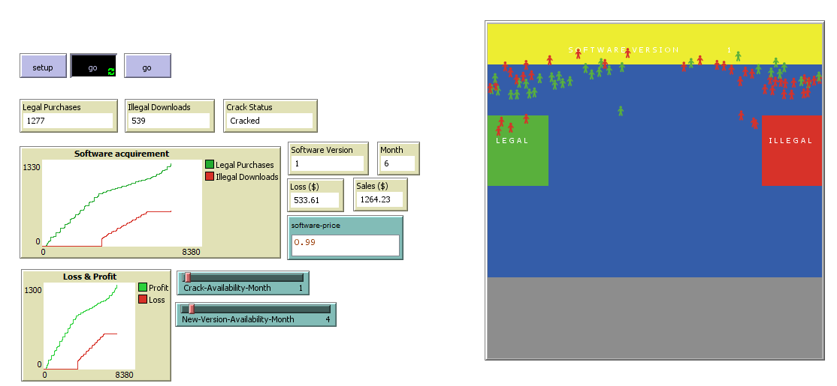

Slide 6
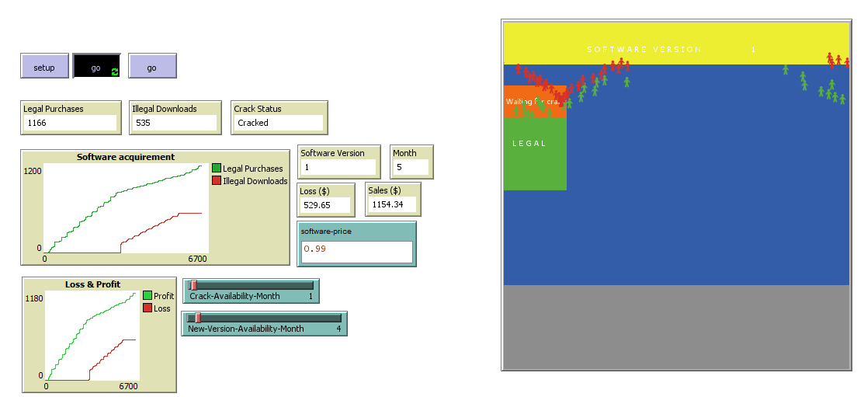

Slide 7
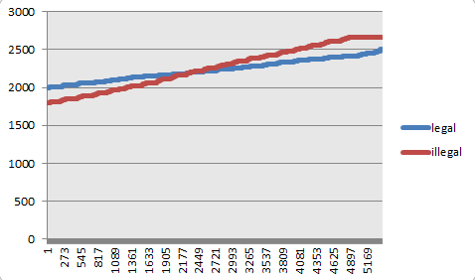
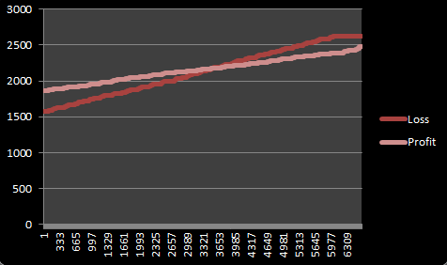
Behavior Space Experiments
When crack is released faster than updates

Slide 8
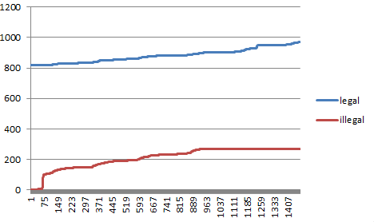
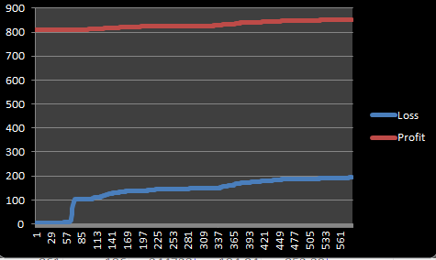
When update is released faster than crack

Slide 9
RESEARCH Questions
1) How does morality affect the piracy in a society?
2) What effects does increasing/decreasing the time period between updates of software has on the levels of piracy?

Slide 10
References
Three-Level Mechanism of Consumer Digital Piracy: Development and Cross-Cultural Validation which appears on Journal of Business Ethics March 2016, Volume 134, Issue 1, pp 15–27.

