Slide 1

Social Media Analytics
Cairo University
Faculty of Engineering
Milestone review
Prepared by: Mahmoud Nabil
Revised by: Dr. Amir Atiya
Dr. Mohamed Aly

Slide 2
Agenda
Introduction
Market and Related Work
Sentiment Analysis Challenges
Experiments
LABR Data Set
Data Preparation
Experiment 1
Experiment 2
Experiment 3
Twitter Data set
Data set Collection
Data set Properties
Future Work

Slide 3
Introduction
Opinion mining is the science of extracting emotions and opinions from raw text reviews.
Opinion mining categorized to [Petz et al., 2012]:
sentiment classification
feature-based opinion mining
We present our progress in the social media analytics task

Slide 4
Introduction(Cont.)
The contributions in this milestone can be summarized as:
Application of sentiment analysis to a large set of book reviews that we collected by applying a wide range of classifiers, to provide a toolbox that can be used for future sentiment analysis applications.
An investigation into the effectiveness of some feature selection techniques.
An application of some other sophisticated classifiers that were never or rarely used in NLP.
Collection of an extensive data set from Twitter

Slide 5
Market and Related Work
Industry and Market
Company | Language |  | Features
 | Arabic | English
HP's Autonomy |  | Yes
IBM's Smarter Analytics |  | Yes | Twitter, Facebook
Sentiment140 |  | Yes | Twitter
twitrratr |  | Yes | Twitter
Social Mention |  | Yes | Twitter ...
tweetfeel |  | Yes | Twitter
Repustate's | Yes |  | Twitter, Facebook,
25trends | Yes |  | Facebook, Twitter, YouTube
Notes:
HP's Autonomy IDOL technology uses sophisticated pattern-matching techniques and probabilistic modeling to interpret information in much the same way humans do.
Twitrratr: use cross-referencing a list of positive and negative keywords against a list of adjectives.
Social Mention:Social search engine and sentiment analysis, keywords similarity

Slide 6
Market and Related Work(Cont.)
According to [Pang and Lee, 2008] sentiment analysis is handled by either
lexicon-based approaches [Taboada et al., 2011]
machine learning [Pak and Paroubek, 2010]
hybrid approaches [Kouloumpis et al., 2011]

Slide 7
Market and Related Work(Cont.)
[Abbasi et al., 2008] perform a multilingual sentiment analysis of English and Arabic Web forums.
Weighted Genetic Algorithm , and SVM
Stylistic features and syntactic features.
[Abdul-Mageed et al., 2012]
large-scale Arabic sentiment lexicon
manually built lexicon then extended with an English lexicon
[Abdul-Mageed et al., 2014] proposed the SAMAR system
Subjectivity and sentiment analysis for Arabic social media using some Arabic morphological features.
SVM
Notes:
Bullets for the features of each system

Slide 8
Market and Related Work(Cont.)
Arabic sentiment data sets
Data Set Name | Size | Source | Type | Cite
TAGREED (TGRD) | 3015 | Tweets | MSA/Dialectal | Abdul-Mageed et al. [2014]
TAHRIR (THR) | 3008 | Wikipedia TalkPages | MSA | Abdul-Mageed et al. [2014]
MONTADA (MONT) | 3097 | Forums | MSA/Dialectal | Abdul-Mageed et al. [2014]
OCA(Opinion Corpus for Arabi) | 500 | Movie reviews | Dialectal | Rushdi-Saleh et al. [2011]
AWATIF | 2855 | Wikipedia TalkPages/Forums | MSA/Dialectal | Abdul-Mageed and Diab [2012]
LABR(Large Scale Arabic Book Reviews) | 63,257 | GoodReads reviews | MSA/Dialectal | Aly and Atiya [2013]

Slide 9
Sentiment Analysis Challenges
Complexities of the Arabic language
Arabic is a morphologically rich language
Different Arabic dialects
Few NLP Arabic research.
Few datasets available for different NLP tasks.
Sarcastic remarks for social data sets.

Slide 10
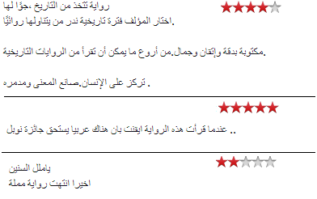
Experiments LABR Data Set
Extensive Arabic book reviews data from the GoodReads portal.
Consists of 63,257 Arabic reviews.
From the first 2143 books of the list of Best Arabic Books.
Rated on a scale of 1 to 5 stars.

Slide 11
Experiments Data Preparation
We partition the data into training, validation and test sets.
The ratio of the data among the three sets is 6:2:2 respectively.

Slide 12
Experiments Data Preparation
We have redesigned our earlier work by considering a three class classification (Pos, Neutral, Neg) instead of two classes (Pos, Neg).
Ratings of 4 and 5 are mapped to positive, rating of 3 is mapped to neutral, and ratings 1 and 2 are mapped to negative.
Harder problem than two class classification
Two datasets were prepared:
Balanced dataset
Unbalanced dataset

Slide 13
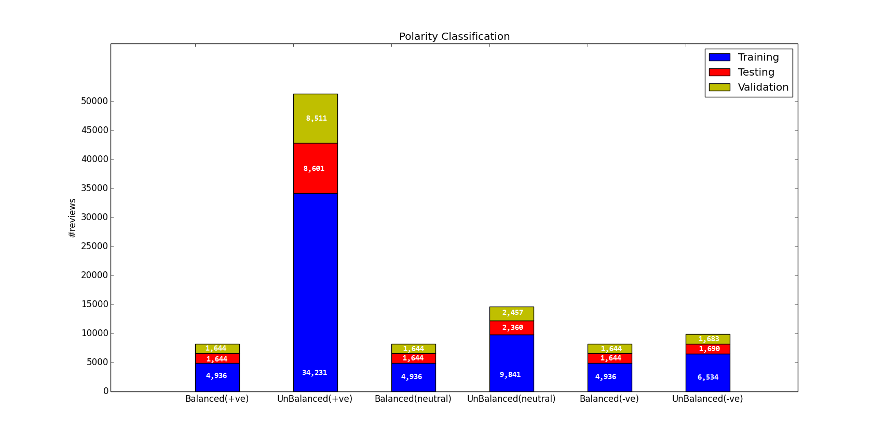
Experiments Data Preparation
Number of reviews for each class category

Slide 14
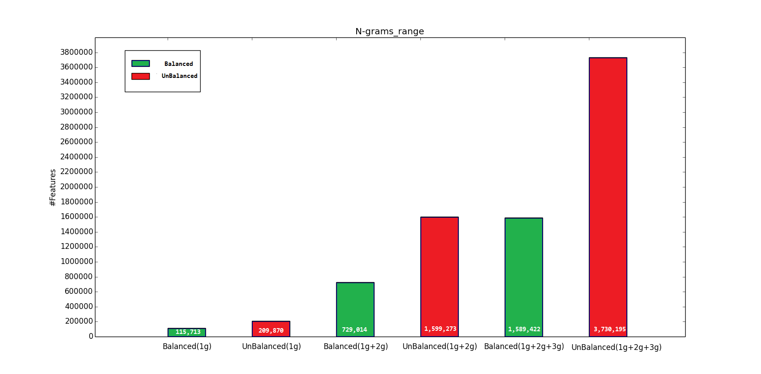
Experiments Data Preparation
Number of uni-grams, bigrams, and trigrams features per each class category

Slide 15
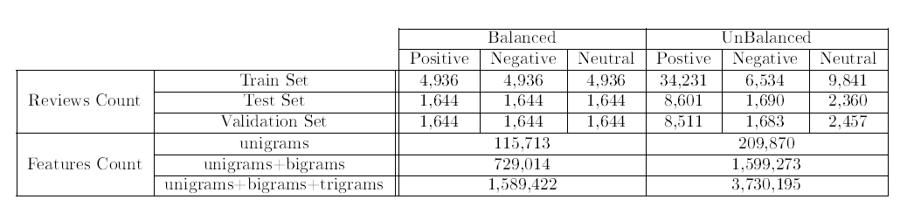
Experiments Data Preparation
Data preparation statistics summary

Slide 16
Experiments
Experiment 1: Baseline classifiers.
Experiment 2: Feature selection.
Experiment 3: Sophisticated classifiers.

Slide 17
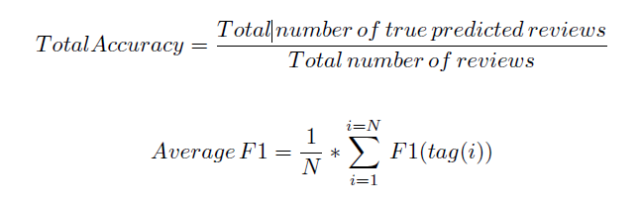

Experiments Experiment 1
A wide range of standard classifiers are applied to both the balanced and unbalanced datasets using n-gram range of unigrams, bigrams and trigrams.
Two accuracy measures are used to calculate the performance which are the total accuracy and average F1 measure.
Notes:
TFIDF

Slide 18
Experiments Experiment 1(Cont.)
The classifiers used in this experiment are widely used in the area of sentiment analysis and can be considered as a baseline for any further experiments.
Multinomial Naive Bayes.
Bernoulli Naive Bayes.
Support Vector Machine.
Passive Aggressive.
Stochastic Gradient Descent.
Logistic Regression.
Perceptron.
K-Nearest Neighbor.
Notes:
Talk about PA,SGD,Perceptron
Passive Aggressive: It is an online learning model that uses a hinge-loss function together with an aggressiveness parameter C, in order to achieve a positive margin high confidence classifier
Perceptron: It is a simple feed-forward single layer linear neural network with a unit step function as an activation function. It uses an iterative algorithm for training the weights, but that algorithm does not take into account the margin
Stochastic Gradient Descent: It is an algorithm that is used to train other machine learning algorithms such as SVM where it samples a subset of training examples at every learning step. Then it calculates the gradient from this subset only, and uses the gradient to update the weight vector w in case of SVM classifier.

Slide 19
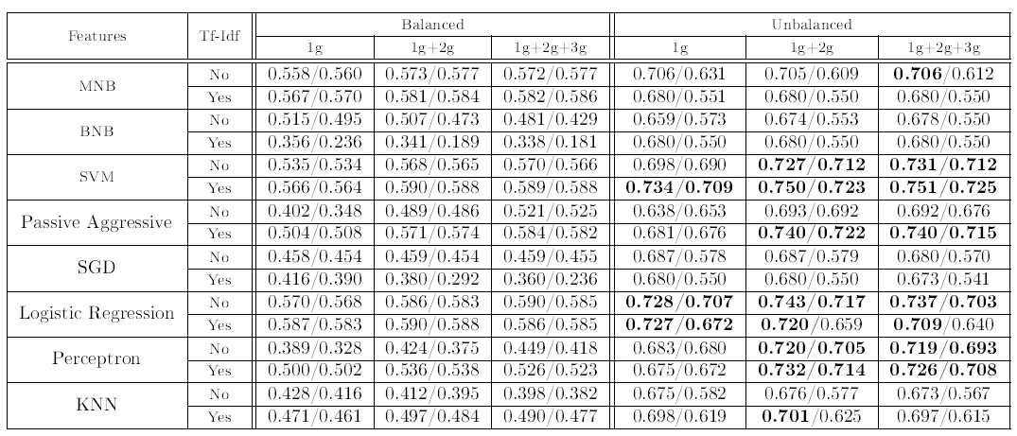
Experiments Experiment 1(Cont.)
Polarity Classification Experimental Results
The numbers represent total accuracy / F1 measure where the
evaluation is on the test set.

Slide 20
Experiments Experiment 1(Cont.)
The inclusion of a third class "neutral" makes the problem much harder, and we get a lower performance than the case of two-class case ("positive“ and "negative").
The balanced set is more challenging than the unbalanced set. We think this is due to the fact it contains much fewer reviews compared to the unbalanced set.
We can get an good overall accuracy and F1 of over 70% using especially SVM and logistic regression classifiers. This is consistent with previous results suggesting that SVM and Logistic Regression are a reliable choice.
Naive Bayes, Passive Aggressive, and Perceptron are also a good choice of classifiers, with the careful choice of parameters.

Slide 21
Experiments Experiment 2
As the degree of n-gram range increases the number of features increases significantly and approaches 3.7 million in trigram range of the unbalanced data set.
There are two significant reasons for applying feature selection.
large number of features may cause the classifier to exhibit some overfitting, due to the curse of dimensionality.
With millions of features, the computational burden will be too high for many classifiers to be practically feasible.

Slide 22
Experiments Experiment 2(Cont.)
Some feature selection techniques were applied to Tf-Idf (token frequency inverse document frequency) trigram training set to explore their effects. The feature selection experiments are:
SVM (L1 loss) classier.
Logistic regression classier.
Chi-squared feature selection.
Analysis of variance feature selection.
Relief feature selection.
Class Separation Feature selection.

Slide 23
Experiments Experiment 2(Cont.)
This Experiment is applied on the Tf-Idf unbalanced dataset then evaluating the result of every one of the following classifiers
SVM, passive aggressive, logistic regression and perceptron
The evaluation was performed on two stages:
Evaluation on the training set with cross validation.
Evaluation on the validation set without cross validation
.

Slide 24
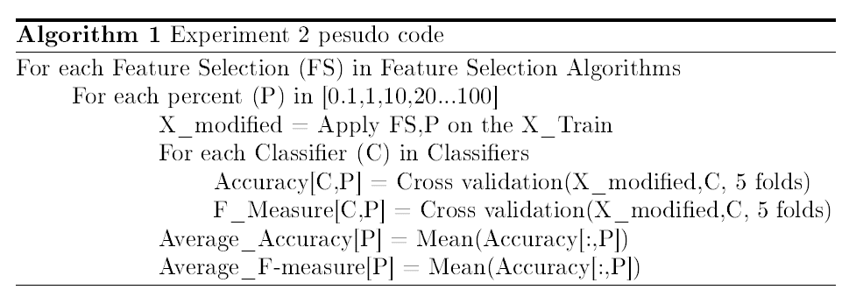
Experiments Experiment 2
Cross validation Algorithm

Slide 25
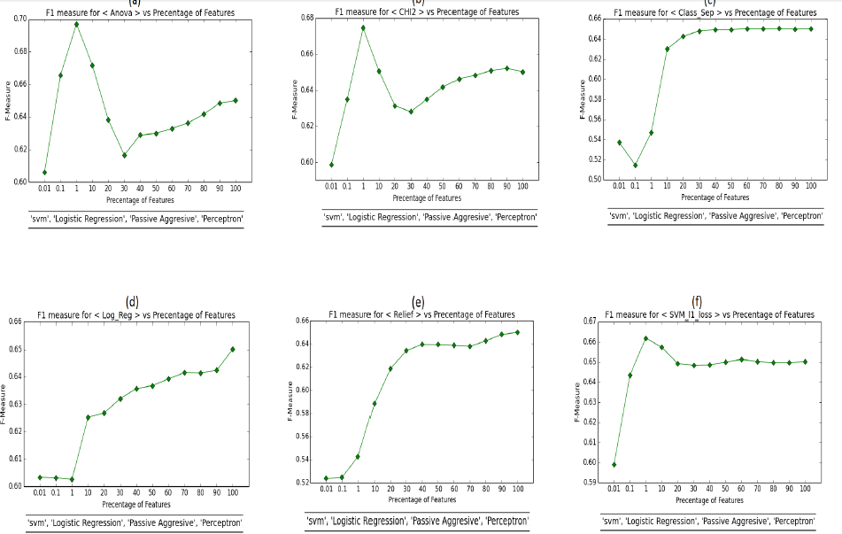
Experiments Experiment 2
Feature Selection Experimental Results with cross validation, results are on the training set.

Slide 26
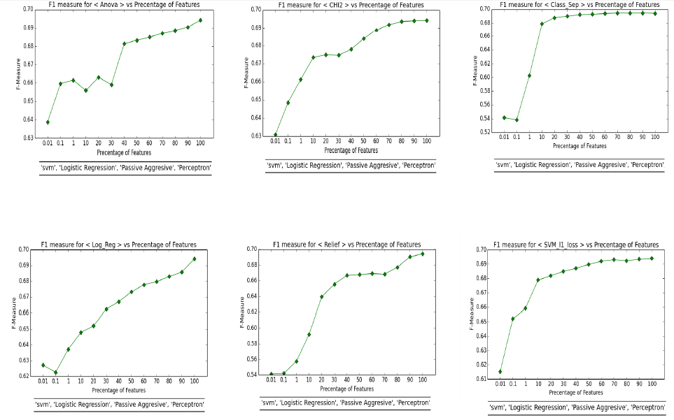
Experiments Experiment 2(Cont.)
Feature Selection Experimental Results with out cross validation, results are on the validation set

Slide 27
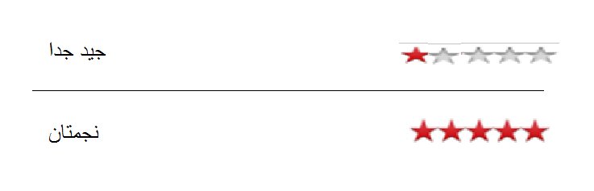
Experiments Experiment 2(Cont.)
We notice that SVM_L1, Anova and Chi2 feature selectors have inconsistent behavior between the two experiments we think the reasons for this might be:
Those feature selector may not be suitable for this experiment
Data is noisy and not reviewed manually.
Due to this inconsistent behavior, we decided to not further pursue feature selection for classifiers that can readily handle all the available features.

Slide 28
Experiments Experiment 3
Sophisticated classifiers in the area of machine learning were applied to this task after applying feature selection to the top 100,1000 and 3000 best features.
The reason for applying feature selection on these classifiers.
They do not naturally perform feature selection, e.g. like what SVM does.
These algorithms generally consume a lot of resources in terms of memory and run time.

Slide 29
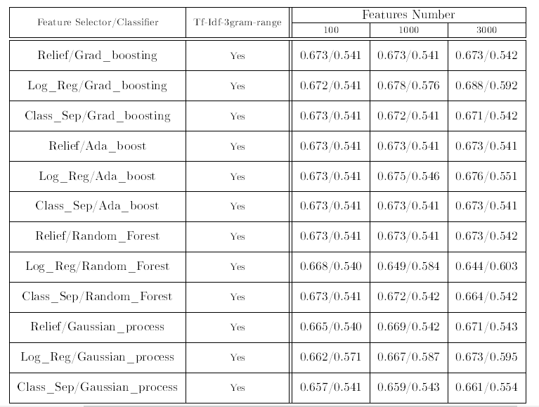
Experiments Experiment 3(Cont.)
Sophisticated Classifiers Experimental Results
The numbers represent total accuracy / F1 measure where the
evaluation is on the validation set.
Notes:
Add results on test set

Slide 30
Experiments Experiment 3(Cont.)
The results show that with using less than 0.1% of the features (3000 features) we get an F1 measure of around 60%, which is close to the 70% achieved using all the features (over 3.7 million).
This is an interesting observation, and we plan to investigate this further in the next phase, in addition to investigating using dimensionality reduction techniques e.g. Principal Component Analysis.
Notes:
(Talk) Results were bad but this is a starting point to us

Slide 31
Twitter Data set
We have collected over 84,000 Arabic tweets on two stages over a period of four months.
Crawling the most active Egyptian Twitter accounts.
Using some of the most trending hashtags in Egypt.
After filtering out the non-Arabic tweets, and performing some pre-processing steps to clean up unwanted content like HTML, we ended up with 54,716 Arabic tweets.

Slide 32
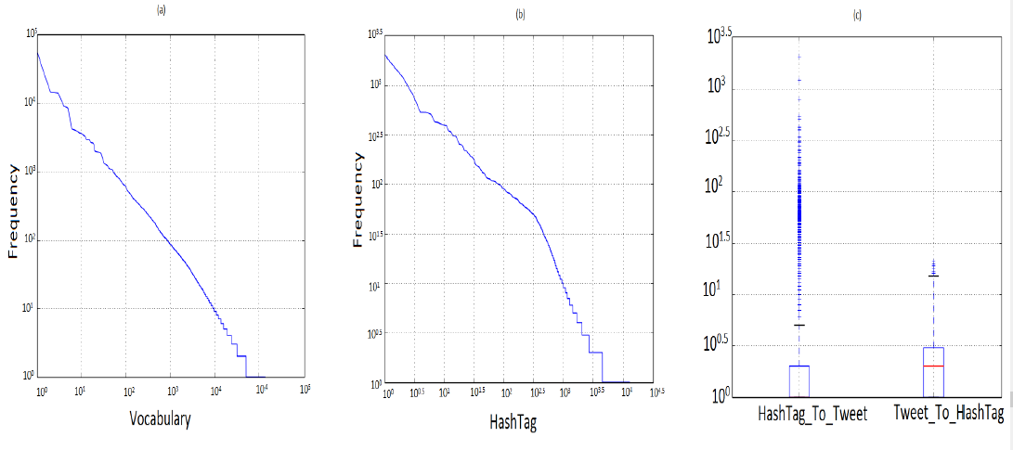
Data set Properties
(a) the frequency distribution of the vocabulary tokens. (b) the frequency distribution of the hash tags tokens. (c) the number of tweets per hash tag and the number of hash tag per
tweet

Slide 33
Amazon Mechanical Turk
Online service that allows companies or individuals to post their data and other workers can manually tag the data.
A predefined charge is given to the workers to complete their work.

Slide 34
Dataset Next steps
For the next steps with the data set we plan to use Amazon Mechanical Turk service to manually tag the data set.
We will use a python API called ‘Boto’ to interface with Amazon web services.
Started with 300 tweet to get some statistics.
Plane to tag 10k tweet.

Slide 35
Future work
Our planned next steps include:
Manually tagging the twitter dataset by using Amazon Mechanical Turk service.
Developing some topic extraction techniques to extract the most important topics for a given set of tweets.
Developing an algorithm for subjectivity and sentiment analysis for a given set of tweets.
Extracting Arabic sentiment lexicon and explore its potential.
Exploring using Arabic specific and more powerful specially tailored features.
We are currently preparing a paper to be submitted in a journal.

Slide 36
Thank You

