Slide 1

Social Media Analytics
Cairo University
Faculty of Engineering
Milestone review
Prepared by: Mahmoud Nabil
Revised by: Dr. Amir Atiya
Dr. Mohamed Aly

Slide 2
Agenda
Introduction
Market and Related Work
Sentiment Analysis Challenges
Experiments
LABR Data Set
Data Preparation
Experiment 1
Experiment 2
Experiment 3
Twitter Data set
Data set Collection
Data set Properties
Future Work

Slide 3
Introduction
Opinion mining is the science of extracting emotions and opinions from raw text reviews.
Opinion mining categorized to [Petz et al., 2012]:
sentiment classification
feature-based opinion mining
We present our progress in the social media analytics task

Slide 4
Introduction(Cont.)
The contributions in this milestone can be summarized as:
Application of sentiment analysis to a large set of book reviews that we collected.
Splitting the data set into three classes instead of two (positive, negative and neutral).
A wide range of classifiers were used and tested, to provide a toolbox that can be used for future sentiment analysis applications.
An investigation into the effectiveness of some feature selection techniques.
An application of some other sophisticated classifiers that were never or rarely used in NLP.
Collection of an extensive data set from Twitter

Slide 5
Market and Related Work
Industry and Market
Company | Language |  | Features
 | Arabic | English
HP's Autonomy |  | Yes
IBM's Smarter Analytics |  | Yes | Twitter, Facebook
Sentiment140 |  | Yes | Twitter
twitrratr |  | Yes | Twitter
Social Mention |  | Yes | Twitter ...
tweetfeel |  | Yes | Twitter
Repustate's | Yes |  | Twitter, Facebook,
25trends | Yes |  | Facebook, Twitter, YouTube
SAMAR | Yes

Slide 6
Market and Related Work(Cont.)
According to [Pang and Lee, 2008] sentiment analysis is handled by either
lexicon-based approaches [Taboada et al., 2011]
machine learning [Pak and Paroubek, 2010]
hybrid approaches [Kouloumpis et al., 2011]

Slide 7
Market and Related Work(Cont.)
[Abbasi et al., 2008] perform a multilingual sentiment analysis of English and Arabic Web forums.
[Abdul-Mageed et al., 2012]
large-scale Arabic sentiment lexicon
[Abdul-Mageed et al., 2014] proposed the SAMAR system
perform subjectivity and sentiment analysis for Arabic social media using some Arabic morphological features

Slide 8
Market and Related Work(Cont.)
Arabic sentiment data sets
Data Set Name | Size | Source | Type | Cite
TAGREED (TGRD) | 3015 | Tweets | MSA/Dialectal | Abdul-Mageed et al. [2014]
TAHRIR (THR) | 3008 | Wikipedia TalkPages | MSA | Abdul-Mageed et al. [2014]
MONTADA (MONT) | 3097 | Forums | MSA/Dialectal | Abdul-Mageed et al. [2014]
OCA(Opinion Corpus for Arabi) | 500 | Movie reviews | Dialectal | Rushdi-Saleh et al. [2011]
AWATIF | 2855 | Wikipedia TalkPages/Forums | MSA/Dialectal | Abdul-Mageed and Diab [2012]
LABR(Large Scale Arabic Book Reviews) | 63,257 | GoodReads reviews | MSA/Dialectal | Aly and Atiya [2013]

Slide 9
Sentiment Analysis Challenges
Complexities of the Arabic language
Arabic is a morphologically rich language
Different Arabic dialects
Few NLP Arabic research.
Few datasets available for different NLP tasks.
Sarcastic remarks for social data sets.

Slide 10
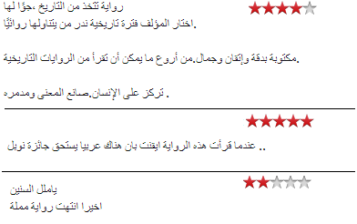
Experiments LABR Data Set
Extensive Arabic book reviews data from the GoodReads portal.
Consists of 63,257 Arabic reviews.
From the first 2143 books of the list of Best Arabic Books.
Rated on a scale of 1 to 5 stars.

Slide 11
Experiments Data Preparation
We partition the data into training, validation and test sets.
The ratio of the data among the three sets is 6:2:2 respectively.
We extend the work in [Aly and Atiya, 2013] by adding a class for neutral.
Ratings of 4 and 5 are mapped to positive, rating of 3 is mapped to neutral, and ratings 1 and 2 are mapped to negative.
Two datasets were prepared:
Balanced dataset
Unbalance dataset

Slide 12
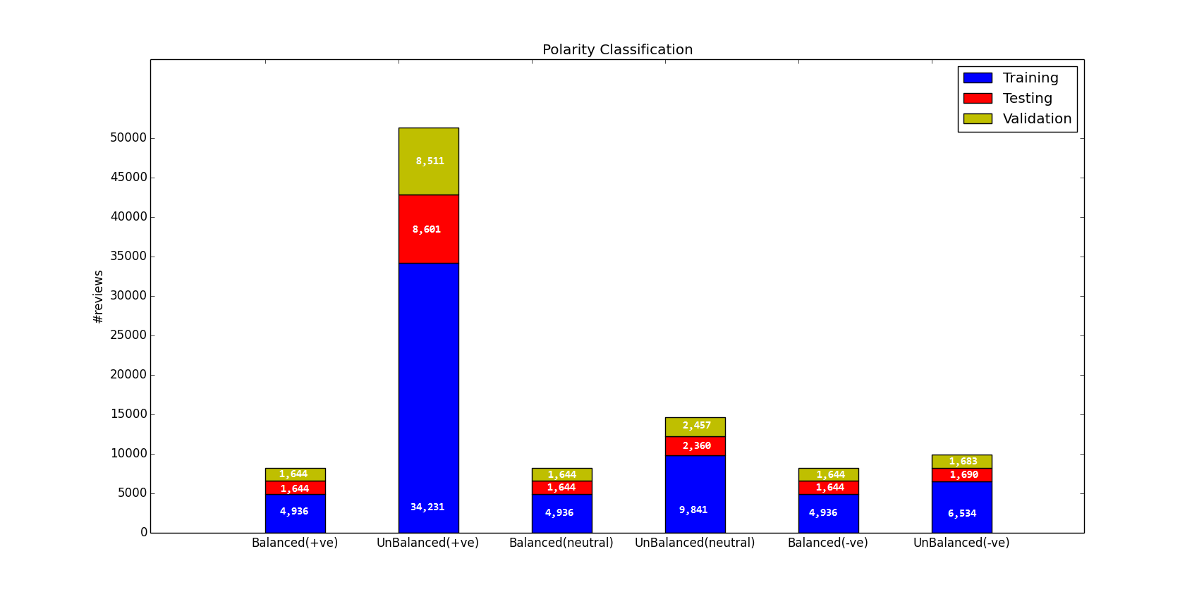
Experiments Data Preparation
Number of reviews for each class category

Slide 13
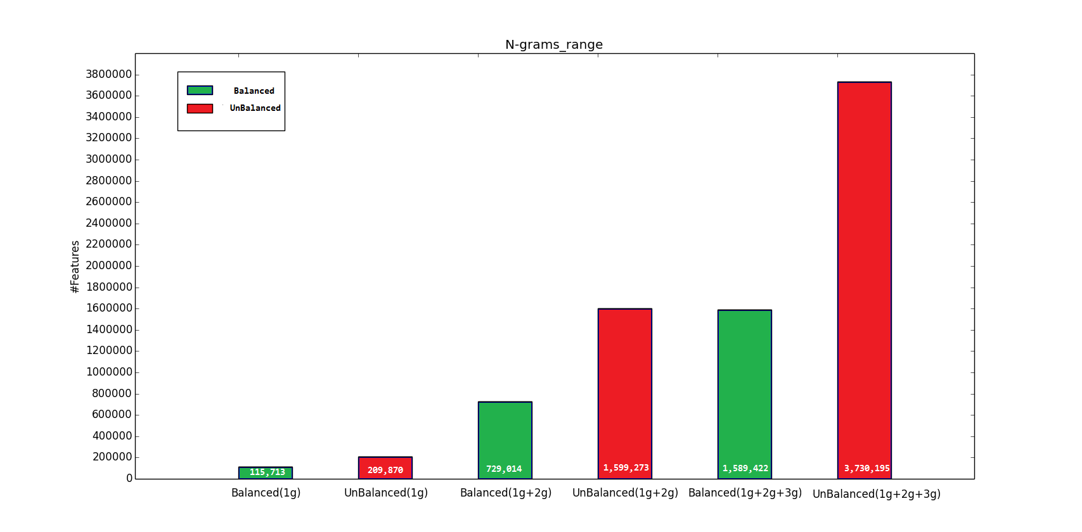
Experiments Data Preparation
Number of uni-grams, bigrams, and trigrams features per each class category

Slide 14
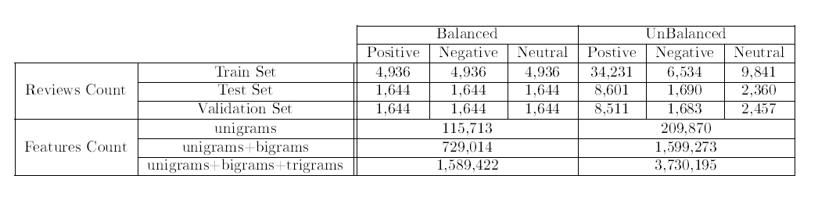
Experiments Data Preparation
Data preparation statistics summary

Slide 15
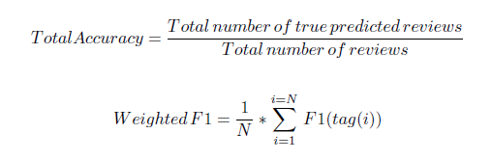

Experiments Experiment 1
A wide range of standard classifiers are applied to both the balanced and unbalanced datasets using n-gram range of unigrams, bigrams and trigrams.
Two accuracy measures are used to calculate the performance which are the total accuracy and weighted F1 measure.

Slide 16
Experiments Experiment 1(Cont.)
The classifiers used in this experiment are widely used in the area of sentiment analysis and can be considered as a baseline for any further experiments.
Multinomial Naive Bayes.
Bernoulli Naive Bayes.
Support Vector Machine.
Passive Aggressive.
Stochastic Gradient Descent.
Logistic Regression.
Perceptron.
K-Nearest Neighbor.

Slide 17
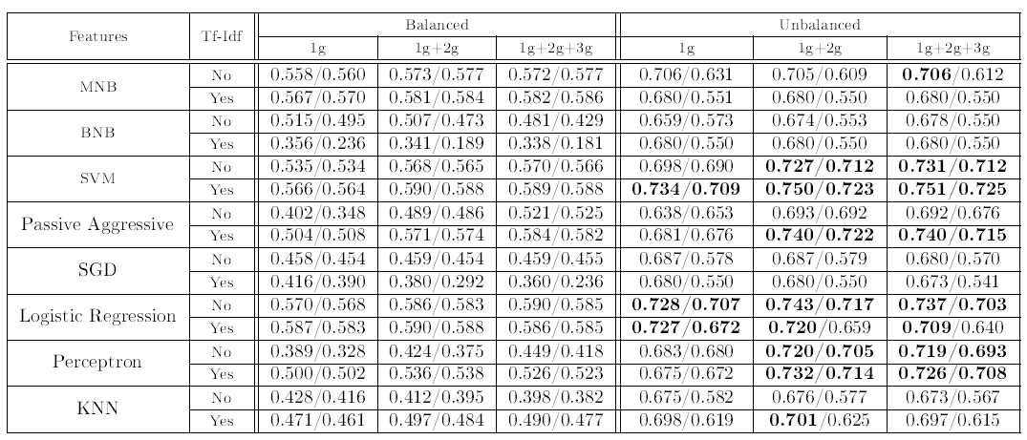
Experiments Experiment 1(Cont.)
Polarity Classification Experimental Results
The numbers represent weighted accuracy / F1 measure where the
evaluation is on the test set.

Slide 18
Experiments Experiment 1(Cont.)
The inclusion of a third class "neutral" makes the problem much harder, and we get a lower performance than the case of two-class case ("positive“ and "negative").
The balanced set is more challenging than the unbalanced set. We think this is due to the fact it contains much fewer reviews compared to the unbalanced set.
We can get an good overall accuracy and F1 of over 70% using especially SVM and logistic regression classifiers. This is consistent with previous results suggesting that SVM and Logistic Regression are a reliable choice.
Naive Bayes, Passive Aggressive, and Perceptron are also a good choice of classifiers, with the careful choice of parameters.

Slide 19
Experiments Experiment 2
As the degree of n-gram range increase the number of features increases significantly and approaches 3.7 million in trigram range of the unbalanced data set.
There are two overriding reasons to apply feature selection.
large number of features may make the classifier can exhibit some over fitting, due to the curse of dimensionality
With millions of features, the computational burden will be too high for many classifiers to be practically feasible

Slide 20
Experiments Experiment 2(Cont.)
Some feature selection techniques were applied to Tf-Idf (token frequency inverse document frequency) trigram training set to explore their effects. The feature selection experiments are:
SVM (L1 loss) classier.
Logistic regression classier.
Chi-squared feature selection.
Analysis of variance feature selection.
Relief feature selection.
Class Separation Feature selection.

Slide 21
Experiments Experiment 2(Cont.)
This Experiment is applied on the Tf-Idf unbalanced dataset then evaluating the result of every one of the following classifiers
SVM, passive aggressive, logistic regression and perceptron (as for these algorithms we get the highest accuracy and F-measure in Experiment 1.
The evaluation was performed on two stages:
Evaluation on the training set with cross validation.
Evaluation on the validation set with out cross validation
.

Slide 22
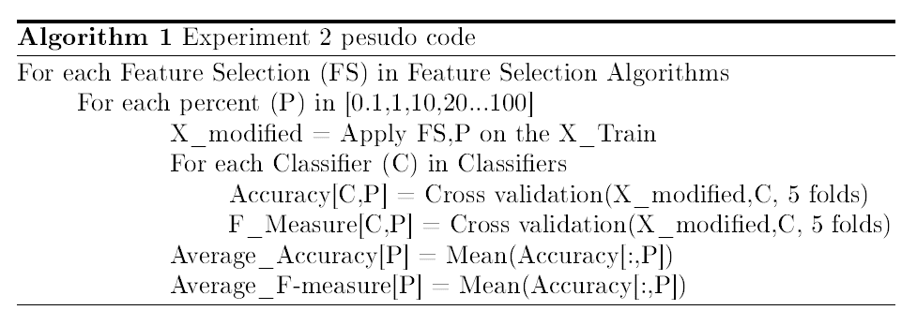
Experiments Experiment 2
Cross validation Algorithm

Slide 23
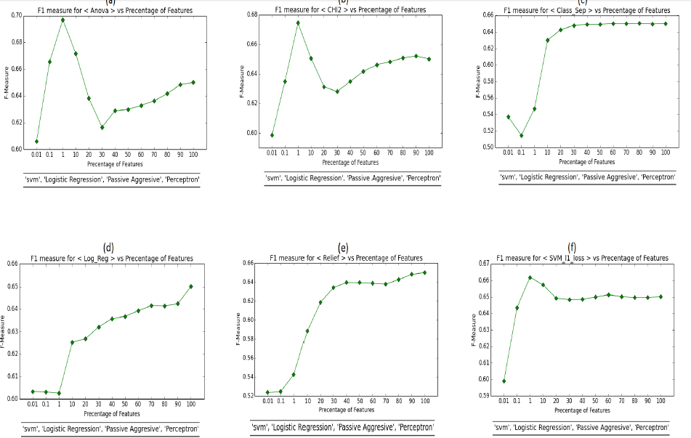
Experiments Experiment 2
Feature Selection Experimental Results with cross validation, results are on the training set.

Slide 24
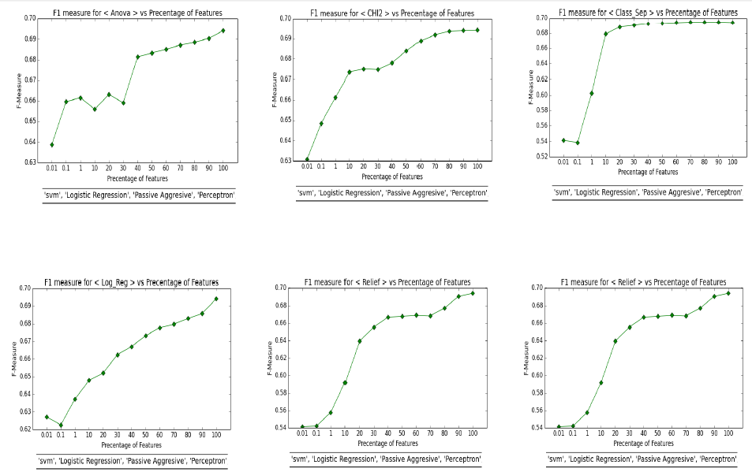
Experiments Experiment 2(Cont.)
Feature Selection Experimental Results with out cross validation, results are on the validation set

Slide 25
Experiments Experiment 2(Cont.)
We notice that SVM_L1, Anova and Chi2 feature selectors have inconsistent behavior between the two experiments we think the reasons for this might be:
Those feature selector may not be suitable for this experiment
Data is noisy and not reviewed manually for example one review has English meaning “wonderful” and the user rating is negative.
Due to this inconsistent behavior, we decided to not further pursue feature selection for classifiers that can readily handle all the available features.

Slide 26
Experiments Experiment 3
Sophisticated classifiers in the area of machine learning were applied to this task after applying feature selection to the top 100,1000 and 3000 best features.
The reason for applying feature selection on these classifiers.
They do not naturally perform feature selection, e.g. like what SVM does.
These algorithms generally consume a lot of resources in terms of memory and run time.

Slide 27
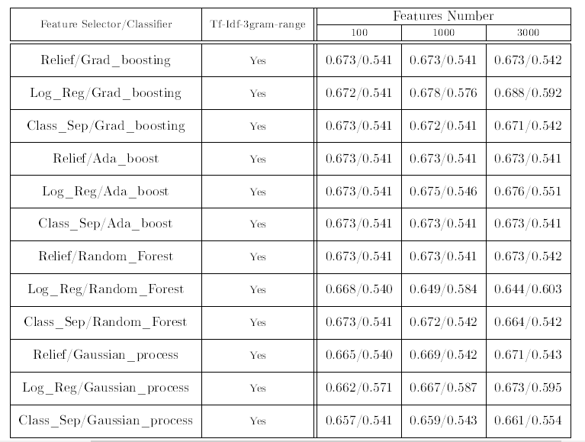
Experiments Experiment 3(Cont.)
Sophisticated Classifiers Experimental Results
The numbers represent weighted accuracy / F1 measure where the
evaluation is on the validation set.

Slide 28
Experiments Experiment 3(Cont.)
The results show that with using less than 0.1% of the features (3000 features) we get an F1 measure of around 60%, which is close to the 70% achieved using all the features (over 3.7 million).
This is an interesting observation, and we plan to investigate this further in the next phase, in addition to investigating using dimensionality reduction techniques e.g. Principal Component Analysis.

Slide 29
Twitter Data set
We have collected over 84,000 Arabic tweets on two stages.
Crawling the most active Egyptian Twitter accounts.
Using some of the most trending hashtags in Egypt.
After filtering out the non-Arabic tweets, and performing some pre-processing steps to clean up unwanted content like HTML, we ended up with 54,716 Arabic tweets.

Slide 30
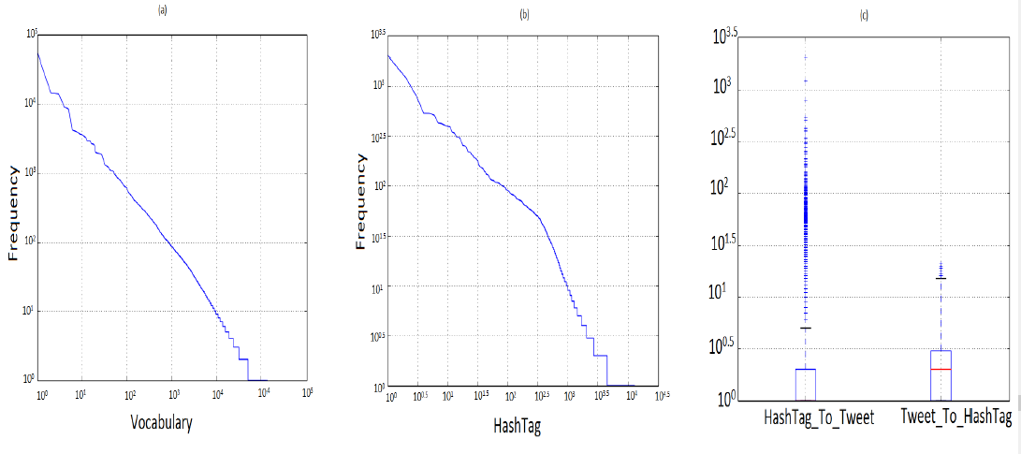
Data set Properties
(a) the frequency distribution of the vocabulary tokens. (b) the frequency distribution of the hash tags tokens. (c) the number of tweets per hash tag and the number of hash tag per
tweet

Slide 31
Dataset Next steps
For the next steps with the data set we plan to use Amazon Mechanical Turk service to manually tag the data set.
We will use a python API called ‘Boto’ to interface with Amazon web services.

Slide 32
Future work
Our planned next steps include:
Manually tagging the data set by using Amazon Mechanical Turk service.
Developing some topic extraction techniques to extract the most important topics for a given set of tweets.
Developing an algorithm for subjectivity and sentiment analysis for a given set of tweets.
Extracting Arabic sentiment lexicon and explore its potential.
Exploring using Arabic specific and more powerful specially tailored features.

Slide 33
Thank You

