Slide 1
Cucumber

Slide 2
Test Driven Development
TDD is an iterative development process
Each iteration starts with a set of tests written for a new piece of functionality
No application code, so test will fail
Application code is written with an intention to pass all the tests
Any failures in the test run are marked and more Application code is written/re-factored to make these tests pass

Slide 3
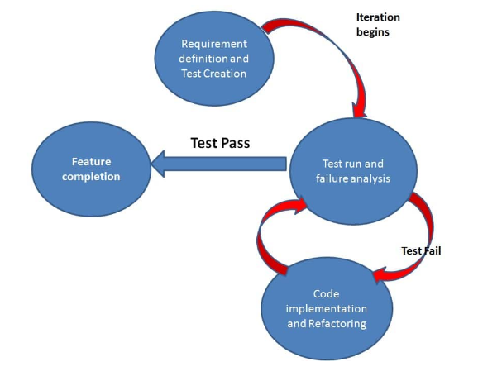
Test Driven Development

Slide 4
Test Driven Development
Benefits
  Unit test proves that the code actually works
  Refactoring allow to improve the design of the code
  Test first reduce the cost of the bugs
  Drawbacks
  Developer can consider it as a waste of time
  Test become part of the maintenance overhead of a project
  Rewrite the test when requirements change

Slide 5
Behavior Driven Development
Tests are written in plain descriptive English type grammar
Tests are explained as behavior of application and are more user focused
Using examples to clarify requirements

Slide 6
Behavior Driven Development
Features
  Shifting from thinking in “tests” to thinking in “behavior”
  Collaboration between Business stakeholders, Business Analysts, QA Team and developers
  Extends Test Driven Development (TDD) by utilizing natural language that non technical stakeholders can understand

Slide 7
Cucumber
Cucumber is a testing framework which supports Behavior Driven Development (BDD)
Defines application behavior in plain meaningful English text using a simple grammar defined by a language called Gherkin
Uses keywords like Given, When, Then & And
The main feature of the Cucumber is that it focuses on Acceptance testing

Slide 8
Cucumber Feature File
Feature File is an entry point to the Cucumber tests
Tests are described in descriptive language
A feature file can contain a scenario or can contain many scenarios
It serves as an automation test script as well as live document

Slide 9
Gherkin Keywords
Feature
  Each Gherkin file begins with a Feature keyword
  It defines the logical test functionality you will test in this feature file
  It is summary of what will be tested

Slide 10
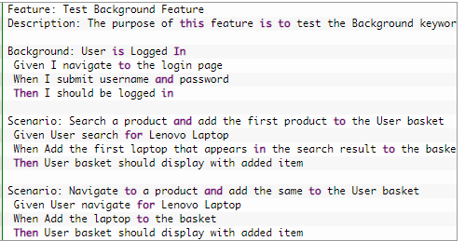
Gherkin Keywords
Background
  It is used to define steps which are common to all the tests in the feature file

Slide 11
Gherkin Keywords
Scenario
  Each test is called a Scenario
  Each scenario/test can be basically broken down into three parts:
    Precondition to the test, which represent with (Given) keyword
    Test step execution, which represent with (When) keyword
    Verification of the output with expected result, which represent with

Slide 12
Gherkin Keywords
Given
  It defines a precondition to the test
  When
    It defines the test action that will be executed
  Then
    It defines the outcome of previous steps
  And
    It is used to add conditions to your steps
  But
    It is used to add negative type comments

