Slide 2
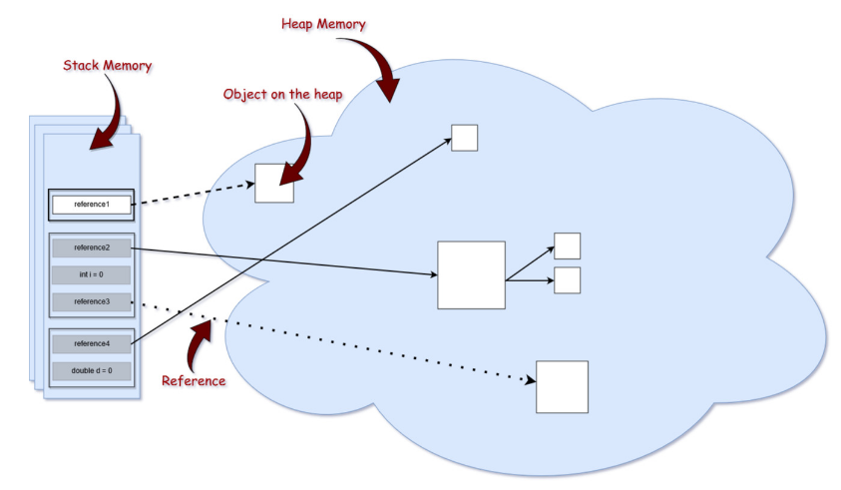
Memory Structure

Slide 3
Stack
Holds references to heap objects
Stores values of variables (primitive)
Stack memory is always referenced in LIFO (Last-In-First-Out) order

Slide 4
Heap
Java Heap space is used by java runtime to allocate memory to Objects
Whenever we create any object, it’s always created in the Heap space
Garbage Collection runs on the heap memory to free the memory used by objects that doesn’t have any reference
Object created in the heap space has global access
Example
ClassName objName = new ClassName();

Slide 5
Example
package com.journaldev.test;
public class Memory {
public static void main(String[] args) { // Line 1
int i=1; // Line 2
Object obj = new Object(); // Line 3
Memory mem = new Memory(); // Line 4
mem.foo(obj); // Line 5 } // Line 9
private void foo(Object param) { // Line 6
String str = param.toString(); // Line 7 System.out.println(str); } // Line 8 }

Slide 6
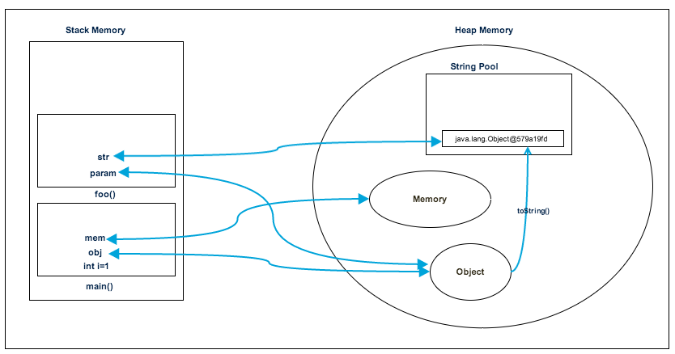
Memory allocation

Slide 7
Heap Space vs Stack Memory
Heap memory is used by all the parts of the application | Stack memory is used only by one thread of execution
Whenever an object is created, it’s always stored in the Heap space | Stack memory only contains local primitive variables and reference variables to objects in heap space.
Objects stored in the heap are globally accessible | Stack memory can’t be accessed by other threads
Heap memory lives from the start till the end of application execution. | Stack memory is short-lived
If heap memory is full, it throws java.lang.OutOfMemoryError: Java Heap Space error | When stack memory is full, Java runtime throws java.lang.StackOverFlowError
Heap memory is comparatively slower | Stack memory is very fast
We can use -Xms and -Xmx JVM option to define the startup size and maximum size of heap | We can use -Xss to define the stack memory size

Slide 8
Strings
Strings are immutable, meaning that each time you do something with a string, another object is actually created on the heap
Java manages a string pool in memory(Heap)
Java stores and reuse strings whenever possible

Slide 9
Strings contd…
String localPrefix = "297";
String prefix = "297";
prefix == localPrefix ➔ True
String localPrefix = new Integer(297).toString();
prefix == localPrefix ➔ False

Slide 10
Final
The final keyword can be applied to declaration of classes, methods and variables
If a class is marked as final, it cannot be subclassed/inherited by another class
final class A { }
class B extends A {} // compile error
A class cannot be both abstract and final
If a class is declared as final then by default all of the methods present in that class are automatically final but variables are not

Slide 11
Final contd…
when a method is final, that means it cannot be overriden, neither by methods in the same class or in sub class
class C {
final void foo() { }
}
class D extends C {
void foo() { } // compile error
}

Slide 12
Final contd…
if a variable is marked as final, its reference cannot be changed to refer to another object
final String message = "HELLO";
message = "BONJOUR"; // compile error

Slide 13
Finalize
It is a method that the Garbage Collector always calls just before destroying the object
It is not a reserved keyword
Finalize method is present in Object class
The finalize method in Object class has empty implementation
We have to override this method to define our own clean-up activities

Slide 14
Finalize example
class Hello {
public static void main(String[] args)
{
String s = new String("RR");
s = null;
// Requesting JVM to call Garbage Collector method
System.gc();
System.out.println("Main Completes");
}
// Here overriding finalize method
public void finalize()
{
System.out.println("finalize method overriden");
}
}

