Slide 2
Classes and Objects
A class is a template or blueprint from which objects are created
It is a logical entity
A class in Java can contain:
Fields
Methods
Constructors
Syntax to declare a class:
class <class_name>{
field;
method;
}

Slide 3
Object
An object is an instance of a class
An object is a real-world entity
An object is a runtime entity
Object is an entity which has state and behavior
Example: A car has states – color, model, name, etc and can have behavior – accelerate, brake, stop, etc
A software object's state is stored in fields and behavior is shown via methods

Slide 4
Variables
Local
Variables defined inside methods, constructors or blocks
Instance variables
Variables within a class but outside any method. These variables are initialized when the class is instantiated.
Class variables
Variables declared within a class, outside any method, with the static keyword

Slide 5
Constructor
It is a block of codes similar to the method
It is called when an object is created
If no constructor is defined then default constructor is called
Creating a constructor
Name must be same as its class name
It must have no explicit return type
It cannot be abstract, static or final

Slide 6
Constructor
Types of constructors
Default constructor (no-arguments)
Parameterized constructor

Slide 7
OOPS
Inheritance
Polymorphism
Abstraction
Encapsulation
Method Overloading
Method Overriding

Slide 8
Inheritance
One object acquires all the properties and behaviors of a parent object
Provides code reusability
Types of Inheritance
Single Inheritance
Multiple Inheritance(Java does not support)
Multilevel Inheritance
Hierarchical Inheritance
Hybrid Inheritance

Slide 9
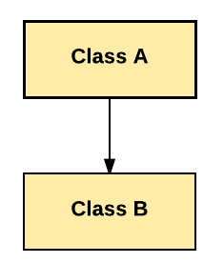
Single Inheritance

Slide 10
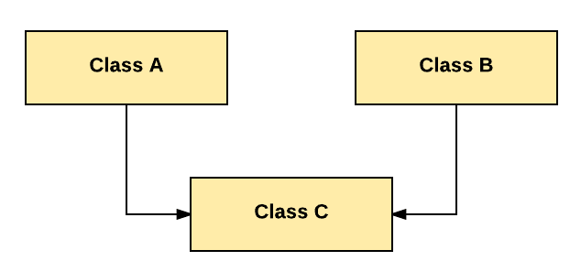
Multiple Inheritance

Slide 11
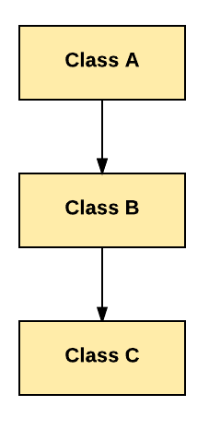
Multilevel Inheritance

Slide 12
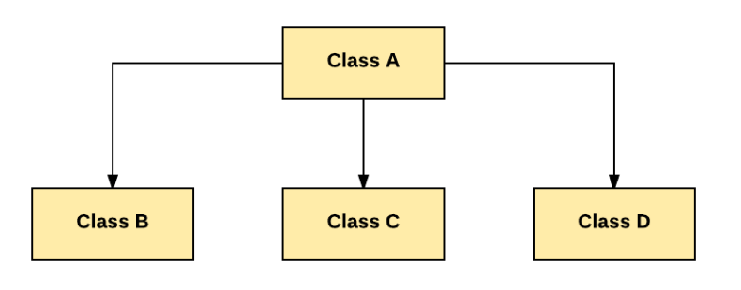
Hierarchical Inheritance

Slide 13
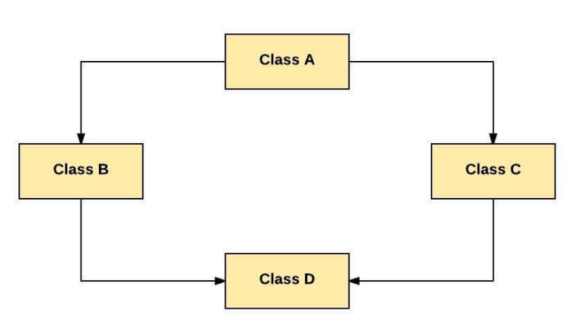
Hybrid Inheritance

Slide 14
Polymorphism
Polymorphism is a OOPs concept where one name can have many forms
Java supports Compile time(overloading) and Run time (overriding) polymorphism

Slide 15
Overloading
Class has multiple methods having same name but different parameters
Method overloading increases the readability of the program
There are two ways to overload the method in java
By changing number of arguments
By changing the data type
Method Overloading is not possible by changing the return type

Slide 16
Overriding
A subclass (child class) has the same method as declared in the parent class
It is used to provide the specific implementation of a method which is already provided by its superclass
Rules for Method Overriding
The method must have the same name as in the parent class
The method must have the same parameter as in the parent class.
There must be an IS-A relationship (inheritance)

Slide 17
Encapsulation
Encapsulation in Java is a mechanism of wrapping the data (variables) and code acting on the data (methods) together as a single unit
The variables of a class will be hidden from other classes, and can be accessed only through the methods of their current class. Therefore, it is also known as data hiding.

Slide 18
Abstraction
It is a process of hiding the implementation details and showing only functionality to the user
lets you focus on what the object does instead of how it does it
There are two ways to achieve abstraction in java
Abstract class (0 to 100%)
Interface (100%)

