Slide 1
Selenium Webdriver

Slide 2
Selenium
Selenium is a software testing framework for the web
It facilitates the automation of browsers
It is an open source tool
It supports all major browsers and programming languages

Slide 3
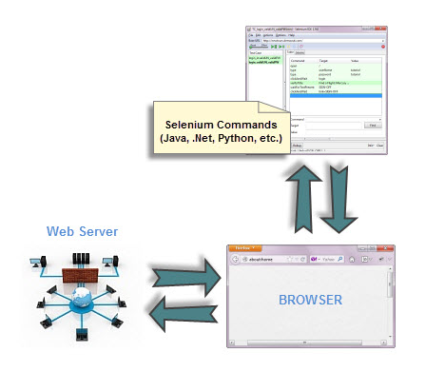
Architecture
Selenium Webdriver controls the browser from the OS level

Slide 4
Driver
Driver consists of three separate pieces:
Browser (Chrome)
language bindings provided by the Selenium (Driver)
Executable
The executable acts as a bridge between "chrome" and the "driver"
WebDriver driver = new ChromeDriver();

Slide 5
Locators
Name
Id
ClassName
CssSelector
TagName
LinkText
PartialLinkText
Xpath

Slide 6
Locating elements
To interact with a webelement, first we need to locate it
WebDriver gives us two methods:
findElement: locates and returns a single web element
findElements: locates and returns a list of web elements
Both the methods accept a parameter (locator) and returns web-element(s)

Slide 7
Locating elements using By Strategy
Locating elements in WebDriver is done by using the findElement(By.locator()) method
The findElement methods take a locator or query object called ‘By’.

Slide 8
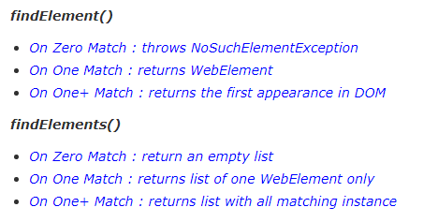
Difference between FindElement & FindElements

Slide 9
Browser Commands
Get
get(String arg0) : void – This method Loads a new web page in the current browser window. Accepts String as a parameter and returns nothing.
driver.get("http://www.google.com");
Get Title
getTitle() : String – This method fetches the Title of the current page. Accepts nothing as a parameter and returns a String value.
driver.getTitle();

Slide 10
Browser Commands (contd..)
Get Current URL
getCurrentUrl() : String – This method fetches the string representing the Current URL which is opened in the browser. Accepts nothing as a parameter and returns a String value.
driver.getCurrentUrl();
Close
close() : void – This method Close only the current window the WebDriver is currently controlling. Accepts nothing as a parameter and returns nothing.
driver.close();

Slide 11
Browser Commands (contd..)
Quit
quit() : void – This method Closes all windows opened by the WebDriver. Accepts nothing as a parameter and returns nothing.
driver.quit();

Slide 12
Practice Exercise – 1
Launch a new Firefox browser.
Open Store.DemoQA.com
Get Page Title name and Title length
Print Page Title and Title length on the Eclipse Console.
Get Page URL and verify if the it is a correct page opened
Get Page Source (HTML Source code) and Page Source length
Print Page Length on Eclipse Console.
Close the Browser.

Slide 13
Browser Navigation Commands
Navigate To Command
to(String arg0) : void – This method Loads a new web page in the current browser window. It accepts a String parameter and returns nothing.
driver.navigate().to("http://www.DemoQA.com");
Forward Command
forward() : void – This method does the same operation as clicking on the Forward Button of any browser. It neither accepts nor returns anything.
driver.navigate().forward();

Slide 14
Browser Navigation Commands (contd..)
Back Command
back() : void – This method does the same operation as clicking on the Back Button of any browser. It neither accepts nor returns anything
driver.navigate().back();
Refresh Command
refresh() : void – This method Refresh the current page. It neither accepts nor returns anything.
driver.navigate().refresh();

Slide 15
WebElement Commands
What is WebElement?
WebElement represents an HTML element
Commands
clear( ) : If this element is a text entry element, this will clear the value
sendKeys(CharSequence… keysToSend ) : This simulate typing into an element, which may set its value.
click( ) : This simulates the clicking of any element.
isDisplayed( ) : This method determines if an element is currently being displayed or not.
isEnabled( ) : This determines if the element currently is Enabled or not?
isSelected( ) : Determine whether or not this element is selected or not.
getText( ) : This method will fetch the visible (i.e. not hidden by CSS) innerText of the element.
getTagName( ) : This method gets the tag name of this element.
getAttribute(String Name) : This method gets the value of the given attribute of the element.

