Slide 2
Exception Handling
An exception (or exceptional event) is a problem that arises during the execution of a program
Normal flow of the program is disrupted and the program/Application terminates abnormally
Exceptions should always be handled

Slide 3
Types of Exceptions
Checked exceptions
It is an exception that is checked (notified) by the compiler at compilation-time
These exceptions cannot simply be ignored, the programmer should take care of (handle) these exceptions
Also called as compile time exceptions

Slide 4
Types of Exceptions
Unchecked exceptions
It occurs at the time of program execution
These include programming bugs, such as logic errors or improper use of an API
Also called as Runtime Exceptions
Runtime exceptions are ignored at the time of compilation

Slide 5
Errors
These are not exceptions at all, but problems that arise beyond the control of the user or the programmer
They are also ignored at the time of compilation
For example, if a stack overflow occurs, an error will arise

Slide 6
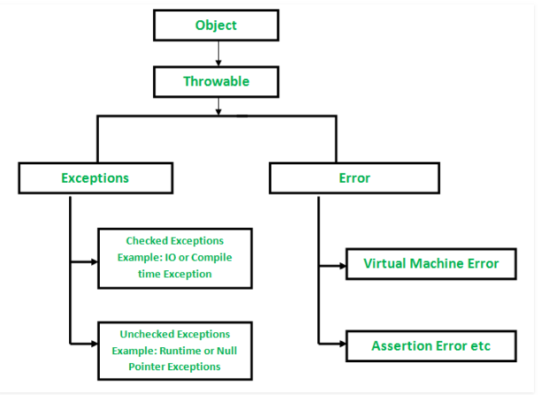
Exception Hierarchy

Slide 7
Catching Exceptions
A method catches an exception using a combination of the try and catch keywords
A try/catch block is placed around the code that might generate an exception
Syntax
try { // Protected code }
catch (ExceptionName e1) { // Catch block }

Slide 8
Multiple Catch Blocks
A try block can be followed by multiple catch blocks. The syntax for multiple catch blocks looks like the following −
Syntax
try { // Protected code }
catch (ExceptionType1 e1) { // Catch block }
catch (ExceptionType2 e2) { // Catch block }
catch (ExceptionType3 e3) { // Catch block }

Slide 9
Finally Block
The finally block follows a try block or a catch block
A finally block of code always executes, irrespective of occurrence of an Exception
Finally block allows you to run any cleanup-type statements that you want to execute, no matter what happens in the protected code

Slide 10
Finally
Syntax
try { // Protected code }
catch (ExceptionType1 e1) { // Catch block }
catch (ExceptionType2 e2) { // Catch block }
catch (ExceptionType3 e3) { // Catch block }
finally { // The finally block always executes. }

Slide 11
Common Exceptions
JVM Exceptions − These are exceptions/errors that are exclusively or logically thrown by the JVM. Examples: NullPointerException, ArrayIndexOutOfBoundsException, ClassCastException.
Programmatic Exceptions − These exceptions are thrown explicitly by the application or the API programmers. Examples: IllegalArgumentException, IllegalStateException.

Slide 12
Throws/Throw
If a method does not handle a checked exception, the method must declare it using the throws keyword
The throws keyword appears at the end of a method's signature
By using the throw keyword, You can throw an exception, either a newly instantiated one or an exception that you just caught

Slide 13
Error vs Exception
ERRORS | EXCEPTIONS
Recovering from Error is not possible. | We can recover from exceptions by either using try-catch block or throwing exceptions back to caller.
All errors in java are unchecked type. | Exceptions include both checked as well as unchecked type.
Errors are mostly caused by the environment in which program is running. | Program itself is responsible for causing exceptions.
Errors occur at runtime and not known to the compiler. | All exceptions occurs at runtime but checked exceptions are known to compiler while unchecked are not.
They are defined in java.lang.Error package. | They are defined in java.lang.Exception package
Examples : java.lang.StackOverflowError, java.lang.OutOfMemoryError | Examples : Checked Exceptions : SQLException, IOException Unchecked Exceptions : ArrayIndexOutOfBoundException, NullPointerException, ArithmeticException.

