Slide 1
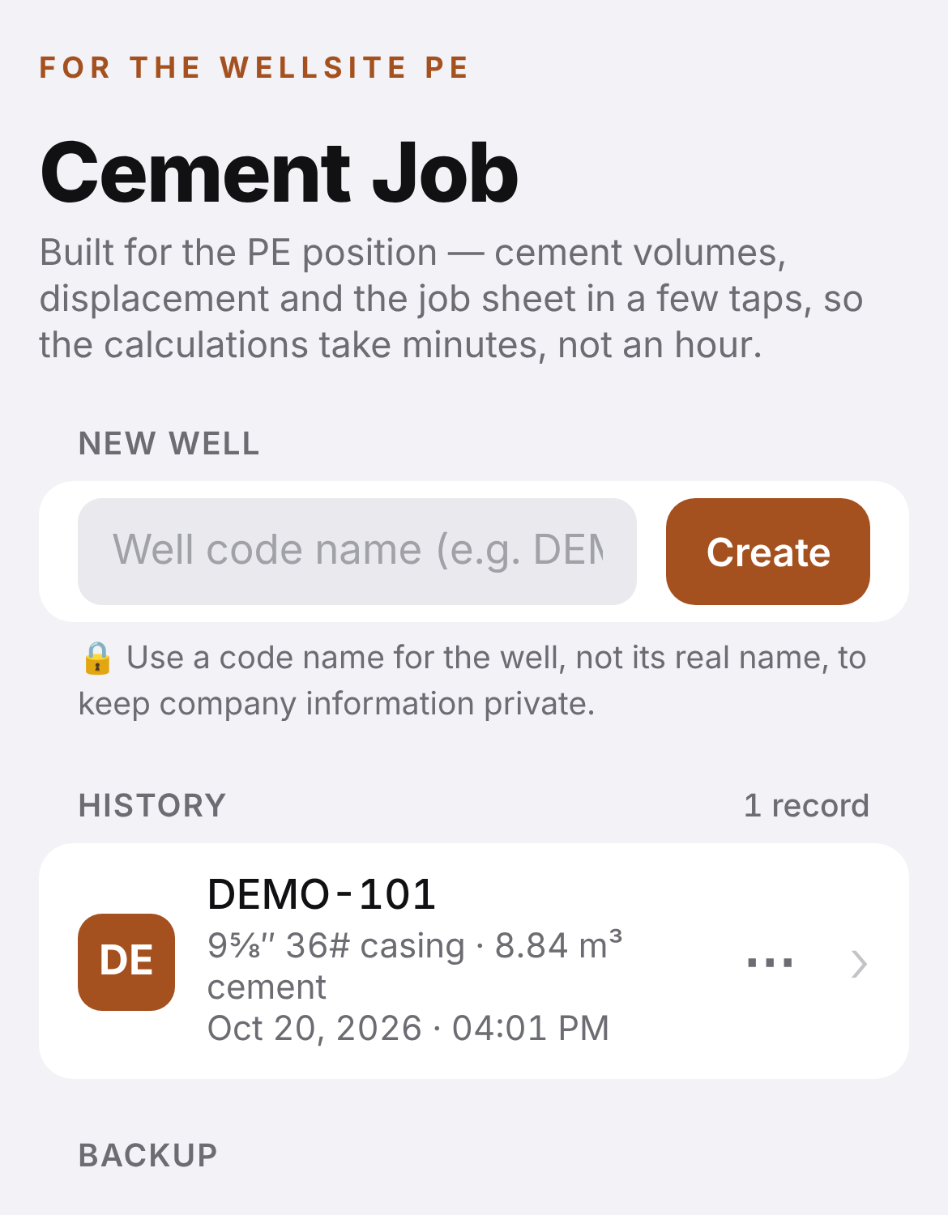
Cement Job Tool
A mobile cement calculation platform for the wellsite PE
Created by Mohammed Al Araimi · MU67673
Notes:
Introduce yourself and the tool: a phone-based calculator that does the full cement job calculation for the wellsite PE and produces the job sheet.

Slide 2



Executive summary
The idea
The objective
Status today
A phone tool that does the full cement job calculation for the wellsite PE and prints a one-page job sheet.
Faster, more accurate and standard cement calculations on every job, with a saved record.
Built and tested against a real 9⅝‑in cement job hand calculation. Ready for a pilot on the next job.
Request: approval for a pilot on the next cement job, and IT support to host the tool internally.
Notes:
One idea, one objective, and where it stands: built, tested against a real job, ready to pilot. The request is at the bottom.

Slide 3
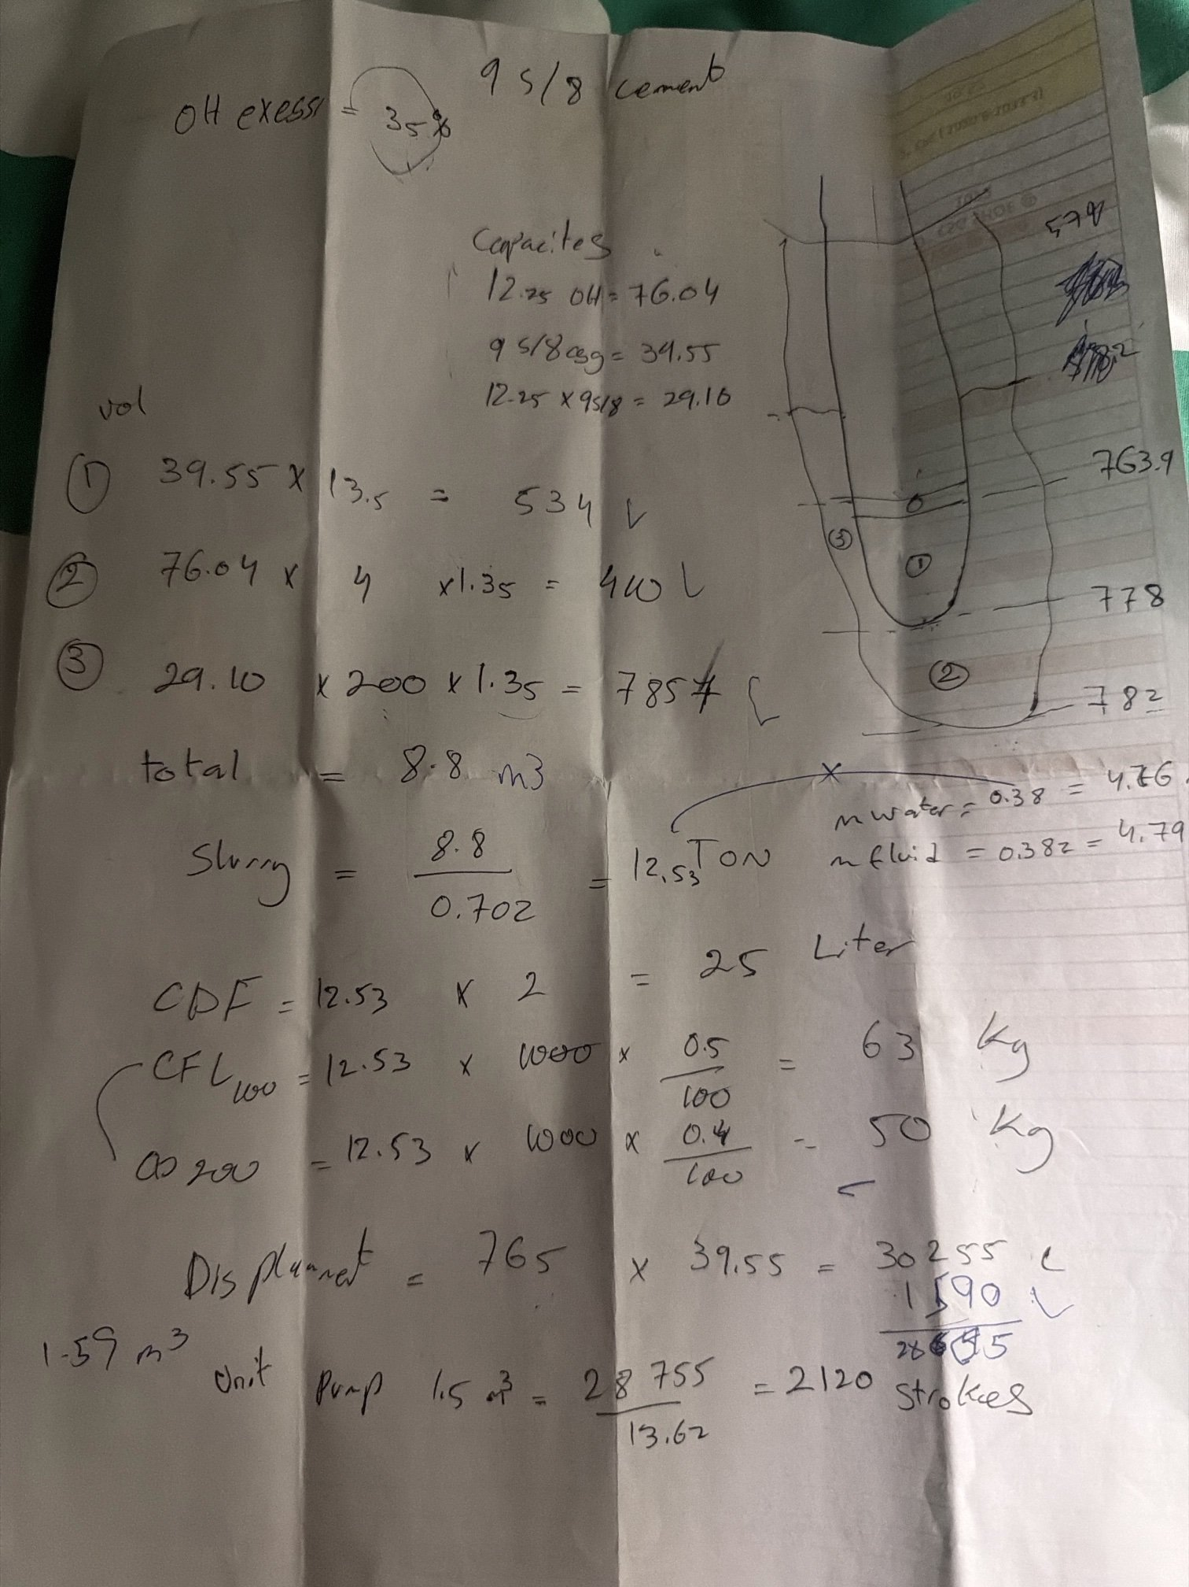
Today: cement calculations are done by hand
Many manual steps
Capacities, section volumes with excess, dry cement, mix water, additives, displacement and strokes.
Errors creep in
Rounded depths (shoe track 13.5 m vs 14.1 m) and the wrong casing capacity (39.55 vs 40.32 L/m) shift displacement by ~0.6 m³ — about 43 strokes.
Excel needs a laptop
The Excel sheet is not practical on the rig floor or phone, has no schematic, and keeps no clear record per well.
Notes:
This is a real handwritten sheet for a 9-5/8 inch job. Many steps, easy to round, and the displacement depends on using the right casing capacity. Excel exists but needs a laptop and gives no schematic or record per well.

Slide 4




Objective: the right numbers, fast, every time
Faster
Accurate
Standard
Full calculation in minutes on the phone
Exact depths and PDO casing data, no rounding
Same method and layout for every job and PE
Documented
Recorded
Private
One-page PDF job sheet with every step shown
Every well saved in a history list
Data stays on the phone; wells use code names
Notes:
Six goals: faster, accurate, standard, documented, recorded and private.

Slide 5



How it works: enter once, everything else is calculated
You enter
The tool calculates
You get
Casing & hole size
Shoe, float collar, TD, TOC
Excess %
Yield & mix fluid
Additive doses
Cement unit volume & pump output
Capacities (PDO CSG & TBG sheet)
Volume of every section
Total cement & dry cement (MT)
Mix fluid & mix water
Additive quantities
Displacement & rig strokes
Well schematic
Results with the working shown
One-page PDF job sheet
Saved record in history
Works offline on the phone
Notes:
The PE enters what is in the cement program; the tool does every calculation and produces the schematic and the PDF.

Slide 6
Worked example: a 9⅝‑in casing job
Demo well DEMO-101 — the same numbers as the handwritten sheet
Notes:
Now a step-by-step run of the tool using the numbers from the real handwritten sheet, under a demo well name.

Slide 7
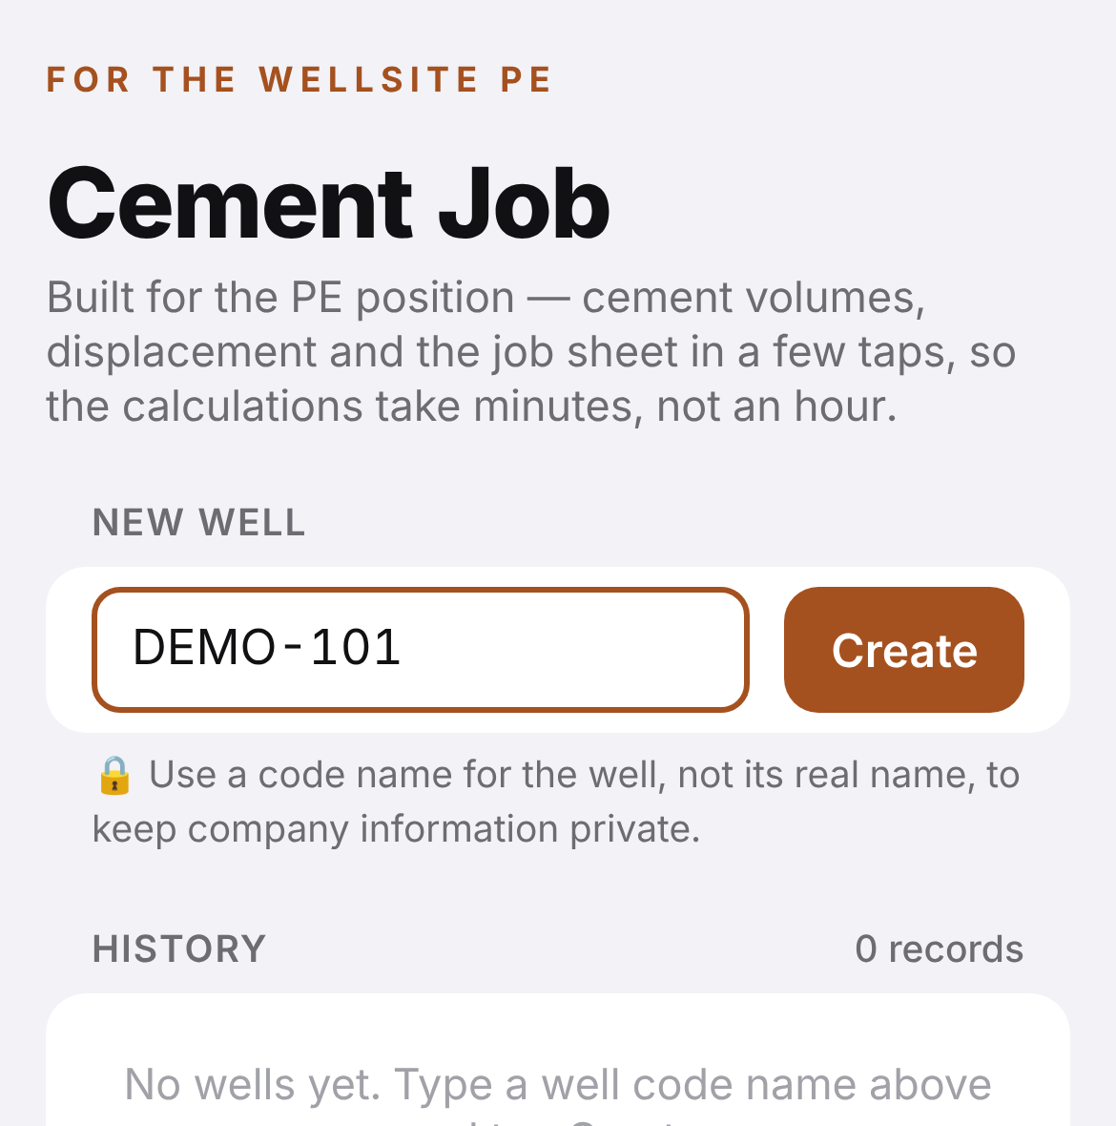
Create the well
1
STEP 1 · HOME PAGE
Type a well code name — here DEMO-101. The real well name is never used, to protect company data.
Tap Create: the cement page opens.
The well is saved in History. Open, rename, duplicate or delete it from the ⋯ menu.
Save a copy / Restore keeps a backup of all wells.
Notes:
Step one: type a code name and create the well. It is saved in the history on the phone.

Slide 8
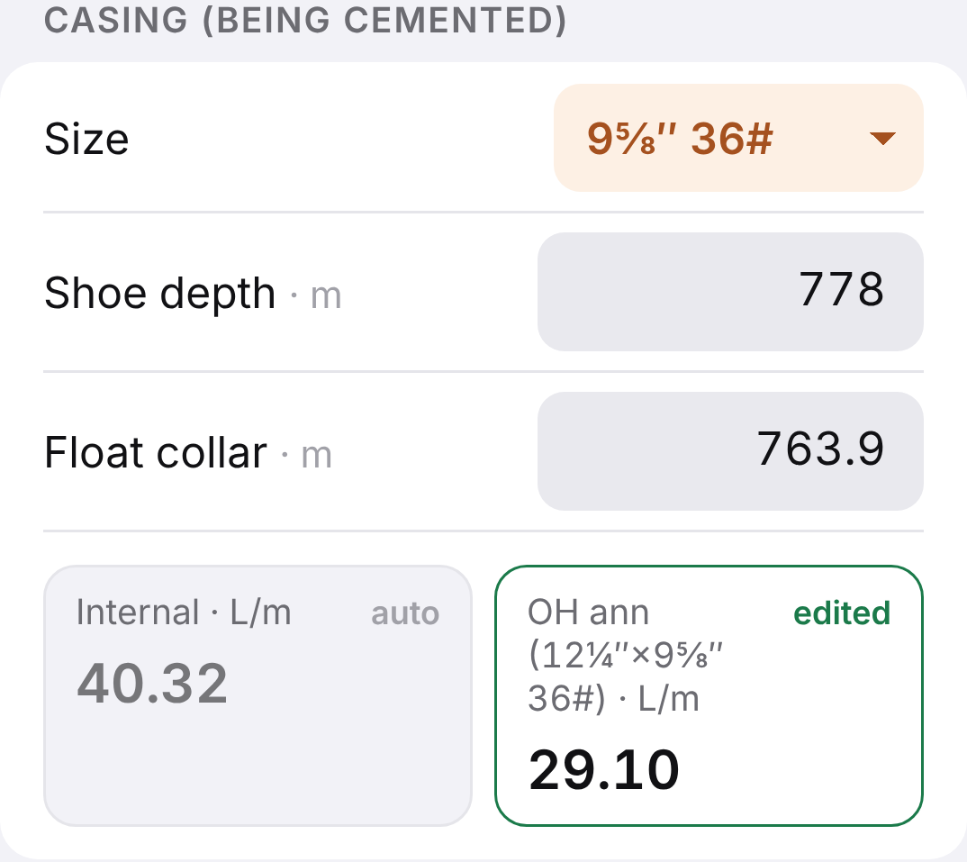
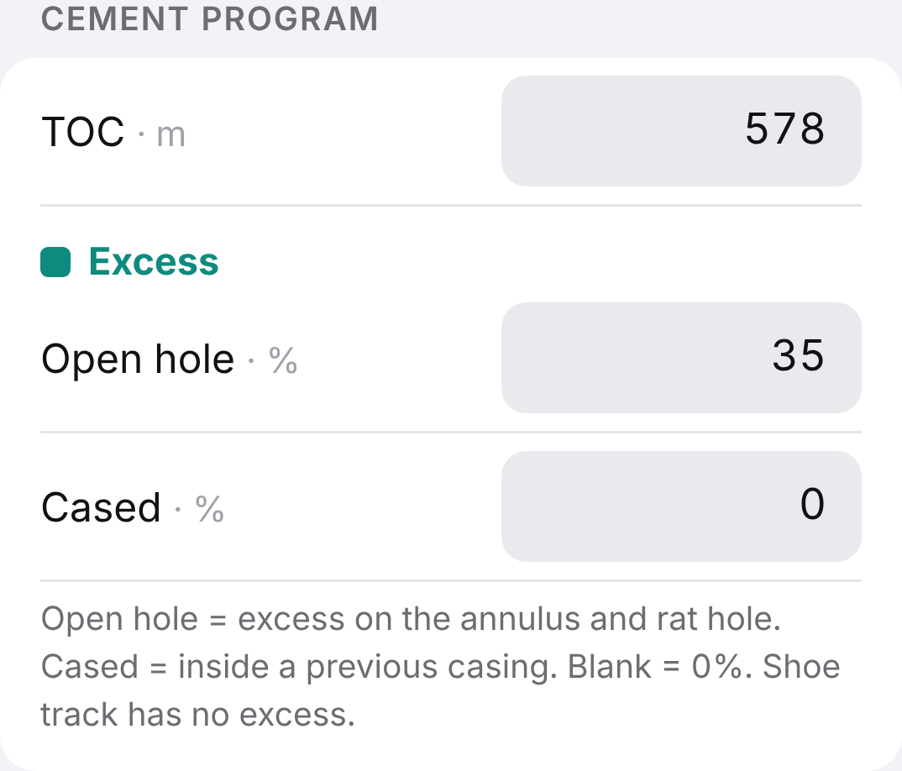
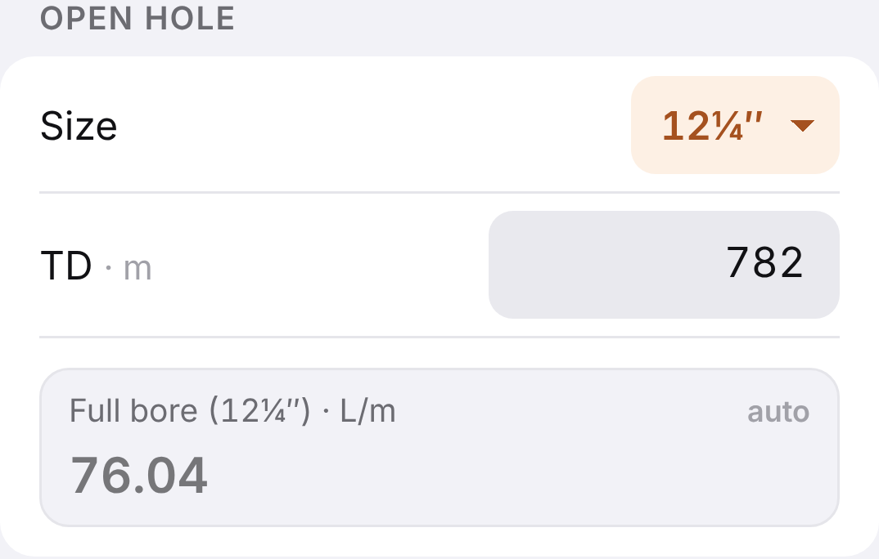
Enter the data from the cement program
2
STEP 2 · INPUTS
Field | Value
Job type | Casing · single slurry
Casing | 9⅝‑in 36# (40.32 L/m, PDO sheet)
Shoe / float collar | 778 m / 763.9 m
Hole / TD | 12¼‑in / 782 m
OH annulus | 29.10 L/m
TOC | 578 m
Open-hole excess | 35%
Yield / mix fluid | 0.702 m³/MT / 0.382 m³/MT
Cement unit / rig pump | 1.59 m³ / 13.62 L/stk
Capacities fill in from the PDO CSG & TBG sheet. A typed value (e.g. 29.10 from the program) overrides it and turns green.
Notes:
These are exactly the numbers on the handwritten sheet. The casing capacity comes from the PDO data sheet; the annulus was typed as 29.10 to match the program.

Slide 9
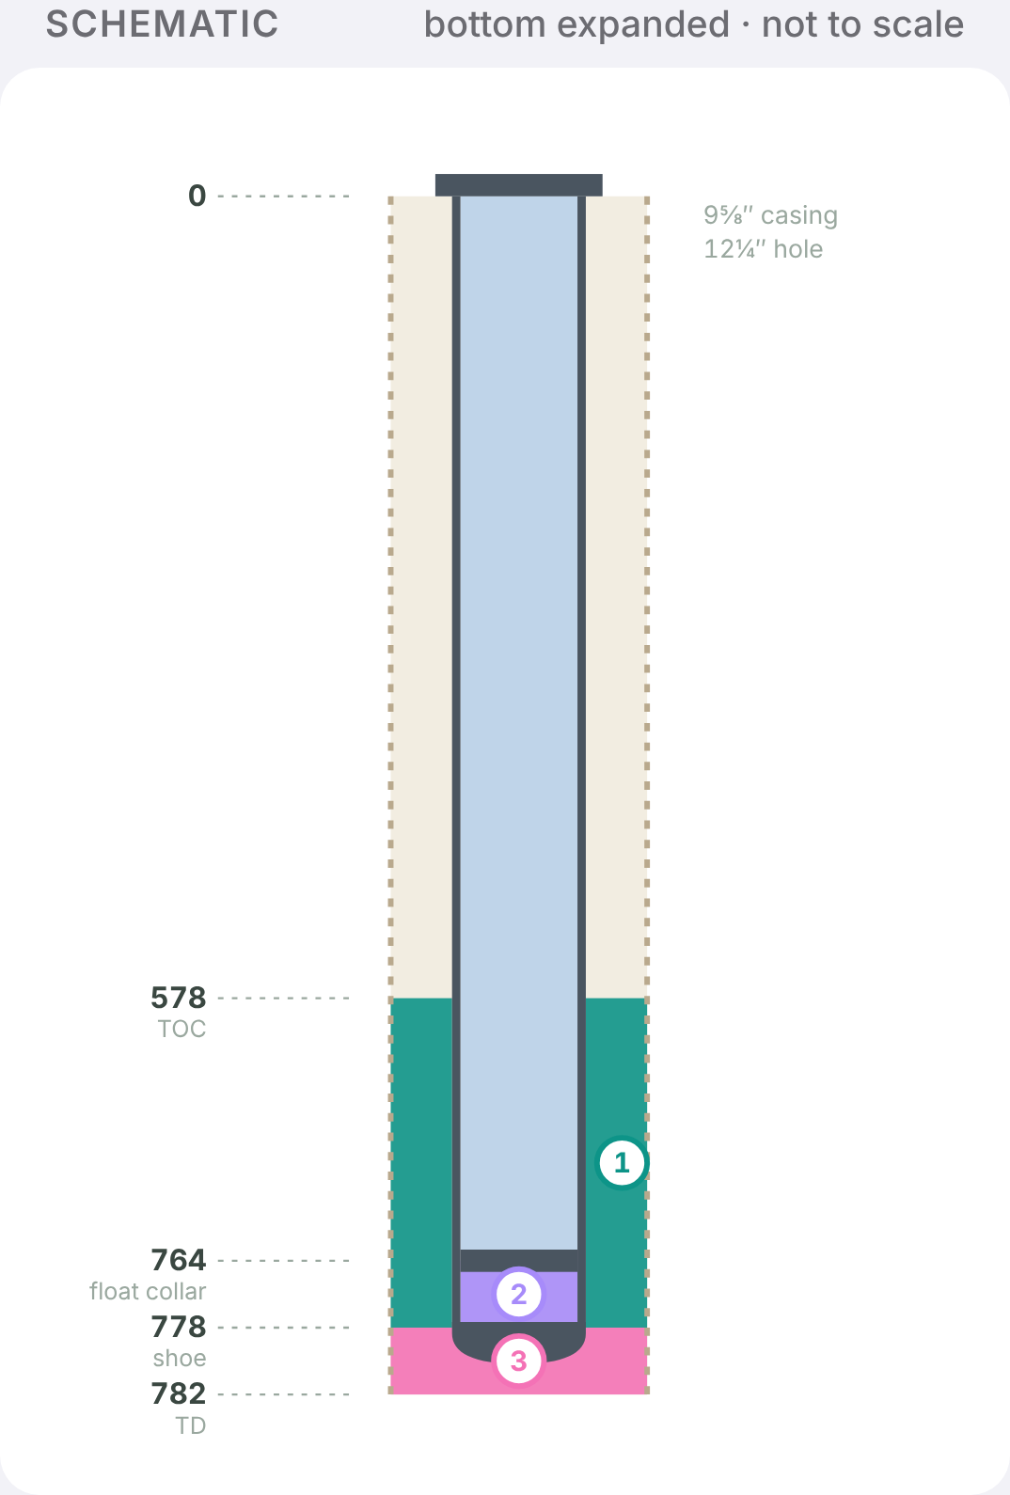
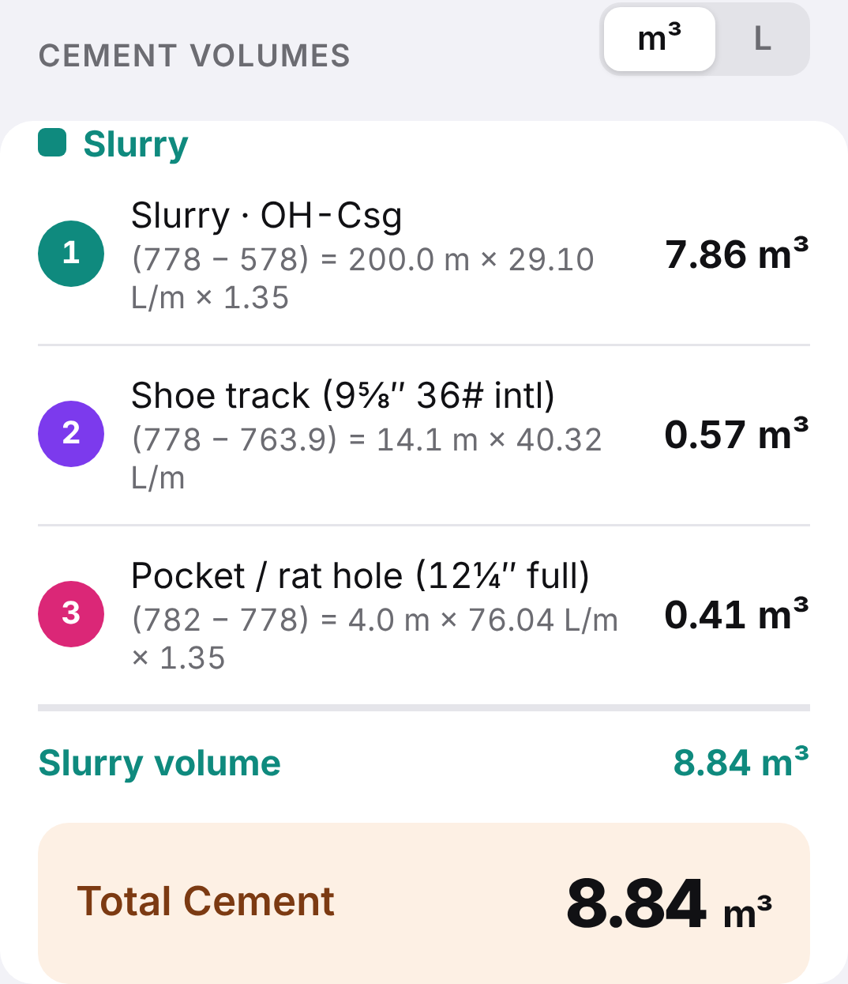
Schematic and cement volumes appear
3
STEP 3 · VOLUMES
① Annulus
7.86 m³
(778 − 578) 200 m × 29.10 × 1.35
② Shoe track
0.57 m³
(778 − 763.9) 14.1 m × 40.32
③ Rat hole
0.41 m³
(782 − 778) 4 m × 76.04 × 1.35
Total cement 8.84 m³
Notes:
The schematic draws itself once the data is in. Each section shows its depth subtraction, capacity and excess. Total 8.84 cubic metres.

Slide 10
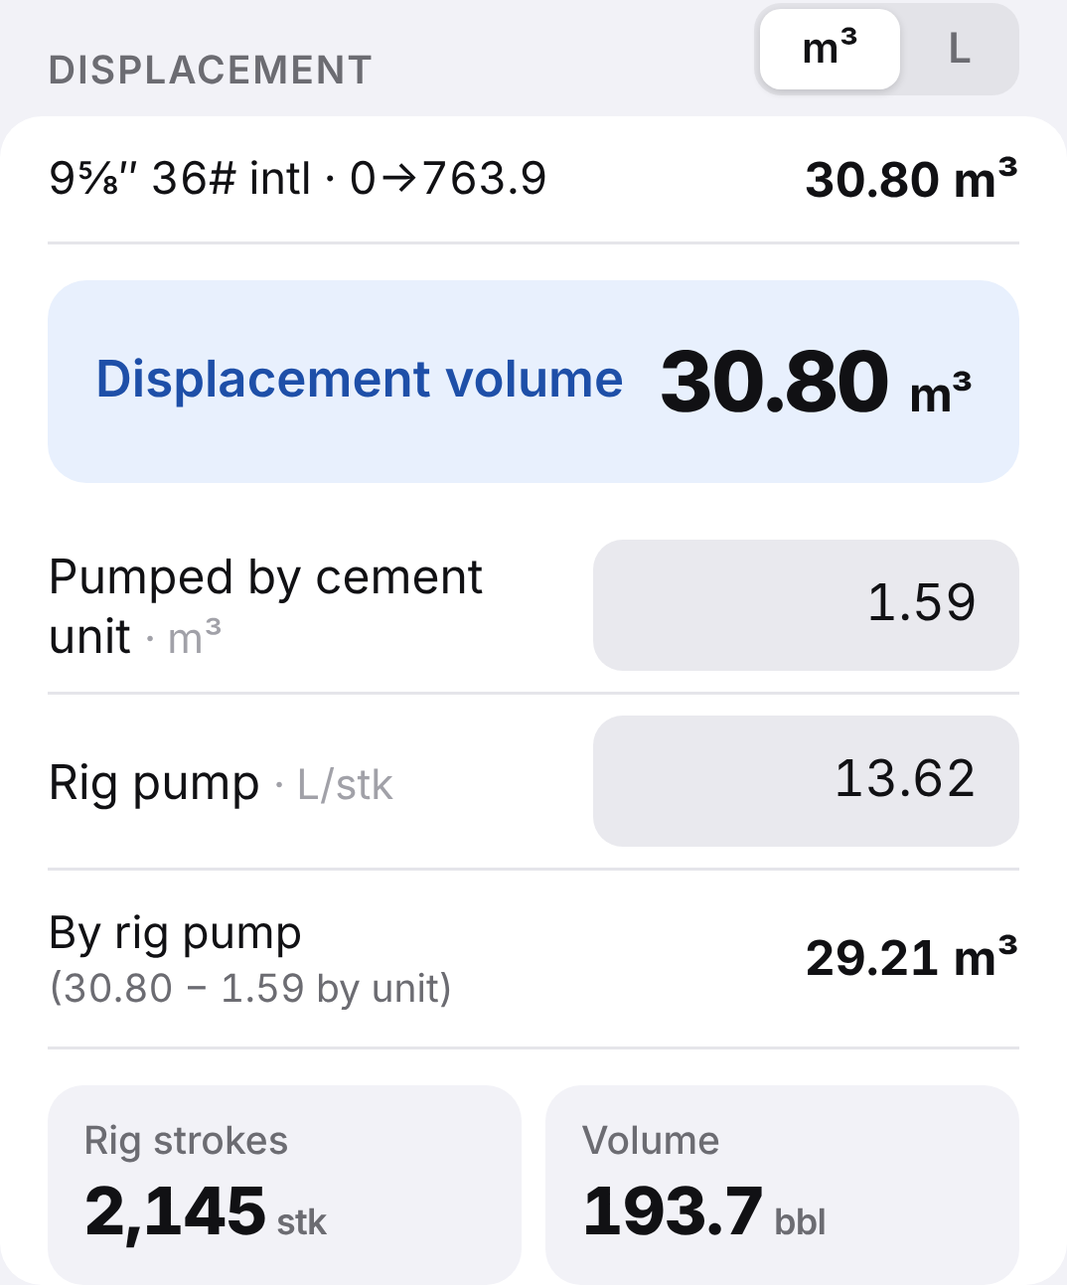
Displacement and rig pump strokes
4
STEP 4 · DISPLACEMENT
30.80 m³
Displacement to float collar
763.9 m × 40.32 L/m
29.21 m³
By rig pump
30.80 − 1.59 m³ by cement unit
2,145
Rig strokes
29,210 L ÷ 13.62 L/stk
Notes:
Displacement is to the float collar. The cement unit volume is taken off, and the rest gives the rig pump strokes the driller counts: 2,145.

Slide 11
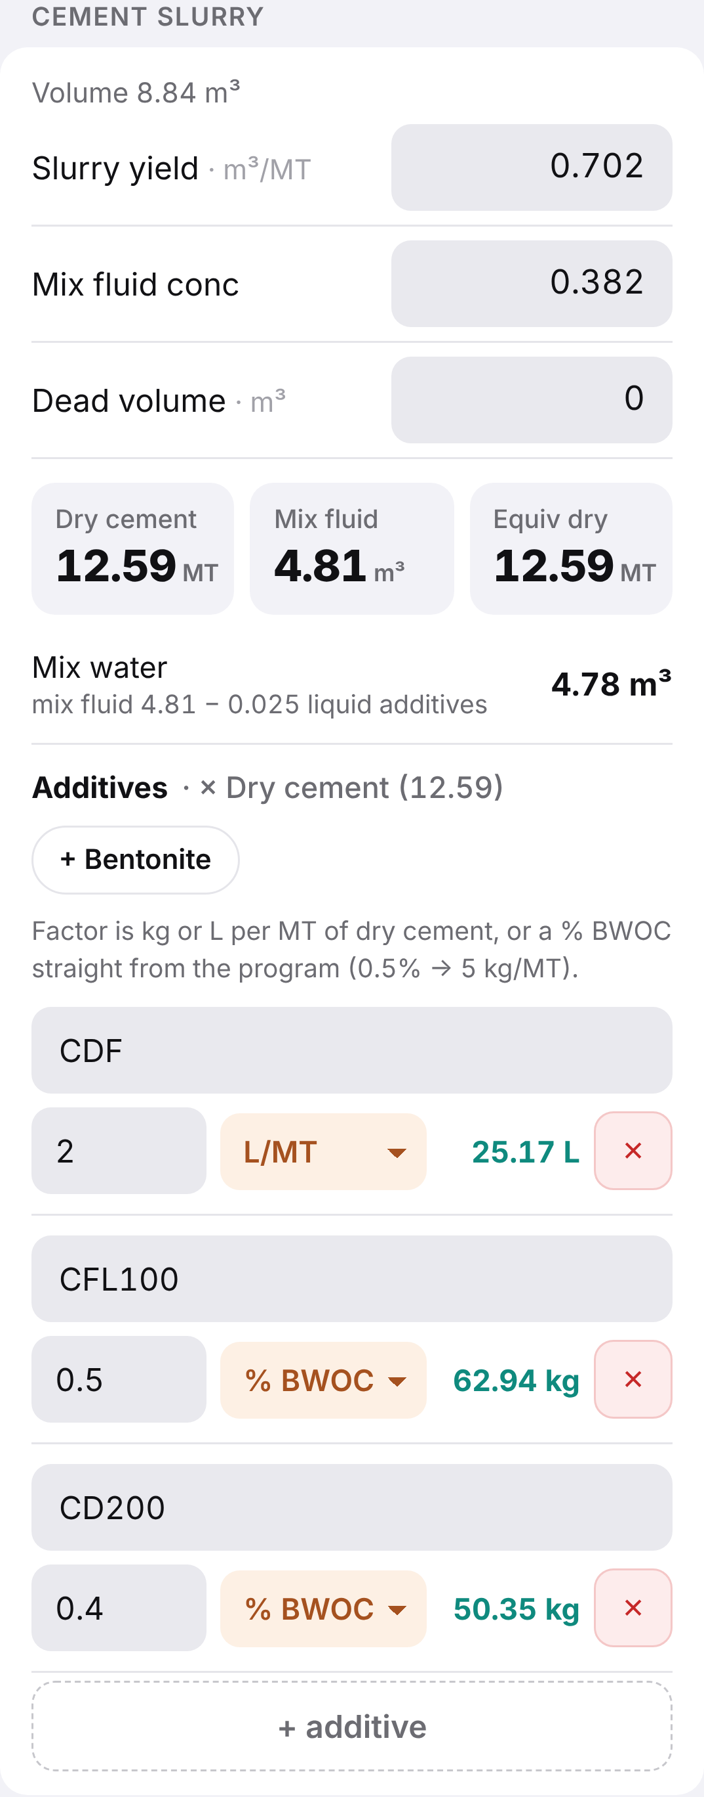
Slurry, mix water and additives
5
STEP 5 · SLURRY
Item | Working | Result
Dry cement | 8.84 m³ ÷ 0.702 | 12.59 MT
Mix fluid | 12.59 × 0.382 | 4.81 m³
Mix water | 4.81 − 0.025 liquid additives | 4.78 m³
CDF | 12.59 × 2 L/MT | 25.2 L
CFL100 | 0.5% BWOC | 62.9 kg
CD200 | 0.4% BWOC | 50.4 kg
Additive doses go in as written in the program — L/MT, kg/MT or % BWOC — and the tool converts them.
Notes:
Dry cement from the slurry volume and yield; mix fluid and plain mix water; additives entered straight from the program, including percent BWOC.

Slide 12
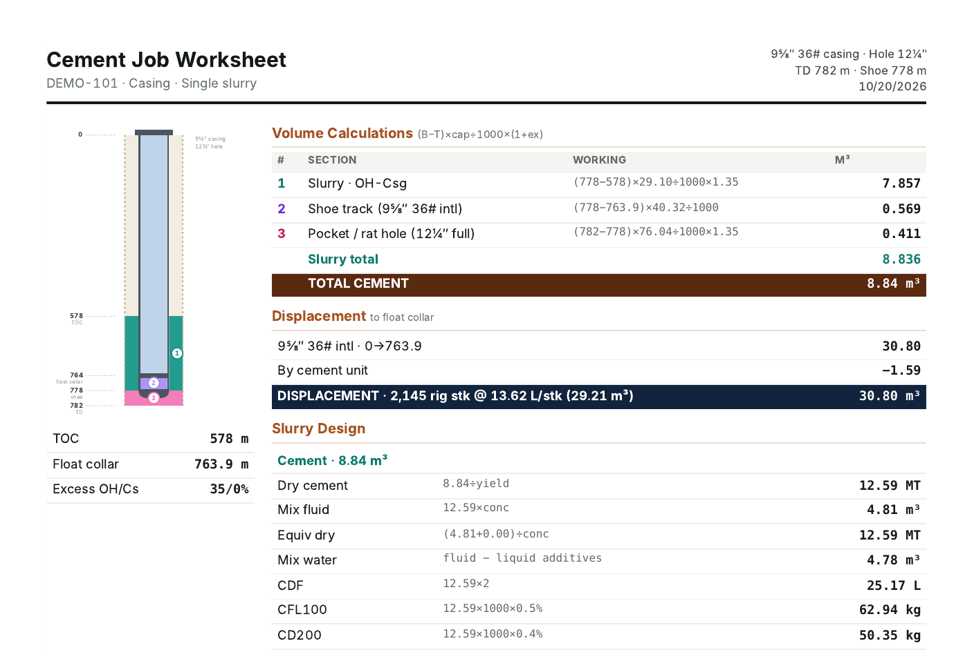
One tap: the PDF job sheet
6
STEP 6 · PDF
Schematic plus the working behind every number
Volumes, displacement with the cement unit, rig strokes, slurry and additives
Well code name, date and author on the page
Saved on the phone, printed or shared for review
Notes:
The final output: an A4 job sheet that the supervisor or the cementing contractor can check line by line.

Slide 13
Checked against the hand calculation
Item | Hand sheet | Tool
Annulus | 7.857 m³ | 7.86 m³
Shoe track | 0.534 m³ | 0.57 m³
Rat hole | 0.410 m³ | 0.41 m³
Total cement | 8.8 m³ | 8.84 m³
Dry cement | 12.53 MT | 12.59 MT
Mix fluid | 4.79 m³ | 4.81 m³
CDF / CFL100 / CD200 | 25 L / 63 / 50 kg | 25.2 L / 62.9 / 50.4 kg
Displacement | 30.255 m³ | 30.80 m³
Rig strokes | 2,120 | 2,145
Where the small gaps come from
Casing data: the hand sheet used 39.55 L/m (9⅝‑in 40#); the PDO sheet gives 40.32 L/m for 9⅝‑in 36#
Rounding on paper: shoe track 13.5 m vs 14.1 m, displacement to 765 m vs 763.9 m
Notes:
Same inputs, same method. The tool matches the hand sheet; the displacement difference is the casing capacity — the PDO sheet value for 36# — plus rounding on paper.

Slide 14
Benefits for the PE and the operation
Minutes
0
1 page
0 cost
for the full calculation, on the phone
manual rounding — exact depths and PDO data
PDF job sheet, every step shown
built in-house, no software purchase
Safety
Standardisation
Data privacy
Correct displacement and strokes lower the risk of over- or under-displacing the cement.
Same method and layout for every job and every PE; easy for the supervisor to check.
No server: all data stays on the user's phone, and wells are saved under code names.
Notes:
Speed, accuracy, a clear job sheet, zero cost — plus safety, a standard method and data privacy.

Slide 15
Next steps and support needed
1
2
3
4
Pilot
Feedback
Host internally
Roll out
Run the tool side by side with the current method on the next cement job
Collect comments from PEs, supervisors and the cementing contractor
Move the tool to an approved PDO internal location with IT support
Share with all wellsite PEs as a standard calculation aid
Support requested: approval for a pilot on the next cement job, and IT support to host the tool internally.
Notes:
The ask: approve a pilot on the next cement job and IT support to host the tool internally.

Slide 16

Thank you
Questions — and a live demo on the phone
Created by Mohammed Al Araimi · MU67673
Notes:
Close and offer a live demo: create a new well and enter the numbers in front of them.

