Slide 1

An introduction to
POWERUp 2025

Slide 2



About Michael Dawson
Node.js lead for Red Hat and IBM
Active Node.js community member
Node.js Collaborator, Node.js Technical Steering Committee,
Active in a number of Working group(s)
Active OpenJS Foundation member
Voting Cross Project Council Member
Community Director 2020-2022
Twitter: @mhdawson1
GitHub: @mhdawson
Linkedin: https://www.linkedin.com/in/michael-dawson-6051282

Slide 3
Agenda
What is Node.js
Why Node.js?
Node.js components
Key Node.js fundamentals
Node.js Reference Architecture
Platform Support
Where to get Node.js

Slide 4
What is it?
JavaScript != Java
Node.js = Server-side JavaScript
Event-Oriented
Non-blocking
Asynchronous

Slide 5
History - over 15 years of growth/maturity
The early years
2009 – written by Ryan Dhal
2010 - npm, Joyent sponsors Node.js
2011 – windows support added
2012 – 2014 – Hand over to Isaac Schlueter, then Timothy J. Fontaine
2014 – io.js fork
2015 – Node.js Foundation created, Node.js 4.x unites io.js/node.js 0.12.x lines
2015 -2025
2 Majors every year
LTS every october
2019 - Node.js Foundation merged into OpenJS foundation

Slide 6


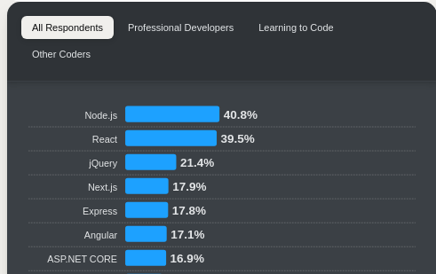
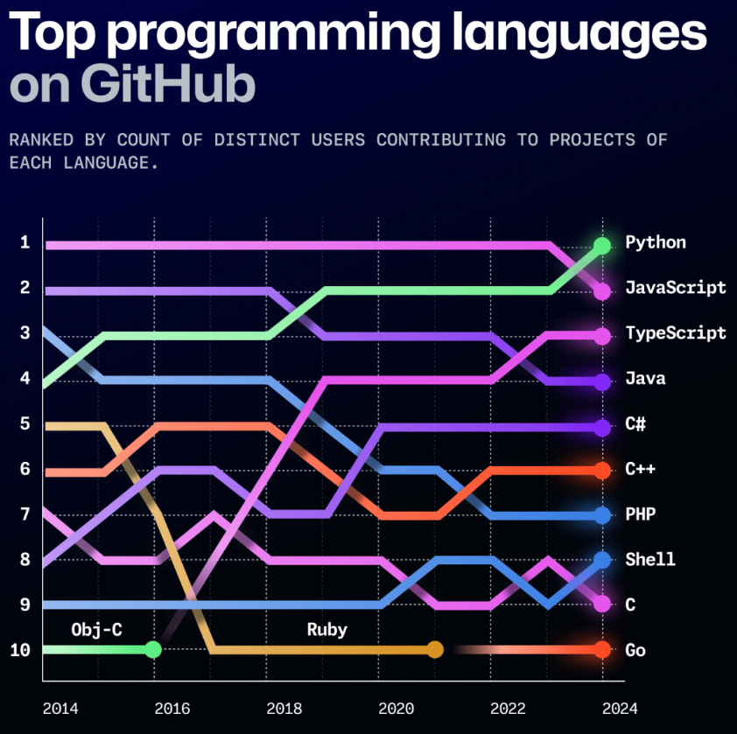
Widely Used
* Even after docker activities pushing people to cache
Massive usage in last year
Over 1B downloads from
Almost 800M docker pulls*
Tops recent surveys
.org
2 - JavaScript
3 - typeScript
Notes that combined still higher than Python
https://survey.stackoverflow.co/2024/technology/
https://github.blog/news-insights/octoverse/octoverse-2024/

Slide 7
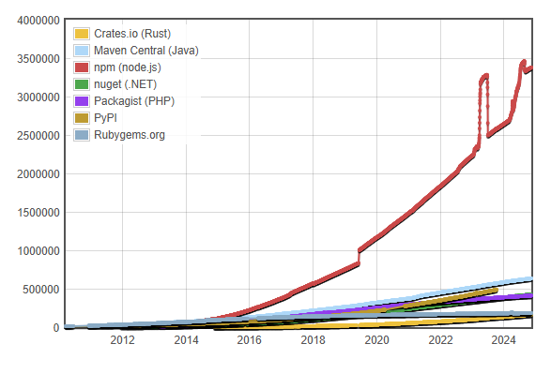
Broad Ecosystem
http://www.modulecounts.com/

Slide 8
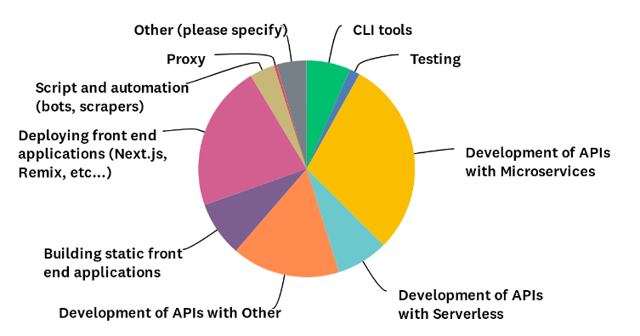
What is it used for?
53% back end services
22% deploying front end apps
21% building, and scripting
Use Cases
https://github.com/nodejs/next-10/blob/main/surveys/2024-04

Slide 9
Why? - Productivity and Performance
Productivity
Performance
‘Took ½ the time with less people, 33% fewer lines of code, 40% fewer files’ - PayPal
‘We're used to working in JavaScript all day long. Having Node just makes it feel like a very natural extension of our work environment’ - Netflix
‘Double the number of request per second, response time 35% lower’ - PayPal
‘Reduced page load time by 50%’ - Groupon

Slide 10


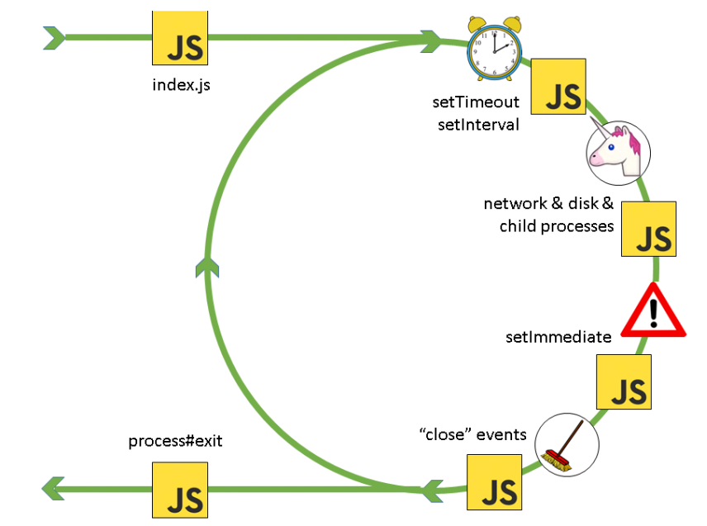
Building blocks
Node.js
Node Libraries
Node Binding Layer
Other:
ICU
Cares
Zlib
http_parser
…
libuv
Asynchronous I/O library
OpenSSL
Crypto
library
JavaScript Engine
OS

Slide 11
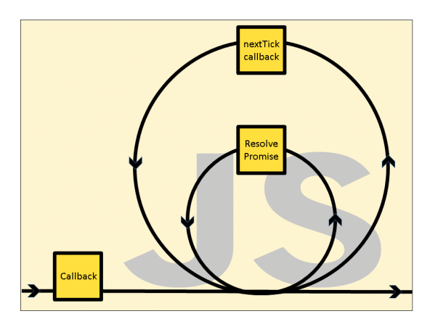
The event loop

Slide 12
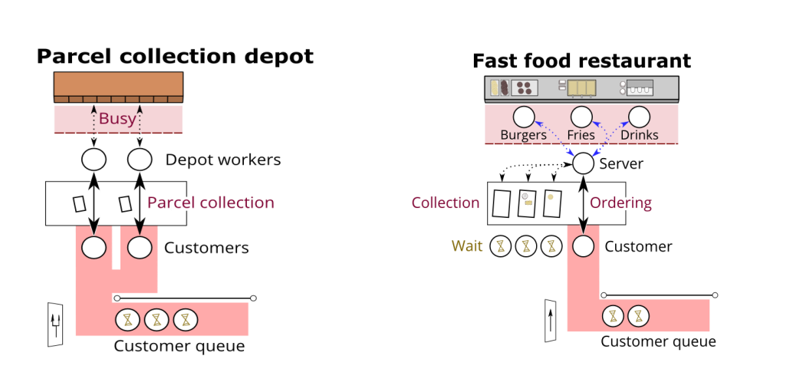
Unlocking parallelism

Slide 13
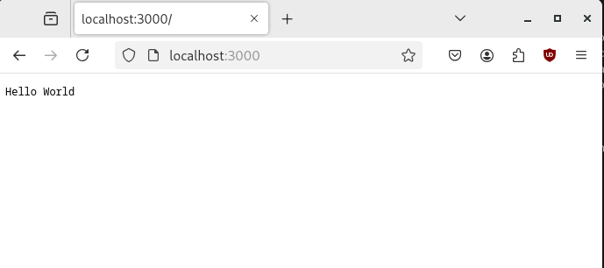
Unlocking productivity
const http = require('http');
const server = http.createServer(function(request, response) {
response.end('Hello World');
});
server.listen(3000);

Slide 14
Callbacks
const http = require('http');
const server = http.createServer(function(request, response) {
response.end('Hello World');
});
server.listen(3000);

Slide 15
Callback Hell
const http = require('http');
const fs = require('fs');
const server = http.createServer((request, response) => {
fs.stat('newfile.txt', (err, stats) => {
fs.writeFile('newfile.txt', 'the file content', (err) => {
response.end('Hello World' + ' : ' + err);
});
});
});
server.listen(3000);

Slide 16
Promises
const thePromise = new Promise((resolve, reject) => {
setTimeout(() => {
resolve('done');
}, 100);
});
thePromise.then((data) => {
console.log('Fulfilled:' + data);
}, (err) => {
console.log('Error:' + err);
});

Slide 17
Await
const thePromise = new Promise((resolve, reject) => {
setTimeout(() => {
resolve('done');
}, 100);
});
async function doit() {
try {
const data = await thePromise;
console.log('Fulfilled:' + data);
} catch (err) {
console.log('Error:' + err);
}
}
doit();

Slide 18
Async/Await
async function waitAndSucceed() {
return new Promise((resolve, reject) => {
setTimeout(() => {
resolve('done');
}, 100);
});
};
async function doit() {
try {
const data = await waitAndSucceed();
console.log('Fulfilled:' + data);
} catch (err) {
console.log('Error:' + err);
};
};
doit();

Slide 19
CJS/ESM
const express = require('express')
const app = express()
const port = 3000
app.get('/', (req, res) => {
res.send('Hello World!')
})
app.listen(port, () => {
console.log(`Example app listening on port ${port}`)
})

Slide 20
CJS/ESM
import express from 'express';
const app = express()
const port = 3000
app.get('/', (req, res) => {
res.send('Hello World - ESM!')
})
app.listen(port, () => {
console.log(`Example app listening on port ${port}`)
})

Slide 21
CJS/ESM Interoperability
hello.js
const greeter = require('./greeter.js').default;
const greeting = greeter('World');
console.log(greeting);
CJS
greeter.js
import util from 'node:util';
export default function (greeting) {
return 'Hello ' + greeting;
};
ESM

Slide 22
It just works!
>node hello.js
Hello World
Backported to 22.x in 22.12.0
The Fine Print:
Depends on two features that are still experimental but stability is “release candidate”, and no experimental warnings.
Options to turn of in case of issues
--no-experimental-require-module
-> ESM must be synchronous
--no-experimental-detect-module
-> depends on syntax detection - https://nodejs.org/api/packages.html#syntax-detection
-> may load file twice
-> recommended to use "type": "module" in package.json where possible

Slide 23
Package Management
midawson@midawson-virtualbox:~/presentations$ node express.mjs
node:internal/modules/esm/resolve:844
throw new ERR_MODULE_NOT_FOUND(packageName, fileURLToPath(base), null);
^
Error [ERR_MODULE_NOT_FOUND]: Cannot find package 'express' imported from /home/midawson/presentations/express.mjs
at packageResolve (node:internal/modules/esm/resolve:844:9)
at moduleResolve (node:internal/modules/esm/resolve:901:20)
at defaultResolve (node:internal/modules/esm/resolve:1121:11)
at ModuleLoader.defaultResolve (node:internal/modules/esm/loader:396:12)
at ModuleLoader.resolve (node:internal/modules/esm/loader:365:25)
at ModuleLoader.getModuleJob (node:internal/modules/esm/loader:240:38)
at ModuleWrap.<anonymous> (node:internal/modules/esm/module_job:85:39)
at link (node:internal/modules/esm/module_job:84:36) {
code: 'ERR_MODULE_NOT_FOUND'
}
Node.js v20.10.0

Slide 24
Package Management
midawson@midawson-virtualbox:~/presentations$ npm install express
added 66 packages, and audited 67 packages in 1s
14 packages are looking for funding
run `npm fund` for details
found 0 vulnerabilities
midawson@midawson-virtualbox:~/presentations$ cat package.json
{
"dependencies": {
"express": "^5.1.0"
}
}

Slide 25
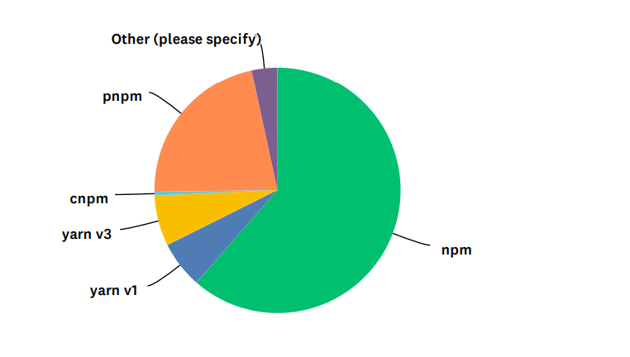
Package Management
*npm bundled with Node.js

Slide 26
Worker Threads
Useful for doing CPU intensive work
Don’t block the even loop
Can take advantage of multiple CPUs
Not much help with I/O intensive work
Can share memory
transferring ArrayBuffer
SharedArrayBuffer

Slide 27
Worker Threads
const { Worker, isMainThread, parentPort } =
require('node:worker_threads');
if (isMainThread) {
const worker = new Worker(__filename);
worker.once('message', (message) => {
console.log(message);
});
worker.postMessage('Hello, world!');
} else {
// When a message from the parent thread is received, send it back:
parentPort.once('message', (message) => {
parentPort.postMessage(message + ' From worker');
});
}
Derived from https://nodejs.org/api/worker_threads.html#workerparentport

Slide 28
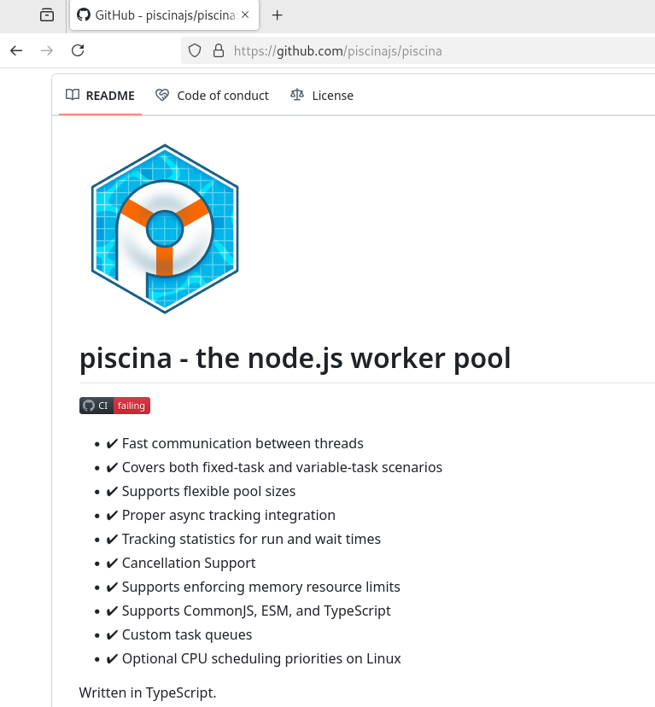
Worker Threads
Now you are managing
Thread Pools
Concurrency
piscina

Slide 29
What are native addons
What
JavaScript functions, objects, etc. that are not actually written in JavaScript !
Why
Re-use: Lots of existing code written in other languages
sharp, bcrypt, sqlite3, etc.
Speed: Some things run faster in other languages
Access: Some resources are not available from JavaScript natively
serialport

Slide 30
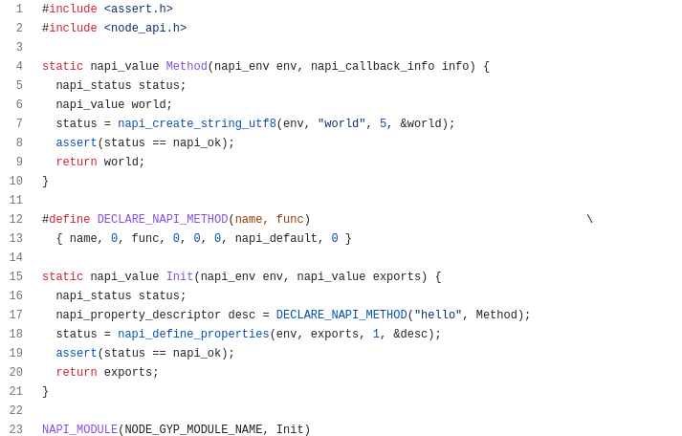

Building C/C++ addons - node-api

Slide 31
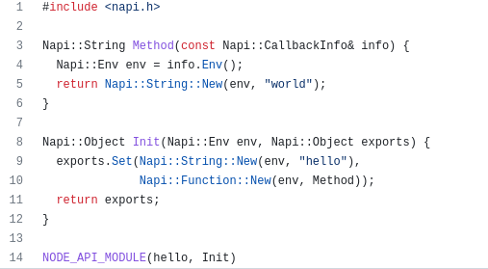
Building C/C++ addons - node-addon-api

Slide 32
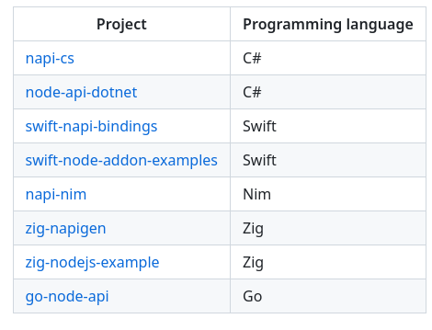
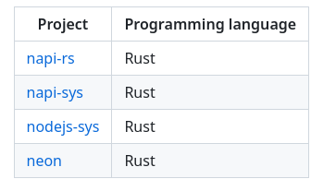
Cross language support
Node-API bindings for other languages
Early stage
+

Slide 33
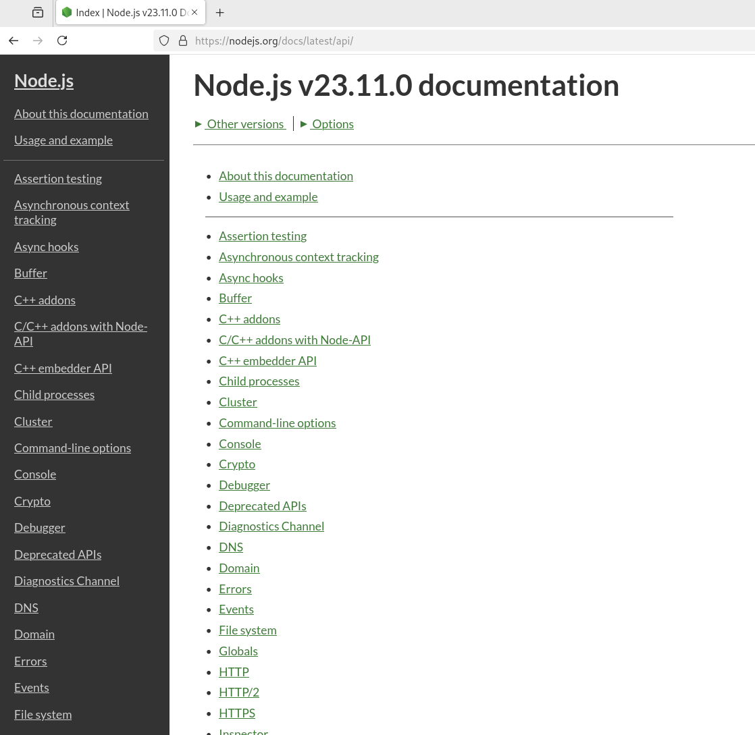
Other core concepts
nodejs.org/docs/latest/api

Slide 34
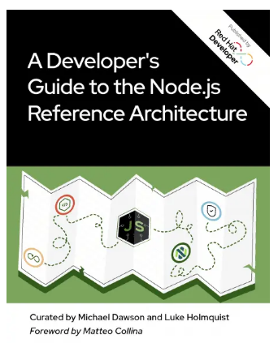
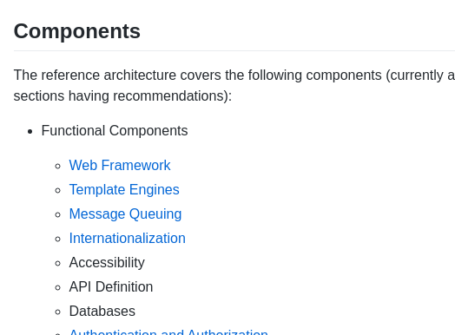
Building Enterprise Applications - Ref Arch
A Developer's Guide to the Node.js Reference Architecture
https://github.com/nodeshift/nodejs-reference-architecture

Slide 35
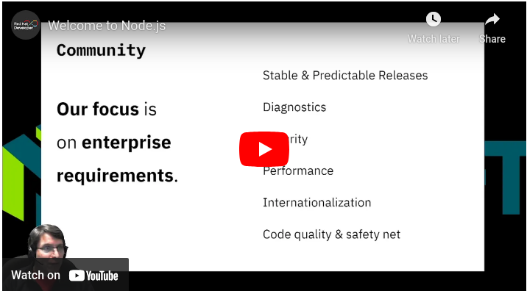
Upstream Contribution - Enterprise Focus
Stable and Predictable releases
Platform support
Security
Diagnostics
Performance
Code quality and safety net
Key Features
https://youtu.be/Y0H4ki4bWN0

Slide 36
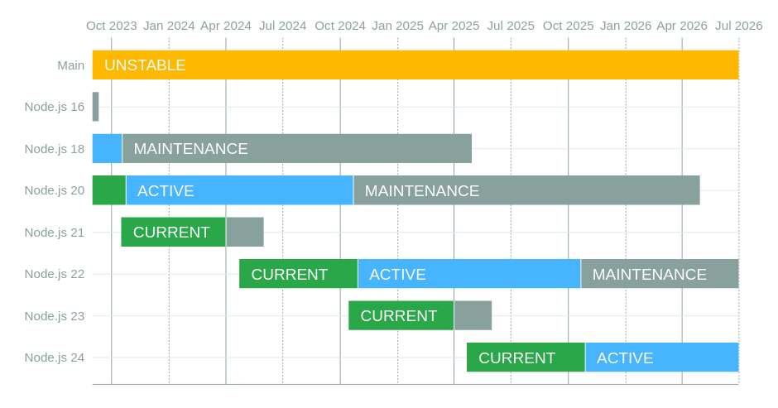
Releases Schedule
Last Major Community Release
24.x in April 2025 (Current)
Ongoing LTS Releases
Node.js 18.x - ends April 2025
Node.js 20.x - ends April 2026
Node.js 22.x - ends April 2027
Node.js 24.x - ends April 2028

Slide 37



Broad Platform Support
x64

Slide 38
IBM i installation
IBM i
yum install nodejs${version}
For example yum install nodejs22

Slide 39
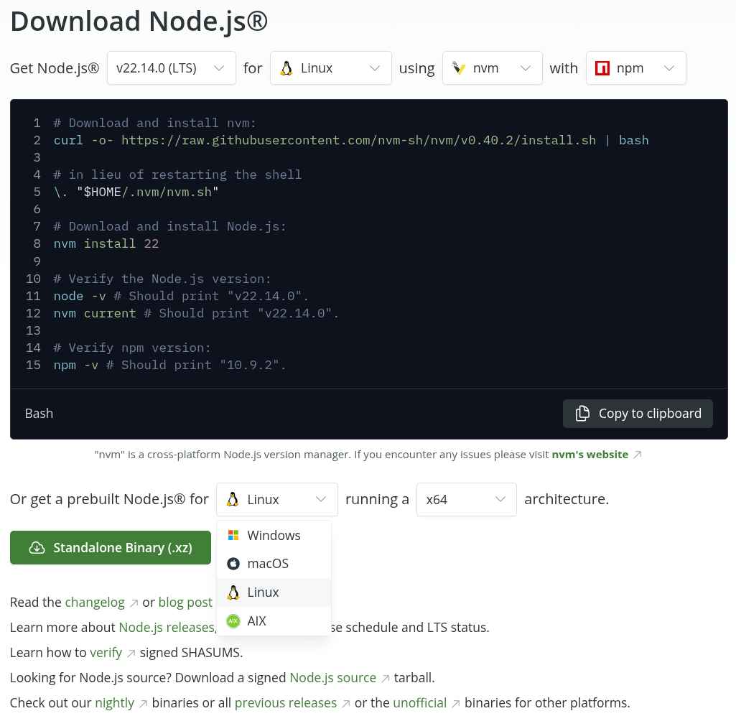
Other Operating Systems
nodejs.org/en/download

Slide 40
IBM i Integrations
Database:
Mapepire - https://mapepire-ibmi.github.io/guides/usage/nodejs/
Node ODBC - https://www.npmjs.com/package/odbc
Node.js idb-connector - https://www.npmjs.com/package/idb-connector
Running CL Commands, Service Programs / Programs:
itoolkit - https://www.npmjs.com/package/itoolkit

Slide 41
Thank You
Thank You
Questions?

Slide 42
Copyright and Trademarks
© Red Hat, IBM. All Rights Reserved
Red Hat, the Red Hat logos are trademarks or registered trademarks of Red Hat
IBM, the IBM logo, ibm.com are trademarks or registered trademarks of International Business Machines Corp.,
registered in many jurisdictions worldwide.
A current list of IBM trademarks is available on the Web at “Copyright and trademark information” at
www.ibm.com/legal/copytrade.shtml
Node.js is an official trademark of Joyent. IBM SDK for Node.js is not formally related to or endorsed by the official Joyent Node.js open source or commercial project.
Java, JavaScript and all Java-based trademarks and logos are trademarks or registered trademarks of Oracle and/or its affiliates.
npm is a trademark of npm, Inc.
Other trademarks or logos are owned by their respective owners.

