Slide 1

AgriSense: AI for Proactive Crop Disease Detection
Leveraging Machine Learning to Secure Small-Scale Harvests

Slide 2
Executive Summary
AgriSense is an AI-driven mobile application that provides instant, highly accurate diagnosis of crop diseases from leaf images. It empowers small-scale farmers with timely intervention strategies, significantly reducing crop loss and ensuring food security.

Slide 3


The Problem: A Widening Gap
The Global Threat
The "Why"
Crop diseases are a major cause of yield loss (up to 40% globally), especially for smallholder farmers who are the backbone of the world's food supply.
These farmers often lack access to experts, timely lab testing, or rapid diagnostics. This leads to economic hardship, food insecurity, and inefficient resource use.

Slide 4


Our Guiding Principles
Our Mission
Our Vision
To democratize access to advanced agricultural diagnostics using accessible AI technology.
A world where no farmer loses their harvest due to preventable or undiagnosed plant diseases.

Slide 5
Objectives & Key Goals
95%+
Objective & Justification
Objective: To develop a Convolutional Neural Network (CNN) model integrated into a simple mobile app for real-time, accurate disease identification.
Target accuracy for disease classification
Justification: This project aligns with a career in Applied Machine Learning and Computer Vision, while directly addressing the UN's Sustainable Development Goal 2: Zero Hunger.

Slide 6
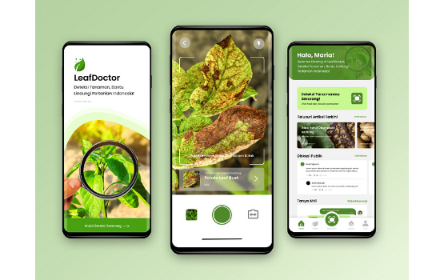
The Solution: AgriSense
The AgriSense mobile app allows a farmer to simply take a picture of a diseased leaf.
The image is sent to our AI model, which returns the disease name, confidence score, and a recommended action plan—all in under 5 seconds.

Slide 7






Technology & Framework
AI & Machine Learning
Backend & API
Frontend App
Deployed on Google Cloud Platform (GCP) with a Flask API for handling image processing requests.
Cross-platform mobile app built with Flutter for a simple, accessible user experience.
Python, TensorFlow, and Keras using a Convolutional Neural Network (CNN) model (ResNet-50).

Slide 8
Our Value Proposition
Speed: Instant diagnosis in seconds vs. days waiting for lab results.
Cost-Effective: Free or low-cost access vs. expensive expert consultations.
Accuracy: >95% confidence rates via deep learning, exceeding human-expert guesswork.
Accessibility: Designed to be simple, multilingual, and work on basic smartphones.

Slide 9
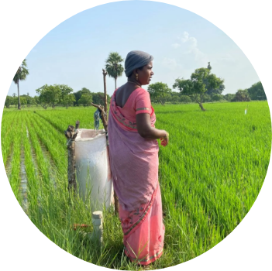
Target Audience & Market
Primary Audience
Small-to-medium scale farmers in developing regions with high smartphone adoption but limited access to agricultural experts.
Secondary Audience
Agricultural extension workers, home gardeners, and agricultural researchers.

Slide 10






Societal Impact
Food Security
Economic Growth
Environmental
Boosts local food production and farmer self-sufficiency by reducing yield loss.
Directly increases farmer income and profitability by protecting harvests.
Promotes targeted use of pesticides, reducing chemical runoff and promoting sustainability.

Slide 11
Business Development Roadmap
Q3-Q4: Growth
Year 3: Expansion
Expand disease database, integrate regional weather data, and begin localization.
Explore pest detection and automated satellite imagery analysis.
Q1-Q2: MVP Launch
Year 2: Scaling
Focus on 3 major crops, local testing, and model validation.
Partner with NGOs and governmental agricultural agencies for wide deployment.

