Slide 1
Study the Effects of Renewable Resources on Electric Grid Frequency Mohamed Abuella ECGR8090 POWER QUALTY Fall 2014 University of North Carolina at Charlotte

Slide 2
Frequency Deviation Impacts
Frequency Deviating Mitigations
Frequency Deviation Causes
Presentation Outline

Slide 3
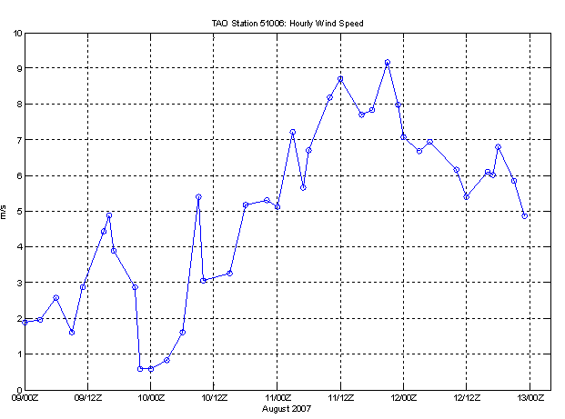


Frequency deviation causes
P_{G}=P_{D} + P_{loss}
Renewables Generations
(Wind and Solar) are Too Variable
ΔP ➔ Δf

Slide 4
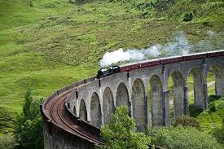

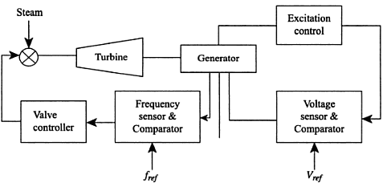
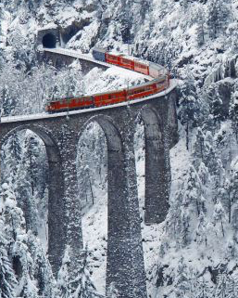
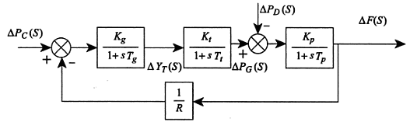
Frequency deviation causes
P_{G}=P_{D} + P_{loss}
Prime Mover Governor
Automatic Generation Control
(AGC)
ΔP ➔ Δf
Area Control Error (ACE) ➔ Minimize {ΔP, Δf}

Slide 5
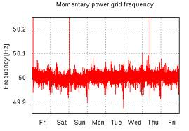
Frequency deviation causes
Frequency setting
Frequency nadir
ΔP/ ΔF
Frequency bias
In small systems 2-3MW/ 0.1Hz
In Large systems 500-600MW/ 0.1HZ
Frequency stability is the ability of the system frequency to stay stable within the safe limits and retunes to its stability after the disturbance is removed.
IEEE1547 Standard for Interconnecting Distributed Resources with Electric Power Systems.
NERC Standard BAL-003, Frequency Response and Frequency Bias.

Slide 6
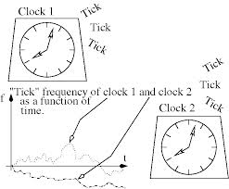

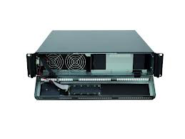

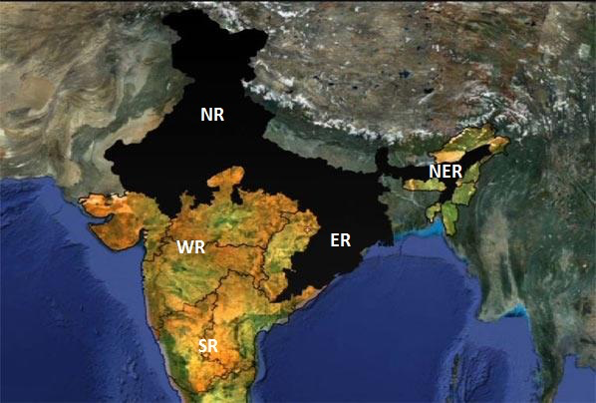
Frequency deviation impacts
On customer side:
Sensitive electronic devices.
On the grid:
Shed the loads or the generations ➔ Reliability and security of the system.
30-July-2012 and 31-July-2012

Slide 7
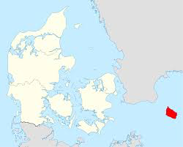
Frequency deviation impacts
CASE STUDIES:
Frequency Stability Study for Bornholm Island (2007)
Bornholm is a Danish island
Bornholm ➔Minimum load 13MW peak load 63MW.
AC submarine cable to Sweden 60MW
Fossil-fueled units 35MW
Standby units 25MW
Wind 30MW
Biogas 2MW
Voltage levels 60kV, 10kV and 0.4kV

Slide 8
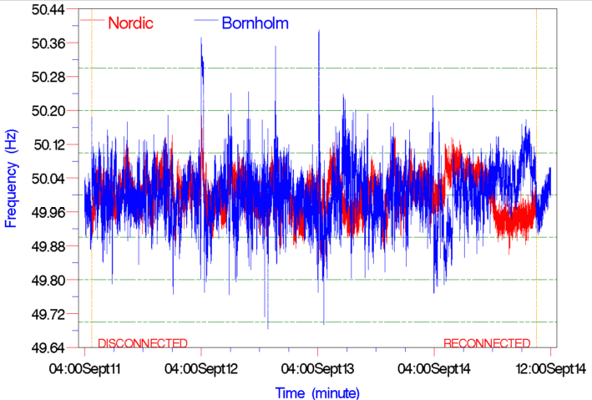
Frequency deviation impacts
CASE STUDIES:
Study conducted on frequency stability impacts:
In 2007 DTU researchers carried out the study.
From 11 to 14 September 2007
-AC cable disconnected ➔ island operation mode
The recorded data was taken every 20ms by PMUs.
Comparison between the frequency deviations of Nordic grid and Bornholm islanding operation mode with only 6MW wind power (out of 30MW)!
Conclusion ➔ Islanding mode was suffering from several fluctuations in frequency.
With 6MW out of 30 MW of wind power ➔ serious problem of frequency deviation This level of deviation is not allowed in Nordic Grid (2007)
Note: According Nordic Grid regulations the frequency deviation < 0.1Hz around 50Hz

Slide 9
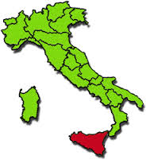
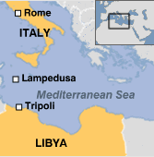
Frequency deviation impacts
CASE STUDIES:
Frequency Stability Study for Sicily Island (2012)
Sicily is an Italian island in Mediterranean sea.
Sicily’ monthly load ranges (2.3GW - 3.7GW)
AC submarine cable to Italy 1GW
Fossil-fueled units 5.8GW
Wind 1.68GW
Hydropower plant 730MW
PV Solar 864MW
Biomass 54MW

Slide 10
Frequency deviation impacts
CASE STUDIES:
Study conducted on frequency deviation after a real incident:
Note: Before 31 May 2012 the over/under frequency trips set to 50.3 and 49.7 Hz for PVs.
The incident:
In 18 May 2011, ➔ system is operating as an islanding mode, AC link was under maintenance.
150 MW generating unit at S. Filippo del Mela power plant➔shed down.
frequency decline ➔49.7Hz ➔PVs of 200MW is also tripped
frequency decline ➔49Hz. (UFLS) ➔ 180MW (Frequency restored)

Slide 11
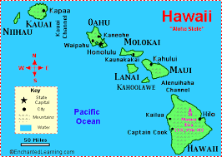
Frequency deviation impacts
CASE STUDIES:
Frequency Stability Study for Hawaii (2010)
Hawaiian Electric Company (HECO) is the main electric utility since 1908 in Hawaii. Subsidiaries Hawaii Electric Light (HELCO) and Maui Electric (MECO).
HELCO ➔Minimum load 90MW peak load 191MW.
Fossil-fueled units fleet including steam, combined-cycle gas, and diesel turbines 200MW
Geothermal plants 38MW
Wind 31MW
Hydropower 17MW
PV distributed generation >38MW + 0.5 MW CSP plant

Slide 12
Frequency deviation mitigations
The following are the facilities that deal with the roots of frequency deviation to mitigate it.
Generation and Load Shedding
Sacrifice the some to Save the all (it’s a trade off).
It should be the last choice to maintain the frequency stability.
Because: loss of generations or load ➔ the security and the reliability of the system
B. Keeping Some Inertia
In Denmark, decentralized combined heat plants (DCHP) are located beside the load centers and they are adding inertia to the system.
Hawaii Electric Light HELCO keeps at least two of its three steam units online for all load levels.
Moreover, fast-start gas generators ➔ frequency regulation

Slide 13
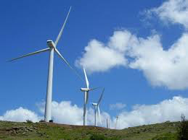
Frequency deviation mitigations
C. Modifying AGC’s Control Scheme
In case of including variable generations ➔ increase deadband of AGC (Region of no-control) to smooth the frequency response.
Using the droop response of the turbine governor ➔ small frequency variations, AGC ➔ more affective frequency deviations.
These procedures could bring some risk of not response quickly for severe faults.
In 2006 and 2007, two wind installed in Hawaii island.
AGC modified ➔ To overcome the over-control issue in AGC resulting
from wind fluctuations. AGC’s deadband (no-control region) set to ±0.2
At excess energy ➔ wind power curtailment is done➔ less frequency changes

Slide 14
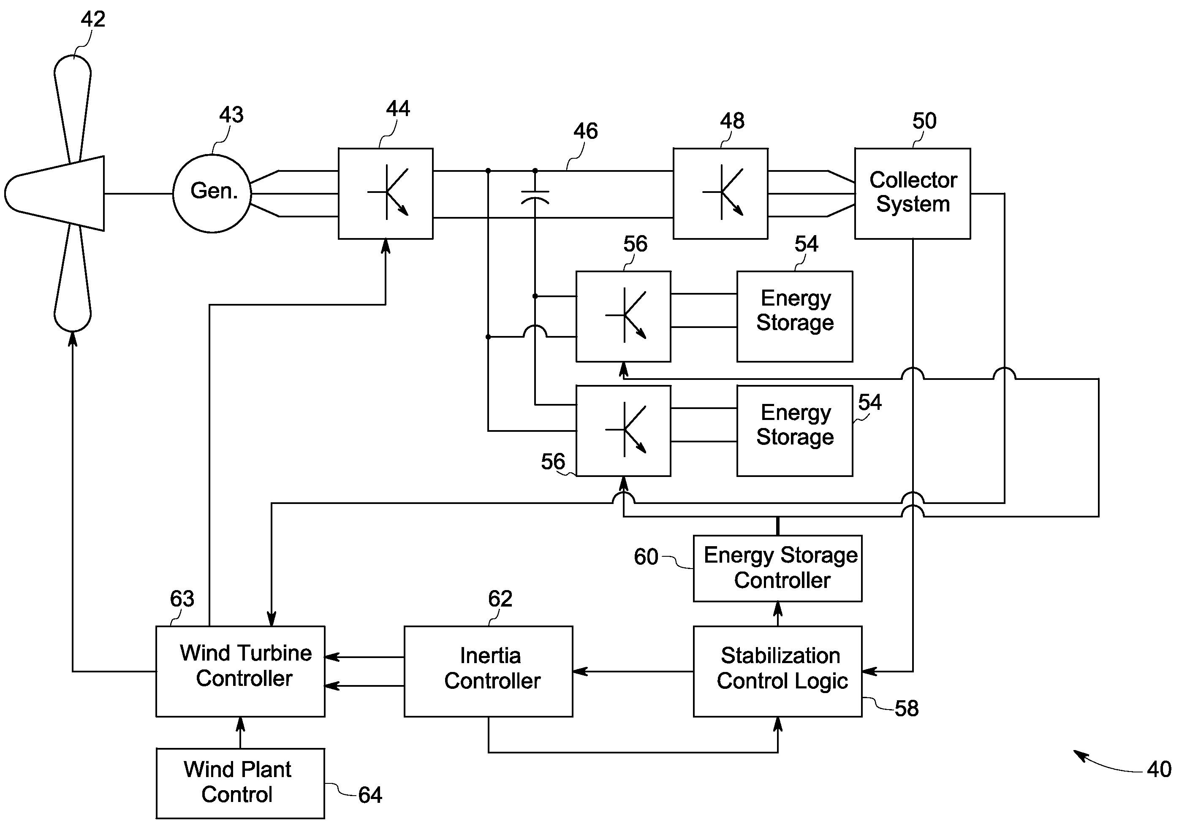
Frequency deviation mitigations
D. Control of Inertial Response in Wind Turbines
Wind turbines a virtual inertia from the rotor shaft.➔ specific control techniques
GE WindINERTIA controller provides +provides +5% improving in frequency nadir.

Slide 15
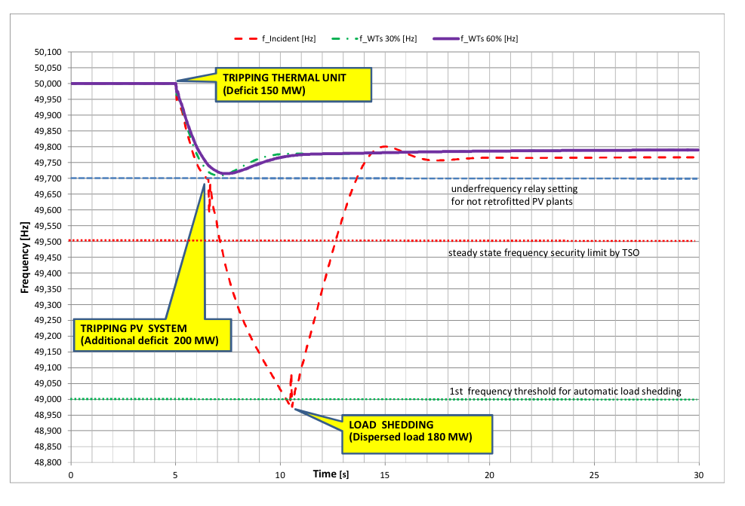
Frequency deviation mitigations
D. Control of Inertial Response in Wind Turbines.
What If ? Scenario
If 30% and 60 % of wind turbines have inertial response in Sicily Island

Slide 16
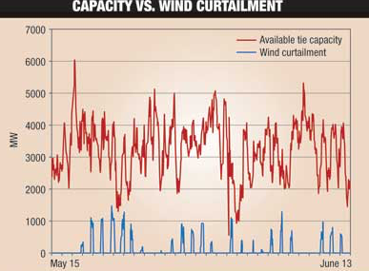
Frequency deviation mitigations
E. Governor-like Response of Wind Turbines (Wind Power Curtailment)
If the power form wind turbines is harnessed less than the available ➔ wind turbines can be controlled as a governor in thermal unit.
This control scheme of curtailed wind power is effective in frequency response and can arresting the frequency deviation.
This governor-like control can be carried out for large-scale solar plants as well.
But has economic impacts since the power is lost and not recoverable (not like thermal units)

Slide 17
Frequency deviation mitigations
F. Retrofitting the PV Solar Systems
Retrofitting / modifying PV solar systems by just including upgraded the software settings used with inverters and simple new hardware adjustments.
This lead to smooth and flexible disconnect of PV solar systems from the grid.
In 2008 HELCO study➔ Revised IEEE1547.
Under frequency load shed (ULFS) 59 ➔58.8Hz.
Trip setting of PVs 59.3 Hz ➔ as close as possible to ULFS (59Hz).

Slide 18
Frequency deviation mitigations
F. Retrofitting the PV Solar Systems
What If ? Scenario
If 30% , 50, and 100 % of PV retrofitting in Sicily Island

Slide 19
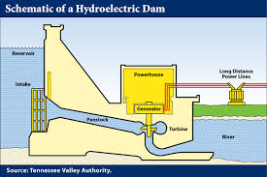
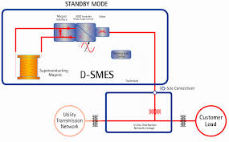
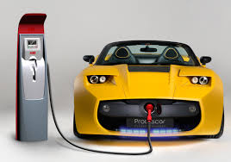
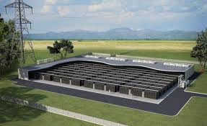
Frequency deviation mitigations
G. Energy Storage
Storage systems can provide more flexibility to the system operation and helps for support the frequency stability by decreasing the imbalance.
Pumping station storage;
Electric vehicles;
Nickel-cadmium and Lithium-ion batteries;
Fuel cells;
Air-compressed reservoirs;
Flywheels;
Superconducting magnetic energy.

Slide 20
Frequency deviation mitigations
G. Energy Storage
Battery Energy Storage System (BESS)
What If ? Scenario
If Pumping station and BESS are used in Sicily Island

Slide 21
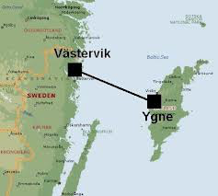

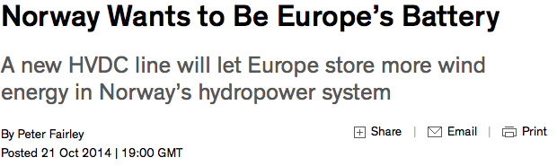
Frequency deviation mitigations
H. Demand Response and Energy Efficiency Measures
Significant agricultural loads ➔ Water pumping load tripping
Air conditions, water heaters.
Energy efficiency➔ the incandescent light ➔compact fluorescent lights (CFL)
Using variable speed drives
HVDC Links
No frequency or synchronization issues involved.
Even with AC links➔ with larger systems absorb frequency deviations efficiently.
Gotland Island
HVDC link 1954

Slide 22
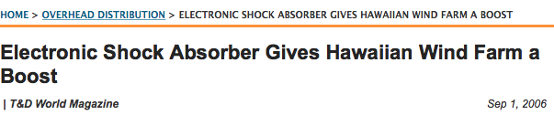
Frequency deviation mitigations
J. Power System Stabilizer (PSS)
Reduce the oscillation in poorly damped inter-area.
And with fast response of governor-like wind turbines oscillation.
K. Electronic Shock Absorber (ESA)
ESA is a device invented by Hawaiian electric company to smooth frequency from short-term
wind power variations. Its mechanism is as a shock absorber
Storing the excess energy during the period of surplus generation of wind power and release it
in the period of deficit wind power generation.

Slide 23

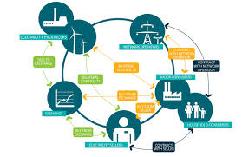
Frequency deviation mitigations
L. Variable Generation Forecasting
Helps of keeping the power balance of the system and mitigate the problem
of frequency stability.
M. Electricity Market Structure
Restructure the market for the frequency response.
Bids and offers between the participants at regulation marketing periods.
Incentives for energy storage and demand response schemes.
Such strategies can be allowing more flexibility in balancing the power and hence improving the frequency stability.

Slide 24
Conclusions
The frequency deviation is taking more attention since many electrical systems work at its frequency boundary.
In the small isolated systems such as island systems the frequency stability becomes more a considerable issue.
Especially, when the renewable resources are taking a large share of the generation in these systems.
The mitigation facilities sometimes are not affordable or have an economic impacts
There is a need for updating the policy to accommodate the modern structure of electrical systems.
Advancement in frequency stability studies should take place and continue to develop affordable solutions to improve the frequency stability.

Slide 25
References
[1] Y. Chen, Zhao Xu, and J. Østergaard, “Frequency analysis for planned islanding operation in the Danish
distribution system-Bornholm,” Univ. Power Eng. …, pp. 9–13, 2008.
[2] A. J. Conejo, J. M. Morales, J. A. Martínez, and A. Motivation, “Tools for the Analysis and Design of Distributed
Resources — Part III : Market Studies,” vol. 26, no. 3, pp. 1663–1670, 2011.
[3] E. Reliability and P. I. Plan, “Lessons Learned : Planning and Operating Power Systems with Large Amounts of
Renewable Energy-Based Power Generation,” no. August, 2012.
[4] Z. Hussain, Z. Chen, and P. Thøgersen, “Challenges of Danish Power System and their possible solutions,” proc.
IEEE Conf. POWERCON, 2012.
[5] “HELCO Facts.” [Online]. Available: http://www.hawaiielectriclight.com/helco/About-Us/Company-Facts.
[6] L. C. Dangelmaier, “System frequency performance of the Hawaii Electric Light System,” 2011 IEEE Power Energy
Soc. Gen. Meet., pp. 1–8, Jul.2011.
[7] E. Ciapessoni and D. Cirio, “Renewable power integration in Sicily: Frequency stability issues and possible
countermeasures,” in IREP Symposium-Bulk Power System Dynamics and Control, 2013.
[8] N. W. Miller, “California ISO Frequency Response Study,” no. November, 2011.
[9] ECOFYS, “Impact of Large-scale Distributed Generation on Network Stability,” 2011.
[10] B. P. Fairley, “Norway Wants to Be Europe ’ s Battery A new HVDC line will let Europe store more wind energy in
Norway ’ s hydropower system,” pp. 4–5, 2014.
[11] IEC, “Grid integration of large-capacity Renewable Energy sources and use of large-capacity Electrical Energy
Storage,” 2012.
[12] M. Matsuura, “Island Breezes,” IEEE Power Energy Mag., no. December, pp. 59–64, 2009.
[13] J. Horne, D. Flynn, and T. Littler, “Frequency stability issues for islanded power systems,” IEEE PES Power Syst.
Conf. Expo. 2004., pp. 188–195.
[14] “Hawaiian Electric exec receives patent on device to stabilize wind energy,” 2004. [Online]. Available:
http:// www.elp.com/articles/2004/07/hawaiian-electric-exec-receives-patent-on-device-to-stabilize-wind-
energy-on-small-or-remote-grids.html.

Slide 26
Thank you for listening
Any Question ?

