Slide 1
STUDY OF USING PARTICLE SWARM FOR OPTIMAL POWER FLOW IN IEEE
BENCHMARK SYSTEMS INCLUDING WIND POWER GENERATORS
by
Mohamed A. Abuella
A Thesis
Submitted in Partial Fulfillment of the Requirements for the
Master of Science Degree
Department of Electrical and Computer Engineering
Southern Illinois University Carbondale
2012

Slide 2
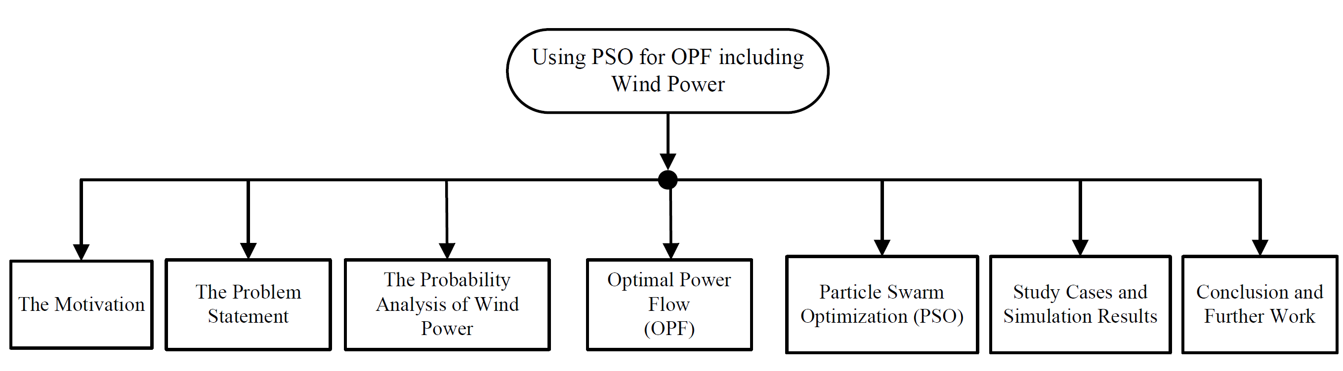
THE OUTLINE

Slide 3
The main aim of the thesis is to obtain the optimal economic dispatch of real power in systems that include wind power.
Model considers intermittency nature of wind power.
Solve OPF by PSO.
IEEE 30-bus test system.
6-bus system with wind-powered generators.

Slide 4
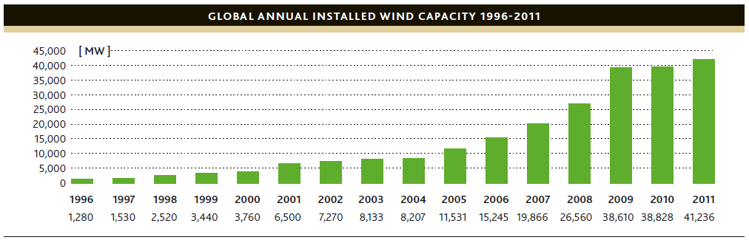
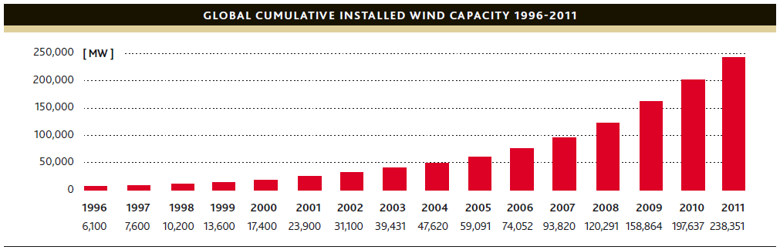
MOTIVATION:
The Growing Importance of Wind Energy:

Slide 5


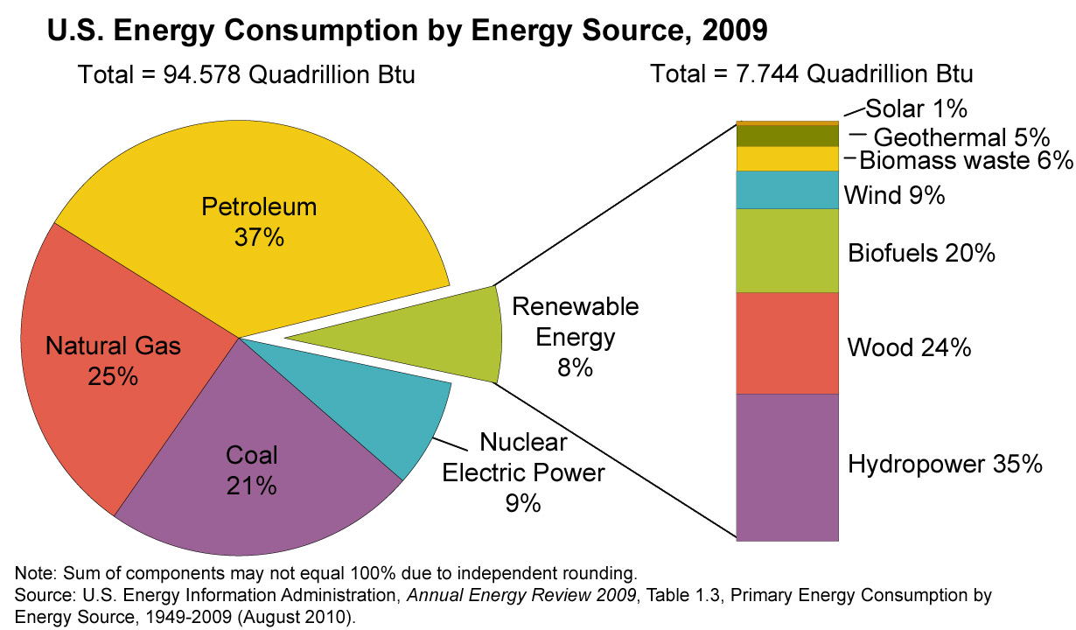
MOTIVATION:
The Cost of Wind Energy:
Abundance of wind power everywhere;
Fluctuations of oil prices;
One of the most competitive renewable resources.

Slide 6
MOTIVATION:
The Optimal Economic Dispatch of Wind Power:
It’s a challenging topic to search about.
Spring 2011
ECE488
Power Systems Engineering
ECE580
Wind Energy Power
Systems

Slide 7


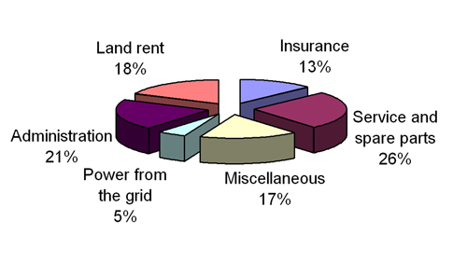
STATEMENT OF THE PROBLEM
The objective function of the optimization problem in the thesis is to minimize the operating cost of the real power generation.
Conventional-thermal generators
Wind-powered generators

Slide 8
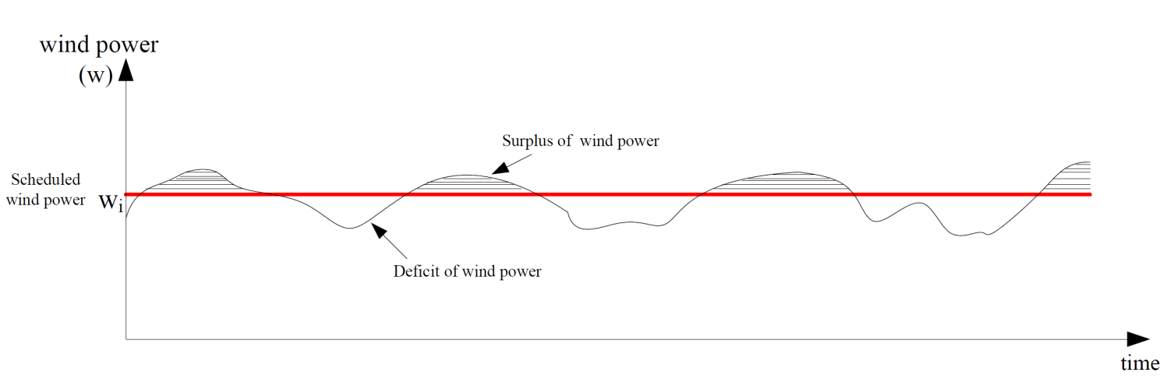
STATEMENT OF THE PROBLEM
Since Weibull probability distribution function (pdf) of wind power.
In similar fashion,

Slide 9
STATEMENT OF THE PROBLEM
The model of OPF for systems including thermal and wind-powered generators:
Where:
Particle Swarm Optimization (PSO) algorithm is used for solving this optimization problem.

Slide 10
PROBABILITY ANALYSIS OF WIND POWER:
The wind speeds in particular place take a form of Weibull distribution over time,
as following:
Weibull probability density functions (pdf) of wind speed for three values of scale factor c

Slide 11
PROBABILITY ANALYSIS OF WIND POWER:
The cumulative distribution function (cdf) of Weibulll distribution is:
Weibull pdf and cdf of wind speed for c=5 m/s

Slide 12
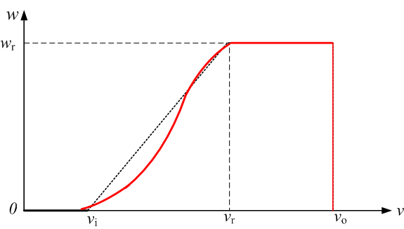
PROBABILITY ANALYSIS OF WIND POWER:
The captured wind power ➔
The captured wind power can be assumed to be linear in its curved portion:
The captured wind power

Slide 13
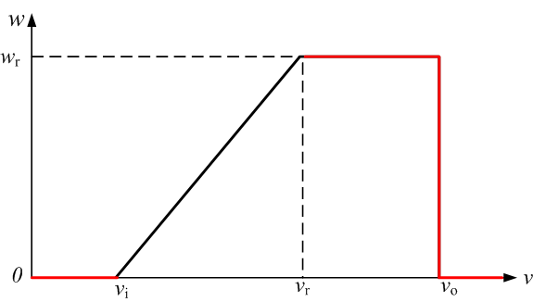
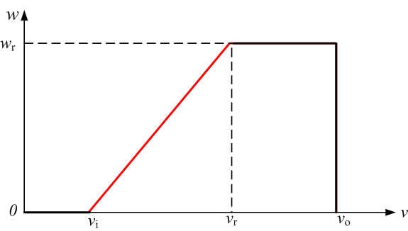
PROBABILITY ANALYSIS OF WIND POWER:
The linear transformation (in terms of probability) from wind speed to wind power is done as following:
While for the continuous portion:

Slide 14
PROBABILITY ANALYSIS OF WIND POWER:
Probability vs. Wind power for C=10, 15 and 20
The probability density function pdf of wind power
The cumulative distribution function (cdf) of wind power

Slide 15
PROBABILITY ANALYSIS OF WIND POWER:
Then, plug the transformed wind power equations in the model:

Slide 16
OPTIMAL POWER FLOW (OPF)
The optimal power flow (OPF) is a mathematical optimization problem set up to minimize
an objective function subject to equality and inequality constraints.
Where:
While:

Slide 17
OPTIMAL POWER FLOW (OPF)
On the other hand, for inequality constraints
Where: Generator Constraints:
Whereas: Transformer Constraints:
While: Shunt VAR Constraints:
Finally: Security Constraints:

Slide 18
OPTIMAL POWER FLOW (OPF)
By using penalty function principle, all constraints are included in the objective function
Where: are penalty factors.

Slide 19


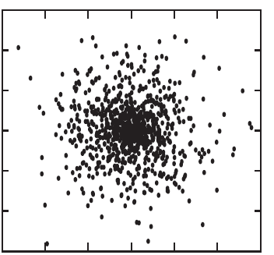
PARTICLE SWARM OPTIMIZATION (PSO)
PSO suggested by Kennedy and Eberhart (1997).

Slide 20
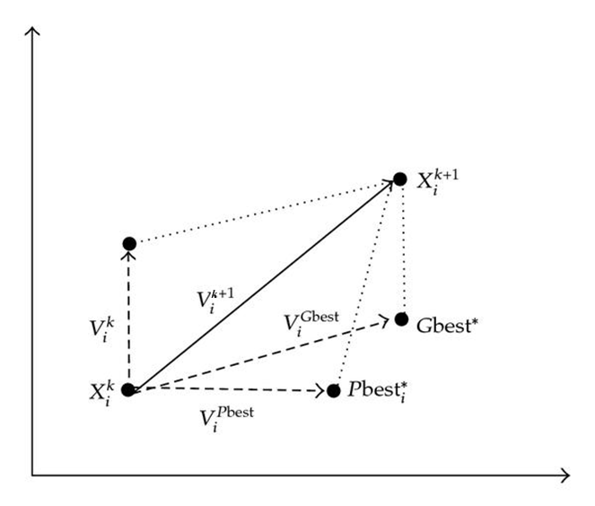
PARTICLE SWARM OPTIMIZATION (PSO)
PSO Searching Mechanism:
Where:

Slide 21
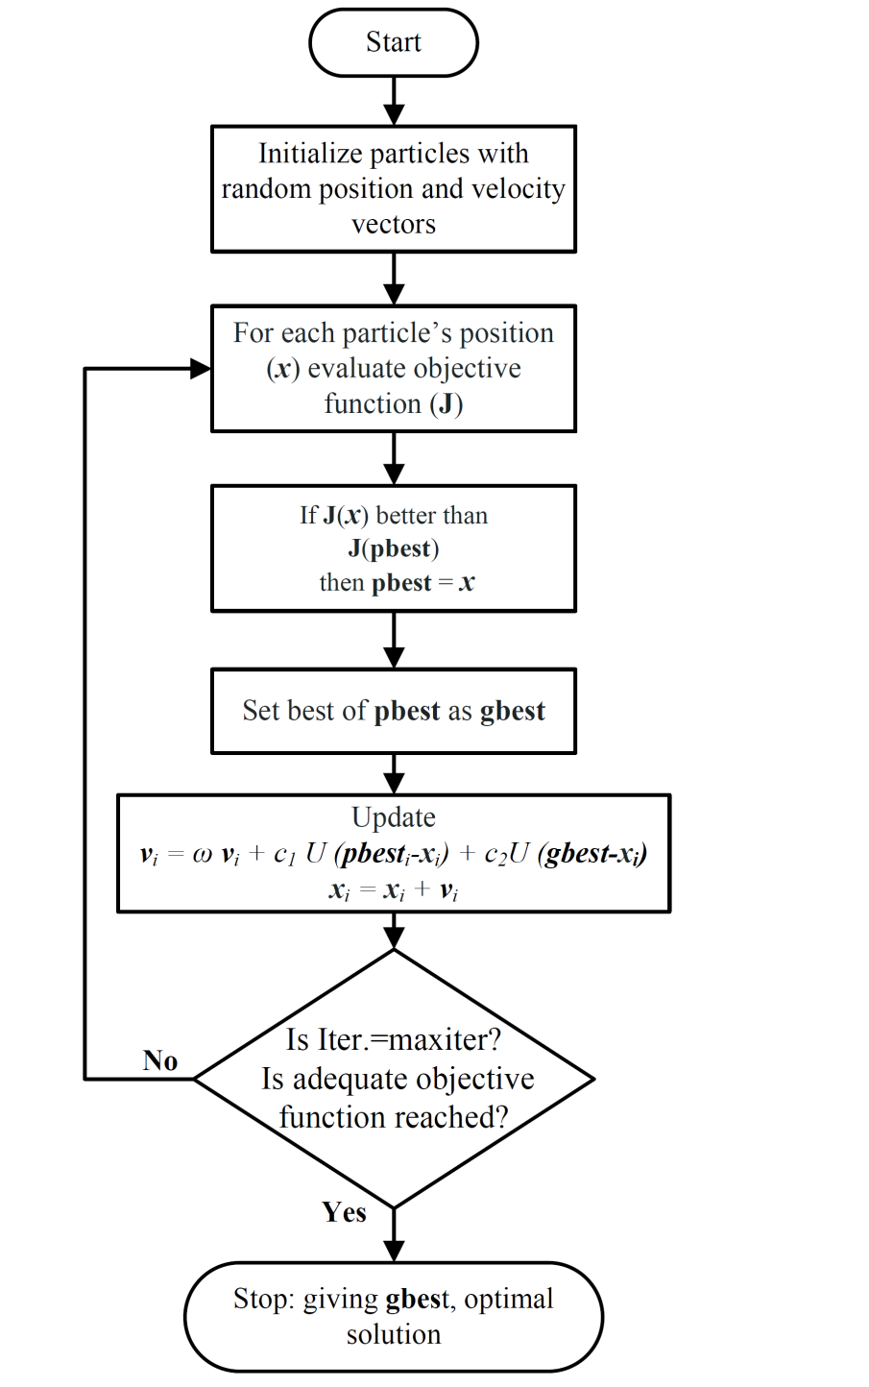
PARTICLE SWARM OPTIMIZATION (PSO)
PSO Algorithm Flowchart

Slide 22
PARTICLE SWARM OPTIMIZATION (PSO)
Implementation of PSO for Solving OPF:
Where:
Since:

Slide 23
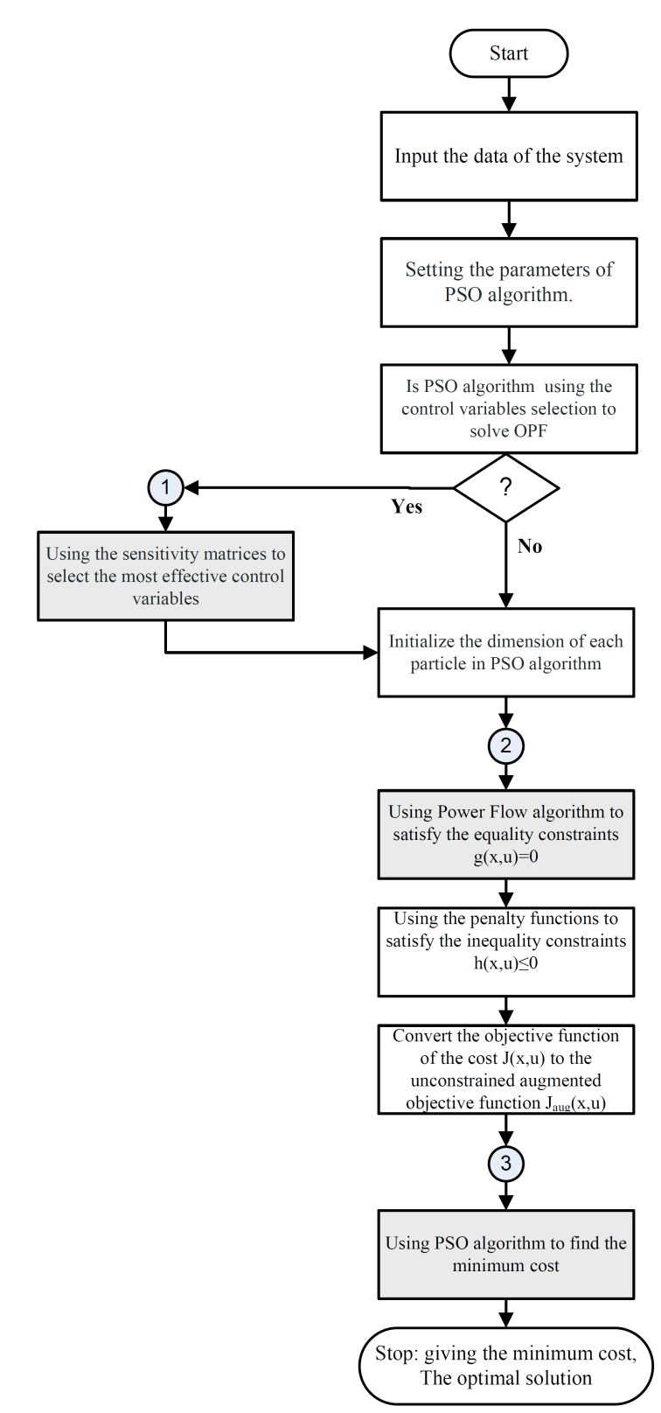
STUDY CASES AND SIMULATION RESULTS
OPF Main Flowchart

Slide 24
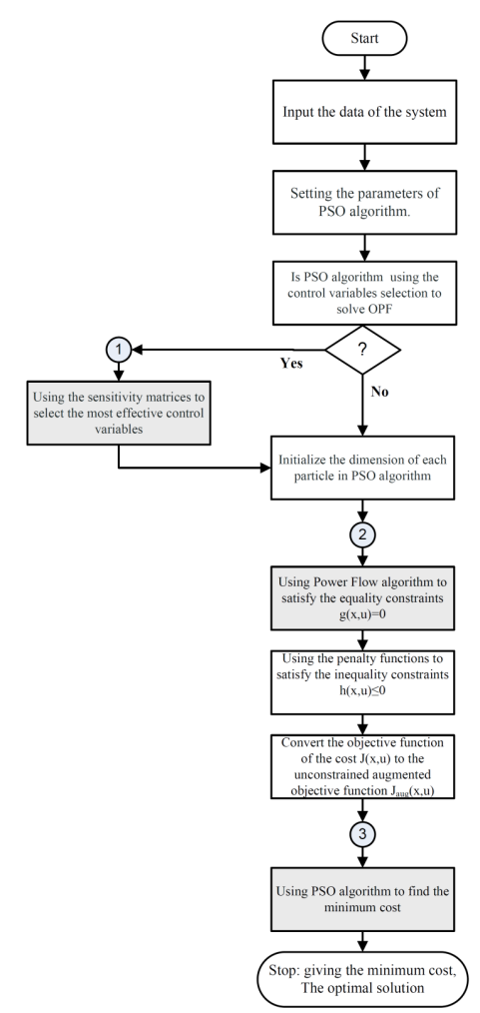
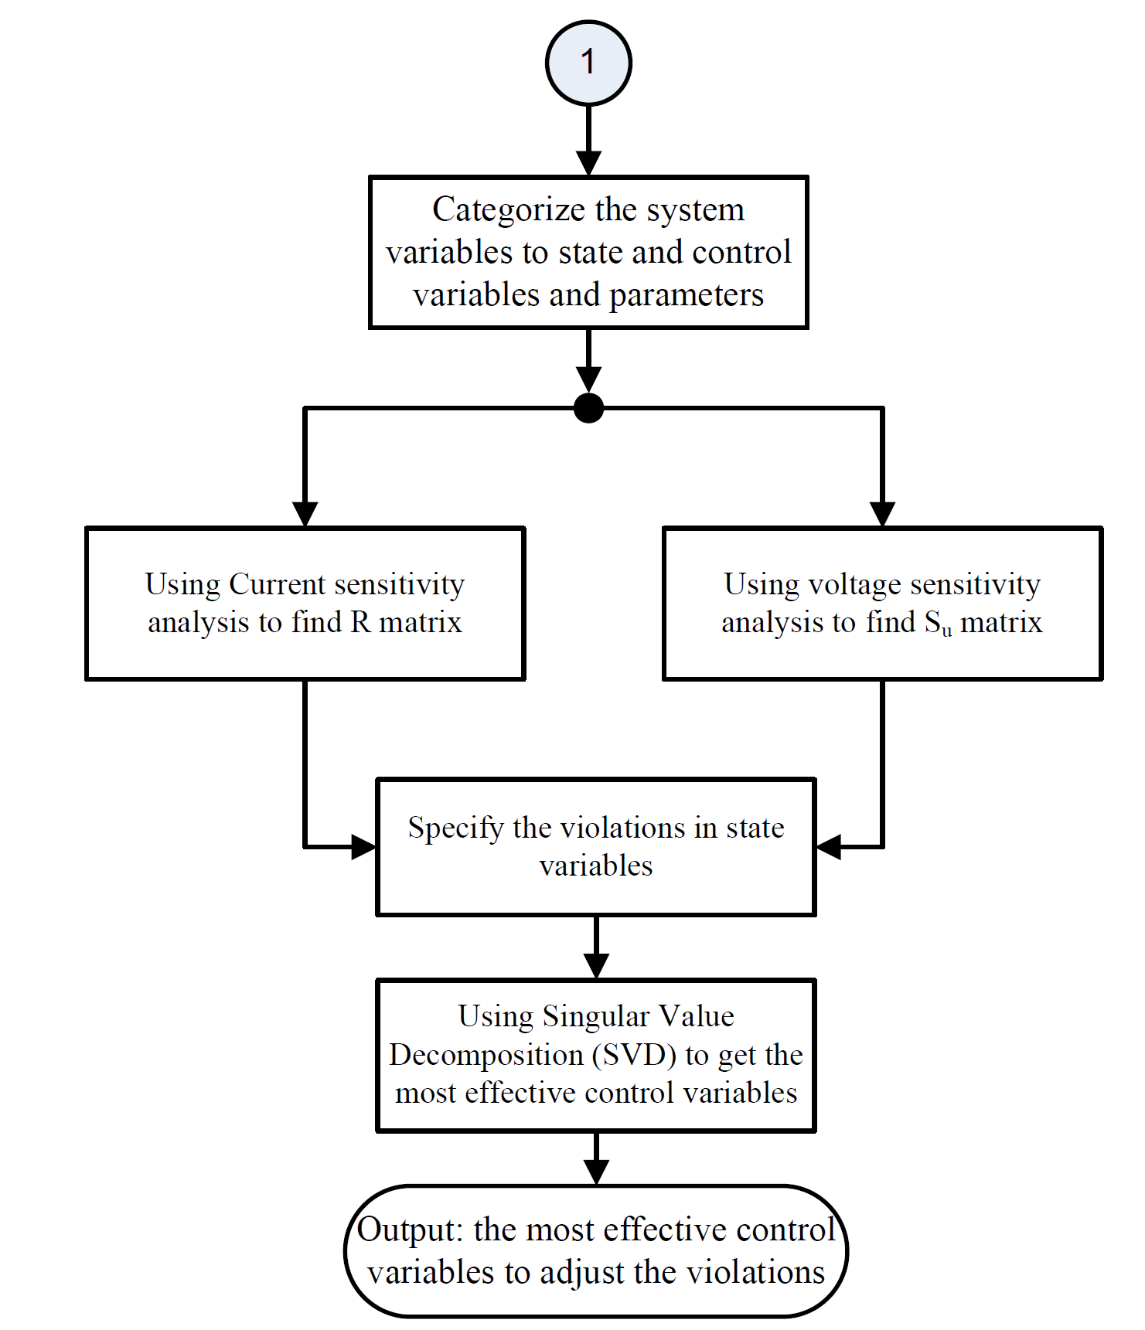
STUDY CASES AND SIMULATION RESULTS
Using Sensitivity Matrices to Select the Most Control Variables:

Slide 25
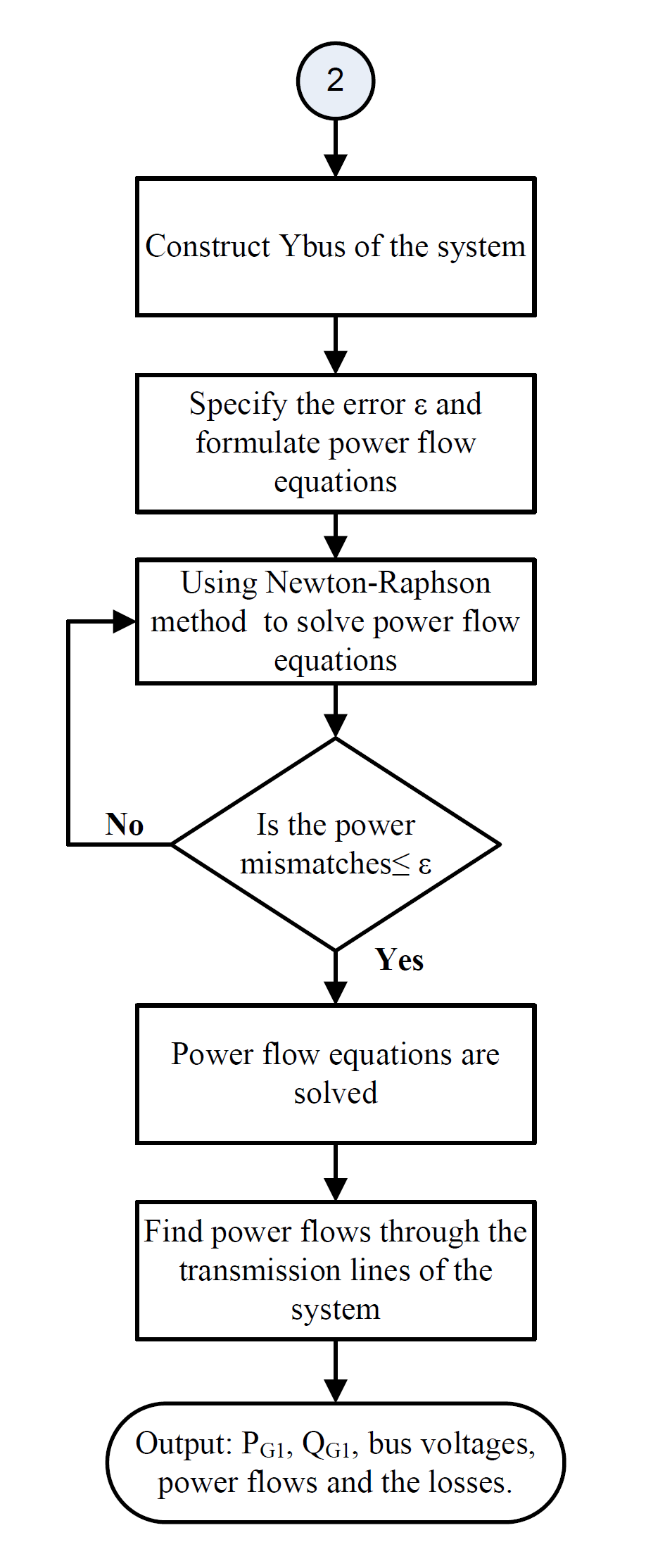
STUDY CASES AND SIMULATION RESULTS
Using Power Flow algorithm to satisfy the equality constraints g(x,u)=0

Slide 26
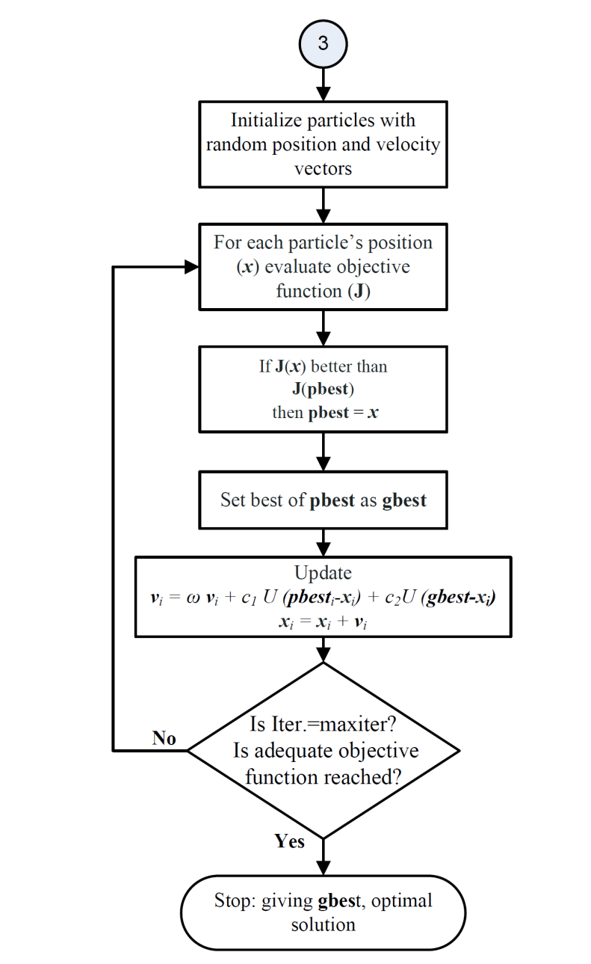
STUDY CASES AND SIMULATION RESULTS
Using PSO algorithm to find the minimum cost

Slide 27
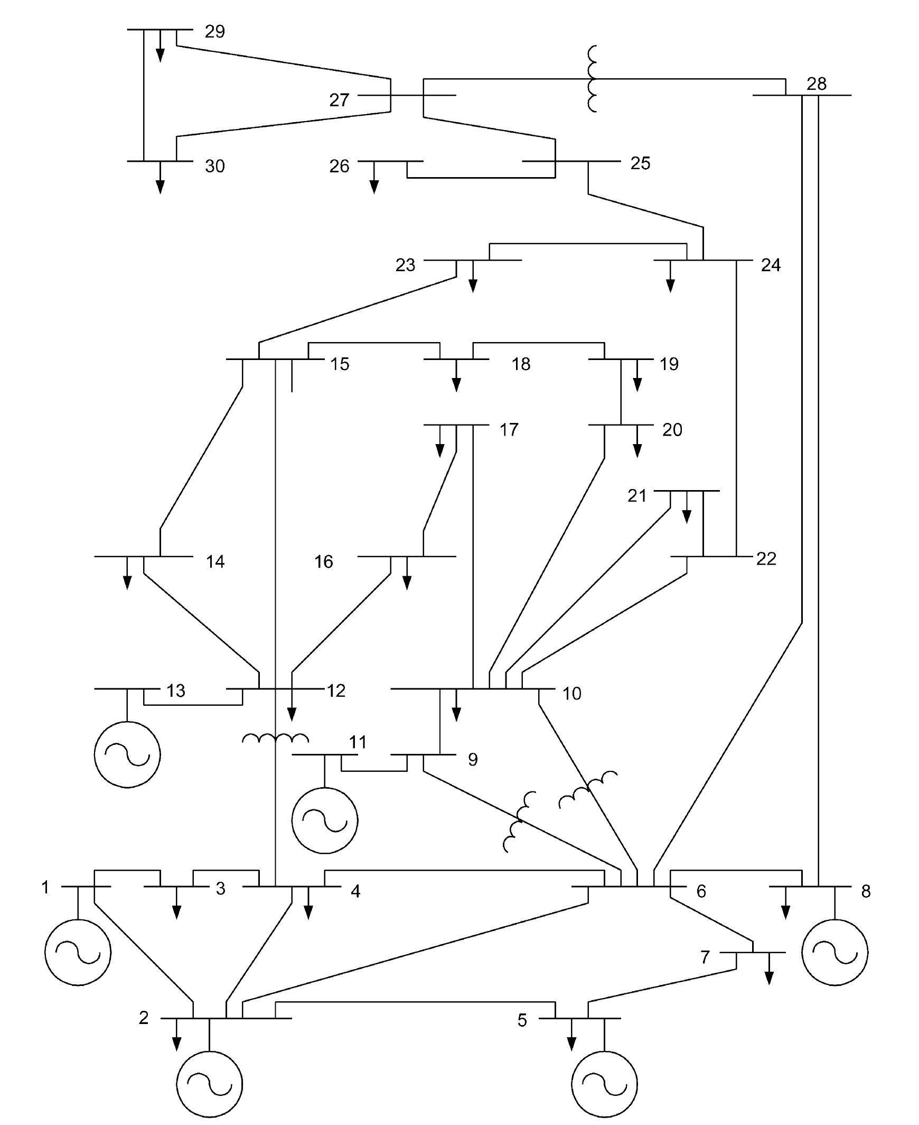
STUDY CASES AND SIMULATION RESULTS
IEEE 30-BUS TEST SYSTEM:

Slide 28
STUDY CASES AND SIMULATION RESULTS
Study of Base Case:

Slide 29
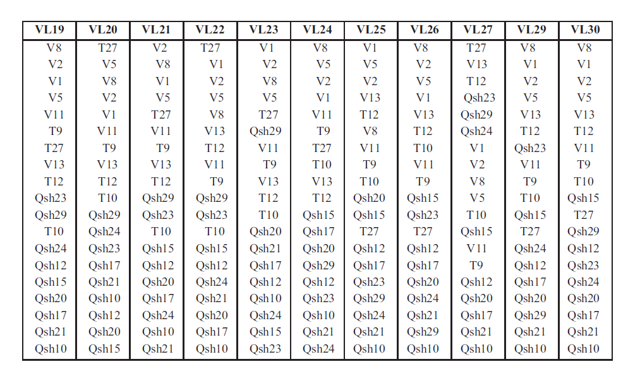
STUDY CASES AND SIMULATION RESULTS
Application of Sensitivity Analysis for OPF :
The order of most effective control variables is:

Slide 30
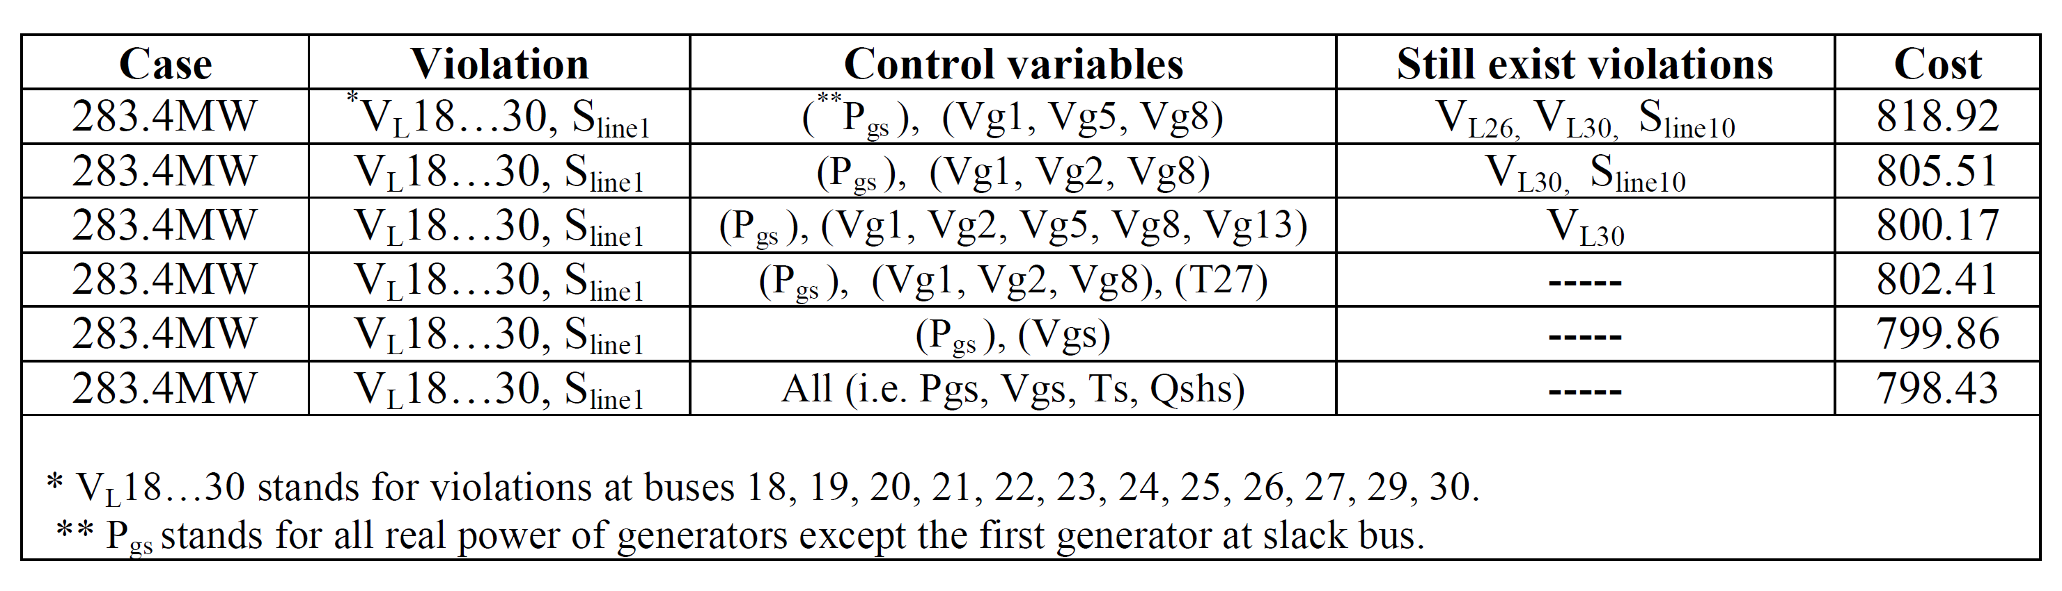
STUDY CASES AND SIMULATION RESULTS
Using combinations of the most effective control variables for Base Case OPF:
The order of most effective control variables is:

Slide 31
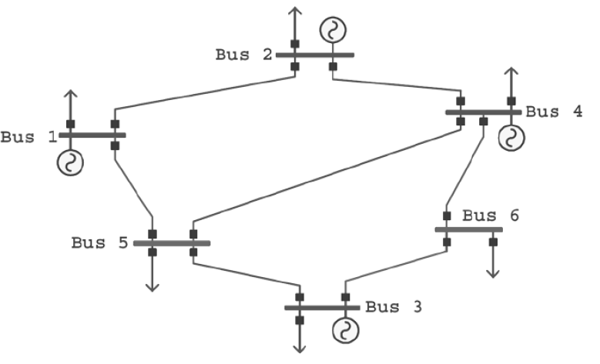
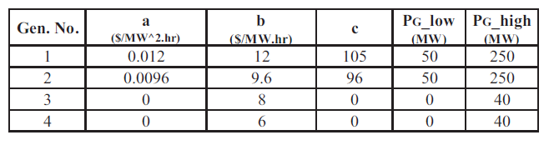
STUDY CASES AND SIMULATION RESULTS
6-BUS SYSTEM INCLUDING WIND-POWERED GENERATORS

Slide 32
STUDY CASES AND SIMULATION RESULTS
6-BUS SYSTEM INCLUDING WIND-POWERED GENERATORS

Slide 33
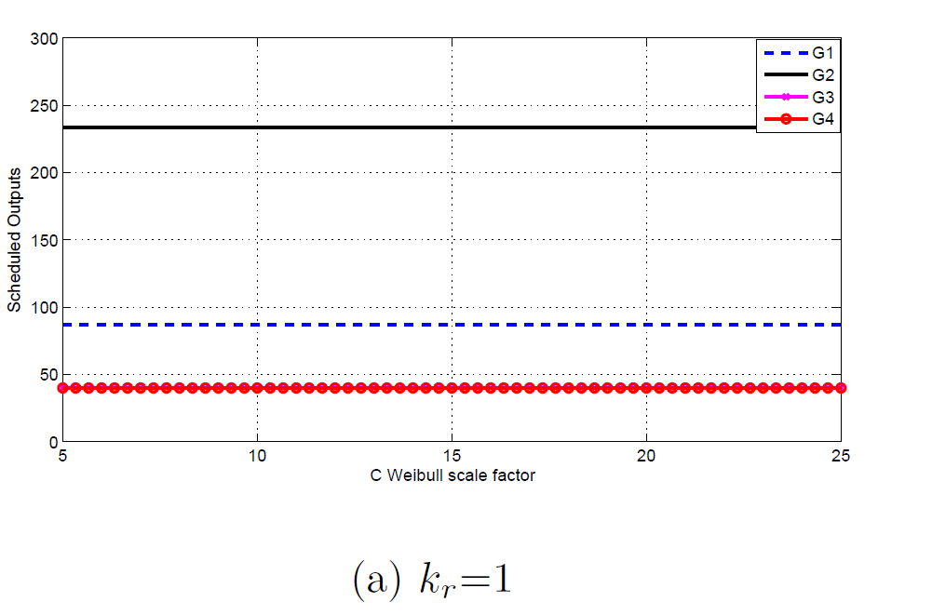
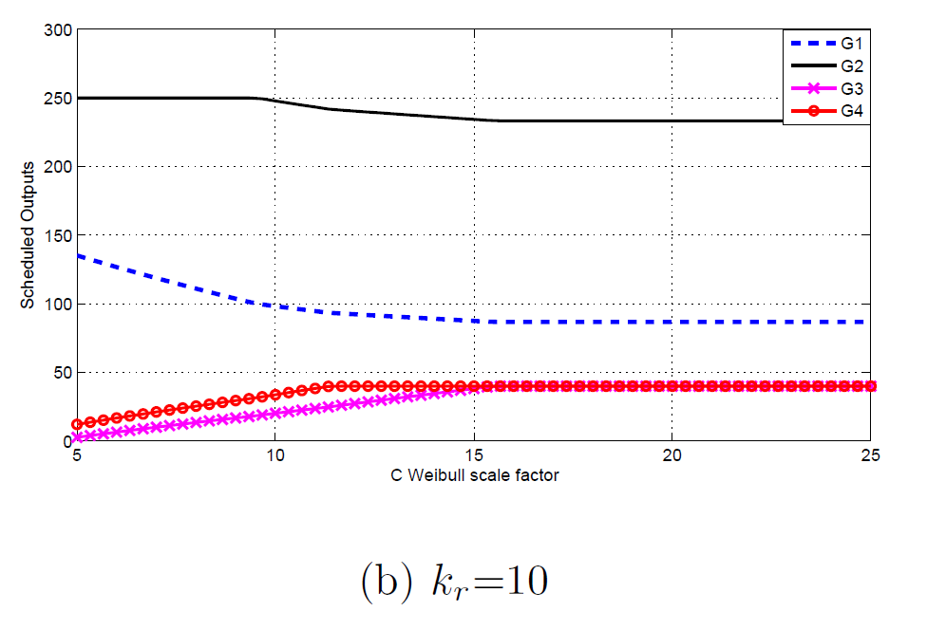
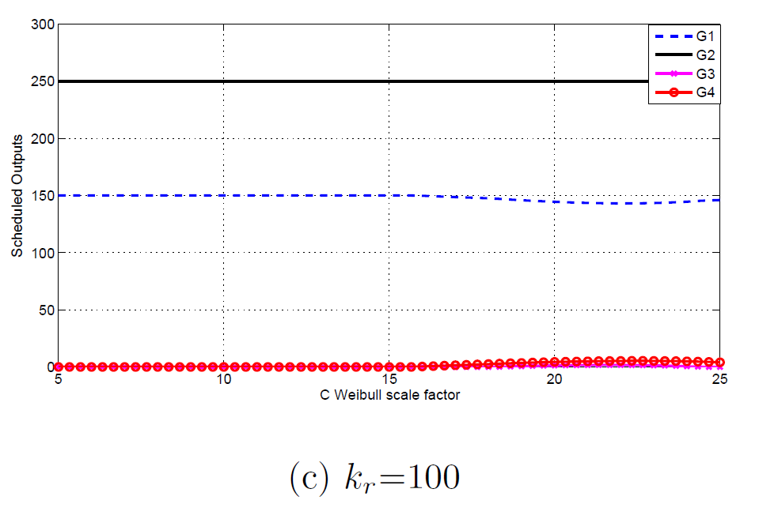
STUDY CASES AND SIMULATION RESULTS
The Effect of Wind Power Cost Coefficients
The Effects of Reserve Cost Coefficient k_{r} (and k_{p}=0):

Slide 34
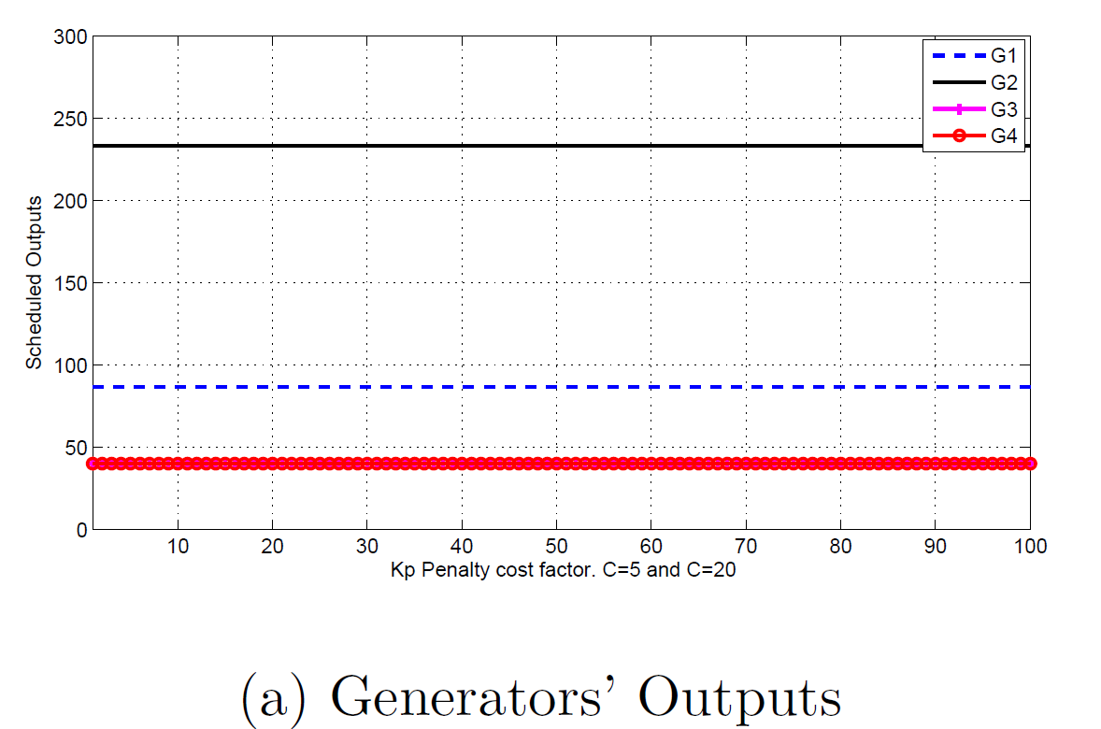
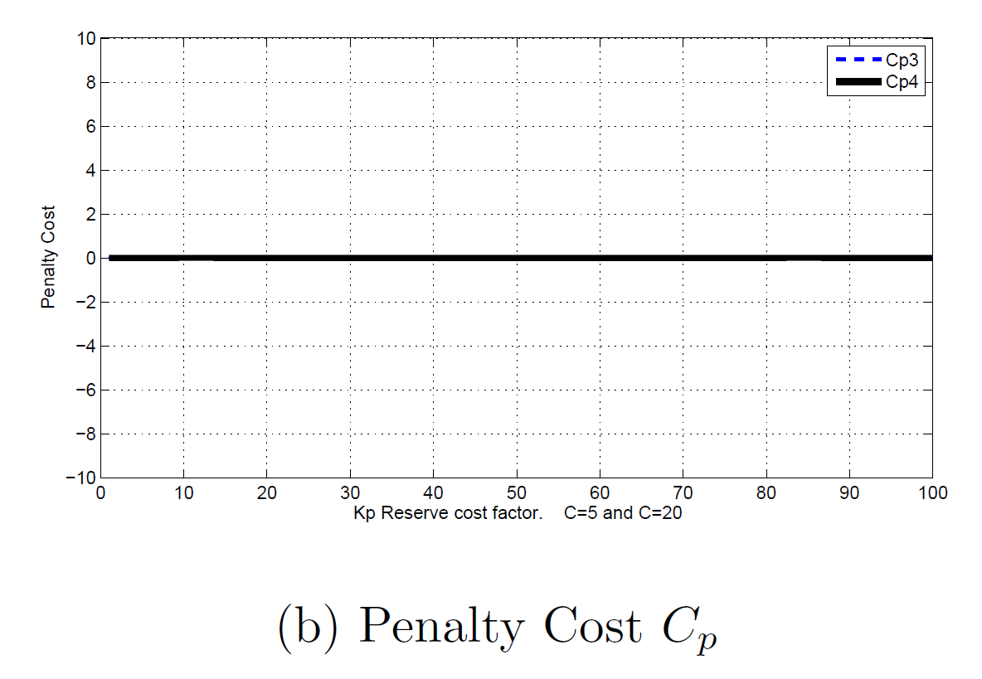
STUDY CASES AND SIMULATION RESULTS
The Effects of Penalty Cost Coefficient k_{p} (and k_{r}=0):

Slide 35
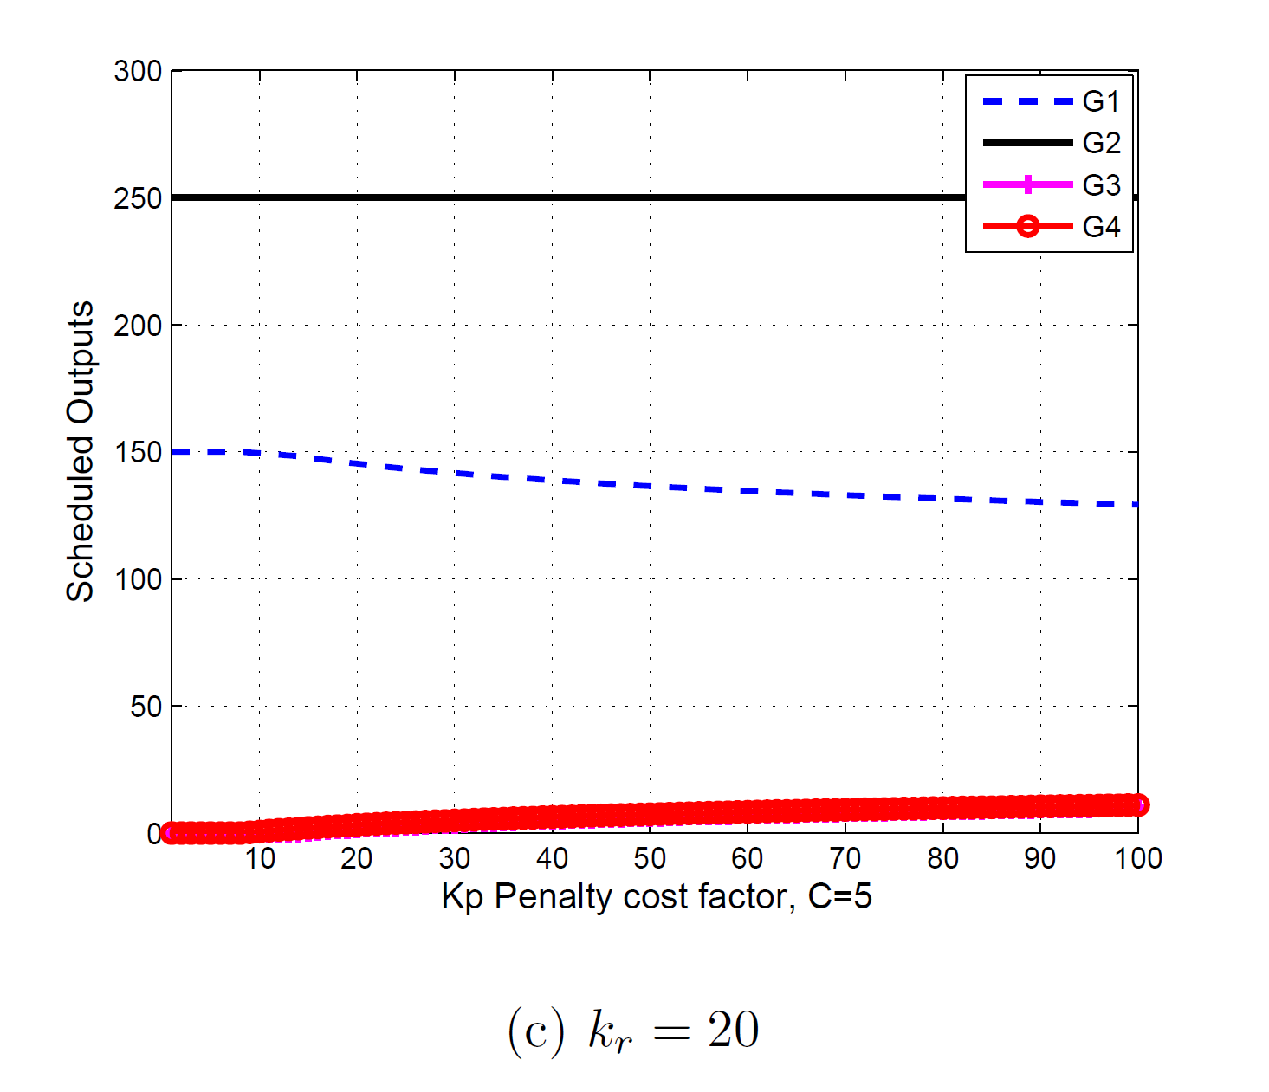
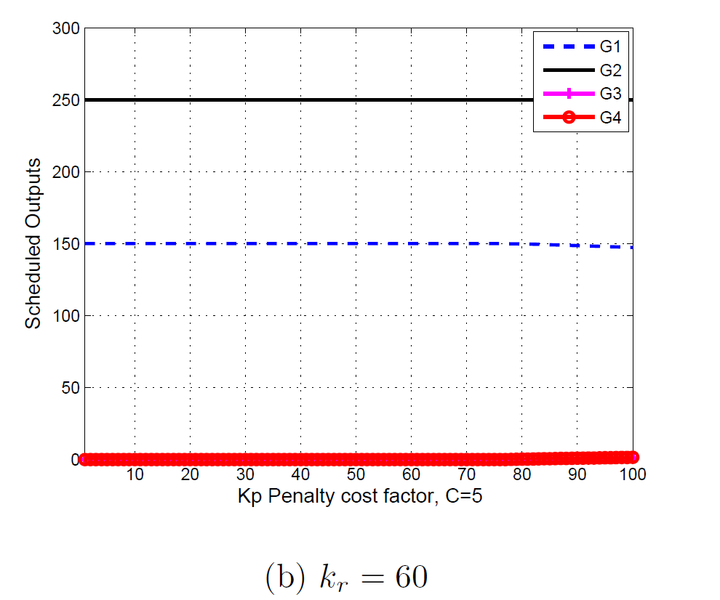
STUDY CASES AND SIMULATION RESULTS
The Effects of Reserve Cost Coefficient k_{r} and Penalty Cost Coefficient k_{p}:
(a) k_{r}=20

Slide 36
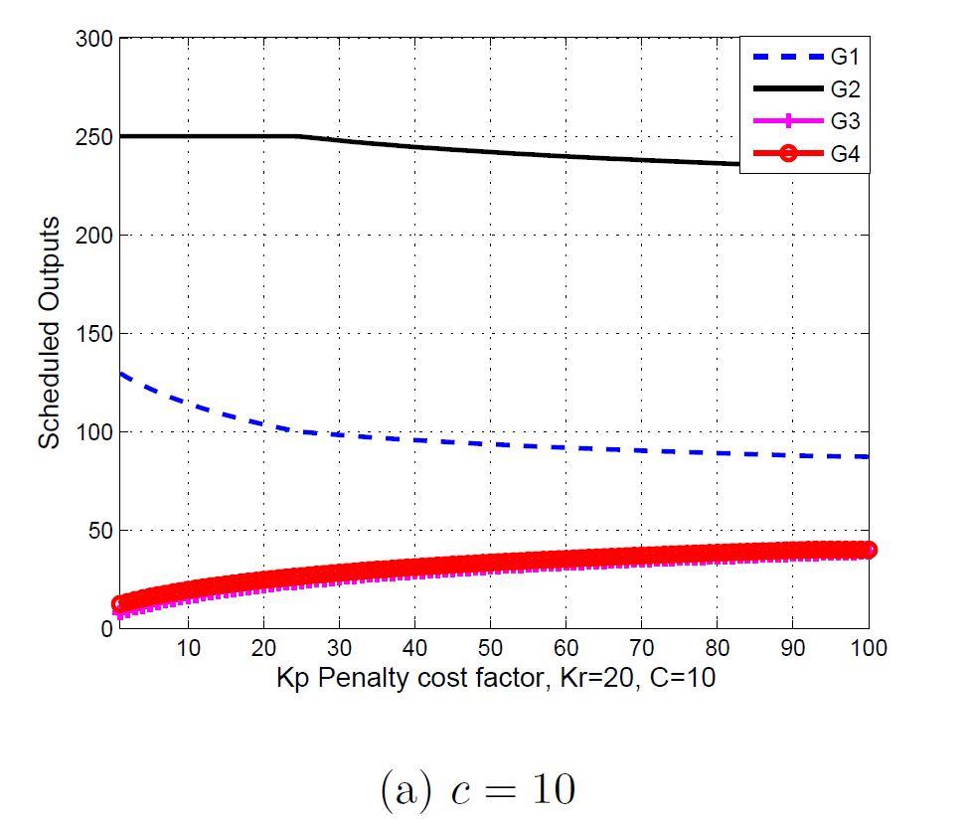
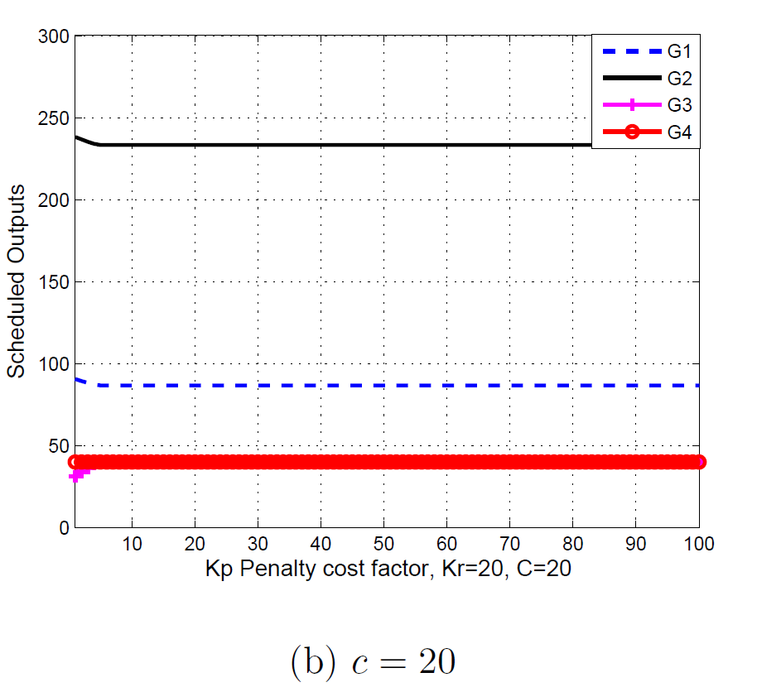
STUDY CASES AND SIMULATION RESULTS
The Effects of Reserve Cost Coefficient k_{r} and Penalty Cost Coefficient k_{p}:

Slide 37
Conclusion and Further Work
Conclusion
The implementation of PSO algorithm to find OPF solution is useful and worth of investigation.
PSO algorithm is easy to apply and simple since it has less number of parameters to deal with comparing to other modern optimization algorithms.
PSO algorithm is proper for optimal dispatch of real power of generators that include wind-powered generators.
The used model of real power optimal dispatch for systems that include wind power is contains possibilities of underestimation and overestimation of available wind power plus to whether the utility owns wind turbines or not; these are the main features of this model.

Slide 38
Conclusion and Further Work
Conclusion
The probability manipulation of wind speed and wind power of the model is suitable since wind speed itself is hard of being expected and hence the wind power as well.
In IEEE 30-bus test system, OPF has been achieved by using PSO and gives the minimum cost for several load cases.
Using OPF sensitivity analysis can give an indication to which of control variables have most effect to adjust violations of operating constraints.
The variations of wind speed parameters and their impacts on total cost investigated by 6-bus system.

Slide 39
Conclusion and Further Work
Further Work
PSO algorithm needs some work on selecting its parameters and its convergence.
PSO can be applied in wind power bid marketing between electric power operators.
The same model can be adopted for larger power systems with wind power.
The environment effects and security or risk of wind power penetration can be included in the proposed model and it becomes multi-objective model of optimal dispatch.
Fuzzy logic is worth of investigation to be used instead probability concept which is used in the proposed model, especially when security of wind power penetration is included in the model.

Slide 40
Conclusion and Further Work
Further Work
Using the most effective control variables to adjust violations in OPF needs more study.
The incremental reserve and penalty costs of available wind power can be compared with incremental cost of conventional-thermal quadratic cost; this comparison could lead to useful simplifications of an economic dispatch model that includes thermal and wind power.

Slide 41
Thank You for Listening
Any Question
?

