Slide 1

A Post-processing Approach for Solar Power Combined Forecasts of Ramp Events
Mohamed Abuella
Supervised by:
Prof. Badrul Chowdhury
A dissertation submitted to the faculty of
The University of North Carolina at Charlotte
in partial fulfillment of the requirements
for the degree of Doctor of Philosophy in
Electrical Engineering
Charlotte
October 1st, 2018

Slide 2
Dissertation Organization
Dissertation Layout
Presentation Outline
Highlights, Motivation, Literature Review, Problem Statement & Contribution,
Theoretical Background & Methodology
Modeling and Results
Conclusions and Future Work
https://www.researchgate.net/publication/328757565_A_Post-processing_Approach_for_Solar_Power_Combined_Forecasts_of_Ramp_Events/download

Slide 3
Highlights
A post-processing approach combines and improves solar power forecasts.
The approach also adjusts the combined forecasts in terms of ramp events.
A classification of all possible thresholds and classes of ramp event forecasts.
A customized cost function for imbalanced classification of ramp events.
Suitable metrics for the feature selection process and performance evaluation.
An uncertainty analysis for probabilistic forecasts of solar power ramp events.

Slide 4
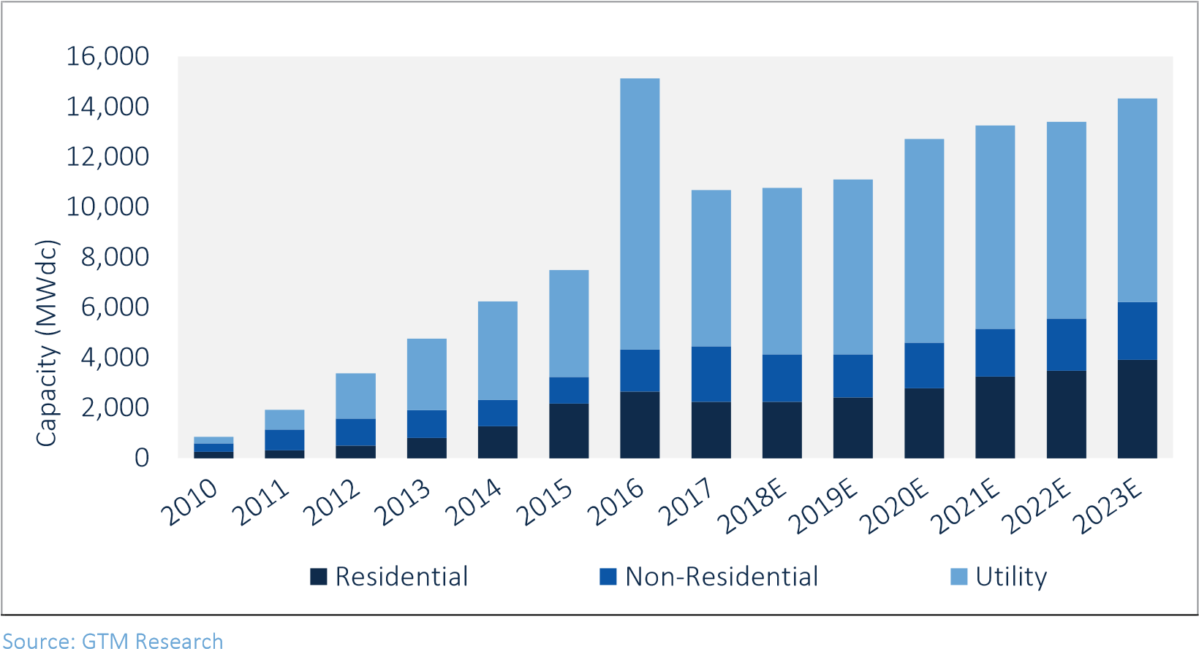
Motivation
Source: SEIA/GTM Research
A U.S. PV solar market study * prepared by Solar Energy Industries Association (SEIA)
and GTM Research
https://www.seia.org/us-solar-market-insight (June 12, 2018, insight of US Solar Market)

Slide 5

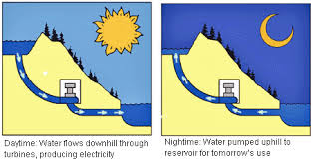




Motivation
Why Forecast?
P_{Supply} = P_{Demand} +P_{Loss}
PV Solar Power Generations
are Too Variable
Coordination with Operating Reserves and Energy Storage
Systems
Reducing
Cost
and Pollution
Illustration of the motivation of PV solar power forecasts

Slide 6
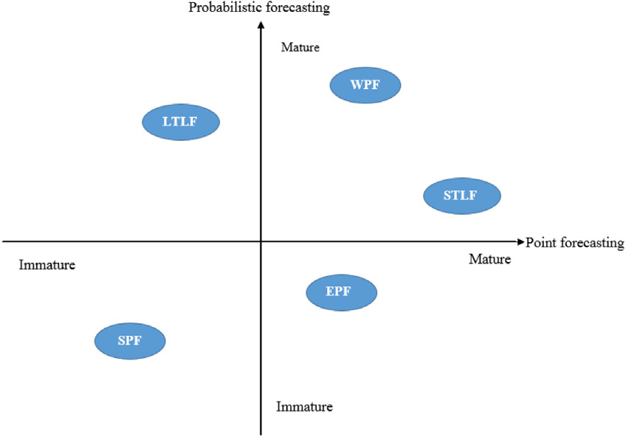
Motivation
Challenges
Maturity quadrant of the energy forecasting subdomains (SPF: solar power forecasting; LTLF: long term load forecasting; EPF: electricity price forecasting; WPF: wind power forecasting; STLF: short term load forecasting) .
Hong, Tao, et al. "Probabilistic energy forecasting: Global energy forecasting competition 2014 and beyond." International Journal of Forecasting 32.3 (2016): 896-913.

Slide 7

Motivation
Challenges
These are the objectives of the ongoing research on this field that are addressed and recommended for the academy and industry.
0.22
The RMSE of the Models
M1
0.2
M2
M3
M4
0.18
M5
M6
M7
-Accurate V.G. Forecasting;
0.16
M8
M9
0.14
M10
E
M11
S
M12
M
0.12
M13
-Ensemble Forecasts;
R
M14
0.1
M15
M16
M17
0.08
M18
-Probabilistic Forecasts;
M19
M20
0.06
M21
M22
0.04
M23
-Ramp Event Forecasts;
M24
Combined Forecasts
0.02
1
2
3
4
5
6
7
8
9
10
11
12
13
14
15
16
17
18
19
20
21
22
23
24
25
26
27
28
29
30
31
Average Forecasts
Days
-Better Evaluation Methods for Forecasts;
-Forecasts for PV Solar Distributed Generation
Systems “Behind-the-Meter Resources”;
-Study the economic value of V.G. forecasting;
-Electricity System Operation Adjustments for
Optimal Implementation of the Forecast.
Solar Forecasting: Methods, Challenges, and Performance (IEEE Power & Energy Magazine Nov. 2015)
By Aidan Tuohy, John Zack, Sue Ellen Haupt, Justin Sharp, Mark Ahlstrom, Skip Dise, Eric Grimit, Corinna Möhrlen, Matthias Lange, Mayte Garcia Casado, Jon Black,Melinda Marquis, and Craig Collier.
7

Slide 8
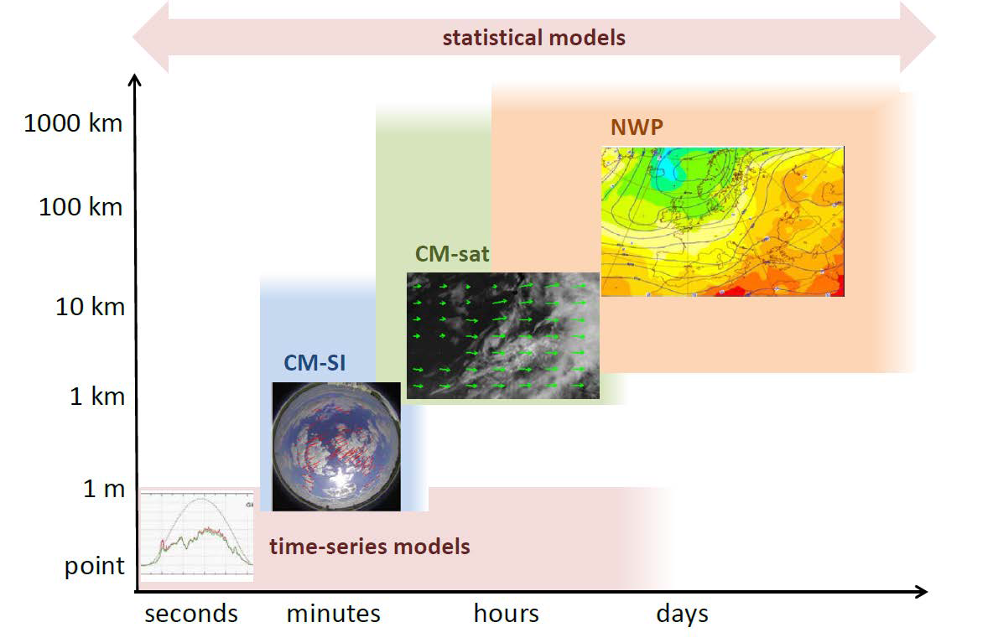
Literature Review
Taxonomy of solar forecasting methods based on temporal and spatial resolution#
CM-sat: cloud motion by satellite images;
CM-SI: cloud motion by sky-imagers
NWP: Numerical weather prediction Systems
Statistical models: blending and post-processing all of the methodologies.
# M. Sengupta, A. Habte, C. Gueymard, S. Wilbert, and D. Renne, Best practices handbook for the collection and use of solar resource data for solar energy applications," Tech. rep., National Renewable Energy Lab.(NREL), Golden, CO (United States), 2017
Yang, D., Kleissl, J., Gueymard, C. A., Pedro, H. T., & Coimbra, C. F. (2018). History and trends in solar irradiance and PV power forecasting: A preliminary assessment and review using text mining. Solar Energy. (**This review paper published in 2018, and reviewing 1000 solar forecast studies).

Slide 9
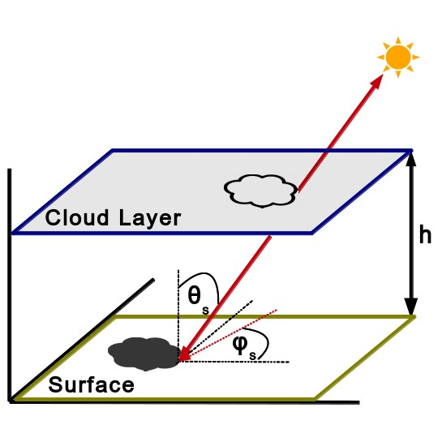
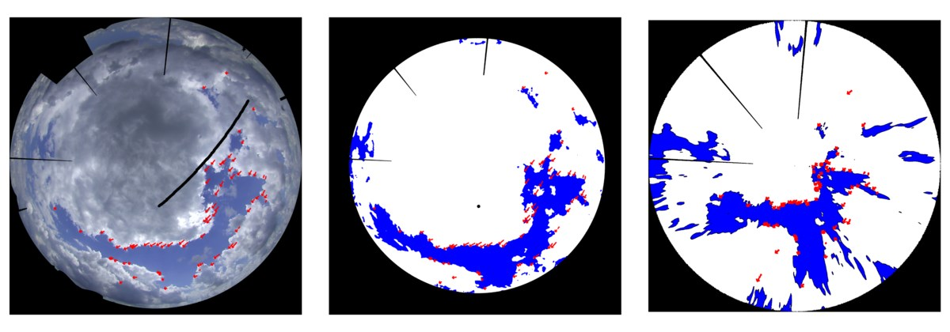
Literature Review
Main methods for solar irradiance / power ramp events:
Forecast Approaches:
a) Physical models to track the cloud motion: sky imagers and satellite systems.
b) Statistical models that are selected based on forecasts of weather conditions.
2) Identification/Detection Approaches:
a) Anomaly detection methods, such as swinging door algorithm ^{[R.4].}
b) Classification by using machine learning techniques.
Raw and projected cloud map form sky imaging devices ^{[R.1]}
Shadow projection by sky imagine devices ^{[R.1]}
[R.1] Schmidt, T., Calais, M., Roy, E., Burton, A., Heinemann, D., Kilper, T., & Carter, C. (2017). Short-term solar forecasting based on sky images to enable higher PV generation in remote electricity networks. Renewable Energy and Environmental Sustainability.
[R.2] Palmer, D., Koubli, E., Cole, I., Betts, T., & Gottschalg, R. (2018). Satellite or ground-based measurements for production of site specific hourly irradiance data: Which is most accurate and where?. Solar Energy, 165, 240-255.
[R.3] Bessa, R. J., Trindade, A., & Miranda, V. (2015). Spatial-temporal solar power forecasting for smart grids. IEEE Transactions on Industrial Informatics, 11(1), 232-241.
[R.4] Cui, M., Zhang, J., Florita, A., Hodge, B. M., Ke, D., & Sun, Y. (2015, August). Solar power ramp events detection using an optimized swinging door algorithm. In ASME 2015 International Design Engineering and Computers and Information in Engineering Conference.

Slide 10
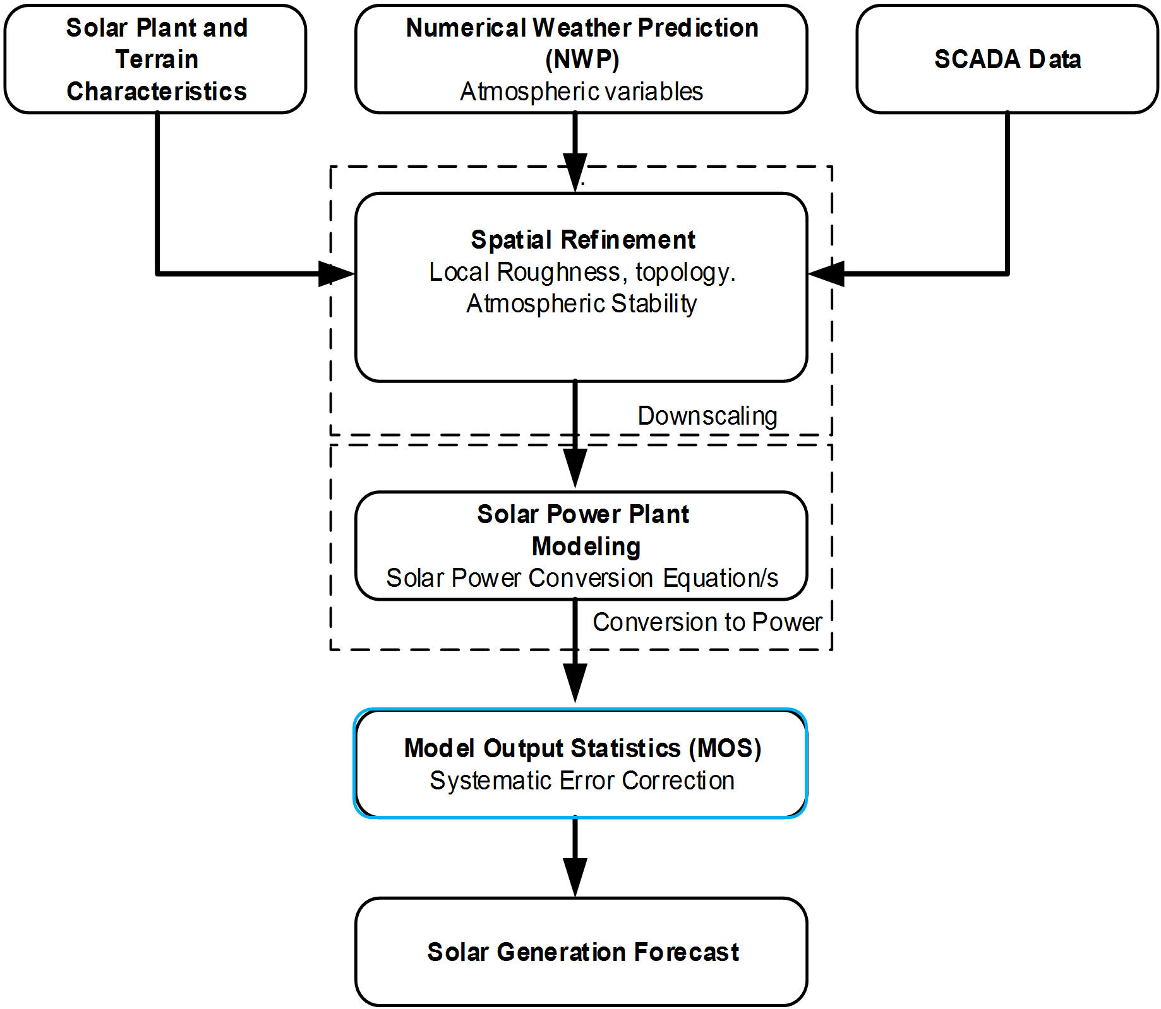
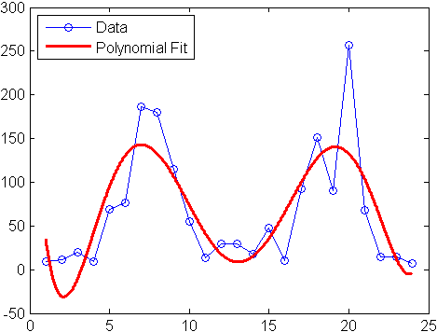
Problem Statement and Contribution
The Problem Statement
Combining of different forecasts can reduce the systemic bias of the individual models, boost the overall accuracy, and make the performance more robust, but it also smooths out the sharp changes of the forecasts, which leads to reduced accuracy of the combined forecasts for ramp events.
The post-processing methods (MOS) are affecting the ramp event forecasts by smoothing the sharp changes in the raw forecasts. (Kleissl 2013; Inman et al. 2013)
Kleissl, J. (2013). Solar energy forecasting and resource assessment. Academic Press.
Inman, R. H., Pedro, H. T., & Coimbra, C. F. (2013). Solar forecasting methods for renewable energy integration. Progress in energy and combustion science, 39(6), 535-576.

Slide 11
Problem Statement and Contribution
The Contribution
Due to the issue that was highlighted (Kleissl 2013; Inman et al. 2013), it is therefore, there is room for improvement by applying the proposed approach for adjusting the combined forecasts of solar power in terms of ramp events.
To the best of our knowledge, this is the first attempt to tackle this issue of the combined forecasts for solar power ramp events.
A post-processing approach combines and improves solar power forecasts.
The approach also adjusts the combined forecasts in terms of ramp events.
A classification of all possible thresholds and classes of ramp event forecasts.
A customized cost function for imbalanced classification of ramp events.
Suitable metrics for the feature selection process and performance evaluation.
An uncertainty analysis for probabilistic forecasts of solar power ramp events.

Slide 12
Graphical Abstract of the Proposed Adjusting Approach
Flowchart of Solar Power Forecasts

Slide 13
Graphical Abstract of the Proposed Adjusting Approach
Day
Statistical
-
ahead Forecasts
Weather Data
&
including the past forecasts
(
NWP
AI Models
)
Outcomes
Ramp Rates of
:
MLR
,
ANN
,
SVR
Day
-
ahead
Random
Forecasts
Forest
Combining by
fit by
Adjusted Hour
PV System
-
Data
Random Forest
MSE
ahead Forecasts
&
F
Persistence
Ramp Rates of
MSE
Hour
RR
Hour
-
ahead
Model
-
ahead Forecasts
including the past forecasts
Forecasts
Outcomes
Persistence and
:
Combined Forecasts
Forecasting Stage
Combining Stage
Adjusting Stage
Block diagram of the adjusting approach

Slide 14
Graphical Abstract of the Proposed Adjusting Approach
•
PV System Data
•
Measured PV power output
Location and modules type
,
Pre
-
orientation
,
tilt
Processing
Forecasting Models
,
..
etc
.
•
Outlier detection and
•
Persistence model
Weather Data
data cleansing
•
Statistical models
•
Solar irradiance
•
Feature engineering
•
Artificial intelligence models
•
Temperature
•
Cloud coverage
Combining the models’ outcomes
•
Humidity
by ensemble learning
•
...
etc
.
Point forecast
Post
-
•
Processing
•
Ensemble
Analog ensemble
Flowchart of Solar Power Forecasts
Probabilistic forecast
Day
Statistical
-
ahead Forecasts
Weather Data
&
including the past forecasts
(
NWP
AI Models
)
Outcomes
Ramp Rates of
:
MLR
,
ANN
,
SVR
Day
-
ahead
Random
Combining by
Forecasts
Forest
fit by
Adjusted Hour
PV System
Random Forest
-
Data
MSE
ahead Forecasts
&
F
Persistence
Ramp Rates of
MSE
Hour
RR
Hour
-
ahead
Model
-
ahead Forecasts
Forecasts
including the past forecasts
Outcomes
Persistence and
:
Combined Forecasts
Forecasting Stage
Combining Stage
Adjusting Stage
Block diagram of the adjusting approach

Slide 15


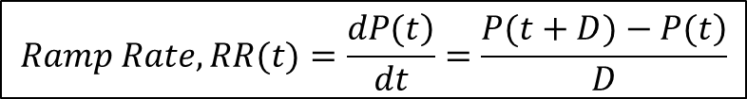
Solar Power Ramp Rates
Solar power ramp rate (RR) is the change of solar power during a certain time interval.
$$Ramp Rate, RR(t)=\frac{\left.dP(t\right)}{dt}=\frac{\left.P(t+D)−P(t\right)}{D}$$
$$ΔP$$
where P(t) is the solar power of the target hour, it can also be its forecast F(t); D is the time duration for which the ramp rate is determined.
$$Δt$$
For the illustrated cloudy day below:
Ramp rate, $\frac{ΔP}{Δt}$ = $\frac{0.2−0.85}{12:00−11:00}=−0.65 \left(−65\%\right) ramp down of its normal capacity, (pu/hr)$
Ramp rate, $\frac{ΔP}{Δt}$ = $\frac{0.48−0.1}{14:00−13:00}=+0.38 \left(+38\%\right) ramp up of its normal capacity, (pu/hr)$
Some ramps are with low rates, while others with high rates.
Ramp Events During a Cloudy Day

Slide 16
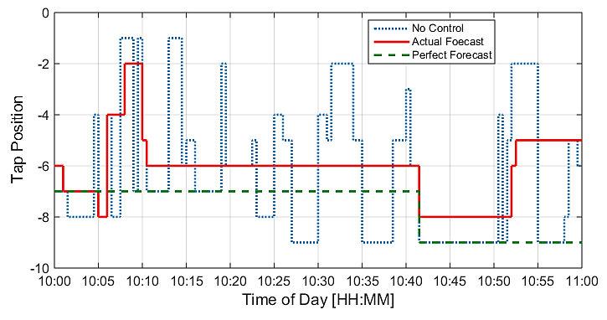
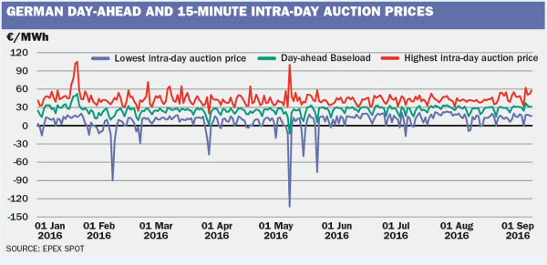
Potential Applications
There are several applications of power systems that rely on solar power ramp event forecasts
Distribution level:
Optimizing the voltage regulation equipment.
Control schemes of energy storage systems.
Optimizing the Transformer's Tap Changer position sequences using the solar forecast
Transmission / bulk level:
Trading & dispatching the operating reserve.
Managing the ramp capability / system flexibility with high-level of renewable energy integration.
EPEX: European power exchange spot trading

Slide 17
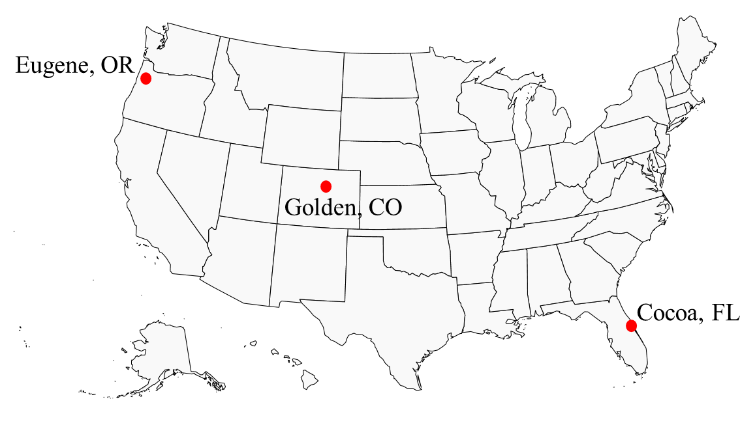
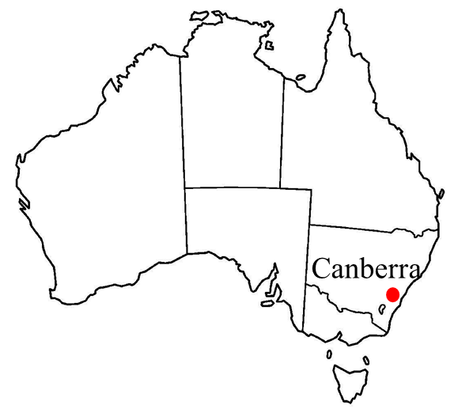
Data Preprocessing
Data Description:
Dataset | Golden, CO | Cocoa, FL | Eugene, OR | Canberra
Country | USA | USA | USA | Australia
Climate type | Semi-arid | Subtropical | Marine coast | Oceanic
Latitude (°, -S) | 39.74 | 28.39 | 44.05 | -35.16
Longitude (°, -W) | -105.18 | -80.46 | -123.07 | 149.06
Elevation above sea (m) | 1798 | 12 | 145 | 595
Number of panels | 11 | 11 | 11 | 8
Panel tilt (°) from horizontal | 40 | 28.5 | 44 | 36
Panel orientation (°) clockwise from North | 180 | 180 | 180 | 38
Total capacity (W) | 1252 | 1272 | 1290 | 1560
Time period of observations | Aug. 2012 to Sep. 2013 | Jan. 2011 to March 2012 | Dec. 2012 to Jan. 2014 | April 2012 to May 2014
Data resolution | 15min | 5min | 5min | 1hr
Missing (% of observations) | 18% | 17% | 10% | 0%
Variability (data resolution) Std.Div. | (15min) 0.256 (1hr) 0.119 | (5min) 0.251 (1hr) 0.164 | (5min) 0.250 (1hr) 0.161 | (1hr) 0.259
B. Marion, A. Anderberg, C. Deline, J. del Cueto, M. Muller, G. Perrin, J. Rodriguez, S. Rummel, T. J. Silverman, F. Vignola, et al., New data set forvalidating pv module performance models," in Photovoltaic Specialist Conference (PVSC), 2014 IEEE 40th, pp. 1362{1366, IEEE, 2014.
https://crowdanalytix.com/contests/global-energy-forecasting-competition-2014-probabilistic-solar-power-forecasting

Slide 18
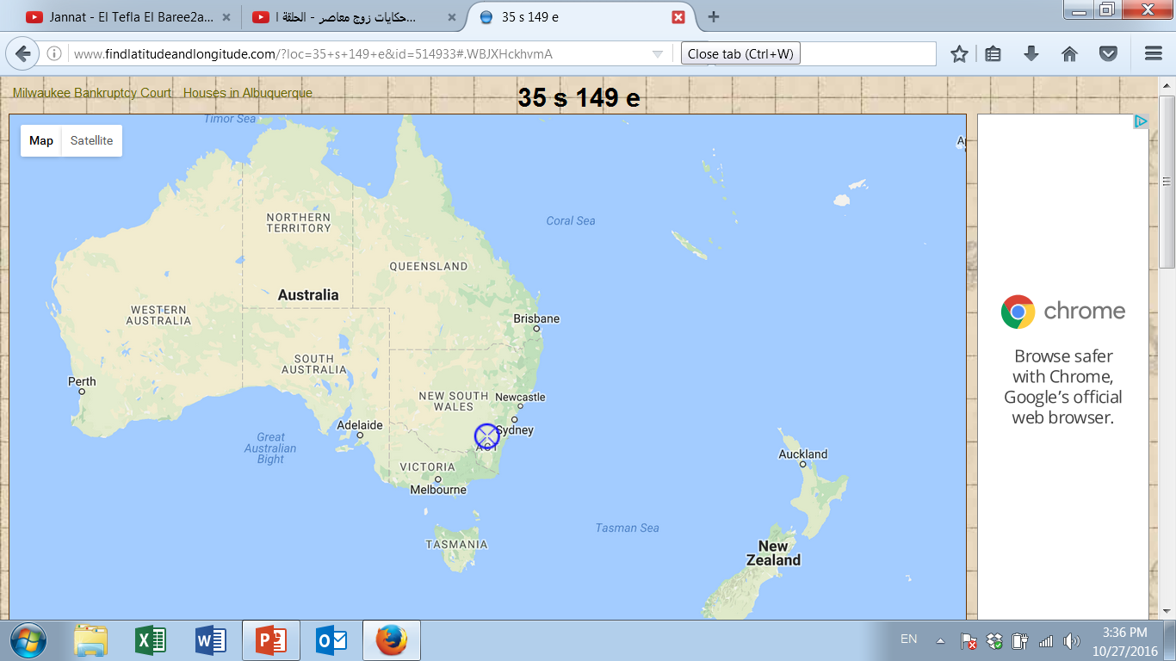
Data Preprocessing
Data Description:
PV solar system is near Canberra, Australia, consisting of 8 panels, its nominal power of (1560W), and panel orientation 38° clockwise from the north, with panel tilt (of 36°). The historical observed solar power data are normalized to the rated capacity (i.e., 1560W).
Available data
No. | Input Variable, (X)
1 | Cloud Water Content
2 | Cloud Ice Content
3 | Surface Pressure
4 | Relative Humidity
5 | Cloud Cover
6 | 10m - U Wind
7 | 10m - V Wind
8 | 2-m Temperature
9 | Surface solar radiation down
No. | Input Variable, (X)
10 | Surface thermal radiation down
11 | Top net solar radiation
12 | Total precipitation
13 | Heat Index
14 | Wind Speed
15 | Hours
16 | Months
17 | Days of Month
18 | Days of Year
Weather predictions are produced by a global numerical weather prediction system, European Centre for Medium-Range Weather Forecasts (ECMWF).
Data partition into training and testing sets
 | Month | Year | Partition
From | April | 2012 | Training Set
To | May | 2013
From | June | 2013 | Testing Set
To | May | 2014
https://crowdanalytix.com/contests/global-energy-forecasting-competition-2014-probabilistic-solar-power-forecasting

Slide 19
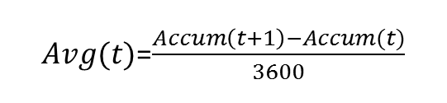
Data Preprocessing
Benchmark Data
Data Cleansing
Select most Effective Variables
Scatter & Box plots the Data
Greedy Search - Wrapping Approach
Flowchart of Data Preparation
$Avg(t)$=$\frac{Accum\left(t+1\right)−Accum(t)}{3600}$
Solar Power vs. Surface Solar Irradiance Down (SSRD) provide by NWP
Scatter plot of the observed solar power vs. Solar Irradiance

Slide 20
Data Preprocessing
Benchmark Data
Data Cleansing
Select most Effective Variables
Scatter & Box plots the Data
Greedy Search - Wrapping Approach
Flowchart of Data Preparation
September 24th, 2013
There are missing data:
All minutes at hour=9 and some minutes at hour=10, 12, and 14.
Filling of missing data
by interpolation
One week:
August 14th to 20th ,2012

Slide 21


Data Preprocessing
Benchmark Data
Data Cleansing
Select most Effective Variables
Scatter & Box plots the Data
Greedy Search - Wrapping Approach
Flowchart of Data Preparation
Pick up a feature from the available features set;
Run the model with this feature;
Score the model, by using the following score: Max(Diff. Index),
where Diff. Index is the difference between true and false ramp events;
Add another feature to the selected features;
Repeat steps 2 and 3;
Choose subset of features with the best score, remove the selected from the available features;
Repeat steps 1 to 6;
If there is no longer any feature to select, Stop.
Objective: Increase the true events, Decrease the false events.
$$True Events$$
& F$alse Events$

Slide 22
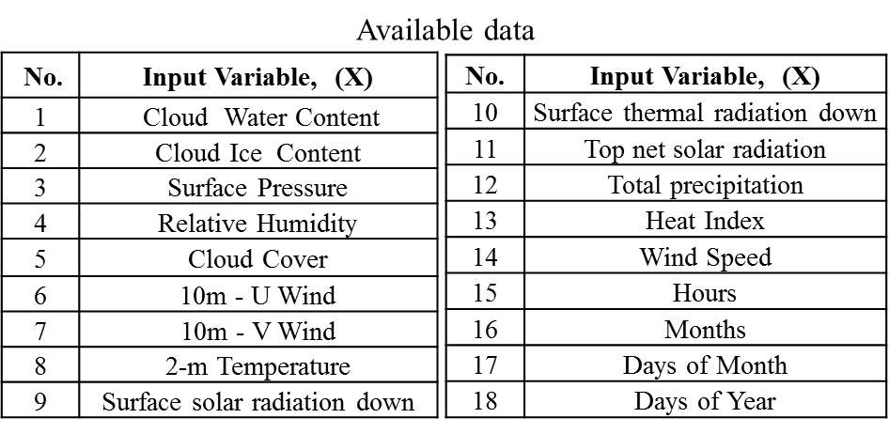
Data Preprocessing
Models' parameters and their selected input variables

Slide 23


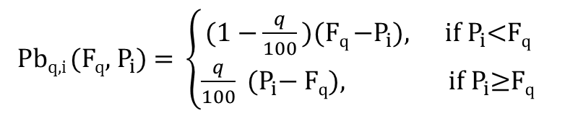
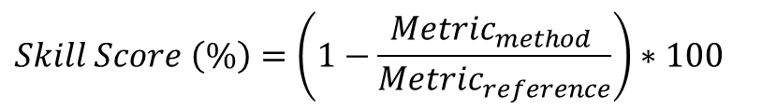
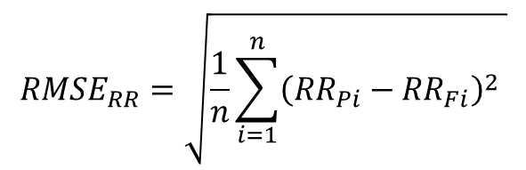


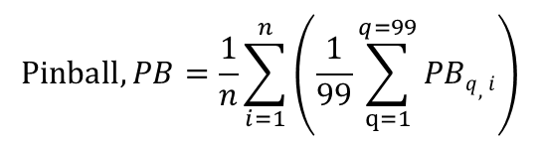
Evaluation Metrics
These are negatively oriented metrics except the skill score,
which is the higher is the better.
$$RMSE=\sqrt{\frac{1}{n}\sum_{i=1}^{n}{({{P_{i}−F}_{i})}^{2}}}$$
$${RMSE}_{RR}=\sqrt{\frac{1}{n}\sum_{i=1}^{n}{\left({\left.{{RR}_{Pi}−RR}_{Fi}\right)}^{2} \right.}}$$
$$MAE=\frac{1}{n}\sum_{i=1}^{n}{\left|{P_{i}−F}_{i}\right|}$$
$$MBE=\frac{1}{n}\sum_{i=1}^{n}{\left({P_{i}−F}_{i}\right)}$$
Pb_{q,i} (F_{q}, $P_{i}$) = $\left\{\begin{matrix}\text{(}\text{1 }\text{−}\frac{q}{100}\text{)}\text{(}\text{F}\text{q} \text{−}P_{i}\text{), } \text{if}{ P}_{i}\text{<}\text{Fq} \\ \frac{q}{100} \text{(}P_{i}\text{−} \text{F}\text{q}\text{)}, \text{if}{ P}_{i}\text{≥}\text{F}\text{q}\end{matrix}\right.$
Quantiles, q$∈$[1- 99]
$$\text{Pinball}, PB=\frac{1}{n}\sum_{i=1}^{n}{\left(\frac{1}{99}\sum_{q=1}^{q=99}{PBq,i}\right)}$$
$$Skill Score \left(\%\right)=\left(1−\frac{{Metric}_{method} }{{Metric}_{reference}}\right)∗100$$

Slide 24
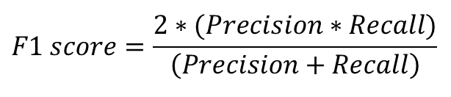
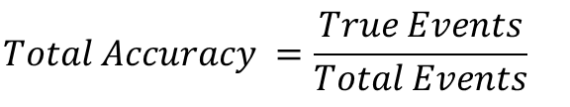
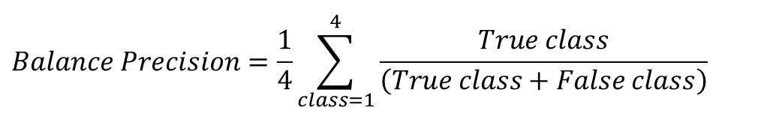
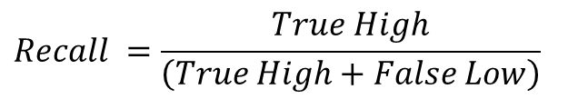
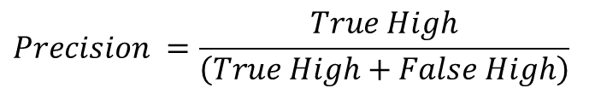
Evaluation Metrics
The evaluation metrics to assess the classification for solar ramp events:
Objective: Increase the true events, Decrease the false events.
$$Total Accuracy =\frac{True Events}{Total Events}$$
$$True Events$$
& F$alse Events$
$$Precision =\frac{True High}{\left(True High+False High\right)}$$
$$Recall =\frac{True High}{\left(True High+False Low\right)}$$
$$Balance Precision=\frac{1}{4}\sum_{class=1}^{4}{\frac{True class}{\left(True class+False class\right)}}$$
Confusion matrix of possible cases of solar power ramp events
$$F1 score=\frac{2∗(Precision∗Recall)}{\left(Precision+Recall\right)}$$
$$Diff. Index=\left(True−False\right) of High Rate Events$$
The most suitable metrics for our application are the Diff. Index and the F1 score.

Slide 25
Methodology
Regression or Classification Models
Input Variables:
(Solar power and weather forecasts)
Training Dataset:
(Past solar power and weather data)
Fitting / Learning Algorithm of the
Forecasting Model
Task:
(Regression /
Classification)
Output Variable:
(PV solar power ramp event forecasts)
Block diagram of PV solar power ramp event forecasting models

Slide 26
Methodology
Ensemble Forecasts: Combining Various Models
Individual Forecasts of PV Solar Power Ramp Events
Model A
Ensemble Learning (RF) for Combining of Forecasts
Model B
Combined Forecasts
Model N
:
Weather Data
General diagram of combining different models
F_{comb}=W_{A}*M_{A}+ W_{B}*M_{B} + W_{C}*M_{C} ….+ W_{N}*M_{N}
Method of Combining The Models
Random forest (RF) is chosen to be the ensemble learning method for combining the various models’ outcomes.
T. Hastie, R. Tibshirani, J. Friedman, and others, The elements of statistical learning, 2nd Edition. Springer-Verlag New York, 2009.

Slide 27
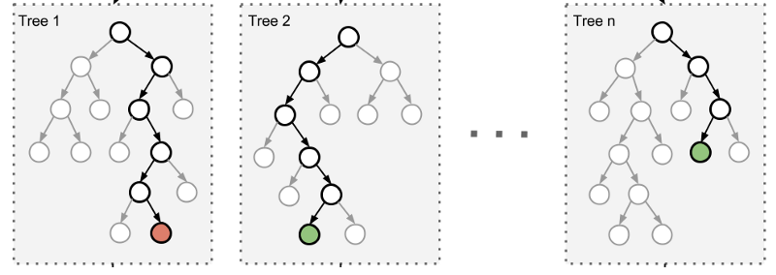
Methodology
Probabilistic Forecasts
NWP point forecasts
Solar power point forecasts
Probabilistic model
Probabilistic forecasts of solar power
Ensemble-based probabilistic forecasts
(a)
Diagram of ensemble-based probabilistic forecasts,
Splitting mechanism of trees in random forest,
Sample of ensemble-based probabilistic forecasts of solar power of 3 days
(b)
(c)

Slide 28


Methodology
Probabilistic Forecasts
Analog Ensemble (AnEn) method:
Schematic diagram of analog ensemble method
$$\left|F_{Given}^{Hr}−F_{Past}^{Hr}\right|≤ε,$$
$ε$= 0.1
where $F_{Given}^{Hr}$denotes the given point forecast at an hour Hr, for which the prediction interval will be estimated, $F_{Past}^{Hr}$ the point forecasts at the same hour of the day.
Delle Monache, L., Eckel, F. A., Rife, D. L., Nagarajan, B., & Searight, K. (2013). Probabilistic weather prediction with an analog ensemble. Monthly Weather Review, 141(10), 3498-3516.
Alessandrini, S., Delle Monache, L., Sperati, S., & Cervone, G. (2015). An analog ensemble for short-term probabilistic solar power forecast. Applied energy, 157, 95-110.

Slide 29
Methodology
Probabilistic Forecasts
Persistence probabilistic method:
Schematic diagram of persistence probabilistic method
The 10, 20 and 30 recent observed powers are carried out.
It is found that the recent 10 observed solar powers at the given hour with CDF distribution achieve more accurate persistence probabilistic forecasts.

Slide 30
Methodology
Probabilistic Forecasts
Probability distributions of the random forest outcomes at 12:00 pm on May 29th
(a)
(b)
(c)
(a) Solar power observations of the given day, (b) histograms of the random forest outcomes of the forecast at 12:00pm,(c) estimated CDFs for the probabilistic forecasts at 12:00pm

Slide 31
Methodology
Producing Different Models’ Outcomes
Combining by Ensemble Learning
Adjusting and Correcting the Combined Forecasts By the Ramp Rates
Schematic and block diagrams of the adjusting post-processing approach

Slide 32
Modeling and Results
Improving Combined Forecasts
Implementing the adjusting approach for Improving Combined Solar Power Forecasts
Combined forecasts of solar power for a cloudy day before and after applying the adjusting

Slide 33
Modeling and Results
Improving Combined Forecasts
Improving Combined Solar Power Forecasts
Monthly RMSEs of combined forecasts before and after applying the adjusting approach
Comparison of hour-ahead forecasts over a complete year
Method | Persistence | MLR | ANN | SVR | Simple Average | Ensemble (Before Adjusting) | Ensemble (After Adjusting)
MBE (Bias)­ | 0.0756 | -0.1498 | -1.852 | -4.291 | -1.554 | 0.0469 | 0.0747
RMSE­ | 0.1209 | 0.0763 | 0.0681 | 0.0700 | 0.0667 | 0.0628 | 0.0523
RMSE_{RR}­ | 0.1383 | 0.0771 | 0.0722 | 0.0747 | 0.0796 | 0.0750 | 0.0698
RMSE Improve (%) | 57% | 31% | 23% | 25% | 22% | 17% | ---

Slide 34
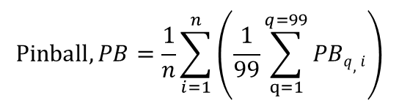
Probabilistic Forecasts
Modeling and Results
Improving Combined Forecasts
Pb_{q,i} (F_{q}, $P_{i}$) = $\left\{\begin{matrix}\text{(}\text{1 }\text{−}\frac{q}{100}\text{)}\text{(}\text{F}\text{q} \text{−}P_{i}\text{), } \text{if}{ P}_{i}\text{<}\text{Fq} \\ \frac{q}{100} \text{(}P_{i}\text{−} \text{F}\text{q}\text{)}, \text{if}{ P}_{i}\text{≥}\text{F}\text{q}\end{matrix}\right.$
Quantiles, q$∈$[1- 99]
$$\text{Pinball}, PB=\frac{1}{n}\sum_{i=1}^{n}{\left(\frac{1}{99}\sum_{q=1}^{q=99}{PBq,i}\right)}$$
Graphs of the probabilistic forecasts of the three methods for three days

Slide 35
Probabilistic Forecasts
Modeling and Results
Improving Combined Forecasts
Month | Pinball |  |  |  |  | Improvement of Adjusted Ensemble Over:
 | Persistence | Before Adjusting |  | After Adjusting
 |  | Analog Ensemble | Ensemble | Analog Ensemble | Ensemble | Persistence | Before adjust AnEn | Before adjust Ensemble
June | 0.0166 | 0.0099 | 0.0093 | 0.0088 | 0.0087 | 47% | 12% | 7%
July | 0.0176 | 0.0119 | 0.0121 | 0.0091 | 0.0094 | 47% | 21% | 22%
August | 0.0182 | 0.0105 | 0.0113 | 0.0089 | 0.0095 | 48% | 9% | 15%
September | 0.0173 | 0.0117 | 0.0114 | 0.0101 | 0.0092 | 47% | 21% | 19%
October | 0.0149 | 0.0097 | 0.0093 | 0.0095 | 0.0082 | 45% | 16% | 12%
November | 0.0191 | 0.0103 | 0.0104 | 0.0093 | 0.0087 | 54% | 15% | 16%
December | 0.0162 | 0.0089 | 0.0087 | 0.0078 | 0.0074 | 54% | 16% | 15%
January | 0.0179 | 0.0080 | 0.0076 | 0.0070 | 0.0069 | 62% | 14% | 10%
February | 0.0215 | 0.0099 | 0.0095 | 0.0085 | 0.0079 | 63% | 20% | 17%
March | 0.0208 | 0.0129 | 0.0131 | 0.0101 | 0.0102 | 51% | 21% | 22%
April | 0.0194 | 0.0099 | 0.0098 | 0.0078 | 0.0079 | 59% | 20% | 19%
May | 0.0137 | 0.0086 | 0.0078 | 0.0073 | 0.0065 | 53% | 24% | 17%
Average | 0.0178 | 0.0102 | 0.0100 | 0.0087 | 0.0084 | 52% | 18% | 16%

Slide 36
Probabilistic Forecasts
Modeling and Results
Improving Combined Forecasts

Slide 37

Modeling and Results
Combined Forecasts of Ramps
Implementing several classification models to forecasts solar power ramp events
Objective: Increase the true events, Decrease the false events.
$$True Events$$
& F$alse Events$
Ramp Classes as following:
Class1: Ramp up of high rate, $\text{|}\text{rate}\text{|}≥$ Tsh
Class2: Ramp up of low rate, |rate|$<$ Tsh
Class3: Ramp down of high rate, |rate|$≥$Tsh
Class4: Ramp down of low rate, |rate|$<$ Tsh
Classes of solar power ramp events in the case study
Distribution of the classes of solar power ramp events at threshold (Tsh) =0.4pu/hr.

Slide 38
Modeling and Results
Combined Forecasts of Ramps
Implementing several classification models to forecasts solar power ramp events
Objective: Increase the true events, Decrease the false events.
$$True Events$$
& F$alse Events$
Individual Classification Models for Solar Power Ramp Event Forecasting
Naive Bayes
LDA
kNN
Ensemble Learning (RF) for Combining of Forecasts
DT
Combined Forecasts
Log. Reg
RF
SVM
ANN
Weather Data
Combining classification models for solar power ramp event forecasting
F_{comb}=W_{A}*M_{A}+ W_{B}*M_{B} + W_{C}*M_{C} ….+ W_{N}*M_{N}
where W_{A} is an assigned weight for an outcome of model (A)
T. Hastie, R. Tibshirani, J. Friedman, and others, The elements of statistical learning, 2nd Edition. Springer-Verlag New York, 2009.
38

Slide 39
Available Features for classification of solar power ramp events
Modeling and Results
Combined Forecasts of Ramps
Additional Features:
 | Solar power forecasts & their ramp rates
 | Classes (Labels) of Ramp Event
 |  | Weather Data |  |  | Day and Hour-ahead Forecasts |  |  |  |  |  | Forward Ramp Rates |  |  | Backward Ramp Rates
 |  | No. | Variable Name |  | No. |  | Variable Name | RMSE | Horizon |  | No. | Variable Name |  | No. | Variable Name
 |  | 1 | Cloud Water Content |  | 15 |  | Persistence Farm 1 | 0.1209 | hour-ahead |  | 31 | MLR |  | 34 | Persistence Farm 1
 |  | 2 | Cloud Ice Content |  | 16 |  | Persistence Farm 2 | 0.2108 | hour-ahead |  | 32 | ANN |  | 35 | Persistence Farm 2
 |  | 3 | Surface Pressure |  | 17 |  | Persistence Farm 3 | 0.1393 | hour-ahead |  | 33 | SVR |  | 36 | Persistence Farm 3
 |  | 4 | Relative Humidity |  | 18 |  | MLR | 0.0763 | day-ahead |  |  |  |  | 37 | MLR
 |  | 5 | Cloud Cover |  | 19 |  | ANN | 0.0681 | day-ahead |  | No. | Variable Name |  | 38 | ANN
 |  | 6 | 10m- U Wind |  | 20 |  | SVR | 0.0715 | day-ahead |  | 50 | std. dev (all ramp rates) |  | 39 | SVR
 |  | 7 | 10m- V Wind |  | 21 |  | Combined 0.0628 | 0.0628 | hour-ahead |  |  |  |  | 40 | Combined 0.0628
 |  | 8 | 2-m Temperature |  | 22 |  | Combined 0.0554 | 0.0554 | hour-ahead |  |  |  |  | 41 | Combined 0.0554
 |  | 9 | Surface solar radiation down |  | 23 |  | Combined 0.0523 | 0.0523 | hour-ahead |  |  |  |  | 42 | Combined 0.0523
 |  | 10 | Surface thermal radiation down |  | 24 |  | Combined 0.0579 | 0.0579 | hour-ahead |  |  |  |  | 43 | Combined 0.0579
 |  | 11 | Top net solar radiation |  | 25 |  | ARIMA 0.0928 | 0.0928 | hour-ahead |  |  |  |  | 44 | ARIMA 0.0928
 |  | 12 | Total precipitation |  | 26 |  | ARIMAX 0.0915 | 0.0915 | hour-ahead |  |  |  |  | 45 | ARIMAX 0.0915
 |  | 13 | Heat Index |  | 27 |  | NAR Hr1 | 0.0890 | hour-ahead |  |  |  |  | 46 | NAR Hr1
 |  | 14 | Wind Speed |  | 28 |  | NAR Hr2 | 0.1384 | hour-ahead |  |  |  |  | 47 | NAR Hr2
 |  |  |  |  | 29 |  | NARX Hr1 | 0.0760 | hour-ahead |  |  |  |  | 48 | NARX Hr1
 |  |  |  |  | 30 |  | NARX Hr2 | 0.1419 | hour-ahead |  |  |  |  | 49 | NARX Hr2
Classes of the Forecasts
51 | Persistence Farm 1
52 | Persistence Farm 2
53 | Persistence Farm 3
54 | MLR
55 | ANN
56 | SVR
57 | Combined 0.0628
58 | Combined 0.0554
59 | Combined 0.0523
60 | Combined 0.0579
61 | ARIMA 0.0928
62 | ARIMAX 0.0915
63 | NAR Hr1
64 | NAR Hr2
65 | NARX Hr1
66 | NARX Hr2
39

Slide 40
Modeling and Results
Combined Forecasts of Ramps
Data projection onto PC1 and PC2:
Threshold=0.4pu/hr
For clarity, low-rate classes (2&4) become as a one class, class3: ➔
Class | Class1 | Class2 | Class3 | Total
Samples | 131 | 31 | 3666 | 3828
1) All 14 weather variables
2) All 30 Features (add solar power forecasts)
3) All 50 Features (add ramp rates of forecasts)
4) All 66 Features (add class labels of forecasts)
40

Slide 41
Modeling and Results
Combined Forecasts of Ramps
(a) The most 12 important features out of 66; (b) selected features and parameters for each model
(a)
(b)
No. | Most Important Features
1 | Cloud water content, NWP output
2 | Cloud cover, NWP output
3 | Top net solar radiation, NWP output
4 | Hour-ahead combined forecasts of solar power
5 | Ramp rates of NWP-driven day-ahead solar power forecasts by ANN
6 | Ramp rates of NWP-driven day-ahead solar power forecasts by SVR
7 | Ramp rates of hour-ahead combined forecasts of solar power
8 | Ramp rates of time-series hour-ahead forecasts of solar power by NARX
9 | Ramp classes of persistence hour-ahead forecasts of solar power
10 | Ramp classes of NWP-drive day-ahead solar power forecasts by ANN
11 | Ramp classes of NWP-driven day-ahead solar power forecasts by SVR
12 | Ramp classes of hour-ahead combined forecasts of solar power
Model | Parameters | Selected Features
Naïve Bayes | Distribution=Normal; distribution parameters are estimated in the training. | 1, 5, 11
LDA | Its coefficients (μ) are fitted in the training. | 1, 2, 3, 6, 9, 10, 12
Decision Tree | Max of splits=15; Min leaf size=1 | 1, 12
kNN | Euclidean distance; k=15 (nearest 15 neighbors) | 1, 4, 6, 7, 8
Logistic Regression | Its coefficients (β) are fitted in the training. | 1, 3, 11, 12
Random Forests | Forest size=100 trees; Min. leaf size=1 | 1, 3, 11, 12
SVM | Kernel= Radial basis function; C=184; gamma=5 | 1, 3, 11, 12
ANN | Hidden layer=1; Neurons=10 | 1, 5, 12
41

Slide 42
Modeling and Results
Combined Forecasts of Ramps
Method | Naïve Bayes | LDA | Decision Trees | kNN | Logistic Regression | Random Forest | SVM | ANN | Combined Classifiers
Precision (%) | 62% | 65% | 73% | 68% | 79% | 79% | 77% | 70% | 79%
Recall (%) | 43% | 40% | 38% | 31% | 30% | 43% | 43% | 38% | 50%
Balanced Precision (%) | 75% | 78% | 80% | 78% | 59% | 80% | 80% | 78% | 87%
F1-Score (%) | 51% | 49% | 50% | 43% | 44% | 56% | 55% | 49% | 61%
Diff. Index | 27 | 30 | 38 | 27 | 36 | 51 | 48 | 35 | 60
Solar power ramp event forecasts of the high-rate ramp events, (|Rate| ≥ 0.4 pu/hr = 162 events)
by the classification techniques.
42

Slide 43
Modeling and Results
Combined Forecasts of Ramps
Implementing the adjusting approach
to forecasts solar power ramp events
Distribution of the classes of solar power ramp events at threshold (Tsh) =0.4pu/hr.
Solar Ramp Events
Block diagram of the adjusting approach of solar power ramp event forecasting
Ramp-Up Events
Ramp-Down Events
High-Rate
Low-Rate
High-Rate
Low-Rate
Class1
Rate ≥ +Tsh
Class2
0 ≤ Rate < +Tsh
Class3
Rate ≤ −Tsh
Class4
0 ≥ Rate > −Tsh

Slide 44
Modeling and Results
Combined Forecasts of Ramps
Implementing the adjusting approach to forecasts solar power ramp events
 | Persistence, PV1 | NARX | Simple Average (NARX, MLR, ANN, SVR) | Combined (Pers.1, MLR, ANN, SVR) | Adjust Approach (Pers.1, MLR, ANN, SVR) | Combined (Pers.1&3 +NARX, Clouds, MLR, ANN, SVR) | Adjust Approach (Pers.1&3 +NARX, Clouds, MLR, ANN, SVR) | Probabilistic Forecasts (Q1 to Q99) | Probabilistic Forecasts (Q25 to Q75)
Precision (%) | 0% | 45% | 67% | 74% | 75% | 81% | 87% | 88% | 81%
Recall (%) | 0% | 6% | 32% | 28% | 39% | 49% | 51% | 53% | 67%
Balanced Precision (%) | 34% | 61% | 80% | 79% | 83% | 81% | 86% | 90% | 88%
F1-Score (%) | 0% | 10% | 43% | 41% | 51% | 64% | 64% | 66% | 73%
Diff(True-False) | 0 | -2 | 26 | 30 | 42 | 61 | 71 | 74 | 83
Solar power ramp event forecasts of the high-rate ramp events, (|Rate| ≥ 0.4 pu/hr = 162 events) by the adjusting approach

Slide 45
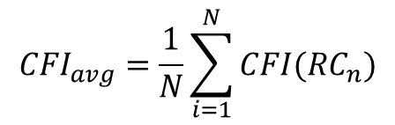

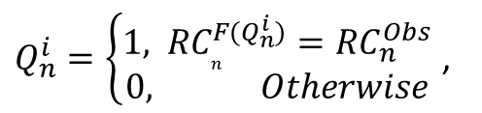
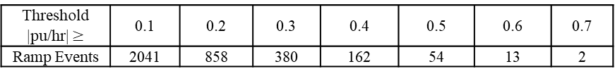
Modeling and Results
Combined Forecasts of Ramps
The uncertainty analysis
$$CFI({RC}_{n})=\frac{1}{99}\sum_{i=1}^{i=99}{Q_{n }^{i},}$$
$${CFI}_{avg}=\frac{1}{N}\sum_{i=1}^{N}{CFI({RC}_{n})}$$
$Q_{n}^{i}=\left\{\begin{matrix}\text{1, }{ RC}_{n}^{F(Q_{n}^{i})}={RC}_{n}^{Obs} \\ 0, Otherwise\end{matrix} \right.$,
The certainty forecasts for high-rate (HR) events by the adjusting approach for different ranges of ramp rates when threshold=0.4 pu/hr
Range of Rates, |p.u/hr| | [0-0.1) | [0.1-0.2) | [0.2-0.3) | [0.3-0.4) | [0.4-0.5) | [0.5-0.6) | [0.6-0.7) | [0.7-0.8)
Ramp Events | 1787 | 1183 | 478 | 218 | 108 | 41 | 11 | 2
The certainty of forecasts for high-rate (HR) events by the adjusting approach with different thresholds,
Tsh=0.1 to 0.7 pu/hr
Threshold |pu/hr| $≥$ | 0.1 | 0.2 | 0.3 | 0.4 | 0.5 | 0.6 | 0.7
Ramp Events | 2041 | 858 | 380 | 162 | 54 | 13 | 2

Slide 46

Modeling and Results
Intra-Hour Forecasts
Data Description:
In this study the adjusting approach is implemented for intra-hour forecasts.
This study also serves as an out-of-sample test* to verify the adjusting approach performance.
Golden – August 14, 2012, through September 24, 2013, semi-arid climate.
Cocoa – January 21, 2011, through March 4, 2012, subtropical climate.
Eugene – December 20, 2012, through January 20, 2014, marine west coast climate.
Available data
Weather variables (measurements)
Plane-of-Array (POA) Irradiance (W/m²) | Amount of solar irradiance received on the PV panel surface
Back-Surface Temperature of PV Panel (◦C) | PV panel back-surface temperature, measured behind the center of PV panel
Relative Humidity (%) | Relative humidity at the site
Precipitation (mm) | Accumulated daily total precipitation in millimeter
Direct Normal Irradiance (DNI) (W/m²) | Amount of solar irradiance received within a 5.7◦ field-of-view centered on the sun
Global Horizontal Irradiance (GHI) (W/m²) | Total amount of direct and diffuse solar irradiance received on a horizontal surface
Diffuse Horizontal Irradiance (DHI) (W/m²) | Amount of solar irradiance received from the sky (excluding the solar disk) on a horizontal surface
Data partition into training and testing sets:
The cross-validation strategy is adopted
3 Forecast horizons (15, 30, 60min) for 3 sites, (Golden, CO, Cocoa, FL, Eugene, OR) ➔9 cases.
* L. J. Tashman, Out-of-sample tests of forecasting accuracy: an analysis and review," International journal of forecasting, vol. 16, no. 4, pp. 437-450, 2000.

Slide 47



Modeling and Results
Intra-Hour Forecasts
The individual intra-hourly forecasts of solar power
$$RMSE=\sqrt{\frac{1}{n}\sum_{i=1}^{n}{\left({\left.{P_{i}−F}_{i}\right)}^{2}\right.}}$$
$$MAE=\frac{1}{n} \sum_{i=1}^{n}{|{P_{i}−F}_{i}|}$$
$$BIAS=\sum_{i=1}^{n}{\left({P_{i}−F}_{i}\right)}$$
Location | Horizon | Persistence |  |  | NAR |  |  | ARIMA |  |  | ANN |  |  | ELM
 |  | RMSE | MAE | MBE | RMSE | MAE | MBE | RMSE | MAE | BIAS | RMSE | MAE | MBE | RMSE | MAE | MBE
Golden | 15min | 0.0344 | 0.0255 | 0.2394 | 0.0327 | 0.0235 | -4.647 | 0.0346 | 0.0254 | -0.0007 | 0.0344 | 0.0257 | -5.276 | 0.0340 | 0.0254 | -0.969
 | 30min | 0.0481 | 0.0365 | 0.2113 | 0.0434 | 0.0322 | -2.108 | 0.0459 | 0.0346 | -0.3162 | 0.0432 | 0.0322 | -7.525 | 0.0464 | 0.0345 | -2.022
 | 60min | 0.0715 | 0.0541 | 0.2113 | 0.0586 | 0.0438 | -6.070 | 0.0608 | 0.0462 | 0.8859 | 0.0571 | 0.0431 | -3.672 | 0.0646 | 0.0465 | 3.773
Cocoa | 15min | 0.0411 | 0.0303 | 0.3746 | 0.0390 | 0.0269 | -6.028 | 0.0405 | 0.0287 | 0.3298 | 0.0384 | 0.0274 | -9.703 | 0.0408 | 0.0302 | -0.904
 | 30min | 0.0553 | 0.0417 | 0.3005 | 0.0479 | 0.0315 | -2.244 | 0.0470 | 0.0334 | 0.2949 | 0.0451 | 0.0307 | 2.389 | 0.0492 | 0.0325 | -0.482
 | 60min | 0.0870 | 0.0678 | 0.4302 | 0.0587 | 0.0420 | -7.261 | 0.0595 | 0.0427 | -0.1683 | 0.0562 | 0.0394 | -2.768 | 0.0579 | 0.0413 | 0.107
Eugene | 15min | 0.0358 | 0.0235 | 0.2126 | 0.0360 | 0.0238 | 0.939 | 0.0355 | 0.0219 | 0.2201 | 0.0350 | 0.0215 | -5.825 | 0.0344 | 0.0215 | -2.752
 | 30min | 0.0483 | 0.0344 | 0.2144 | 0.0425 | 0.0271 | -7.997 | 0.0442 | 0.0281 | -2.9847 | 0.0425 | 0.0270 | 3.761 | 0.0421 | 0.0270 | -3.048
 | 60min | 0.0738 | 0.0561 | 0.2144 | 0.0586 | 0.0397 | 0.187 | 0.0616 | 0.0415 | -0.0845 | 0.0575 | 0.0397 | -3.480 | 0.0568 | 0.0394 | -3.485
Total Average |  | 0.0550 | 0.0411 | 0.2676 | 0.0464 | 0.0323 | -3.9143 | 0.0477 | 0.0336 | -0.2026 | 0.0455 | 0.0319 | -3.5665 | 0.0474 | 0.0332 | -1.0871
The aggregated* evaluation of the individual intra-hourly forecasts of solar power
Forecast | Persist | NAR | ARIMA | ANN | ELM
RMSE_{avg} | 0.0550 | 0.0464 | 0.0477 | 0.0455 | 0.0474
MAE_{avg} | 0.0411 | 0.0323 | 0.0336 | 0.0319 | 0.0332
BIAS_{avg} | 0.2676 | -3.9143 | -0.2026 | -3.5665 | -1.0871
*Aggregation is conducted by taking the average of the evaluating values of all 3 horizons and 3 sites.

Slide 48
Modeling and Results
Intra-Hour Forecasts
Implementing the adjusting approach to forecasts solar power ramp events
Block diagram of the adjusting approach for intra-hour forecasts of solar power and ramp events

Slide 49
Modeling and Results
Intra-Hour Forecasts
Average improvements of the combined forecasts by the adjusting approach with respect to other forecasts
Location | Forecast Horizon | RMSE
 |  | Persist. | NAR | ARIMA | ANN | ELM | Simple Average | Adjusting Approach
Golden | 15min | 0.0344 | 0.0327 | 0.0346 | 0.0344 | 0.0340 | 0.0322 | 0.0246
 | 30min | 0.0481 | 0.0434 | 0.0459 | 0.0432 | 0.0464 | 0.0328 | 0.0280
 | 60min | 0.0715 | 0.0586 | 0.0608 | 0.0571 | 0.0637 | 0.0484 | 0.0453
Cocoa | 15min | 0.0411 | 0.0389 | 0.0405 | 0.0384 | 0.0408 | 0.0288 | 0.0240
 | 30min | 0.0553 | 0.0478 | 0.0470 | 0.0451 | 0.0484 | 0.0345 | 0.0288
 | 60min | 0.0870 | 0.0587 | 0.0594 | 0.0562 | 0.0578 | 0.0511 | 0.0420
Eugene | 15min | 0.0358 | 0.0360 | 0.0355 | 0.0350 | 0.0344 | 0.0255 | 0.0193
 | 30min | 0.0483 | 0.0425 | 0.0441 | 0.0425 | 0.0421 | 0.0313 | 0.0257
 | 60min | 0.0738 | 0.0586 | 0.0607 | 0.0575 | 0.0568 | 0.0465 | 0.0411
Average |  | 0.0550 | 0.0464 | 0.0476 | 0.0455 | 0.0472 | 0.0368 | 0.0310

Slide 50
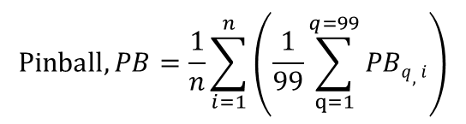
Modeling and Results
Intra-Hour Forecasts
Probabilistic Forecasts
Pb_{q,i} (F_{q}, $P_{i}$) = $\left\{\begin{matrix}\text{(}\text{1 }\text{−}\frac{q}{100}\text{)}\text{(}\text{F}\text{q} \text{−}P_{i}\text{), } \text{if}{ P}_{i}\text{<}\text{Fq} \\ \frac{q}{100} \text{(}P_{i}\text{−} \text{F}\text{q}\text{)}, \text{if}{ P}_{i}\text{≥}\text{F}\text{q}\end{matrix}\right.$
Quantiles, q$∈$[1- 99]
$$\text{Pinball}, PB=\frac{1}{n}\sum_{i=1}^{n}{\left(\frac{1}{99}\sum_{q=1}^{q=99}{PBq,i}\right)}$$
Location | Forecast Horizon | Pinball (PB)
 |  | Persistence | AnEn Simple Average | AnEn Adjusting Approach | Ensemble Adjusting Approach
Golden | 15min | 0.0236 | 0.0098 | 0.0071 | 0.0064
 | 30min | 0.0271 | 0.0102 | 0.0084 | 0.0077
 | 60min | 0.0289 | 0.0162 | 0.0141 | 0.0124
Cocoa | 15min | 0.0277 | 0.0082 | 0.0069 | 0.0063
 | 30min | 0.0304 | 0.0101 | 0.0081 | 0.0073
 | 60min | 0.0319 | 0.0166 | 0.0123 | 0.0109
Eugene | 15min | 0.0316 | 0.0067 | 0.0053 | 0.0046
 | 30min | 0.0370 | 0.0087 | 0.0072 | 0.0062
 | 60min | 0.0415 | 0.0148 | 0.0126 | 0.0106
Average |  | 0.0311 | 0.0113 | 0.0091 | 0.0080

Slide 51
Modeling and Results
Intra-Hour Forecasts
Forecasts | NAR | ARIMA | ANN | ELM | Simple Avg. | Adj. Approach
Precision (%) | 39% | 36% | 45% | 33% | 69% | 60%
Recall (%) | 13% | 9% | 14% | 11% | 24% | 48%
Balanced Precision (%) | 50% | 46% | 53% | 47% | 71% | 69%
F1 Score (%) | 19% | 12% | 20% | 15% | 29% | 53%
Diff. Index | 19 | 17 | 31 | 18 | 34 | 79
Intra-hour forecasts of solar power ramp events of the high-rate ramp events,
(|Rate| ≥ 0.1 pu/dt) by the adjusting approach.

Slide 52
Modeling and Results
Comparison of Hourly Forecasts
Comparison the hourly forecasts of solar power by the adjusting approach with different datasets
Location | Australia | Golden, CO | Cocoa, FL | Eugene, OR
RMSE | 0.0523 | 0.0453 | 0.0420 | 0.0411
Pinball | 0.0084 | 0.0124 | 0.0109 | 0.0106
Specifications of solar PV systems and data statistics
Dataset | Golden, CO | Cocoa, FL | Eugene, OR | Canberra
Country | USA | USA | USA | Australia
Climate type | Semi-arid | Subtropical | Marine coast | Oceanic
Latitude (°, -S) | 39.74 | 28.39 | 44.05 | -35.16
Longitude (°, -W) | -105.18 | -80.46 | -123.07 | 149.06
Elevation above sea (m) | 1798 | 12 | 145 | 595
Number of panels | 11 | 11 | 11 | 8
Panel tilt (°) from horizontal | 40 | 28.5 | 44 | 36
Panel orientation (°) clockwise from North | 180 | 180 | 180 | 38
Total capacity (W) | 1252 | 1272 | 1290 | 1560
Time period of observations | Aug. 2012 to Sep. 2013 | Jan. 2011 to March 2012 | Dec. 2012 to Jan. 2014 | April 2012 to May 2014
Data resolution | 15min | 5min | 5min | 1hr
Missing (% of observations) | 18% | 17% | 10% | 0%
Variability (data resolution) Std.Div. | (15min) 0.256 (1hr) 0.119 | (5min) 0.251 (1hr) 0.164 | (5min) 0.250 (1hr) 0.161 | (1hr) 0.259

Slide 53
Conclusions
The adjusting approach improves the combined forecasts.
The approach is simple vs. the classification techniques.
Ramp classes more separable with features: forecasts, ramp-rates, clouds, neighboring PVs.
Most effective weather variables:
Cloud information: cloud type, height and cloud formation.
Clear-sky solar irradiance / Top solar irradiance at Earth's atmospheric layer.
Diff. Index of high-rate ramps is efficient for the imbalanced classification.
Probabilistic forecasts as a tool of situational awareness.

Slide 54
Future Work
Recommendations and further work for this dissertation are as follows:
A direct comparison between the satellite-driven forecasts and the proposed approach.
Datasets with more different levels of variability of solar power.
Applying the adjusting approach to forecast wind power ramp events.
Assimilating power of neighboring PV systems, sky imaging and satellite data.
Using operational weather forecasts of high-resolution rabid refresh (HRRR) model.

Slide 55
https://www.researchgate.net/publication/328757565_A_Post-processing_Approach_for_Solar_Power_Combined_Forecasts_of_Ramp_Events/download
Vita
Dissertation-based Publications
M. Abuella and B. Chowdhury, “Solar Power Probabilistic Forecasting by Using Multiple Linear Regression Analysis,” in IEEE Southeast Con. Proceedings, 2015.
M. Abuella and B. Chowdhury, “Solar Power Forecasting using Artificial Neural Networks,” in North American Power Symposium (NAPS), 2015.
M. Abuella and B. Chowdhury, “Solar Power Forecasting Using Support Vector Regression,” in Proceedings of the American Society for Engineering Management 2016 International Annual Conference, 2016.
M. Abuella and B. Chowdhury, “Random forest ensemble of support vector regression models for solar power forecasting,” in 2017 IEEE Power Energy Society Innovative Smart Grid Technologies Conference (ISGT), 2017.
M. Abuella and B. Chowdhury, “Hourly probabilistic forecasting of solar power,” in 2017 North American Power Symposium (NAPS), 2017.
M. Abuella and B. Chowdhury, “Forecasting Solar Power Ramp Events Using Machine Learning Classification Techniques,” in 2018 IEEE 8th International Symposium on Power Electronics for Distributed Generation Systems (PEDG), 2018.
M. Abuella and B. Chowdhury, “Qualifying Combined Solar Power Forecasts in Ramp Events’ Perspective,” in IEEE Power & Energy Society General Meeting, 2018.
M. Abuella, & B. Chowdhury, “Improving Combined Solar Power Forecasts Using Estimated Ramp Rates: Data-driven Post-processing Approach,” IET Renewable Power Generation Journal, 2018.
M. Abuella, & B. Chowdhury, “Forecasting of Solar Power Ramp Events: A post Processing Approach,” Renewable Energy, 2018.

Slide 56


Thanks for Your Listening
Any Question?
A Post-processing Approach for Solar Power Combined Forecasts of Ramp Events
Mohamed Ali Abuella
mabuella@uncc.edu
https://epic.uncc.edu
Energy Production and Infrastructure Center
University of North Carolina at Charlotte

