Slide 1
Wind Energy Resources
Modeling and Analysis
Technical Presentation
By
Mohamed Abuella
August 6th, 2019

Slide 2
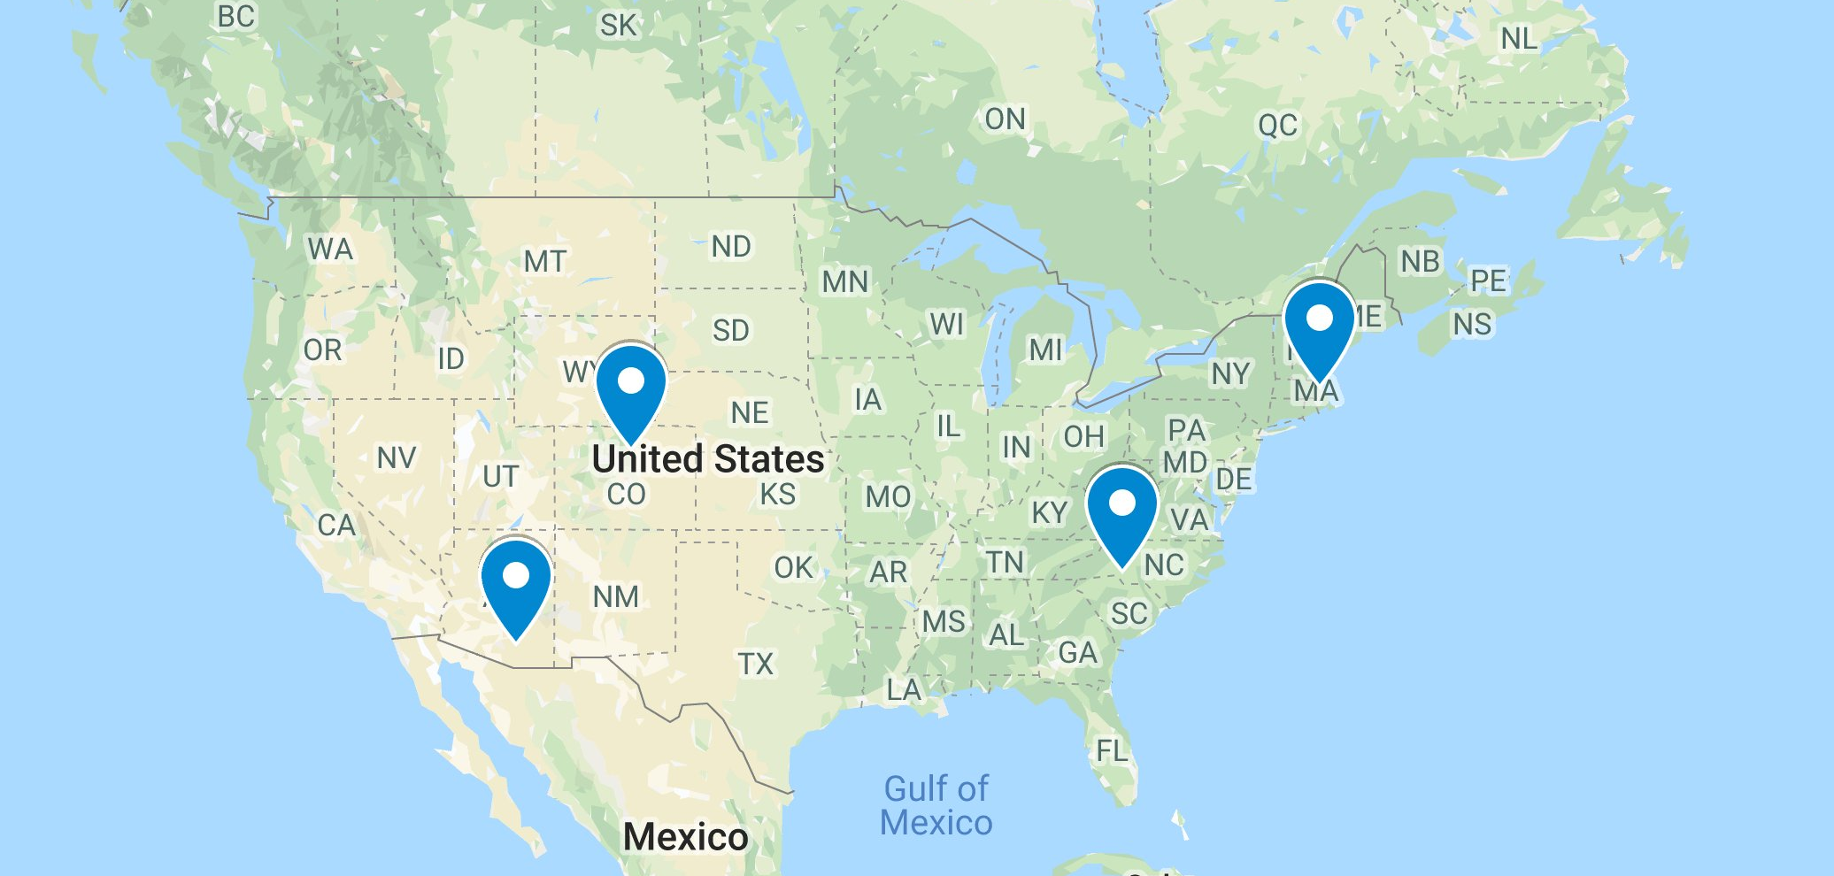
Wind Energy Resources Modeling and Analysis
For Different Locations in the U.S.
Four U.S. Locations are Chosen for Comparison of Wind Energy Modeling
Charlotte NC, Boston MA, Boulder CO, Tucson AZ.
Data are retrieved from NREL’s Developer Network: https://developer.nrel.gov/

Slide 3
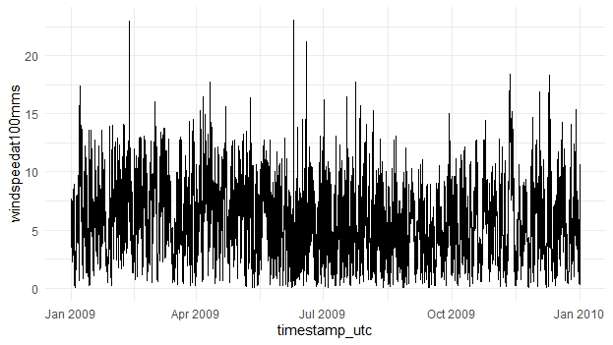
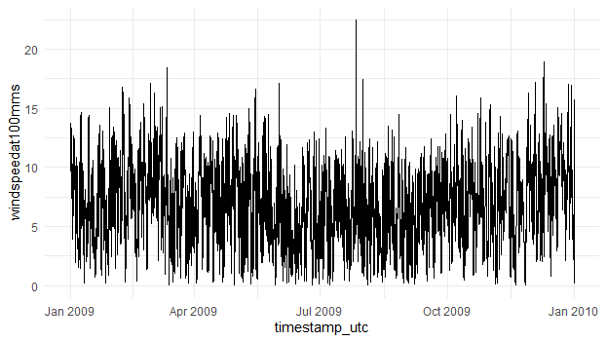
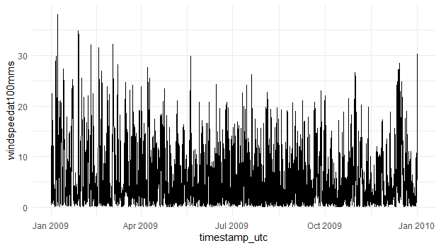
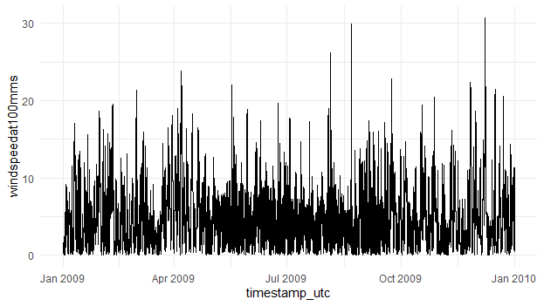

Wind Energy Resources Modeling
Charlotte, NC
Time series of wind speed at height 100m (m/s)
Boston, MA
$$Pw=\frac{1}{2}ρAv^{3}$$
Boulder, CO
Tucson, AZ

Slide 4
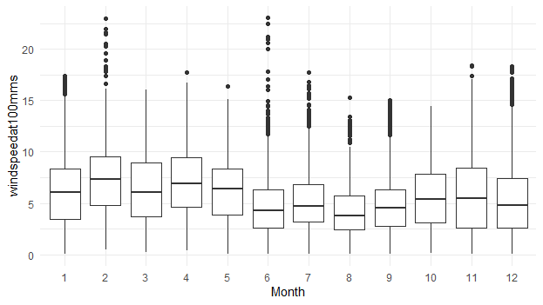
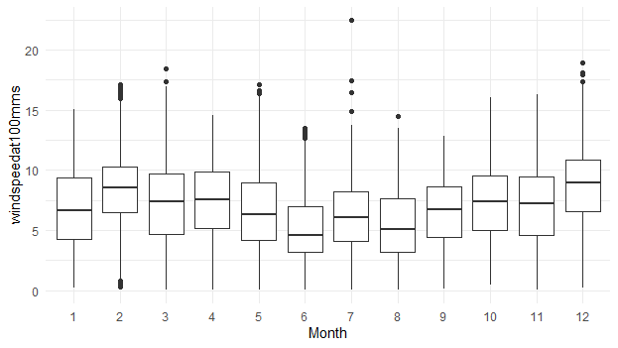
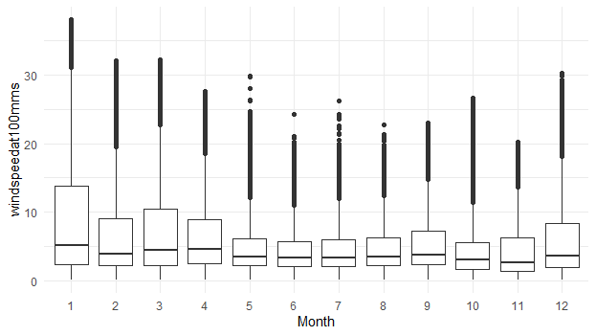
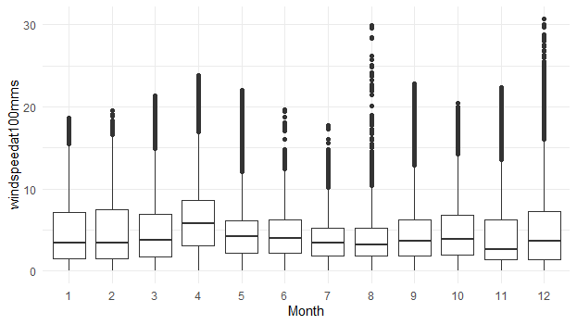
Wind Energy Resources Modeling
Charlotte, NC
Boxplots of monthly distribution of wind speed
Boston, MA
Boulder, CO
Tucson, AZ

Slide 5
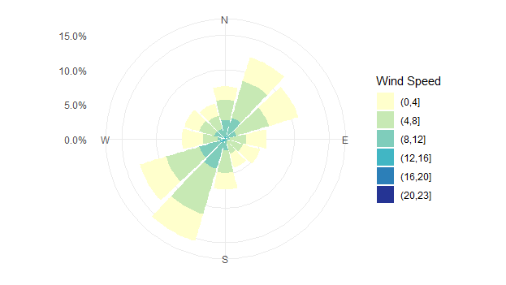
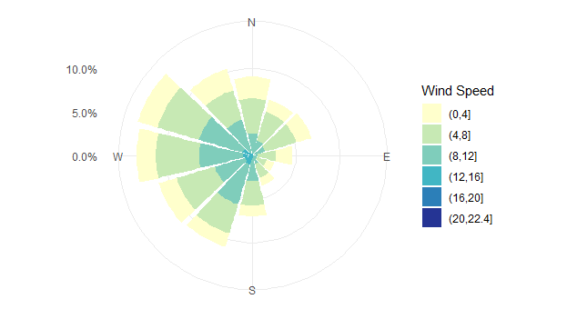
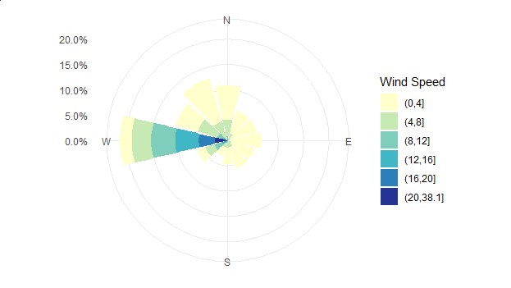
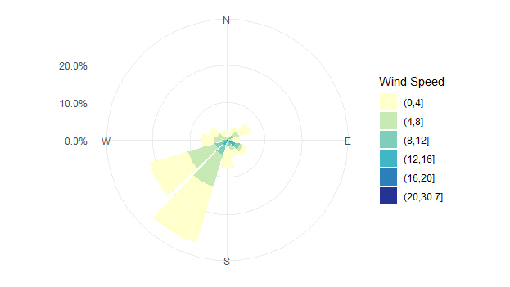
Wind Energy Resources Modeling
Charlotte, NC
Wind Roses of Wind Speed
Boston, MA
Distribution of wind direction and speed
Boulder, CO
Tucson, AZ

Slide 6
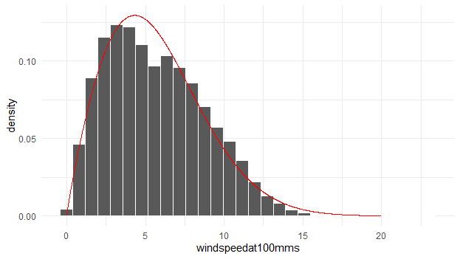
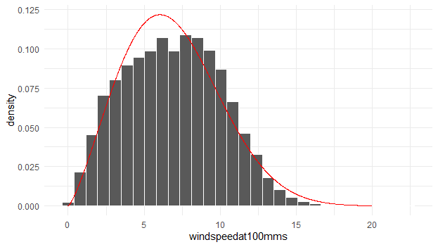
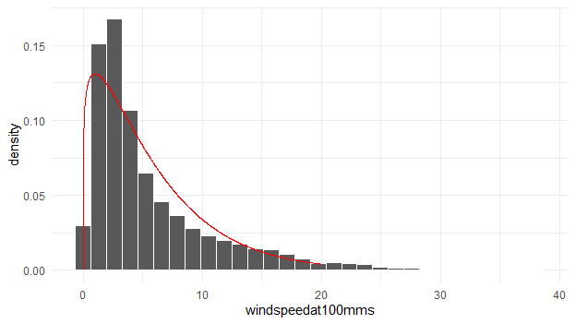
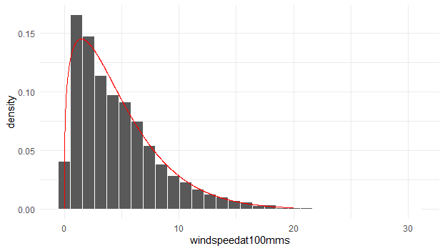
Wind Energy Resources Modeling
Charlotte, NC
Probability density distribution of wind speed
Boston, MA
Boulder, CO
Tucson, AZ

Slide 7
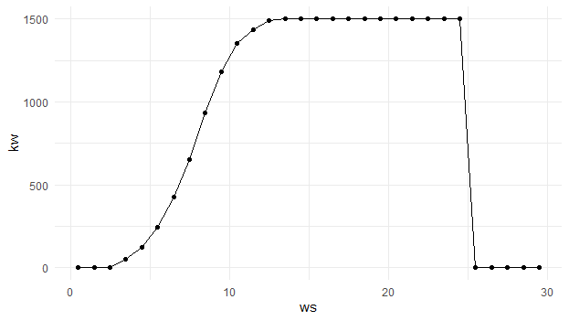

Wind Energy Resources Modeling
Charlotte, NC
Wind turbine GE 1.5SLE 77m is utilized for modeling
Boston, MA
The wind power curve for GE 1.5SLE 77m
to covert the wind speed to wind power
$$Pw=\frac{1}{2}ρAv^{3}$$
Boulder, CO
Tucson, AZ
http://www.wind-power-program.com/Downloads/Databasepowercurves(May2017).zip

Slide 8
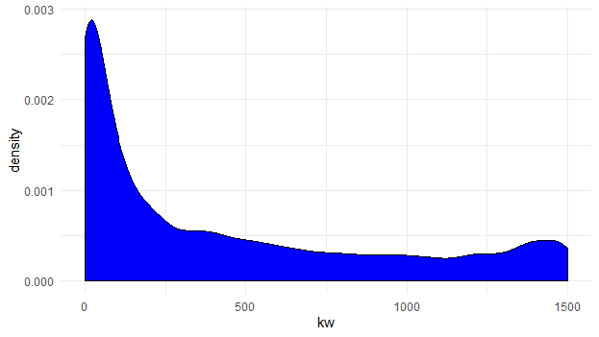
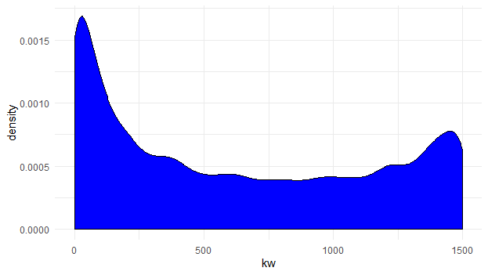
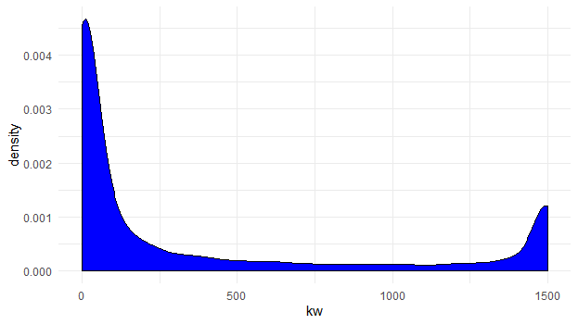
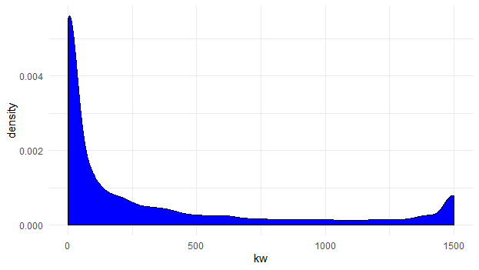

Wind Energy Resources Modeling
Charlotte, NC
Probability density distribution of wind power
Boston, MA
Considering other parameters such as air pressure, temperature and density at the given height=100m
$$Pw=\frac{1}{2}ρAv^{3}$$
Boulder, CO
Tucson, AZ

Slide 9

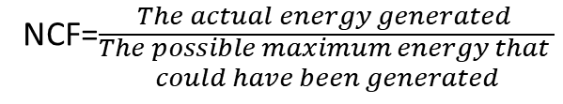
Wind Energy Resources Modeling
Charlotte, NC
Wind Energy Modeling
in 2009
Boston, MA
Month | MWh | NCF
1 | 387.574 | 34.70%
2 | 455.725 | 45.20%
3 | 410.236 | 36.80%
4 | 456.256 | 42.20%
5 | 381.352 | 34.20%
6 | 193.475 | 17.90%
7 | 230.690 | 20.70%
8 | 141.379 | 12.70%
9 | 197.738 | 18.30%
10 | 310.630 | 27.80%
11 | 355.663 | 32.90%
12 | 298.279 | 26.70%
Month0 | MWh | NCF
1 | 467.945 | 41.90%
2 | 584.361 | 58.00%
3 | 510.499 | 45.70%
4 | 512.191 | 47.40%
5 | 420.662 | 37.70%
6 | 239.808 | 22.20%
7 | 354.663 | 31.80%
8 | 285.923 | 25.60%
9 | 396.328 | 36.70%
10 | 504.488 | 45.20%
11 | 471.683 | 43.70%
12 | 691.553 | 62.00%
Calculating the net capacity factor (NCF)
for each month, then over the entire year
NCF=$\frac{The actual energy generated }{\begin{aligned}The possible maximum energy that \\ could have been generated\end{aligned}}$
Boulder, CO
Tucson, AZ
Month | MWh | NCF
1 | 413.396 | 37.00%
2 | 288.217 | 28.60%
3 | 382.094 | 34.20%
4 | 339.568 | 31.40%
5 | 222.077 | 19.90%
6 | 187.928 | 17.40%
7 | 216.100 | 19.40%
8 | 215.737 | 19.30%
9 | 268.648 | 24.90%
10 | 206.966 | 18.50%
11 | 224.898 | 20.80%
12 | 312.770 | 28.00%
NCF=$\frac{The actual energy (MWh) }{The capacity ∗time (MWh)}$
Month0 | MWh | NCF
1 | 262.764 | 23.50%
2 | 247.664 | 24.60%
3 | 259.804 | 23.30%
4 | 378.228 | 35.00%
5 | 184.679 | 16.50%
6 | 188.630 | 17.50%
7 | 111.523 | 10.00%
8 | 143.448 | 12.90%
9 | 223.078 | 20.70%
10 | 258.261 | 23.10%
11 | 236.885 | 21.90%
12 | 274.958 | 24.60%

Slide 10
Wind Energy Resources Modeling
Wind Energy Modeling
in 2009 and 2010
2009 | MWh | NCF
Charlotte | 3818.9 | 29.1%
Boulder | 3278.4 | 24.9%
Boston | 5440.1 | 41.4%
Tucson | 2769.9 | 21.1%
2010 | MWh | NCF
Charlotte | 3544.6 | 27.0%
Boulder | 2676.9 | 20.4%
Boston | 6107.7 | 46.5%
Tucson | 2969.9 | 22.6%

Slide 11
Wind Energy Resources Modeling and Analysis
Conclusion
The performance of wind energy resources depends significantly on their location and weather conditions.
Further Work
Modeling and evaluate the wind resources backed up by energy storage systems.
References
https://www.r-bloggers.com/time-series-analysis-with-wind-resource- assessment-in-r/
https://github.com/mhdella/AWEA_WRA_Working_Group/blob/master/Example_Wind_Resource_Assessment_Using_R.md

