Slide 1
Wind and Solar Energy Resources
Modeling and Analysis
Technical Presentation
By
Mohamed Abuella
The University of North Carolina at Charlotte
August 9th, 2019

Slide 2
Solar Energy Resources
Modeling
Wind Energy Resources
Modeling
Presentation Outline

Slide 3
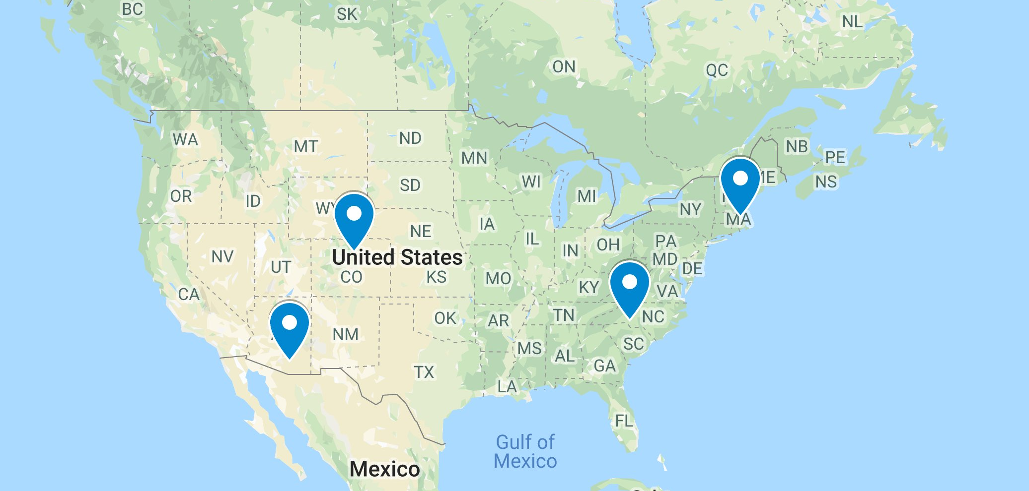
Wind and Solar Energy Resources Modeling and Analysis
For Different Locations in the U.S.
Four U.S. Locations for Comparison of Renewable Energy Modeling and Analysis
Charlotte NC, Boston MA, Boulder CO, Tucson AZ.
Data are retrieved from NREL’s Developer Network: https://developer.nrel.gov/

Slide 4
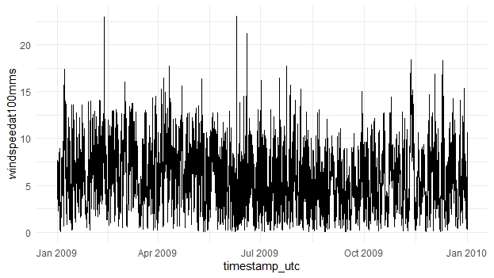
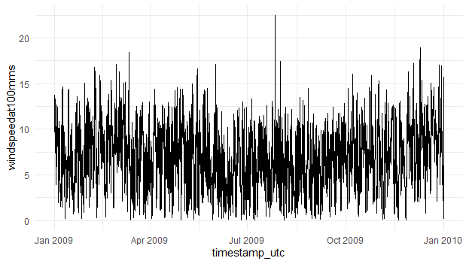
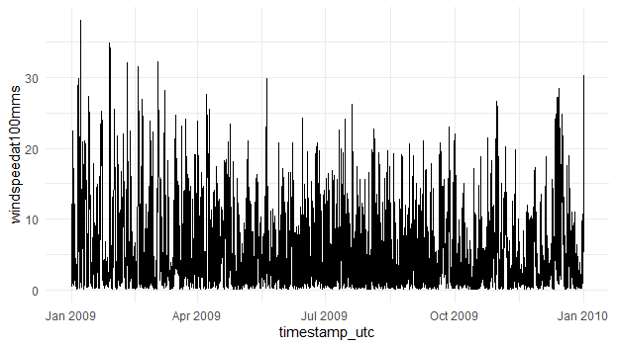
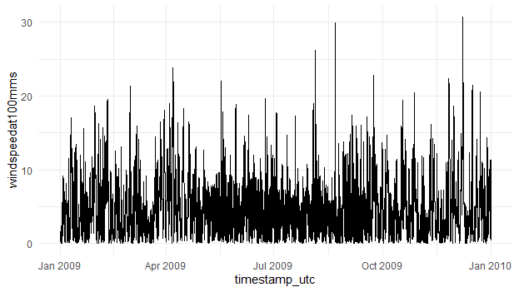

Wind Energy Resources Modeling
Charlotte, NC
Time series of wind speed at height 100m (m/s)
Boston, MA
$$Pw=\frac{1}{2}ρAv^{3}$$
Boulder, CO
Tucson, AZ

Slide 5
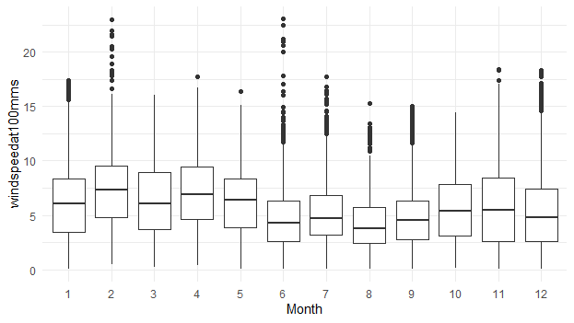
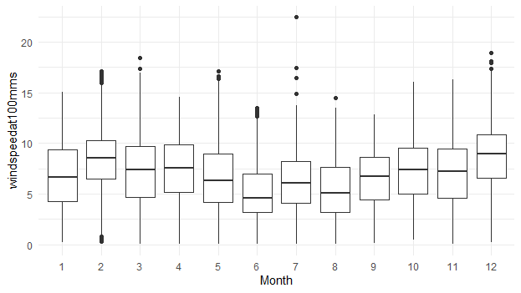
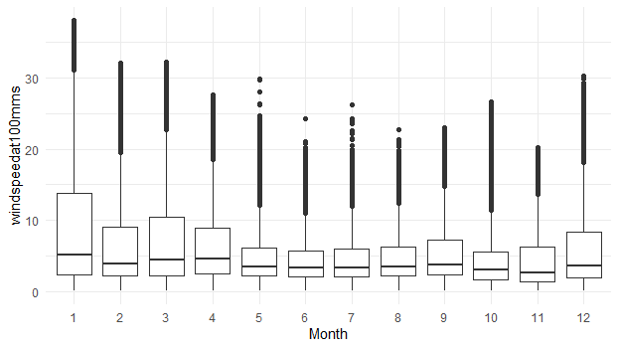
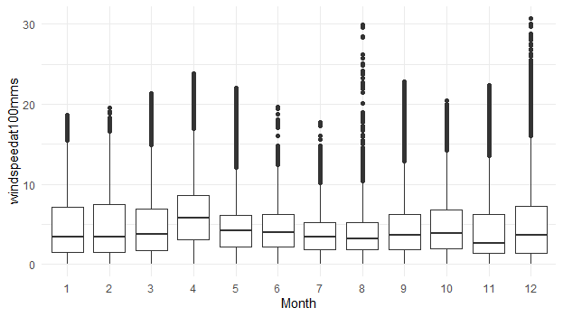
Wind Energy Resources Modeling
Charlotte, NC
Boxplots of monthly distribution of wind speed
Boston, MA
Boulder, CO
Tucson, AZ

Slide 6
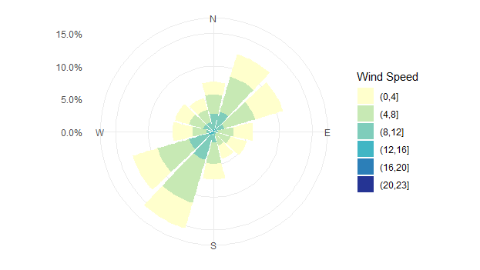
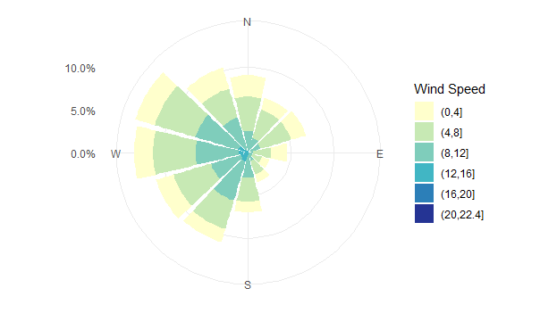
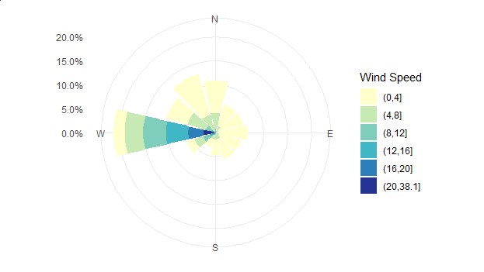
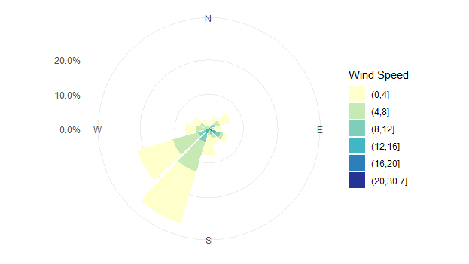
Wind Energy Resources Modeling
Charlotte, NC
Wind Roses of Wind Speed
Boston, MA
Distribution of wind direction and speed
Boulder, CO
Tucson, AZ

Slide 7
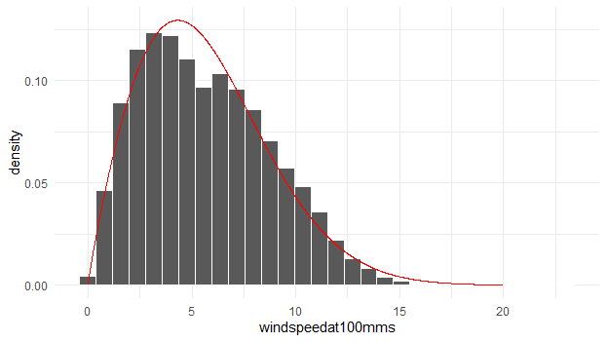
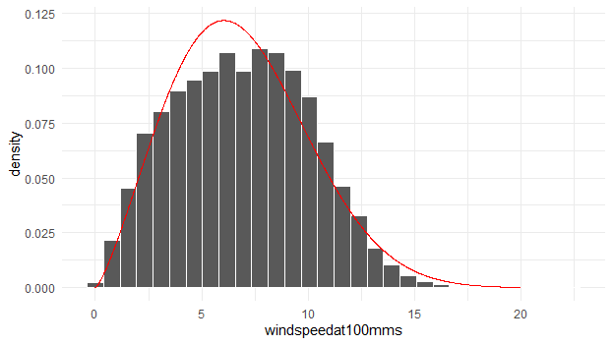
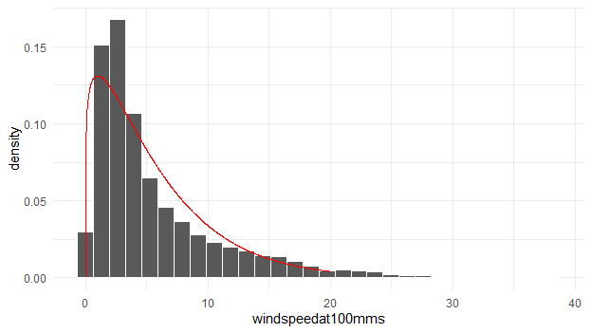
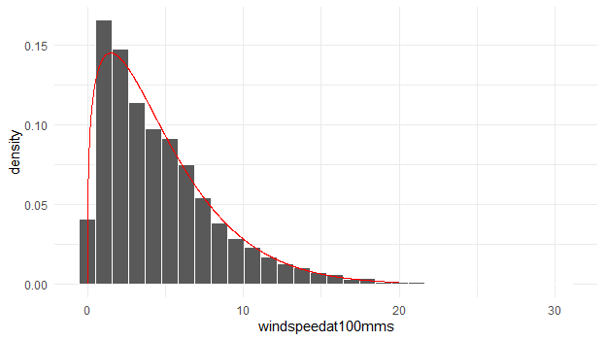
Wind Energy Resources Modeling
Charlotte, NC
Probability density distribution of wind speed
Boston, MA
Boulder, CO
Tucson, AZ

Slide 8
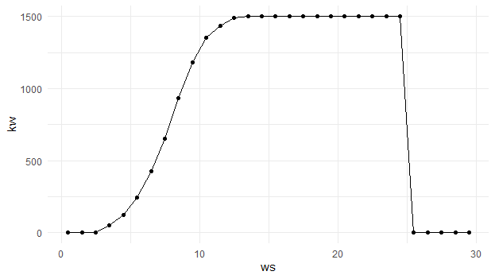

Wind Energy Resources Modeling
Charlotte, NC
Wind turbine GE 1.5SLE 77m is utilized for modeling
Boston, MA
The wind power curve for GE 1.5SLE 77m
to covert the wind speed to wind power
$$Pw=\frac{1}{2}ρAv^{3}$$
Boulder, CO
Tucson, AZ
http://www.wind-power-program.com/Downloads/Databasepowercurves(May2017).zip

Slide 9
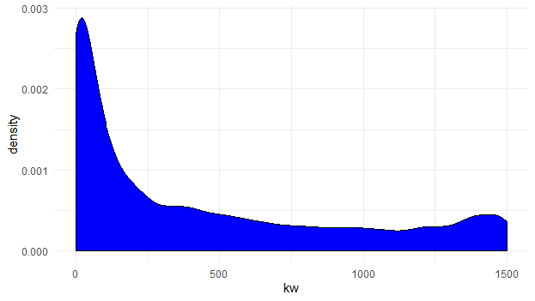
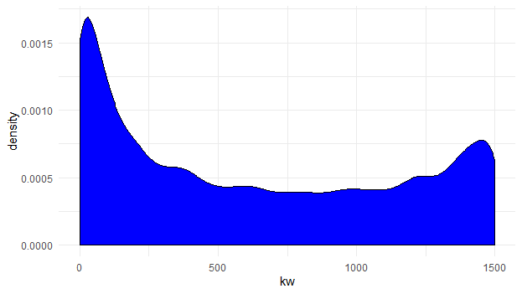
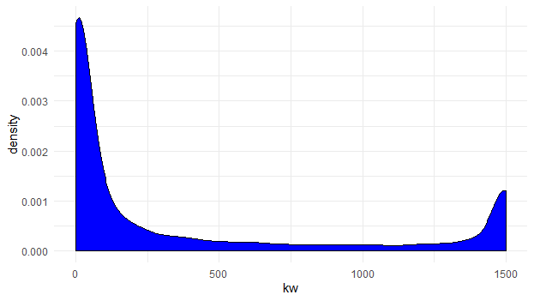
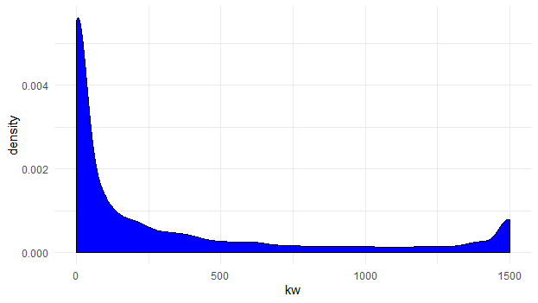

Wind Energy Resources Modeling
Charlotte, NC
Probability density distribution of wind power
Boston, MA
Considering other parameters such as air pressure, temperature and density at the given height=100m
$$Pw=\frac{1}{2}ρAv^{3}$$
Boulder, CO
Tucson, AZ

Slide 10

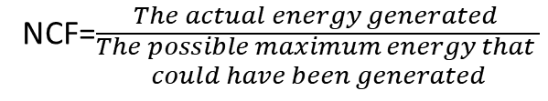
Wind Energy Resources Modeling
Charlotte, NC
Wind Energy Modeling
in 2009
Boston, MA
Month | MWh | NCF
1 | 387.574 | 34.70%
2 | 455.725 | 45.20%
3 | 410.236 | 36.80%
4 | 456.256 | 42.20%
5 | 381.352 | 34.20%
6 | 193.475 | 17.90%
7 | 230.690 | 20.70%
8 | 141.379 | 12.70%
9 | 197.738 | 18.30%
10 | 310.630 | 27.80%
11 | 355.663 | 32.90%
12 | 298.279 | 26.70%
Month0 | MWh | NCF
1 | 467.945 | 41.90%
2 | 584.361 | 58.00%
3 | 510.499 | 45.70%
4 | 512.191 | 47.40%
5 | 420.662 | 37.70%
6 | 239.808 | 22.20%
7 | 354.663 | 31.80%
8 | 285.923 | 25.60%
9 | 396.328 | 36.70%
10 | 504.488 | 45.20%
11 | 471.683 | 43.70%
12 | 691.553 | 62.00%
Calculating the net capacity factor (NCF)
for each month, then over the entire year
NCF=$\frac{The actual energy generated }{\begin{aligned}The possible maximum energy that \\ could have been generated\end{aligned}}$
Boulder, CO
Tucson, AZ
Month | MWh | NCF
1 | 413.396 | 37.00%
2 | 288.217 | 28.60%
3 | 382.094 | 34.20%
4 | 339.568 | 31.40%
5 | 222.077 | 19.90%
6 | 187.928 | 17.40%
7 | 216.100 | 19.40%
8 | 215.737 | 19.30%
9 | 268.648 | 24.90%
10 | 206.966 | 18.50%
11 | 224.898 | 20.80%
12 | 312.770 | 28.00%
NCF=$\frac{The actual energy (MWh) }{The capacity ∗time (MWh)}$
Month0 | MWh | NCF
1 | 262.764 | 23.50%
2 | 247.664 | 24.60%
3 | 259.804 | 23.30%
4 | 378.228 | 35.00%
5 | 184.679 | 16.50%
6 | 188.630 | 17.50%
7 | 111.523 | 10.00%
8 | 143.448 | 12.90%
9 | 223.078 | 20.70%
10 | 258.261 | 23.10%
11 | 236.885 | 21.90%
12 | 274.958 | 24.60%

Slide 11
Wind Energy Resources Modeling
Wind Energy Modeling
in 2009 and 2010
2009 | MWh | NCF
Charlotte | 3818.9 | 29.1%
Boulder | 3278.4 | 24.9%
Boston | 5440.1 | 41.4%
Tucson | 2769.9 | 21.1%
2010 | MWh | NCF
Charlotte | 3544.6 | 27.0%
Boulder | 2676.9 | 20.4%
Boston | 6107.7 | 46.5%
Tucson | 2969.9 | 22.6%

Slide 12
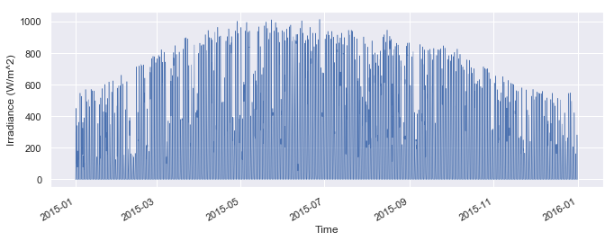
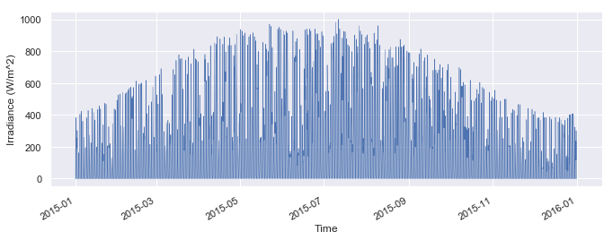
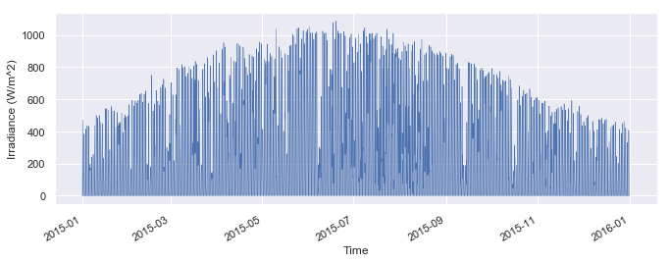
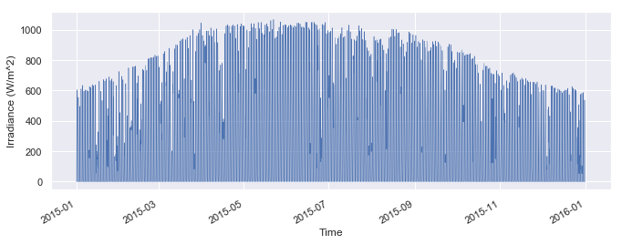
Solar Energy Resources Modeling
Time series of Global Horizontal Solar Irradiance data (W/m²)
Charlotte, NC
Boston, MA
Boulder, CO
Tucson, AZ

Slide 13
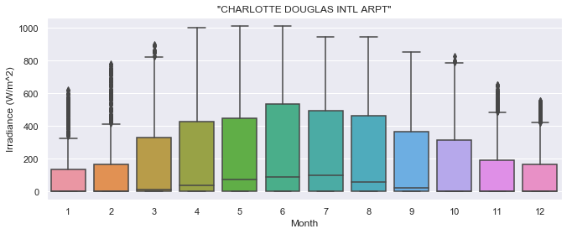
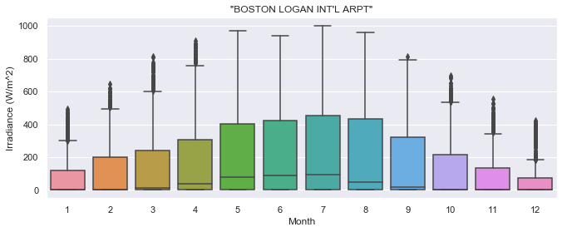
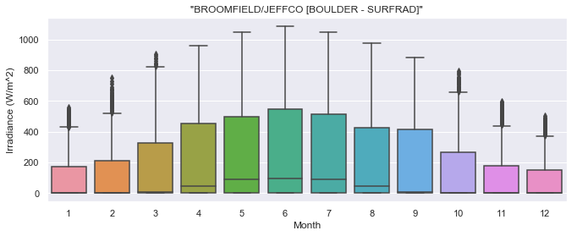
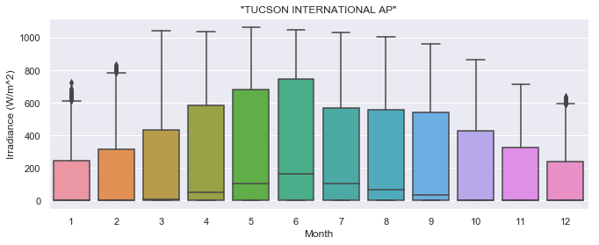
Solar Energy Resources Modeling
Boxplots of monthly distribution of Global Horizontal
Solar Irradiance (GHI)
Charlotte, NC
Boston, MA
Boulder, CO
Tucson, AZ

Slide 14
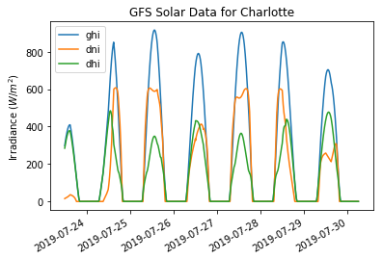
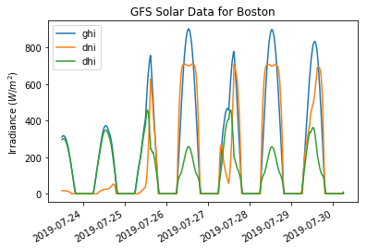
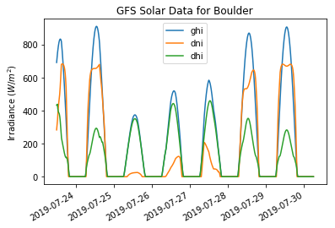
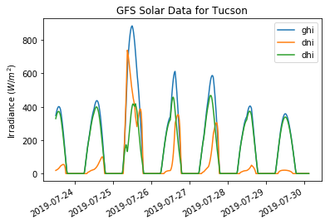
Solar Energy Resources Modeling
Time series of components of solar irradiance, GHI, DNI, DHI (W/m²)

Slide 15
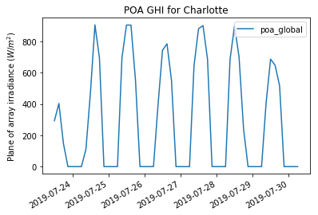
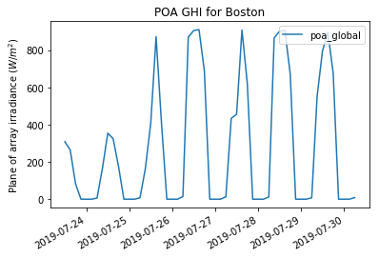
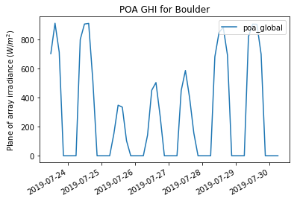
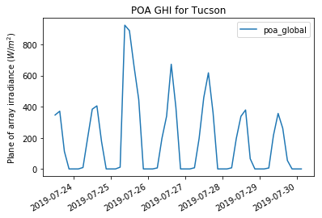
Solar Energy Resources Modeling
Global Horizontal Irradiance (GHI) at the plane of array (POA)

Slide 16
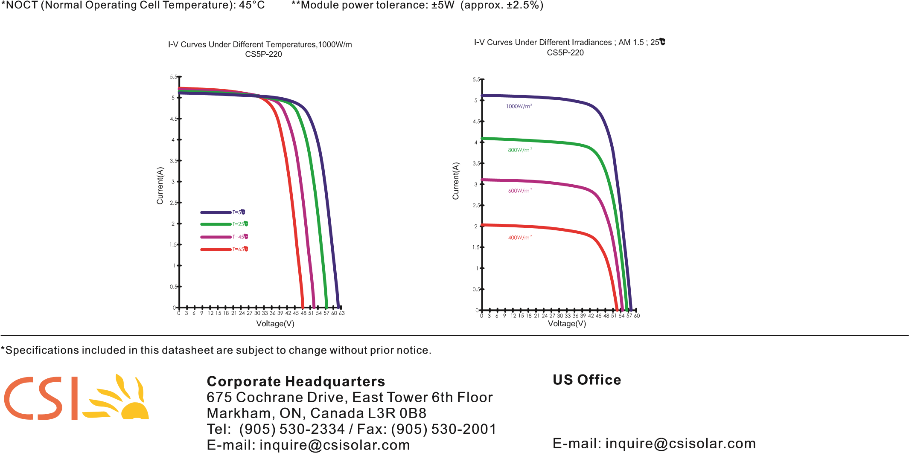
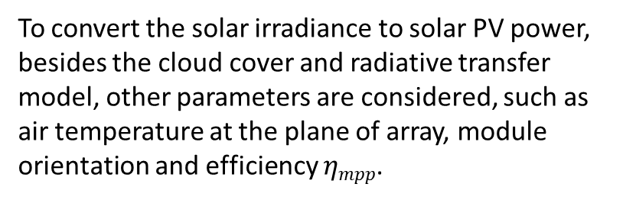
Solar Energy Resources Modeling
Convert GHI at the POA to Solar PV Power
To convert the solar irradiance to solar PV power, besides the cloud cover and radiative transfer model, other parameters are considered, such as air temperature at the plane of array, module orientation and efficiency $ηmpp$.
$$Psol≅ηmpp\left(GHIPOA , Tm\right)GHIPOA∗A$$
PV Module CS5P-220M
Manufacturer: Canadian Solar Type: Polycrystalline Cells
Power: 220 W (Maximum)
Length: 63.1in (1,602mm)
Width: 41.8in (1,061mm)
Depth: 1.6in (40mm)
https://www.solarover.com/panels/cs5p.pdf
Pvlib Toolbox from Sandia and NREL’s SAM package and Weather Data from GFS Global Model
https://pvlib-python.readthedocs.io/en/latest/introexamples.html
https://pvlib-python.readthedocs.io/en/latest/forecasts.htm

Slide 17
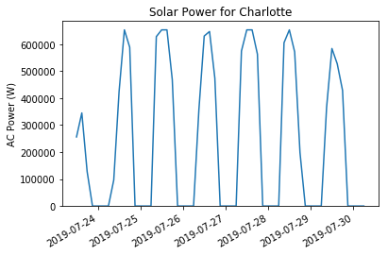
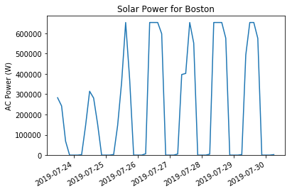
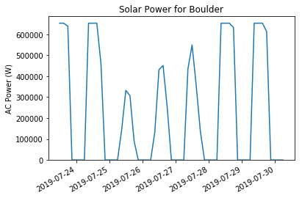
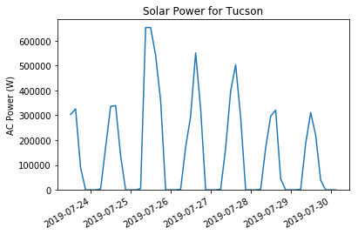
Solar Energy Resources Modeling
Time series of Solar Power (W), for a solar plant with 15*300 PV modules (220W for each)

Slide 18

Solar Energy Resources Modeling
Charlotte, NC
Solar Energy Modeling
Typical Meteorological Year (TMY)
Boston, MA
Month | Wh | NCF
1 | 24215.85 | 14.79%
2 | 23356.93 | 15.80%
3 | 32597.21 | 19.92%
4 | 34440.42 | 21.74%
5 | 34155.32 | 20.87%
6 | 34034.79 | 21.49%
7 | 33878.82 | 20.70%
8 | 32241.97 | 19.70%
9 | 29538.82 | 18.65%
10 | 32026.31 | 19.57%
11 | 24730.09 | 15.61%
12 | 23873.06 | 14.60%
Month0 | Wh | NCF
1 | 20036.95 | 12.24%
2 | 24185.77 | 16.36%
3 | 28973.17 | 17.70%
4 | 30208.65 | 19.07%
5 | 34770.35 | 21.24%
6 | 32713.24 | 20.65%
7 | 35418.34 | 21.64%
8 | 33992.69 | 20.77%
9 | 29731.42 | 18.77%
10 | 25504.76 | 15.58%
11 | 19138.34 | 12.08%
12 | 17866.74 | 10.93%
For 1 PV module (220W, PV Module CS5P-220M)
Calculating the net capacity factor (NCF)
for each month, then over the entire year
NCF=$\frac{The actual energy generated }{\begin{aligned}The possible maximum energy that \\ could have been generated\end{aligned}}$
Boulder, CO
Tucson, AZ
Month | Wh | NCF
1 | 26432.06 | 16.15%
2 | 26847.92 | 18.16%
3 | 34451.63 | 21.05%
4 | 36840.41 | 23.26%
5 | 38157.38 | 23.31%
6 | 35819.85 | 22.61%
7 | 35061.05 | 21.42%
8 | 34979.76 | 21.37%
9 | 33776.53 | 21.32%
10 | 31482.96 | 19.23%
11 | 25915.03 | 16.36%
12 | 25576.46 | 15.65%
NCF=$\frac{The actual energy (Wh) }{The capacity ∗time (Wh)}$
Month0 | Wh | NCF
1 | 32631.67 | 19.94%
2 | 31464.61 | 21.28%
3 | 38343.02 | 23.43%
4 | 41304.64 | 26.08%
5 | 41329.6 | 25.25%
6 | 38467.5 | 24.29%
7 | 35637.61 | 21.77%
8 | 36685.47 | 22.41%
9 | 36643.06 | 23.13%
10 | 38215.38 | 23.35%
11 | 35144.2 | 22.19%
12 | 32264.5 | 19.74%

Slide 19
Solar Energy Resources Modeling
Calculating the total energy and net capacity factor, as it is done in the wind energy modeling
For 1 PV module (220W, PV Module CS5P-220M)
TMY | KWh | NCF
Charlotte | 359.0896 | 18.63%
Boulder | 385.341 | 19.99%
Boston | 332.5404 | 17.26%
Tucson | 438.1313 | 22.73%
TMY: Typical Meteorological Year, which means it assumes the same variability of solar output for other years.

Slide 20
Wind and Solar Energy Resources Modeling
Comparison of NCF for Resources of Wind & Solar Energy
2009 | NCF
 | Wind Energy | Solar Energy
Charlotte | 29.10% | 18.63%
Boulder | 24.90% | 19.99%
Boston | 41.40% | 17.26%
Tucson | 21.10% | 22.73%
2010 | NCF
 | Wind Energy | Solar Energy
Charlotte | 27.00% | 18.63%
Boulder | 20.40% | 19.99%
Boston | 46.50% | 17.26%
Tucson | 22.60% | 22.73%

Slide 21
Wind and Solar Energy Resources Modeling
Conclusion
The performance of wind and solar energy resources depends significantly on their location and weather conditions.
Further Work
Modeling and evaluate the wind and solar resources backed up by energy storage systems.
References
https://www.r-bloggers.com/time-series-analysis-with-wind-resource- assessment-in-r/
https://github.com/mhdella/AWEA_WRA_Working_Group/blob/master/Example_Wind_Resource_Assessment_Using_R.md
https://pvlib-python.readthedocs.io/en/latest/introexamples.html
Stein, J. S., Holmgren, W. F., Forbess, J., & Hansen, C. W. (2016, June). PVLIB: Open source photovoltaic performance modeling functions for Matlab and Python. In 2016 ieee 43rd photovoltaic specialists conference (pvsc) (pp. 3425-3430). IEEE.
Blair, N., Dobos, A. P., Freeman, J., Neises, T., Wagner, M., Ferguson, T., ... & Janzou, S. (2014). System advisor model, sam 2014.1. 14: General description (No. NREL/TP-6A20-61019). National Renewable Energy Lab.(NREL), Golden, CO (United States).

Slide 22


Thanks for Listening
Any Question?
Mohamed Abuella
https://mohamedabuella.github.io
http://epic.uncc.edu/
Energy Production and Infrastructure Center
University of North Carolina at Charlotte

