Slide 1
Wind Energy Modeling and Analysis

Slide 2
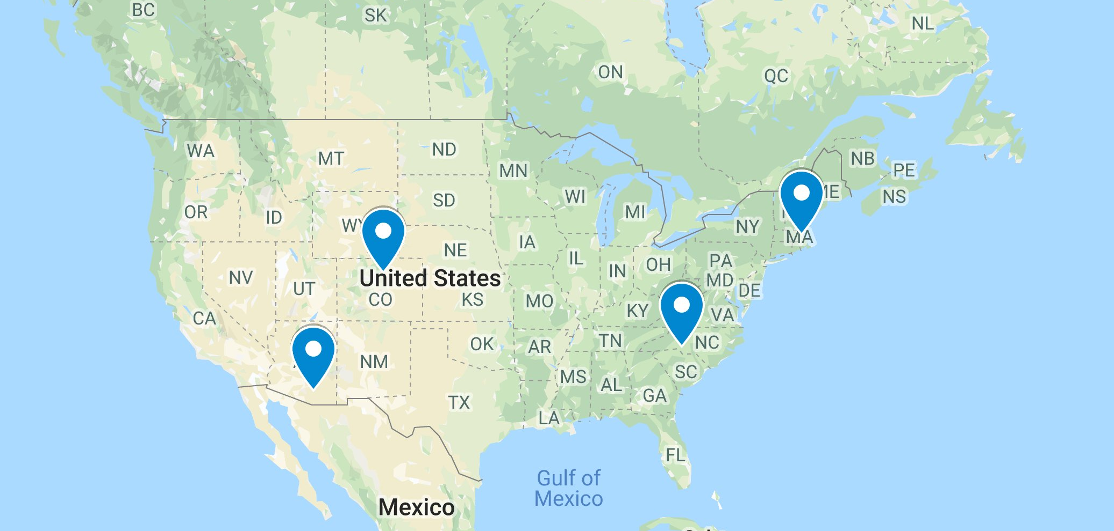
Four U.S. Locations for Comparison of Renewable Energy Modeling and Analysis
Charlotte NC, Boston MA, Boulder CO, Tucson AZ.

Slide 3
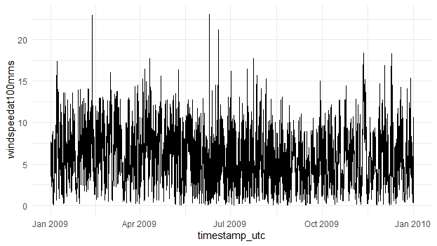
Charlotte, NC

Slide 4
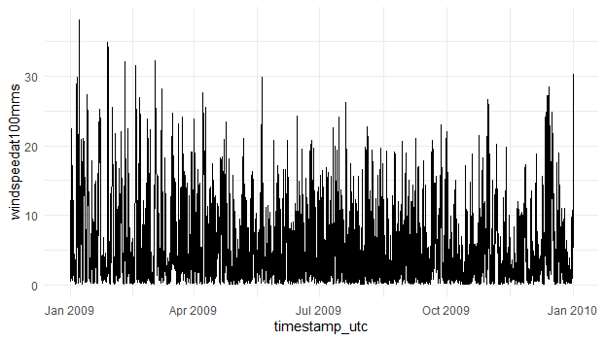
Boulder, CO

Slide 5
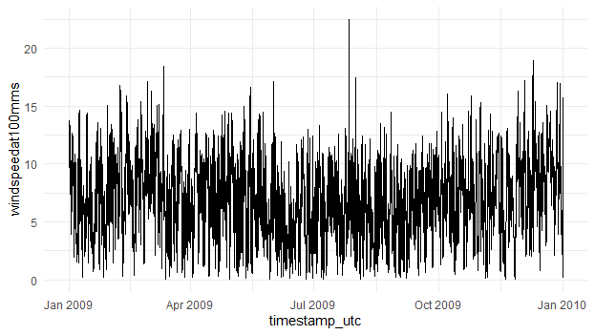
Boston, MA

Slide 6
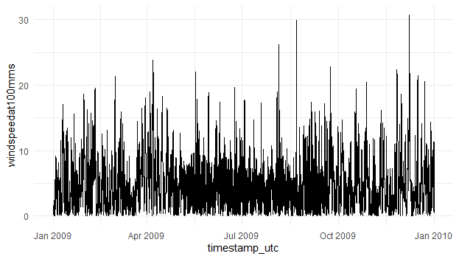
Tucson, AZ

Slide 7
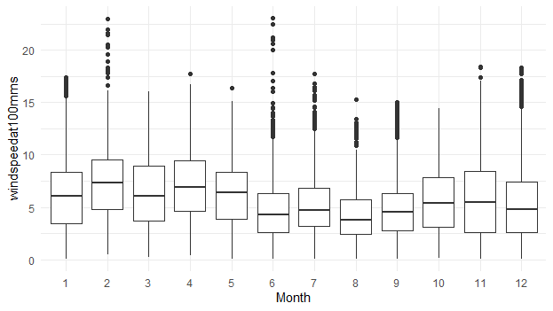
Charlotte, NC

Slide 8
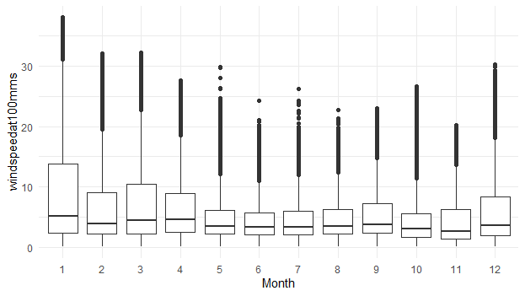
Boulder, CO

Slide 9
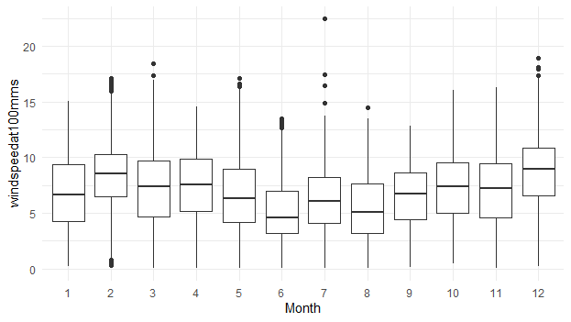
Boston, MA

Slide 10
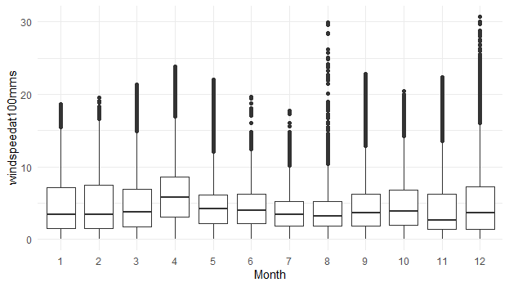
Tucson, AZ

Slide 11
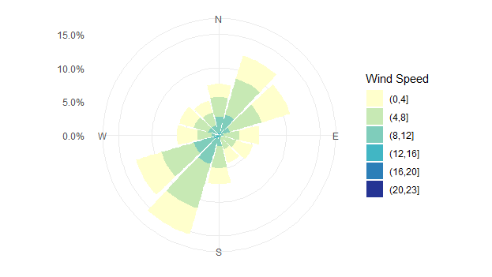
Charlotte, NC

Slide 12
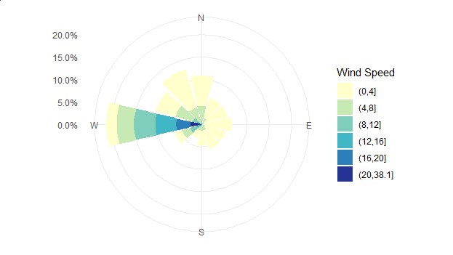
Boulder, CO

Slide 13
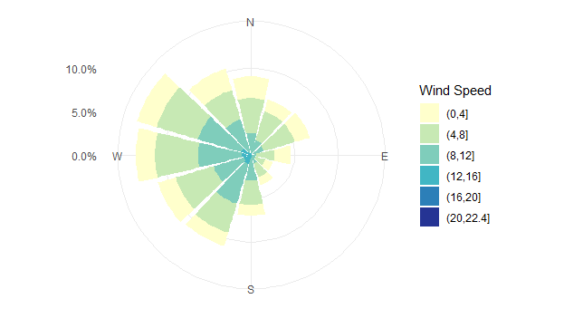
Boston, MA

Slide 14
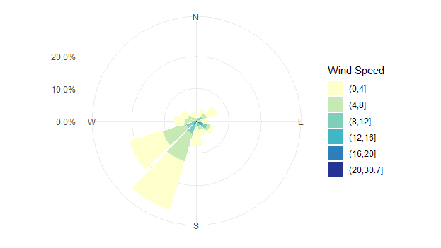
Tucson, AZ

Slide 15
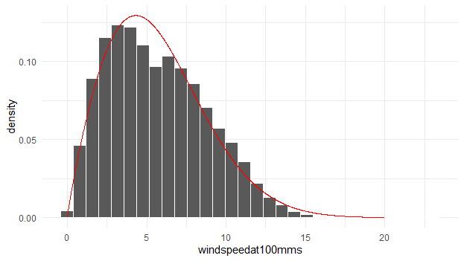
Charlotte, NC

Slide 16
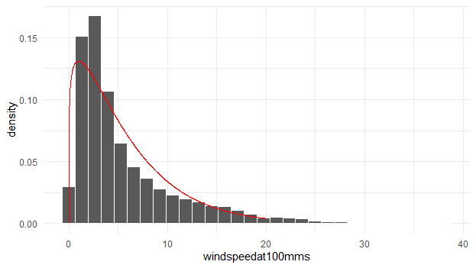
Boulder, CO

Slide 17
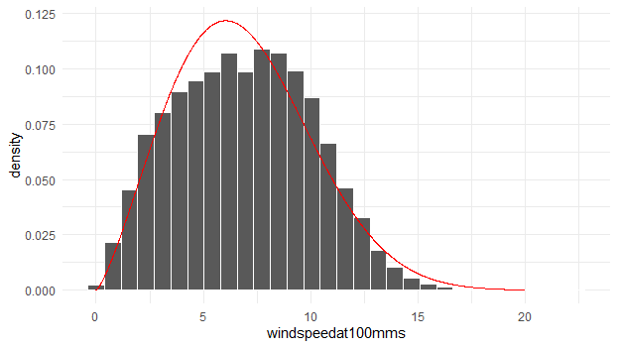
Boston, MA

Slide 18
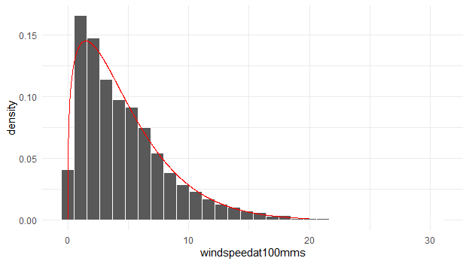
Tucson, AZ

Slide 19
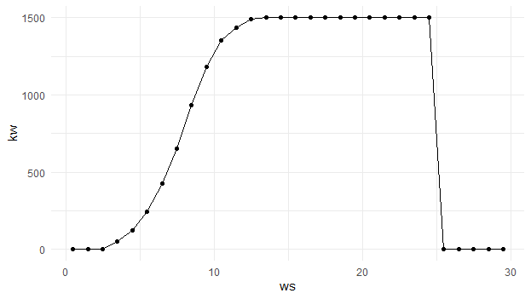
Charlotte, NC

Slide 20
Boulder, CO

Slide 21
Boston, MA

Slide 22
Tucson, AZ

Slide 23
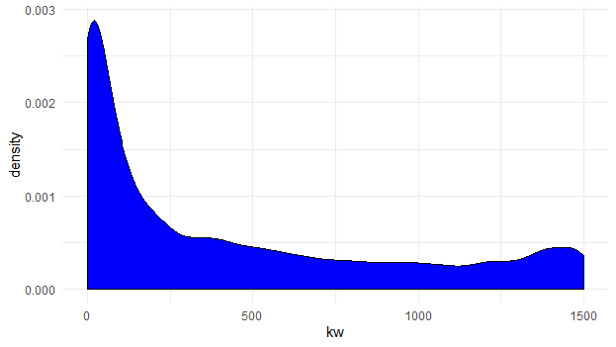
Charlotte, NC

Slide 24
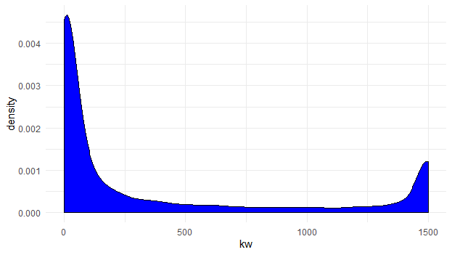
Boulder, CO

Slide 25
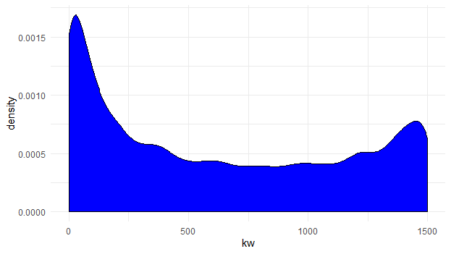
Boston, MA

Slide 26
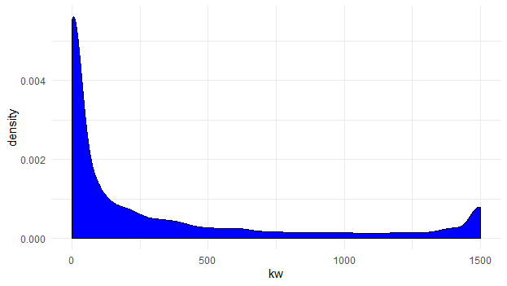
Tucson, AZ

Slide 27
Annual capacity factors 2014-2016 US average
Power Plant | Coal | CCGT | Wind | Solar PV | Nuclear
Annual Capacity Factor | 56% | 53% | 33% | 26% | 92%
Charlotte, NC
Month | Hours | Wind speed | MWh | NCF
1 | 744 | 6.179 | 387.574 | 34.70%
2 | 672 | 7.154 | 455.725 | 45.20%
3 | 744 | 6.374 | 410.236 | 36.80%
4 | 720 | 6.987 | 456.256 | 42.20%
5 | 744 | 6.225 | 381.352 | 34.20%
6 | 720 | 4.692 | 193.475 | 17.90%
7 | 744 | 5.073 | 230.690 | 20.70%
8 | 744 | 4.146 | 141.379 | 12.70%
9 | 720 | 4.740 | 197.738 | 18.30%
10 | 744 | 5.567 | 310.630 | 27.80%
11 | 720 | 5.918 | 355.663 | 32.90%
12 | 744 | 5.298 | 298.279 | 26.70%
MWh | NCF
3818.9 | 29.1%
While U.S. annual capacity factors from 2013 through 2016 range from 32.2% to 34.7%, "EIA - Electricity Data". www.eia.gov. Retrieved 2017-04-10.
In the United Kingdom during the five year period from 2011 to 2015 the annual capacity factor for wind was over 30% "Digest of United Kingdom energy statistics (DUKES) for 2012 to 2016:

Slide 28
Boulder, CO
Month | Hours | Wind speed | MWh | NCF
1 | 744 | 8.377 | 413.396 | 37.00%
2 | 672 | 6.736 | 288.217 | 28.60%
3 | 744 | 6.973 | 382.094 | 34.20%
4 | 720 | 6.441 | 339.568 | 31.40%
5 | 744 | 4.745 | 222.077 | 19.90%
6 | 720 | 4.380 | 187.928 | 17.40%
7 | 744 | 4.600 | 216.100 | 19.40%
8 | 744 | 4.742 | 215.737 | 19.30%
9 | 720 | 5.381 | 268.648 | 24.90%
10 | 744 | 4.609 | 206.966 | 18.50%
11 | 720 | 4.409 | 224.898 | 20.80%
12 | 744 | 6.096 | 312.770 | 28.00%
MWh | NCF
3278.4 | 24.9%

Slide 29
Boston, MA
Month | Hours | Wind speed | MWh | NCF
1 | 744 | 6.813 | 467.945 | 41.90%
2 | 672 | 8.320 | 584.361 | 58.00%
3 | 744 | 7.204 | 510.499 | 45.70%
4 | 720 | 7.373 | 512.191 | 47.40%
5 | 744 | 6.716 | 420.662 | 37.70%
6 | 720 | 5.166 | 239.808 | 22.20%
7 | 744 | 6.156 | 354.663 | 31.80%
8 | 744 | 5.479 | 285.923 | 25.60%
9 | 720 | 6.443 | 396.328 | 36.70%
10 | 744 | 7.271 | 504.488 | 45.20%
11 | 720 | 7.053 | 471.683 | 43.70%
12 | 744 | 8.707 | 691.553 | 62.00%
MWh | NCF
5440.1 | 41.4%

Slide 30
Tucson, AZ
Month | Hours | Wind speed | MWh | NCF
1 | 744 | 4.705 | 262.764 | 23.50%
2 | 672 | 4.705 | 247.664 | 24.60%
3 | 744 | 4.867 | 259.804 | 23.30%
4 | 720 | 6.585 | 378.228 | 35.00%
5 | 744 | 4.501 | 184.679 | 16.50%
6 | 720 | 4.496 | 188.630 | 17.50%
7 | 744 | 3.697 | 111.523 | 10.00%
8 | 744 | 3.897 | 143.448 | 12.90%
9 | 720 | 4.725 | 223.078 | 20.70%
10 | 744 | 4.905 | 258.261 | 23.10%
11 | 720 | 4.627 | 236.885 | 21.90%
12 | 744 | 5.020 | 274.958 | 24.60%
MWh | NCF
2769.9 | 21.1%

Slide 31
Charlotte, NC

Slide 32
Boulder, CO

Slide 33
Boston, MA

Slide 34
Tucson, AZ

Slide 35
Charlotte, NC

Slide 36
Boulder, CO

Slide 37
Boston, MA

Slide 38
Tucson, AZ

Slide 39
Charlotte, NC

Slide 40
Boulder, CO

Slide 41
Boston, MA

Slide 42
Tucson, AZ

Slide 43
Charlotte, NC

Slide 44
Boulder, CO

Slide 45
Boston, MA

Slide 46
Tucson, AZ

