Slide 1

DEKKSON ERP DOKUMENTASI
DEKKSON
ERP
ERP.DEKKSON.COM

Slide 2
FITURE AWAL
-Daily Report
-Request Sample
-Request Promotion
-Schedule
-SPK
-Pricelist

Slide 3
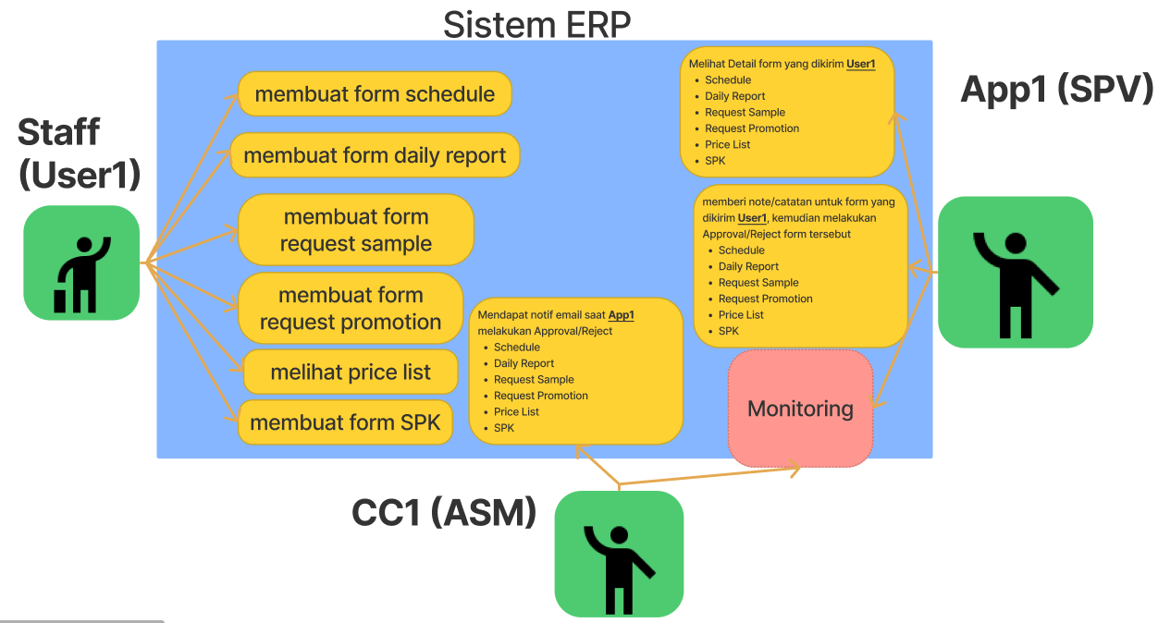
FITURE AWAL

Slide 4
List user login

Slide 5
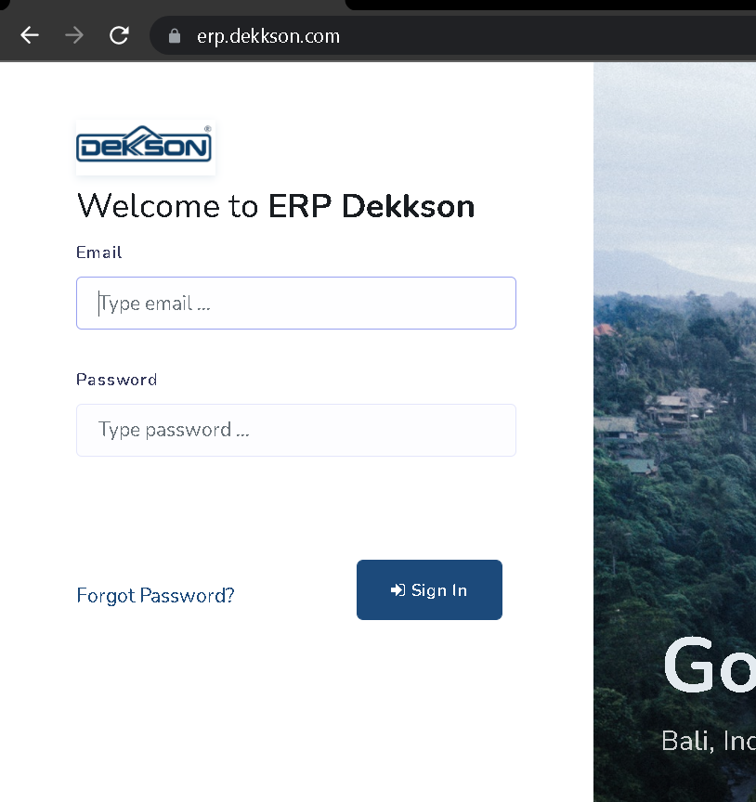
Login user
erp.dekkson.com
Masukan email karyawan
123

Slide 6
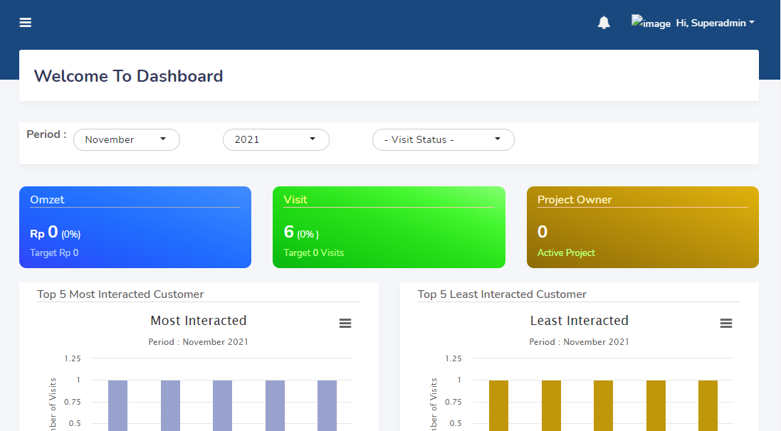
DAShboard (halaman awal login)
1
2
3
1. Notifikasi
2. User Profile, Logout
3. Periode data visit
4. Data omset, Visit, dan Project Owner
5. Top 5 Most interacter Customer
6. Top 5 Least interacter Customer
4
5
6

Slide 7
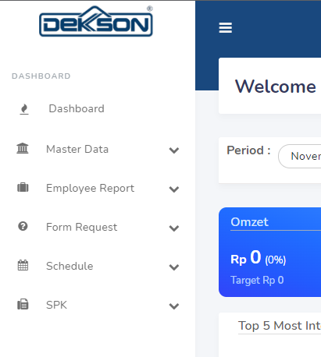
Staff Menu
Dashboard (halaman awal)
Master Data (Company, People, Product)
Employee Report (Work report, Competitor Product Report, Event Report, Complain Customer)
Form Request(Sample, Promotion)
Schedule (Agenda)
SPK
1
2
3
4
5
6

Slide 8
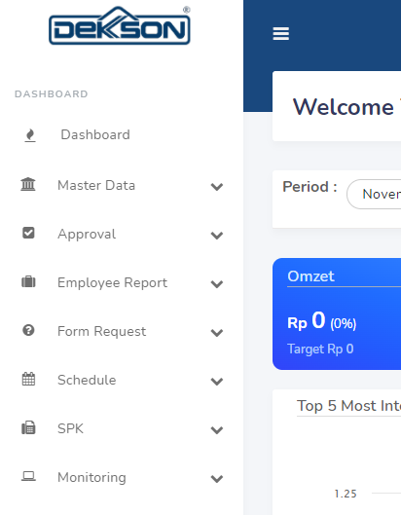
supervisor dan asm Menu
1
Dashboard (halaman awal)
Master Data (Company, People, Product)
Approval
Employee Report (Work report, Competitor Product Report, Event Report, Complain Customer)
Form Request(Sample, Promotion)
Schedule (Agenda)
SPK
Monitoring
2
3
4
5
6
7
8

Slide 9
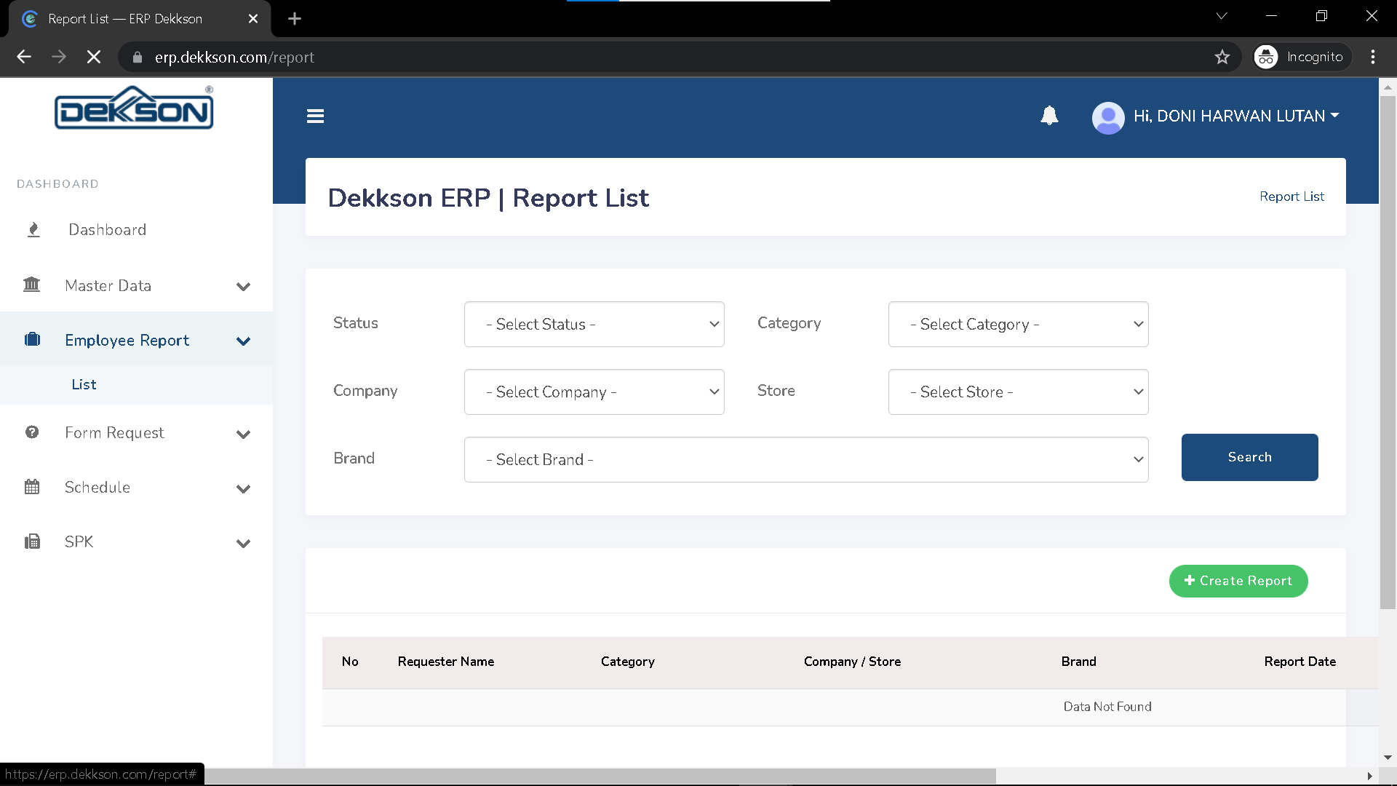
Cara membuat daily report
Klik employe Report,
kemudian klik List
2. Klik create project
1
2

Slide 10
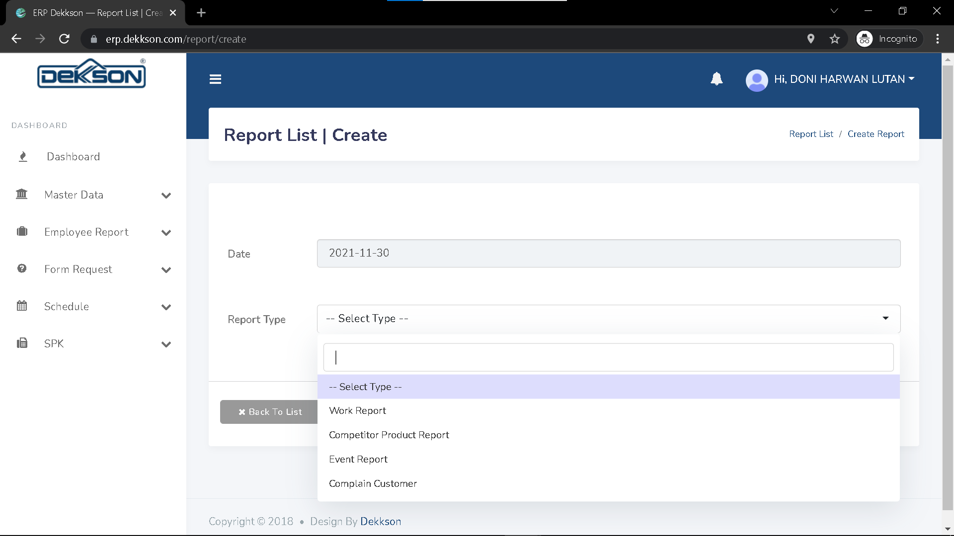
Cara membuat daily report
Klik ‘--Select Type—’
2. Pilih jenis laporan
1
2

Slide 11
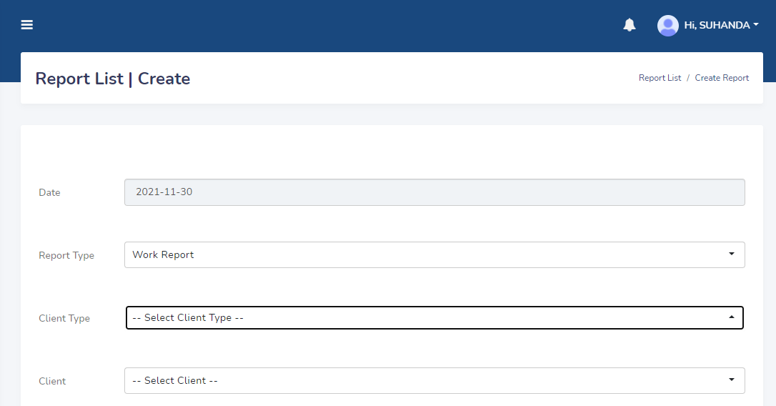
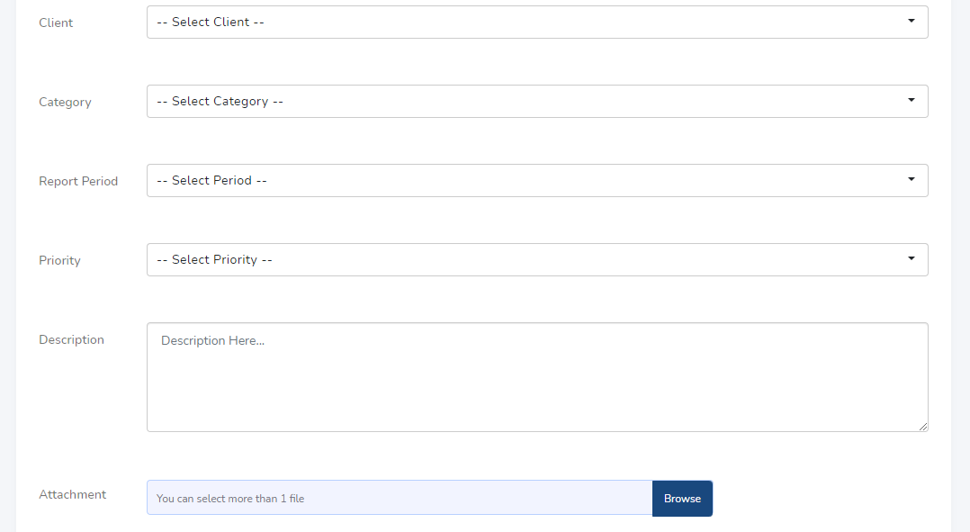
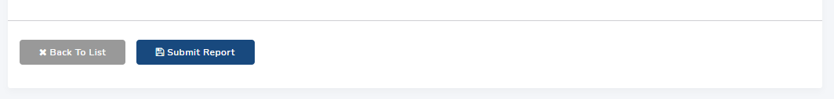
4
5
6
7
1
8
2
9
3
10
4

Slide 12
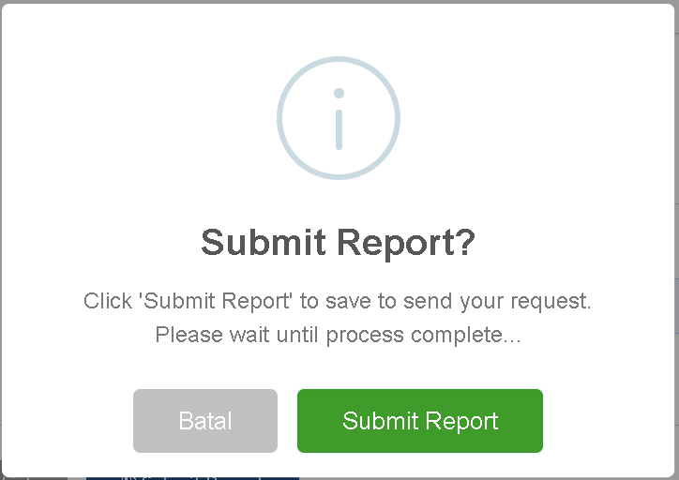
1
2

Slide 13
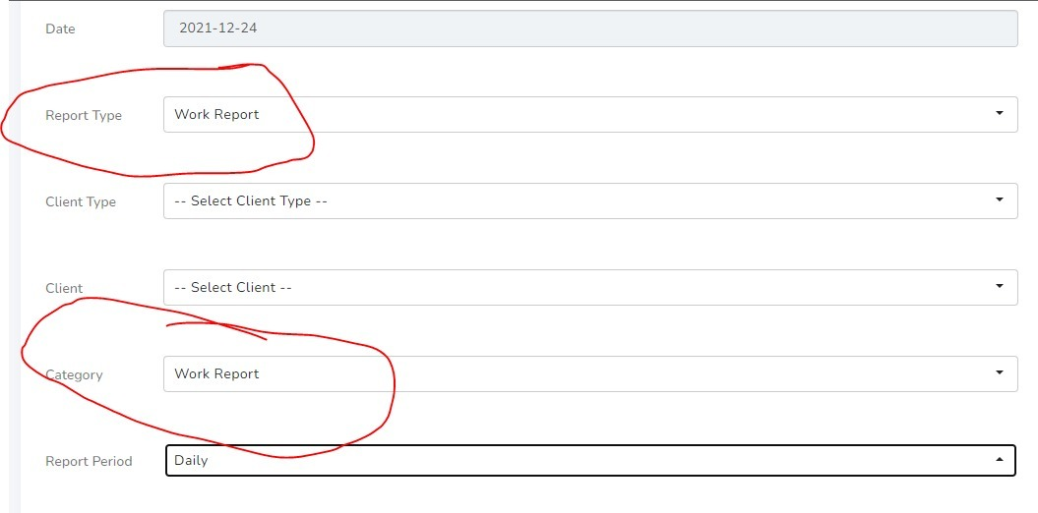
WORK FROM OFFICE

Slide 14
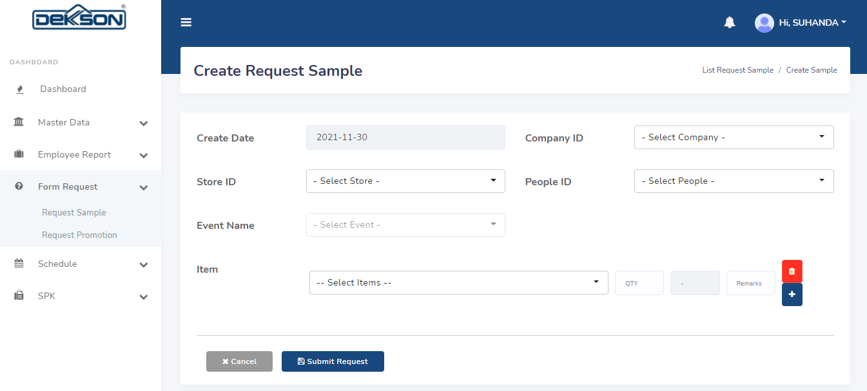
Request sample

Slide 15
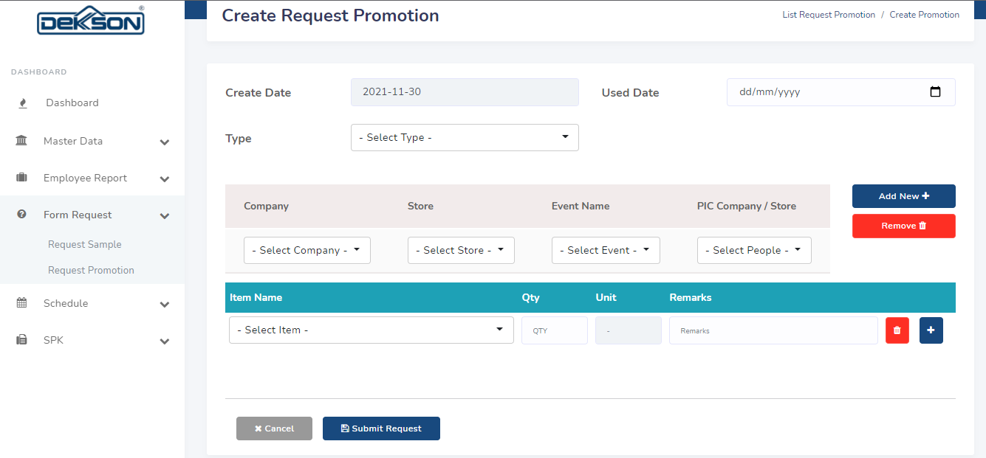
Request promotion

Slide 16
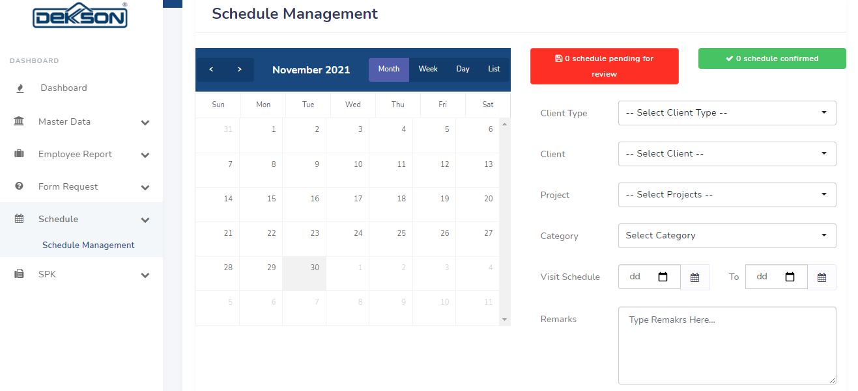
schedule

Slide 17
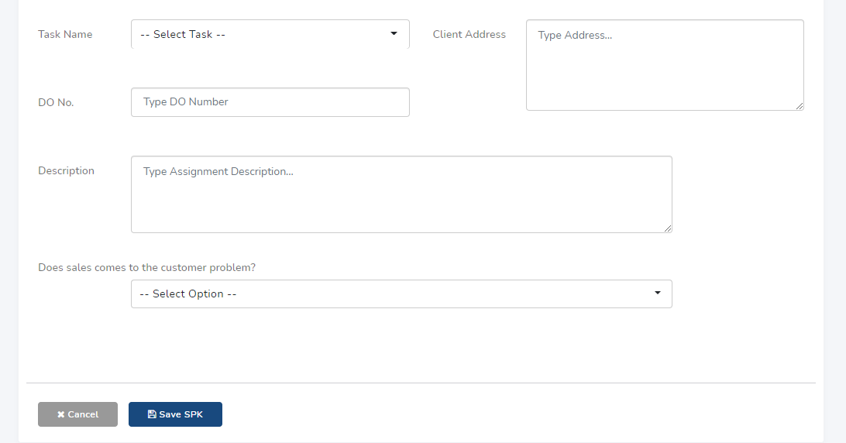
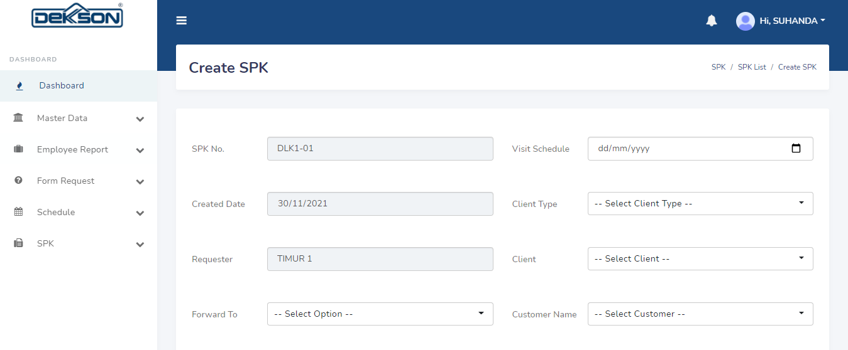
spk

Slide 18
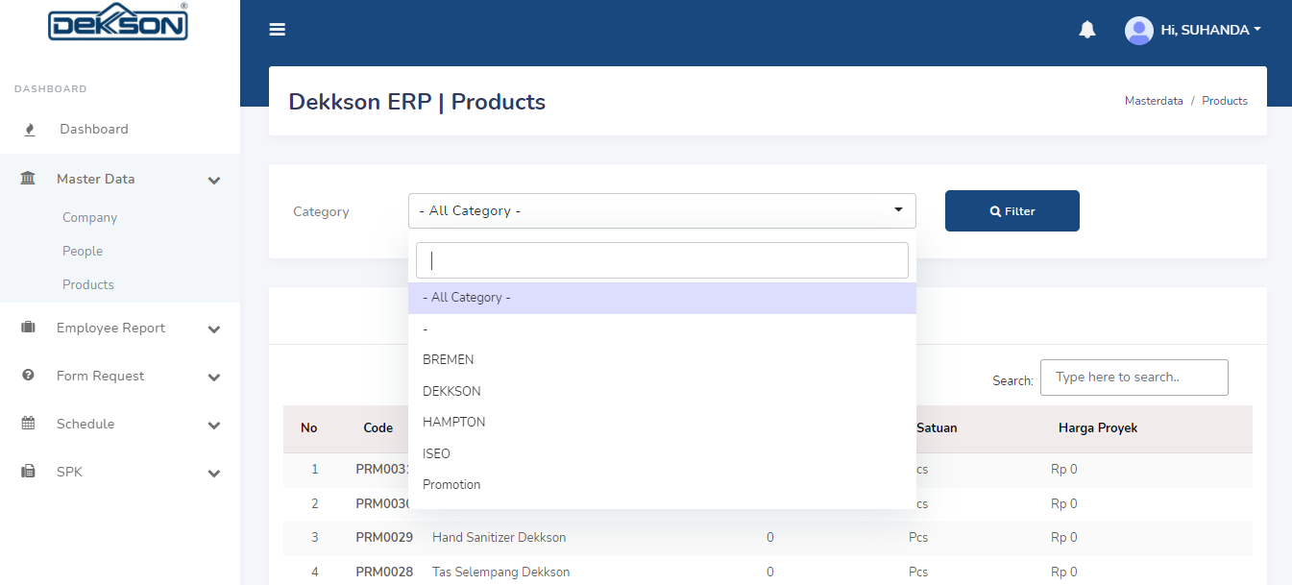
Price list
3
1
2
4
5

Slide 19
Thank You.
FR
FABRIKAM RESIDENCES

