Slide 1
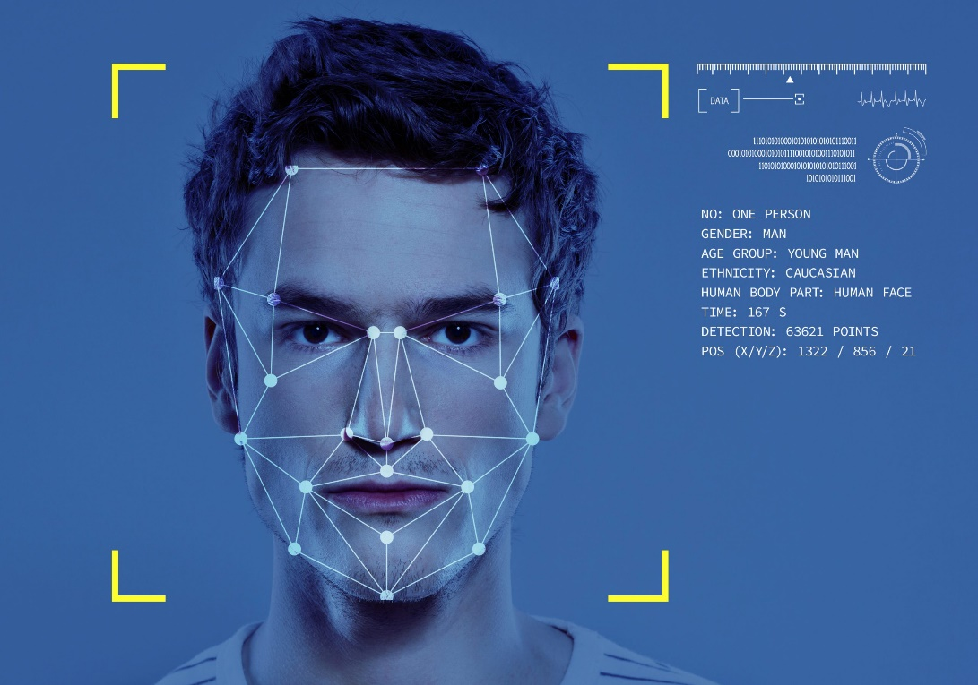
Facial Emotion Detection Using CNN and
Haar Cascade
Team name:Algo Alliance
Department: AI & DS
Date: 30-July-2025

Slide 2
Introduction
This project detects emotions from human faces using AI techniques.
Motivation: Emotion recognition is vital for human-computer interaction.
Real-world relevance: Used in education, healthcare, and customer service.

Slide 3
Problem Statement
Existing systems fail to recognize emotions in real-time effectively.
Challenge: Variations in lighting, pose, and expressions.
Importance: Enhances engagement analysis, safety, and automation.

Slide 4
Objectives
Build a CNN-based model for emotion classification.
Detect emotions: Happy, Sad, Neutral.
Integrate Haar Cascade for face detection.
Achieve real-time detection through OpenCV.

Slide 5
Domain & Algorithms Used
Domain: Computer Vision and Deep Learning.
Algorithms:
- Haar Cascade Classifier for face detection.
- CNN for emotion classification.

Slide 6
Dataset Details
Source: FER 2013 dataset from kaggle.
Classes: Happy, Sad, Neutral.
Image size: 48x48 grayscale.
Preprocessing: Resizing, normalization, one-hot encoding.

Slide 7
System Architecture
Workflow:
1. Input: Webcam or image file.
2. Face Detection: Haar Cascade.
3. Preprocessing: Resize to 48x48, normalize.
4. CNN Model Prediction.
5. Output: Emotion label displayed on screen.

Slide 8
Model Building
Framework: TensorFlow/Keras.
Model Layers: Conv2D, MaxPooling, Flatten, Dense, Dropout.
Optimizer: Adam, Loss: Categorical Crossentropy.
Epochs: 20, Batch Size: 32.

Slide 9
Results and Evaluation
Achieved accuracy: ~85% on test data.
Real-time performance validated with webcam input.
Correctly classified Happy, Sad, Neutral emotions.

Slide 10
Conclusion
Successfully implemented a real-time emotion detection system.
Combined Computer Vision (Haar Cascade) with CNN.
Useful for education, healthcare, and customer analytics.

Slide 11
Future Scope
Add more emotions like Angry, Fear, Surprise.
Deploy as a mobile or web application.
Improve accuracy with transfer learning models like VGG16.

Slide 12
Acknowledgment & Q&A
Special thanks to our guide and institution.
Data sources: Custom dataset, OpenCV Haar Cascade XML.
Questions?

