Slide 1
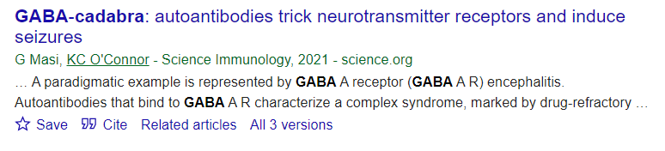

Epitope mimicry in autoimmune psychosis
Sadly, I couldn’t think of an NMDAR pun :(
Lab meeting 12/05/2022

Slide 2
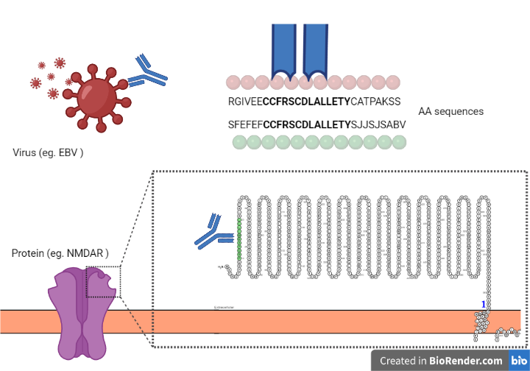
Theory: common epitope involved in autoimmune psychosis

Slide 3
Exploring simple sequence matching
A A A A A A A A A A A
A A B A A A A A B A A
Testing the amino acid sequences of:
NMDAR subunits against a virus database
Sequences of length 10 - 15
Allowing for 2 (or less) AA mismatches
Initial virus database:
~60 unique viruses
~3500 total including variants

Slide 4
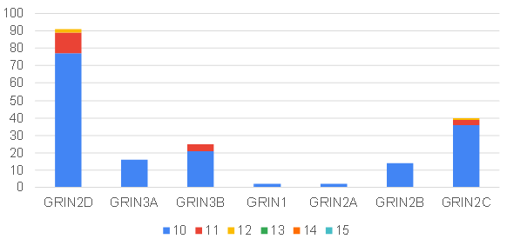
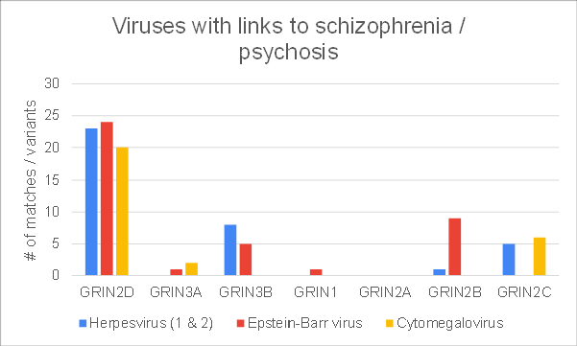
Number of common virus / NMDAR subunit subsequences

Slide 5
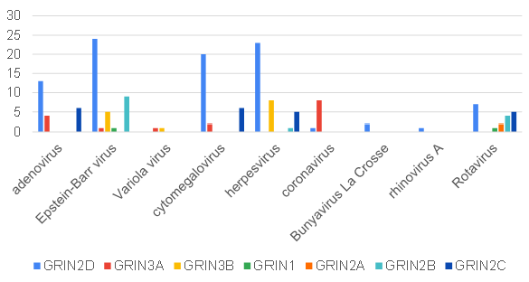
Which viruses?

Slide 6



Viruses with links to schizophrenia / psychosis

Slide 7
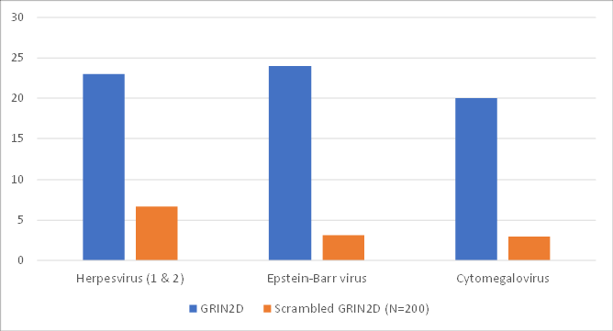
Are these matches simply naturally occurring?

Slide 8
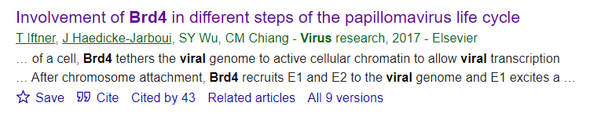
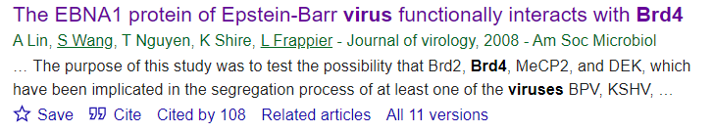
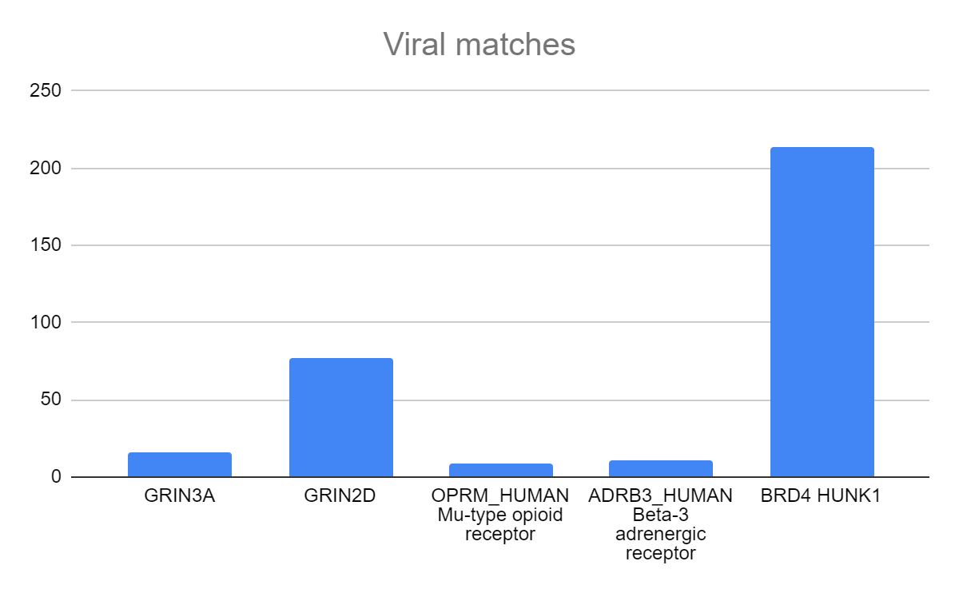
Positive & negative (ish) controls

Slide 9
Junk sequences? Overlaps?
GAGAGAGGAGA
QQQQQQDQPT
SGGAGGGGGG

Slide 10
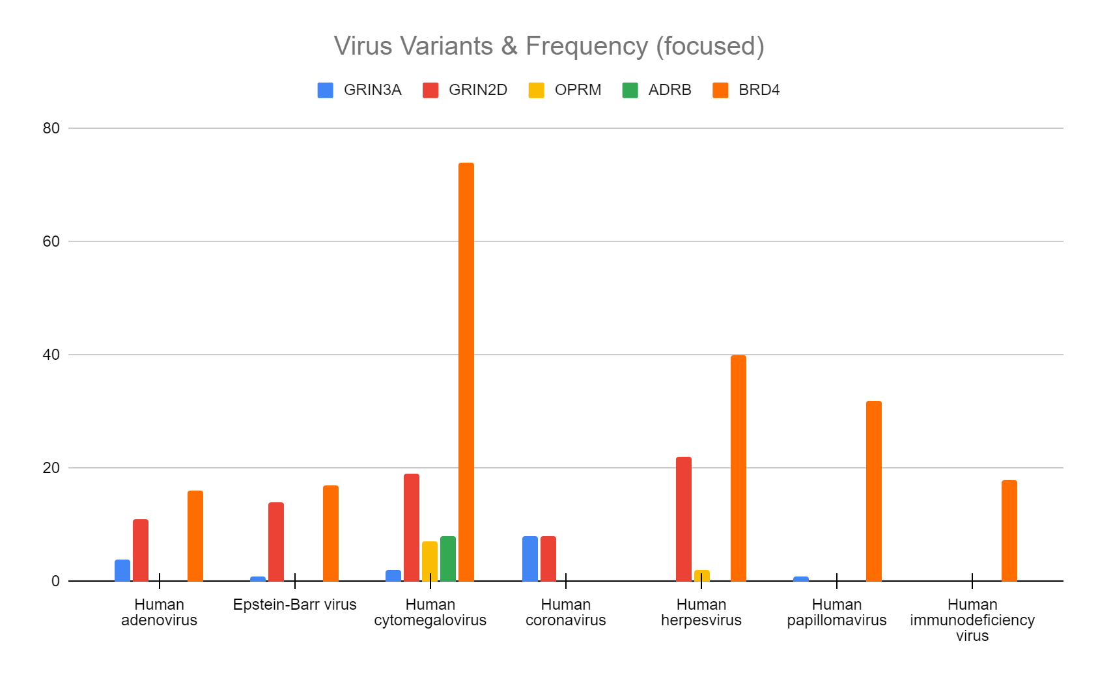
????

Slide 11
Does it make biological sense?

Slide 12
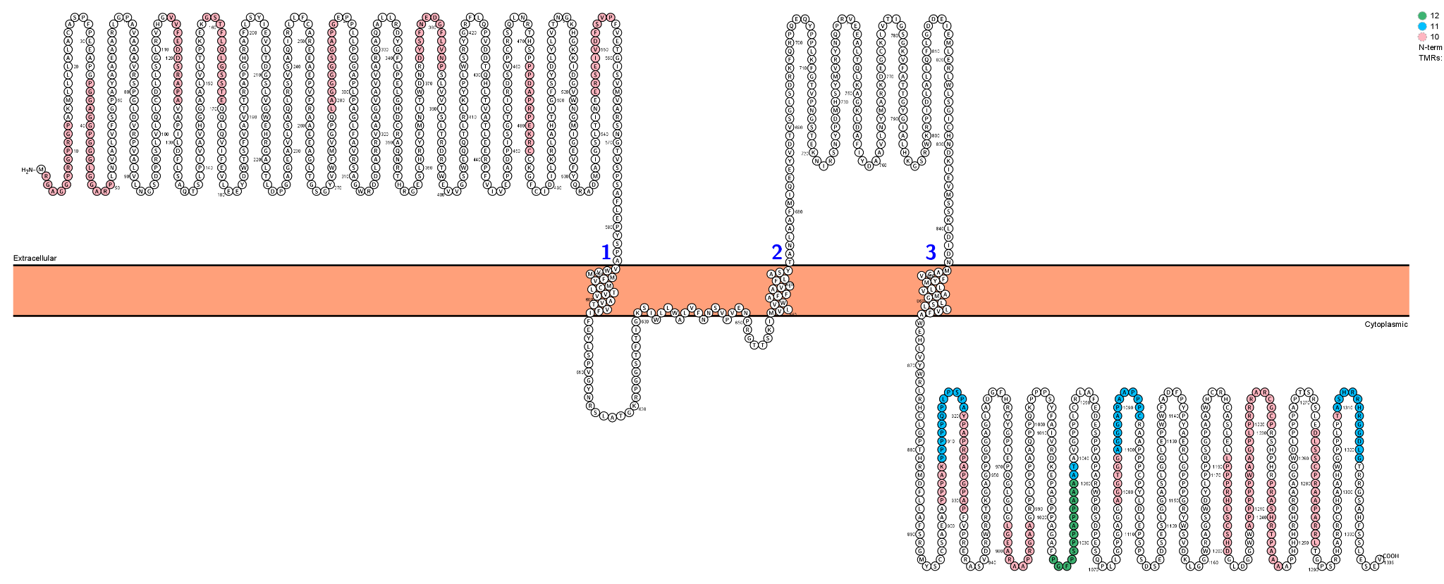
Position of matches
Sequence Lengths
GRIN2D

Slide 13
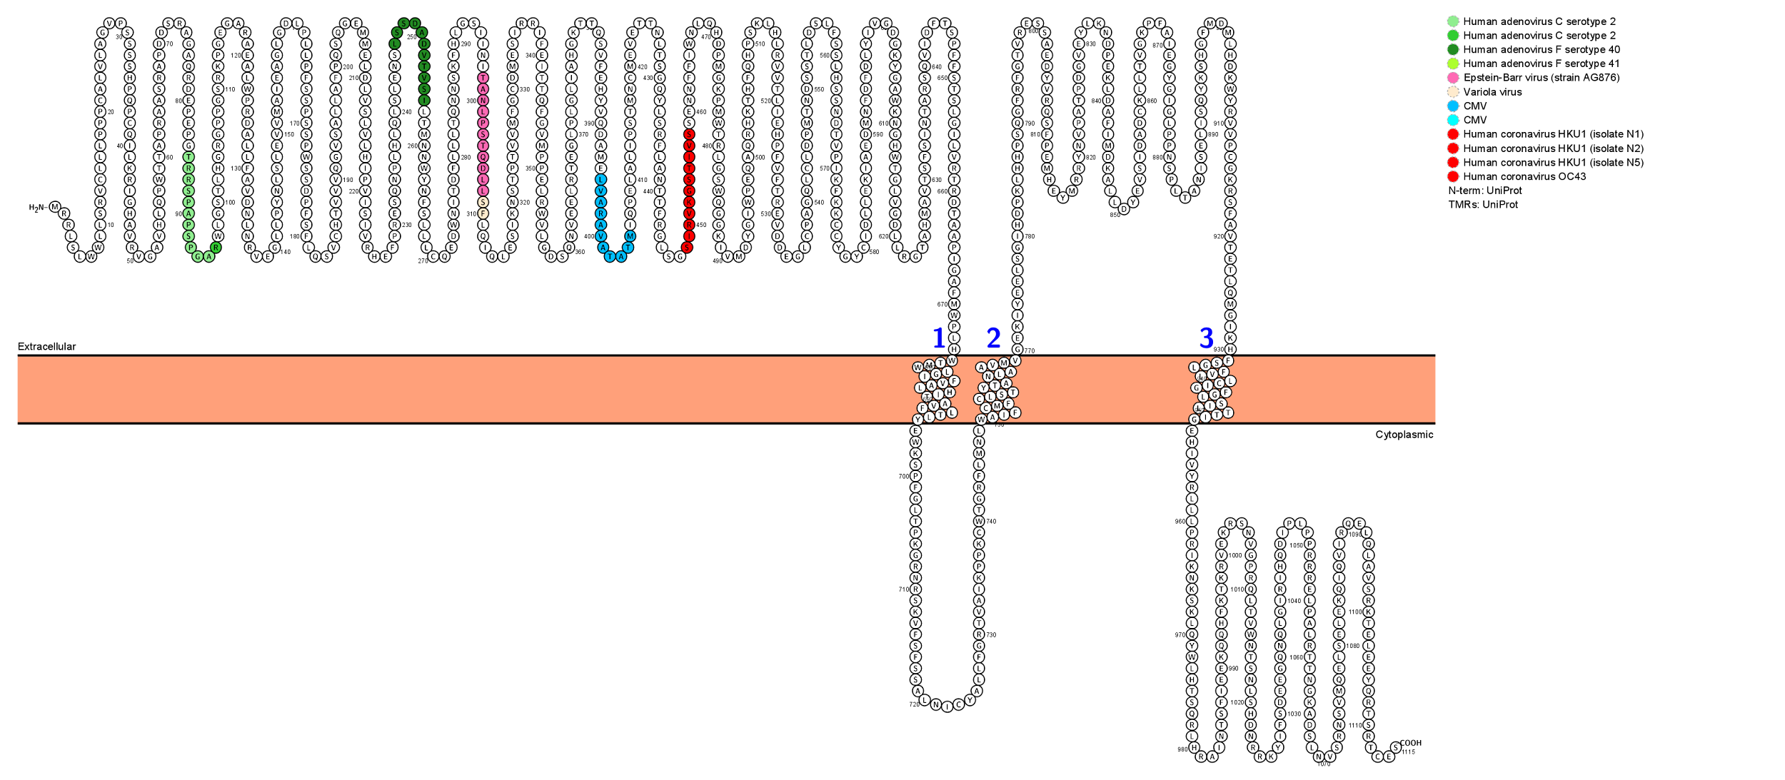
Position of virus specific matches
GRIN3A

Slide 14
Can we test against a known disease with an autoimmune pathogenesis?

Slide 15
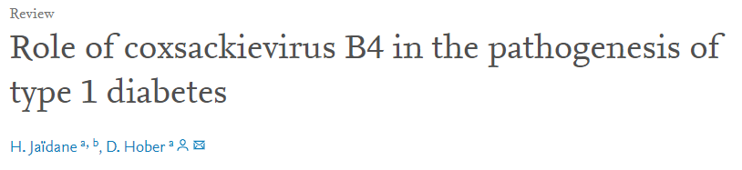
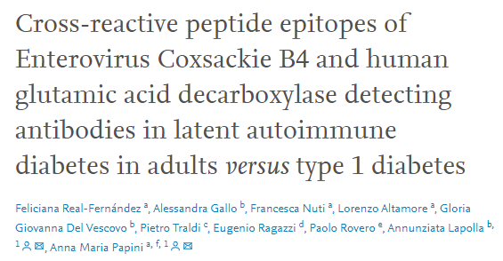

Autoimmune Type 1 Diabetes
Type 1 diabetes has been strongly linked to viral infections
As early as the 80’s
Recent paper shows common reactive epitope

Slide 16
Autoimmune Type 1 Diabetes
Test:
Beta cells are thought to be involved with autoimmune mediated diseases while Alpha cells rarely are.
Using the same virus database:
Test proteins differentially expressed in both Alpha cells and Beta cells
Choudhary et al, 2014

Slide 17
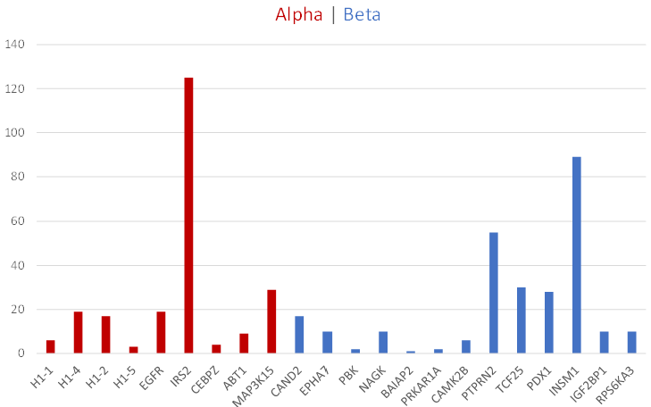
Common sequences: differentially expressed proteins of Alpha & Beta cells

Slide 18
Common sequences: differentially expressed proteins of Alpha & Beta cells
Is differentially expressed relevant here?
Data / code error?
Junk Sequences?
Overlapping?

Slide 19
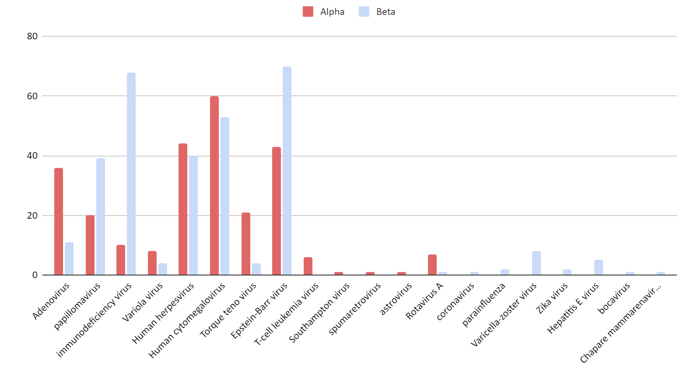
Virus variants: differentially expressed proteins of Alpha & Beta cells

Slide 20
Results for the Coxsackie virus
Running the same differentially expressed proteins for the coxsackievirus
Cell (differentially expressed) | Protein | Sequence length | Coxsackie sequence | Protein sequence
Beta | UBE3C | 10 | GREGPWQSTL | GRIGPLQSTL
Alpha | - | - | - | -

Slide 21
Do they mean anything?
VFIFEYLSPV
FIFEYLSPVG
FTIGKSIWLL
ALVFNNSVPV
MVLVWAFFAV
IFLASYTANL
FLASYTANLA
YMVRYNQPRV
FLGDDEIEML
KLDIDNMAGV
LLVFAWEHLV
QQLQVIFEV
FLSYIEVLT
SLHRYFMNI
FLVNPSLVV
VFIFEYLSPV
FIFEYLSPVG
FTIGKSIWLL
ALVFNNSVPV
MVLVWAFFAV
IFLASYTANL
FLASYTANLA
YMVRYNQPRV
FLGDDEIEML
KLDIDNMAGV
LLVFAWEHLV
QQLQVIFEV
FLSYIEVLT
SLHRYFMNI
FLVNPSLVV
RLAHTIGFSYDLYL
VAVTVFIFEYLSPV
WLLWALVFNNSVPV
FLASYTANLAAFMI
FLSAQTSLPIVAV
AVTVFIFEYLSPV
LLWALVFNNSVPV
FLGDDEIEMLERL
KLDIDNMAGVFYM
YMLLVAMGLSLLV
ALLRDYGFLPEL
VTVFIFEYLSPV
MLLVAMGLSLLV
FLSAQTSLPIV
FVMCLTVVAV
FIFEYLSPV
LVFNNSVPV
VLVWAFFAV
FLASYTANL
FLGDDEIEM
NMAGVFYML
YMLLVAMGL
LVFAWEHLV
FLLAFSRGM
FVMCLTVVAV
FIFEYLSPV
LVFNNSVPV
VLVWAFFAV
RLAHTIGFSYDLYL
VAVTVFIFEYLSPV
WLLWALVFNNSVPV
FLASYTANLAAFMI
FLSAQTSLPIVAV
AVTVFIFEYLSPV
LLWALVFNNSVPV
FLGDDEIEMLERL
KLDIDNMAGVFYM
YMLLVAMGLSLLV
ALLRDYGFLPEL
VTVFIFEYLSPV
MLLVAMGLSLLV
FLSAQTSLPIV
VFIFEYLSPV
FIFEYLSPVG
FTIGKSIWLL
ALVFNNSVPV
MVLVWAFFAV
IFLASYTANL
FLASYTANLA
YMVRYNQPRV
FLGDDEIEML
KLDIDNMAGV
LLVFAWEHLV
QQLQVIFEV
FLSYIEVLT
SLHRYFMNI
FLVNPSLVV
FVMCLTVVAV
FIFEYLSPV
LVFNNSVPV
VLVWAFFAV
FLASYTANL
FLGDDEIEM
NMAGVFYML
YMLLVAMGL
LVFAWEHLV
FLLAFSRGM
FVMCLTVVAV
FIFEYLSPV
LVFNNSVPV
VLVWAFFAV
VFIFEYLSPV
FIFEYLSPVG
FTIGKSIWLL
ALVFNNSVPV
MVLVWAFFAV
IFLASYTANL
FLASYTANLA
YMVRYNQPRV
FLGDDEIEML
KLDIDNMAGV
LLVFAWEHLV
QQLQVIFEV
FLSYIEVLT
SLHRYFMNI
FLVNPSLVV
RLAHTIGFSYDLYL
VAVTVFIFEYLSPV
WLLWALVFNNSVPV
FLASYTANLAAFMI
FLSAQTSLPIVAV
AVTVFIFEYLSPV
LLWALVFNNSVPV
FLGDDEIEMLERL
KLDIDNMAGVFYM
YMLLVAMGLSLLV
ALLRDYGFLPEL
VTVFIFEYLSPV
MLLVAMGLSLLV
FLSAQTSLPIV
FVMCLTVVAV
FIFEYLSPV
LVFNNSVPV
VLVWAFFAV
FLASYTANL
FLGDDEIEM
NMAGVFYML
YMLLVAMGL
LVFAWEHLV
FLLAFSRGM
FVMCLTVVAV
FIFEYLSPV
LVFNNSVPV
VLVWAFFAV
RLAHTIGFSYDLYL
VAVTVFIFEYLSPV
WLLWALVFNNSVPV
FLASYTANLAAFMI
FLSAQTSLPIVAV
AVTVFIFEYLSPV
LLWALVFNNSVPV
FLGDDEIEMLERL
KLDIDNMAGVFYM
YMLLVAMGLSLLV
ALLRDYGFLPEL
VTVFIFEYLSPV
MLLVAMGLSLLV
FLSAQTSLPIV
VFIFEYLSPV
FIFEYLSPVG
FTIGKSIWLL
ALVFNNSVPV
MVLVWAFFAV
IFLASYTANL
FLASYTANLA
YMVRYNQPRV
FLGDDEIEML
KLDIDNMAGV
LLVFAWEHLV
QQLQVIFEV
FLSYIEVLT
SLHRYFMNI
FLVNPSLVV
FVMCLTVVAV
FIFEYLSPV
LVFNNSVPV
VLVWAFFAV
FLASYTANL
FLGDDEIEM
NMAGVFYML
YMLLVAMGL
LVFAWEHLV
FLLAFSRGM
FVMCLTVVAV
FIFEYLSPV
LVFNNSVPV
VLVWAFFAV
VFIFEYLSPV
FIFEYLSPVG
FTIGKSIWLL
ALVFNNSVPV
MVLVWAFFAV
IFLASYTANL
FLASYTANLA
YMVRYNQPRV
FLGDDEIEML
KLDIDNMAGV
LLVFAWEHLV
QQLQVIFEV
FLSYIEVLT
SLHRYFMNI
FLVNPSLVV
RLAHTIGFSYDLYL
VAVTVFIFEYLSPV
WLLWALVFNNSVPV
FLASYTANLAAFMI
FLSAQTSLPIVAV
AVTVFIFEYLSPV
LLWALVFNNSVPV
FLGDDEIEMLERL
KLDIDNMAGVFYM
YMLLVAMGLSLLV
ALLRDYGFLPEL
VTVFIFEYLSPV
MLLVAMGLSLLV
FLSAQTSLPIV
FVMCLTVVAV
FIFEYLSPV
LVFNNSVPV
VLVWAFFAV
FLASYTANL
FLGDDEIEM
NMAGVFYML
YMLLVAMGL
LVFAWEHLV
FLLAFSRGM
FVMCLTVVAV
FIFEYLSPV
LVFNNSVPV
VLVWAFFAV
RLAHTIGFSYDLYL
VAVTVFIFEYLSPV
WLLWALVFNNSVPV
FLASYTANLAAFMI
FLSAQTSLPIVAV
AVTVFIFEYLSPV
LLWALVFNNSVPV
FLGDDEIEMLERL
KLDIDNMAGVFYM
YMLLVAMGLSLLV
ALLRDYGFLPEL
VTVFIFEYLSPV
MLLVAMGLSLLV
FLSAQTSLPIV
VFIFEYLSPV
FIFEYLSPVG
FTIGKSIWLL
ALVFNNSVPV
MVLVWAFFAV
IFLASYTANL
FLASYTANLA
YMVRYNQPRV
FLGDDEIEML
KLDIDNMAGV
LLVFAWEHLV
QQLQVIFEV
FLSYIEVLT
SLHRYFMNI
FLVNPSLVV
FVMCLTVVAV
FIFEYLSPV
LVFNNSVPV
VLVWAFFAV
FLASYTANL
FLGDDEIEM
NMAGVFYML
YMLLVAMGL
LVFAWEHLV
FLLAFSRGM
FVMCLTVVAV
FIFEYLSPV
LVFNNSVPV
VLVWAFFAV
VFIFEYLSPV
FIFEYLSPVG
FTIGKSIWLL
ALVFNNSVPV
MVLVWAFFAV
IFLASYTANL
FLASYTANLA
YMVRYNQPRV
FLGDDEIEML
KLDIDNMAGV
LLVFAWEHLV
QQLQVIFEV
FLSYIEVLT
SLHRYFMNI
FLVNPSLVV
RLAHTIGFSYDLYL
VAVTVFIFEYLSPV
WLLWALVFNNSVPV
FLASYTANLAAFMI
FLSAQTSLPIVAV
AVTVFIFEYLSPV
LLWALVFNNSVPV
FLGDDEIEMLERL
KLDIDNMAGVFYM
YMLLVAMGLSLLV
ALLRDYGFLPEL
VTVFIFEYLSPV
MLLVAMGLSLLV
FLSAQTSLPIV
RLAHTIGFSYDLYL
VAVTVFIFEYLSPV
WLLWALVFNNSVPV
FLASYTANLAAFMI
FLSAQTSLPIVAV
AVTVFIFEYLSPV
LLWALVFNNSVPV
FLGDDEIEMLERL
KLDIDNMAGVFYM
YMLLVAMGLSLLV
ALLRDYGFLPEL
VTVFIFEYLSPV
MLLVAMGLSLLV
FLSAQTSLPIV
FVMCLTVVAV
FIFEYLSPV
LVFNNSVPV
VLVWAFFAV
FLASYTANL
FLGDDEIEM
NMAGVFYML
YMLLVAMGL
LVFAWEHLV
FLLAFSRGM
FVMCLTVVAV
FIFEYLSPV
LVFNNSVPV
VLVWAFFAV
FVMCLTVVAV
FIFEYLSPV
LVFNNSVPV
VLVWAFFAV
FLASYTANL
FLGDDEIEM
NMAGVFYML
YMLLVAMGL
LVFAWEHLV
FLLAFSRGM
FVMCLTVVAV
FIFEYLSPV
LVFNNSVPV
VLVWAFFAV

Slide 22
Re-assess: How to confirm a meaningful match
Using epitopes that make biological sense (cleavage points, protein digestion… )
Narrow the search using smaller epitopes ~6-8 as experimentally shown in other cases
Original range of 10-15 could create a lot of noise
Investigate T cells and B cells:
Primarily T cells and the binding affinity to MHC alleles

Slide 23
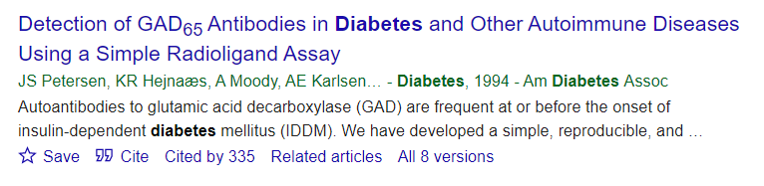
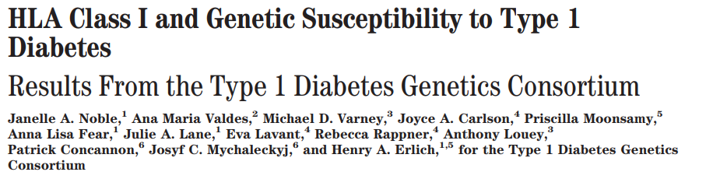
Recent paper experimentally shows same theory for Diabetes type 1
Strong link to:
Coxsackievirus B4
Protein GAD-65
Various HLA alleles
( eg. DQ8 , MHC ii ; A*2402, MHC i )
Common epitope?

Slide 24
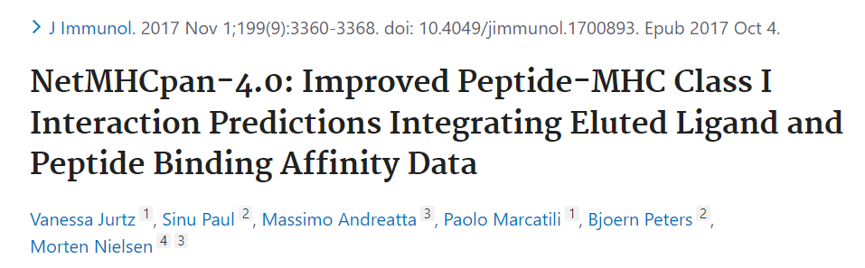
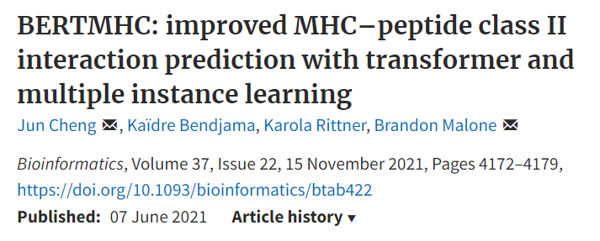
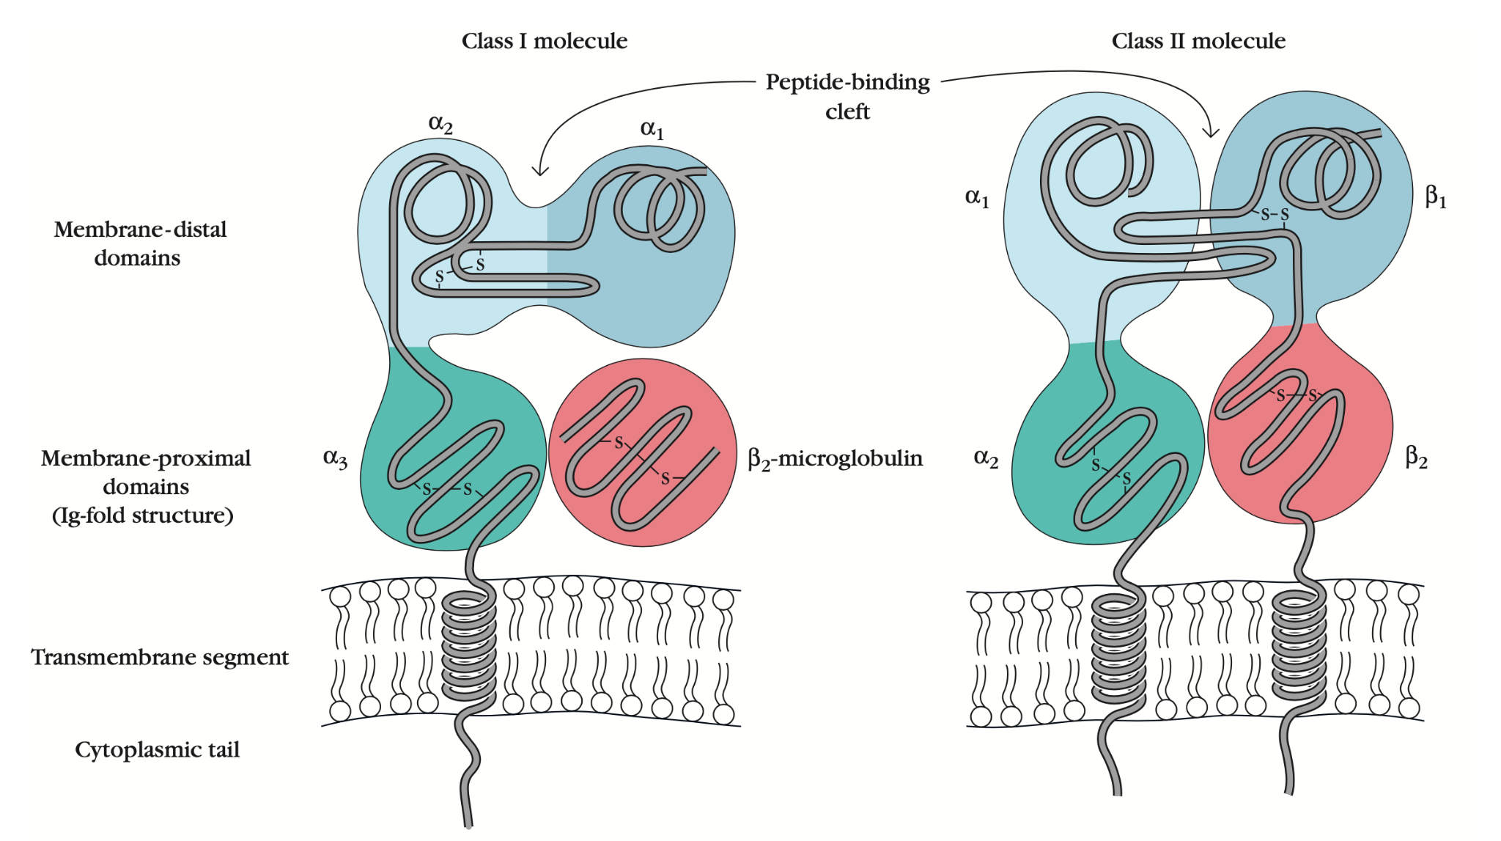
Predicting epitope binding affinity

Slide 25
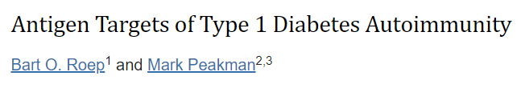
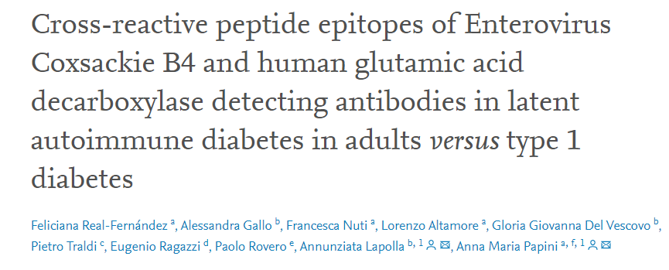
Adjusting test for type 1 diabetes
Testing antigen targets of type 1 diabetes (instead of differentially expressed)
Reduce search length to 8
Distinguish ‘broken’ sequences
Broken Identical
Does this produce the same common epitope?
A A A A A A A A
A A B A A B A A
A A A A A A A A
B A A A A A A B

Slide 26
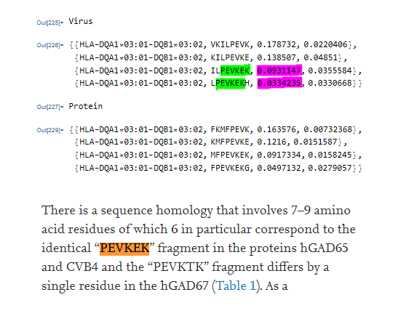
Confirmation of the experimental results for cross reactive epitopes between GAD65 & Coxsackievirus B4
Real-Fernandez et al. , 2021

Slide 27
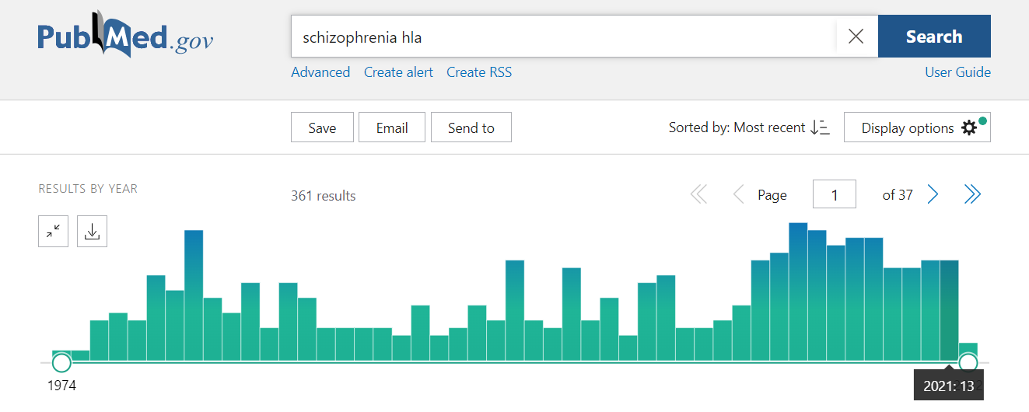
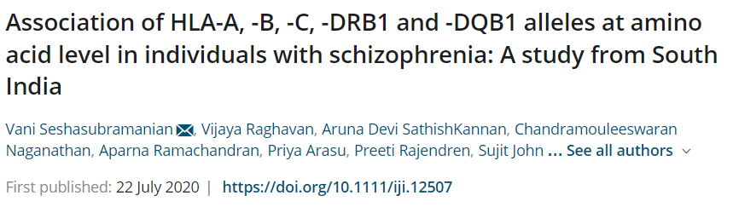
Potentially applying the same theory to autoimmune psychosis?
Adjust original NMDAR search:
Streamline search space to sequence length 8
Use a proteome database of schizophrenia / psychosis linked viruses ( EBV, CMV, Herpes )
Test binding affinity to MHC alleles

Slide 28
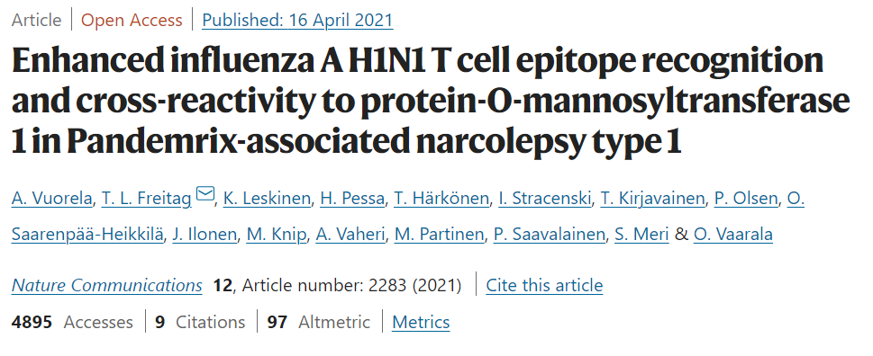
Compare to a similar application of the theory

Slide 29
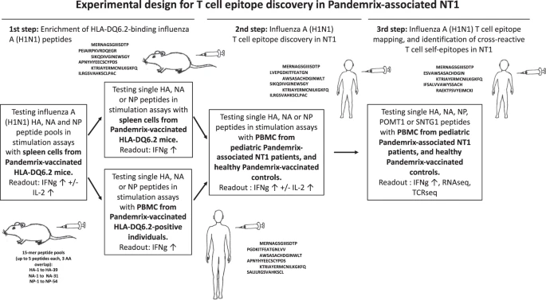
Common epitope between virus H1N1 and protein POMT1 experimentally shown to induce autoimmune narcolepsy type 1 (NT1)

Slide 30
Next steps:
Validate theory using Diabetes type 1 case:
Strong link to:
Coxsackievirus B4
Protein GAD-65
Various HLA alleles
( eg. DQ8 , MHC ii ; A*2402, MHC i )
Common epitope?
Explore potential application to autoimmune psychosis case:
Linked viruses ( Epstein-bar virus, cytomegalovirus, herpesvirus 1)
NMDAR subunit proteins
Various HLA alleles
Antibodies, T cells and B cells
Further membrane proteins associated with potentially autoimmune psychiatric disorders

