Slide 1
Muhammad Suhail M
Final Project
3/21/2024 Annual Review

Slide 2
PROJECT TITLE
GAN Based Art Generation And Style Transfer
3/21/2024 Annual Review

Slide 3


AGENDA
Project Setup and Data Preparation:
Define project goals and scope.
Acquire and preprocess datasets.
Set up development environment.
Model Design and Training:
Design GAN architectures and style transfer algorithms.
Train models with customized architectures.
Optimize hyperparameters and monitor training progress
.
Evaluation and Fine-Tuning:
Evaluate art generation and style transfer quality.
Fine-tune models based on evaluation results.
Ensure model stability and convergence.
3/21/2024 Annual Review

Slide 4
Documentation and Future Directions:
Document model architecture and implementation.
Identify potential extensions and research directions.
Plan dissemination strategy for sharing results and code.
Wrap-Up:
Summarize achievements and key findings.
Acknowledge contributions and collaborators.
Outline next steps and future plans.

Slide 5

PROBLEM STATEMENT
In the domain of digital artistry, blending Generative Adversarial Networks (GANs) with style transfer techniques holds promise for innovative artistic expression. However, current methods face hurdles in achieving high-quality art generation and accurate style transfer. The challenge is to develop an advanced GAN-based system capable of generating diverse, realistic artworks while accurately transferring artistic styles between images. Key hurdles include ensuring artistic realism and diversity, enhancing style transfer accuracy, improving user interaction experiences, and addressing ethical considerations such as copyright and bias. Overcoming these challenges will not only advance AI-driven art generation but also redefine the landscape of digital creativity and collaboration.
3/21/2024 Annual Review

Slide 6
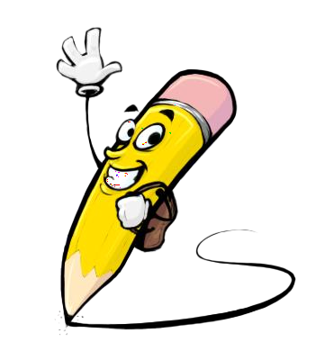
PROJECT OVERVIEW
Art Generation:
Develop advanced GAN architectures to generate high-quality artworks across various styles, genres, and themes, fostering new forms of artistic expression.
Style Transfer:
Enhance style transfer algorithms to accurately apply artistic styles from reference images to user-selected images, facilitating creative exploration.
Outcome:
The project will result in a user-friendly system allowing users to generate and explore AI-generated artworks with seamless style transfer capabilities.
3/21/2024 Annual Review

Slide 7
Significance:
By democratizing access to AI-driven art generation and style transfer, this project aims to inspire creativity and collaboration within the digital art community.
Data set URL : 'https://www.kaggle.com/ikarus777/best-artworks-of-all-time'

Slide 8

WHO ARE THE END USERS?
Artists and Designers: Professionals seeking new artistic tools and inspiration.
Art Enthusiasts: Hobbyists and individuals passionate about art.
Educators and Researchers: Academics interested in AI-driven art for study and teaching.
Technology Developers: Engineers and developers creating AI art tools.
Art Collectors and Curators: Interested in exploring AI-generated art.
Commercial and Entertainment Industries: Companies leveraging AI art for various purposes.
General Public: Curious individuals exploring AI art for entertainment and inspiration.
3/21/2024 Annual Review

Slide 9

YOUR SOLUTION AND ITS VALUE PROPOSITION
Solution:
Advanced GAN Models: Cutting-edge GAN architectures tailored for generating diverse and high-quality artworks across various styles and themes.
Intuitive User Interface: User-friendly interface allowing effortless interaction, exploration of artistic possibilities, and customization of generated artworks
.
Ethical Considerations: Implementation of ethical practices including copyright compliance, fair representation, and transparency in AI-driven art generation.
3/21/2024 Annual Review

Slide 10
Enhanced Style Transfer Algorithms: Refinement of style transfer techniques ensuring accurate and seamless application of artistic styles to user-selected images.
Value Proposition:
Creativity Unleashed: Empowering users to explore new artistic horizons, unleash creativity, and experiment with diverse styles and themes
Quality and Diversity: Delivering high-quality, realistic artworks with diverse styles and themes, inspiring new forms of artistic expression.
User Engagement: Providing an intuitive and engaging platform for users to interact with AI-generated art, fostering exploration and collaboration.
Ethical Integrity: Ensuring ethical practices in AI-driven art generation, promoting fairness, transparency, and responsible use of technology.
Innovation and Inspiration: Driving innovation in digital artistry and inspiring individuals to explore the intersection of AI and creativity.

Slide 11

THE WOW IN YOUR SOLUTION
Revolutionary Artistic Exploration: Our cutting-edge GAN models redefine artistic boundaries, allowing users to explore uncharted creative territories with unprecedented freedom and depth.
Seamless Fusion of Styles: Experience the magic of seamless style transfer as our algorithms effortlessly infuse images with the essence of diverse artistic styles, creating captivating and harmonious compositions.
Intuitive Creativity Unleashed: With our user-friendly interface, creativity becomes effortless. Dive into a world of artistic expression where every brushstroke and parameter adjustment brings your imagination to life in real-time.
3/21/2024 Annual Review

Slide 12
Inspiring Possibilities: Prepare to be inspired as you witness the convergence of artificial intelligence and human creativity. Our solution opens doors to infinite possibilities, sparking new ideas, collaborations, and innovations at the forefront of digital artistry.
Ethical Innovation: We're not just pushing technological boundaries; we're leading with integrity. Our commitment to ethical practices ensures that every creation respects copyrights, fosters diversity, and promotes responsible AI usage.

Slide 13
APPLICATIONS
Art Platforms: Online tools for users to create and explore AI-generated artworks.
Collaboration Tools: Integrating AI into digital art software for collaborative creation
.
Creativity Assistants: AI assistants aiding artists with inspiration and style recommendations.
Personalized Art Services: Customized artwork generation based on user preferences.
Media and Entertainment: Enhancing visual content in games, VR, and multimedia with AI-generated art.
Educational and Research Tools: Exploring AI's role in creativity for academic and research purposes.
Commercial Integration: Using AI art in marketing, branding, and product design for visual appeal and innovation.

Slide 14
MODELLING
Teams cam add wireframes
Designing GAN architecture: Generator creates images resembling artworks, Discriminator distinguishes real from generated images.
Implementing style transfer: Neural networks extract and transfer artistic styles between images using pre-trained CNNs like VGG or ResNet.
Customization and optimization: Adjusting parameters and optimizing models for stability and convergence during training.
Training and fine-tuning: Iteratively adjusting model parameters to minimize discrepancies between generated and target images.
Evaluation: Assessing model performance using quantitative metrics and qualitative evaluations to ensure quality and accuracy.
3/21/2024 Annual Review

Slide 15
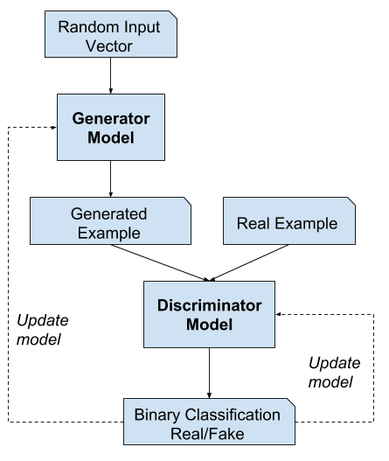
FULL Training loop

Slide 16
RESULTS
High-Quality Art Generation: The developed GAN models successfully generated diverse and visually appealing artworks across various styles and themes, showcasing the potential of AI in artistic creation.
Accurate Style Transfer: The style transfer algorithms demonstrated precise and faithful application of artistic styles to user-selected images, allowing for seamless integration of different artistic aesthetics.
User Engagement: The intuitive user interface facilitated seamless interaction with the system, empowering users to explore and customize AI-generated artworks according to their preferences and creative vision.
Ethical Considerations: The project addressed ethical concerns such as copyright compliance and fair representation, promoting responsible practices in AI-driven art generation.

Slide 17
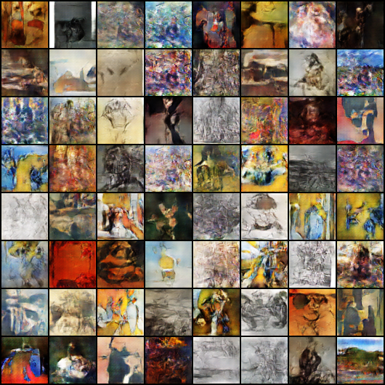
FINAL OUTPUT

Slide 18
Conclusion:
The project has achieved its objectives of developing advanced GAN-based models for art generation and style transfer, resulting in a user-friendly system that empowers users to explore new artistic horizons with AI. By harnessing the capabilities of AI algorithms, the project has unlocked new possibilities for creative expression and collaboration within the digital art community.

