Slide 1

WORKSHOP COLD OPEN
Communication is
architecture,
not telepathy.
The Shared Meaning Lab
Zero-assumption delegation & AI orchestration
SAME WORDS · DIFFERENT WORLDS
1 MISSING UNIT CONTRACT → 1 SPACECRAFT LOST
THE SHARED MEANING LAB
01
Notes:
Welcome to the Shared Meaning Lab. Today we stop blaming people and start engineering communication.
Facilitation: Ask: ‘Who has ever delivered exactly what was requested—and still been told it was wrong?’ Take two fast hands or chat reactions.
Build / animation: Title first; squiggle side appears; blueprint side snaps into view; reveal the unit-contract hook last.
[Sources]
- Original workshop content and generated illustration; no external source.

Slide 2

THE ASSUMPTION GAP
What you asked for ≠ what came back
WHAT YOU ASKED
WHAT LANDED
“Send a quick update.”
42 slides. 8 rockets.
One ‘synergistic tapestry.’
QUICK POLL
HUMANS GUESS · AI PREDICTS
THE SHARED MEANING LAB
02
Notes:
The receiver did not fail to understand a complete instruction. The instruction was incomplete, so the receiver completed it with assumptions.
Facilitation: Poll the room and online chat: ‘Do you more often receive too little, too much, or the wrong kind of output?’
Build / animation: Sticky-note side slides in gently; paper tower lands; the central equation expands last.
[Sources]
- Original workshop content and generated illustration; no external source.

Slide 3
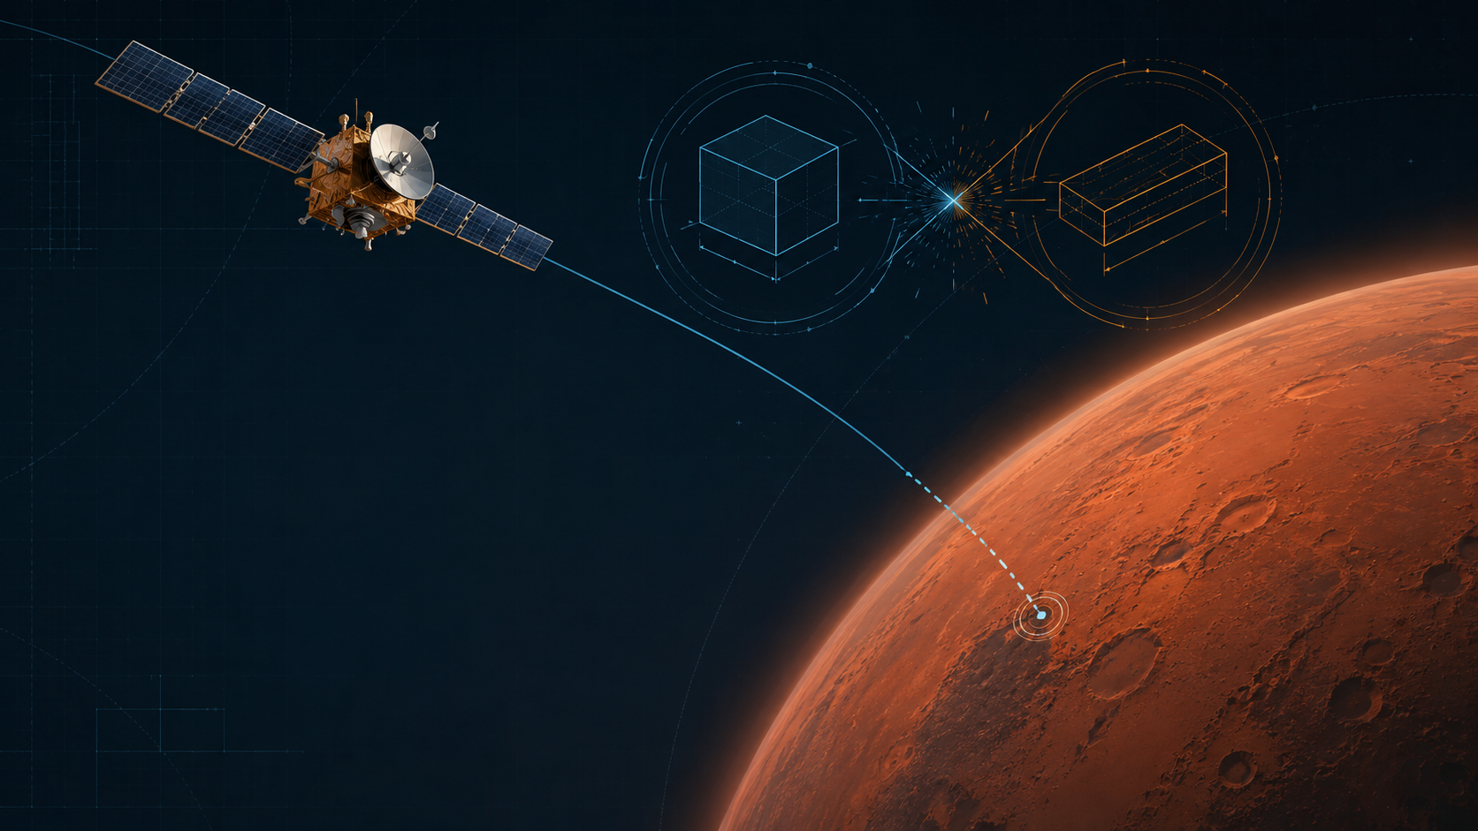
CASE STUDY · 1999
A boundary failure
reached Mars.
Lockheed output
Thruster impulse delivered in pound-force seconds (lbf·s).
JPL expectation
The interface required and navigation assumed newton-seconds (N·s).
LOW BY A FACTOR OF 4.45
The corrected estimate placed periapsis at 57 km—too low for survival.
FLUENCY IS NOT EVIDENCE.
THE SHARED MEANING LAB
03
Notes:
No one needed more intelligence. They needed an explicit, verified unit contract across the interface.
Facilitation: Ask participants to name modern equivalents: date formats, time zones, currency, data schemas, confidence thresholds, or audience definitions.
Build / animation: Spacecraft moves first; the two unit motifs collide; the factor and 57 km consequence reveal last.
[Sources]
- NASA, Mars Climate Orbiter Mishap Investigation Board Phase I Report (1999): https://discovery.larc.nasa.gov/discovery/PDF_FILES/MCO_report_2.pdf
- NASA JPL, Mars Climate Orbiter mission page: https://www.jpl.nasa.gov/missions/mars-climate-orbiter/

Slide 4

INTERACTIVE GAME 1
Words are a lossy compression format
90 SEC
ROUND 1
Zero-feedback protocol
Architect speaks. Builder stays silent.
No pointing. No questions. No correction.
EXPECT: MISMATCH
ROUND 2
Grounded verification loop
Define origin, scale and angle. Builder paraphrases. Architect corrects once.
EXPECT: ALIGNMENT
THE SHARED MEANING LAB
04
Notes:
The builder is not allowed to be ‘bad at listening.’ In round one, the protocol itself creates guessing.
Facilitation: Run in pairs. Online participants use camera-visible paper or a shared whiteboard. Compare drawings; do not score artistic quality.
Build / animation: Timer appears; reveal round one; show mismatched blocks; reveal round two and alignment stamp.
[Sources]
- Original workshop content and generated illustration; no external source.

Slide 5

INTERACTIVE GAME 2
The same action can mean three different things
SAME ACTION
“May I touch your hair?”
UNFRAMED
No role. No reason. Boundary friction rises.
ROLE-FRAMED
“I’m a stylist. May I examine the cutting technique?”
GOAL-DRIVEN
“Don’t move—there’s a wasp near your hair.”
VOTE 1 · 2 · 3
THE SHARED MEANING LAB
05
Notes:
Context does not merely decorate a request. It changes risk, consent, urgency, and the receiver’s correct response.
Facilitation: Read only the unframed request first. Ask for the immediate reaction. Then reveal the role and goal frames one at a time.
Build / animation: Keep the central action fixed; flip the three frames sequentially. Pause after each reaction.
[Sources]
- Original workshop content and generated illustration; no external source.

Slide 6

INTERACTIVE GAME 3
Role + audience create operational reality
PROMPT
“Write a plan to reach the top of that oak tree.”
Physiotherapist
Balance, coordination, safe movement.
Risk auditor
Load checks, fall zone, controls.
Arborist
Tree health, deadwood, branch unions.
Visitor with no shared language
Mime, spatial bounds, visual confirmation.
THE SHARED MEANING LAB
06
Notes:
A role is valuable only when it changes what the receiver notices, prioritizes, and verifies.
Facilitation: Assign one lens to each table and each online participant. Give 60 seconds, then compare the first three steps of each plan.
Build / animation: Prompt appears; each lens zooms in; reveal the four operational interpretations one by one.
[Sources]
- Original workshop content and generated illustration; no external source.

Slide 7
UNIVERSAL ENGINE
Make intent observable with C.L.E.A.R.+
Six design decisions. One shared execution model.
C
Context & Goal
L
Limits
E
Expected Output
Baseline + success
Boundaries + forbidden
Schema + length
A
Audience & Tone
R
Role & Process
+
Iterate & Verify
Depth + stance
Judgment + checkpoints
Diagnose + constrain
THE SHARED MEANING LAB
07
Notes:
C.L.E.A.R.+ is not a magic prompt formula. It is a checklist for designing shared meaning with humans and machines.
Facilitation: Ask participants which letter they already use consistently—and which one they usually leave implicit.
Build / animation: Reveal modules clockwise: C, L, E, A, R, then +. Use a soft chime only if the room supports audio.
[Sources]
- Original workshop content and generated illustration; no external source.

Slide 8

C.L.E.A.R.+ · C
Give the work a destination
C
Context & Goal
WORKPLACE
IoT logs from 500 edge nodes; 15% loss. Goal: predict bearing wear before failure.
HOME
Grandparents arrive at 18:00. Goal: clear floor and prepare clean beds.
PARTNER
Social battery is empty. Goal: a quick, quiet meal—no cooking, no dishes.
THE SHARED MEANING LAB
08
Notes:
Context tells the receiver what world the work lives in. The goal tells them where the work must land.
Facilitation: For each example, ask what a vague instruction would have forced the receiver to guess.
Build / animation: Reveal the weak prompt verbally, then show the context-and-goal version. Build workplace, home, partner.
[Sources]
- Original workshop content and generated illustration; no external source.

Slide 9
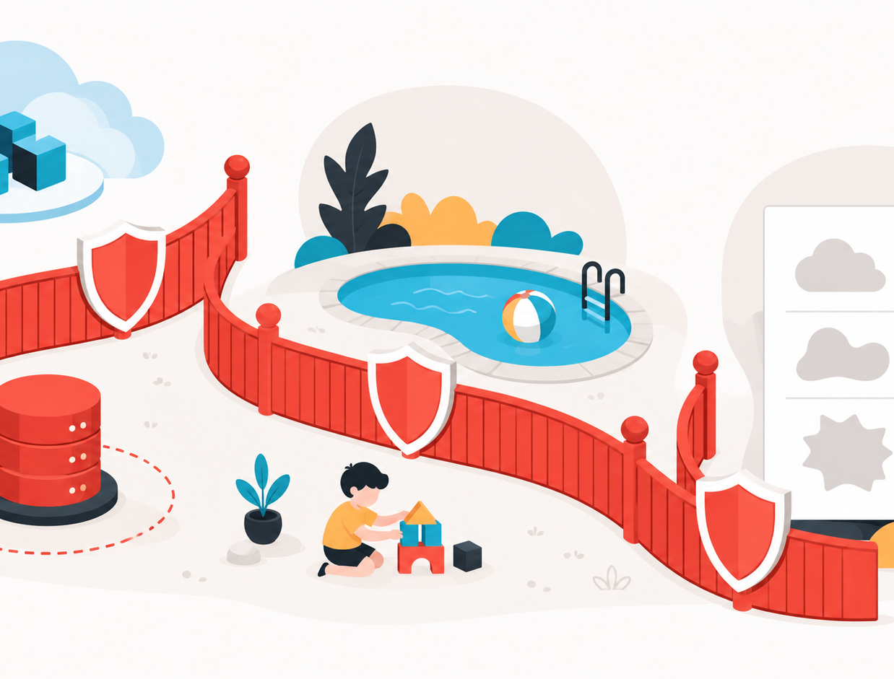
C.L.E.A.R.+ · L
Fence the cliff edges before execution
L
Limits & Negative Constraints
CLOUD
AWS subnet B only. Never connect production DB. Cap monthly cost at $50.
PARENTING
Living room or yard only. Never cross the pool fence. No screens after 17:00.
BUSINESS
No ‘synergy’, ‘game-changer’, ‘delve’ or unverified metrics.
THE SHARED MEANING LAB
09
Notes:
Quality is shaped as much by what must not happen as by what should happen.
Facilitation: Ask participants for one costly failure that a single negative constraint could have prevented.
Build / animation: Show scenario; pop in forbidden outcomes; stamp each out with the relevant boundary.
[Sources]
- Original workshop content and generated illustration; no external source.

Slide 10
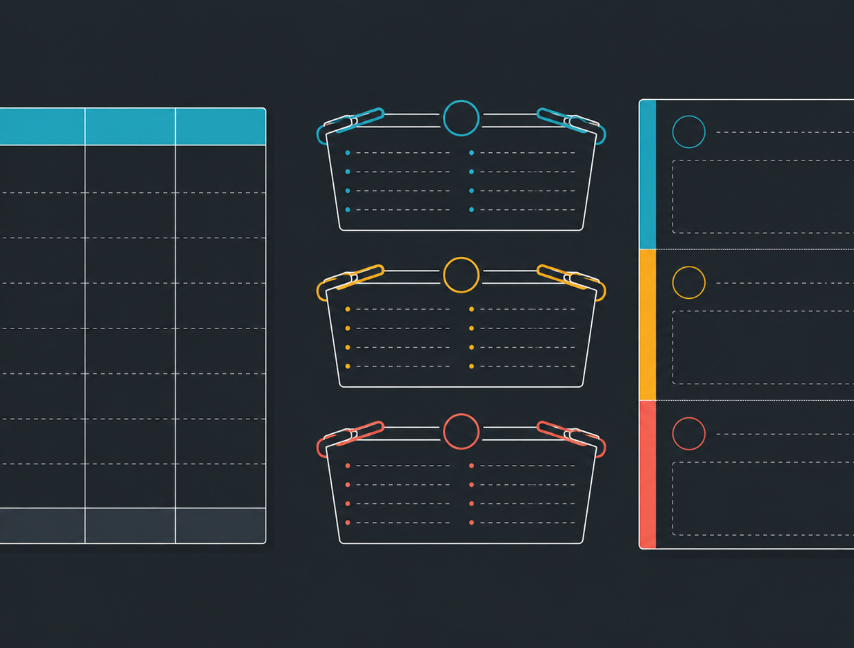
C.L.E.A.R.+ · E
Draw the container before filling it
E
Expected Output
FINANCE
4 columns: Scenario | Base CapEx | Worst-case OpEx | NPV @ 8%. Notes ≤150 words.
GROCERY
Exactly 3 aisles: Produce, Dairy, Bakery. Include quantity and maximum price.
PRODUCT
One page: Now, Next, Later. Exactly 3 items per section with lead and decision.
THE SHARED MEANING LAB
10
Notes:
The output format is not cosmetic. It determines whether the result can be compared, reviewed, or used immediately.
Facilitation: Ask: ‘What downstream action must this output support?’ Then define the smallest structure that supports it.
Build / animation: Blank containers arrive first; content populates into each container in sequence.
[Sources]
- Original workshop content and generated illustration; no external source.

Slide 11

C.L.E.A.R.+ · A
Calibrate the receiver, not just the message
A
Audience & Tone
INCIDENT
200 nontechnical staff. Calm, accountable, jargon-free. Acknowledge the outage first.
CHILD
Overwhelmed 7-year-old. Direct, warm, eye-level. One visible action at a time.
PARTNER
Anxious about bills. Reassuring, team-first. Review the travel fund together.
THE SHARED MEANING LAB
11
Notes:
Tone is operational: it changes trust, cognitive load, resistance, and the probability of action.
Facilitation: Invite participants to rewrite one sentence for a skeptical expert and then for a stressed beginner.
Build / animation: Move the warmth, depth, and skepticism sliders before revealing each audience example.
[Sources]
- Original workshop content and generated illustration; no external source.

Slide 12

C.L.E.A.R.+ · R
Assign judgment—not a costume
R
Role & Process
SECURITY
Reproduce exploit → isolate route → write regression test.
TUTOR
Identify variables → draw box model → ask the next question. Do not reveal the answer.
REPAIR
Separate parts and labor → verify OEM numbers → classify urgent vs deferrable.
THE SHARED MEANING LAB
12
Notes:
A useful role gives the receiver a decision standard and a process. ‘Act as a genius’ gives neither.
Facilitation: Ask participants to replace one decorative persona with a real responsibility, checklist, and stopping condition.
Build / animation: Illuminate step one, two, and three on each pathway. Reveal the stopping rule with the final step.
[Sources]
- Original workshop content and generated illustration; no external source.

Slide 13
C.L.E.A.R.+ · +
Refine the failing part before restarting
Professional prompting is debugging—not wishing harder.
RAW OUTPUT
1
2
3
“Our revolutionary synergy will delve into...”
DIAGNOSE
ISOLATE
CONSTRAIN
Name the defect
Quote only the failing part
Apply a local boundary
Defect: tone + banned words
FIX THE SMALLEST FAILING PART
Then verify the repaired output against the original goal.
THE SHARED MEANING LAB
13
Notes:
Do not reward a flawed output by throwing away all the working context. Debug the smallest failing unit.
Facilitation: Ask someone for a recent bad AI output. Identify one defect, quote the smallest defective span, and add one local constraint.
Build / animation: Highlight the defect in red; cut it into an isolation box; move through Diagnose, Isolate, Constrain; snap the verified result back.
[Sources]
- Original workshop content and generated illustration; no external source.

Slide 14
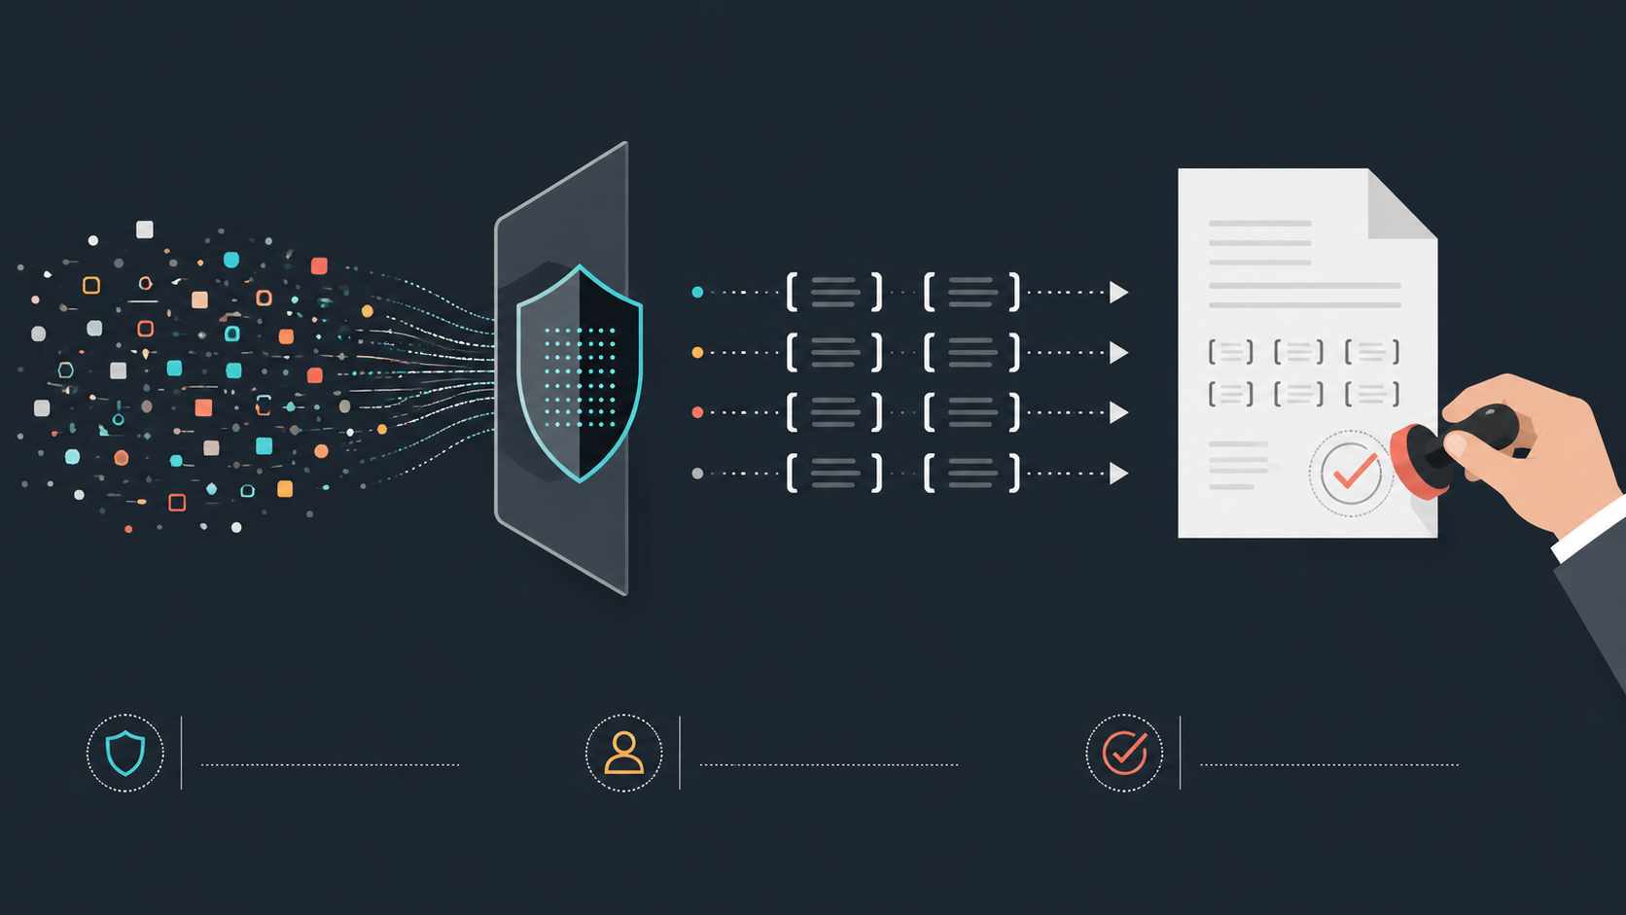
ENTERPRISE SAFETY
The human is the accountability firewall
MASK
VERIFY
OWN
Replace PII and secrets with placeholders.
Check claims against ground truth.
Humans approve, sign and carry liability.
THE SHARED MEANING LAB
14
Notes:
AI can draft, classify, summarize, and propose. It cannot take your legal, ethical, or professional accountability.
Facilitation: Ask participants to identify one data field they should mask and one decision that must always keep a human signature.
Build / animation: Raw tokens move through the shield and become placeholders; the human verification stamp lands last.
[Sources]
- Original workshop content and generated illustration; no external source.

Slide 15

SEVEN-DAY COMMITMENT
Make intent
observable.
Communication is not what leaves your mouth or keyboard. It is what the receiver can reconstruct and execute.
FRONT
C.L.E.A.R.+ checklist + negative constraints
BACK
Diagnose → Isolate → Constrain + zero-trust
MY 7-DAY COMMITMENT
I will make one recurring request observable.
THE SHARED MEANING LAB
15
Notes:
Communication is never what leaves your mouth or keyboard; it is what the receiver can reconstruct and execute.
Facilitation: Give everyone 30 seconds to write one recurring request they will redesign with C.L.E.A.R.+ this week. Invite three public commitments, including one online participant.
Build / animation: Reference card flips; front and back rules appear; close with light confetti and the public commitment.
[Sources]
- Original workshop content and generated illustration; no external source.

