Slide 1
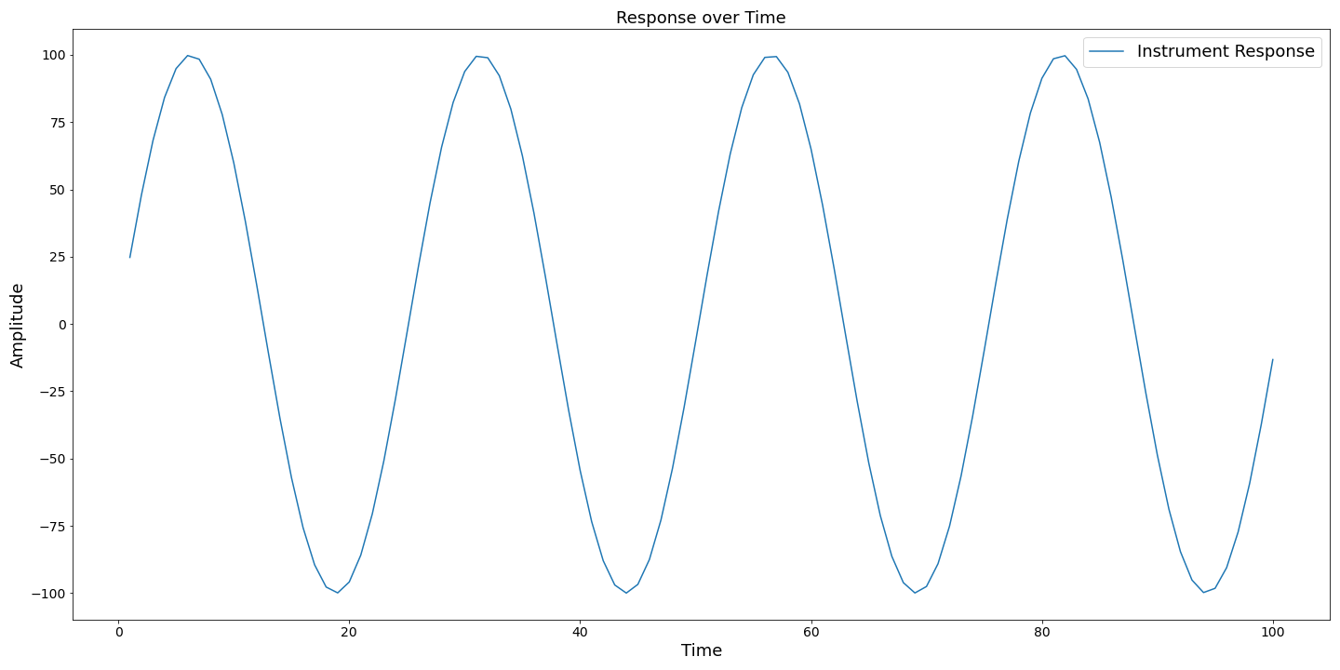
Title
Axis
Legend
Y Tick Label
Y Label
X Tick Label
X Label

