Slide 1
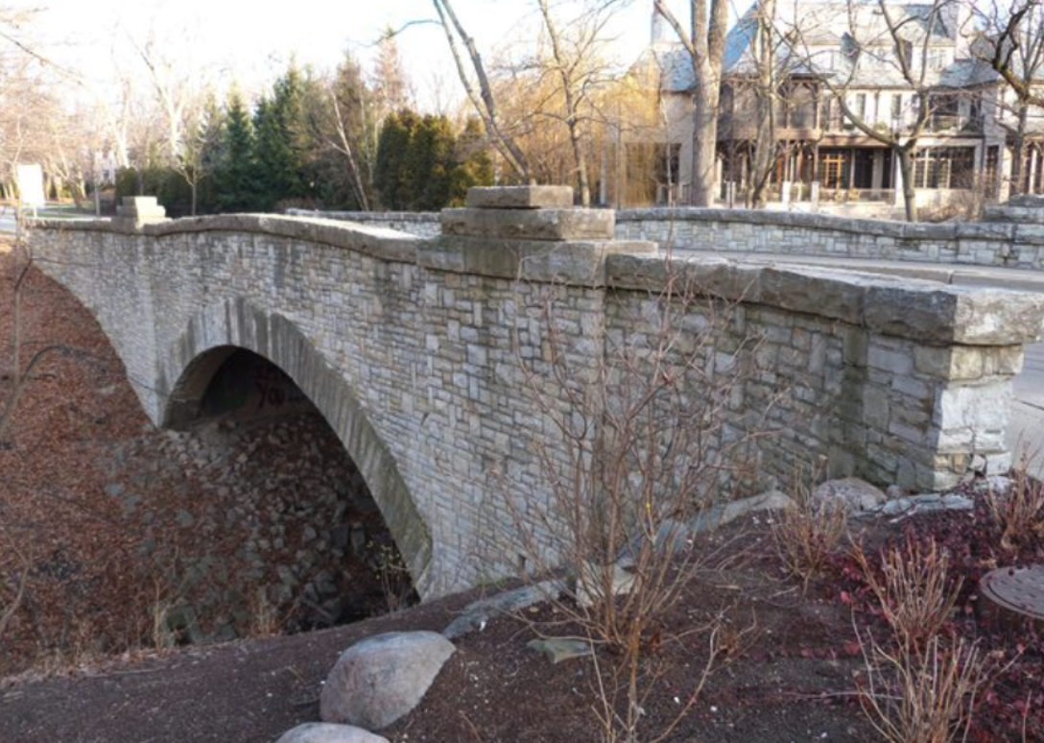

Template Talk
Item 1
Item 2
Item 3

