Slide 1
Data retrieval for data assimilation
Markus Heene, DWD

Slide 2
Agenda
Welcome
Data retrieval for data assimilation
Meteorological Codes
  BUFR - general introduction
  BUFR - processing
  BUFR - overview software
Q&A
Workshop Material:
https://github.com/mheene/NWPconf-IRIMO-20181120-Codes

Slide 3
Data retrieval for data assimilation

Slide 4
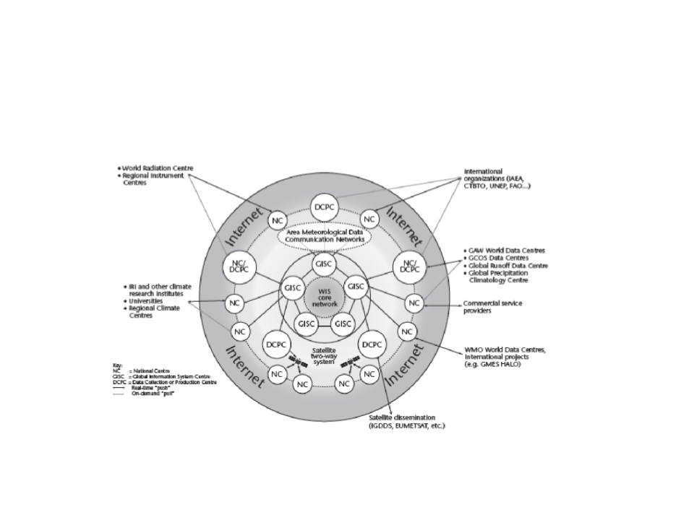
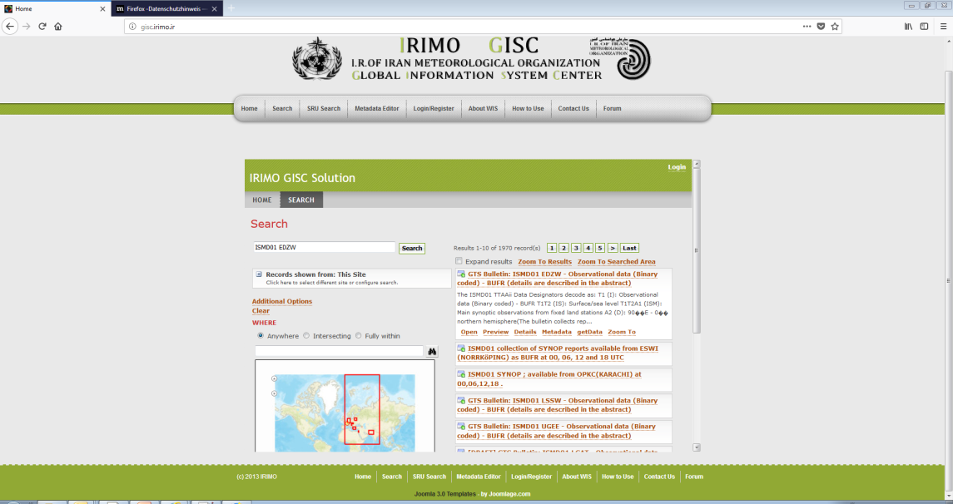
WIS & GISC IRIMO
Overarching approach to manage data and information
Use international standards for protocol, hardware and software
Build on the existing WMO Global Telecommunication System (GTS),
with a special attention to a smooth and coordinated transition
Provide time-critical data exchange, as well as data access and retrieval services
Support all WMO and related international programmes
Link: http://gisc.irimo.ir

Slide 5
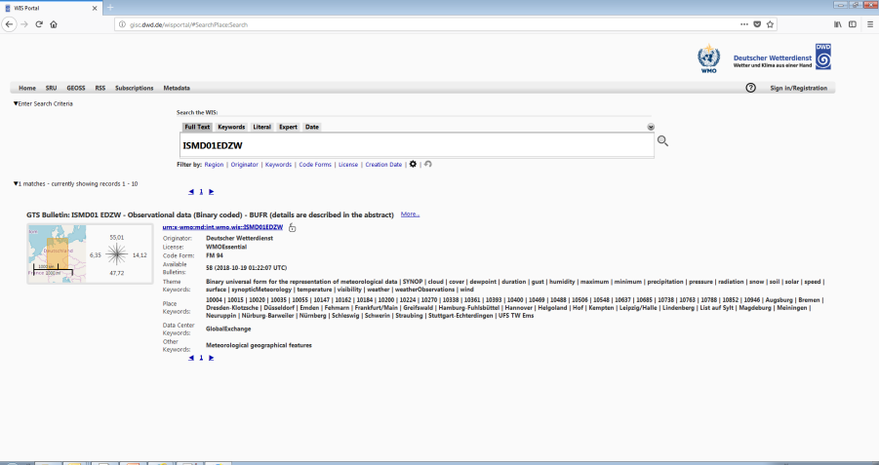
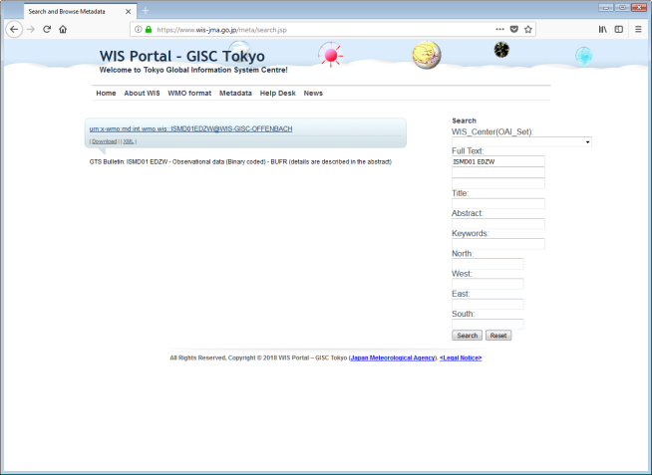
Other GISCs
https://gisc.dwd.de
https://www.wis-jma.go.jp/cms/index.html

Slide 6
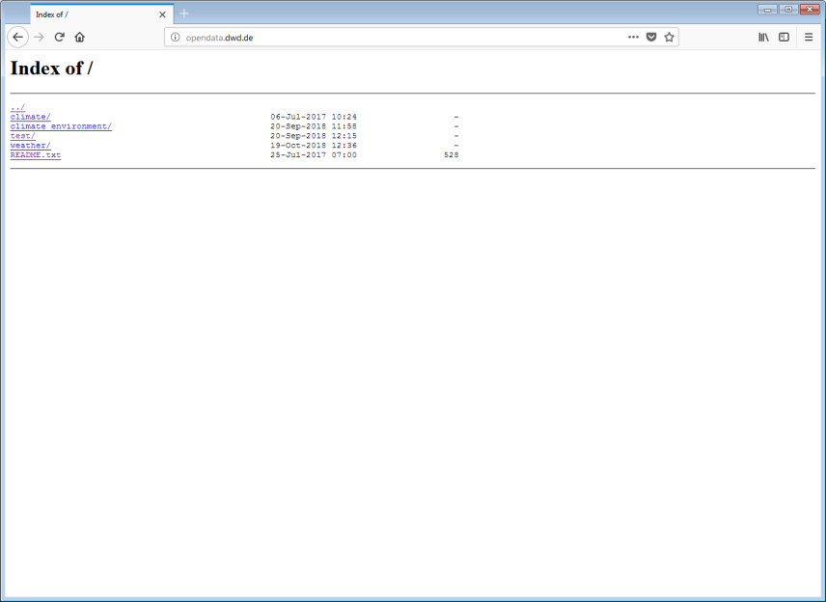
Other ways to find data
More than 50% of the data shared on the GTS (Global Telecommunication System) are without metadata → invisible for a catalogue system [as of end of 2016]
Co-existing information resources: DAR catalogue ←→ VolC1
Example: IWXXM; VolC1 contains 0 IWXXM bulletins, while the DAR catalogue lists 22 bulletins
A lot of data exists which is not shared on the GTS
Examples: ICON EPS, COSMO D2 EPS, …
https://opendata.dwd.de
Serves ~ 10 TB per day / 180 million hits per day
Download script: fetchOpenData.sh

Slide 7
opendata.dwd.de
Usage of fetchOpenData.sh
Change the BASE_URL variable to https://opendata.dwd.de/weather/weather_reports/ to retrieve all files in the tree „weather/weather_reports“
Remark: The directory of the BASE_URL must contain the file „content.log.bz2“
Run the script in a loop to retrieve all updates:
while(true); do ./fetchOpenData.sh && sleep 300; done
Hint: If you need less data e.g. only „road_weather_stations“ modify in the file WHAT_WE_WANT
WHAT_WE_WANT ="road_weather_stations/HS"

Slide 8
(Open) Data Servers
FMI (Finland) https://en.ilmatieteenlaitos.fi/open-data
KNMI (The Netherlands) https://data.knmi.nl/datasets
DWD (Germany) https://opendata.dwd.de
MET.no (Norway) https://api.met.no/
JMA (Japan) https://www.wis-jma.go.jp/d/o/
Canada http://dd.weather.gc.ca/
BOM (Australia) http://www.bom.gov.au/catalogue/data-feeds.shtml
Hint: Search for „Open Data <Name of the Meteorological Agency/Service>“
Please always check the LICENSE agreement and make sure it is suitable for your purposes

Slide 9
(Open) Data Servers
Meteorological Data on AWS (Amazon Web Services)
https://registry.opendata.aws/dwd-icon-global-pds/
https://registry.opendata.aws/dwd-cosmo-d2-pds/
https://registry.opendata.aws/dwd-icon-eu-pds/
https://registry.opendata.aws/sentinel-2/
https://registry.opendata.aws/ecmwf-era5/
https://registry.opendata.aws/hirlam/ (High Resolution Limited Area Model FMI)
https://registry.opendata.aws/mogreps/ (UK Met Office Global and Regional Ensemble Prediction System )
https://registry.opendata.aws/noaa-nexrad/
https://registry.opendata.aws/noaa-goes/
https://registry.opendata.aws/modis/ (Moderate Resolution Imaging Spectroradiometer)
Usage examples: https://registry.opendata.aws/usage-examples/

Slide 10
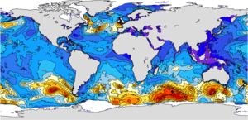
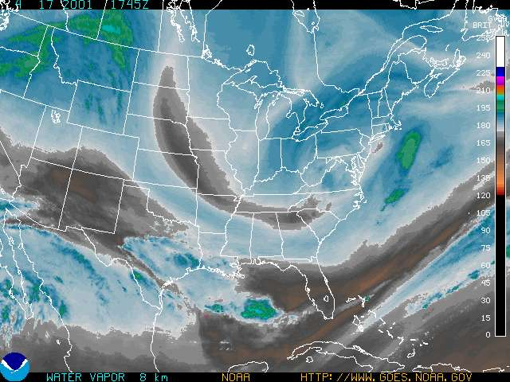
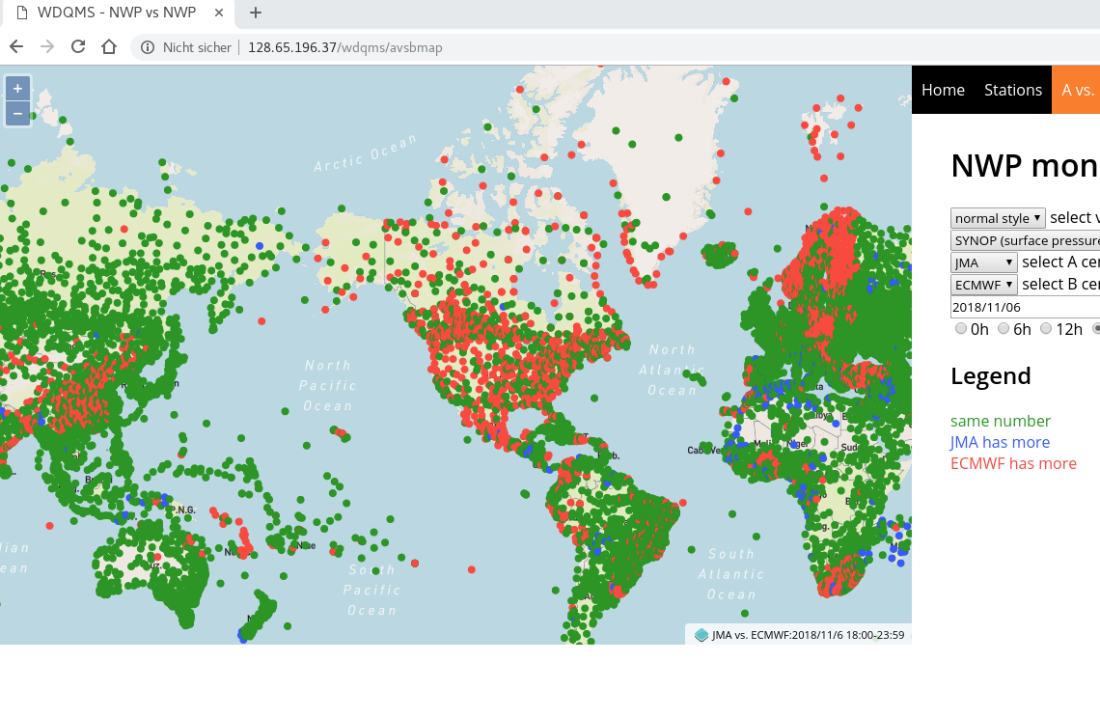
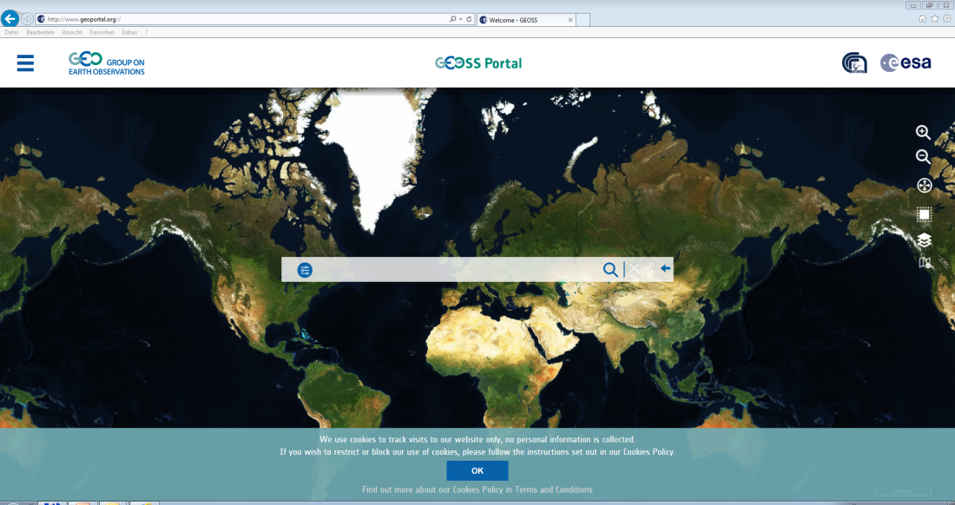
(Open) Data Servers
http://marine.copernicus.eu/ (access your OCEAN information)
https://satepsanone.nesdis.noaa.gov/ (GOES Product Server)
http://128.65.196.37/wdqms WIGOS Data Quality Monitoring System
https://confluence.ecmwf.int//display/TCBUF/SYNOP+Coverage
(ECMWF Coverage Charts)
Other Resources
GEOSS Portal
http://www.geoportal.org/

Slide 11
Meteorological Codes
Introduction to BUFR

Slide 12

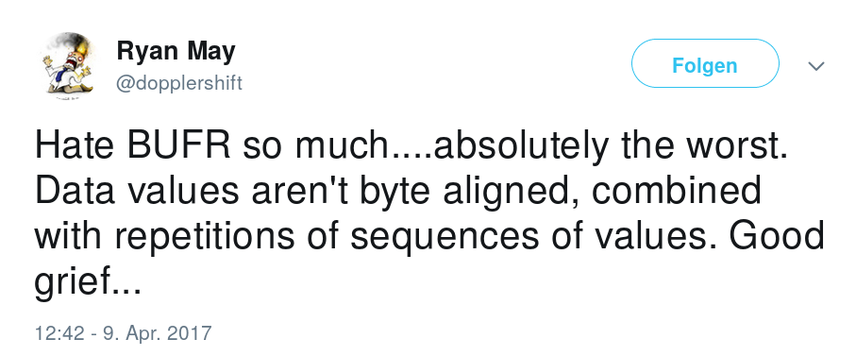
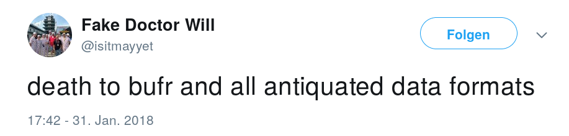
BUFR - Binary Universal Form for the
Representation of meteorological data
I want readable data
I want HDF5
I want GeoTIFF
I want my TAC back
0100001001010101010001100101001000000000000000011111000000000100
I want CSV
#*&@!!
I want XML
I want netCDF
I want JSON

Slide 13

BUFR
Binary Universal Form for the Representation of meteorological data
It is used to encode data such as surface observations, satellite observations …
It is purely binary format
It is maintained by the WMO
It is a table-driven code form
Roughly twice a year (May and November a new version is published)
Latest version is 31, effective from 7th of November 2018
Resources:
  Manual on Codes (WMO-No. 306) http://www.wmo.int/pages/prog/www/WMOCodes.html
  Tables http://www.wmo.int/pages/prog/www/WMOCodes/WMO306_vI2/LatestVERSION/LatestVERSION.html

Slide 14
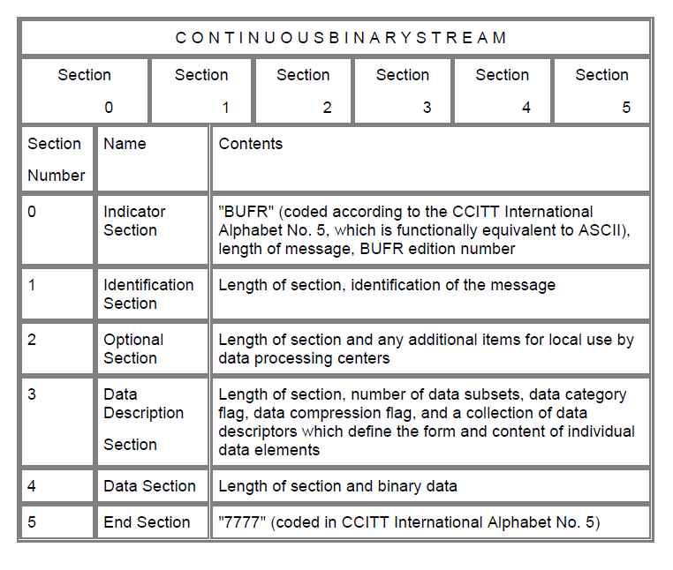
BUFR structure
Notes: Section 0 has a fixed length of 8 octets, Section 5 of 4 octets (1 octet = 8 bits)

Slide 15
Section 0 - Indicator section
|01000010|01010101|01000110|01010010|00000000|00000000|10111001|00000100|
Section 0: Length always 8 octets
Octets 1-4 “BUFR” (in CCITT IA5)
Octets 5-7 Total length of the message (including Section 0)
Octet 8 Edition number (currently 4)

Slide 16
Section 1 - Identification section
|00000000|00000000|00010110|00000000|00000000|01011000|00000000|00000000|
|00000000|00000000|00000000|00000010|00000000|00001110|00000000|00000111|
|11100010|00001010|00000100|00000000|00000000|00000000|
Section 1: Identification section
Octets 1-3 Length of section
Octet 4 BUFR master table ( 0 if standard WMO FM 94 BUFR table, 10 for IOC)
Octet 5-6 Identification of originating/generating centre
Octet 7-8 Identification of originating/generating sub-centre
Octet 9 Update sequence number
Octet 10 Optional section (Bit 1 = 0 no optional section, Bit 1 = 1 optional section follows, Bits 2-8 0)
Octet 11 - 12 International data category and sub-category
Octet 13 Local data sub-category
Octet 14 Version number of master table
Octet 15 Local table Version
Octet 16 - 22 Most typical time for the BUFR message contents
Octet 23 - Optional for local use

Slide 17
Section 2 - Optional section
Octet 1 -3 Length of section
Octet 4 Set to zero (reserved)
Octet 5 - Reserved for local use

Slide 18
Section 3 - Data description section
|00000000|00000000|00001101|00000000|00000000|00000001|10000000|11000111|
|01001111|00000100|00011001|00001011|00101010|
Octet 1- 3 Length of section
Octet 4 0 Set to zero (reserved)
Octet 5-6 Number of data subsets (typically individual observations)
Octet 7 Bit 1 (= 1 Observed data, = 0 Other data), Bit 2 ( =1 Compressed, = 0 Non-compressed)
Octet 8 - data description: collection of element descriptors, replication descriptor, operator descriptors and sequence descriptors -- (blue print of the data section)
Descriptor: F-X-Y, (2 octets)
F 2 bits, X 6 bits , Y 8 bits
F = 0, element descriptor (meteorological parameter like temperature, wind speed, …) Table B
F = 1, replication descriptor (fixed - number is pre-determined, delayed differ from one subset to the next)
F = 2, operator descriptor (changes to other descriptors like scale, reference value, ..) Table C
F = 3, sequence descriptor (alias for pre-defined list of descriptors) Table D

Slide 19

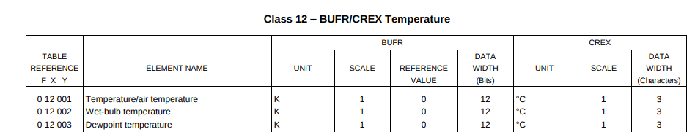
Element descriptors
F = 0 (F-X-Y)
value = (intValue + Reference)10**(-scale)
All bits set to 1 = MISSING VALUE
Example:
valueMin = (0 + 0)10**(-1) = 0 valueMax = (2**12 -2 + 0)10**(-1)
valueMax = 4094*10**(-1) = 409.4

Slide 20
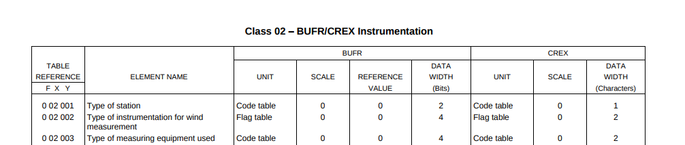
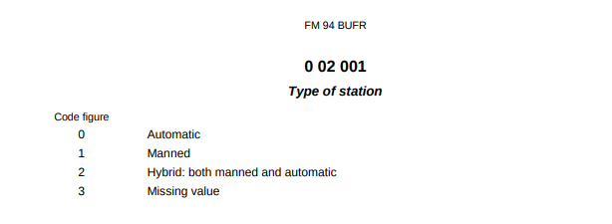
Element descriptors
Code Table vs Flag Table (choice of one vs combination of choices)
F = 0 (F-X-Y)
Type of station (0-02-001) is a Code table (Check Code and Flag Tables)

Slide 21
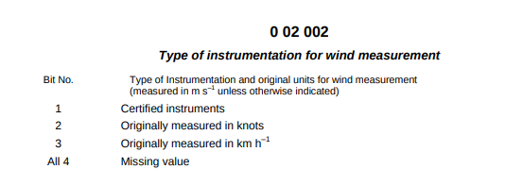
Element descriptors
Code Table vs Flag Table (choice of one vs combination of choices)
F = 0 (F-X-Y)
Type of Instrumentation for wind measurement (0-02-002) is a Flag Table
Example:
You have a wind measurement from a certified instrument which originally measures in knots
Result: 1 (2**3) + 1 (2**2) + 0 (2**1) + 0 (2**0) = 12
Bit No. 1 | Bit No. 2 | Bit No. 3 | Bit No. 4
1 | 1 | 0 | 0

Slide 22

Replication descriptors
F = 1 (F-X-Y)
Describe the repetition of one or more element, operator, sequence or other replication descriptors
Allows a loop-like structure
Used for repetitive data such as the individual levels in vertical soundings or temperature profiles
Fixed:
The number of repetitions is predetermined and the same for all data subsets
X is an integer between 1 and 63, defines the number of descriptors to be repeated
Y is an integer between 1 and 255, defines how many times the X descriptors are to be repeated
Variable:
The number of repetitions can differ from one subset to the next (delayed replication)
X is an integer between 1 and 63, defines the number of descriptors to be repeated
Y = 0

Slide 23
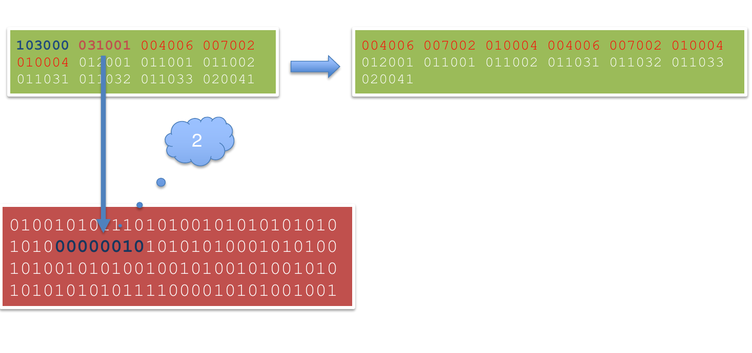
Replication descriptors
F = 1 (F-X-Y)
Fixed replication: F = 1, X = 3, Y = 2:
103002 004006 007002 010004 → 004006 007002 010004 004006 007002 010004
Delayed replication: F = 1, X = 3, Y = 0

Slide 24
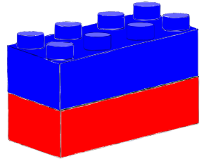
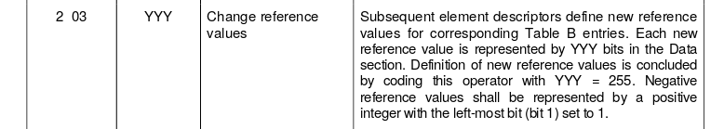
Operator descriptors
F = 2 (F-X-Y)
Describe changes to be made to other descriptors
  Changing scale, reference value or data width
  Add quality control information
  Defined in Table C
Change reference value with 2 03 YYY

Slide 25
Operator descriptors
Example: Change the reference value in the elements 0 07 030 (Height of station ground above mean sea level) and 0 07 031 (Height of barometer above mean sea level) from - 400 m to - 500 m
Reference Value
Data Width
Element Name
Unit
Scale
2 03 014 007030 007031 2 03 255
operation for subsequent element descriptor
operation concluded
00000000|00000000|11001101|00000000|11001110|001000 11|00111000|1000
1 100111001000
- 5000
Result:

Slide 26
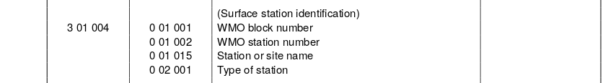
Sequence Descriptors
F = 3 (F-X-Y)
Predefined list of other element, replication, sequence and operator descriptors
Defined in Table D
Example: 3 01 004

Slide 27

Section 4 - Data section
Octet 1 - 3 Length of Data section
Octet 4 Set to zero (reserved)
Octet 5 - Binary data as defined by descriptors which begin at octet 8, Section 3
|00000000|00000000|10001010|00000000|10110010|
|11111100|00101010|00101001|00100111|10100110|00100110|00010000|00010000|
|00010000|00010000|00010000|00010000|00010000|00010000|00010000|00010000|
|00010000|00010000|00010000|00010000|00010000|00001111|11000101|01000010|
|00000000|00000000|11011011|10010100|10000010|00101101|00010010|00000000|
|01000010|11001100|00100000|11000001|01000000|01101001|00110010|11110011|
|11100000|11111111|11111111|11111111|11111111|11111111|11111000|00000110|
|01000010|11111101|00101010|11100110|11011010|11111111|11111111|11111111|
|11111111|10000000|10010110|01111111|11111111|11111111|11111111|11111111|
|11111111|11111111|11111111|11111111|11111000|00000000|00000011|11110111|
|11111111|11111111|11111111|11111111|11000111|11111101|11111110|10111111|
|11111111|11111111|11111111|11111111|11111111|11111111|11000000|01001011|
|00011111|11101011|11111111|11111111|11111111|11111111|11111100|00000011|
|00100001|11111111|11100000|00000001|01111111|01011101|11111111|11100000|
|00000001|01111110|01101100|00001111|10100010|00000100|11111110|11001101|
|11000000|00001000|11111111|11111111|11111111|11111111|11111101|10100110|
|00111111|11100000|01001101|11111111|11111111|11111111|11111111|11111111|
|10000000|00011010|01100000|00000101|00000000|

Slide 28
Section 5 - End section
|00110111|00110111|00110111|00110111|
Octet 1 -4 7777 (in CCITT IA5)

Slide 29
Summary
|01000010|01010101|01000110|01010010|00000000|00000000|10111001|00000100| : 8
|00000000|00000000|00010110|00000000|00000000|01011000|00000000|00000000| : 16
|00000000|00000000|00000000|00000010|00000000|00001110|00000000|00000111| : 24
|11100010|00001010|00000100|00000000|00000000|00000000|00000000|00000000| : 32
|00001101|00000000|00000000|00000001|10000000|11000111|01001111|00000100| : 40
|00011001|00001011|00101010|00000000|00000000|10001010|00000000|10110010| : 48
|11111100|00101010|00101001|00100111|10100110|00100110|00010000|00010000| : 56
|00010000|00010000|00010000|00010000|00010000|00010000|00010000|00010000| : 64
|00010000|00010000|00010000|00010000|00010000|00001111|11000101|01000010| : 72
|00000000|00000000|11011011|10010100|10000010|00101101|00010010|00000000| : 80
|01000010|11001100|00100000|11000001|01000000|01101001|00110010|11110011| : 88
|11100000|11111111|11111111|11111111|11111111|11111111|11111000|00000110| : 96
|01000010|11111101|00101010|11100110|11011010|11111111|11111111|11111111| : 104
|11111111|10000000|10010110|01111111|11111111|11111111|11111111|11111111| : 112
|11111111|11111111|11111111|11111111|11111000|00000000|00000011|11110111| : 120
|11111111|11111111|11111111|11111111|11000111|11111101|11111110|10111111| : 128
|11111111|11111111|11111111|11111111|11111111|11111111|11000000|01001011| : 136
|00011111|11101011|11111111|11111111|11111111|11111111|11111100|00000011| : 144
|00100001|11111111|11100000|00000001|01111111|01011101|11111111|11100000| : 152
|00000001|01111110|01101100|00001111|10100010|00000100|11111110|11001101| : 160
|11000000|00001000|11111111|11111111|11111111|11111111|11111101|10100110| : 168
|00111111|11100000|01001101|11111111|11111111|11111111|11111111|11111111| : 176
|10000000|00011010|01100000|00000101|00000000|00110111|00110111|00110111| : 184
|00110111|
BUFR is maintained by the WMO
BUFR is flexible
  It can represent a wide range of data types
BUFR is table-driven
  Tables A, B, C and D (and code and flag tables) contain majority
  of information needed to encode and decode data
  Most likely no changes to software (encoder, decoder) are needed to use newly released tables
BUFR is self-describing
  The data description section describes the data, using element (Table B), replication, operator (Table C) and sequence (Table D) descriptors
Compression can be used to reduce the size of the data themselves

Slide 30
Suggested reading and resources
Manual on Codes, Volume I.2
ECMWF, Introduction to BUFR decoding with ecCodes
ECMWF, ecCodes Training: BUFR
WMO, Guide to WMO Table-Driven Code Forms
Simon Elliott, EUMETSAT: “Introduction to BUFR”

Slide 31
Introduction to BUFR
processing with ecCodes

Slide 32
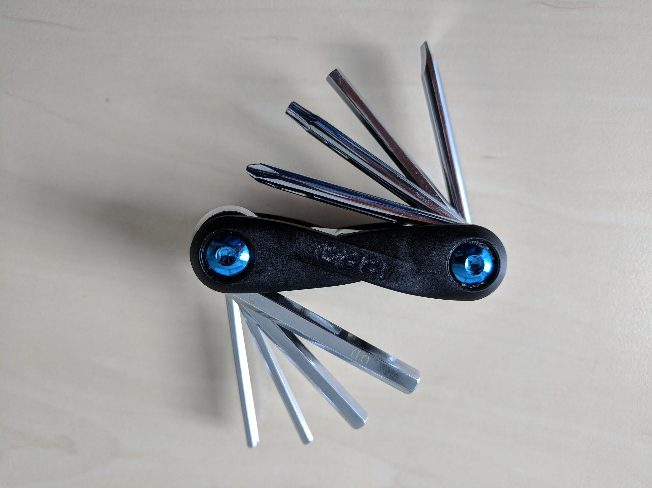
ecCodes – multi-tool for BUFR processing
bufr_filter
bufr_compare
bufr_ls
bufr_copy
bufr_dump
bufr_count
bufr_set

Slide 33
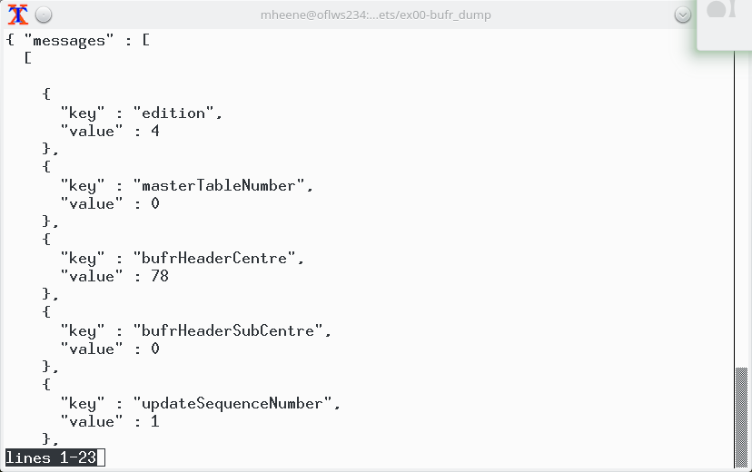
Tools: ecCodes – bufr_dump
Exercise 0
Exercise 0: Get an overview of the BUFR with: bufr_dump –ja <bufr_file>
Inspect a BUFR with bufr_dump in particular to get the name of the keys
bufr_dump –O (Octet mode. WMO documentation style dump, flag if section 2 is present, not available in JSON output )

Slide 34
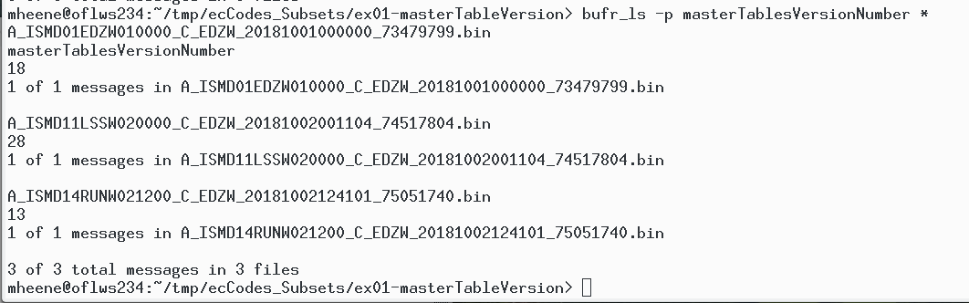
Tools: ecCodes – bufr_ls
Exercise 1
Exercise 1: Determine master table version:
bufr_ls –p masterTablesVersionNumber <bufr_file>
As you can see BUFR disseminate over the GTS use different master table versions
The master table version is part of Section 1
Note: bufr_ls doesn’t unpack the data section (Section 4)

Slide 35
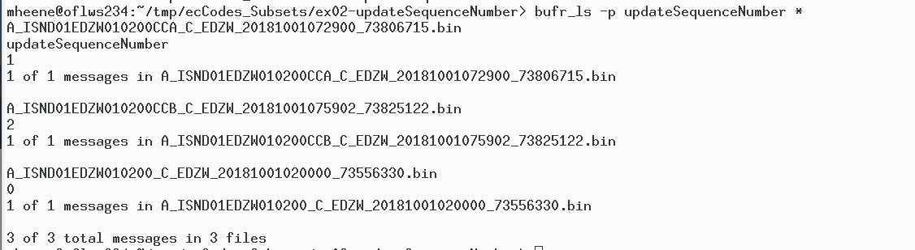
Tools: ecCodes – bufr_ls
Exercise 2
Exercise 2: Determine updateSequenceNumber:
bufr_ls –p updateSequenceNumber <bufr_file>
The original message has the updateSequenceNumber 0
The first correction (CCA) has the updateSequenceNumber 1
The second correction (CCB) has the updateSequenceNumber 2
The updateSequenceNumber is part of Section 1

Slide 36
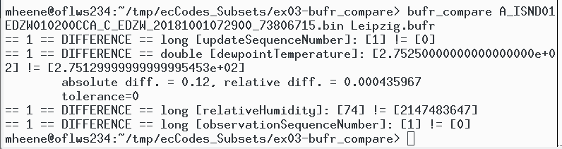
Tools: ecCodes - bufr_compare
Exercise 3
The previous example showed an original message and 2 corrections
Now let us compare the difference between the original message and the 1th correction
In a first step we need to figure out which station provided a correction and than we need to create a new BUFR which contains only one subset with the relevant station from the original message – this will be demonstrated later – for now let us assume we finished already the task
bufr_compare <bufr_1> <bufr_2>
The dewpointTemperature is corrected and the relativeHumidity contains a value. The original message contained a MISSING_VALUE

Slide 37
Tools: ecCodes – bufr_filter
Macro language to process bufr from the command-line
Advanced command-line tool with access to Section 4 too
Macro language does not provide the capabilities of a „full-blown“ programming language e.g no loop constructs
Usage: bufr_filter [-o output] <rule_file> <input_bufr>
You need to set unpack = 1 to decode (unpack) the data section
You need to set pack = 1 to encode (pack) the data section
Each instruction in the rule_file must end with a semicolon „;“
For details of bufr_filter please refer to the ECMWF training pages

Slide 38
Tools: ecCodes – bufr_filter
Exercise 4
bufr_filter: Extract 1 subset of a BUFR
Step 1: Get stationname of the corrected BUFR → „Leipzig/Halle“ e.g. with bufr_dump
Step 2: Get subsetNumber of the subset with the observation of „Leipzig/Halle“ e.g. inspect BUFR with bufr_dump or write a rule-file → Subset: 15
  set unpack =1;
  print "SubsetNumber [subsetNumber] ";
  print "Name [stationOrSiteName]";
Step 3: Extract subset = 15 from the original BUFR
bufr_filter –o Leipzig.bin extractSubset.flt <Original_BUFR>
  set unpack=1;
  set extractSubset=15;
  set doExtractSubsets=1;
  write;

Slide 39
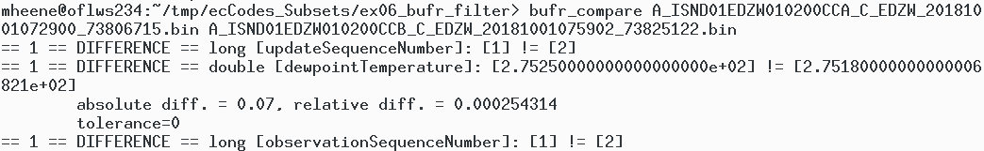
Tools: ecCodes – bufr_filter
Exercise 5
Exercise: Manipulate a BUFR – In Exercise 2 we had an original BUFR message with 2 corrections. Let us figure out the difference between correction 1 and 2 in a first step while in a second step we produce correction 2 manually
Step 1: bufr_compare <BUFR_CCA.bin> <BUFR_CCB.bin>

Slide 40
Tools: ecCodes – bufr_filter
Exercise 5
Step 2: bufr_filter –o myCorrection writeRule.flt <BUFR_CCA.bin>
writeRule.flt:
set unpack = 1;
set dewpointTemperature = 275.18;
set updateSequenceNumber = 2;
set observationSequenceNumber =2;
set pack = 1;
write;
Step 3: bufr_compare myCorrection <BUFR_CCB.bin>
Note: Please note that diff says that the binary files differ while bufr_compare recognizes both files as same (the difference is that the bulletin contains a bulletin header)

Slide 41
Tools: ecCodes – bufr_set
Exercise 6
Exercise: Remove a local section from a message
Step 1: Check if local section is present
bufr_ls -p section2Present <in.bufr>
Step 2: Remove the local section
bufr_set -s section2Present=0 <in.bufr> <out.bufr>
Step 3: Compare both messages
bufr_compare <in.bufr> <out.bufr> (Note: bufr_compare shows no difference)

Slide 42
Tools: ecCodes – bufr_count and bufr_copy
Exercise 7
One file can contain more than one BUFR
Example: simply cat several BUFRs into one file:
cat *.bin > multi_bufr.bin
Count the number of BUFRs in the file with bufr_count:
bufr_count multi_bufr.bin
Split a file with multiple BUFRs into separate files:
bufr_copy -v multi_bufr.bin out_[count].bufr

Slide 43
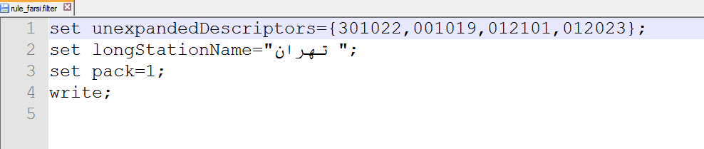
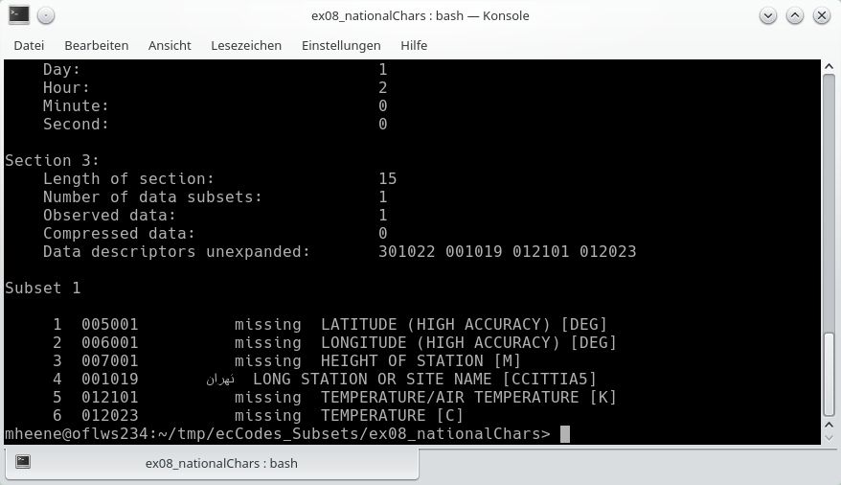
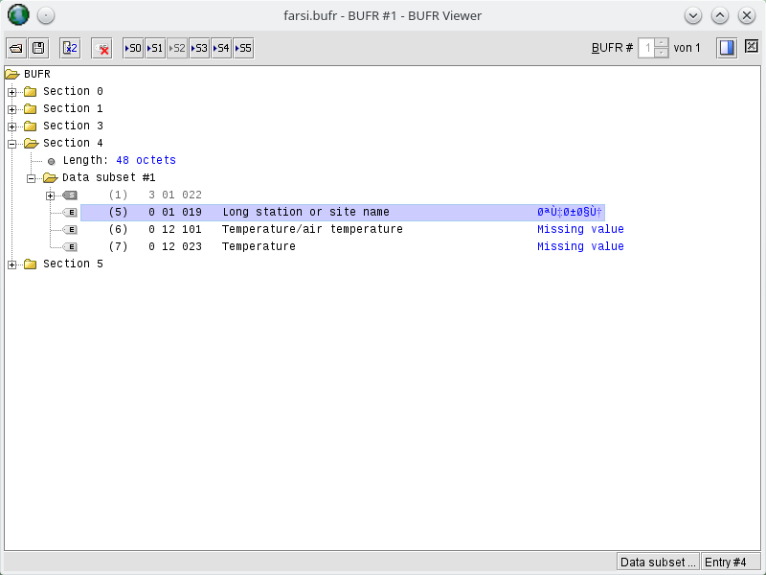
Some notes
Exercise 8
National Chars in BUFR (Note: Only CCITT IA5 is supported)
Consider the following example (example 8)
bufrread.pl (Geo::BUFR)
BUFR Tools (DWD)

Slide 44
Validation and Sanitization of data
Exercise 9
Step 1a: Someone creates an evil BUFR
set unexpandedDescriptors={301022,001019,012101,012023};
set longStationName="touch boom.txt";
set pack=1;
write;
Step 1b: bufr_filter –o evil.bufr rule_boom.filter <input_bufr>
Step 2a: A data scientist reads the evil.bufr with a filter like this:
set unpack = 1;
print "[longStationName] ";
Step 2b: VAR=`bufr_filter station.filter evil.bufr`
Step 2c: and executes $VAR
This creates a file in the current working directory

Slide 45
Summary ecCodes Tools
Inspect a BUFR with: bufr_dump, bufr_ls or bufr_filter
Compare BUFR messages with bufr_compare
Manipulate BUFR messages with bufr_set or bufr_filter
Remove a local section from a BUFR message with bufr_set
Extract a subset from a BUFR message with bufr_filter
Split a file with multiple BUFR messages into separated files with bufr_copy
Count BUFR in a file with bufr_count

Slide 46
ecCodes - API
Python
ecCodes
Fortran90
C

Slide 47
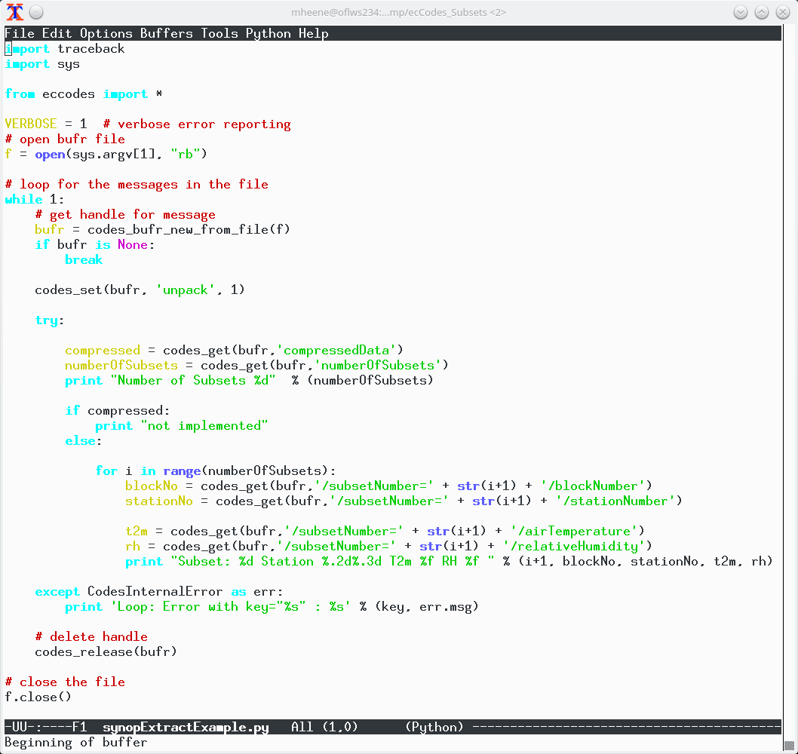
ecCodes - API
Exercise 10

Slide 48
Suggested reading and resources
ECMWF, Introduction to BUFR decoding with ecCodes
ECMWF, ecCodes Training: BUFR
ECMWF, ecCodes API Reference
ECMWF, ecCodes BUFR examples
ECMWF, ecCodes How-to Articles

Slide 49
Overview BUFR software
Software | Language | Online resource
BUFR Tools (DWD) | Web Service | https://kunden.dwd.de/bufrviewer/
ecCodes (ECMWF) | C/Fortran90/Python | http://apps.ecmwf.int/codes/bufr/validator/
Geo::BUFR | Perl | https://metacpan.org/pod/Geo::BUFR
libECBUFR (MSC) | C | https://launchpad.net/libecbufr
PyBufrKit | Python | https://github.com/ywangd/pybufrkit
TrollBufr | Python | https://github.com/pytroll/trollbufr
BUFRDC (discountinued) |  | https://confluence.ecmwf.int/display/BUFR/BUFRDC+Home

Slide 50
BUFR Validation Dashboard
Initiative by Wang Peng (CMA), Yang Wang (former BOM), Abbas (IRIMO) and Markus (DWD)
https://github.com/mheene/bufrValidationDashboard
https://github.com/mheene/allInOne
Idea:
  Make results of different decoders available for users without the need to install all decoders
  Provide a web-service for BUFR encoder developers to test their software
  Create awareness that different decoders handle corrupt BUFRs differently

Slide 51
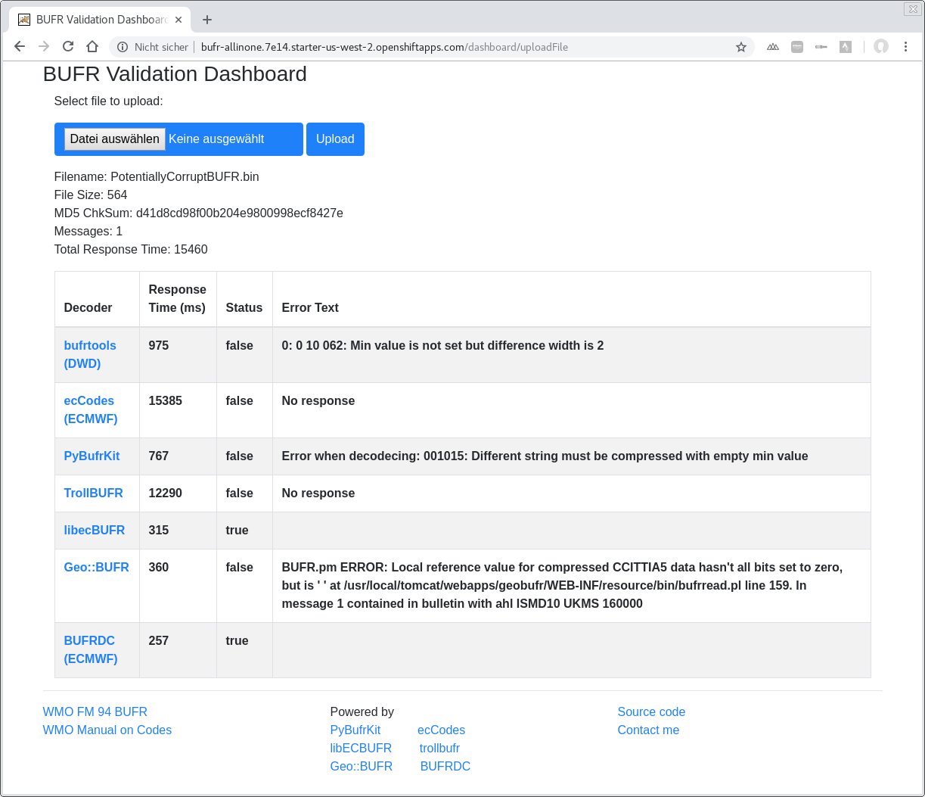
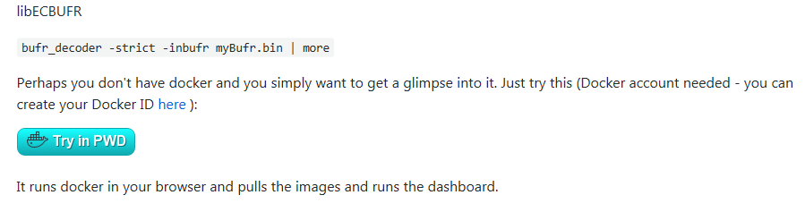
BUFR Validation Dashboard

Slide 52
Thank you very much indeed for your attention
|01000010|01010101|01000110|01010010|00000000|00000000|10111001|00000100| : 8
|00000000|00000000|00010110|00000000|00000000|01011000|00000000|00000000| : 16
|00000000|00000000|00000000|00000010|00000000|00001110|00000000|00000111| : 24
|11100010|00001010|00000100|00000000|00000000|00000000|00000000|00000000| : 32
|00001101|00000000|00000000|00000001|10000000|11000111|01001111|00000100| : 40
|00011001|00001011|00101010|00000000|00000000|10001010|00000000|10110010| : 48
|11111100|00101010|00101001|00100111|10100110|00100110|00010000|00010000| : 56
|00010000|00010000|00010000|00010000|00010000|00010000|00010000|00010000| : 64
|00010000|00010000|00010000|00010000|00010000|00001111|11000101|01000010| : 72
|00000000|00000000|11011011|10010100|10000010|00101101|00010010|00000000| : 80
|01000010|11001100|00100000|11000001|01000000|01101001|00110010|11110011| : 88
|11100000|11111111|11111111|11111111|11111111|11111111|11111000|00000110| : 96
|01000010|11111101|00101010|11100110|11011010|11111111|11111111|11111111| : 104
|11111111|10000000|10010110|01111111|11111111|11111111|11111111|11111111| : 112
|11111111|11111111|11111111|11111111|11111000|00000000|00000011|11110111| : 120
|11111111|11111111|11111111|11111111|11000111|11111101|11111110|10111111| : 128
|11111111|11111111|11111111|11111111|11111111|11111111|11000000|01001011| : 136
|00011111|11101011|11111111|11111111|11111111|11111111|11111100|00000011| : 144
|00100001|11111111|11100000|00000001|01111111|01011101|11111111|11100000| : 152
|00000001|01111110|01101100|00001111|10100010|00000100|11111110|11001101| : 160
|11000000|00001000|11111111|11111111|11111111|11111111|11111101|10100110| : 168
|00111111|11100000|01001101|11111111|11111111|11111111|11111111|11111111| : 176
|10000000|00011010|01100000|00000101|00000000|00110111|00110111|00110111| : 184
|00110111|
Workshop Material:
https://github.com/mheene/NWPconf-IRIMO-20181120-Codes

