Slide 1
PA13A-1971: Automatic Metadata Generation for Dark Data to Support Information Systems
Markus Heene, Deutscher Wetterdienst (DWD) Email: markus.heene@dwd.de

Slide 2
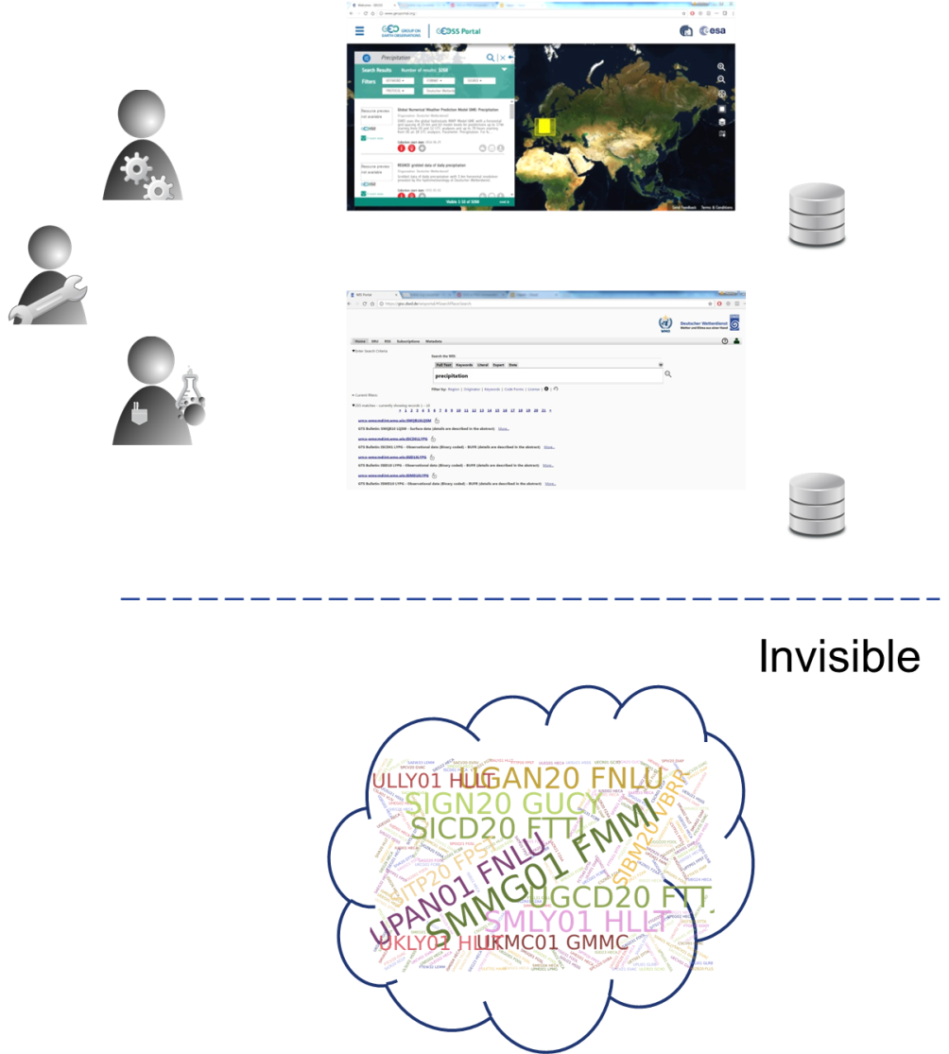
Initial Situation
User: I want all precipitation data for South-East Europe
The Information System „knows“ only the data and products described by metadata
More than 50% of all data and products are without metadata → dark data for Information Systems

Slide 3
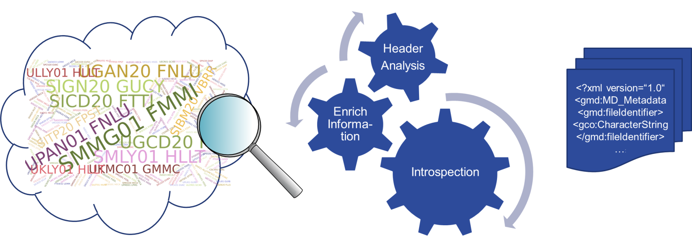
Automatic Metadata Generation
Data and products follow a formal naming concept
Header Analysis
Enrich initial information with additional knowledge sources
Introspection
Generate metadata

Slide 4
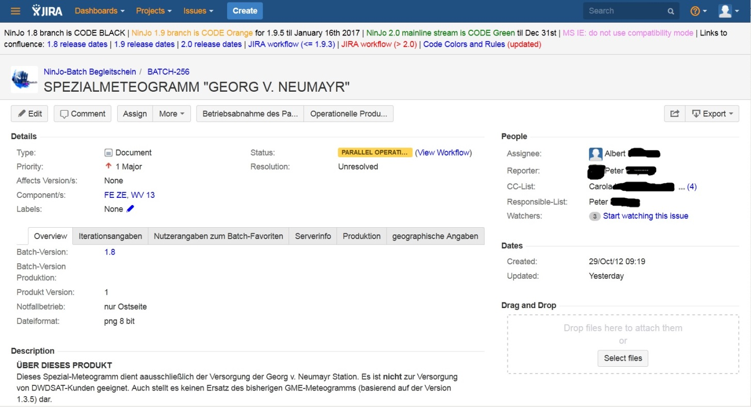
Other Usage Scenarios
Ticket-System with product descriptions
Export structured data
Extracting relevant information: theme keywords, geographic bounding box, …
Enriching with additional data from knowledge repositories

Slide 5
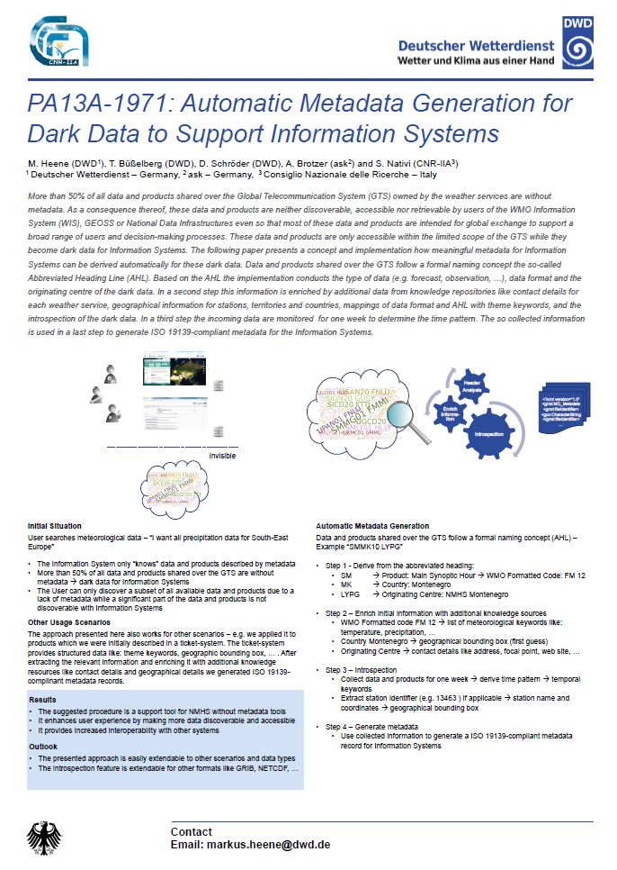
PA13A-1971 Results & Outlook
Support tool for NMHS without metadata tools
It makes more data discoverable and accessible
It provides Increased interoperability with other systems
Easily extendable to other scenarios and data types
The introspection feature is extendable for other formats like GRIB, NETCDF

