Slide 1
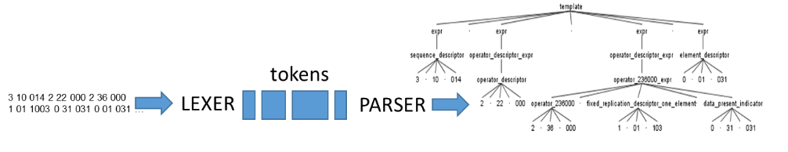
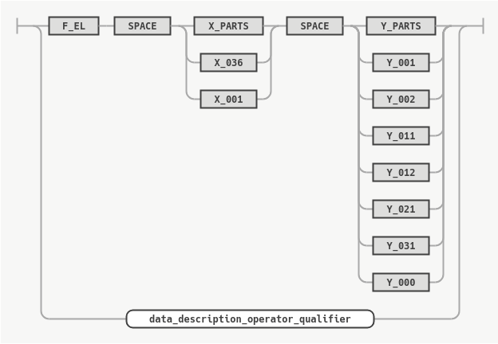
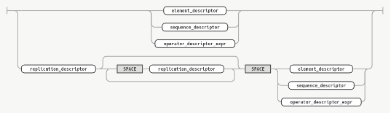
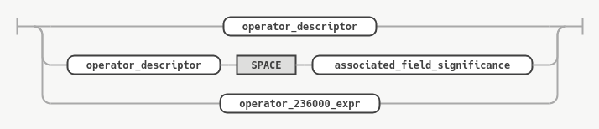
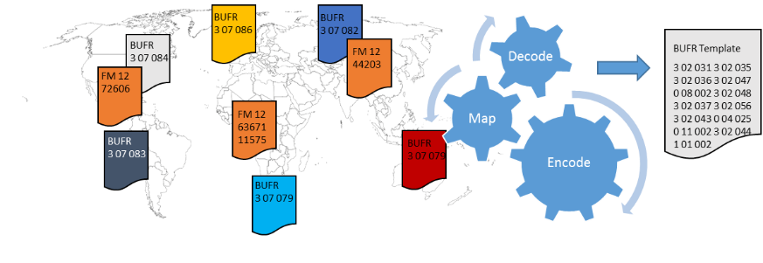
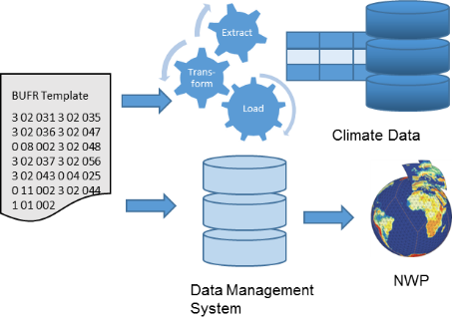
IN23D-0901 - Addressing the ‘R’ of the FAIR Data Principles with BUFR (Binary Universal Form for the Representation of meteorological data)
Markus Heene, Deutscher Wetterdienst (DWD)
The code form FM 94 BUFR (Binary Universal Form for the Representation of meteorological data) is well established in the meteorological community. In particular this form is used for data exchange and data archives. It is a table driven code form and the tables are maintained by an expert team under the stewardship of the World Meteorological Organization (WMO). The Deutscher Wetterdienst (DWD) is with experts involved into the continuously maintenance and the specification of new editions. The BUFR is heavily used in DWDs central systems and as archive format. Due to the standardized structure it is reusable for many different applications like data assimilation or climatology. However the code form is not limited to the meteorological community. The following paper provides a brief introduction into the BUFR and describes the advantages of the code form as an exchange format. Furthermore it high-lights the reusability aspect of the code form. In addition it outlines how the existing definition of code form could be translated to a formal grammar which would increase the interoperability.
Grammar
Data Exchange and Meteorological Codes
The WMO (World Meteorological Organi-zation) has more than 190 members. These members exchange their observa-tions and measurements around-the-clock. The Manual on Codes contains the inter-national codes for these meteorological data. The Traditional Alphanumeric Codes (like SYNOP FM 12) are no longer main-tained and the migration to BUFR is on-going. BUFR is a table driven code form which means you can easily extend it with-out changing the software. BUFR is main-tained by an WMO Expert team.
^{Message decoding}
DWD collects in its role as GISC all global available observations and measurement intended for global exchange and additional data from other networks.These data is encoded in different formats.In a first step all these different formats are processed by our decoding system. The software decodes the different formats and than maps the entities on an internal harmonzied BUFR templates. The resulting BUFR is than stored. Figure 1 shows this process for synoptic messages. You will likely find similar processes in all centers which run a global model.
^{Complexity reduction}
The previous step reduces the complexity for the succeeding steps.Each of the following processes needs only to decode the relevant harmonized BUFR template(s) and not the full variety of all incoming formats.
In addition it reduces the number of decoding software we need to provide and maintain (in particular for historical formats).
Furthermore the likeness of misinterpreation is significant reduced due to precise description of the elements in the BUFR tables.
^{BUFR as an archive format}
DWD maintains an „eternal“ memory of all observation and measurements. All these data are stored in a relational database. A quality controll of the values takes place and different kind of aggregating like daily average, min and max values … . The db is optimized for the retrieval of long timeseries. An ETL process decodes the BUFR and loads the values into the appropritated tables.
While the latter db is mainly used by climatologist the data management system is mainly used by the numerical weather prediction (NWP). As described before for example all synoptic observations are stored with a harmonized SYNOP BUFR template, same applies for upper air measurements which are stored with a harmonized TEMP BUFR template.
The same data management system is used to store the model output.
Summary
Figure 1: Schematic overview of the collection and processing of synoptic observations.
Figure 2: Schematic overview of the data storage process.
Abteilungsbezeichnung und/oder Internetadresse (Arial, schwarz, fett, 42 Pkt.)
Contact: Markus Heene, markus.heene@dwd.de

