Slide 1
BUFR Grammar
Markus Heene TI12B, DWD

Slide 2
Agenda
BUFR Grammar – Introduction
BUFR Grammar – Implementation
BUFR Grammar – Usage
BUFR Grammar – Examples
BUFR Grammar – Summary & Outlook

Slide 3
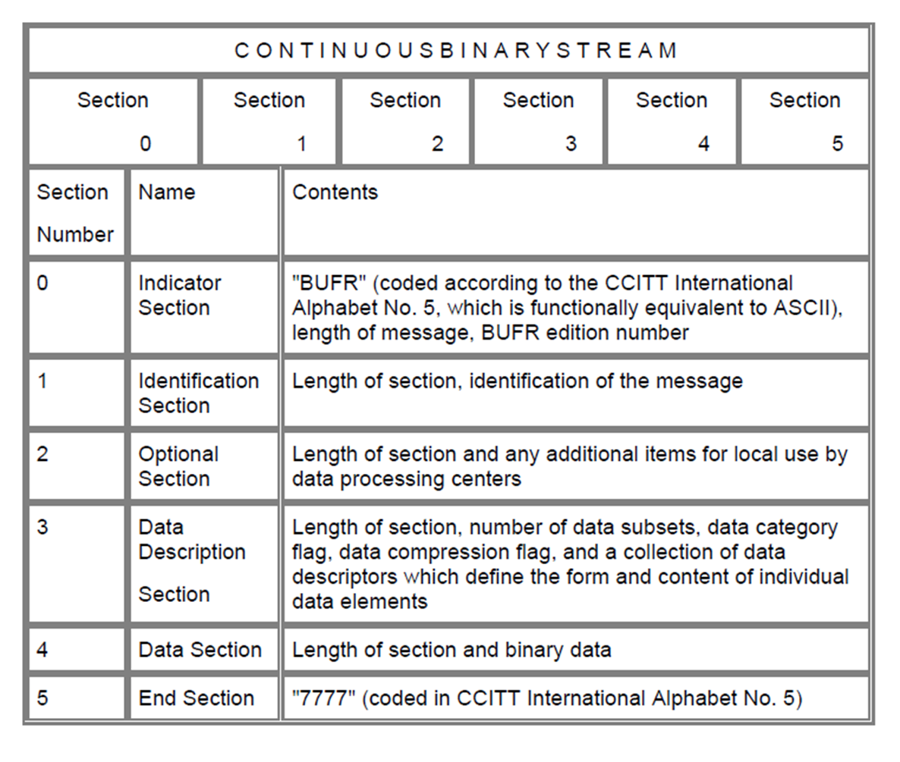
BUFR Grammar – Introduction
BUFR (Binary universal form for the representation of meteorological data) is a binary code form to encode meteorological data
A BUFR consists of sections
Section 3 is the blue print of Section 4 and contains a collection of descriptors

Slide 4
BUFR Grammar – Introduction
F = 0 is the "element descriptor" which defines a single data item (temperature, pressure, humidity, ...)
F = 1 is the "replication descriptor". In this case X indicates the number of descriptors to be repeated, and Y the total number of replications. For Y = 0 we call the descriptor "delayed replication descriptor" and the number of replications is encoded in the data section with the so called "delayed descriptor replication factor" e.g. 0 31 000, 0 31 001, ...
F = 2 is the "operator descriptor“
F = 3 is the "sequence descriptor". A sequence descriptor defines a list of element descriptors, replication descriptors, operator descriptors and/or sequence descriptors.
Example: 3 10 014 2 22 000 2 36 000 1 01 103 0 31 031 0 01 031 …
Descriptor: F – X –Y
F ∈ [0,3] (2 bits), X ∈ [0,63] (6 bits), Y ∈ [0, 255] (8 bits)

Slide 5
BUFR Grammar - Implementation
Looking from a different perspective the rules as a whole can be interpreted as a language. This language is a set of valid sentences, and sentences are composed of phrases and clauses. Hereby a sentence structure follows a grammar. In our case the descriptors represent the phrases and clauses.
The following sequence of descriptors is a valid sentence: 3 10 014 2 22 000 2 36 000 1 01 103 0 31 031 0 01 031. The rules for applying and combining the descriptors are our grammar.
Requirements:
  Describe tokens (alphabet)
  Describe descriptors (element, replication, operator and sequence descriptors)
  Describe rules e.g. 1 02 000 0 31 000, 2 36 000 1 01 103 0 31 031, …
  Describe valid sentence

Slide 6
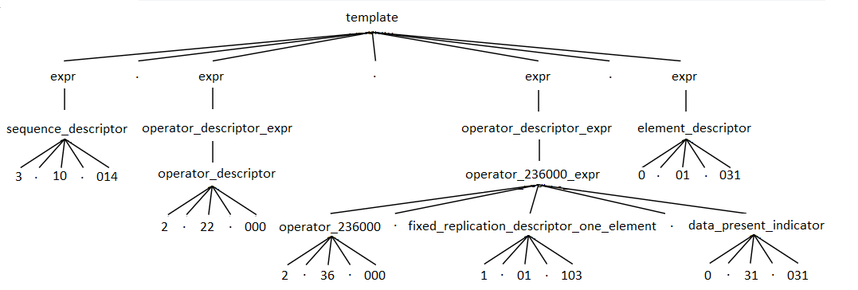

BUFR Grammar - Implementation
Basic data flow of a language recognizer
Lexical analysis, lexing or tokenization is the process of converting a sequence of characters (such as in a computer program or web page) into a sequence of tokens
A parser is a software component that takes input data (frequently text) and builds a data structure – often some kind of parse tree, abstract syntax tree or other hierarchical structure, giving a structural representation of the input while checking for correct syntax.
see wikipedia

Slide 7
BUFR Grammar - Implementation
We need:
  Grammar
  Lexer
  Parser
A basic version of a BUFR grammar is available on github https://github.com/mheene/bufr-grammar
The grammar is formulated in ANTLR (ANother Tool for Language Recognition) https://www.antlr.org/
  ANTLR automatically generates lexer and parser passed on the formulated grammar for us

Slide 8
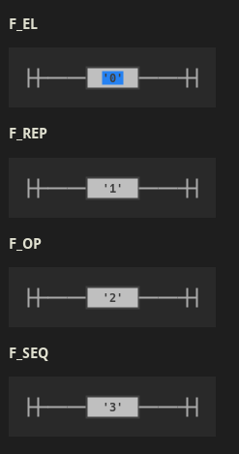
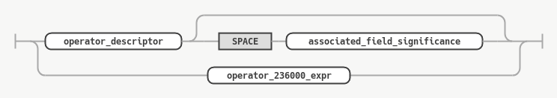
BUFR Grammar - Implementation
Lexer rules for „F“
Railroad diagram for the parser rule „operator descriptor expr“

Slide 9
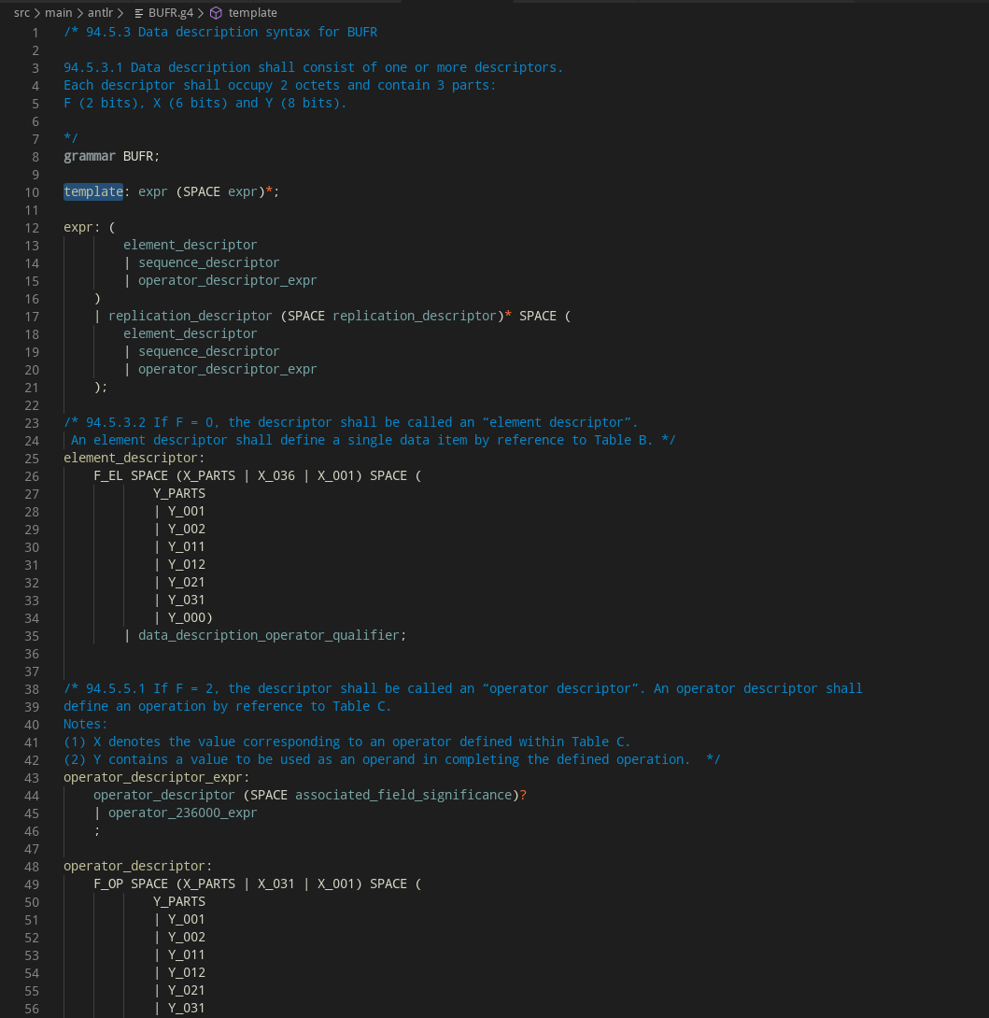
BUFR Grammar - Implementation

Slide 10
BUFR Grammar - Implementation
The project uses gradle as build tool
gradlew jar - builds the project as a standalone jar
java -jar build/libs/counter-0.0.1.jar material/valid/301003.txt - checks the file 301003.txt based on the BUFR grammar and the additional replication descriptor checks
gradlew grun -PinputFile=material/valid/301003.txt - builds with grun( ANTLR test rig) a parse tree of the file 301003.txt
gradlew test - checks all WMO sequences and some additional test against the grammar dn the additional replication descriptor checks

Slide 11
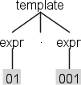
BUFR Grammar - Examples
Example 1: Invalid Descriptor 5 01 001
java -jar build/libs/counter-0.0.1.jar talk/examples/01_invalid_descriptor.txt
Output:
line 1:0 token recognition error at: '5 'rule stack: [template, expr]line 1:2 at [@0,2:3='01',<14>,1:2]: mismatched input '01' expecting {F_EL, F_REP, F_OP, F_SEQ}rule stack: [template, expr]line 1:5 at [@2,5:7='001',<6>,1:5]: mismatched input '001' expecting {F_EL, F_REP, F_OP, F_SEQ}Errors Listener: line 1:5 at [@2,5:7='001',<6>,1:5]: mismatched input '001' expecting {F_EL, F_REP, F_OP, F_SEQ}
gradlew grun -PinputFile=talk/examples/01_invalid_descriptor.txt

Slide 12
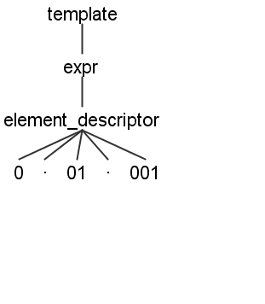
BUFR Grammar - Examples
Example 4: Valid Descriptor 0 01 001
java -jar build/libs/counter-0.0.1.jar talk/examples/04_valid_descriptor.txt
gradlew grun -PinputFile=talk/examples/04_valid_descriptor.txt

Slide 13
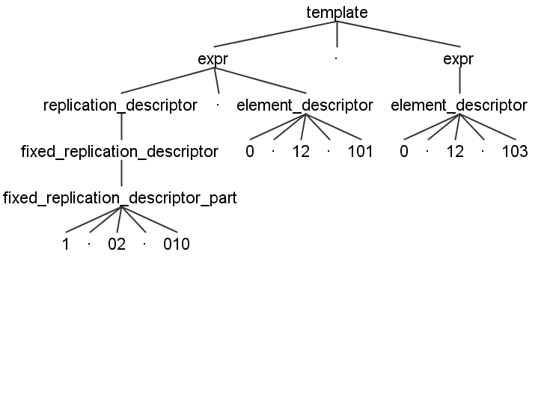
BUFR Grammar - Examples
Example 5: Valid Replication 1 02 010 0 12 101 0 12 103
java -jar build/libs/counter-0.0.1.jar talk/examples/05_valid_replication.txt
gradlew grun -PinputFile=talk/examples/05_valid_replication.txt

Slide 14
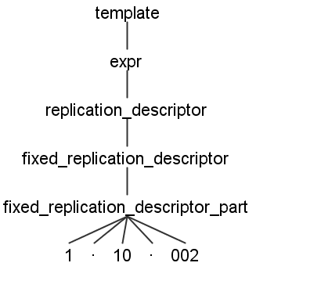
BUFR Grammar - Examples
Example 6: Invalid Replication 1 10 002
java -jar build/libs/counter-0.0.1.jar talk/examples/06_invalid_replication.txt
Output:
rule stack: [template, expr]line 2:0 at [@5,9:8='<EOF>',<-1>,2:0]: mismatched input '<EOF>' expecting ' ‚
Errors iterator: Error in Replications detected.
Errors iterator: DescriptorList:
Errors iterator: Descriptor: Position 0 Name: 1 10 002 Replications: 10
Errors Listener: line 2:0 at [@5,9:8='<EOF>',<-1>,2:0]: mismatched input '<EOF>' expecting ' ‚
gradlew grun -PinputFile=talk/examples/06_invalid_replication.txt
Output:
line 2:0 mismatched input '<EOF>' expecting ' '

Slide 15
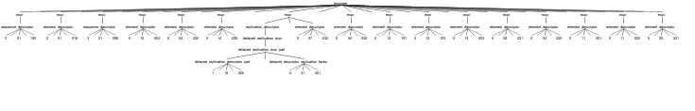
BUFR Grammar - Examples
Example 7: Hightower wrong replications
java -jar build/libs/counter-0.0.1.jar talk/examples/07_hightower.txt
Output:
Errors iterator: Error in Replications detected.
Errors iterator: DescriptorList:
Errors iterator: Descriptor: Position 0 Name: 1 16 000 0 31 001 Replications: 6
./gradlew grun -PinputFile=talk/examples/07_hightower.txt
The additional rules in the listener implemented detect the error while the grammar finds no error
Note: ecCodes rejects with an internal error the construction of this BUFR

Slide 16
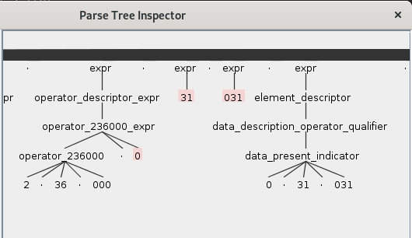
BUFR Grammar - Examples
Example 8: Satellite Data (Atmospheric Motion Vectors ) RKSL
java -jar build/libs/counter-0.0.1.jar talk/examples/08_avm_rksl.txt
Output:
rule stack: [template, expr, operator_descriptor_expr, operator_236000_expr]
line 1:945 at [@630,945:945='0',<1>,1:945]: mismatched input '0' expecting F_REP
rule stack: [template, expr]
line 1:947 at [@632,947:948='31',<15>,1:947]: mismatched input '31' expecting {F_EL, F_REP, F_OP, F_SEQ}
rule stack: [template, expr]
line 1:950 at [@634,950:952='031',<11>,1:950]: mismatched input '031' expecting {F_EL, F_REP, F_OP, F_SEQ}
Errors Listener: line 1:950 at [@634,950:952='031',<11>,1:950]: mismatched input '031' expecting {F_EL, F_REP, F_OP, F_SEQ}
gradlew grun -PinputFile=talk/examples/08_avm_rksl.txt
Note: The template violates rule 94.5.5.3 (“data present bit-map”)
and is rejected by GloBUS while other decoders like
ecCodes, BUFRDC, Geo::BUFR, PyBufrKit, libECBUFR
decode the BUFR message

Slide 17
BUFR Grammar – Summary and Outlook
Basic version of BUFR Grammar is available including lexer and parser
It validates all WMO BUFR sequences and detects invalid replications and “data present bit-map”
With the help of the grammar a BUFR template developer can now check her/his template for syntax errors.
The BUFR specification is maintained by WMO as a human readable document while a machine readable grammar does not exists. Furthermore no reference implementation of the BUFR specification exists. Therefore a validation of a BUFR decoder/encoder or an BUFR against the specification isn’t easy. This step could be simplified with a grammar.
Present BUFR Grammar to IPET-CM in 2020
Contribution for BUFR 5 development
https://github.com/mheene/bufr-grammar

Slide 18
Q&A

Slide 19
Excursus
Build tool gradle
  Official build tool for Android
  Other build tools for java: ant and maven
Github
  Github action – works on private branches too
  Multi OS and multi jvm test: matrix
Linux | Windows | Mac OS
8 | 8 | 8
11 | 11 | 11
12 | 12 | 12
13 | 13 | 13

