Slide 1

Mini Project 2 COMP 472
X on A 2
Team: MLG Tic Tac Toe
Marc Hegedus
Lorenzo Monge

Slide 2

The Meat and Potatoes
Heuristic e1():
Searches for a single opening horizontally, vertically, diagonally and off diagonals
Heuristic e2():
Builds on top of e1()
Counts the number of open line permutations horizontally, vertically, diagonally and off diagonals
Counts the number of X’s or O’s within the open line permutation
Takes into consideration adjacency

Slide 3
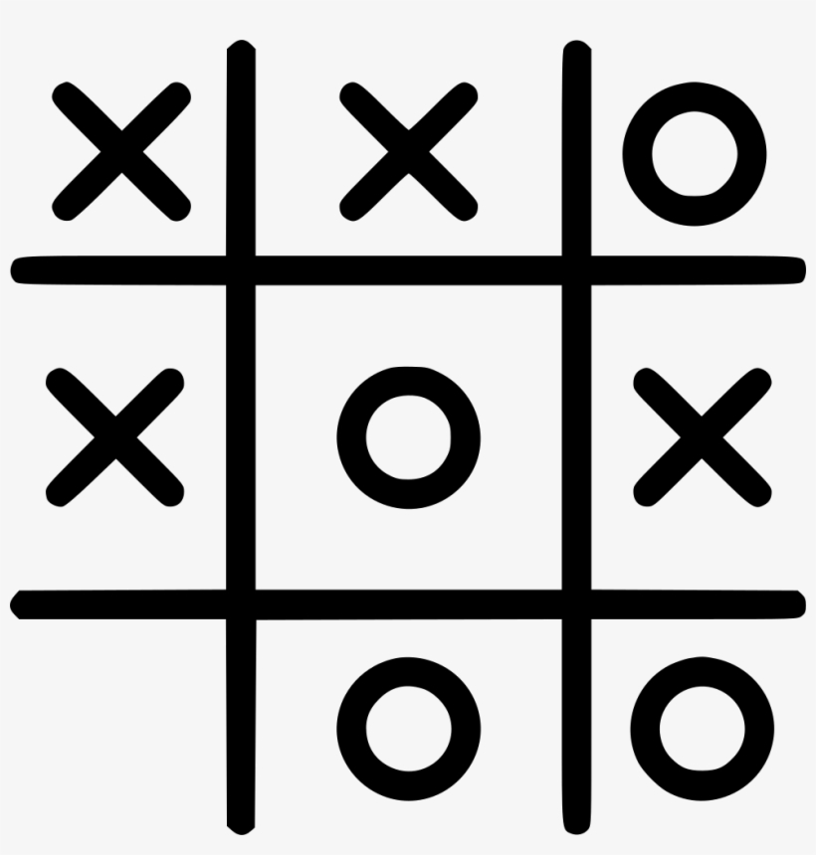
Lets look at some traces!

Slide 4

Scoreboard Run
10 runs of each configuration outlined in the handout
Each heuristic swaps player after 5 rounds,
e1 plays first for 5 games and then e2 (Swapping heuristics is the same as swapping player order)
Results of each configuration is then stored in scoreboard.txt

Slide 5
Lets check out the results!

Slide 6

Q & A

Slide 7
Thank you for listening!

