Slide 1
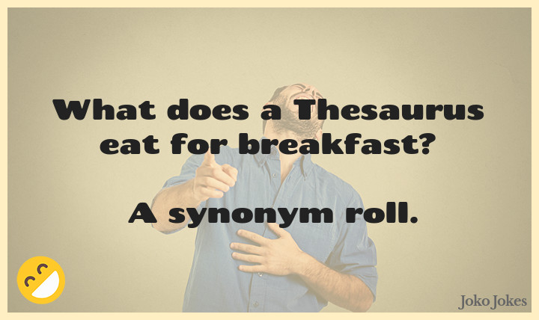
Mini Project 3 COMP 472
Team: MLG Tic Tac Toe
Marc Hegedus
Lorenzo Monge

Slide 2
Task 1
Evaluate the word2vec-google-news-300 pre-trained model on the Synonym Test.
If the word in question or all its synonyms were missing from the corpus, the system guesses.
If only a few of the synonyms were missing they were given a value of 0.0.
Save details in a .csv and the overall performance in analysis.csv
See how it performs vs the “Gold Standard”.

Slide 3
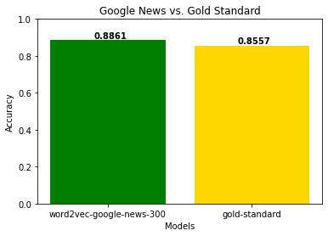
Task 1 Results

Slide 4
Task 2
Evaluate how 2 models with different corpora but the same embedding size perform against each other.
Evaluate how 2 models of the same corpus but the same embedding size perform against each other.
If only a few of the synonyms were missing they were given a value of 0.0.
Save details in a .csv and the overall performance in analysis.csv.
Evaluate how they perform against each other and the “Gold Standard”.

Slide 5
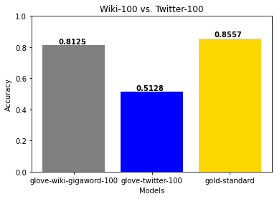
Task 2: Different Corpora, Same Embedding Size
Wiki greatly our performs twitter, but slightly under “Gold Standard”, due to small embedding size

Slide 6
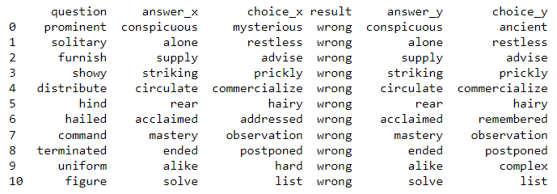
Task 2: Different Corpora, Same Embedding Size
Had 11 overlap in mistakes

Slide 7

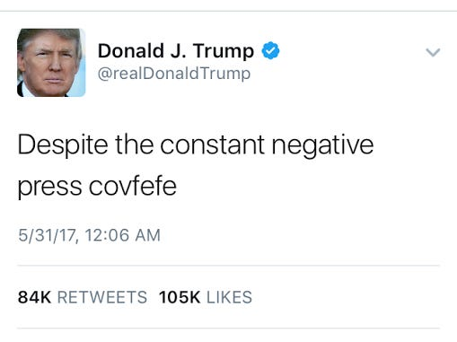
Why Is Twitter So Bad?
Small embedding size.
Limited format (280 characters), more complex words tend to be longer so are probably avoided, smaller data on usage.
Tweets are made by the general public. Prone to grammatical error, typos, slang words, etc.

Slide 8
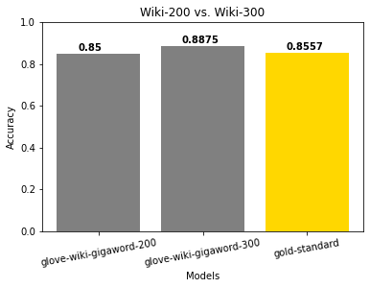
Task 2: Same Corpus, Different Embedding Size
Both perform very similarly, the version with 300 embeddings did better than the one with 200 and the “Gold Standard”.

Slide 9
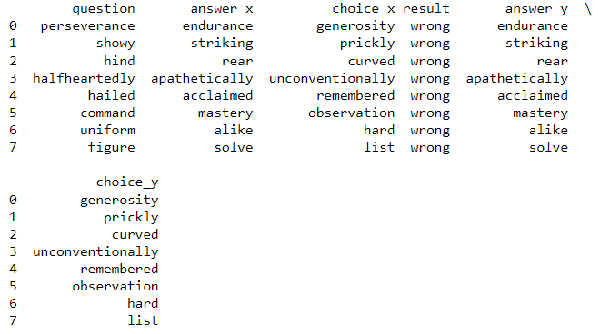
Task 2: Same Corpus, Different Embedding Size
Unsurprisingly had 8 overlap in mistakes
Both models made the same mistake in choice

Slide 10
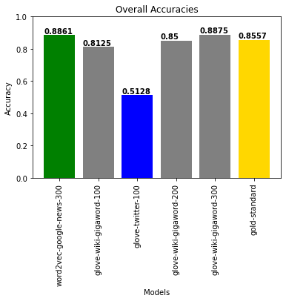
Overall Results
Most models did very well, besides Twitter….
300 embeddings seem to be the point where models can surpass the “Gold Standard”

Slide 11
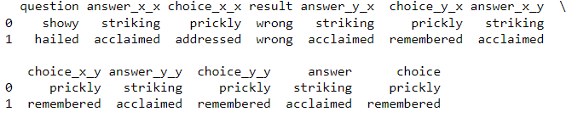
Overall Results
Surprisingly all models had overlap on 2 words, showy and hailed.
They all made the same mistake in choice for showy, picking prickly.

Slide 12

Q & A

Slide 13
Thank you for listening!

