Slide 1

Mini Project 2 COMP 472
X on A 2
Team: MLG Tic Tac Toe
Marc Hegedus
Lorenzo Monge

Slide 2

The Meat and Potatoes
Heuristic e1():
Searches for a single opening horizontally, vertically, diagonally and off diagonals
Heuristic e2():
Builds on top of e1()
Counts the number of open line permutations horizontally, vertically, diagonally and off diagonals
Counts the number of X’s or O’s within the open line permutation
Takes into consideration adjacency

Slide 3
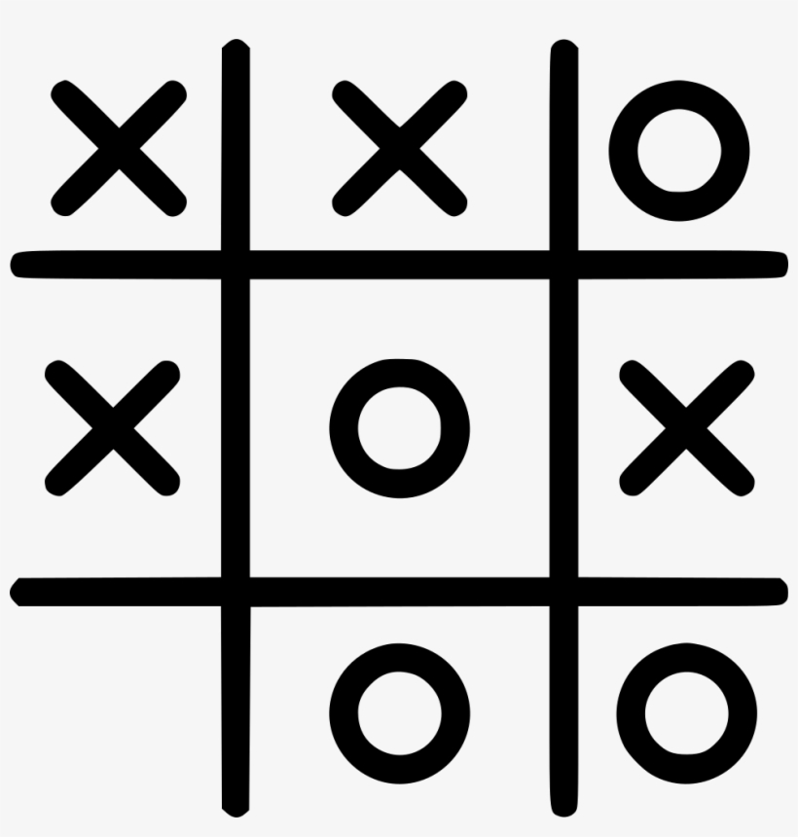
Lets look at some traces!

Slide 4

Scoreboard Run
Configuration 1 for 10 runs
board size of 4
4 blocks placed at [(0,0),(0,4),(4,0),(4,4)]
max depths at 6
winning line size of 3
max time to think at 5 seconds
using MiniMax
player 1 using e1() and player 2 using e2()
Configuration 2 for 10 runs
board size of 4
4 blocks placed at [(0,0),(0,4),(4,0),(4,4)]
max depths at 6
winning line size of 3
max time to think at 1 second
using AlphaBeta
player 1 using e2() and player 2 using e1()

Slide 5

Is player 1 cheating?!

Slide 6

Q & A

Slide 7
Thank you for listening!

