Slide 1


Movie Recommendation System
M.Heidari & Z.Koohestani
G09
Dr.Ghadiri | Fundamental of Data Mining | 22 Apr 2021

Slide 2
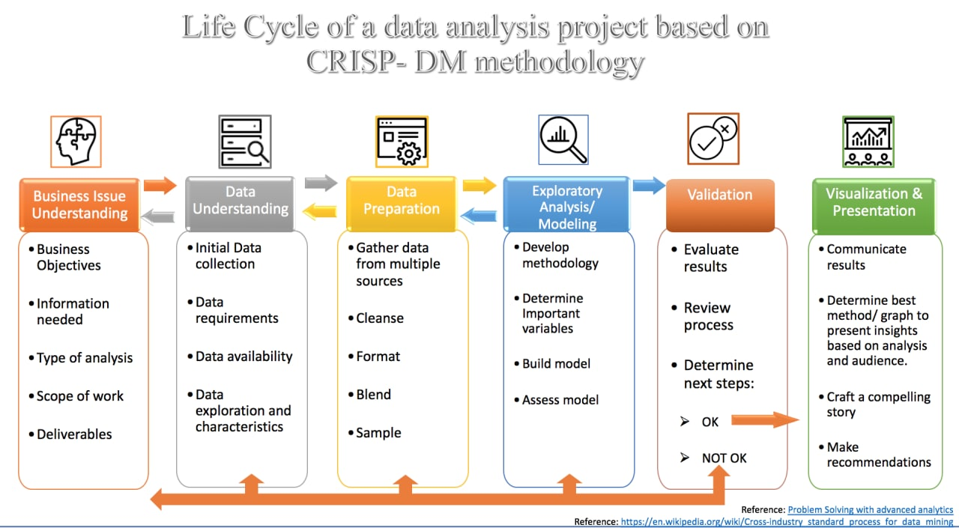
CRoss Industry Standard Process for Data Mining (CRISP-DM)
I. Business Understanding II. Data Understanding III. Data Preparation IV. Modeling V. Evaluation VI. Deployment

Slide 3
I. Business Understanding
During the last few decades, with the rise of Youtube, Amazon, Netflix and many other such web services, recommender systems have taken more and more place in our lives. From e-commerce (suggest to buyers articles that could interest them) to online advertisement (suggest to users the right contents, matching their preferences), recommender systems are today unavoidable in our daily online journeys.
In a very general way, recommender systems are algorithms aimed at suggesting relevant items to users (items being movies to watch, text to read, products to buy or anything else depending on industries).
Recommender systems are really critical in some industries as they can generate a huge amount of income when they are efficient or also be a way to stand out significantly from competitors. As a proof of the importance of recommender systems, we can mention that, a few years ago, Netflix organised a challenges (the “Netflix prize”) where the goal was to produce a recommender system that performs better than its own algorithm with a prize of 1 million dollars to win.

Slide 4
I. Business Understanding
Why the Recommendation system?
Benefits users in finding items of their interest.
Help item providers in delivering their items to the right user.
Identity products that are most relevant to users.
Personalized content.
Help websites to improve user engagement.

Slide 5
II. Data Understanding
MovieLens
Yahoo Movies (R4)
CiaoDVD
FilmTrust
Netflix
MovieTweetings
1. MovieLens Latest Datasets ( https://grouplens.org/datasets/movielens )
27,000,000 ratings and 1,100,000 tag applications applied to 58,000 movies by 280,000 users. Includes tag genome data with 14 million relevance scores across 1,100 tags. Last updated 9/2018.
2. IMDb movies extensive dataset ( https://www.kaggle.com/stefanoleone992/imdb-extensive-dataset )
81k+ movies and 175k+ cast members scraped from IMD
https://github.com/mheidari98/Movie-Recommender-Systems/blob/main/DataSets.md

Slide 6
III. Data Preparation
links | movieId :: imdbId :: tmdbId | (58’098, 3)
movies | movieId :: title :: genres | (58’098, 3)
ratings | userId :: movieId :: rating :: timestamp | (27’753’444, 4)
tags | userId :: movieId :: tag :: timestamp | (1’108’997, 4)
genome_scores | movieId :: tagId :: relevance | (14’862’528, 3)
genome_tags | tagId :: tag | (1’128, 2)
MovieLens

Slide 7
III. Data Preparation
imdb extensive dataset
IMDb_movies
[ 'imdb_title_id', 'title', 'original_title', 'year', 'date_published', 'genre', 'duration', 'country', 'language', 'director', 'writer’,
'production_company', 'actors', 'description', 'avg_vote', 'votes', 'budget', 'usa_gross_income', 'worlwide_gross_income', ‘
metascore', 'reviews_from_users', 'reviews_from_critics’ ]
IMDb_ratings
49 col
'imdb_title_id’,
'mean_vote’,
'total_votes'

Slide 8
MERGE
A = movies[['movieId','genres’] (Merge) links[['movieId','imdbId’]
Create imdb_title_id with imdbId tt00114709 <= 114709
Col = ['imdb_title_id', 'title', 'year', 'duration', 'country', 'director', 'budget', 'usa_gross_income', 'worlwide_gross_income', 'metascore','reviews_from_users', 'reviews_from_critics’ ]
B = A (Merge) IMDb_movies[Col]
Movies_metadata = B (Merge) IMDb_ratings[['imdb_title_id','mean_vote','total_votes']

Slide 9
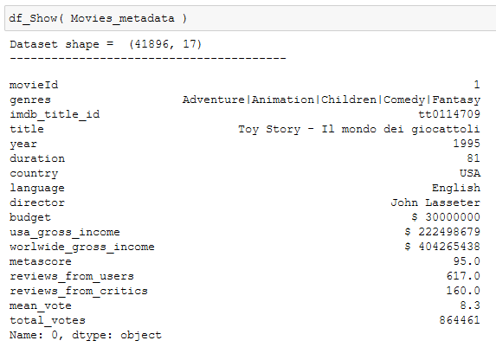
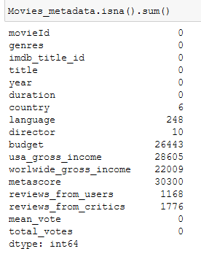


Slide 10
binning director based on mean of mean_vote param of their movie (17240 unique)
bins=[0.0, 2.5, 5.0, 7.5, 10.0]
Modify the [budget, usa_gross_income, worlwide_gross_income] column
StandardScaler
['year','duration','budget','usa_gross_income','worlwide_gross_income’,
'metascore','reviews_from_users','reviews_from_critics','mean_vote','total_votes’,
'director_r’]
KNNImputer
['budget','usa_gross_income','worlwide_gross_income','metascore','reviews_from_users',
'reviews_from_critics', 'director_r’]
detect outlier with zscore

Slide 11
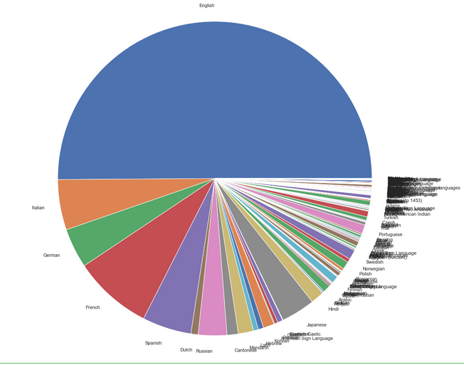
'EU', Europe
'AS', Asia
'NA', north Americas
'AF', Africa
'AN', Antarctica
'SA', south Americas
'OC', Oceania
idk
Country2Continent => webscraping 3189 to 8
binning Language to 7 bin (2986 unique)
['English' , 'French' , 'Italian','German','Spanish','Russian', 'Other']
Dummies Genre to 16 column
Final 52 columns with no null value

Slide 12
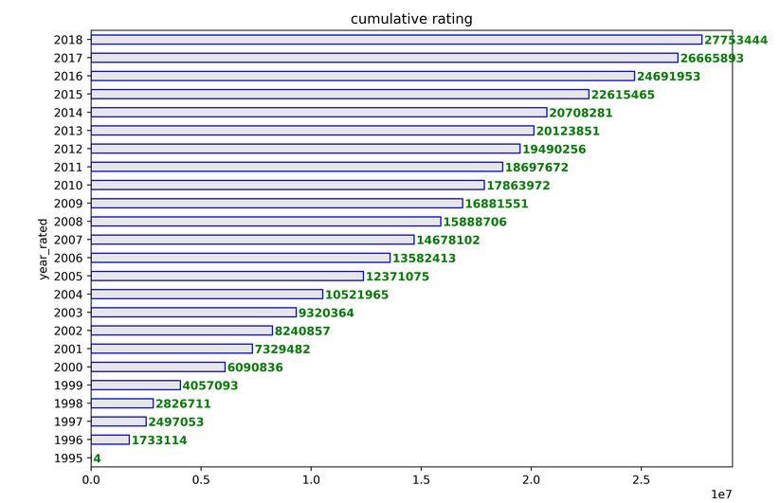
cumulative rating per year
Ratings Dataset

Slide 13
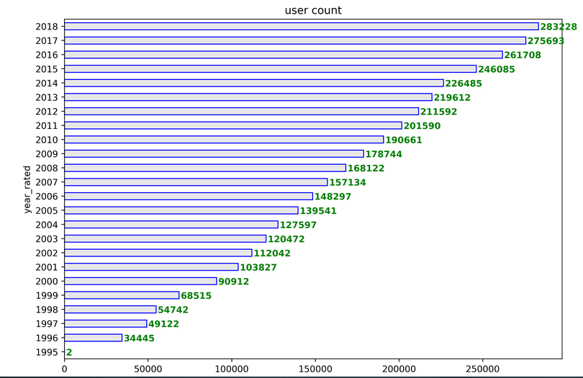
user count per year
Ratings Dataset

Slide 14
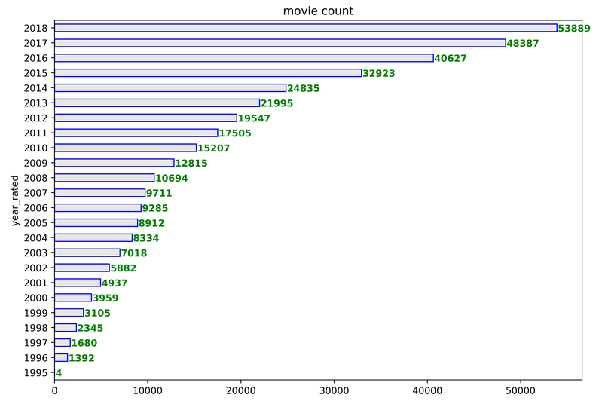
movie count per year
Ratings Dataset

Slide 15
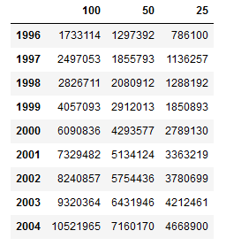
rating count per year
Ratings Dataset

Slide 16
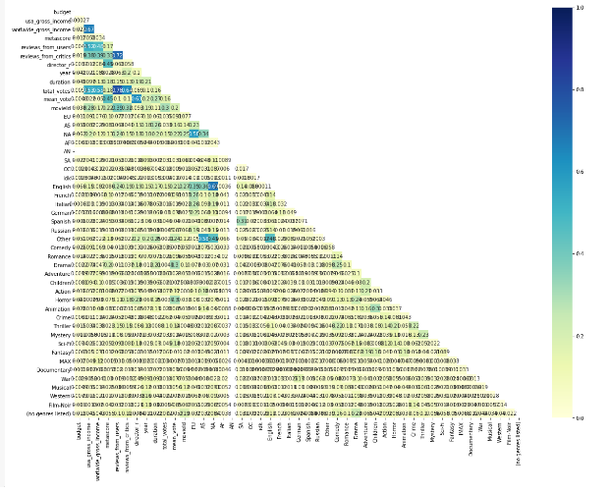
IV. EDA

Slide 17
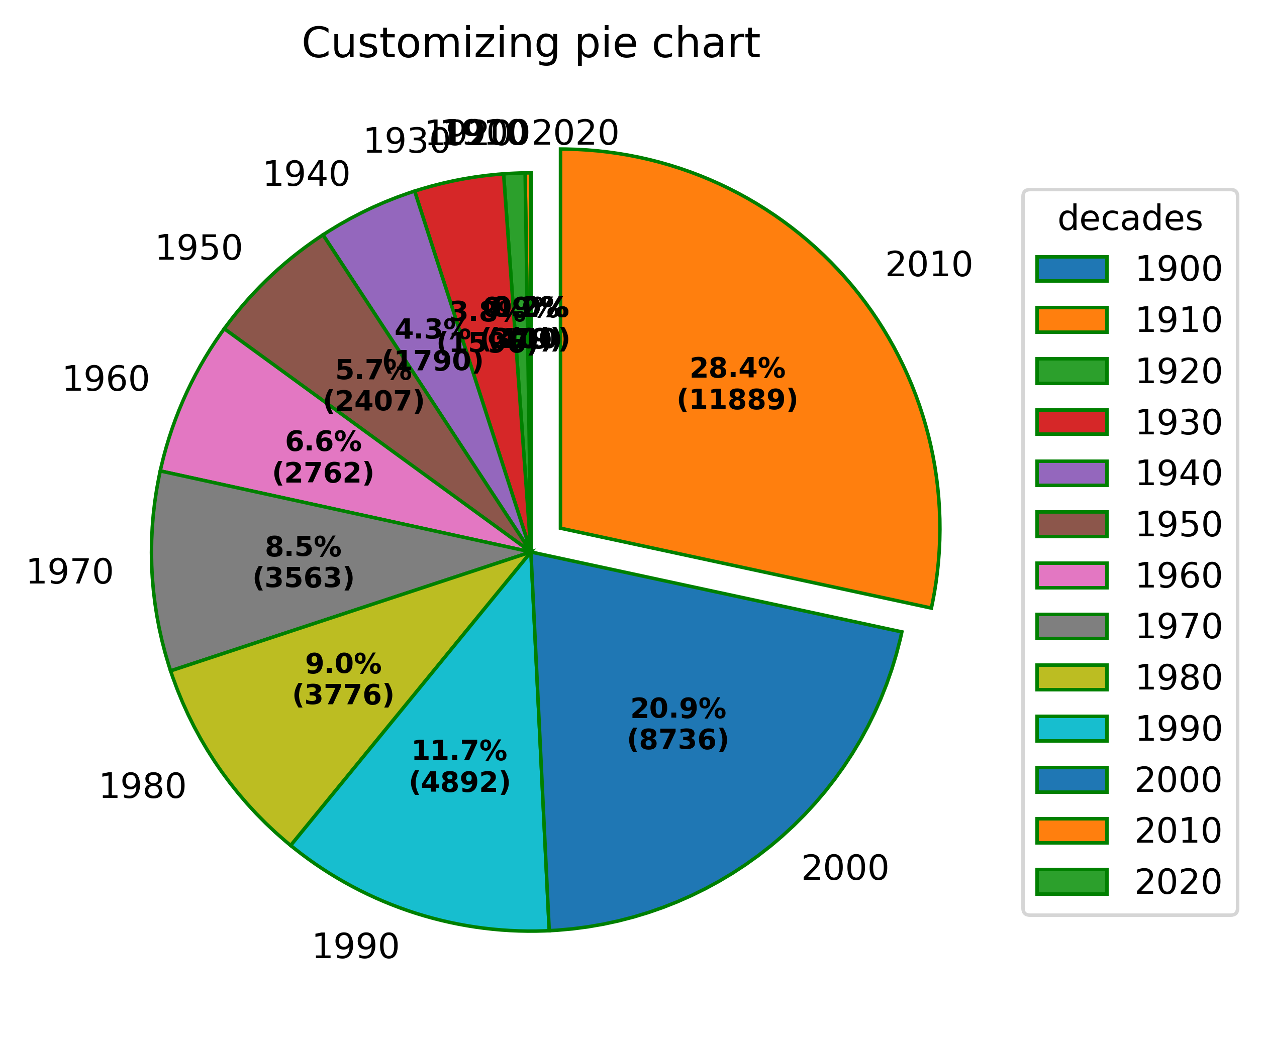
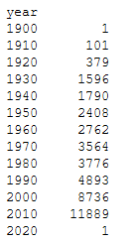
Movies per year

Slide 18
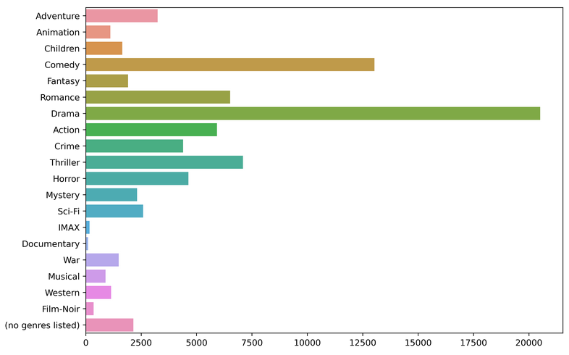
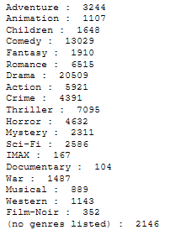
Genres count

Slide 19
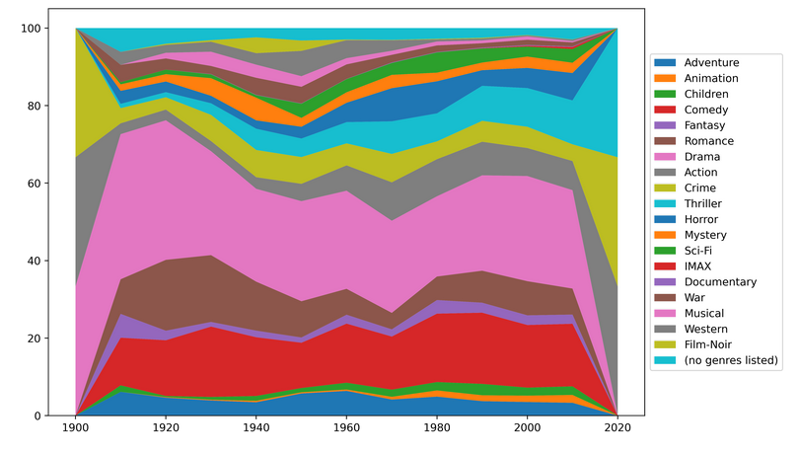
Movies genres per decade

Slide 20
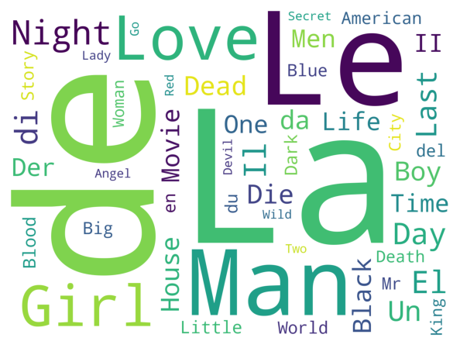
original_title WordCloud

Slide 21
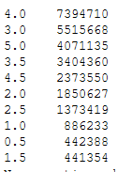
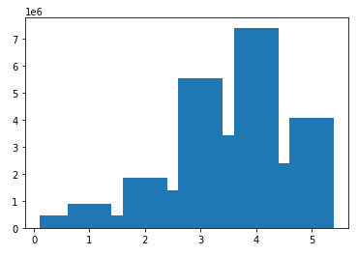
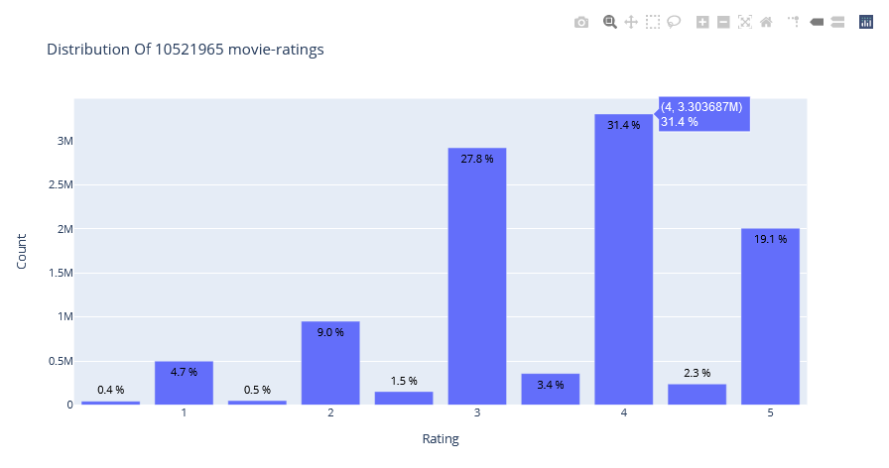
Ratings Distribution

Slide 22
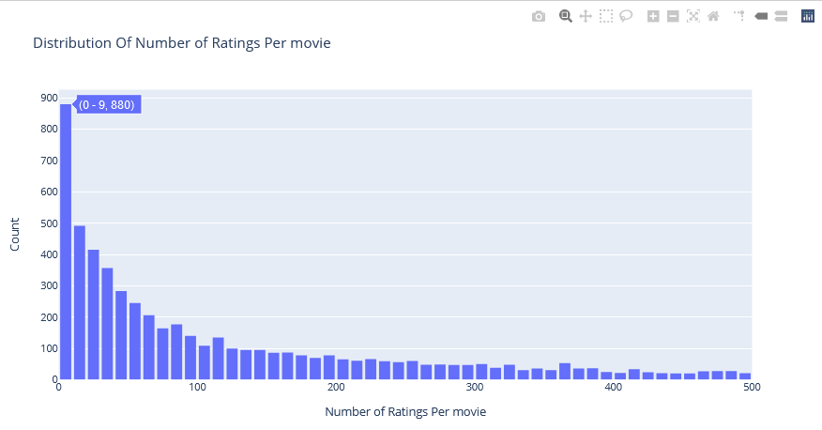
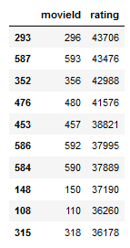
Ratings Distribution By movie

Slide 23
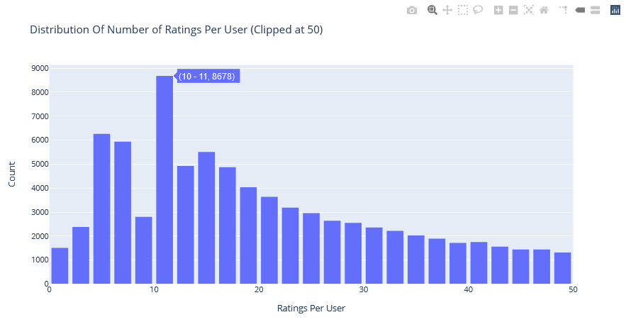
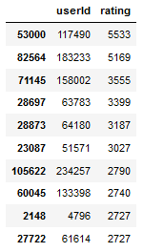
Ratings Distribution By User

Slide 24
IV. Modeling
Simple_Item_Based_Collaborative_Filtering
SurPRISE_Recommender
LightFM
Association_Rules
Keras & Keras_USER_Recommender
Regression & Regression_USER_Recommender

Slide 25
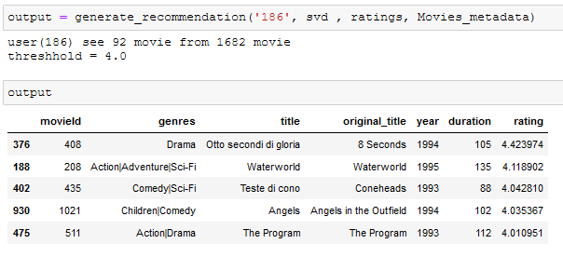
SurPRISE_Recommender
generate_recommendation(user_id, model, ratings, metadata, count=5)
Shuffle Movies not seen
Calculate thresh based on 50% user rate
count > Calculate predicted rated for movie not seen
return movie info

Slide 26
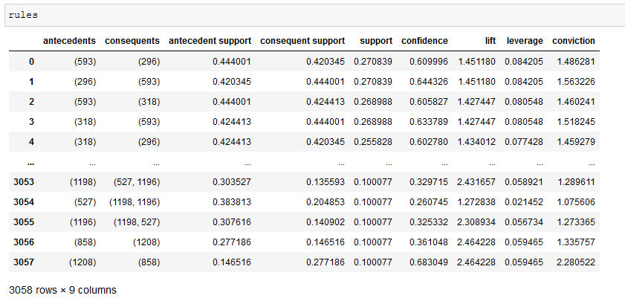
Apriori => bfs
Fpgrowth => dfp
Association_Rules

Slide 27
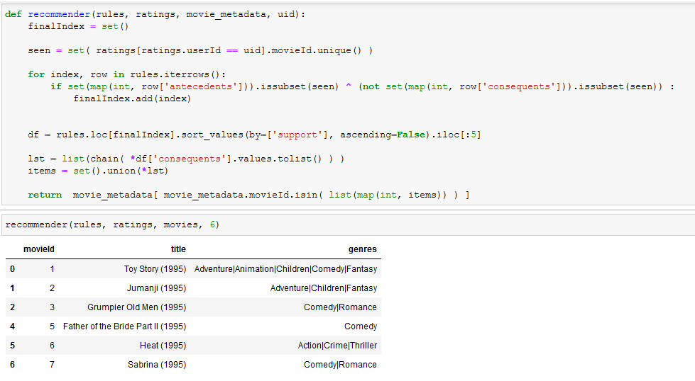

Slide 28
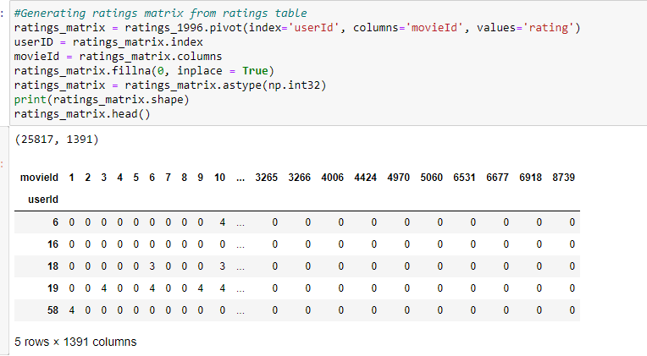
LightFM

Slide 29
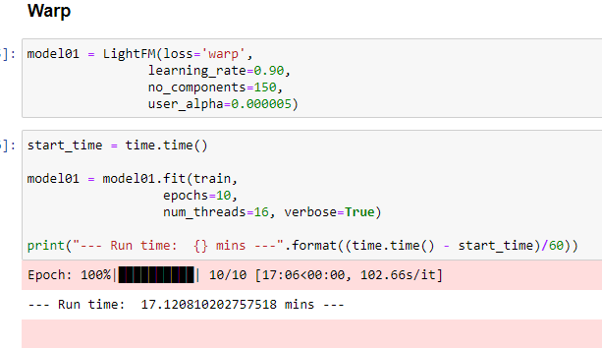
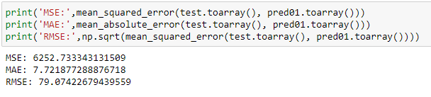

Slide 30
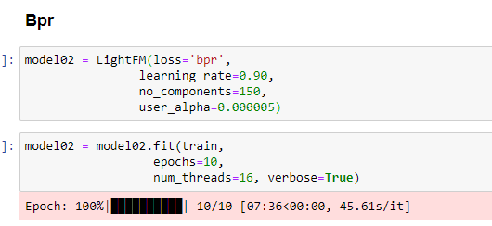
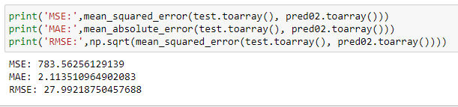

Slide 31
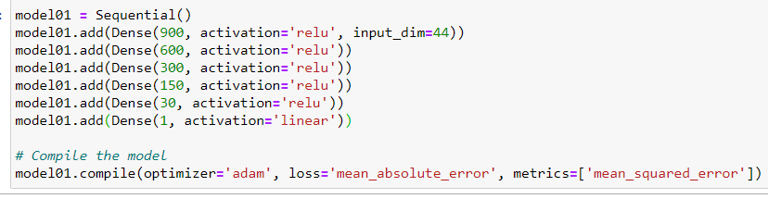
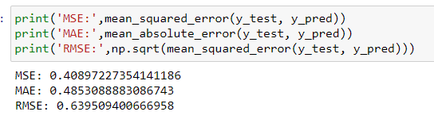
Keras & Keras_USER_Recommender
Predict mean vote

Slide 32
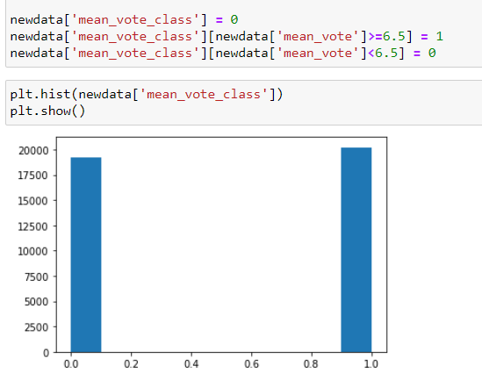
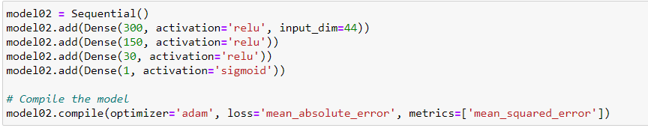
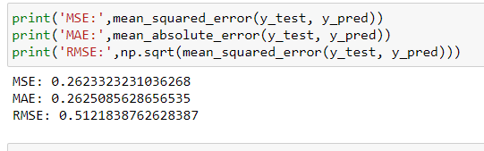
Predict mean vote class

Slide 33
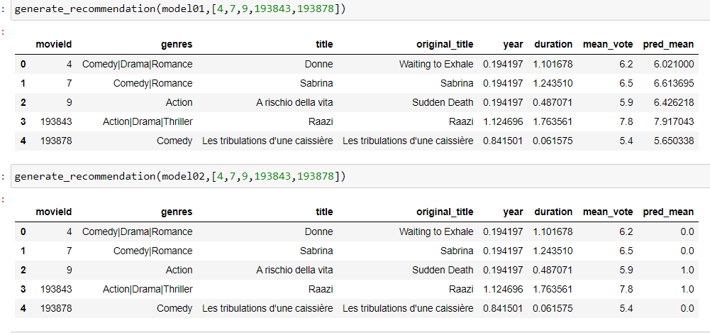
Simple output

Slide 34
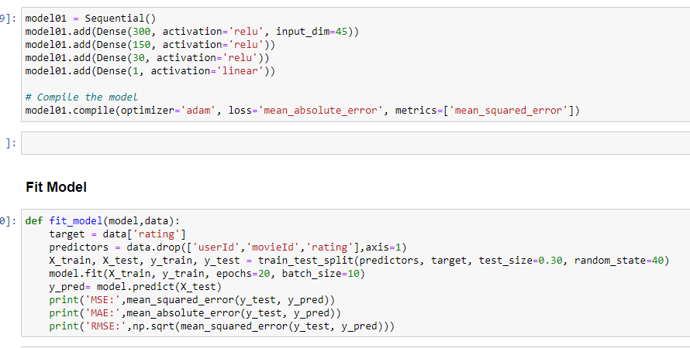
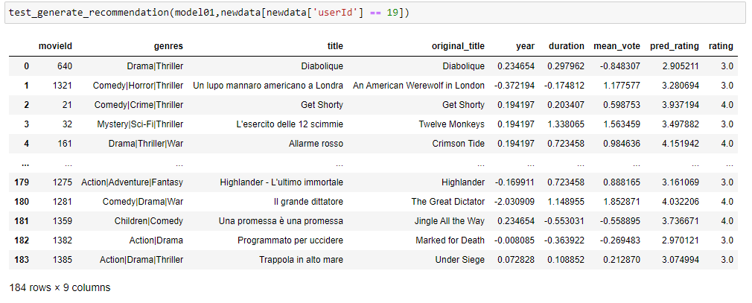

Slide 35
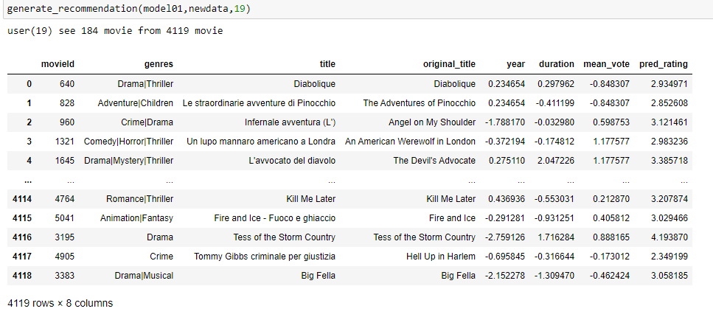

Slide 36
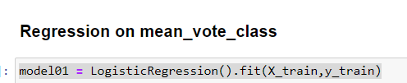
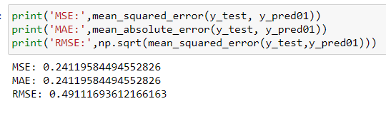
Regression & Regression_USER_Recommender

Slide 37
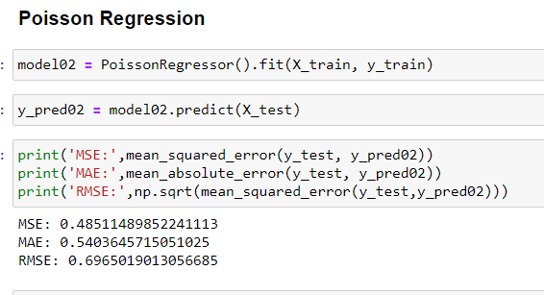
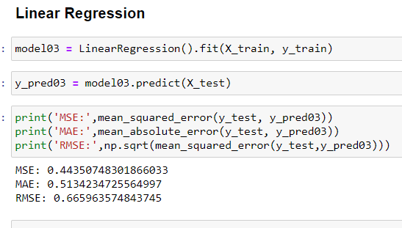

Slide 38
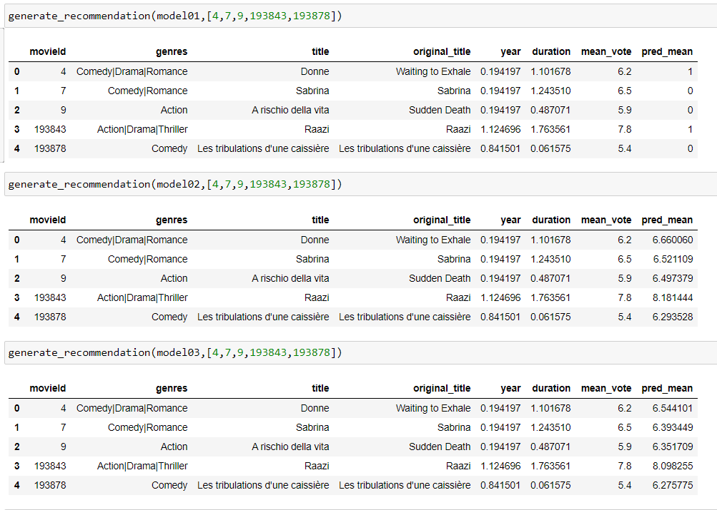

Slide 39
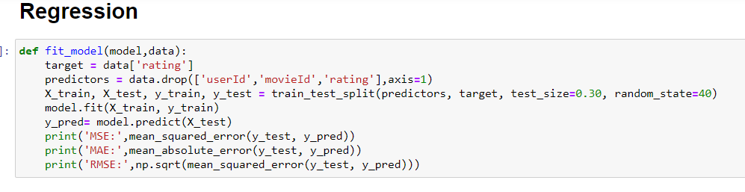
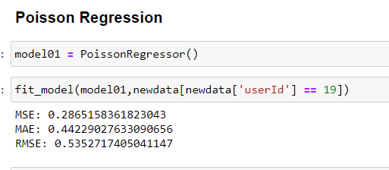
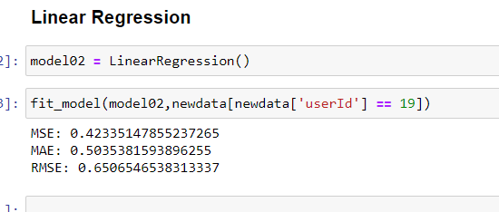

Slide 40
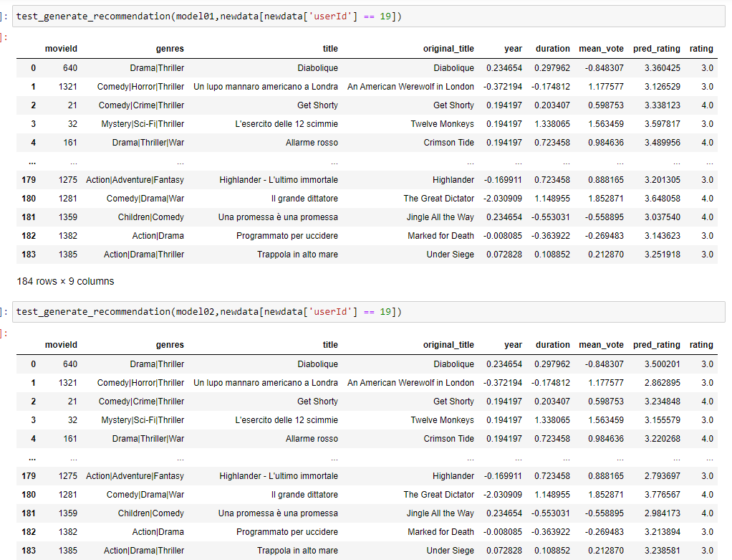

Slide 41
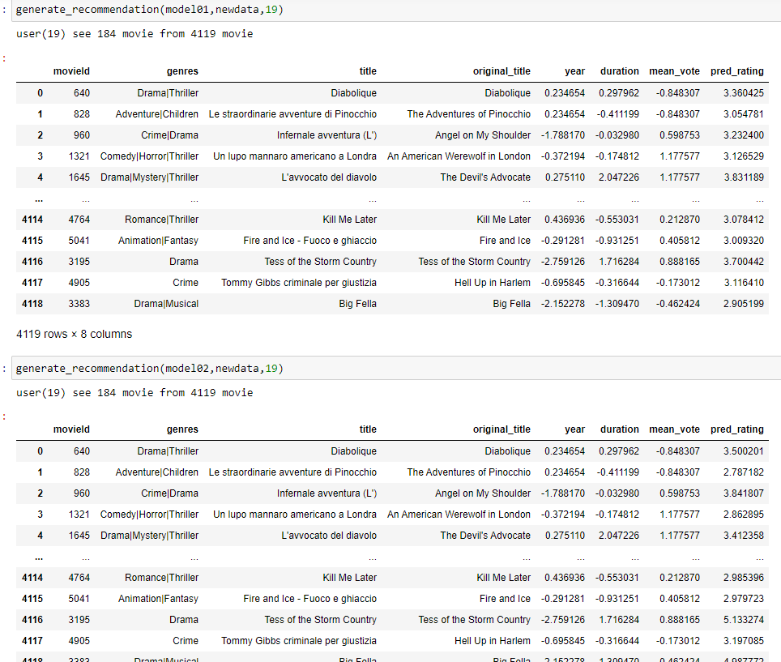

Slide 42
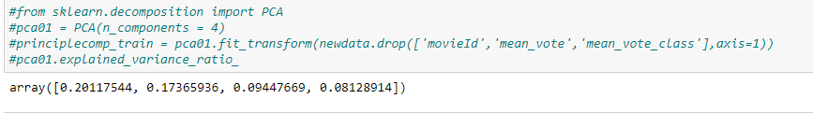
PCA

Slide 43
Challenge

