Slide 1


DSB2
Bitcoin Volatility
Prediction
MOHAMMED HEJAIRI
CAPSTONE PROJECT

Slide 2
AGENDA
01
Introduction
05
Our Data
02
The Problem
06
Live Testing
03
What We Built
07
Real-World Use
04
Models We Tried
08
The Results

Slide 3

INTRODUCTION
Bitcoin swings hard, in bursts. This project predicts how big the swings will be — not which way price moves.

Slide 4
Nobody knows how rough next week will be.

Slide 5



WHAT WE BUILT
A Turbulence Forecast
Tested Like Real Trading
Ready to Use
Predicts how much Bitcoin will move over the next week — not which direction.
Checked against months of brand-new data the model never saw while learning.
Built to plug straight into real risk and pricing decisions.

Slide 6
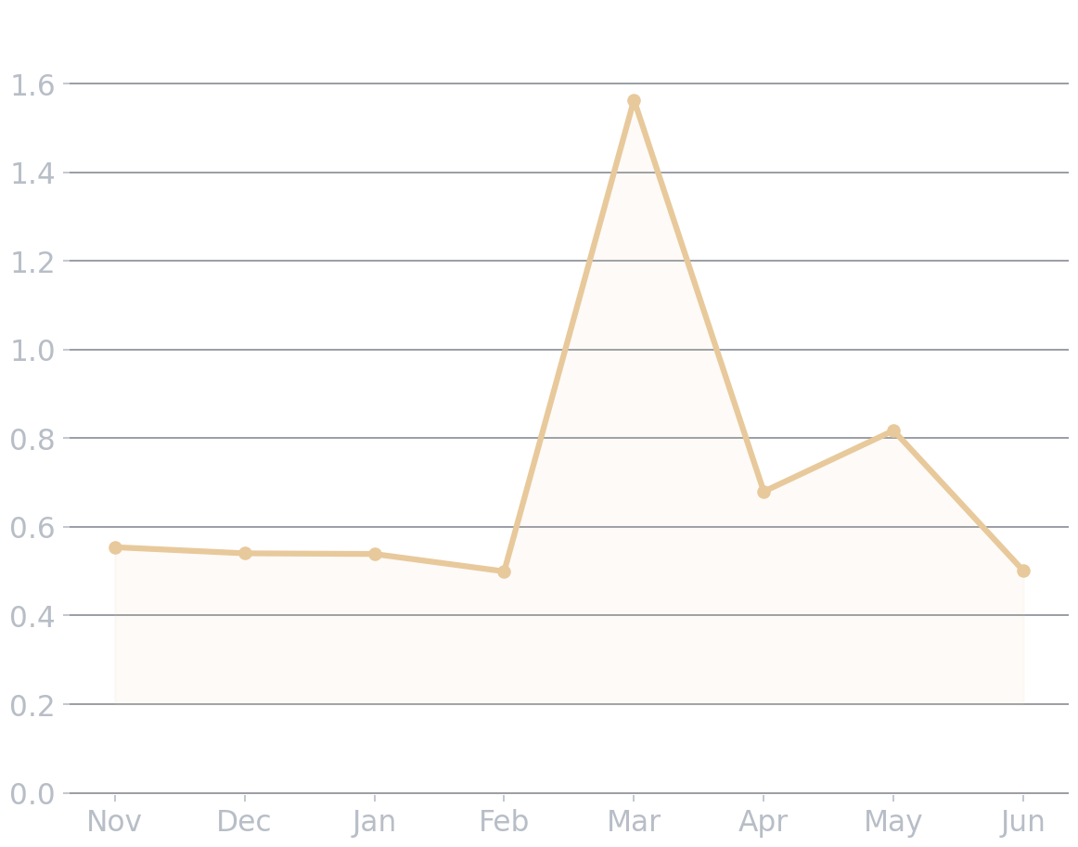
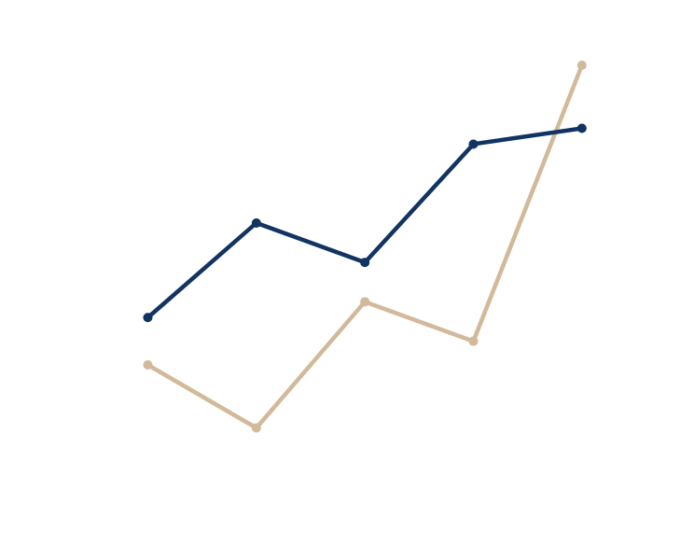
OUR DATA
8 Years of History
Hourly Bitcoin trading data going back to 2017 — over 70,000 hours in total.
Calm, Then Chaos
Long quiet stretches, then sudden bursts. That pattern is exactly what the model learns to predict.

Slide 7
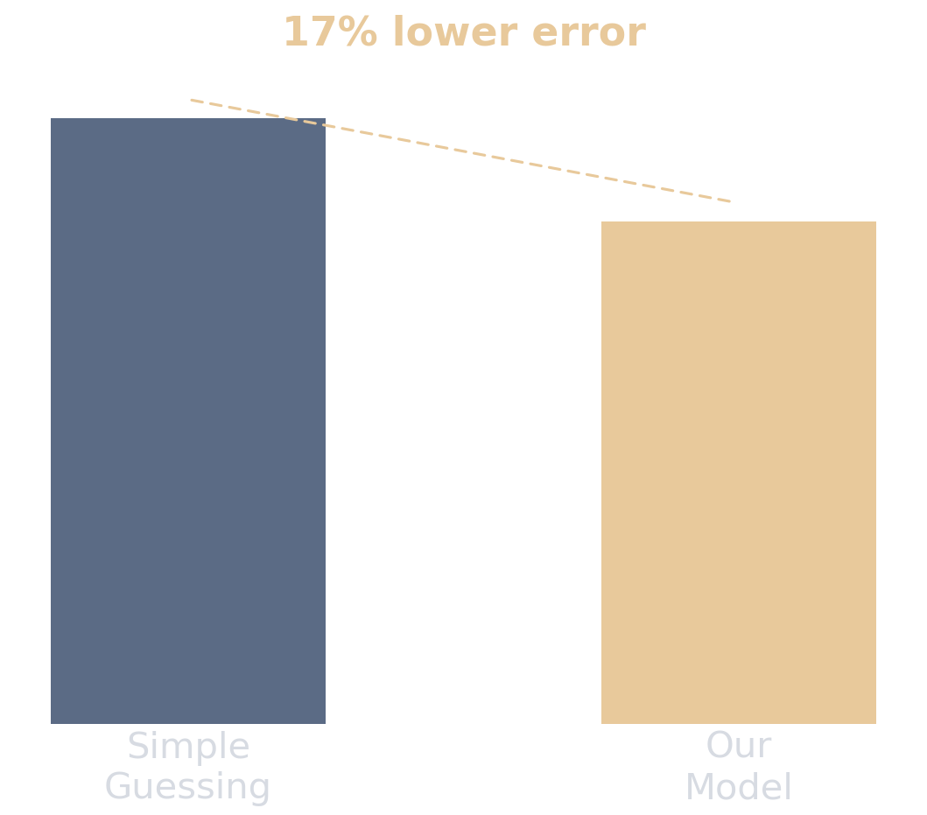

THE RESULTS
Our best model beat simple guessing by 17%.
And it kept working on brand-new data it had never seen before — the real test of whether a model actually works.

Slide 8
OUR MODELS
Classic
Winner
Runner-Up
GARCH
HAR-RV-X
EWMA
The textbook approach to volatility. Struggled at this longer forecast horizon.
Combines short-, medium-, and long-term trends. Our best performer, on old and brand-new data alike.
A simpler, industry-standard method. Solid, but not as sharp as our winner.

Slide 9




LIVE TESTING
The real test: brand-new Bitcoin data the model had never seen, scored the way a trader actually would — before the outcome was known.
COLLECT
PREDICT
COMPARE

Slide 10

REAL-WORLD USE
01
Sizing a Trade
If the model expects a bigger swing, a trader risks less money on that trade — and gets a clear estimate of how much they could lose in a bad week.

Slide 11



REAL-WORLD USE
02
Pricing an Option
Option prices depend on how much a market is expected to move. Our forecast gives a data-driven answer to compare against what the market is charging.

Slide 12


MARKET NEWS
GOOD TO KNOW
Price data alone can't see breaking news or new regulation — a real limit on any forecast like this.
Two honest caveats
No model is perfect. Two things are worth knowing before using this one.
ONE COIN ONLY
This model only looks at Bitcoin. It doesn't yet use signals from other cryptocurrencies.

Slide 13
QUESTIONS?
THANK YOU
Cohort
Project
Presenter
DSB2
Bitcoin Volatility Prediction
Mohammed Hejairi

