Slide 1

Bitcoin Volatility
Prediction
Forecasting 2-day realized volatility, not price direction
79,000+ Hourly BTC/USDT Records (2017-2026)
MOHAMMED HEJAIRI · DSB FT2 2026
CAPSTONE PROJECT

Slide 2
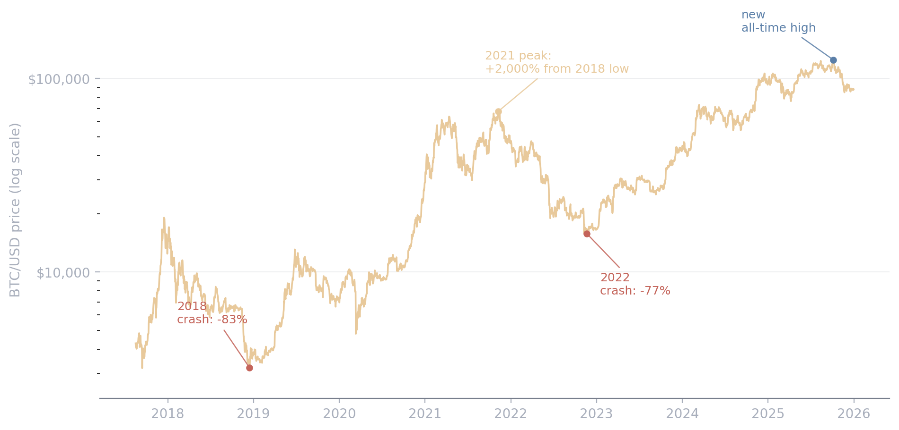
How Bitcoin's Price Swings
Big rallies, sharp crashes, and everything in between
Bitcoin's price is highly non-stationary: since 2017 it has drawn down more than 80% twice, then rallied to new all-time highs both times. These swings - not day-to-day direction - are the volatility this project forecasts.
WHAT THIS MEANS
These price swings are volatility - the dispersion of returns, not their direction. This project forecasts the magnitude of that dispersion 2 days ahead.
2

Slide 3

What Is Volatility, and Why Predict It?
Volatility measures the dispersion of price movements over time, independent of direction. Low volatility means small, tight moves; high volatility means large, rapid swings either way.
HOW IT'S CALCULATED
AN ANALOGY
r = hourly return, r̄ = its average, N = 48 hours (2 days)
Predicting price is like guessing exactly where a boat will be tomorrow - nearly impossible. Predicting volatility is like guessing how rough the sea will be. That's a more tractable question, and usually the more useful one for risk management.
INTUITION
The standard deviation of the last 48 hourly returns. A wider spread around the mean means a more turbulent 2 days; a tighter spread means a calmer one.
Why Predicting It Matters
Who Uses It | Why It Matters
Options traders | Required input for Black-Scholes σ
Risk managers | Scales Value-at-Risk estimates
Traders | Position sizing under changing risk
Exchanges | Sets margin/collateral requirements
3

Slide 4
Problem Statement
From a vague question to a testable target
THE AIM
Predict Bitcoin's 2-day realized volatility, 48 hours ahead of the features used to predict it - not the next hour's value. This gives traders and risk desks a continuously-updating volatility estimate, usable directly in position-sizing and margin decisions.
Target Definition
A NUMBER, NOT A CATEGORY
Target
volatility_2d, 48h ahead of the features
Downstream uses - option pricing, Value-at-Risk, margin - need a continuous estimate, not a high/low label. That rules out classification: this is a regression problem.
Horizon
48 hours (2 days) - never the next hour
Features
Lagged price/volume history
Success bar
Beat GARCH and naive persistence
4

Slide 5
Data Overview & Feature Dictionary
DATASET: 79,000+ hourly BTC/USDT records
FEATURES: Price, volume, engineered volatility measures, and calendar
TARGET: Volatility over the next 2 days
Feature | Description | Type
RV_day / RV_week / RV_month | Realized volatility over the past day/week/month (HAR horizons) | Numeric
ATR_X | Average True Range, as a % of price | Numeric
BB_width | Bollinger Band width, as a % of the moving average | Numeric
dow_sin / dow_cos | Cyclical day-of-week encoding (confirmed significant, see Feature Selection) | Numeric
hourly_return | Hour-over-hour % price change | Numeric
volatility_2d (target) | 2-day realized volatility, 48h ahead of the features | Target
5

Slide 6
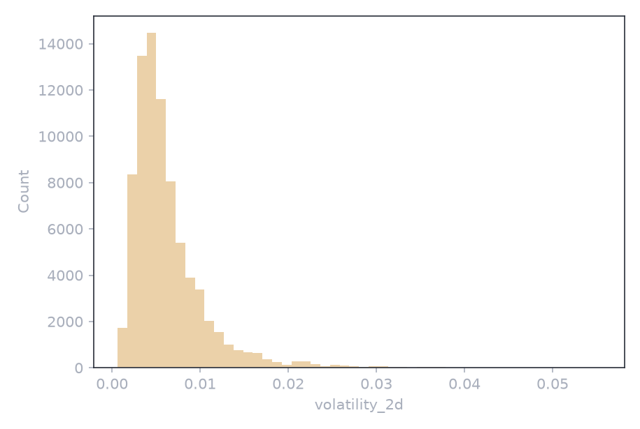
Dataset & Data Cleaning
Data Cleaning Steps
Fixed 29 timestamp gaps in the combined 2017-2026 hourly series
1
Merged historical and live-collected data into one continuous file
2
Standardized hourly timestamp frequency, zero duplicates
3
Dropped ~30 days of rolling-window warm-up rows
4
Regime Mapping
Level | Regime | Volatility Range
0 | Low | <= 0.0041
1 | Moderate | 0.0041 - 0.0065
2 | High | > 0.0065
6

Slide 7
Feature Engineering: HAR Horizons & ATR_X
The core volatility-based features
HAR Horizons (RV_day / RV_week / RV_month)
ATR_X (Average True Range)
WHAT IT IS & WHAT IT MEANS
WHAT IT IS & WHAT IT MEANS
RV_week = mean(volatility_2d, past 168h). Same idea at 24h and 720h windows (Corsi's HAR model, 2009). Volatility has memory at multiple timescales - a rough day in a calm month differs from one in an already-turbulent month, and a single window can't tell those apart.
True Range = max(High-Low, |High-PrevClose|, |Low-PrevClose|) - catches gaps a simple range misses (Wilder, 1978). ATR_X = mean(True Range, 14h) / Close: scale-free, comparable across any price level.
WHY WE NEED IT
WHY WE NEED IT
Confirmed by our own EDA: ACF/PACF shows slow-decaying, long memory; the trend decomposition shows the trend range (0.031) is 16x the seasonal range (0.0019) - regime shifts dominate, exactly what RV_week/RV_month sense. All three correlate at r = 0.58-0.61 with the target.
The single strongest feature in the project - r = 0.685 with the target, ahead of every HAR horizon. Gives the model its most immediate, hour-by-hour read on current turbulence.
7

Slide 8
Feature Engineering: BB_width & What Got Dropped
Not every engineered feature makes the cut
BB_width (Bollinger Band Width)
Tested and Dropped
WHAT IT IS & WHAT IT MEANS
WHAT IT IS & WHAT IT MEANS
upper/lower = MA_20h +/- 2 x std_20h (Bollinger, 1980s). BB_width = (upper - lower) / MA_20h, as a percentage. Widens in choppy trading, squeezes in quiet trading - the classic "squeeze" before a big move.
Three more candidates, tested the same rigorous way: KC_width (Keltner Channel width - ATR-based envelope), SKEW_X (realized skewness - do returns lean up or down), and RVI (Relative Volatility Index - up-move vs. down-move volatility).
WHY WE NEED IT
WHY WE NEED IT
Correlates at r = 0.557 with the target - kept because it measures dispersion around a trend over a 20h window, not ATR_X's bar-by-bar range. Related to ATR_X (r = 0.82) but not redundant - both carry independent weight in every model.
KC_width: r = 0.993 with ATR_X - near-duplicate, dropped. SKEW_X (r = -0.07) and RVI (r = -0.009): essentially zero correlation - dropped. Reporting what didn't work is part of an honest feature-selection process, not just what did.
8

Slide 9
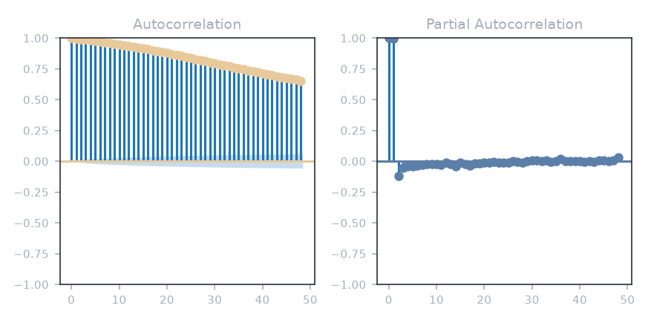
EDA: Temporal Features
Is autocorrelation present - and how was it handled?
Diagnosing Autocorrelation
ACF / PACF (48 Lags)
PRESENT - CONFIRMED
The ACF decays slowly across many lags instead of dropping to zero, and the ADF test rejects a unit root (stat = -12.76, p < 0.001) - the series is stationary but has real memory. This is genuine volatility clustering, not noise.
HOW IT WAS RESOLVED
Autocorrelated data breaks the i.i.d. assumption behind random splits and K-fold CV - a random shuffle would leak adjacent-in-time rows into training. Resolved with a chronological train/test split and TimeSeriesSplit CV (Preprocessing), plus lagged features - and by using the autocorrelation itself as HAR-RV-X's core signal, not discarding it.
TAKEAWAY
Autocorrelation isn't a nuisance to remove here - it's the predictive signal. HAR-RV-X's lagged, multi-horizon regressors exploit it directly, while chronological splitting keeps evaluation honest.
9

Slide 10
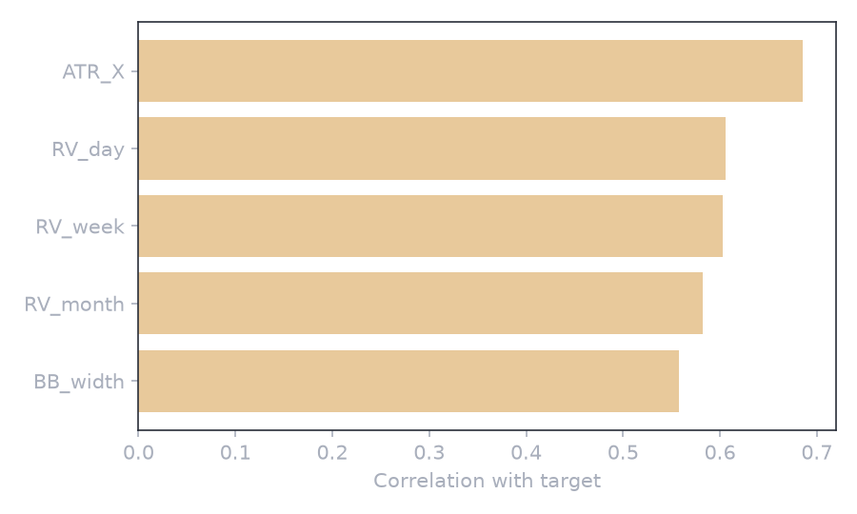
Feature Selection: Correlation & Chi-Square
Correlation Analysis: every continuous feature kept for modeling is meaningfully correlated with the target - none are statistical accidents.
Chi-Square: Calendar Features
HOUR OF DAY - NOT SIGNIFICANT
chi2 = 3.82, p = 1.0 - no relationship with the volatility regime. Not used as a feature, in any model.
DAY OF WEEK - SIGNIFICANT
chi2 = 2886.3, p < 0.001 - a real weekly rhythm. Mon/Sun skew toward low volatility, Tue-Fri skew toward moderate/high. Added as dow_sin/dow_cos to every model.
STRONGEST FEATURE
ATR_X leads the continuous features at r = 0.685 with the target - the single best predictor kept in the final feature set.
10

Slide 11
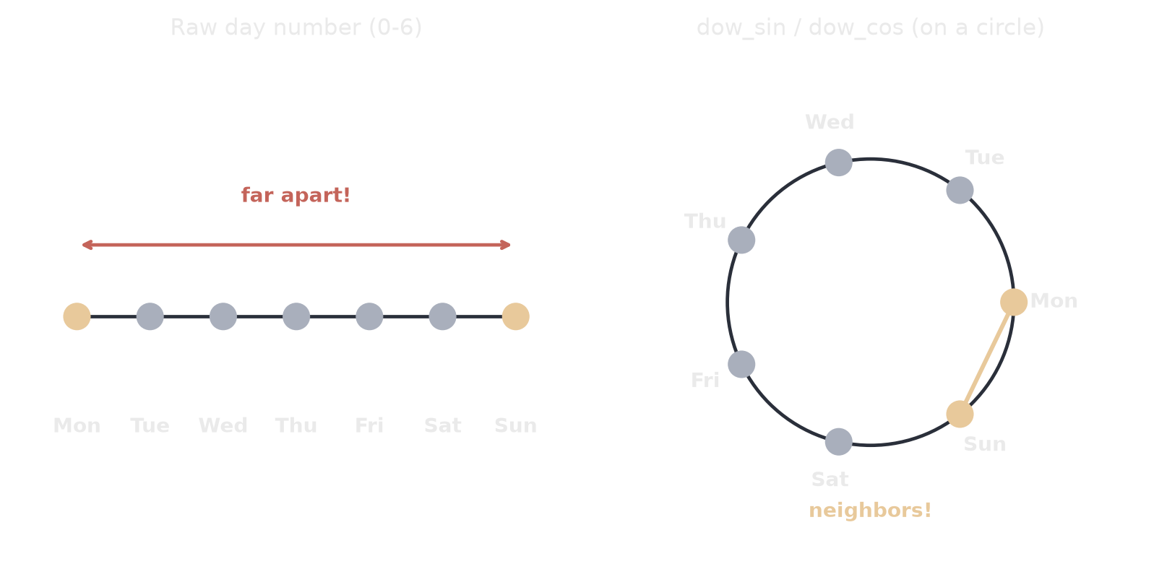
Using Time as a Feature: dow_sin & dow_cos
Making sure the model reads Sunday and Monday as neighbors
IN XGBOOST
THE RESULT
- add_time_features() builds hour_sin, hour_cos, dow_sin, dow_cos from Date
- day-of-week: kept (p < 0.001). hour-of-day: dropped (p = 1.0)
11

Slide 12
Using Time as a Feature: dow_sin & dow_cos
Making sure the model reads Sunday and Monday as neighbors
The problem: raw day numbers confuse a model - Sunday (6) and Monday (0) look far apart, even though they're next to each other on the calendar
1
The fix: place each day on a circle using sine and cosine - dow_sin and dow_cos
2
Now Sunday and Monday sit right next to each other, just like on a real calendar
3
In XGBoost specifically: an add_time_features() function builds all 4 cyclical columns - hour_sin, hour_cos, dow_sin, dow_cos - from the Date column, and adds them on top of the HAR features just for XGBoost's own feature matrix
4
Chi-square test: day-of-week is real (p < 0.001) - kept. Hour-of-day is not (p = 1.0) - dropped
5
THE RESULT
dow_sin and dow_cos became real features in HAR-RV-X and XGBoost - not just tested and thrown away. hour_sin/hour_cos stayed in XGBoost too, but ended up with almost zero importance, exactly as the chi-square test predicted.
12

Slide 13
Preprocessing
Preparing a leak-free feature matrix and target for modeling
Preprocessing Steps
Train/Test Split
Build target: volatility_2d shifted 48h (HORIZON) into the future
1
TRAIN SET
TEST SET
55,821 rows
22,602 rows
HORIZON set equal to the volatility window - zero overlapping hours
2017-09 to 2024-01
2024-02 to 2026-08
2
Chronological split at a fixed date - never randomly shuffled
WHY CHRONOLOGICAL
3
Time-series data is autocorrelated - a random shuffle would leak information from adjacent-in-time rows into training. Every split (train/test, and every cross-validation fold) respects chronological order.
TimeSeriesSplit (5-fold) for every hyperparameter search - never random K-fold
4
ZERO-OVERLAP TARGET
HORIZON (48h) equals the volatility window (48h) on purpose, so the most recent known feature value and the target share zero overlapping hours - no leakage.
13

Slide 14

Baseline: GARCH
Formula and Parameter Meanings
FORMULA
WHAT EACH PARAMETER MEANS
CHARACTERISTICS
- sigma^2_t = the variance being solved for (today's estimate)
- omega = baseline/floor variance level
- alpha = weight on yesterday's squared shock - how reactive the model is
- beta = weight on yesterday's own variance estimate - how much memory it has
- epsilon_(t-1) = the previous shock (return surprise)
- Fitted here: omega=0.0138, alpha=0.10, beta=0.88 (alpha+beta=0.98 - very persistent)
- Textbook, most-cited baseline for volatility forecasting
- Sets the performance bar every other model here must clear
- Forecast mean-reverts within roughly 34 hours (alpha+beta = 0.98)
- By 48 hours, has already lost most of its ability to react to current conditions
- Reflected directly in its badly negative R2 (-1.62)
14

Slide 15
Baseline: GARCH
Standard GARCH(1,1) with Student-t Errors
FORMULA
Model Configuration
Performance (Test Set)
Vol Model
GARCH(1,1)
R2 (Test Set)
-1.62
Distribution
Student's t
Fit on
Hourly returns
Forecast horizon
48 hours
RMSE
MAE
0.003342
0.003042
KEY INSIGHT
GARCH's forecast mean-reverts toward a long-run average well before 48 hours are up - a structural weakness at this horizon, not an implementation bug. It sets the bar every required model below must clear.
15

Slide 16

Model 1: EWMA
Formula and Parameter Meanings
FORMULA
WHAT EACH PARAMETER MEANS
CHARACTERISTICS
- sigma^2_t = today's variance estimate (what's being solved for)
- lambda = the decay factor - the model's only tunable parameter
- sigma^2_(t-1) = yesterday's variance estimate
- r^2_(t-1) = yesterday's squared return (the newest shock)
- Tuned value: lambda=0.99 - barely reacts to any single hour, stays near a smooth average
- Useful midpoint in complexity between GARCH and a full regression
- One dial, no distributional assumptions, no feature engineering
- Tuned via TimeSeriesSplit CV (best lambda = 0.99)
- Comfortably clears the GARCH baseline (R2 = 0.140 vs -1.618)
- No exogenous features - caps how far it can go on its own
16

Slide 17
Model 1: EWMA
RiskMetrics-Style Exponential Smoothing (Tuned)
FORMULA
Model Configuration
Performance (Test Set)
Named After
RiskMetrics (J.P. Morgan, 1996)
R2 (Test Set)
0.140
Lambda (Tuned)
0.99
Search Range
0.85 - 0.995
Selection
TimeSeriesSplit CV
RMSE
MAE
0.001916
0.001434
KEY INSIGHT
A single, fully transparent parameter - no hidden layers, nothing opaque. Clears the GARCH baseline by a wide margin, but its recursive, features-free design caps how much further it can improve.
17

Slide 18
Model 2: HAR-RV-X
Formula and Parameter Meanings
FORMULA
WHAT EACH PARAMETER MEANS
CHARACTERISTICS
- beta_0 = intercept (baseline level)
- beta_1...beta_7 = regression coefficients - how strongly each feature moves the forecast
- RV_day/week/month = realized volatility at 3 lookback windows
- ATR_X, BB_width = technical indicators
- dow_sin/dow_cos = cyclical day-of-week
- epsilon = residual error
- Tuned via Ridge, alpha=0.01 - light regularization
- Natural fit for our EDA: strong autocorrelation and a large trend component
- Best-performing model of the 3 required models (R2 = 0.310)
- Edges out XGBoost once day-of-week was added as a feature
- Day-of-week confirmed significant by chi-square (chi2 = 2886, p < 0.001)
18

Slide 19
Model 2: HAR-RV-X
Ridge-Regularized Regression on RV Horizons (Tuned)
FORMULA
Model Configuration
Performance (Test Set)
Regressors
7 (RV horizons, ATR_X, BB_width, dow_sin/cos)
R2 (Test Set)
0.310
Regularization
Ridge
Alpha (GridSearchCV)
0.01
CV
TimeSeriesSplit, 5-fold
RMSE
MAE
0.001715
0.001281
KEY INSIGHT
Best of the 3 required models. Adding day-of-week (dow_sin/dow_cos), backed by a significant chi-square result, lifted R2 from 0.234 to 0.31 - the single biggest jump in the whole project.
19

Slide 20
Model 3: XGBoost
Formula and Parameter Meanings
FORMULA
WHAT EACH PARAMETER MEANS
CHARACTERISTICS
- y_hat = the predicted value
- f_k(x) = the k-th tree's contribution, built to correct trees 1...k-1's errors
- x = the feature vector (HAR features + calendar)
- K (n_estimators) = number of trees in the ensemble
- Tuned via GridSearchCV: n_estimators=100, max_depth=3, learning_rate=0.05
- Tests whether the feature-volatility relationship is genuinely nonlinear
- Clearest overfitting story in the project
- Default settings overfit badly (R2 = -0.14)
- GridSearchCV-tuned shallow trees fix that (R2 = 0.306)
- Sharpest before/after tuning contrast in the whole notebook
20

Slide 21
Model 3: XGBoost
Gradient-Boosted Trees, Tuned with GridSearchCV
FORMULA
Model Configuration
Performance (Test Set)
Regressors
HAR features + cyclical hour/day-of-week
R2 (Test Set)
0.306
n_estimators
100
max_depth / learning_rate
3 / 0.05
CV
TimeSeriesSplit, 5-fold
RMSE
MAE
0.001721
0.001279
KEY INSIGHT
Untuned XGBoost overfits badly (R2 = -0.14) - GridSearchCV's shallow, slow-learning trees fix that. Slightly behind HAR-RV-X here once day-of-week was added to both models.
21

Slide 22
Model Comparison
Every Model Tried in the Final Notebook, Test-Set Performance
Model | RMSE | R2 | MAE | Type
GARCH (baseline) | 0.003342 | -1.618 | 0.003042 | Baseline
EWMA (base, lambda=0.94) | 0.002191 | -0.125 | 0.001620 | Model 1 - base
EWMA (tuned, lambda=0.99) | 0.001916 | 0.140 | 0.001434 | Model 1 - tuned
HAR-RV-X (base, LinearReg) | 0.001714 | 0.311 | 0.001278 | Model 2 - base
HAR-RV-X (tuned, Ridge) | 0.001715 | 0.310 | 0.001281 | Model 2 - tuned
XGBoost (base, default) | 0.002204 | -0.139 | 0.001493 | Model 3 - base
XGBoost (tuned, GridSearchCV) | 0.001721 | 0.306 | 0.001279 | Model 3 - tuned
HAR-RV-X (log-target) | 0.001732 | 0.297 | 0.001212 | Extra attempt
XGBoost (log-target) | 0.001698 | 0.324 | 0.001172 | Extra - best overall
Ensemble (HAR-RV-X + XGBoost) | 0.001710 | 0.315 | 0.001274 | Extra attempt
XGBoost (PowerTransformer) | 0.001705 | 0.319 | 0.001173 | Extra attempt
EWMA (log-space tuned) | 0.001916 | 0.140 | 0.001434 | Extra attempt
Facebook Prophet (base) | 0.002604 | -0.589 | 0.001905 | Extra attempt
Facebook Prophet (tuned) | 0.003429 | -1.755 | 0.002780 | Extra - worst overall
HAR-RV-X (detrended via RV_month) | 0.001713 | 0.313 | 0.001274 | Extra attempt
KEY FINDING
XGBoost (log-target) is the best number overall (R2=0.324); HAR-RV-X (tuned) is the best of the 3 required models (R2=0.310); Facebook Prophet (tuned) is the single worst result.
22

Slide 23
Limitations
Category 01
Category 02
Category 03
Data Constraints
Modeling Constraints
Statistical Ceiling
-
No fundamental or on-chain signals - only price/volume history.
-
GARCH's mean-reversion is structural, not tunable away.
-
Even the strongest feature (ATR_X) has only r = 0.685 with the target.
-
News, regulation, and macro shocks are invisible to the model.
-
Chi-square confirmed day-of-week matters but hour-of-day doesn't.
-
Models cannot exceed the information content of their inputs.
-
Single asset - no cross-crypto spillover signal used.
-
Time constraints limited exhaustive deep-learning exploration.
-
A moderate R2 ceiling is a predictable result, not a bug.
KEY TAKEAWAY
Meaningful improvement needs genuinely new information (news sentiment, on-chain metrics), not further tuning of what's already here. Neither more model complexity nor more compute alone is sufficient.
23

Slide 24
Operational Implications
Where a 0.31 R2 forecast is genuinely useful - and where it is not.
Appropriate Uses
Inappropriate Uses
Position Sizing
Sole Trading Signal
Scale trade size to the forecast - bigger expected move, smaller position.
Explains ~31% of variance - never trade on this number alone.
Options Pricing Input
Real-Time Execution
One data-driven volatility estimate to compare against market pricing.
Not built or tested for split-second, automated trade triggers.
Risk Reporting
Certainty in Legal/Compliance Filings
A continuous VaR input for short-horizon risk reviews, not a single trade call.
A forecast with real error bars, not a guarantee.
One input, not the final answer.
24

Slide 25
Thank You
Any Questions?
MOHAMMED HEJAIRI · DSB FT2 2026
CAPSTONE PROJECT
25

