Slide 1
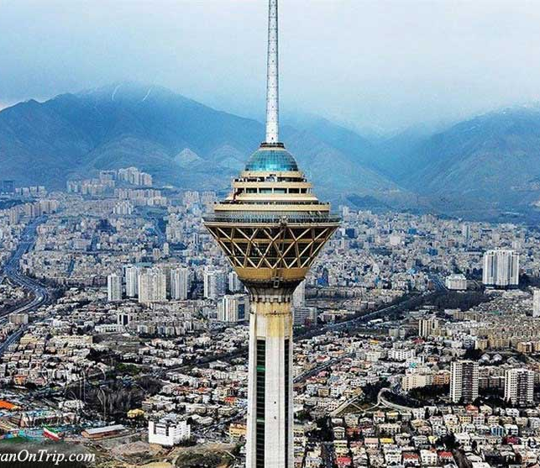
Weather condition in Tehran 2023-2024
Mona Hejazi
201996350
Computer Based Research Tools and Applications Fall 2024

Slide 2
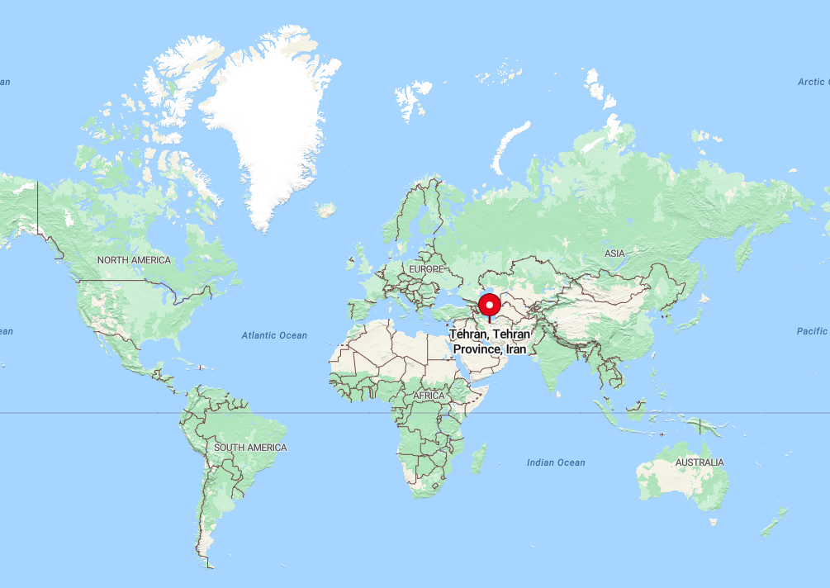
Weather Data Overview
(1 October 2023 – 30 September 2024)
Dataset Details:
Total Records: 366 daily weather data points from Tehran, Iran
Variables Included:
date: Date of the weather record
tavg: Average temperature (°C)
tmin: Minimum temperature (°C)
tmax: Maximum temperature (°C)
prcp: Precipitation (mm)
wspd: Wind speed (m/s)
pres: Atmospheric pressure (hPa)
Source: Meteostat

Slide 3
Hypothesis
No normal distribution for average temperature, wind speed, and precipitation.
No no linear correlation between average temperature and precipitation.
Linear correlation exists between wind speed and precipitation.
Removing outliers improves statistical results.

Slide 4
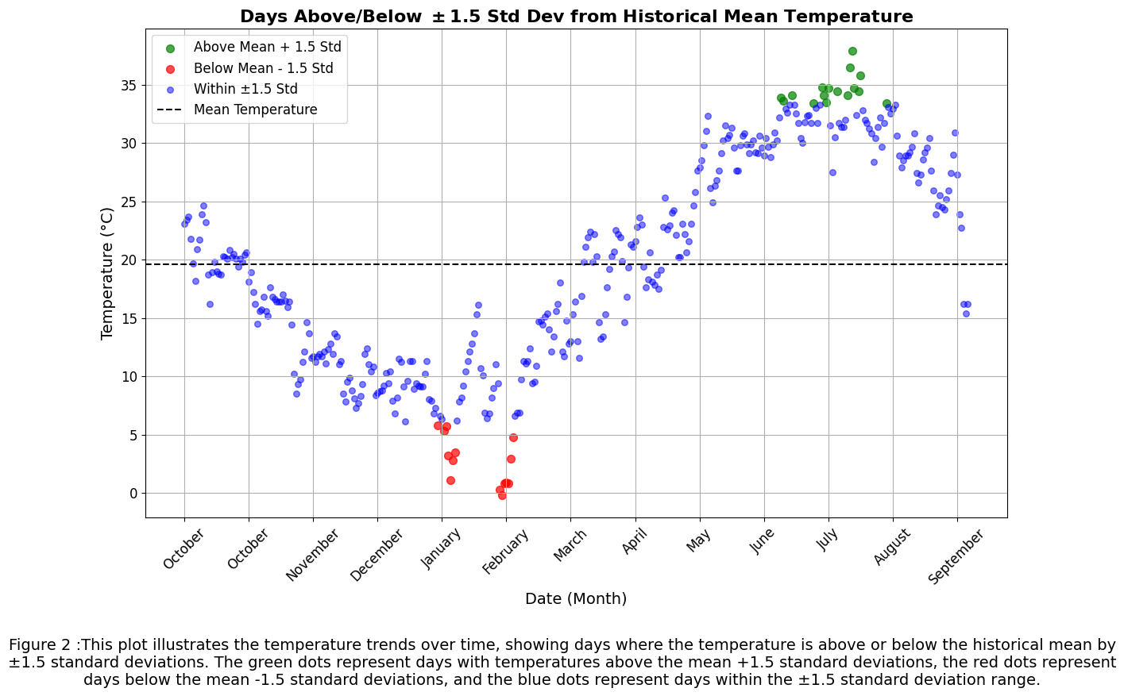
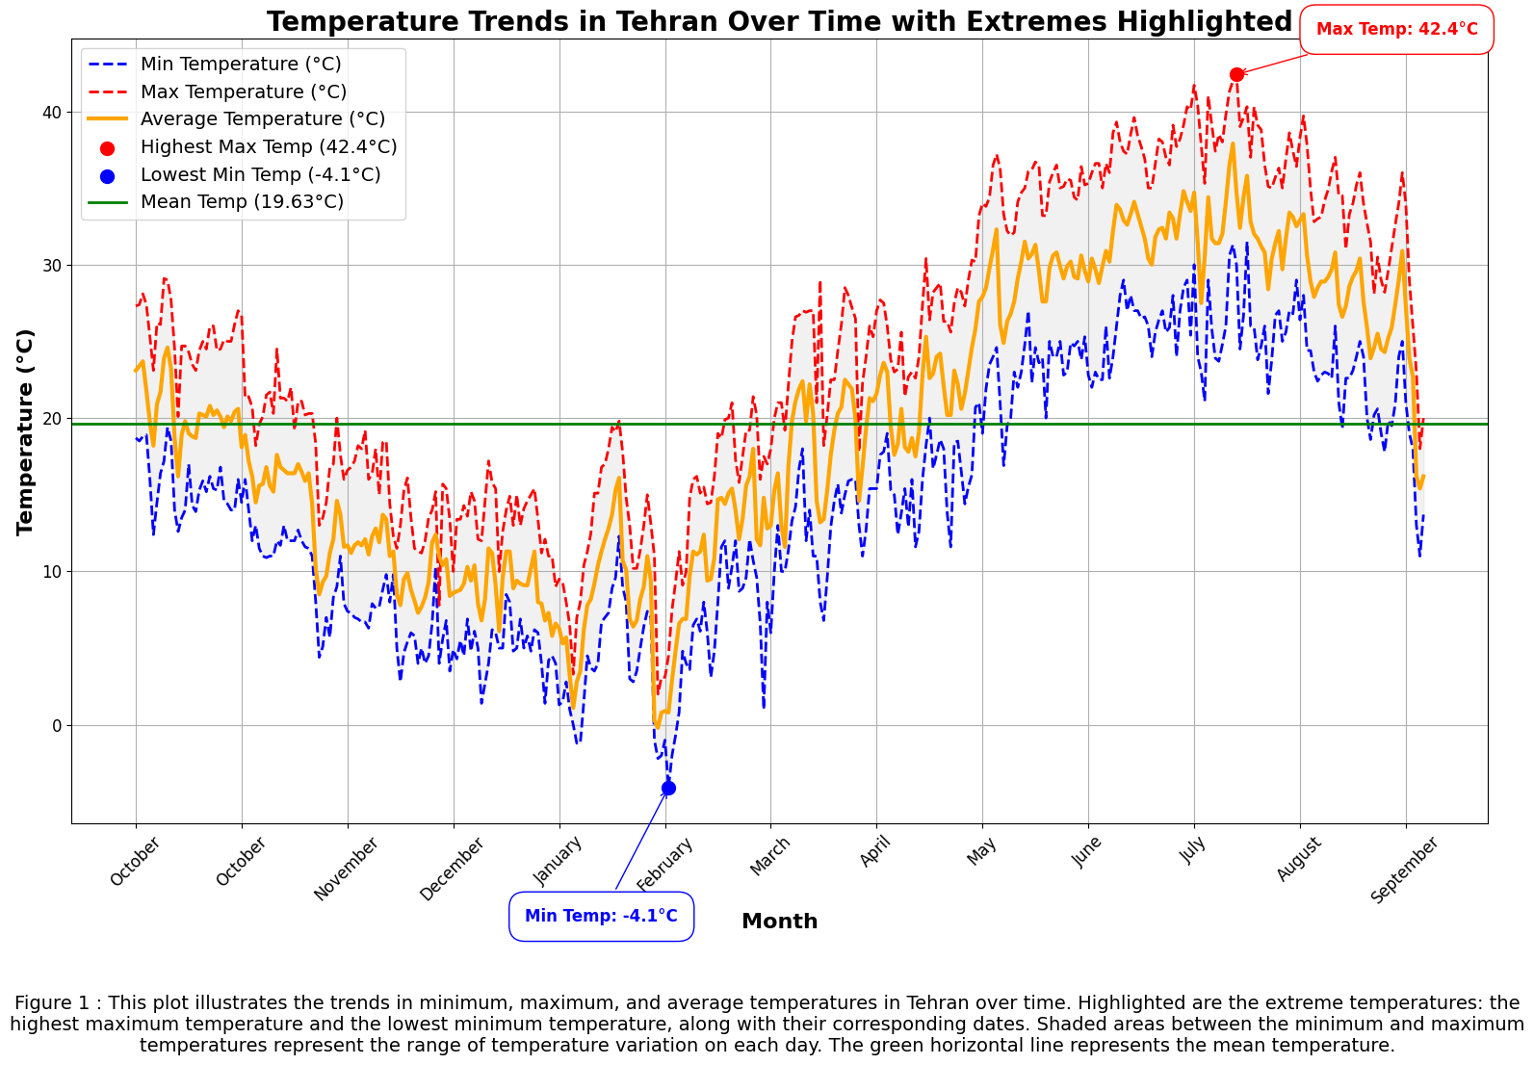
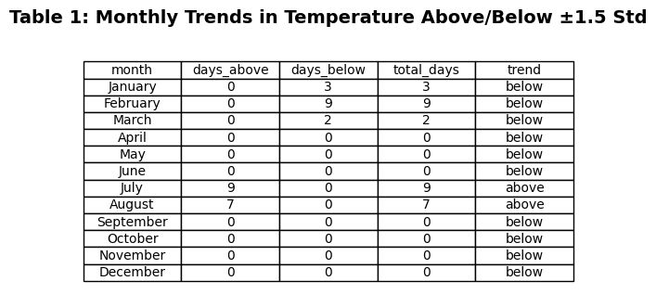
Temperature trend over the year

Slide 5
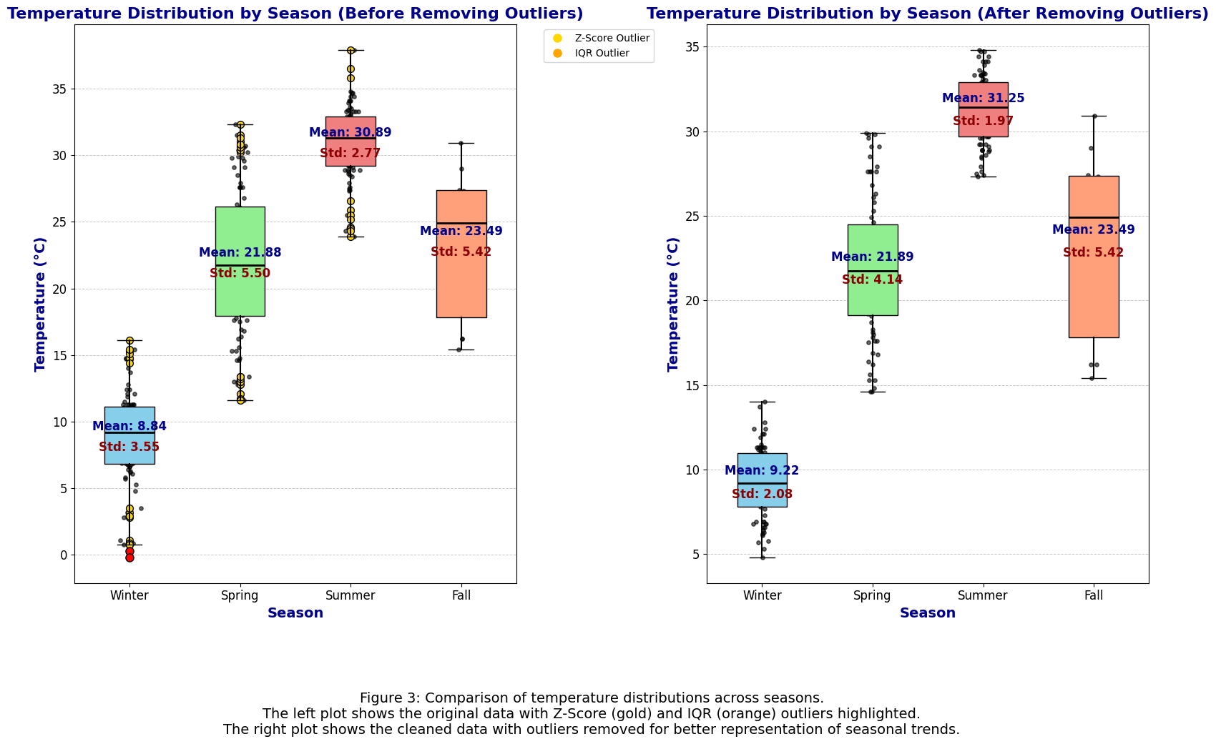
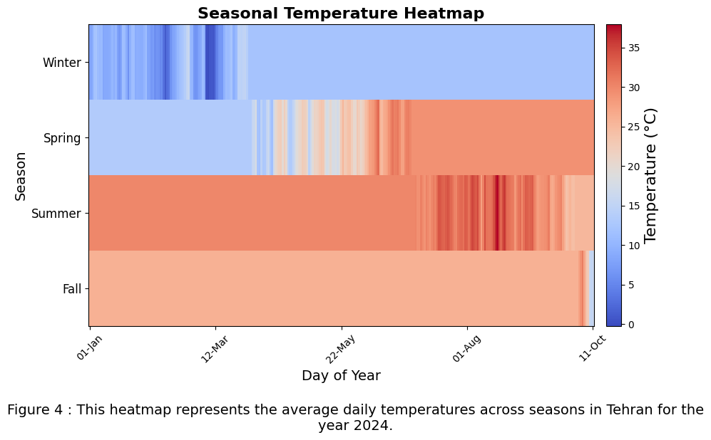
Seasonal temperature
Calculate Z-Score and IQR outliers
The information of outlier removal data:
Season | Number of Outliers Removed | Percentage of Data Removed
Winter | 17 | 18.68%
Spring | 18 | 19.57%
Summer | 11 | 11.96%
Fall | 0 | 0.00%
Total | 46 | 16.14%

Slide 6
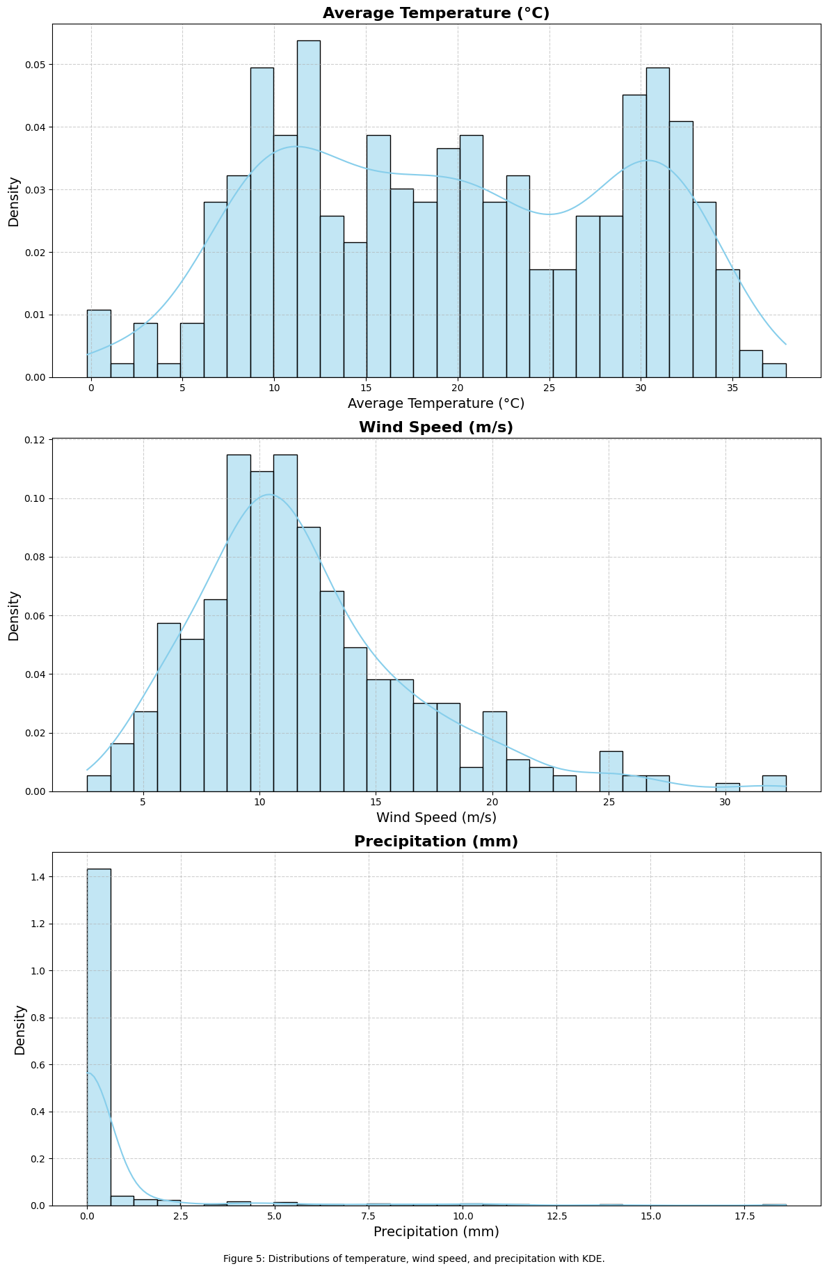
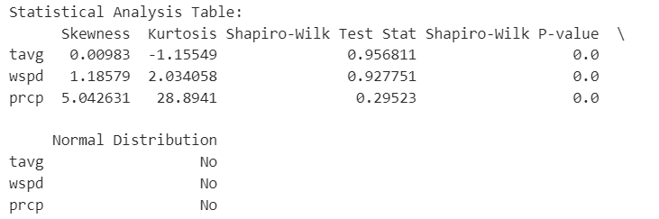
Distribution of data

Slide 7
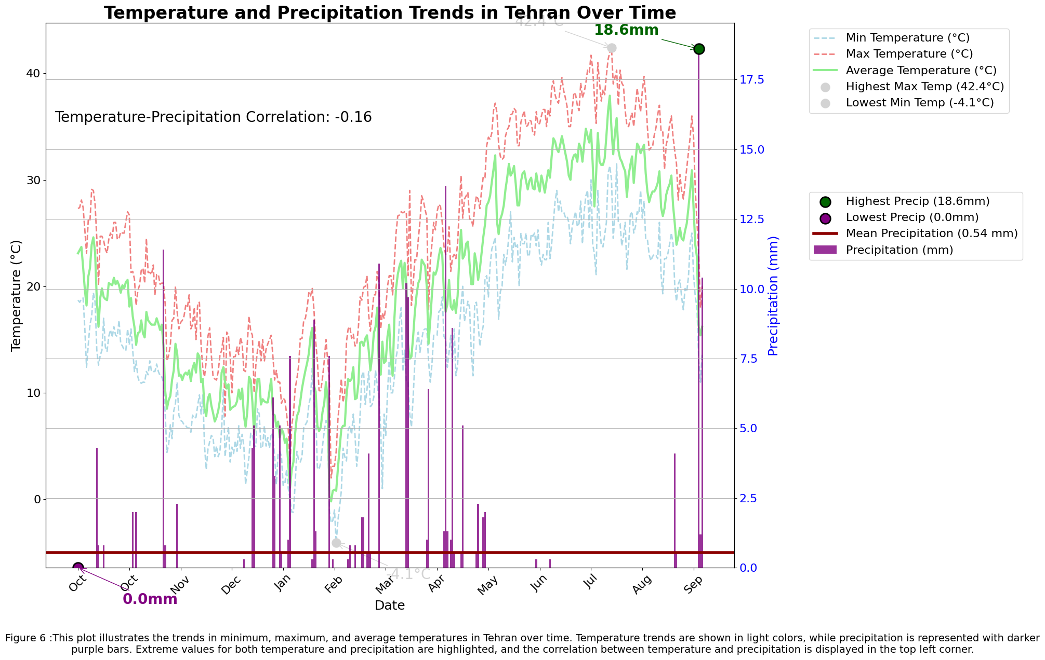
Months with less than the mean precipitation:
['Oct', 'Dec', 'Jun', 'Jul', 'Aug']

Slide 8
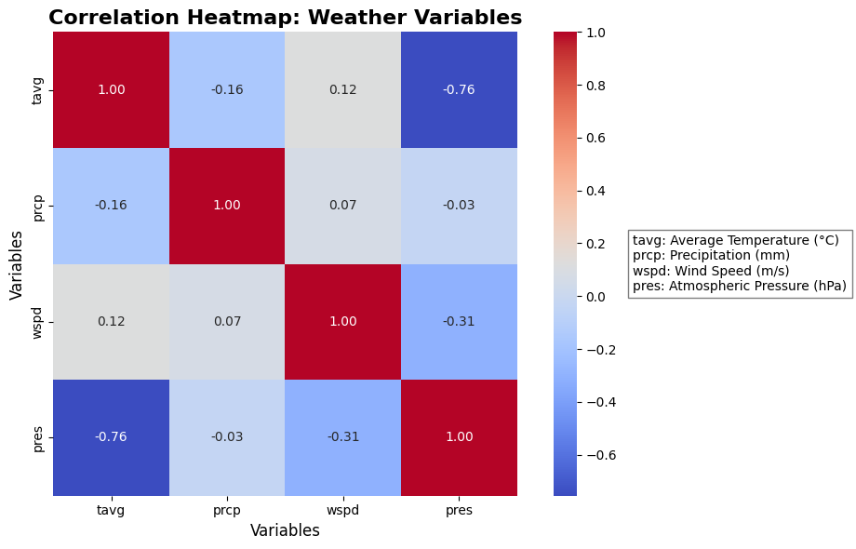
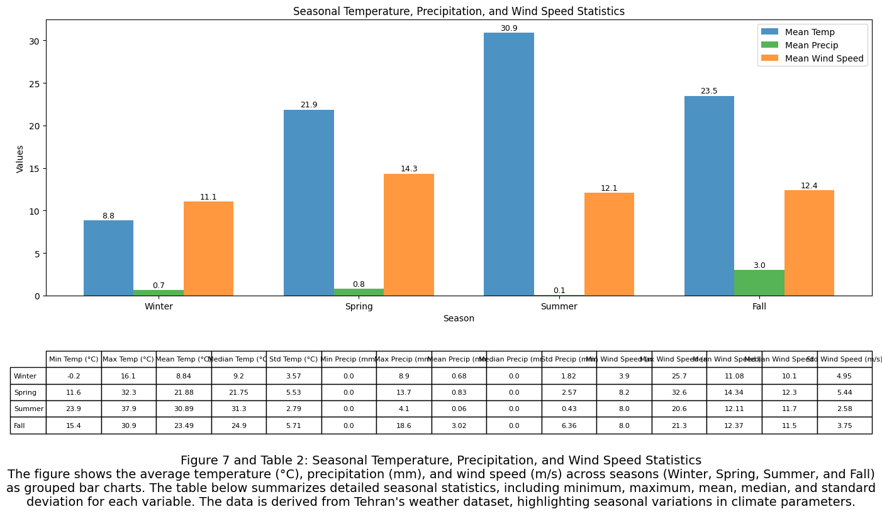
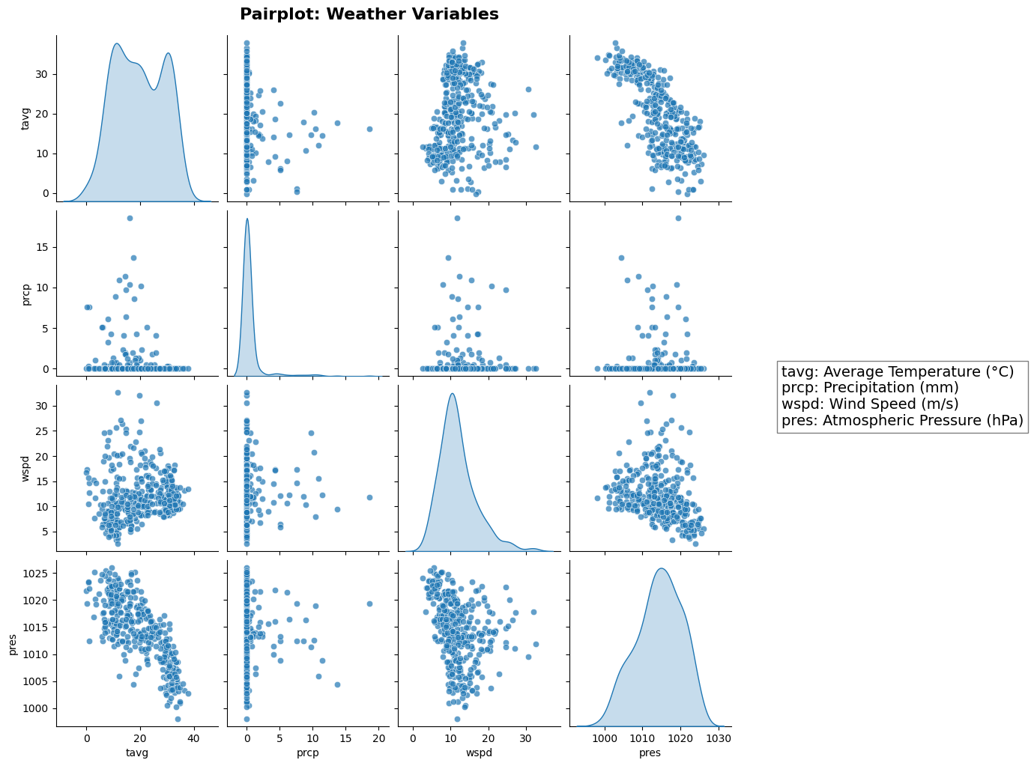
Temperature shows a slight negative trend with wind speed and pressure
Figure 8: The correlation heatmap and pairplot illustrate relationships among selected weather variables in Tehran.

Slide 9


Conclusion
Tehran is a relatively dry and hot city!

