Slide 1
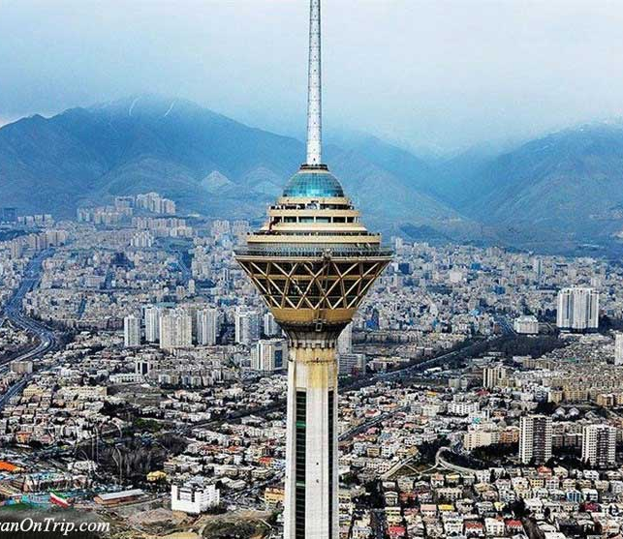
Weather condition in Tehran 2023-2024
Mona Hejazi
201996350
Computer Based Research Tools and Applications Fall 2024

Slide 2
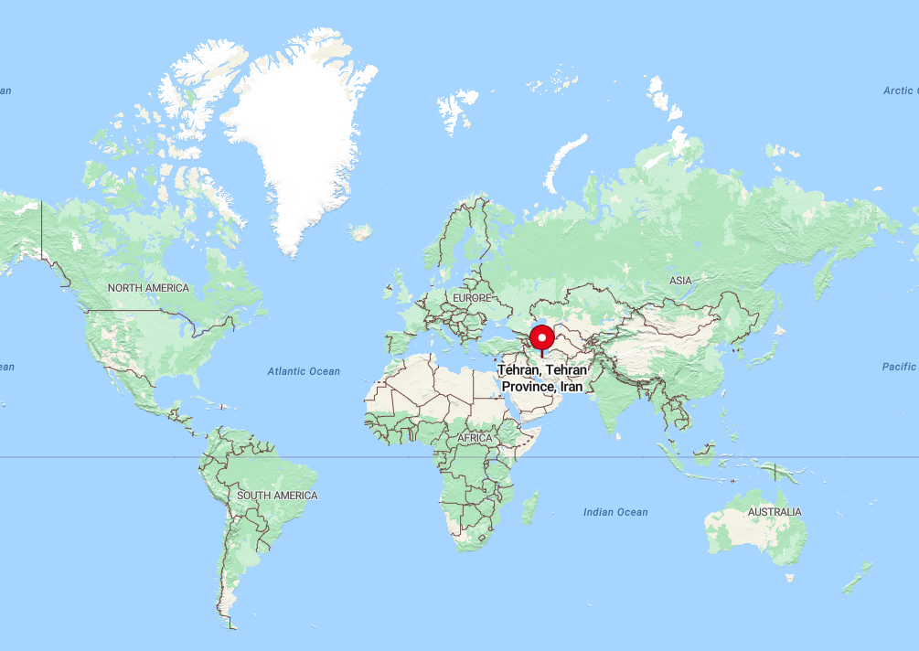
Weather Data Overview (1 October 2023 – 30 September 2024)
Dataset Details:
Total Records: 366 daily weather data points from Tehran, Iran
Variables Included:
date: Date of the weather record
tavg: Average temperature (°C)
tmin: Minimum temperature (°C)
tmax: Maximum temperature (°C)
prcp: Precipitation (mm)
wspd: Wind speed (m/s)
pres: Atmospheric pressure (hPa)
Source: Meteostat

Slide 3
Hypothesis
No normal distribution for average temperature, wind speed, and precipitation.
No no linear correlation between average temperature and precipitation.
Linear correlation exists between wind speed and precipitation.
Removing outliers improves statistical results.

Slide 4
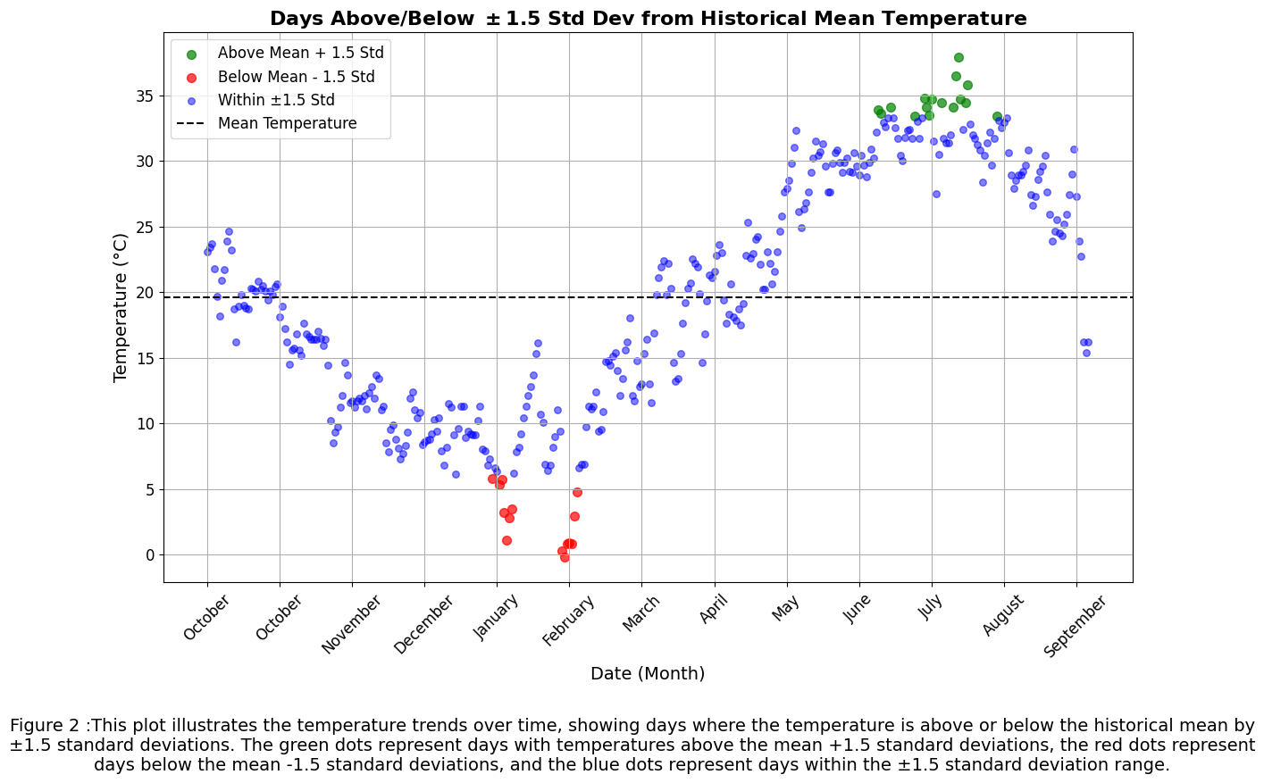
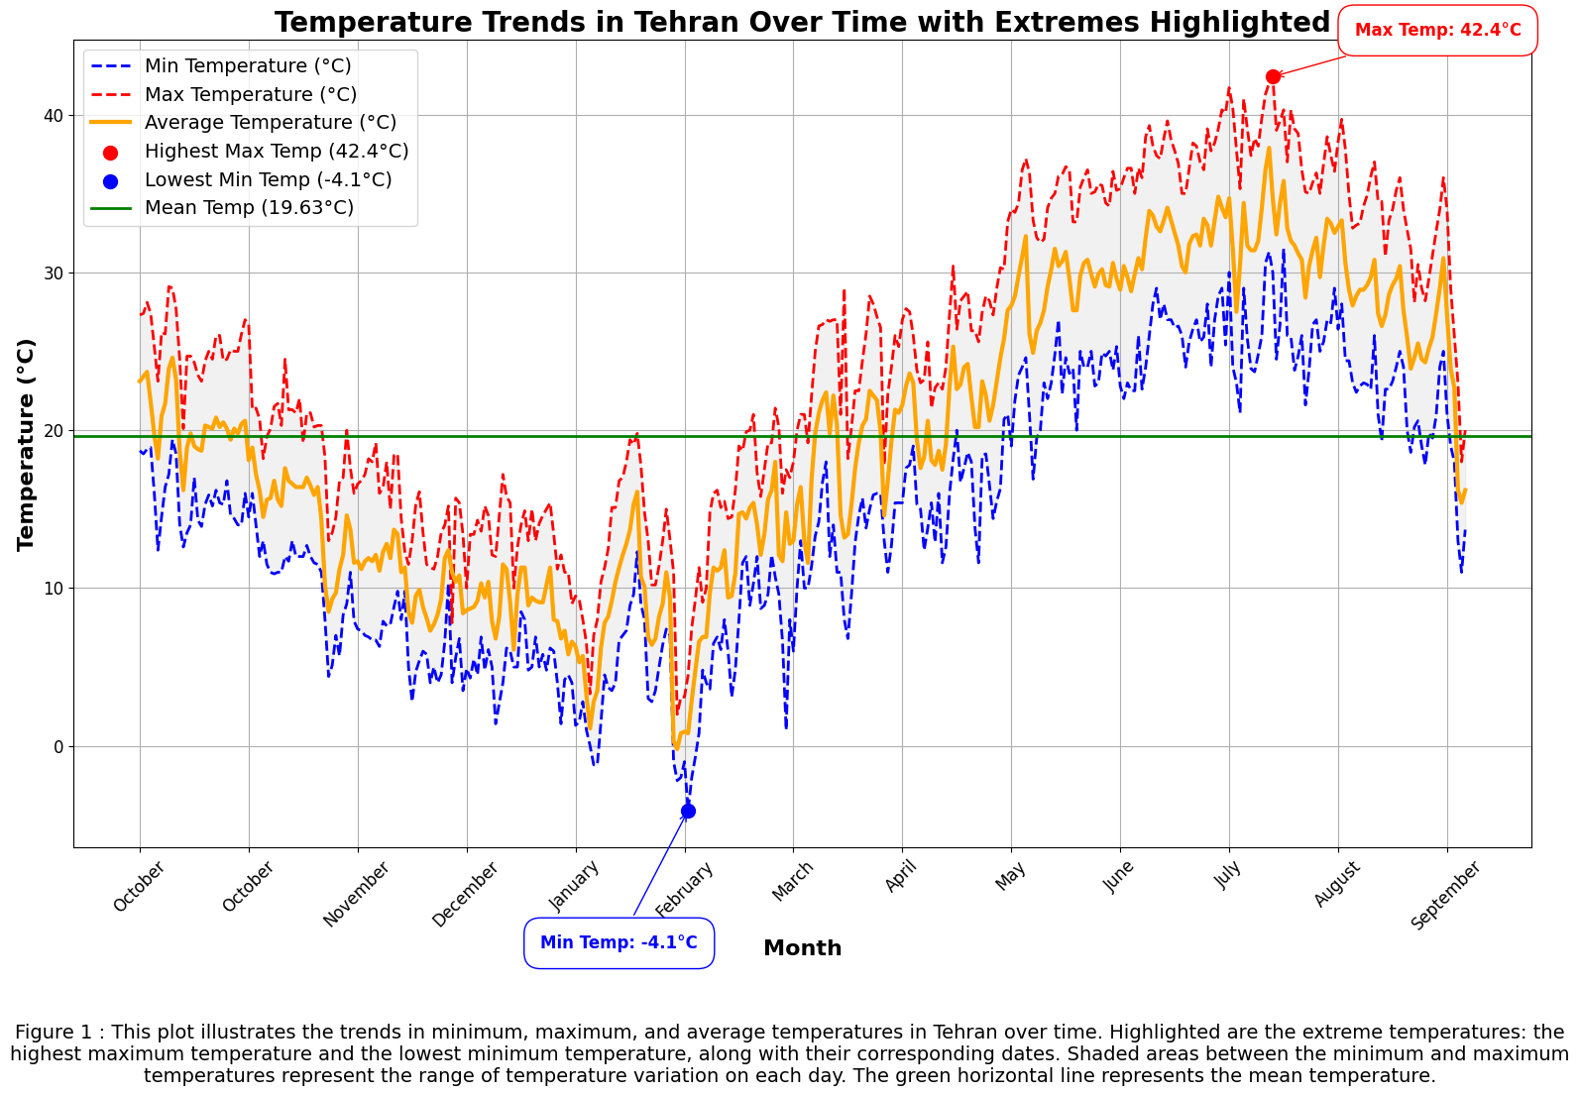
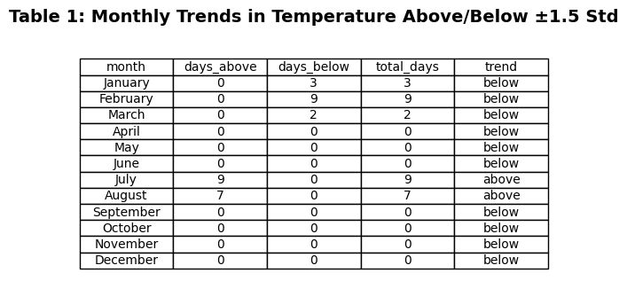
Temperature trend over the year

Slide 5
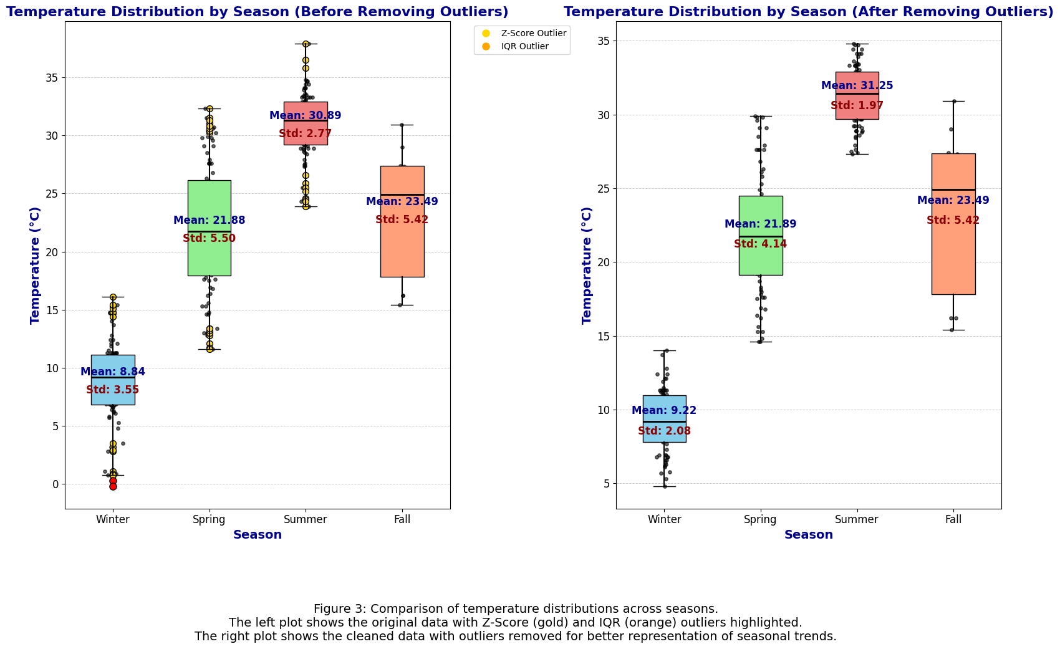
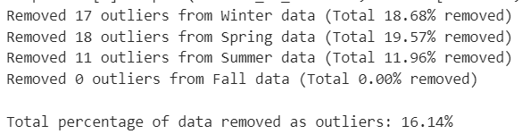
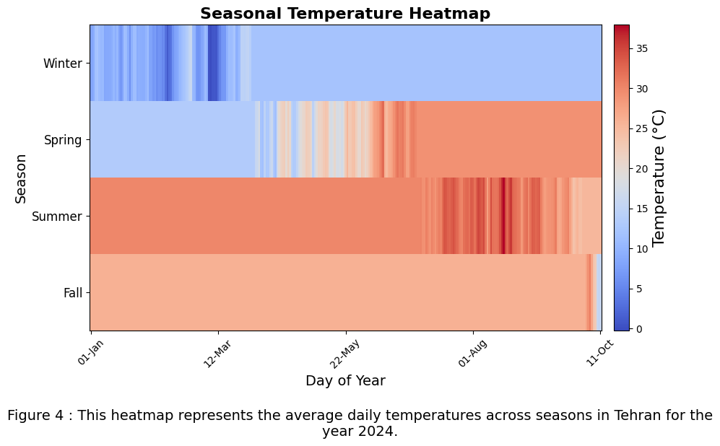
Seasonal temperature
Calculate Z-Score and IQR outliers

Slide 6
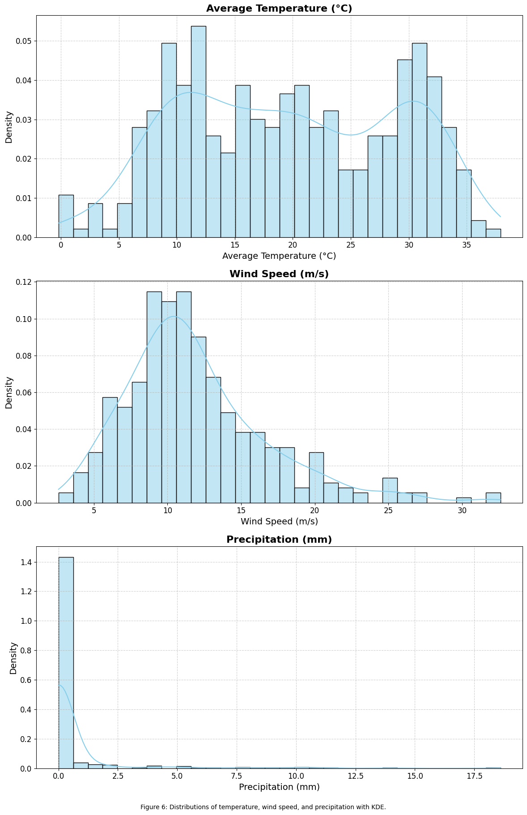
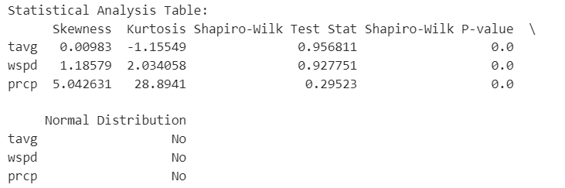
Distribution of data

Slide 7
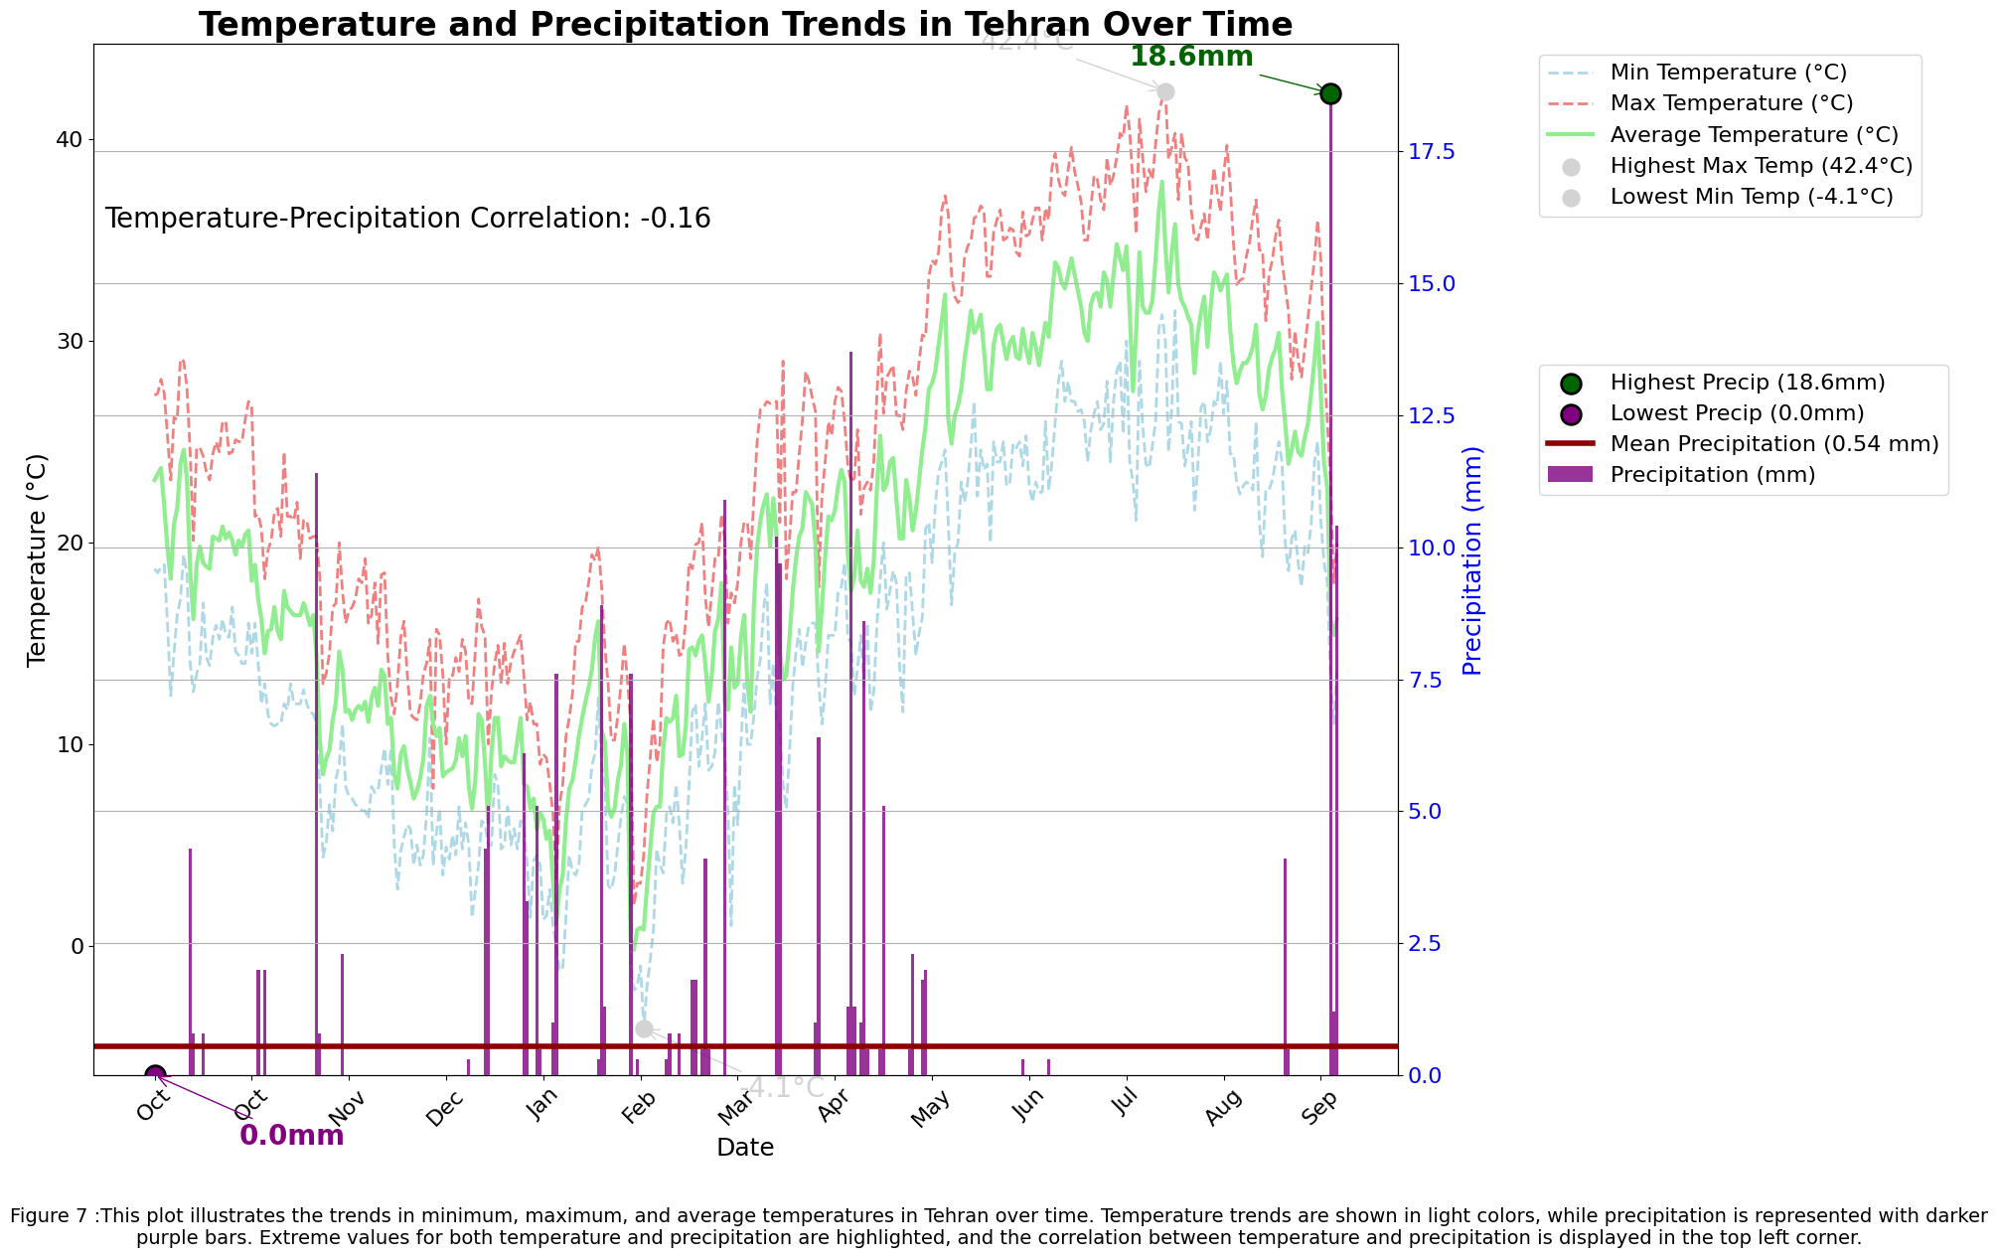


Slide 8
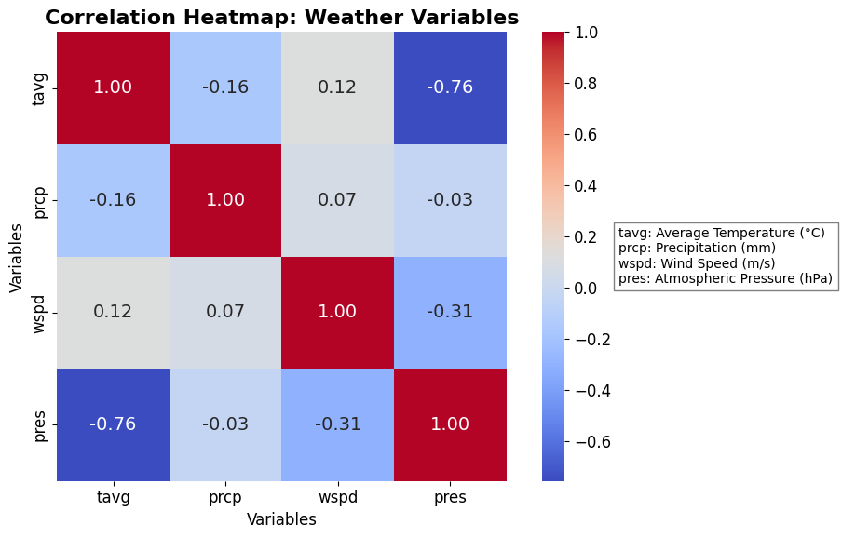
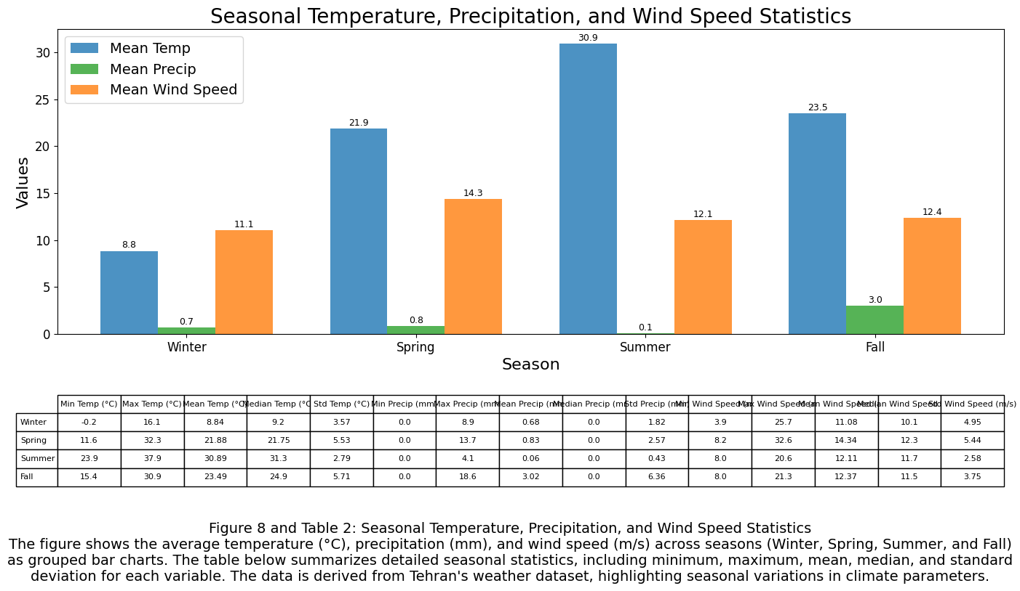
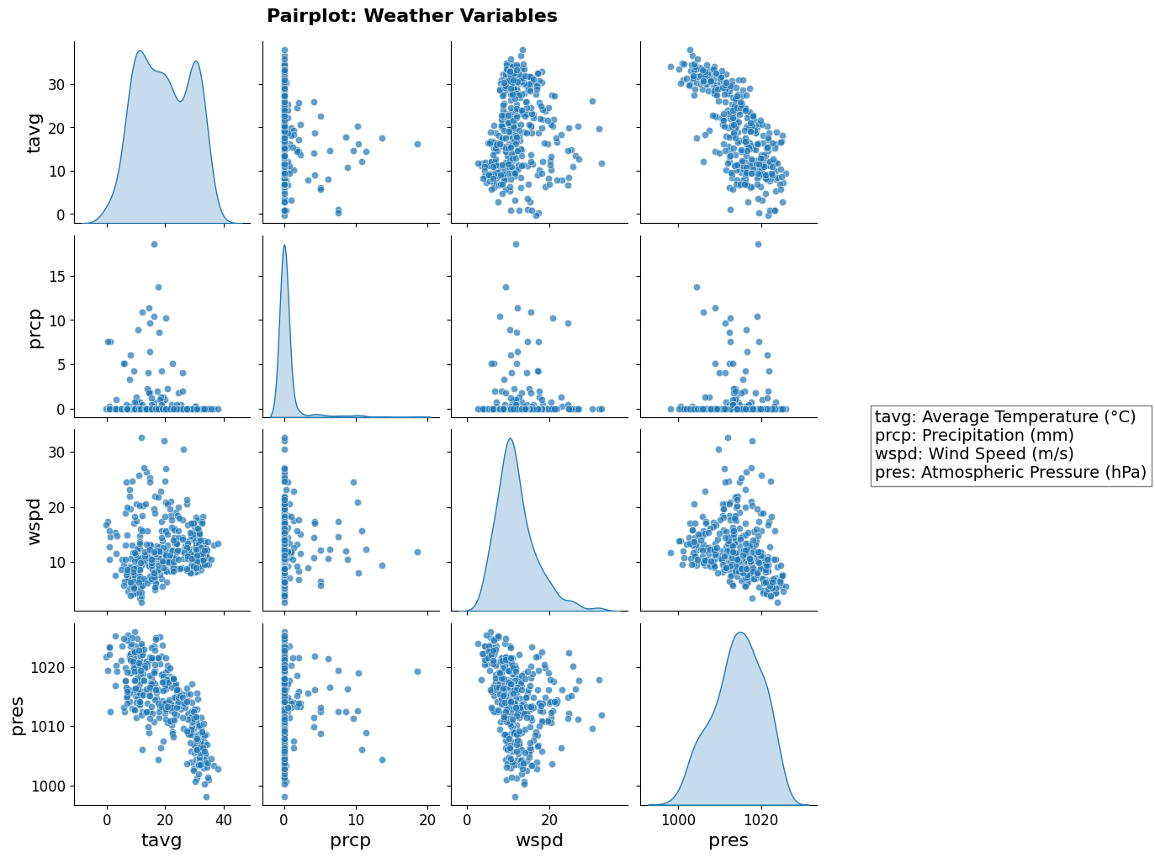

Slide 9


Conclusion
Tehran is quite a dry and hot city!

