Slide 1
Persisting and unit testing objects and their relationships with tiOPF & DUnit2

Slide 2
Topics
  Demo
  Object model and database structure
  Examples in code
    Business object model
    Unit tests
    User interface
  Questions and discussion

Slide 3
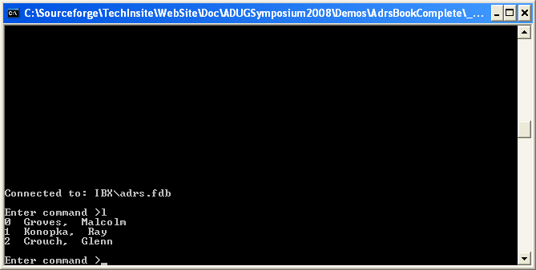
User interface – Command box

Slide 4
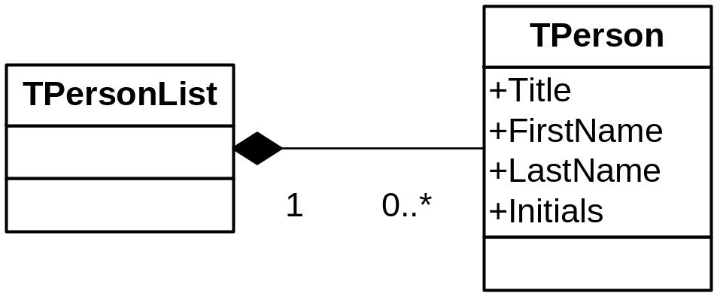
The business object model

Slide 5

UI – BOM - Database

Slide 6
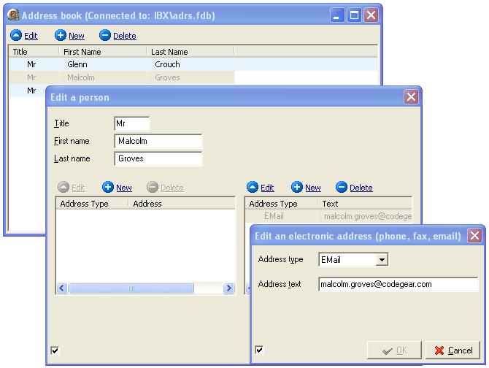
Modal form based UI

Slide 7
Modal form based UI

Slide 8
Add persistence to an XML flat file
- <table table_name="person">
- <fields>
<field field_name="oid" field_kind="string" field_Size="36" />
<field field_name="first_name" field_kind="string" field_Size="60" />
<field field_name="last_name" field_kind="string" field_Size="60" />
</fields>
- <rows>
<row oid=“..1" first_name="Ray" last_name="Konopka" title="Mr"/>
<row oid=“..2" first_name="Glenn" last_name="Crouch" title="Mr"/>
<row oid=“..3" first_name="Malcolm" last_name="Groves" title="Mr"/>
</rows>
</table>

Slide 9
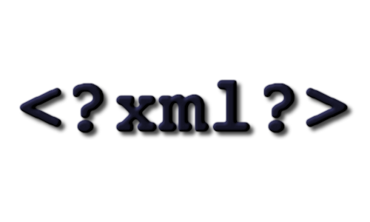
Add persistence to an XML flat file

Slide 10

Add persistence over the internet

Slide 11
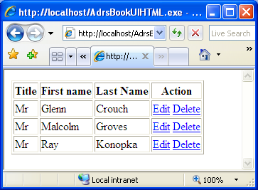
Add a web based client

Slide 12
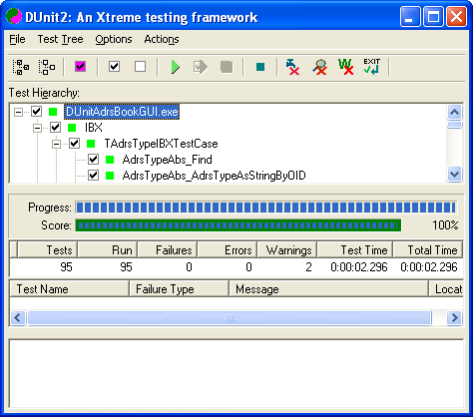
Unit tests are the starting point

Slide 13
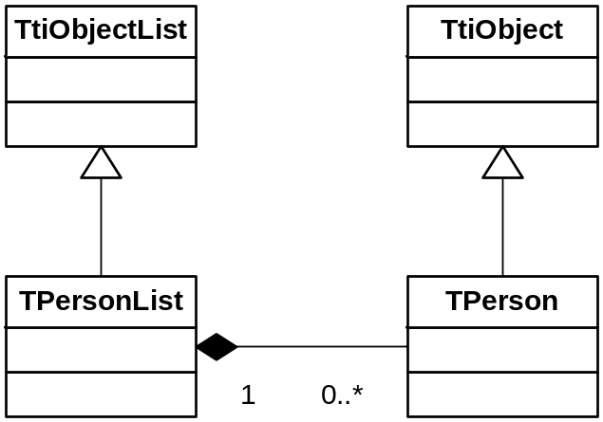
Code example
  Building the BOM

Slide 14
Code example
  Building the BOM
  Persisting to SQL & non SQL database
  using tiOPF-Automap
  Unit test
  A robust unit test methodology for object persistence

Slide 15
Code example
  Building the BOM
  Persisting to SQL & non SQL database using tiOPF-Automap
  Unit test
  A robust unit test methodology for object persistence

Slide 16
Code example
  Building the BOM
  Persisting to SQL & non SQL database using tiOPF-Automap
  Unit test
  A robust unit test methodology for object persistence

Slide 17
Key points
  Each developer (and the build server) requires a database instance. This can be a challenge in large corporates with a DBA department;
  Require a rapid means of emptying and setting up the database;

Slide 18
Key points
  Persistence unit tests are written in the order:
  Read, Create, Update, Delete
  With each test depending on previously tested code;
  Group these under TtiTestSetup
  Allow two hours to write each class, persistence code and unit test (simple classes).

Slide 19
Source code on the web
The source from this presentation, and the latest version of the documentation
can be found at:
www.tiopf.com
Peter Hinrichsen
peter_hinrichsen@techinsite.com.au

