Slide 1
Rolling your own
Object Persistence Framework (OPF)
  Please consider the following questions:
  What do you expect from an OPF?
  What do you expect from this tutorial?

Slide 2
Tutorial Topics
  Part 1: What is an OPF?
  What can an OPF do for me?
  Part 2: The core principles of the tiOPF.
  Part 3: A worked example of using the tiOPF

Slide 3
What is an OPF?
  What is an OPF?
  What do you expect from an OPF?
  Demo of an OPF application.
  Why build an OPF. RAD vs OPF.
  Ambler, Jedi-Obiwan and my design requirements of an OPF.
  Architecture of the tiOPF

Slide 4
What do you expect from an OPF?
How long have you used Delphi?
What do you build with Delphi?
How to you currently build your apps?
What is an OPF?
What do you expect from an OPF?
1.
2.

Slide 5
What is an OPF?
  What is an OPF?
  What do you expect from an OPF?
  Demo of an OPF application.
  Why build an OPF. RAD vs OPF.
  Ambler, Jedi-Obiwan and my design requirements of an OPF.
  Architecture of the tiOPF

Slide 6
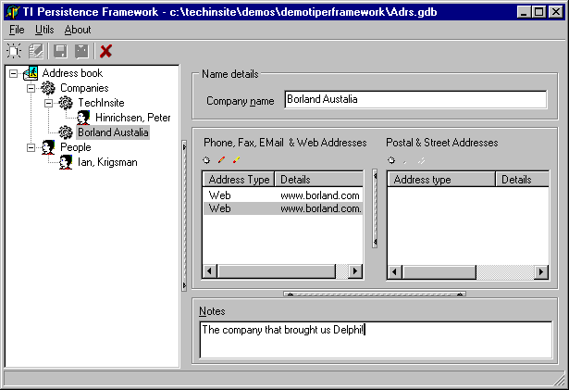
Demonstration - the address book application

Slide 7
What is an OPF?
  What is an OPF?
  What do you expect from an OPF?
  Demo of an OPF application.
  Why build an OPF. RAD vs OPF.
  Ambler, Jedi-Obiwan and my design requirements of an OPF.
  Architecture of the tiOPF

Slide 8
Definitions: RAD and OPF
  RAD: TDataModule, TQuery, TDatabase, TClientDataSet and data aware controls.
  OPF: Custom persistence layer, custom business objects and custom edit controls 

Slide 9
Advantages of RAD & Data Aware Controls
  Good for prototypes.
  Good for simple, single tier apps.
  Good for seldom used forms, like one-off setup screens that may be used to populate a new database with background data.
  Plenty of third party controls available.
  Can re-configure themselves as the database schema changes (sometimes) 

Slide 10
Disadvantages of RAD & Data Aware Controls
  Higher maintenance and debugging costs.
  Higher network traffic.
  Can not be used to edit custom file formats, registry entries or data that is not contained in a TDataSet.
  Harder to develop data aware controls than regular controls.
  Hard to use when the DB does not map directly into the GUI ie, a well normalised database.
  Difficult to make extensive reuse of code 

Slide 11
When do I use RAD and data aware controls?
  Low end customers (small businesses with few user).
  Throw away prototypes.
  Data maintenance apps that my customers will not see.
  Systems where I have total control over the database design.
  When the user wants the app to look and perform as if it were written in VB 

Slide 12
Advantages of an OPF
  Good for complex applications.
  Lower network traffic.
  When the database is storing non text data like multi-media, or perhaps scientific data which must be manipulated with complex algorithms.
  Decouple GUI from database - multiple databases
  Lower total cost of ownership 

Slide 13
Disadvantages of an OPF
  More skilled development team.
  Higher up front development cost.
  Many reporting tools take input from a TDataSet. Some extra code would be needed to connect the persistence framework to the reporting tool.
  Must re-build what comes out of the box with Delphi 

Slide 14
When do I use an OPF?
  High end (corporate) customers with many users where performance is important.
  Systems that have complex data models that I have little control over.
  Systems that require a TreeView, ListView look and feel.
  Systems that must be database vendor independent 

Slide 15
What is an OPF?
  What is an OPF?
  What do you expect from an OPF?
  Demo of an OPF application.
  Why build an OPF. RAD vs OPF.
  Ambler, Jedi-Obiwan and my design requirements of an OPF.
  Architecture of the tiOPF

Slide 16
Ambler, Obiwan & PWH’s requirements of an OPF #1
  Who or what are Ambler & Obiwan?
  Object Persistence – Storage and retrieval of object data & object relationships
  Multiple architectures – Single-tier, two-tier (client-server), multi-tier & internet enabled
  Object Identity - All objects must be uniquely identified
  Proxies or primary key objects – For performance optimisation and human navigation

Slide 17
Ambler, Obiwan & PWH’s requirements of an OPF #2
  Data as objects, or TDataSet – For use with reporting tools
  Layering of application - Separation of Business Logic and User Interface
  Several types of persistence mechanism – SQL databases, flat files, XML, legacy systems.
  Various database versions and/or vendors.

Slide 18
Ambler, Obiwan & PWH’s requirements of an OPF #3
  Generic or native database drivers – Generic (ODBC, BDE, ADO) or native (DOA, IBX, MSDOM)
  Multiple connections - Multiple connections to multiple databases in a thread safe way.
  Transactions – Database transactions, and object – database transaction relationships
  Auto generated SQL and DBA optimised SQL 

Slide 19
What is an OPF?
  What is an OPF?
  What do you expect from an OPF?
  Demo of an OPF application.
  Why build an OPF. RAD vs OPF.
  Ambler, Jedi-Obiwan and my design requirements of an OPF.
  Architecture of the tiOPF

Slide 20
Three layer architecture of the tiOPF
  1. Business objects layer: Manipulate data in the application as objects. Based on GoF’s Composite Pattern.
  2. Persistence layer: Persist objects to a variety of data stores including SQL-RDBMSs, XML, CSV. Based on GoF’s Visitor, Template Method and Adaptor Patterns.
  3. Presentation layer: Provide a family of controls to simplify user interaction with the BOM 

Slide 21
The tiOPF can be configured in 5 ways
  Single-tier, single user, files based application
  Two-tier, client server application
  Multi-tier, internet enabled application
  HTML / browser based application
  System to system data pump application
  (We will look at three of these) 

Slide 22
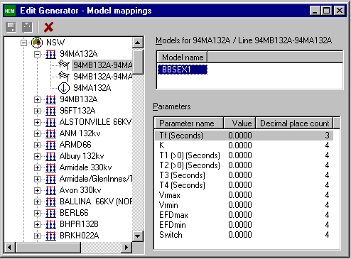
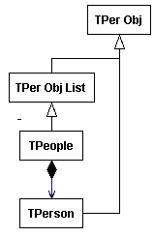
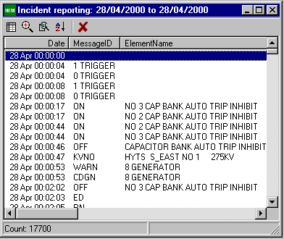
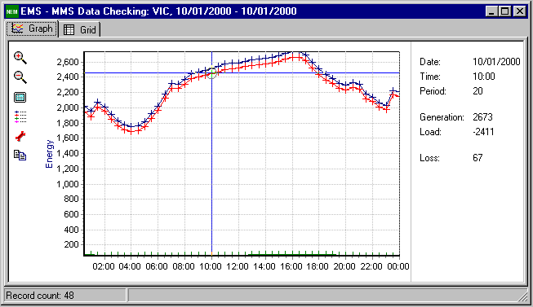
Two-tier, client-server application
Win32 Application
Presentation
BOM
PerMgr
Mapps BOM to persistence plugin
PerPlugin
Saves data
to choosen database
Persistent
Store
(Database)

Slide 23
Multi-tier, Internet enabled application
Win32 Application
Server app
Presentation
BOM
PerMgr
Mapps BOM to persistence plugin
PerMgr
Mapps BOM to persistence plugin
PerPlugin
Saves data
using XML over HTTP
PerPlugin
Saves data
to choosen database
Persistent
Store
(Database)

Slide 24
HTML, Browser based application
Browser
Web server
Presentation
Presentation
BOM
Framework to map BOM into HTML or XML & XSL
PerMgr
Mapps BOM to persistence plugin
PerPlugin
Saves data
to choosen database
Persistent
Store
(Database)

Slide 25
System to system, data pump application
Win32 Application
BOM
PerMgr
Mapps BOM to persistence plugin
PerMgr
Mapps BOM to persistence plugin
Persistent
Store ‘A’
(Database)
PerPlugin
Saves data
to choosen database
PerPlugin
Saves data
to choosen database
Persistent
Store ‘B’
(Database)

Slide 26
Steps to understanding this architecture
To achieve this architecture, we require:
  An abstract business object model
  A way of traversing the model
  A swappable database connection layer
  Some GUI controls to make building the presentation layer easier
These will be developed in the next part: The core principles of the tiOPF 

Slide 27
Tutorial Topics
  Part 1: What is an OPF?
  What can an OPF do for me?
  Part 2: The core principles of the tiOPF.
  Part 3: A worked example of using the tiOPF

Slide 28
A walk through of the framework source
  Where to download: www.techinsite.com.au/tiOPF/download.htm
  How to install:
  www.techinsite.com.au/tiOPF/GettingStarted.htm
  Directory structure
  Applications - In tiPerFramework project group 

Slide 29
A walk through the documentation
  What is an OPF (chapter 1)
  The Visitor pattern framework (chapter 2)
  The Visitor and SQL databases (chapter 3)
  Building an abstract BOM (chapter 4)
  Installing the tiOPF (chapter 5)
  A worked example (chapter 6)
  The Adaptor pattern and database
  independence (chapter 7)
  And now, a detailed look at chapter 2 

Slide 30
The core principles of the tiOPF
Aim: To come up with a generic way of performing a family of related tasks on some objects in a list. The task we perform may be different depending on the internal state of each object. We may not perform any tasks at all, or we may perform multiple tasks on multiple list objects. (The Visitor Pattern framework) 

Slide 31
Tutorial Topics
  Part 1: What is an OPF?
  What can an OPF do for me?
  Part 2: The core principles of the tiOPF.
  Part 3: A worked example of using the tiOPF

Slide 32
A worked example of using the tiOPF
Demonstration...

Slide 33
Source code on the web
The source from this presentation, and the latest version of the documentation
can be found at:
www.techinsite.com.au
Peter Hinrichsen
TechInsite Pty Ltd

